Slide 1
感恩遇见，相互成就，本课件资料仅供您个人参考、教学使用，严禁自行在网络传播，违者依知识产权法追究法律责任。
更多教学资源请关注
公众号：溯恩英语
知识产权声明

Slide 2
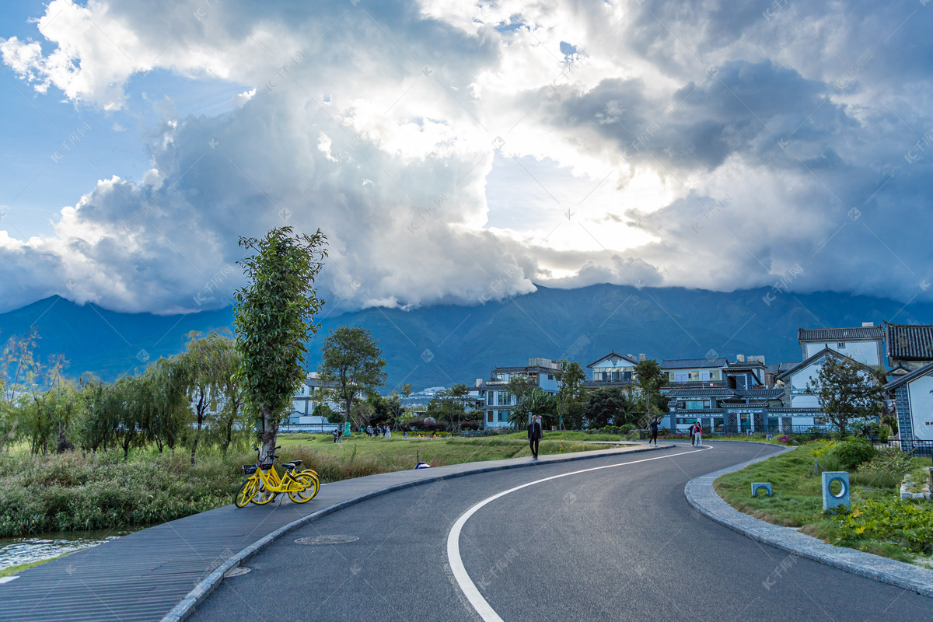
2024年浙江省五校考试英语
试卷讲评课件
傅嘉

Slide 3
PART 1
阅读理解

Slide 4
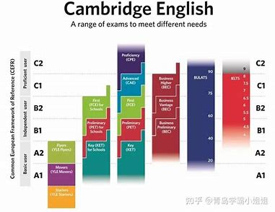
A 篇介绍
Oklahoma School Testing Program for English Language Arts
校考的三个方面：考试目的；考试形式，考试内容，考试打分；监考详情等。

Slide 5
主题语境--人与社会
A 篇：应用文
Test Structure, Format, and Scoring
The English Language Arts operational test is meant to be administered in two sessions within one day with a break between sessions or on two instructional days in a row. Each section of the test consists of 25 operational items and 5 field-test items.
点击添加标题
数字计算题
21. How many test items are there in total?
A.25 B.30 C.50 D.60

Slide 6
主题语境--人与社会
A 篇：应用文
Students will be able to use scratch paper and/or unmarked grid（方格） paper for the paper. The scratch paper must be collected and destroyed by the test administrator immediately following the test.
点击添加标题
细节理解题
22. What is prohibited in the test?
A. Taking away scratch paper. B. Using a Pencil.
C. Using unmarked grid paper. D. Flipping pages.

Slide 7
主题语境--人与社会
A 篇：应用文
Oklahoma School Testing Program for English Language Arts
Purpose
…
Test Structure, Format, and Scoring
…
Test Administration Details
…
点击添加标题
根据大标题以及小标题
推理判断题
23. Where is the text probably taken from?
A textbook. B. A course plan.
C. An exam paper. D. An exam guideline.

Slide 8
A 篇：语料库
1. testing assessment system 考试评估系统
2. utilize vt. 利用
3. administer vt. 实施；执行
4. multiple pieces of evidence 多个证据
5. is meant to do sth 意在做某事；为了做某事
6. administrate 管理
7. test administrator 监考官
8. in two sessions 两场考试
9. in a row 连续地
10.item 项目；
11. scratch paper 草稿纸
12. flip pages 翻书页
13. prohibit 禁止= ban / forbid

Slide 9
B 篇
坚强抗癌的母亲 血浓于水的亲情

Slide 10
主题语境--人与社会
B 篇：记叙文
(Para. 1) It is October again. It has been a year since my mother was diagnosed with lung cancer; a year since she started her good, brave fight. It has been a year marked with so many milestones, so many shared smiles and secret fears.
点击添加标题
24. What has happened to Grandma over the year?
She has refused others' visits.
B. She has pulled through the cancer.
C. She has lost her fight with the tumor.
D. She has recovered without side effects.
细节理解题

Slide 11
主题语境--人与自我
B 篇：记叙文
(Para. 2) Usually, children, with eyes that see all and minds that are still free to wonder, are extraordinarily accepting the changes in routine, the shift in seasons. This week, however, when I took my two younger boys with me for a visit to Mom's without telling her in advance, Sean ran into her bedroom to greet her, then quickly returned to the living room to talk to me. “Mom,” my four-year-old whispered, careful not to be overheard or offending, “Grandma has no hair.
点击添加标题
细节理解题
25. Why was Sean surprised when visiting Grandma?
A. Because he found Grandma tired and thin.
B. Because just overheard Grandma's cancer.
C. Because he couldn't accept Grandma's appearance.
D. Because he had never seen Grandma hairless before.

Slide 12
主题语境--人与自我
B 篇：记叙文
(Para. 1) It is October again. It has been a year since my mother was diagnosed with lung cancer; a year since she started her good, brave fight. It has been a year marked with so many milestones, so many shared smiles and secret fears.
(Para. 5) “Would you like to touch my head, Sean?” my mother asked as my son stared at her, his blue eyes filled with questions and curiosity.
点击添加标题
推理判断题
26. Which of the following can best describe Grandma?
A. Loving and optimistic. B. Loyal and honest.
C. Humble and committed. D. Generous and humorous.
．

Slide 13
主题语境--人与自我
B 篇：记叙文
(Para.6) It is surprising to see your mother—or anyone you love—without hair, but surprisingly it's something that you can get used to quickly. We are, after all, not really these bodies—these are just the shells that transport who we are, and no matter what the physical changes, those connected by love seem to be able to recognize their own.
点击添加标题
主旨大意题
27. What message does the author convey in the text?
Every cloud has a silver lining.
B. Never judge a book by its cover.
C. Love goes beyond physical changes.
D. What doesn't kill us makes us stronger.

Slide 14
B 篇：语料库
1.be diagnosed with… 被诊断出患有……
2.milestone n. 里程碑
3.side effect 副作用
4.catch her by surprise 让她大吃一惊
5.pull through the cancer 战胜癌症；熬过…

Slide 15
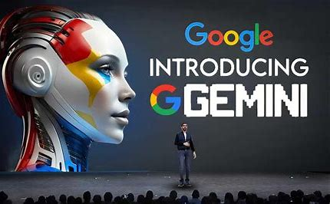
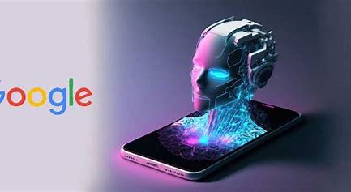
C 篇
谷歌研发的聊天机器人Google Gemini的议论

Slide 16
主题语境--人与社会之科技
C 篇：夹叙夹议文
(Para. 1) Users of Google Gemini, the tech giant's artificial-intelligence model, recently noticed that asking it to create images of Vikings, or German soldiers from 1943 produced surprising results: hardly any of the people depicted were white. Other image-generation tools have been criticized because they tend to show white men when asked for images of entrepreneurs or doctors. Google wanted Gemini to avoid this trap; instead, it fell into another one, depicting George Washington as black. Now attention has moved on to the chatbot's text responses, which turned out to be just as surprising.
点击添加标题
28. What do the words “this trap” underlined in the first paragraph refer to?
A. Having a racial bias. B. Responding to wrong texts.
C. Criticizing political figures. D. Going against historical facts.
词义猜测题

Slide 17
（para1)…. attention has moved on to the chatbot's text responses, which turned out to be just as surprising.
(Para. 3) Gemini happily provided arguments in favor of positive action in higher education, but refused to provide arguments against. It declined to write a job ad for a fossil-fuel lobby group（游说团体）, because fossil fuels are bad and lobby groups prioritize “the interests of corporations over public well-being”. Asked if Hamas is a terrorist organization, it replied that the conflict in Gaza is “complex”; asked if Elon Musk's tweeting of memes had done more harm than Hitler, it said it was “difficult to say”. You do not have to be a critic to perceive its progressive bias.
点击添加标题
归纳概括题
29. What is Paragraph 2 mainly about?
Gemini's refusal to make progress.
Gemini's failure to give definite answers.
C. Gemini's prejudice in text responses.
D. Gemini's avoidance of political conflicts.．

Slide 18
C 篇：夹叙夹议文
(Para. 3) Inadequate testing may be partly to blame. Google lags behind OpenAI, maker of the better-known ChatGPT. As it races to catch up, Google may have cut corners. Other chatbots have also had controversial launches. Releasing chatbots and letting users uncover odd behaviors, which can be swiftly addressed, lets firms move faster, provided they are prepared to weather（经受住） the potential risks and bad publicity, observes Eth an Mollick, a professor at Wharton Business School.
点击添加标题
细节理解题
30. What does Eth an Mollick think of Gemini's early launch?
A. Creative. B. Promising. C. Illegal. D. Controversial.

Slide 19
C 篇：夹叙夹议文
(Para. 3) But Gemini has clearly been deliberately adjusted, or “fine-tuned”, to produce these responses. This raises questions about Google's culture. Is the firm so financially secure, with vast profits from internet advertising, that it feels free to try its hand at social engineering? Do some employees think it has not just an opportunity, but a responsibility, to use its reach and power to promote a particular agenda? All eyes are now on Google's boss, Sundar Pichai. He says Gemini is being fixed. But does Google need fixing too?
点击添加标题
31. What can we infer about Google from the last paragraph?
A. Its security is doubted. B. It lacks financial support.
C. It needs further improvement. D. Its employees are irresponsible.
推理判断题

Slide 20
1.depict vt. 描绘
2.image-generation tools 图像生成工具
3. criticize vt. 批评
4.critic n. 批评家；评论家
5. decline to write a job ad 拒绝写职业广告
6.prioritize “the interests of corporations over public well-being
把公司的利益优先于民众的幸福
7.perceive its progressive bias 察觉到它的激进的偏见
8.Inadequate testing may be partly to blame.
部分原因是因为测试不充分。
9.lag behind … 落后于……
C 篇：语料库

Slide 21
C 篇：语料库
11.have cut corners 走捷径
12. chatbots 聊天机器人
13.controversial launch 有争议的上市；
14.deliberately 故意地
15.promote a particular agenda 推动 特别的一项议程
16.a racial bias 种族偏见
17.prejudice 偏见
18.irresponsible adj. 不负责任的

Slide 22
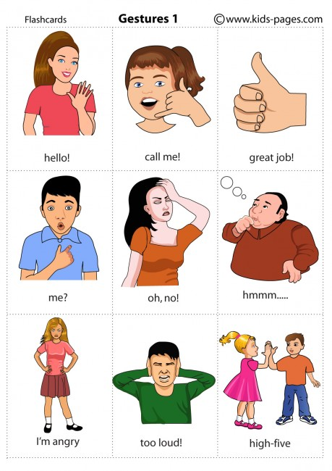
D 篇
探讨人类的手势的意义表达

Slide 23
D 篇：说明文
主题语境--人与社会
(Para. 1) “Tie an Italian's hands behind his back,” runs an old joke, “and he’ll be speechless.” This rests on a national stereotype: Italians are talkative and emotional, and all that arm-waggling supposedly goes to prove it.
点击添加标题
写作手法题
32. Why does the author mention the old joke in Paragraph 1?
A. To present an argument. B. To describe a scene.
C. To lead in the topic. D. To clarify a doubt.

Slide 24
D 篇：说明文
(Para. 2) Susan Goldin-Meadow of the University of Chicago has a rather different view. Emotions come out in lots of ways: facial expressions, posture, tone of voice and so on. But people are doing something different when they use gestures with speech, which she sums up in the title of her new book, “Thinking with Your Hands”. It is a masterly tour through a lifetime's research.
点击添加标题
推理判断题
33. Which statement will Susan Goldin-Meadow probably agree with?
A. The disabled seldom use gestures. B. Gestures literally embody cognition.
C. Thinking only occurs inside the brain. D. Gestures are improper in communication.

Slide 25
(Para. 4-5）In fact, gestures that accompany speech are a second channel of information. Subjects watch a film in which a cat runs but are told to lie and say it jumped. They do so in words—while their hands make a running motion. People who say they believe in sexual equality but gesture with their hands lower when talking about women are not indicating women's height; they can be shown to have biases of which they may be unaware.
In “The Crown”, a historical drama series, Lady Diana is warned that her hands may betray her real emotions, which could be dangerous; they are tied together so she can learn to speak without gesticulating. No one who reads Susan's book could ever again think that gesturing shows only a lack of control. It is about thinking and communication, and is a sophisticated aid to both.
点击添加标题
归纳概括题
34. What does the author try to prove in the last two paragraphs?
A. Gestures may express what the speaker really thinks.
B. People are unaware of the meanings of their gestures.
C. Gesturing during speech shows only a lack of control.
D. Speakers can lie more easily with the help of gestures.

Slide 26
D 篇：说明文
主题语境--人与社会
标题归纳题
35. Which of the following is the best title for the text?
Speech: A Direct Channel of Information
Gestures: A Vital Form of Communication
C. Italian's Body Language: A National Stereotype
D. Thinking with Your Hands: A Lifetime's Research
点击添加标题
根据第二段，第三段，第四段，第五段的内容，归纳概括可知本文主要讲述的是手势是重要交流形式。

Slide 27
长难句分析；
1.Experimental subjects, told after a research session that they were being watched for gestures, apologize for not having made any—but were doing so the entire time.
主语
非谓语done 作状语
非谓语told 之后跟的宾语从句
谓语
But 后的并列句
do so = 做手势

Slide 28
长难句分析；
非谓语done 作后置定语
2. People born blind gesture when they speak, including to each other.
主语
谓语
When时间状语从句
Doing 伴随动作
gesture vi : 做手势
n. 手势

Slide 29
长难句分析；
3. All this suggests that cognition is, to some extent, “embodied”; thinking is not all done in your head.
主语
谓语
that 引导的宾语从句
插入语
主语
谓语
embody vt : 具体表现；体现
本句是通过分号来连结的两个并列简单句。

Slide 30
D 篇：语料库
1.posture n. 姿势
2.tone of voice 语调
3.gesture n. 手势
4.sum up 总结
5.Virtually everyone gestures, not just Italians. 动词：做手势
6.Experimental subjects 实验对象；研究对象
7.sexual equality 性别平等
8.betray vt. 背叛

Slide 31
PART 2
七选五

Slide 32
首先观察选项设置的特点：
主题语境与语篇分析-- 七选五
A. Safety comes first for various outdoor activities.
B. Surprisingly, dark lenses aren't necessarily the most protective.
C. Indoor heating and air conditioning can dry out the air—and the eyes.
D. Gardening, home repairs and sports all pose the risk of trauma to the eye.
E. Not all eye problems are noticeable, and all are best treated when found early.
F. By incorporating these lifestyle steps, your eyes will stay healthy throughout the year.
G. We have asked experts what lifestyle steps people should take to protect their vision and eye health.
G 和F选项都有关键词 lifestyle steps ,可知有一个选项是冗余选项。

Slide 33
We watch our salt and fat intake to protect our hearts. We exercise and take calcium to protect our bones. We use sunscreen to protect our skin. But what can we do to protect our eyes, all year round? A lot. 36 .
A. Safety comes first for various outdoor activities.
B. Surprisingly, dark lenses aren't necessarily the most protective.
C. Indoor heating and air conditioning can dry out the air—and the eyes.
D. Gardening, home repairs and sports all pose the risk of trauma to the eye.
E. Not all eye problems are noticeable, and all are best treated when found early.
F. By incorporating these lifestyle steps, your eyes will stay healthy throughout the year.
G. We have asked experts what lifestyle steps people should take to protect their vision and eye health.
承上启下

Slide 34
Invest in quality sunglasses
To shield your eyes, wear sunglasses certified to block out 99 to 100 per cent of UVA and UVB light. 37 .“In fact, if the lenses are dark but not UV-protected, that's worse for your eyes, because when you're looking through dark lenses your pupils dilate, which lets more UV light inside to do damage,” says Dr Esen Akpek, a professor at Johns Hopkins University.．
A. Safety comes first for various outdoor activities.
B. Surprisingly, dark lenses aren't necessarily the most protective.
C. Indoor heating and air conditioning can dry out the air—and the eyes.
D. Gardening, home repairs and sports all pose the risk of trauma to the eye.
段中设空。
下文同词复现

Slide 35
Wear safety glasses when needed
You don't have to be doing construction work or factory work to need protective eyewear. 38 .It's estimated that up to 90 per cent of sports-related eye injuries are actually preventable with proper eye protection. “I see people who’ve been gardening, leaned forward and got poked in the eye by a branch,” says Dr Davinder Grover, an ophthalmologist at Glaucoma Associates of Texas.
段中设空。
把握句际的逻辑关系：
主题句 支撑句/分述句+
空格后两个分句的同词复现
A. Safety comes first for various outdoor activities.
B. Surprisingly, dark lenses aren't necessarily the most protective.
C. Indoor heating and air conditioning can dry out the air—and the eyes.
D. Gardening, home repairs and sports all pose the risk of trauma to the eye.

Slide 36
主题语境与语篇分析-- 七选五
Invest in an air purifier
39 . Outdoor cold and wind can be drying, too, while pollution and allergens can cause irritation. In addition to lubricating eye drops, “air purifiers and humidifiers are our friends,” says Akpek.
段首设空。
本段主题句—后面都是支撑分句且可以借助于outdoor activities 排除A项
A. Safety comes first for various outdoor activities.
B. Surprisingly, dark lenses aren't necessarily the most protective.
C. Indoor heating and air conditioning can dry out the air—and the eyes.
D. Gardening, home repairs and sports all pose the risk of trauma to the eye.

Slide 37
主题语境与语篇分析-- 七选五
See an eye specialist regularly
Routine checkup helps maintain good eye health, so please don't forget to see an eye specialist for a checkup regularly, if possible. 40 .
段末设空:
概括总结、呼应主题+
关键词即同畴词复现如 an eye specialist / eye problems/ treated 等
B. Surprisingly, dark lenses aren't necessarily the most protective.
C. Indoor heating and air conditioning can dry out the air—and the eyes.
D. Gardening, home repairs and sports all pose the risk of trauma to the eye.
E. Not all eye problems are noticeable, and all are best treated when found early.

Slide 38
七选五语料库
1.sunscreen n. 防晒霜
2.invest in… 投资…
3.shield your eyes = protect your eyes
4.certified to block out (做某事合格的)；真正可以挡住…
5.an air purifier 空气净化器
6.an eye specialist 眼科专家
7.routine checkup 常规体检
8.maintain good eye health 保护眼睛健康
9.Safety comes first. 安全第一
10. incorporate vt.并入；合并

Slide 39
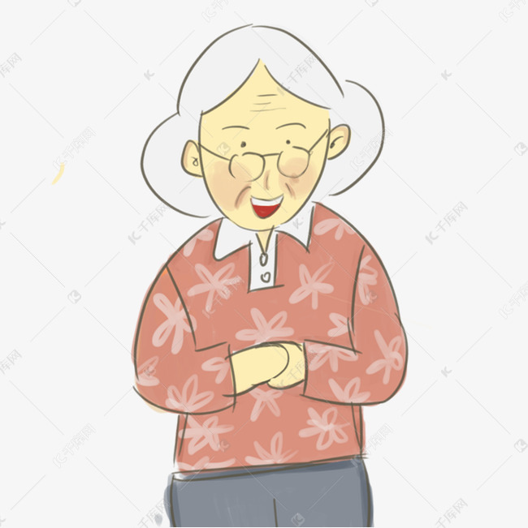
PART 3
完形填空
本文讲述了一位年长的老师在我学习生活中的点滴

Slide 40
Forty years ago, Mrs. Austen was my first-grade teacher, an old lady with salt-and-pepper hair, firm but kind, patient and 41 . She let us bake gingerbread men in the school cafeteria —a delightful 42 that amazed me. And whenever we read the “Jack and Janet” books, she wouldn't let the other kids 43 my classmate Jack or me.
treat 多义性：
I’d like to treat you to an ice cream to celebrate your birthday.(vt.请客）
The audience are treated to a fantastic Beijing opera. (欣赏；享受）
Ginerbreadman is a delightful treat. (n.美味的小吃；美食)
The doctor treated my toothache with some medicine. (vt. 治疗）
5. I do treat him as my best friend. ( vt.对待）
41. A. neighborly B. cowardly C. grandmotherly D. scholarly
42. A. treat B. view C. journey D. story
43. A. call on B. relate to C. laugh at D. engage with

Slide 41
Forty years ago, Mrs. Austen was my first-grade teacher, an old lady with salt-and-pepper hair, firm but kind, patient and 41 . She let us bake gingerbread men in the school cafeteria —a delightful 42 that amazed me. And whenever we read the “Jack and Janet” books, she wouldn't let the other kids 43 my classmate Jack or me.
41. A. neighborly B. cowardly C. grandmotherly D. scholarly
42. A. treat B. view C. journey D. story
43. A. call on B. relate to C. laugh at D. engage with

Slide 42
But I came to truly 44 Mrs. Austen when a dress-up day was 45 . On that day, we were encouraged to wear clothes in the 46 of the mid-1800s. My mother, a superb tailor, made a pioneer-style dress for me. I was so proud 47 it as I walked to school that day. …
44. A. remember B. appreciate C. believe D. approach
45. A. appointed B. canceled C. established D. scheduled
46. A. field B. style C. course D. show
47. A. making B. holding C. wearing D. owning
44. 本题需要从第二段的主旨大意去推断，因为老师穿上时髦的裙子而从而避免让穿了妈妈缝制的时髦裙子的我感到不自在。为此，我真正心怀感激。

Slide 43
…When I got there, however, I was the only one in my class who had dressed up, feeling kind of 48 . Mrs. Austen oohed and aahed over my 49 and then went to her office. It didn't take long before she 50 in a frontier-style dress! She explained that she had asked her husband to bring the costume.
48. A. surprised B. frightened C. disappointed D. embarrassed
49. A. cookies B. present C. costume D. material
50. A. reappeared B. displayed C. announced D. modeled

Slide 44
We moved away two years later, and I still 51 that I never told Mrs. Austen how 52 I was to her, a teacher who went out of her way, and even 53 her husband's help, to keep a little girl from feeling 54 .
51. A. assume B. regret C. imagine D. pretend
52. A. dedicated B. important C. attached D. grateful
53. A. sought B. deserved C. offered D. declined
54. A. at ease B. in order C. out of place D. under control
1.seek help 寻求帮助
2. feel at ease = feel at home
3.feel out of place 感到不自在
4.keep sb from doing sth 阻止sb 做sth
51、52 题： 需回扣到第二段 44 空 truly appreciate.我始终没有亲口和老师说谢谢。所以至今依然后悔。
53、54 题：需要回扣原文第二段 老师为了不让我感到不自在，特意让她丈夫送来时髦的裙子穿上，重新出现在教师。

Slide 45
We moved away two years later, and I still 51 that I never told Mrs. Austen how 52 I was to her, a teacher who went out of her way, and even 53 her husband's help, to keep a little girl from feeling 54 . I had many wonderful teachers throughout the years, but Mrs. Austen has always held a（n） 55 place in my heart.
55. A. typical B. special C. obvious D. ideal
55. Mrs Austen 在我心中占据着一个特别的位子。

Slide 46
完形填空语料库
1.salt-and-pepper hair 花白头发
2.bake gingerbread men 烤姜饼人
3.a dress-up day 化装日
4.a pioneer-style dress =frontier-style dress 时髦的裙子
5.feel kind of embarrassed = feel out of place 感到不自在
6.ooh and aah over my dress 赞叹我的裙子
7.costume n. 戏服；
8.go out of one‘s way 特意去做

Slide 47
PART 4
语法填空

Slide 48
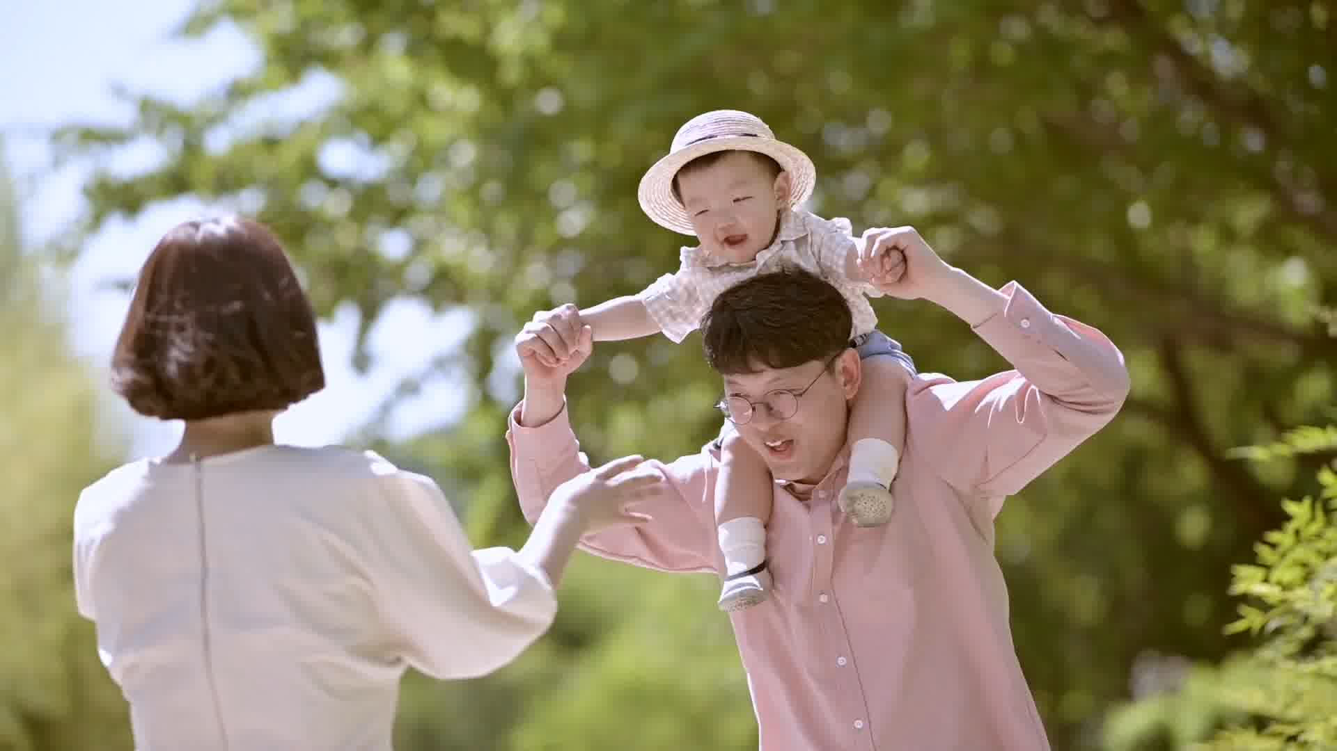
主题语境：人与社会—家庭
主旨大意：中国家庭规模的变迁
设空类型：有提示词5，无提示词5

Slide 49
For thousands of years, Chinese people 56 （value） the large family with three, four, or even five generations living under the same roof. In this way of life, the older generation can enjoy a happy and easy late life with their children, grandchildren or great-grandchildren growing up beside them and keeping them 57 being lonely. However, as society advances and people enjoy a 58 （comfortable） life, the big families begin to break up. Along with the growth of so-called “empty nestles”, which means the young birds have flown away and only 59 old are left alone, young parents are living with their own nuclear families. It goes without saying 60 the collapse of big families and the popularity of smaller ones are the result of our times.
have valued
考查时态：现在完成时
考查介词
from
考查形容词比较级
more comfortable
考查定冠词the +adj表一类人
the
that
考查连词：主语从句

Slide 50
考查连词表并列宾语
It is a time when people think highly of individual freedom 61 happiness. Young people like to have a space all alone to themselves, which helps avoid conflicts 62 （cause） by different living habits from their parents. It's also a time when problems of old age and childcare have been socialized gradually. Senior citizens can live together and 63 （take） good care of by specialized nurses.
and
考查非谓语动词作后置定语
caused
be taken
考查被动语态

Slide 51
Therefore, there is every reason to believe that this trend of families in reduced size is 64 （agree） to our times. To create a brighter future, we should do our best to build our society into one in 65 every member lives healthily and harmoniously.
考查动词变形容词
agreeable
which
考查定语从句关系代词

Slide 52
语法填空语料库
1. empty nestles 空巢
2.nuclear families 核心家庭
3.socialize 社会化
4.senior citizens 老年人
5.specialized nurses 专业护士；专业护工
6.be agreeable to our times 顺应时代
7.harmoniously 和谐地

Slide 53
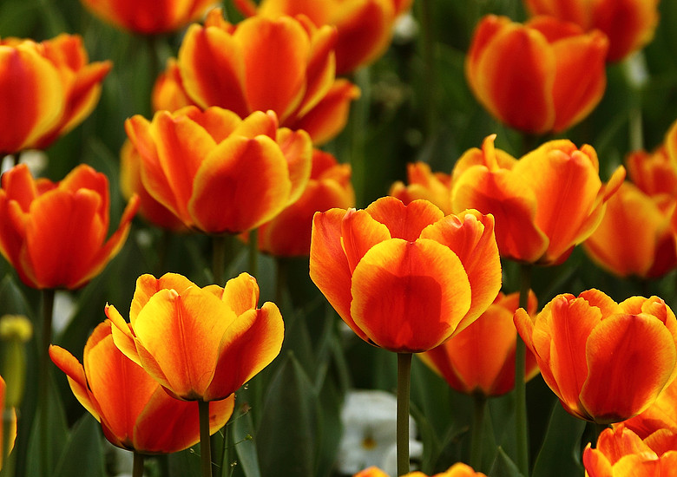
Sharing is joy！

