Slide 1
感恩遇见，相互成就，本课件资料仅供您个人参考、教学使用，严禁自行在网络传播，违者依知识产权法追究法律责任。
更多教学资源请关注
公众号：溯恩高中英语
知识产权声明

Slide 2
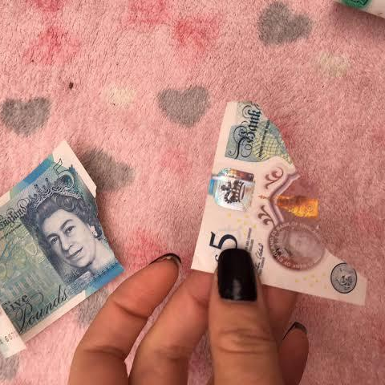
Lesson 7
Mutilated ladies

Slide 3
Target vocabulary
1

Slide 4
Match each word with the best meaning.
1. _____ mutilate A. a man engaged to be married
2. _____ safekeeping B. a printed currency issued by a bank
3. _____ fiancé C. to severely damage or disfigure something
4. _____ microwave D. a feeling of distress, disappointment, or discouragement
5. _____ a bank note E. the act of keeping something safe and protected
6. _____ chew F. a heated chamber used for baking, roasting, or heating food
7. _____ identify G. to recognize or determine the identity of someone or something
8. _____ spokeswoman H. an appliance used for quickly heating or cooking food using
9. _____ dismay I. to grind food with the teeth to break it down before swallowing
10. ____ oven J. a female representative who speaks on behalf of an organization
or group
C
E
A
H
B
I
G
J
D
F

Slide 5
Reading the passage
2

Slide 6
Reading the passage
Has it ever happened to you? Have you ever put your trousers in the washing machine and then remembered there was a large bank note in your back pocket? When you rescued your trousers, did you find the note was whiter than white? People who live in Britain needn't despair when they make mistakes like this (and a lot of people do)! Fortunately for them, the Bank of England has a team called Mutilated Ladies which deals with claims from people who fed their money to a machine or to their dog. Dogs, it seems, love to chew up money!
A recent case concerns Jane Butlin whose fiancé, John, runs a successful furniture business. John had a very good day and put his wallet containing ￡3, 000 into the microwave oven for safekeeping. Then he and Jane went horse-riding. When they got home, Jane cooked their dinner in the microwave oven and without realizing it, cooked her fiancé's wallet as well. Imagine their dismay when they found a beautifully-cooked wallet and notes turned to ash! John went to see his bank manager who sent the remains of wallet and the money to the special department of the Bank of England in Newcastle: the Mutilated Ladies! They examined the remains and John got all his money back. ‘So long as there's something to identify, we will give people their money back,’ said a spokeswoman for the Bank. ‘Last year, we paid ￡1. 5m on 21, 000 claims.’ *Damaged bank notes. The Queen's head appears on English bank notes，and ‘lady’ refers to this.

Slide 7
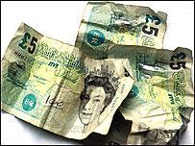
Why did Jane cook John's wallet?
She cooked a meal in the microwave oven without knowing John had put his wallet there.

Slide 8
Reading comprehesion
3

Slide 9
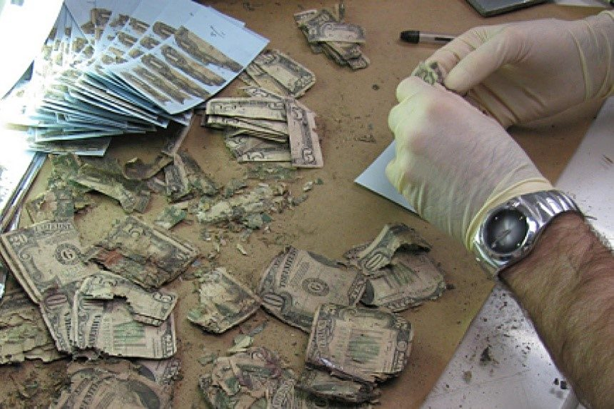
Reading comprehension
1. They call the team in Newcastle ‘Mutilated Ladies’
because _______.
A. their job involves mutilating bank notes
B. ladies accidentally mutilate bank notes in the wash
C. only ladies have the patience for this difficult job
D. they identify pictures of the Queen on mutilated bank notes

Slide 10
Reading comprehension
2. The Bank of England offers a special service to people who
_______.
A. feed their money to the dog
B. try to wash large bank notes
C. mutilate bank notes on purpose
D. have damaged but identifiable bank notes

Slide 11
Reading comprehension
3. You don't get your money back unless _______.
A. your bank manager agrees to help you
B. you have done this sort of thing before
C. there is enough evidence to prove your claim
D. you go to Newcastle and see the Mutilated Ladies

Slide 12
Structure imitation
4

Slide 13
Structure imitation
1. Fortunately for …, …have a…called…which deals with….
Fortunately for students, the university has a support center called "Academic Advising" which deals with providing guidance and assistance in course selection and academic planning.
Fortunately for patients, the hospital has a specialized unit called "Emergency Medicine" which deals with urgent medical conditions and provides immediate care to those in need.
Fortunately for job seekers, the company has a department called "Human Resources" which deals with recruitment, hiring, and employee management.

Slide 14
The old book I found buried in my grandmother’s attic at one time must have been a treasured possession, for it was adorned with a delicate cover of gold and precious jewels that shone brilliantly in the dim light.
Structure imitation
2. … and without realizing it, … as well
Rushing to her next appointment, she absentmindedly locked her car and without realizing it, locked her baby in the car as well.
Juggling multiple tasks, she hastily parked the car and, without realizing it, left her phone behind as well.
Caught up in the excitement, she enthusiastically joined the dance floor and, without realizing it, stepped on her partner's toes as well.
In a rush to catch the train, she hastily grabbed her suitcase and, without realizing it, left her passport behind as well.

Slide 15
Structure imitation
3. Imagine their dismay when…
Imagine their dismay when they entered the conference room, fully prepared for their presentation, only to discover that the projector wasn't working.
Imagine their dismay when they arrived at the restaurant, looking forward to a special anniversary dinner, only to find out that their reservation had been mistakenly canceled.
Imagine their dismay when they arrived at the theme park, ready for a day of thrilling rides, only to find that the park was unexpectedly closed for maintenance.

Slide 16
Story telling
5

Slide 17
Story-telling
1. John ---- successful furniture business ---- ￡3,000 ---- microwave oven ---- safekeeping
2. John and fiancé, Jane ---- horse-riding
3. got home ---- Jane cooked dinner ---- microwave oven, without realizing …
4. dismay ---- cooked wallet ---- notes ---- ash!
5. John ---- bank manager ---- sent remains ---- Mutilated Ladies
6 examined notes ---- John ---- all money back
7. ‘So long ---- something to identify ---- money back,’spokeswoman said
8. last year---- ￡1.5m on 21,000 claims

Slide 18
Summary writing
6

Slide 19
Answer the following questions with complete sentences.
1. What sort of business does John Butlin run?
2. What did he do at the end of a very good day?
3. What did he and his fiancée do then?
4. What did Jane do after they got home?
5. What were they dismayed to find?
6. Who did John go and see?
7. What did the bank manager do?
8. What happened after that?

Slide 20
1. What sort of business does John Butlin run?
John Butlin runs a successful furniture business.
2. What did he do at the end of a very good day?
He put his wallet containing ￡3,000 into the microwave oven for safekeeping.
1+2:
John Butlin runs a successful furniture business and after a very
good day, he put his wallet containing ￡3,000 into the microwave
oven for safekeeping.

Slide 21
3. What did he and his fiancée do then?
He and his fiancée, Jane, went horse-riding.
4. What did Jane do after they got home?
Jane cooked their dinner in the microwave oven.
5. What were they dismayed to find?
They only to find to their dismay that the money had been destroyed.
3+4+5:
Then he and his fiancée, Jane, went horse-riding, after which Jane cooked their dinner in the microwave oven only to find to their dismay that the money had been destroyed.

Slide 22
6. Who did John go and see?
John went and saw his bank manager.
7. What did the bank manager do?
The bank manager sent the remains to the special
department of the Bank of England: the Mutilated ladies.
8. What happened after that?
They examined the remains and John got all his money back.
6+7+8:
John went to see his bank manager who sent the remains to
the Mutilated Ladies department who identified the remains
and returned the money.

Slide 23
A possible version:
John Butlin runs a successful furniture business and after a very good day, he put his wallet containing ￡3,000 into the microwave oven for safekeeping. Then he and his fiancée, Jane, went horse-riding, after which Jane cooked their dinner in the microwave oven only to find to their dismay that the money had been destroyed. John went to see his bank manager who sent the remains to the Mutilated Ladies department who identified the remains and returned the money.

Slide 24
Occasion describing
7

Slide 25
Occasion describing
Jane opened the oven door and saw that her meal was _______. She took the food out of the oven and ___________________________. They both rushed to the oven and ________________________________. At first, they didn't know what ____________________________________. John wanted to ____________________________________________________ but Jane wouldn't __________________________________________________ ’It's best not to ___________________________________________________,’ Jane said. ‘You can see that all the money _______________________’ Jane told John to __________________________________________________, so the next day ____________________________________________________.

Slide 26
Occasion describing
Jane opened the oven door and saw that her meal was _________________. She took the food out of the oven and ____________________________________________________________ which she couldn’t recognize. So she went to find John and ________________ In dismay, John quickly explained that ________________________ ________________________________________________________________. They both rushed to the oven and _____________________________________. At first, they didn't know ____________.
ready to serve
in doing so, noticed something strange inside the oven
told him about it
he had put his wallet
containing the day’s takings into the oven for safekeeping
saw that the money had been destroyed
what to do

Slide 27
Occasion describing
John wanted to _________________________, but Jane wouldn't ________.‘It's best not to ___________________,’Jane said. ‘You can see that all the money _________________________________________’ Jane told John to go and see his bank manager ___________, so the next day ___________________________________________________.
throw the money away
let him
disturb the wallet
is there, even if it has been destroyed
for advice
John took the wallet and the ashes to the bank

Slide 28
Story development
8

Slide 29
Reading the passage
Has it ever happened to you? Have you ever put your trousers in the washing machine and then remembered there was a large bank note in your back pocket? When you rescued your trousers, did you find the note was whiter than white? People who live in Britain needn't despair when they make mistakes like this (and a lot of people do)! Fortunately for them, the Bank of England has a team called Mutilated Ladies which deals with claims from people who fed their money to a machine or to their dog. Dogs, it seems, love to chew up money!
A recent case concerns Jane Butlin whose fiancé, John, runs a successful furniture business. John had a very good day and put his wallet containing ￡3, 000 into the microwave oven for safekeeping. Then he and Jane went horse-riding. When they got home, Jane cooked their dinner in the microwave oven and without realizing it, cooked her fiancé's wallet as well. Imagine their dismay when they found a beautifully-cooked wallet and notes turned to ash! John went to see his bank manager who sent the remains of wallet and the money to the special department of the Bank of England in Newcastle: the Mutilated Ladies! They examined the remains and John got all his money back. ‘So long as there's something to identify, we will give people their money back,’ said a spokeswoman for the Bank. ‘Last year, we paid ￡1. 5m on 21, 000 claims.’

Slide 30
Para 1：
The story of Jane and John became famous in their small town.
Para 2：
Yet, Jane couldn't shake off guilt for ruining John's special day.

Slide 31
One possible version:
The story of Jane and John became quite famous in the small town they lived in. People couldn't help but chuckle at the thought of a microwave-cooked wallet and the Mutilated Ladies team coming to the rescue. Some even joked that it was a clever way to launder money. Jane and John found themselves the center of attention for a while, but eventually, life went back to normal. However, the incident had a lasting impact on Jane and John. They became more cautious with their money and belongings, realizing the importance of being responsible.
Yet, Jane couldn't shake off the feeling of guilt for ruining John's special day. She knew how hard he had worked to earn that money, and she couldn't believe she had been so careless. She tried to make it up to him by cooking his favorite meals and surprising him with small gifts, but she still felt like she had let him down. John, on the other hand, was just happy to have his money back and didn't hold a grudge. He knew that accidents happen, and he was just grateful that the Mutilated Ladies were able to help them out.

Slide 32
One possible version:
The story of Jane and John became famous in their small town. Initially, Jane felt ashamed, but she realized people were intrigued, not judgmental. Some even playfully called her 'The Microwaver.' Jane found humor in the situation, joking about starting a wallet-cooking business. The incident brought Jane and John closer. They bonded over the stress and relief. John saw it as an opportunity to declutter his wallet. Jane was grateful for the Bank of England's Mutilated Ladies, knowing there was a solution for such mistakes.
Yet, Jane couldn't shake off guilt for ruining John's special day. To make it up to him, she planned a surprise picnic at their favorite countryside spot. Jane cooked his favorite foods and wrote an apology letter.When they arrived, John was touched. They enjoyed the afternoon, reminiscing and making plans. Jane wanted to show John how much she cared and cherished their relationship. She learned that genuine love and care are the best way to make up for a mistake.

Slide 33
Vocabulary reiforcement
9

Slide 34
A. Word spelling
Jessica was devastated when she found out that her fiancé had m_________ their bank note. She had been s____________ it in her jewelry box for months, and was planning to use it to pay for their upcoming wedding. She tried to remain calm as she confronted him, but he simply c________ his gum and shrugged it off. Determined to i________ the person responsible for the damage, Jessica contacted the bank and requested an investigation. After a few days, a s______________ called her back with some shocking news: the bank note had been m___________ and then left in the oven for hours. Jessica was filled with d______ as she realized that her fiancé had done it on purpose. She knew that she couldn't marry someone who would do something so cruel and thoughtless, so she ended their e_____________. Even though it was a painful d________, Jessica knew that it was the right thing to do. She couldn't imagine a life with someone who would take pleasure in d__________ something that was important to her.
utilated
afekeeping
hewed
dentify
pokesperson
icrowaved
ismay
ngagement
ecision
estroying

Slide 35
B. Gap filling
happen to whiter than white deal with chew up for safekeeping without realizing it turn to ash give back so long as refer to
1. I will do it __________ you promise to help me later, as I have a lot on my plate right now.
2. It's amazing how people can try to appear _______________, but nobody is perfect.
3. Unfortunately, ________________, I left my phone on the bus and had to go back to get it.
4. The fire was so intense that everything in the room ____________, leaving nothing for me to salvage.
5. I need to ________ the book I borrowed from the library last week, as someone else may need to read it.
so long as
whiter than white
without realizing it
turned to ash
give back

Slide 36
B. Gap filling
happen to whiter than white deal with chew up for safekeeping without realizing it turn to ash give back so long as refer to
6. My dog always ________ my shoes when I'm not home, so I have to remember to put them out of his reach.
7. Could you please _______ the user manual for instructions on how to operate the device, as I'm not quite sure how to use it?
8. ___________ difficult customers can be really challenging, but it's important to remain calm and professional.
9. I put the document in the safe ______________ until Monday, as it contains important information that cannot be lost or damaged.
10. Yesterday, something ___________ my neighbor when she was jogging in the park. She tripped over a rock and fell, injuring her knee."
chews up
refer to
Dealing with
for safekeeping
happened to

