Slide 1


感恩遇见，相互成就，本课件资料仅供您个人参考、教学使用，严禁自行在网络传播，违者依知识产权法追究法律责任。
更多教学资源请关注
公众号：溯恩英语
知识产权声明

Slide 2
Book1 Unit5
POLYGLOTS:
WHAT ARE THEY AND WHO CAN BE ONE?
Shirley Tong

Slide 3



How many languages can you speak?
How do you feel when you started to learn English?
Polyglots:
people who can speak several languages well
Dongbei Dialect
Mandarin
English
Notes:
Feelings difficult interested fun

Slide 4
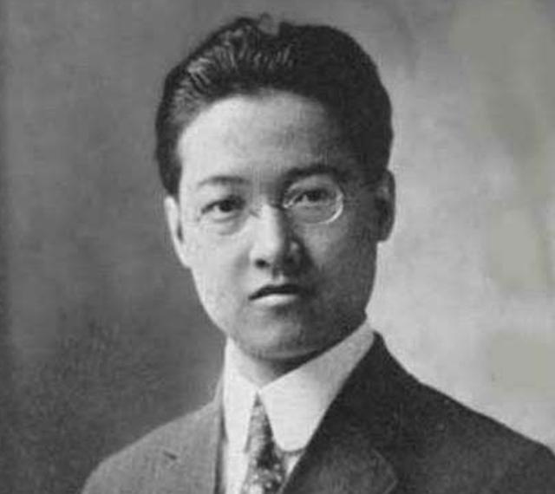
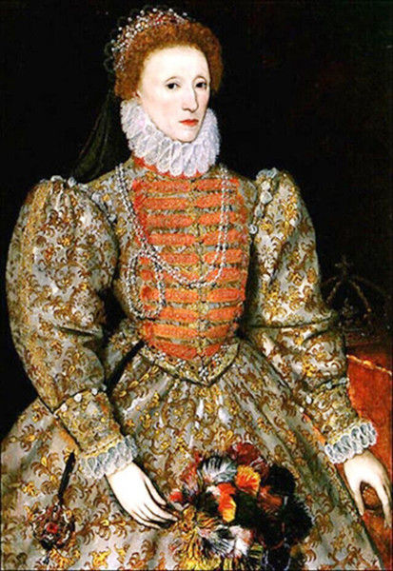
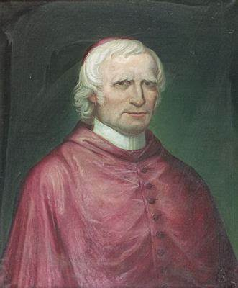
Do you know who they are?
Can you think of any similarities between them?

Slide 5
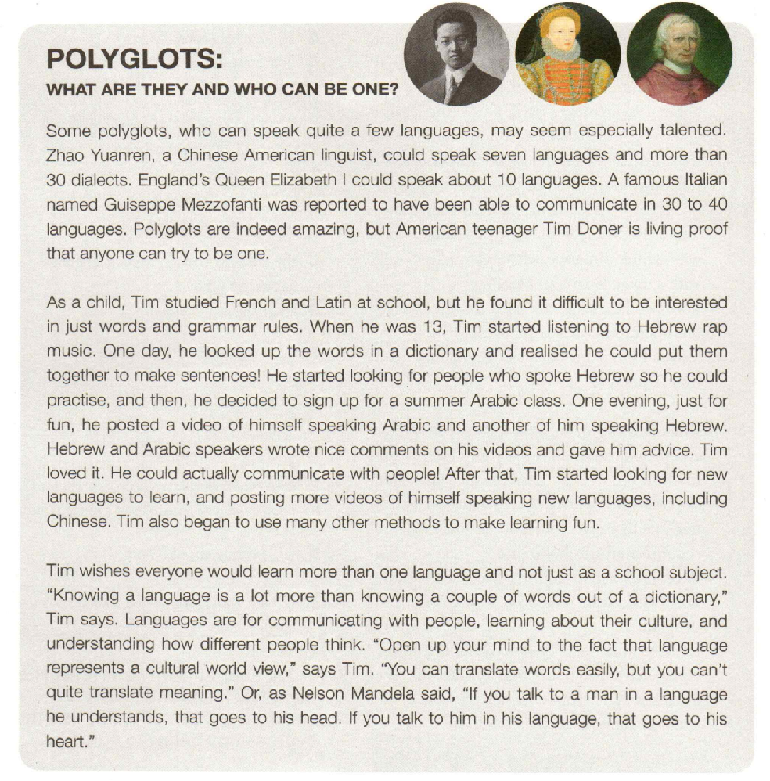


What does the author think of them?
Zhao Yuanren, a Chinese American linguist
speak 7 languages and more than 30 dialects
indeed amazing
England’s Queen Elizabeth I
speak about 10 languages
may seem talented
Polyglots
people who can speak a few languages
Guiseppe Mezzofanti
was reported to be able to communicate in 30 to 40 languages
Notes:
They may seen especially talented. What do author think of them?

Slide 6
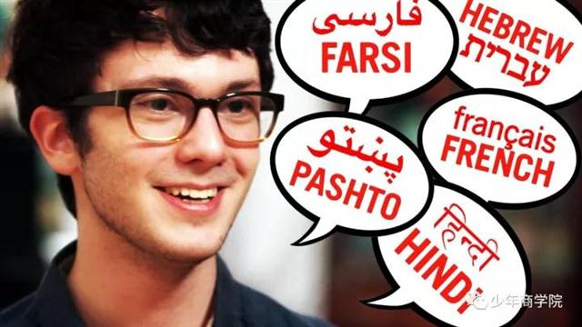

If you have a chance to ask Tim Doner a question, what will you ask?
may seem talented
An American teenager
speak quite a few languages
Polyglots are indeed amazing but American teenager Tim Doner is living proof that anyone can try to be one.
Notes:
What languages do you learn? What are your method of learning it? What difficulties have you face? How do you feel? Why do you want to learn languages?

Slide 7
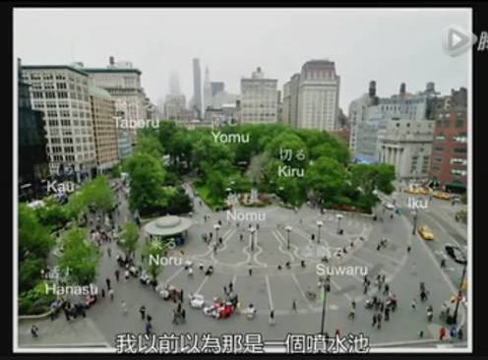

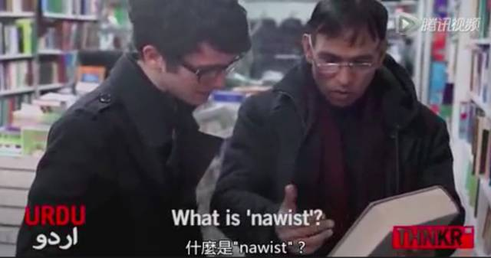

Which method did he find most successful?
Which method impress you most? Why?
How did Tim Doner first become interested in learning languages?
make learning fun
Tim loved it. He could communicate with people!
make video of speaking the language
sign up for summer class
practice with native speakers
found it difficult to be interested in just words and grammar rules
make sentences
French; Latin;
Hebrew; Arabic;
Chinese;
refer to the dictionary
listen to Hebrew rap music
Languages
Difficulties
Methods
Reasons
Notes:
Group discussion

Slide 8
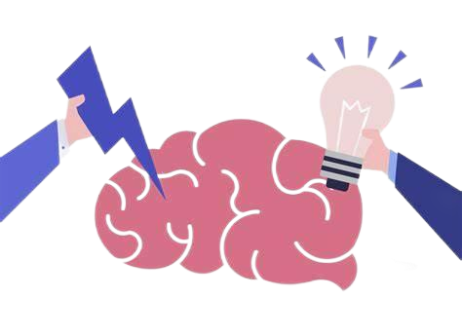


Reasons for learning languages
Tim wishes everyone would learn more than one language and not just as a school subject."Knowing a language is a lot more than knowing a couple of words out of a dictionary.Tim says. Languages are for communicating with people, learning about their culture, and understanding how different people think."Open up your mind to the fact that language represents a cultural world view, "says Tim. "You can translate words easily, but you can't quite translate meaning. "Or, as Nelson Mandela said, "If you talk to a man in a language he understands, that goes to his head. If you talk to him in his language, that goes to his heart."
communicate
learn culture
understand way of thinking

Slide 9

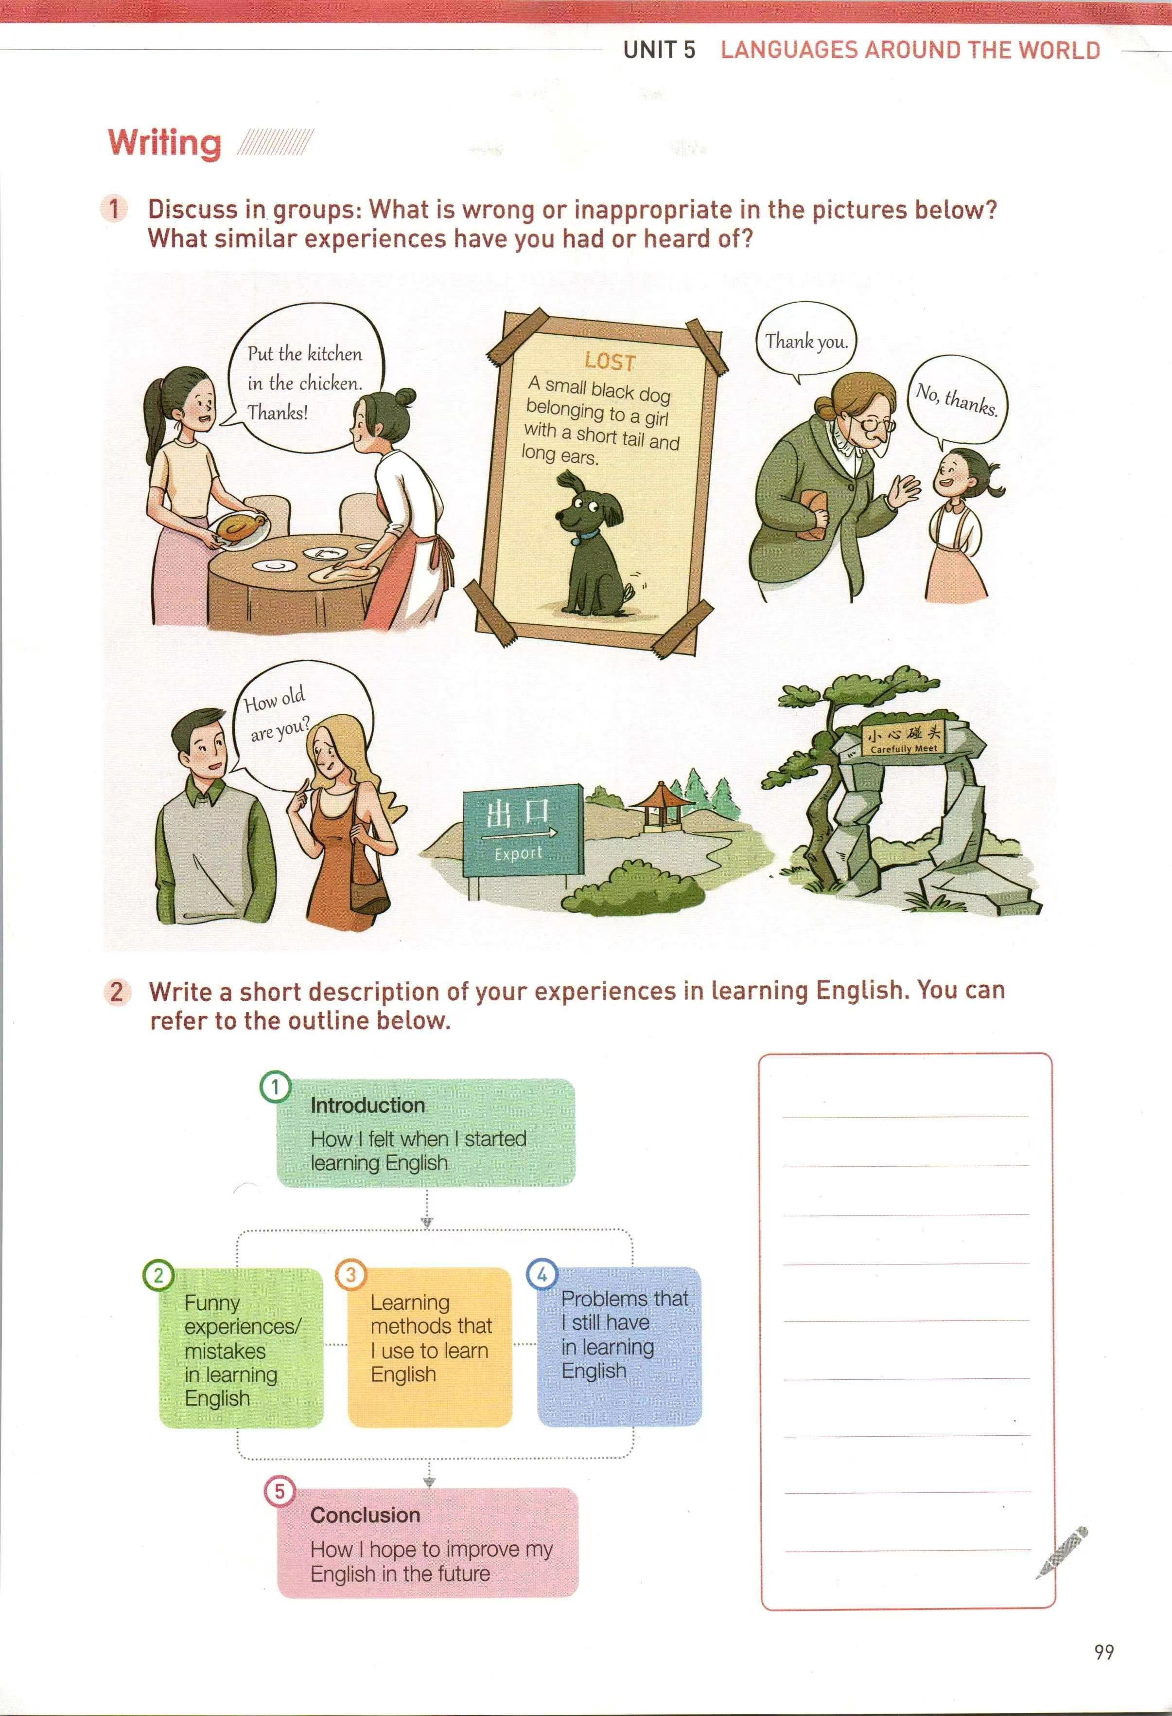
What’s your understanding of the sentence?
"If you talk to a man in a language he understands, that goes to his head. If you talk to him in his language, that goes to his heart." ——Nelson Mandela
in his culture and way of thinking
Cultural inappropriate question

Slide 10

Polyglots:
Who can be one?
Anyone can be a polyglots.
Teacher!+ You
Notes:
What languages do you learn? What are your method of learning it? What difficulties have you face? How do you feel? Why do you want to learn languages?

Slide 11
Group Discussion: What are the secrets to be polyglots?
make learning fun
make video of speaking the language
sign up for summer class
practice with native speakers
understand way of thinking
found it difficult to be interested in just words and grammar rules
make sentences
French; Latin;
Hebrew; Arabic;
Chinese;
refer to the dictionary
learn culture
listen to Hebrew rap music
communicate
Languages
Difficulties
Methods
Reasons
Notes:
Group discussion

Slide 12
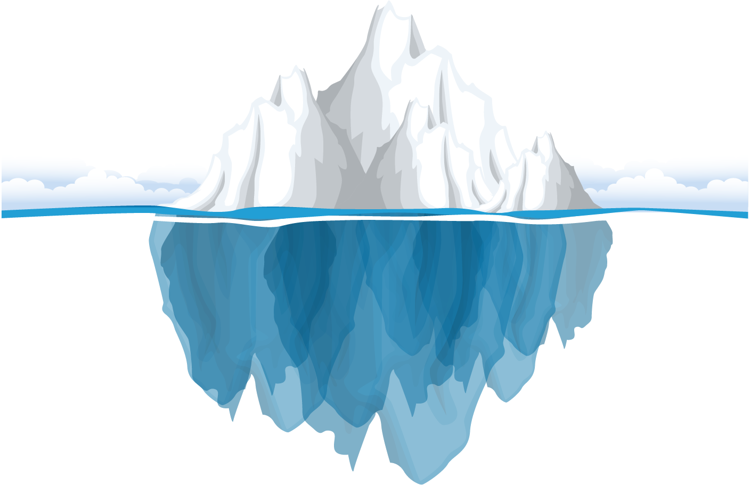
Which do you think is the most important for becoming a polyglot? Why?
Polyglots
Passion for learning
Positive
qualities
(confident;
hardworking;
persistent(坚持的）;
curious
Difficulties
Love for language
Make full use of resources
Discipline

Slide 13
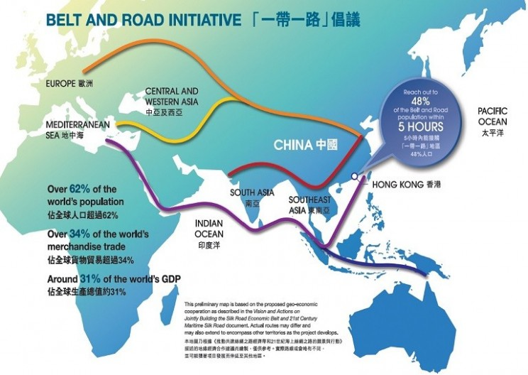
Why do we learn foreign language?
F
o
r
e
i
g
n
Facilitate the concept for a community of a shared-future
Obtain experience for national rejuvenation (复兴）
Reserve international talents
Erase misundestanding and promote mutual understanding
Intensify(增强) cultural confidence
Gain glorious future
Interact with foreigners without obstacles
for yourselves
for our Chinese

Slide 14

Assignment： Think about two questions.
What are your problems when learning English?
What learning methods(fun/efficient) that you use to learn English?
funny experiences /mistakes
The reasons to learn English

