Slide 1
感恩遇见，相互成就，本课件资料仅供您个人参考、教学使用，严禁自行在网络传播，违者依知识产权法追究法律责任。
更多教学资源请关注
公众号：溯恩高中英语
知识产权声明

Slide 2
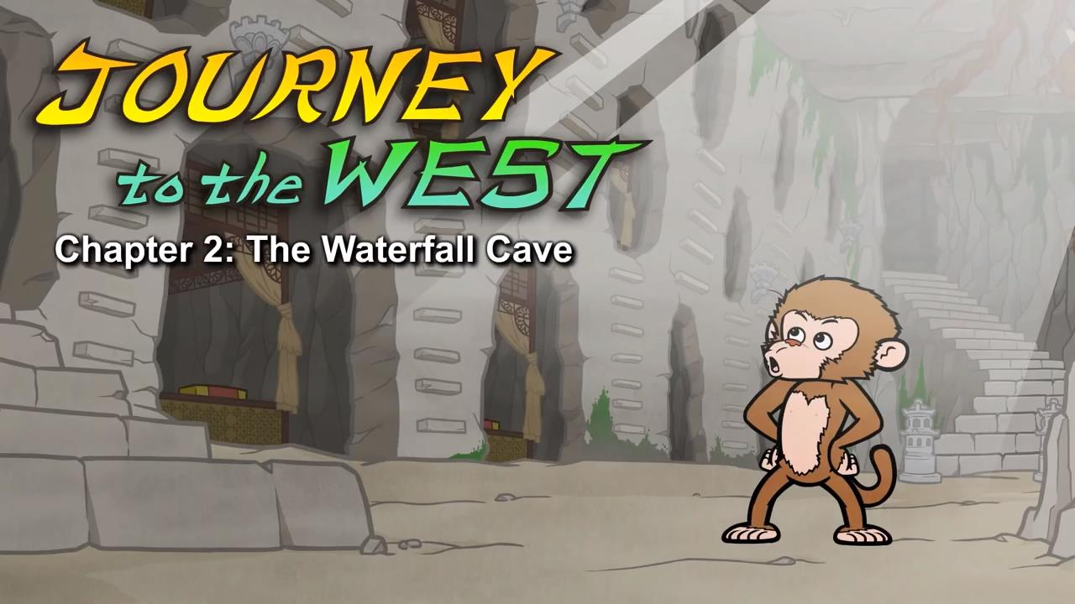
Episode 2: The Waterfall Cave

Slide 3
Part 1 quiz
1.What did Monkey find in the cave?
A.bedrooms B.spiders C.a lake
2.What did the monkeys do in the cave?
A.They argued and fought. B.They played games.
C.They broke everything.
3.Why did everyone bow to Monkey?
A.He gave everyone money. B.He was really big and scary.
C.He found the cave.
4.Why was Monkey sad?
A.He wanted to live forever. B.He didn't get enough food.
C.He wanted more friends.
5.What are sages?
A.very young people B.very wise people C.very rich people
Keys:AACAB

Slide 4
Part 2 vocabulary
1. Wide 张得(或开得)很⼤地 His eyes opened wide.
2. land 降落，登陆 Monkey splashed through the waterfall and landed in a large cave.
3. wide 张得(或开得)很⼤地 His eyes opened wide
4. bamboo ⽵⼦ The cave was filled with bamboo, trees, and beautiful flowers.
5. moss 苔藓，地⾐ Moss covered the walls.
6. glowing鲜艳的，鲜明的，炽热的 A stream flowed through the cave, and glowing light and mist filled the air.
7. fireplace 壁炉 A fireplace sat against one wall.
8. cozy (房间或者家⾥)舒适的，惬意的
Deeper in the cave, Monkey found bedrooms with cozy beds.
9. outside (在)外⾯ Outside, the other monkeys and apes were looking at the waterfall.
10. wash away 冲⾛ He probably got washed away down the river.
11. perfect完美的 I found a perfect home for all of us.
12. dangerous危险的
13.argue争论，辩论 Some of the monkeys and apes began fighting and arguing.
"It still looks dangerous ," said one monkey.

Slide 5
14. Fold 1. 弯曲着，⼸着(脚，⾝体等)，(2. 折叠(纸，布等)) Monkey watched his friends for a moment and then folded his arms.
15. cave洞⽳，洞窟 Monkey splashed through the waterfall and landed in a large cave.
16. Hail 1. 欢呼，喝采，(2. ⼤声招呼(车辆、⼈等)，3. 雹，冰雹) He bowed to Monkey and said, "All hail the Monkey King."
all hail 万岁！He bowed to Monkey and said, " All hail the Monkey King."
17. Safely 安全地 And every night they slept safely in their cave.
18. feast 盛宴，筵席 One night the monkeys and apes had a huge feast.
19. throne 王位，王座 Monkey sat on his throne and smiled.
20. fade1. 逐渐消失，逐渐变弱，(2. (颜⾊)退⾊，褪去) But then his smile faded.
21. frown 皱眉 Soon he was frowning.
22. wrong错的，不对的 What's wrong?
23. sigh 叹⽓，叹息 Monkey sighed.
24. someday 将来有⼀天 Someday our lives will end.
25. last 1. 维持，持续，(2. 最后的) I wish this perfect life could last forever.
26. forever 永远地 I wish this perfect life could last forever.

Slide 6
27. lit up (眼神等)发亮，⾯露喜⾊ The gibbon's eyes lit up.
28. sage 圣⼈，圣贤 Then you must study with a sage.
29. built 建筑，建造 (build-built) The next morning Monkey built a raft and loaded food onto it.
30. raft ⽊筏，橡⽪船 The next morning Monkey built a raft and loaded food onto it.
31. load 1. 装货，装载，(2. 货物，装载物) The next morning Monkey built a raft and loaded food onto it.
32. float 1. 漂流，(2. (在⽔上或空中)漂浮) As the raft began to float away, Monkey waved to his friends.

Slide 7
Part 3 sentences
1.Monkey splashed through the waterfall and landed in a large cave.
2.His eyes opened wide.
3.A fireplace sat against one wall.
墙边上有个壁炉。
4.Monkey shot out of the waterfall and landed in front of the group.
5.Monkey watched his friends for a moment and then folded his arms.
6.His smile faded. Soon he was frowning.
7.The gibbon's eyes lit up.
8.The gibbon rubbed his chin.

