Slide 1
感恩遇见，相互成就，本课件资料仅供您个人参考、教学使用，严禁自行在网络传播，违者依知识产权法追究法律责任。
更多教学资源请关注
公众号：溯恩英语
知识产权声明

Slide 2
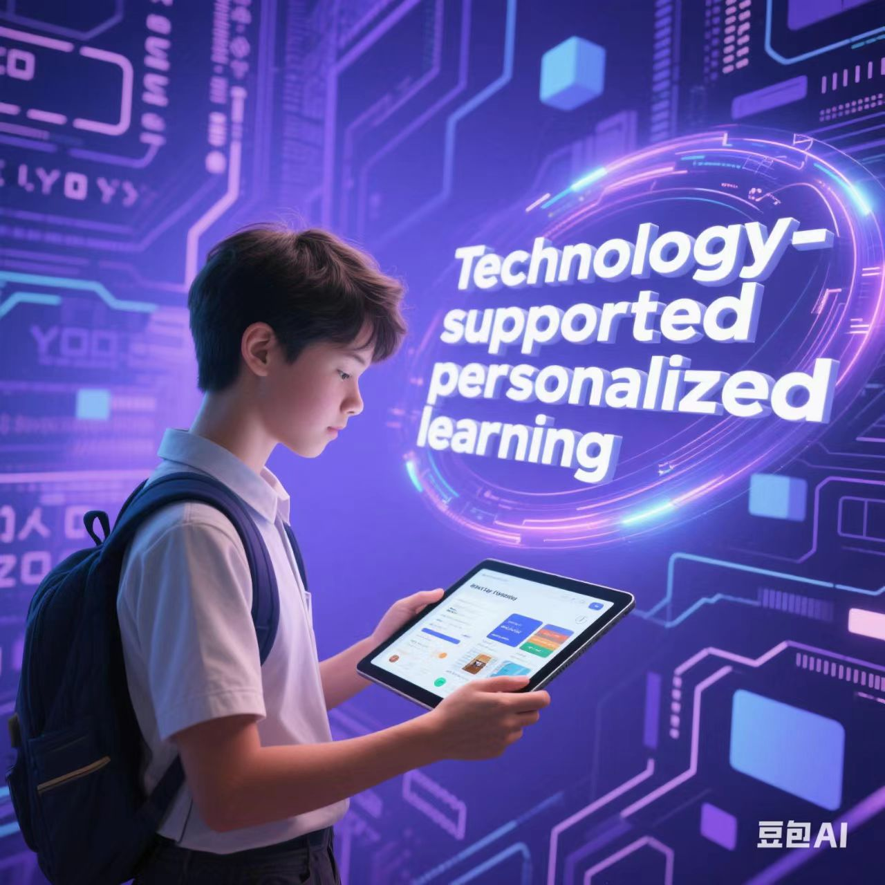
“四维六阶”主题应用文高阶思维培养课堂构建
--- 绍兴二模(2025.4.9.)诊断性考试应用文写作讲评
绍兴市上虞区丰惠中学徐玉茹

Slide 3
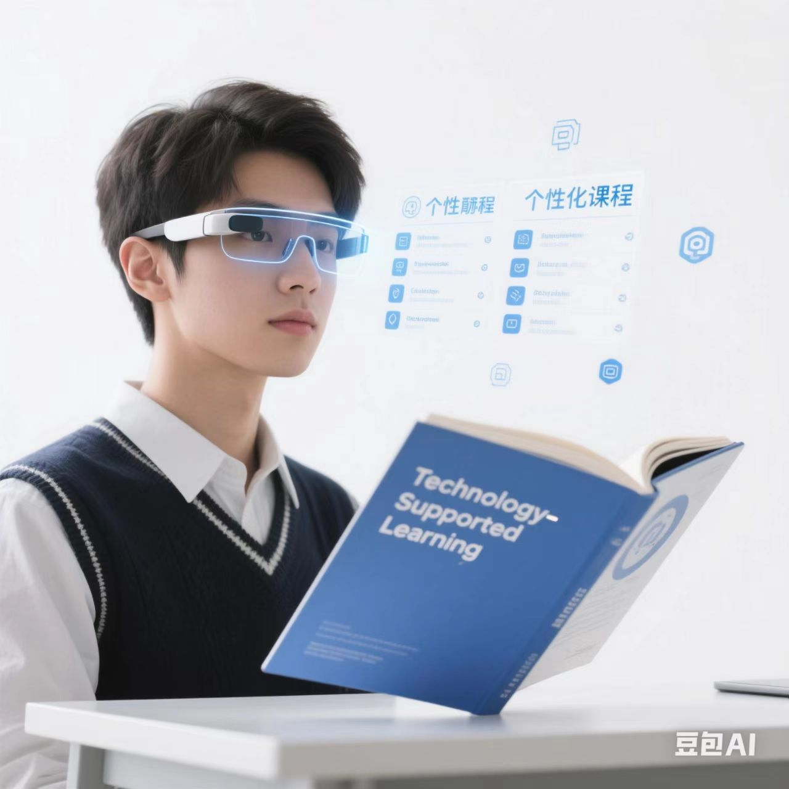
Learning goals
What is the most challenging for you in this Practical Writing?
Possible difficulties:
1.unable to understand well the meaning of the title. (the terms).
2.how to write an English short essay. (structure).
3.how to describe phenomenon. (lead in the topic)
4.how to state opinions on technology-supported personalized learning.
(critical thinking)
5.how to share personal experience.
6. unaware of writing an ending.
...

Slide 4
Step1 Lead in
What is personalized learning?（思维认知）
Personalized learning is a learning style of individual learners that focuses on tailoring learning experiences to meet each learners’ unique needs, interests, abilities, pace, preferences, and goals, ensuring more effective and engaging education.

Slide 5
Step2 Understand
发散性思维训练
How do you understand technology-supported personalized learning?
Quiz(科学)
ChatGPT
DeepSeek
Coursera(视频平台)
ChatGPT Voice
Open AI Sora
technology-supported
Knewton
(课程平台)
NLP
(自然语言处理)
Vocabulary Apps(爱优词、词达人)
Gamified Learning Apps
AI Speaking Coach
Big Data and Study Analysis
Doubao(豆包)

Slide 6
Step3 Analyze
Genre
Topic/Title
Receiver
Background
Writing Puporse
Content
Tense
Person
Short Essay(contribution): Exposition+Narrative
What？
发散性思维训练
My view on technology-supported personalized learning
（2025.4.9. I模在线回顾）近期，你将参加学校组织的英语主题征文活动。请结合自身经历，就“技术支撑下的个性化学习”的主题写一篇短文，内容包括:
1.陈述观点;
2.分享体验。
the editor of school English newspaper
a short essay focused on "technology-supported personalized learning"
to demonstrate critical thinking---my view on technology-supported personalized learning.
‌Para.1.:现象+观点（正/正反辩证; 段2：具体例1/
例子2-3个); 段3：结尾（总结）
content
Present tense:‌ describe phenomenon+结尾
Past tense:‌ share experience
language
四维
thinking
strategy
first person

Slide 7
example（逻辑思维）
Stand Up and Exercise, Everybody!
How to write a short essay?
I would like to recommend rope skipping as a great exercise option during break time. Rope skipping, also known as jump rope, involves swinging a rope over your head and jumping over it as it passes under your feet, which is a simple yet effective physical activity that offers numerous benefits.
Rope skipping requires minimal equipment and can be done individually or with friends anywhere, making it a versatile choice for everyone. Besides, Just a few minutes of jump rope can get your heart rate up and provide a great workout. So it’s an excellent way to maximize your break time and stay active. What’s more, Jumping rope can be a fun activity to enjoy with friends. You can challenge each other with different jump rope techniques or create group routines, which will not only help improve coordination, and agility, but also promote the friendship between classmates.
So, grab a jump rope and start incorporating this enjoyable exercise into your break time routine. Stay active, stay healthy!
title: 简洁\概括
Para.1 点题: (现象/事实) 客观描述+个人观点
Para.2 要点:具体描述+个人心得
Para.3 结尾: 活动意义及评价
语言特色及风格：简洁、精准、客观，常用一般过去时写个人经历，用一般现在时写首段尾段。

Slide 8
Construct
logical（逻辑思维）
Para.1 introduce the background
Introduction
Contribution
state views(正/正反辩证)
specific personal experience
related significance/effect
Body
Summarize/Emphasize/
Anticipate/Wish
Ending

Slide 9
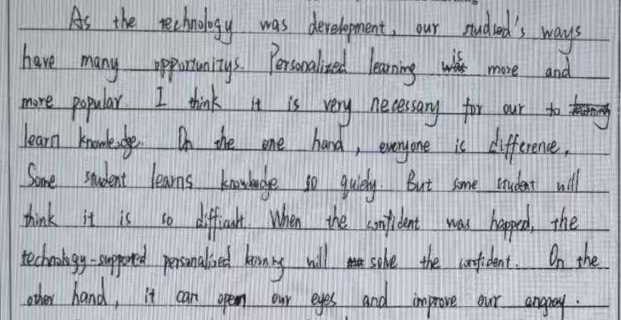
Step4 Discover
How to write Para.1.?
内容？
语言语气？
表述方式？
体裁格式？
four dimensions
1没有切中要点，表意偏离主题。
2.词汇句法单一，语法错误严重。
3.思维混乱，语句之间缺少逻辑。
4.段落层次不分，写作任务不明。
four dimensions

Slide 10
Step5 Explore
How to write Para.1.?
1.个体体验+个人观点陈述+正面肯定
Currently, with the development of artificia intelligence, personalized learning supported by technology is becoming increasingly popular. Personally speaking. The reasonable use of personalized learning with technological support has brought me great benefits in my studies.lt not only helps me understand abstract concepts, but also saves my study time and enhances my proficiency in learning.
2.社会层面+利弊论述+辩证看待
In the digital age, more learners apply technology to their learning. However, some are not totally happy with AI lessons since AI lacks natural responses and is a little boring. Personally, technology has revolutionized the way we learn, making learning more personalized and accessible than ever before. AI-driven platforms offer tailored learning experiences that adapt to individual needs and preferences.
3.个人经验/社会层面+弊多利少+负面肯定（强调人类自主学习大于AI 依附学习）
...... (逆向思维挑战)

Slide 11
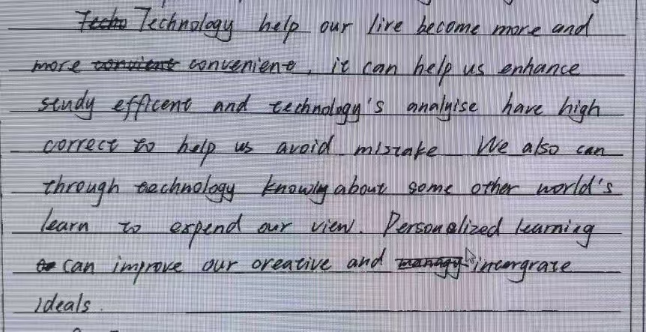
Step4 Discover
How to write Para.2.?
1内容泛泛而谈。
2.语法错误连篇。
3.陈述不分主次。
4.写作策略不明。
four dimensions

Slide 12
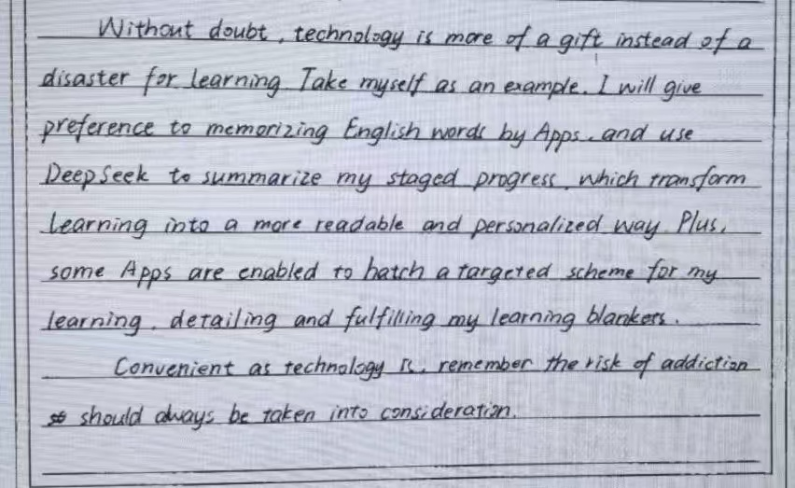
Step5 Explore
How to write Para.2.?
2.选取2-3个个体经验+个人心得 体会（正面肯定）
1.选取一个详细个体经验+个人心得体会 （正面肯定）
From my experience, using AI tools to access resources has made learning more flexible and effective. I once struggled with listening comprehension. Thanks to various language learning apps, I could practice listening with materials at any time. Meanwhile, the apps also analyzed my mistakes, allowing me to focus on the weak areas.
3.个人经验单个/多个+使用过度（负面）
...... (逆向思维挑战)

Slide 13
Step4 Discover
How to write Para.3.?
1内容过于简单。
2.语言表达低级。
3.没有短文总结。
4.要点漏掉或不会写作。
four dimensions

Slide 14
Step5 Explore
How to write Para.3.?
2.总结强调+展望 (正面肯定）
1.总结+正面肯定
In conclusion, technology empowers personalize|d learning. By embracing technology, we can create a more inclusive and dynamic learning environment, empowering every student to reach their full potential.
3. 总结+使用过度（负面警醒）
...... (逆向思维挑战)

Slide 15
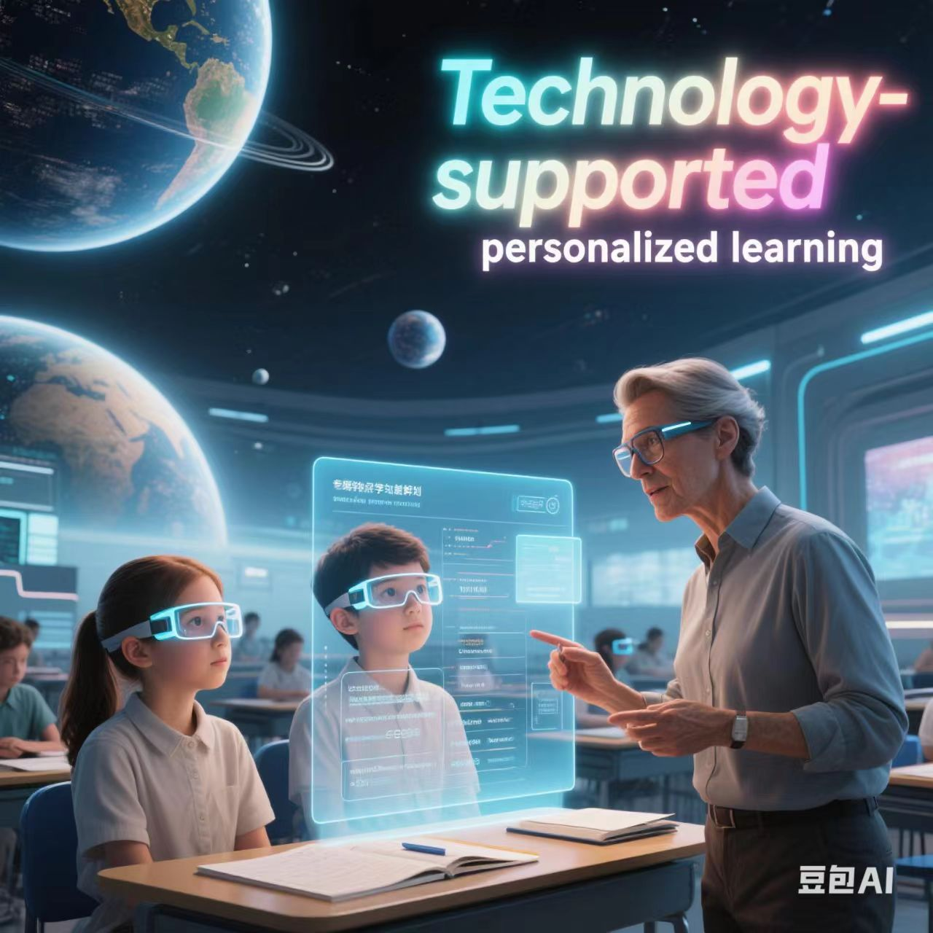
Step6 Practise and Create
（创造性思维训练）
Ss: Presentation 1（Parar.1）
Ss: Presentation 2 (Para.2)
Ss: Presentation 3(Para.3.)

Slide 16
Step6 Practise and Create(创造性思维训练)
2.Translate the above Chinese sentences into English , then make the second presentations .
1. Give Ss five minutes to write down the Chinese
contents of Para.1, then make the first presentation.
Currently, the integration of technology into learning, driven by the rapid advancement of modern tools such as Sora and DeepSeek, has drawn significant attention. In my opinion, this presents a golden opportunity for us to leverage these technologies effectively and engage in personalized learning.
Presentation(Para.1.)
S4:
当前，在诸如Sora和豆包等现代工具的快速发展推动下，科技与学习的融合受到了广泛关注。在我看来，这为我们提供了一个绝佳的机会，让我们能够有效地利用这些技术，开展个性化学习。
S1:
With the rapid development of cutting-edge technology nowadays, high technology is playing an increasingly crucial role in our learning process. In my opinion, technology-supported personalized learning is indeed beneficial. Nevertheless, we should make good use of it in a caucious attitude.
如今，随着尖端技术的迅速发展，高科技在我们的学习过程中正发挥着越来越关键的作用。在我看来，科技支持的个性化学习确实益处颇多。不过，我们仍需谨慎且充分地利用它。
S5:
S2:
In recent years, technology-supported personalized learning has become increasingly popular. While it offers certain conveniences, my personal experience has made me realize the significant negative impacts of over-relying on it.
近年来，技术支撑下的个性化学习越来越受欢迎。虽然它带来了一定的便利，但我个人的经历让我意识到过度依赖它会带来严重的负面影响。
S3:
S6:

Slide 17
Step6 Practise and Create(创造性思维训练)
2.Translate the above Chinese sentences into English , then make the second presentations .
1. Give Ss eight minutes to finish writing the Chinese contents of Para.2, then make the second presentation.
For instance, I often use Sora to create vivid visualizations, which helps me gain a deeper understanding of abstract concepts. Additionally, with the aid of DeepSeek, I can explore a wealth of knowledge beyond the regular curriculum, significantly broadening my horizons.
S10:
Presentation(Para.2.)
例如，我经常使用Sora来创建生动的可视化内容，这有助于我更深入地理解抽象概念。此外，在豆包的帮助下，我能够探索到大量超出常规课程范围的知识，极大地拓宽了我的视野。
S7:
Technology, which is grounded in a vast amount of data, will undoubtedly enhance your learning efficiency by analyzing your personal data. With its help, you can achieve the most significant progress within a limited time frame. Take myself as an example. I once uploaded my test paper to an app, and it provided me with suggestions on where I should exert more effort, specifically in the areas where I was relatively weak. Moreover, it also recommended some learning strategies that were a perfect fit for me.
S11:
科技基于海量数据，通过分析个人数据，无疑能够提高你的学习效率。借助科技的力量，你可以在有限的时间内取得最为显著的进步。以我自己为例，我曾将试卷上传到一个应用程序上，它为我提供了建议，告诉我应该在哪些方面付出更多努力，尤其是在我相对薄弱的领域。此外，它还推荐了一些非常适合我的学习策略。
S8:
Last semester, faced with challenging math problems, instead of thinking independently, I immediately turned to a learning app for ready-made solutions. Gradually, I found myself increasingly dependent on this quick-fix approach. During an exam, without the app's assistance, I struggled to solve even moderately difficult questions, as my problem-solving and critical thinking skills had severely deteriorated.
上学期，面对有挑战性的数学问题，我不再独立思考，而是马上求助于学习应用程序来获取现成的答案。渐渐地，我发现自己越来越依赖这种速成方法。在一次考试中，没有了应用程序的帮助，我甚至连中等难度的问题都难以解决，因为我的解题能力和批判性思维能力已经严重退化。
S9:
S12:

Slide 18
Step6 Practise and Create(创造性思维训练)
2.Translate the above Chinese sentences into English , then make the third presentations .
1. Give Ss five minutes to write down the Chinese
contents of Para.3, then make the third presentation.
In this digital age, actively participating in technology-supported personalized learning is essential. Only by doing so can we enjoy a more efficient and fulfilling learning experience.
Presentation(Para.3.)
S16:
在这个数字时代，积极参与科技支持的个性化学习至关重要。只有这样做，我们才能享受到更高效、更充实的学习体验。
S13:
All in all, although technology-supported personalized learning boasts numerous advantages, we still need to possess the ability to learn independently.
总而言之，尽管科技支持的个性化学习有诸多优点，但我们依然需要具备独立学习的能力。
S17:
S14:
In conclusion, while technology-supported personalized learning can be a useful tool, we must be cautious not to over-rely on it, ensuring we maintain our essential learning and social skills.
总之，虽然技术支撑下的个性化学习可以是一个有用的工具，但我们必须小心不要过度依赖它，要确保我们保持必要的学习和社交技能。
S18:
S15:

Slide 19
参考范文：Mode1
个体经验+个人观点陈述+正面肯定
My View on Technology-Supported Personalized Learning
Currently, the integration of technology into learning, driven by the rapid advancement of modern tools such as Sora and DeepSeek, has drawn significant attention. In my opinion, this presents a golden opportunity for us to leverage these technologies effectively and engage in personalized learning.
For instance, I often use Sora to create vivid visualizations, which helps me gain a deeper understanding of abstract concepts. Additionally, with the aid of DeepSeek, I can explore a wealth of knowledge beyond the regular curriculum, significantly broadening my horizons.
In this digital age, actively participating in technology-supported personalized learning is essential. Only by doing so can we enjoy a more efficient and fulfilling learning experience.

Slide 20
参考范文：Mode2
社会层面+利弊论述+辩证看待
My View on Technology-Supported Personalized Learning
With the rapid development of cutting-edge technology nowadays, high technology is playing an increasingly crucial role in our learning process. In my opinion, technology-supported personalized learning is indeed beneficial. Nevertheless, we should make good use of it in a prudent manner.
Technology, which is grounded in a vast amount of data, will undoubtedly enhance your learning efficiency by analyzing your personal data. With its help, you can achieve the most significant progress within a limited time frame. Take myself as an example. I once uploaded my test paper to an app, and it provided me with suggestions on where I should exert more effort, specifically in the areas where I was relatively weak. Moreover, it also recommended some learning strategies that were a perfect fit for me.
All in all, although technology-supported personalized learning boasts numerous advantages, we still need to possess the ability to learn independently.

Slide 21
参考范文：Mode3
个人经验/社会层面+弊多利少+负面影响
My View on Technology-Supported Personalized Learning
In recent years, technology-supported personalized learning has become increasingly popular. While it offers certain conveniences, my personal experience has made me realize the significant negative impacts of over-relying on it.
Last semester, faced with challenging math problems, instead of thinking independently, I immediately turned to a learning app for ready-made solutions. Gradually, I found myself increasingly dependent on this quick-fix approach. During an exam, without the app's assistance, I struggled to solve even moderately difficult questions, as my problem-solving and critical thinking skills had severely deteriorated.
In conclusion, while technology-supported personalized learning can be a useful tool, we must be cautious not to over-rely on it, ensuring we maintain our essential learning and social skills.

Slide 22
一模参考答案
My view on technology-supported personalized learning
In the digital age, more learners apply technology to their learning. However, some are not totally happy with AI lessons since AI lacks natural responses and is a little boring. Personally, technology has revolutionized the way we learn, making learning more personalized and accessible than ever before. AI-driven platforms offer tailored learning experiences that adapt to individual needs and preferences.
From my experience, using AI tools to access resources has made learning more flexible and effective. I once struggled with listening comprehension. Thanks to various language learning apps, I could practice listening with materials at any time. Meanwhile, the apps also analyzed my mistakes, allowing me to focus on the weak areas.
In conclusion, technology empowers personalized learning. By embracing technology, we can create a more inclusive and dynamic learning environment, empowering every student to reach their full potential.
In conclusion, technology empowers personalize|d learning. By embracing technology, we can create a more inclusive and dynamic learning environment, empowering every student to reach their full potential.

Slide 23
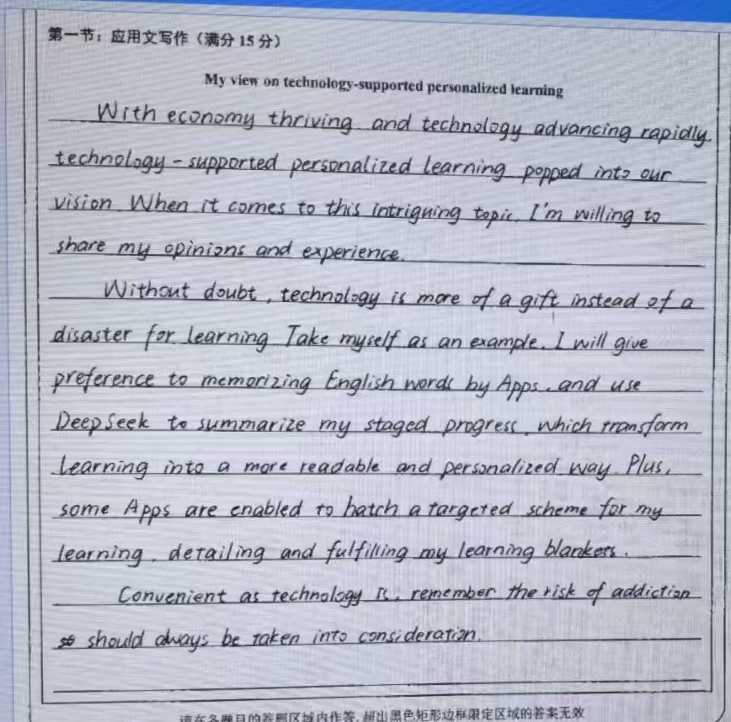
考生优秀现场作文12.5分展示及点评1
evaluation
优点
1.卷面整洁
2.书写优美
3.文字表达穿透力强
4.批判性思维和篇章结构清晰： 段1：开篇点题+引入话题；段2：例子学英语apps 及三个具体使用；段3：负面警醒；
不足
三个明显用词错误：popped into our vision, is more a gift instead of a disater 过于夸张；hatch用词不当。

Slide 24
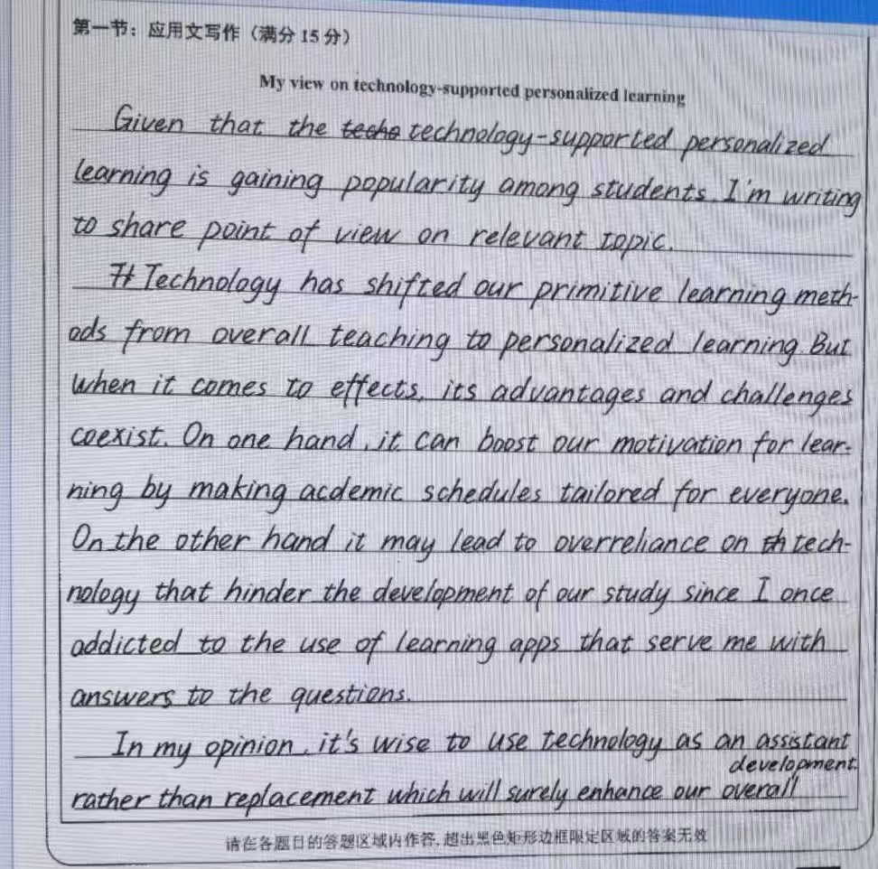
evaluation
考生优秀现场作文12分展示及点评 2
优点
1.卷面、书写俱佳；2.层次清楚，论证有力，有说服力；3.表达流畅，语言虽有少许错误，但不影响整体表达。
不足
1.篇章结构布局不够合理，观点陈述论证偏多，个人体验一笔带过，使整篇文章显得头重脚轻；
2.有2-3处典型语言错误，例如：
1).句子错误:“Given that...”引导的是原因状语从句，不能单独成句，后面应直接衔接主句，无需用句号隔开。
2.用词不当
“share point of view”缺少限定词，应改为“share my point of view”;“relevant topic.”应改为relevant the topic.”等

Slide 25
Assignments
1.根据本节课所学，任选一种模式写一篇投稿短文。
2. 阅读事实和观点类阅读材料，学会区分事实和观点。

Slide 26
THANK YOU

