Slide 1
感恩遇见，相互成就，本课件资料仅供您个人参考、教学使用，严禁自行在网络传播，违者依知识产权法追究法律责任。
更多教学资源请关注
公众号：溯恩英语
知识产权声明

Slide 2
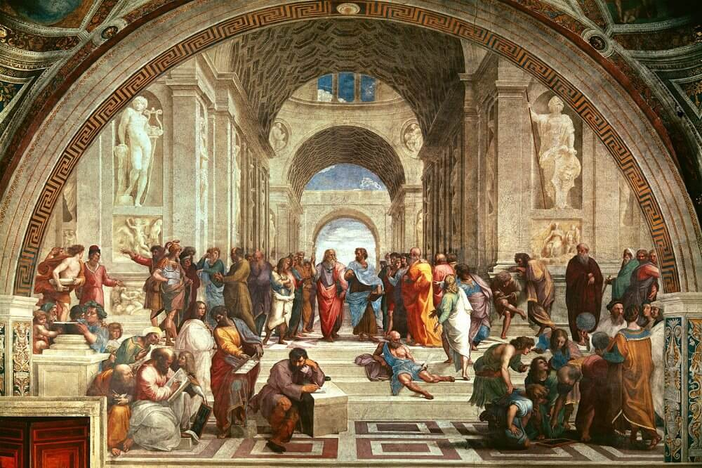
B6 U1 ART
Reading and thinking
language study
language study

Slide 3
Derivative Words from the text
12.给…留下印象 v._____
印象 ______
印象主义 _______
印象主义者 ________
13.主题 n. ____ 主观的 ____
14. 照片 ____, 摄影 _____
摄影师 ______
15. 给…遮挡光线 v. ____
阴影 n._____
16. 温暖的 adj. ____ n. ____
17. 随后的 adj. _____ adv. ____
18. 分析 v. ____ n. _____
1.精确的 adj. ____ adv.____
2.维度 n. _______ adj. _____
3.宗教 n. ______ adj. _____
4.情感，情绪 n. ______ adj. _____
5. 人类 ____ 人文的___ 人性_____
6. 影响 n.v. _______ adj. ______
7. 创新 v. _____ n.____ adj._____
8. 高的 adj. _____ n. _____
9. 强调 v. ______ n. ______
10.准确的 adj. ______ n. _______
11. 神话故事_____
神话学 ______

Slide 4
12.给…留下印象 impress
印象 impression
印象主义 impressionism
印象主义者 impressionist
13.主题 subject
主观的 subjective
14. 照片 photograph
摄影 photography
摄影师 photographer
15. 给…遮挡光线 shade
阴影 shadow
16. 温暖的 warm , warmth
17. 随后的 subsequent
subsequently
18. 分析 analyze v. analysis n.
1.精确的 precise, precisely
2.维度 dimension dimensional
3.宗教 religion religious
4.情感，情绪 emotion, emotional
5. 人类 human
人文的 humanistic humanity
6. 影响 influence influential
7. 创新 innovate, innovation,
innovative
8. 高的 high, height
9. 强调 emphasize, emphasis
10.准确的 accurate, accuracy
11. 神话故事 myth
神话学 mythology

Slide 5
Para 1
1. As there _______________(be) so many different styles of western art, it is impossible to describe them all in a short text.
have been
there be 句型的现在完成时态，表示历史上曾经有过的
(本段下文的over the centuries) ， 因为名词是复数： styles, 所以用复数新式： have been
1) 近期雨水很多。
There has been a lot of rain lately.
2）在过去的几十年里， 我们的城市变化很大。
In the past few decades, there have been great changes in the city.
下午将会有两场会议。
There are going to be two meetings this afternoon.
There will be two meetings this afternoon.

Slide 6
Para 2
While/Although/Though
1. _____________ his paintings still had religious themes, they showed real people in a real environment.
Para 4
_________________ painters as early as Da Vinci had used oil, his technique reached its height with Rembrandt who gained ….
While/Although/Though
while conj. (用于句首) although; despite the fact that…虽然；尽管
Para 7
_________________ many Impressionists painted scenes of nature or daily life, others, such as Renoir (1841--1919), focused on people.
While/Although/Though

Slide 7
In
apart
2. ______ particular, his paintings are set _______ from other paintings by their realistic human faces and deep emotional impact.
1) in particular: especially or particularly 尤其；特别；格外
他特别喜爱科幻小说。
He loves science fiction in particular.
2) adj. very definite about what you like and careful about what you choose 讲究；挑剔 be particular about…
set …apart from…
to make …different from or better than others
使与众不同；使突出；使优于…
她对衣着特别挑剔。
She's very particular about her clothes.
她的高雅风格使她与其他记者截然不同。
Her elegant style sets her apart from other journalists.

Slide 8
Para 5
=who were of high rank
1. Kings, nobles, and people ______ high rank wanted to purchase accurate pictures of themselves and the people they loved.
of
rank 1) n. the position, especially a high position, that somebody has in a particular organization, society, etc.（尤指较高的）地位，级别
一流的画家
a painter of the first rank
她不习惯和社会地位很高的人交往。
She was not used to mixing with people of high social rank.
2) to give somebody/something a particular position on a scale according to quality, importance, success, etc.; to have a position of this kind 把…分等级；属于某等级
在工程学领域，这所大学位居本国第一。
The university is ranked number one in the country for engineering.

Slide 9
v. to buy something
买；购买；采购
make a purchase=buy sth.
采购
这家公司刚刚宣布以 2 700 万英镑买下了帕克酒店。
The company has just announced its £27 million purchase of Park Hotel.
n. the act or process of buying something
购买；采购
purchase
v.n
n. something that you have bought
购买的东西
所购之物若不合意，我们将全额退款。 If you are not satisfied with your purchase we will give you a full refund.

Slide 10
2. Finally, most clients wanted paintings that were beautiful and interesting
to look
at.
和 paintings 有逻辑上的动宾关系
look at the paintings
The chair is comfortable to sit in.
The pen is smooth to write with.

Slide 11
Para 6
1. After that, paintings were no longer needed to preserve ___________ people and the world looked like.
what
v. to keep something in its original state in good condition
维持…的原状；保存；保养

Slide 12
Para 6
2. From this, Impressionism emerged in France.
to move out of or away from something and become possible to see （从隐蔽处或暗处）出现，浮现，露出
游泳者从湖水中浮出来。
The swimmer emerged from the lake.
我们来到明媚的阳光下。
We emerged into bright sunlight.
emerge v.
调查过程中未发现新证据。
No new evidence emerged during the investigation.
(of facts, ideas, etc.事实、意见等) to become known暴露；露出真相；被知晓
他已初露头角，成为这个项目的主要人物。
He emerged as a key figure in the project.
to start to exist; to appear or become known
露头；显现；显露

