Slide 1
感恩遇见，相互成就，本课件资料仅供您个人参考、教学使用，严禁自行在网络传播，违者依知识产权法追究法律责任。
更多教学资源请关注
公众号：溯恩高中英语
知识产权声明

Slide 2
Unit 4
Reading and Thinking

Slide 3
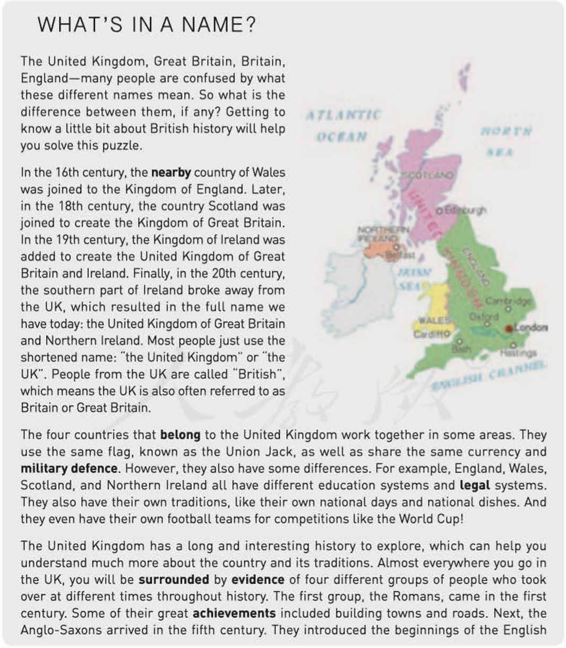

Slide 4
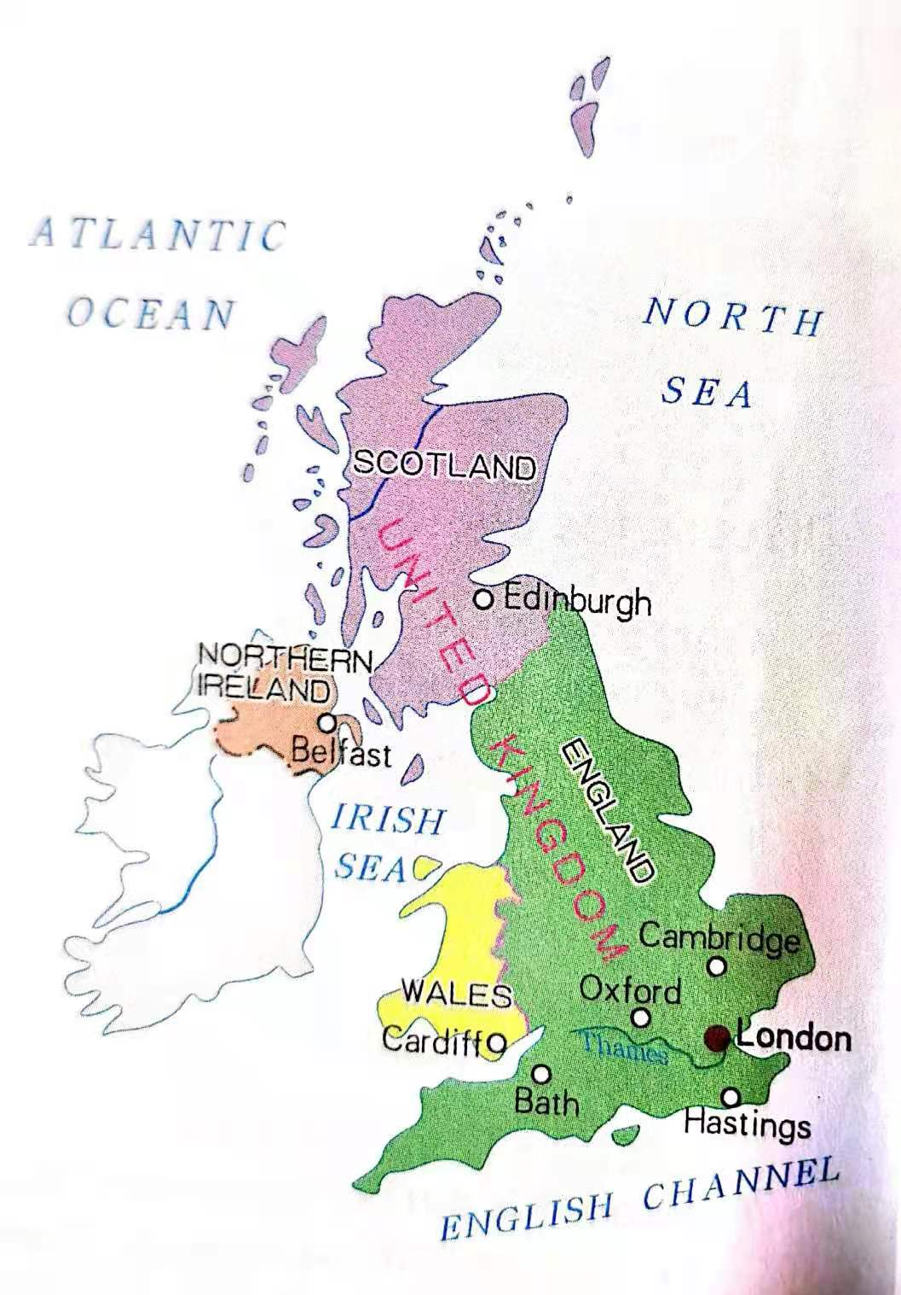
A map of the United Kingdom
Do you know any of those cities? Can you tell us something you know about them?

Slide 5
Make a prediction
What do you expect to read in the passage?

Slide 6
Read for main ideas
Paragraphs | Main Ideas
Para. 1 | Getting to know British _________ helps you solve the puzzle of different _________ of the country.
Para. 2 | How we get the _________ name of the country
Para. 3 | The _________ and _________ between four countries within the UK
Para. 4 | The history of the UK helps us to learn more about the _________ and _________
Para. 5 | Learning the country’s history makes your journey more _________
history
names
full
similarities
differences
country
traditions
enjoyable

Slide 7
Questions about time
Paragraphs | Time
2
3
4
16th century to 20th century
nowadays
1st century to 11th century

Slide 8
Read for structures
Part 1
solves confusion about names
Part 2
learn country and traditions
Part 3
make journey more enjoyable

Slide 9
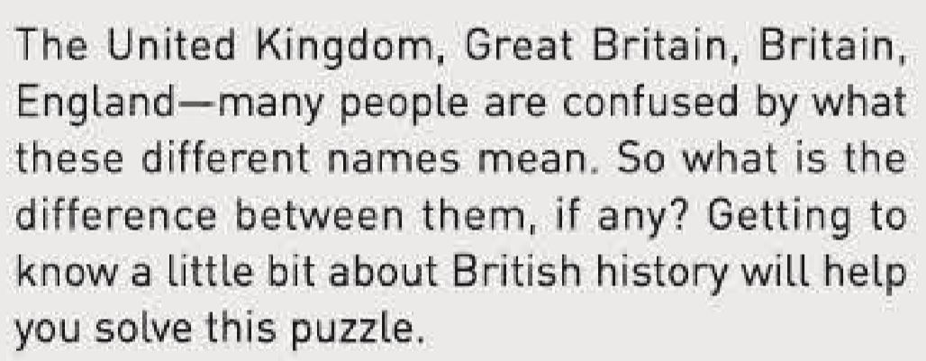
Paragraph 1
How does the writer introduce the topic of this passage?
question --- solution

Slide 10
Read Para. 2, sort out the information according to the timeline.
16th century
Wales
England
England
18th century
Scotland
England
Great Britain
19th century
Ireland
Great Britain
The United Kingdom of Great Britain and Ireland
20th century
The United Kingdom of
Great Britain and Ireland
Republic of Ireland
The United Kingdom of
Great Britain and Northern Ireland

Slide 11
Read Para. 3 and find out similarities and differences between four countries
similarities | differences | examples
flag
systems
currency
traditions
national days; national dishes
military defence
sport teams

Slide 12
Read Para. 4, sort out the information according to the timeline.
groups of people
changes
1st century
Romans
built towns and roads
5th century
Anglo-Saxons
English language;
the way people built houses
new vocabulary;
names of locations
8th century
Vikings
castles; legal system
French words
11th century
Normans

Slide 13
A timeline for British history
When | What happened | What changed
1st century | Romans arrived | built towns and roads
5th century | Anglo-Saxons came | English language; the way people built houses
8th century | Vikings | new vocabulary; names of locations
11th century | Normans | castles; legal system French words
16th century | Wales joined | Kingdom of England
18th century | Scotland joined | Kingdom of Great Britain
19th century | Ireland added | United Kingdom of Great Britain and Ireland
20th century | Southern Ireland broke away | United Kingdom of Great Britain and Northern Ireland

Slide 14
Read Para. 5 and answer these questions
1. Why does the writer mention London?
2.Who might be the target audience of this passage? How can you see?

Slide 15
Passage as a whole
What is the advantage / significance of studying the history of a country?
1. solve confusion about name
2. learn more about the country and tradition
3. make visits more enjoyable
4. know more about the world

Slide 16
Heyday of Roman Empire
1st century
Romans
built towns and roads
the decline of Roman Empire
5th century
Anglo-Saxons
English language;
the way people built houses
new vocabulary;
names of locations
8th century
Vikings
root of Hundred Years’ War
castles; legal system
French words
11th century
Normans

Slide 17
Situation: you are a tour guide for visitors to the UK, make a brief introduction of British history in four parts:
history of four groups of ruling people;
history of how the UK get its full name
the similarities and differences between four countries nowadays
the significance of studying history
Use key words in worksheet;
DO NOT use whole sentences on the textbook

Slide 18
Hello, everyone
Welcome to the United Kingdom of Great Britain and Northern Ireland. It is a country with a long history …

Slide 19
Sample
Hello, everyone
Welcome to the United Kingdom of Great Britain and Northern Ireland. It is a country with a long history. It was once ruled by the Romans, the Anglo-Saxons, the Vikings and the Normans respectively from the 1st century to the 11th century. However, it was the joining of Wales, Scotland and Ireland, as well as the breaking away of southern Ireland that made the full name that we use today. These four countries share the same currency but also keep their traditions. Only by learning the history of the UK can we develop a deeper insight into the culture of this country.

Slide 20
Passage as a whole
What is in a name?
history
political system

Slide 21
A people without the knowledge of their past history, origin and culture is like a tree without roots.
--- Marcus Garvey

Slide 22
Homework
Write a short passage about the history of the UK with about 150 words.

