Slide 1
感恩遇见，相互成就，本课件资料仅供您个人参考、教学使用，严禁自行在网络传播，违者依知识产权法追究法律责任。
更多教学资源请关注
公众号：溯恩高中英语
知识产权声明

Slide 2
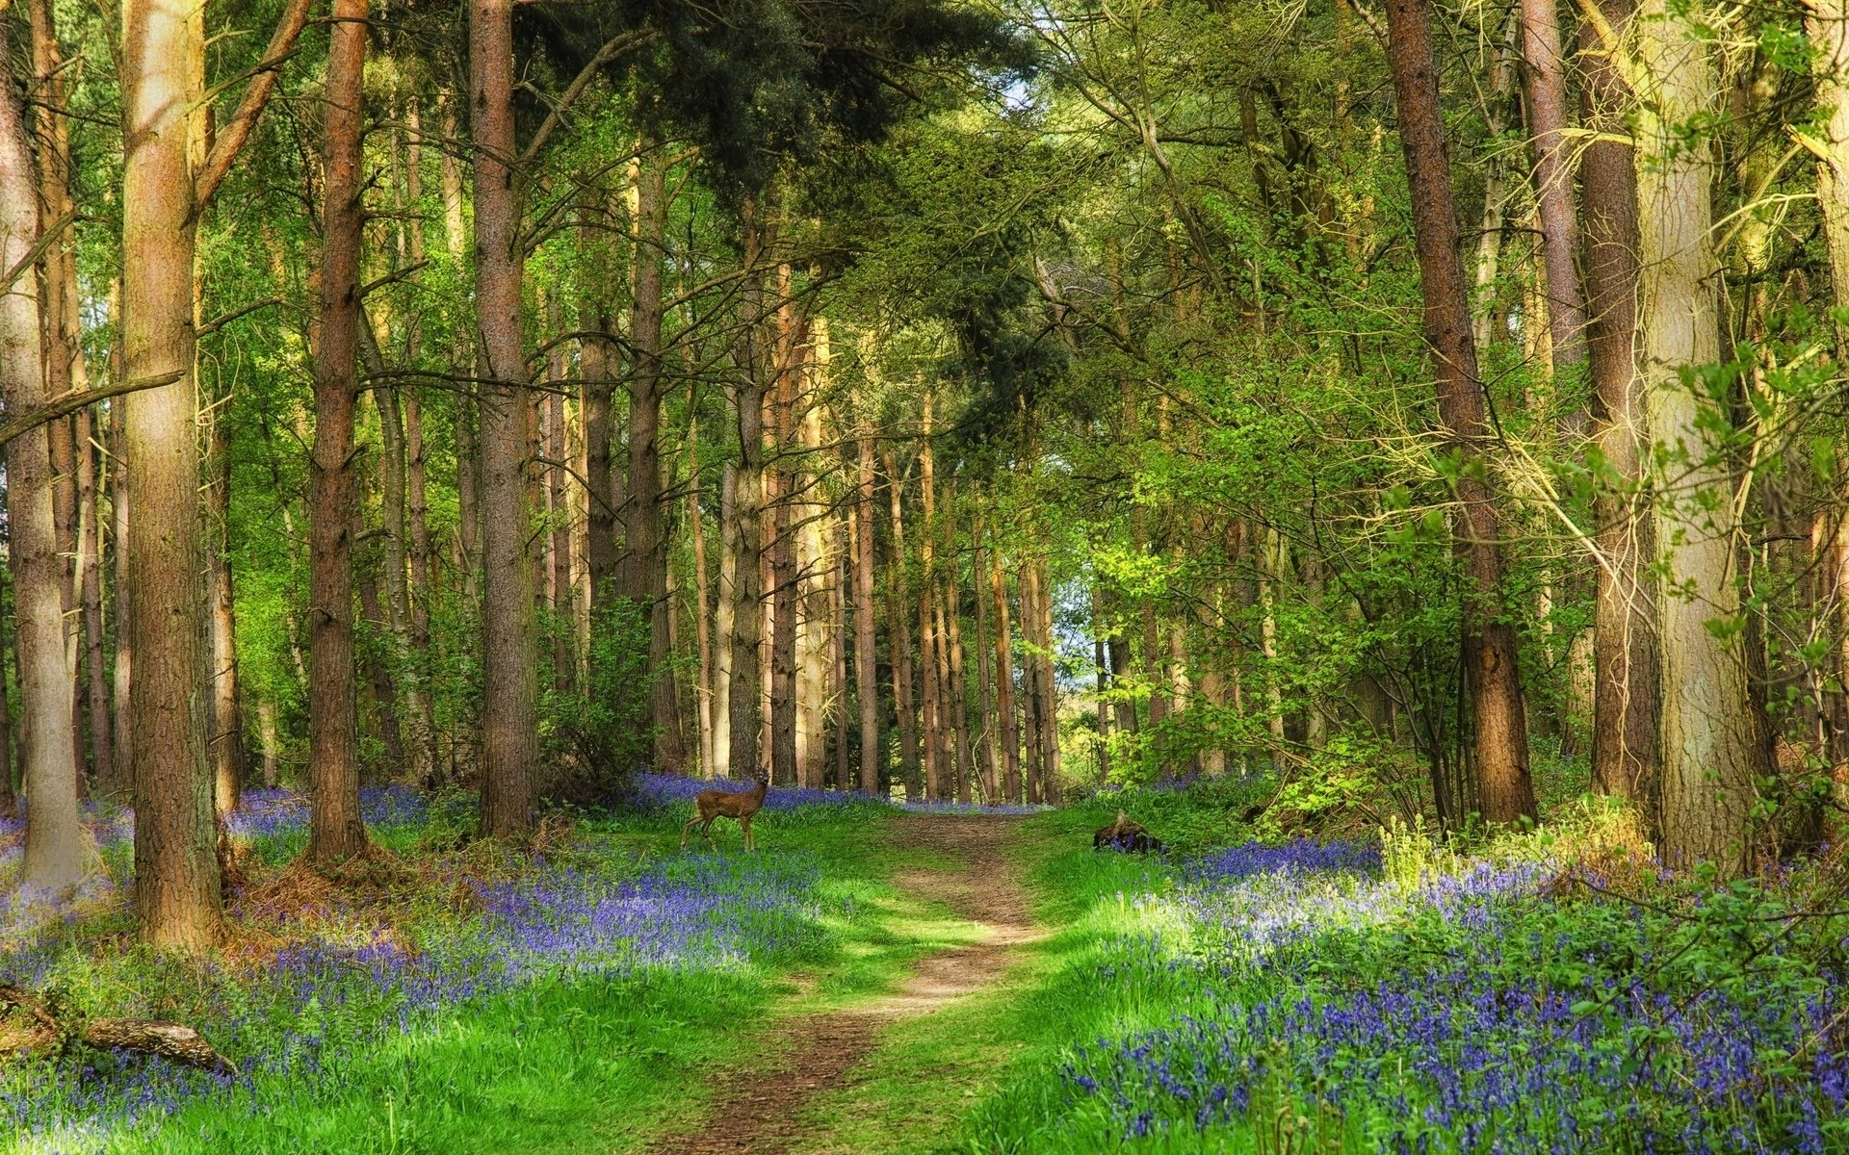
20230901浙江省七彩阳光返校考读后续写讲评
-Lost in the Smoky Mountain
陈星可
浙江省天台中学

Slide 3
文本呈现
Nature, while beautiful, could also be unpredictable and merciless. But most importantly, we bear in mind that in the darkest times, there’s always a light at the end of the tunnel, just like Mrs. Evans’ cabin light.
One bright summer day, my friend Peter and I decided to venture into the unexplored trails of the Great Smoky Mountains. Blessed with rich biodiversity and fascinating landscapes, the national park seemed a perfect getaway. Little did we know that our casual hike would soon turn into an unexpected personal incident, forever engraved in our memories.
We set off early in the morning, equipped with our backpacks and a map that was supposed to guide us through the winding trails. The sun was up, casting long shadows on the forest floor as we set off on our journey. We trekked(艰难行走), laughed, and marveled at the beauty of nature around us.
As we trekked through the dense forests, taking in the natural wonders around us, we couldn’t help but feel a sense of adventure coursing through our veins. The trail was rugged and uneven, but we persevered through the challenging landscape.
Midway through our expedition, we stumbled upon a breathtaking waterfall, its glistening waters cascading down the rocks in a quiet and peaceful melody. We sat down by the water’s edge, taking a moment to get lost in the beauty of nature. The cool mist from the waterfall enveloped us, and we felt refreshed and energetic.
As the day wore on, we ventured deeper into the wilderness, eager to explore every corner of this natural paradise. We were so absorbed in the beauty of nature that just didn’t notice our way and it seemed that we could not find the way back to the familiar part of the forest.
Panicking, we scrambled to find our way back but the dense vegetation and winding trails only served to confuse us further. We tried to remember any possible signs that might lead us back. No sooner had we celebrated our return to the clear trails than something worse happened.
注意：1.续写词数应为150左右；2.请按如下格式在答题卡的相应位置作答。
Suddenly, the weather took an abrupt turn.
Just when we were about to give up, a faint light flickered in the distance.

Slide 4
语言积累-词块
1.记在心/脑里
2.冒险进入..
3.有幸拥有...
4.永远扎根在我的记忆里
5.配备，武装...
6.蜿蜒的小道
7.投下长长的影子
8.对...惊叹
9.观赏/欣赏大自然的杰作
10.情不自禁地做...
1.bear/ keep... in mind
2.venture into...
3.be blessed with...
4.forever engraved/planted/imprinted in my memory
5.be equipped with...
6.the winding trail/path
7.cast /throw long shadows
8.marvel at...
9.take in the natural wonders
10.can’t help but do...,
can’t help/resist doing...

Slide 5
语言积累-词块
11.(情感)在全身血管中流动
12.坚韧不拔穿过那有挑战性
的风景
13.偶然发现让人惊叹的瀑布
14.在旅途半路中
15.感到神清气爽，精力充沛
16.（时间）消逝
17.沉醉于自然的美丽中
18.努力去做某事
19.起到做...的作用
20.庆祝我们的回归
11....course through one’s veins
12.persevere through the challenging landscape
13.stumble on the breathtaking waterfall
14.halfway through the adventure
15.feel refreshed and energetic
16.wear on
17.be lost/absorbed in the beauty of nature
18.scramble/ try/ strive to do...
19.serve to do...
20.celebrate our return

Slide 6
语言积累-句子
1.我们几乎不知道，我们的徒步旅行很快会变成意想不到的个人事件，永远铭刻在我们的记忆中。（Little部分倒装结构+分词状语）
Little did we know that our casual hike would soon turn into an unexpected personal incident, forever engraved in our memories.
2.在探险的中途，我们偶然发现了一个令人惊叹的瀑布，它闪闪发光的水以平静的旋律从岩石上倾泻而下。（高级用词+独立主格结构）
Midway through our expedition, we stumbled upon a breathtaking waterfall, its glistening waters cascading down the rocks in a quiet and peaceful melody.

Slide 7
语言积累-句子
3. 惊慌失措，我们奋力寻找回去的路，但茂密的植被和蜿蜒的小径只会让我们更加困惑。（高级用词+分词状语）
Panicking, we scrambled to find our way back but the dense vegetation and winding trails only served to confuse us further.
4.我们刚刚庆祝我们回到清晰的道路上，更糟糕的事情就发生了。（No sooner 倒装结构）
No sooner had we celebrated our return to the clear trails than something worse happened.
5.我们记住，在最黑暗的时候，隧道的尽头总是有一盏灯，就像埃文斯夫人的小屋的灯。（美句-寓意）
We bear in mind that in the darkest times, there’s always a light at the end of the tunnel, just like Mrs. Evans’ cabin light.

Slide 8
文本解读
1.Nature, while beautiful, could also be unpredictable and merciless. But most importantly, we bear in mind that in the darkest times, there’s always a light at the end of the tunnel, just like Mrs. Evans’ cabin light.
2. One bright summer day, my friend Peter and I decided to venture into the unexplored trails of the Great Smoky Mountains. Blessed with rich biodiversity and fascinating landscapes, the national park seemed a perfect getaway. Little did we know that our casual hike would soon turn into an unexpected personal incident, forever engraved in our memories.
3.We set off early in the morning, equipped with our backpacks and a map that was supposed to guide us through the winding trails. The sun was up, casting long shadows on the forest floor as we set off on our journey. We trekked(艰难行走), laughed, and marveled at the beauty of nature around us.
4.As we trekked through the dense forests, taking in the natural wonders around us, we couldn’t help but feel a sense of adventure coursing through our veins. The trail was rugged and uneven, but we persevered through the challenging landscape.
5.Midway through our expedition, we stumbled upon a breathtaking waterfall, its glistening waters cascading down the rocks in a quiet and peaceful melody. We sat down by the water’s edge, taking a moment to get lost in the beauty of nature. The cool mist from the waterfall enveloped us, and we felt refreshed and energetic.
6.As the day wore on, we ventured deeper into the wilderness, eager to explore every corner of this natural paradise. We were so absorbed in the beauty of nature that we just didn’t notice our way and it seemed that we could not find the way back to the familiar part of the forest.
7. Panicking, we scrambled to find our way back but the dense vegetation and winding trails only served to confuse us further. We tried to remember any possible signs that might lead us back. No sooner had we celebrated our return to the clear trails than something worse happened.
Para1:The message/theme the author wants to convey
Tip:细研第一段文本，把握文本的基调和主旨。
Para2-5: Despite the challenges we faced, we enjoyed the wonders of nature and the adventure.

Slide 9
文本解读
2. One bright summer day, my friend Peter and I decided to venture into the unexplored trails of the Great Smoky Mountains. Blessed with rich biodiversity and fascinating landscapes, the national park seemed a perfect getaway. Little did we know that our casual hike would soon turn into an unexpected personal incident, forever engraved in our memories.
3.We set off early in the morning, equipped with our backpacks and a map that was supposed to guide us through the winding trails. The sun was up, casting long shadows on the forest floor as we set off on our journey. We trekked(艰难行走), laughed, and marveled at the beauty of nature around us.
4.As we trekked through the dense forests, taking in the natural wonders around us, we couldn’t help but feel a sense of adventure coursing through our veins. The trail was rugged and uneven, but we persevered through the challenging landscape.
5.Midway through our expedition, we stumbled upon a breathtaking waterfall, its glistening waters cascading down the rocks in a quiet and peaceful melody. We sat down by the water’s edge, taking a moment to get lost in the beauty of nature. The cool mist from the waterfall enveloped us, and we felt refreshed and energetic.
6.As the day wore on, we ventured deeper into the wilderness, eager to explore every corner of this natural paradise. We were so absorbed in the beauty of nature that we just didn’t notice our way and it seemed that we could not find the way back to the familiar part of the forest.
7. Panicking, we scrambled to find our way back but the dense vegetation and winding trails only served to confuse us further. We tried to remember any possible signs that might lead us back. No sooner had we celebrated our return to the clear trails than something worse happened.
Para2-5: In their eyes, what was the adventure like?
Collins: adventure
A. an exciting experience
B. a dangerous experience
Para6-7:
Absorbed in the wonders, we failed to find our way back.

Slide 10
文本解读-Story mountain
Climax
as the day wore on
ventured deeper; not find the way back; scrambled to find..., try to remember
panicking
midway through our expedition
stumbled upon..., sat down by...,
lost in the beauty of nature
1: Suddenly, the weather took an abrupt turn.
refreshed, energetic
Rising action
?
____________________________________________________
the sun was up
Falling action
trekked, laughed, marveled
relaxed, marvlled
2: Just when we were about to give up, a faint light flickered in the distance.
early in the morning
?
set off, well equipped
excited, expectant
______________________________________
Beginning
Ending

Slide 11
情节构建-段首句
Para1：Suddenly, the weather took an abrupt turn.
Para2：Just when we were about to give up, a faint light flickered in the distance.
1.How was the weather changing?(the sun, the clouds, the storm/wind)
Think：Did the situation turn/change for the better or worse?
No sooner had we celebrated our return to the clear trails than something worse happened.
2.What made the situation even worse? (forest, trail, sounds...)
3.We were in despair.
逆推法确定第一段最后一个情节
1.How did we react to the flickering light?
2.Approaching the light, what did we find? (Mrs. Evans’ house)
3.How did the story end?(呼应第一段的点题句，呼应第二段的 our casual hike would soon turn into an unexpected personal incident, forever engraved in our memories.)

Slide 12
情节构建——Q & A
1.How was the weather changing? (the sun, clouds, wind, rain)
1.Dark clouds were gathering above us and blocked out the bright summer sunshine, as if to swallow us and the entire world around.
2.Black clouds loomed（[luːm]隐约逼近）over the distant horizon. Clouds seemed to be moving towards us.
3. A thick grey cloud masked （[mɑːsk] 罩住） the sun.
4. Dark clouds began to bank up and soon a violent storm broke out.
5.The downpour put us in an even more desperate situation, blocking our vision and making the clear trail we had just spotted muddy and more winding.
6.The wind murmured（[ˈmɜːmə] 低语） in the trees.
7.Dark clouds shrouded（[ʃraʊd]遮蔽） the sky, and a heavy downpour ensued（[ɪnˈsjuː随之而来）. The comforting forest sounds quickly turned into a terrifying symphony of thunder and wind.
8. Lightning tore through the sky, blinding us for a moment and leaving us frozen.
Tip:通过相应的环境描写来烘托主人公的内心活动和情绪状态。

Slide 13
语料积累- 恶劣天气
1.Layers of black heavy clouds clung to the hill and blanketed the city.
2.A massive bank of dark clouds was gatheringing over her. It seemed to writhe and twist(扭来扭去), growling_{([ɡraʊl] 咆哮）}and swelling as if it were alive.
3.The thunder struggled and howled in fits and starts_{（断断续续的）}, until it rumbled_{（[ˈrʌmbl] 发隆隆声）} closer and closer, and crashed overhead.
4.The air shook as the loud booming wind hammered at the trees, and thunder crashed and roared overhead.
5.Thunder rumbled in the distance, the sky continued to darken, the wind blew harder, gusting_{（ [ɡʌst] 猛吹）}against the curtains of rain, screaming through the trees.
6.The breeze was cold, the sky grey, ominous_{([ˈɒmɪnəs]不祥的）} and threatening, the misty haze across the sky, bringing with a feeling of dread.
7.The wind seemed to grow in strength and was soon screaming through the trees.
8.Dark clouds began to bank up and soon a violent storm broke out.

Slide 14
语料积累- 恶劣天气
1.Thunder crashed in the sky.
2.The thunder was rumbling in the distance.
3.An ash of lightning flashed across the sky.
4.Outside, thunder boomed and crashed.
5.Thunder boomed in the sky overhead.
6.The weather in summer is unpredictable. Just now it was sunny. In a flash, lightning and thunder broke out, and the storm began to rain.
7.Thunder rumbled in the mountains all around and rain began to fall in heavy drops.
8.After a loud crash of thunder, it rained furiously.
9.The sky was overcast _{([ˈəʊvəˌkɑːst]乌云密布的)}, darkened with gloomy _{（[ˈɡluːmɪ] 昏暗的)}clouds, and the whole world seemed to be enveloped in a huge gray quilt.
10.The wind was howling horribly and the rain was pouring down, flapping against the trees.

Slide 15
情节构建——Q & A
2.What made the situation even worse? (forest, trail, sounds, map...)
1.The dense forest now turned into a ferocious monster, as if to engulf the whole world with its wide-open mouth.
2.The comforting forest sounds quickly turned into a terrifying symphony of thunder and wind.
3. The trail that was once so clear became a muddy mess, making it impossible for us to make our way back.
4.The gentle breeze we had been enjoying turned into a fierce gust, whipping through the trees and causing leaves to dance wildly in the air.
5.The whole world seemed unnaturally dark, as if it had been drained of all light.
6.We tried the guide map we brought with us, but it didn’t work at all in such a mist-clouded dense forest.

Slide 16
情节构建——Q & A
3.We were in despair.
1.Hours passed,and our attempts to find the trail proved to be in vain. With the cold creeping in, despair started to set in.
2.However, after a long walk, we still failed to find a way out.
3.Despite this, we searched blindly and madly for our way out, exhausted and soaked through.
4.With every possible means tried, we were at a loss. Our life seemed like a tiny broken boat at the mercy of the storm and the forest.
5. We cried for help, but no response; we tried the map, but no luck; we prayed, but no god was in sight.
6.It seemed that our adventurous day would be a disaster.

Slide 17
情节构建——Q & A
2.1.How did we react to the flickering light?
1.Immediately, the fire of hope deep down at heart was reignited, totally replacing the previous fear.
2.Curiosity overpowered our fear, and we decided to follow it.
3.The fear and despair inside immediately disappeared, totally replaced by the desire to reach the light, where hope was.
4.The flickering light threw a light upon our desperate heart, motivating us to plough on.
5.As we drew closer, we saw a small log cabin, lights shining from its windows.
6.Following the muddy trail, we stumbled forward through the big rain and headed in the direction of the light. And it was not long before we arrived at where the light came from- Mrs. Evan’s cabin.

Slide 18
情节构建——Q & A
2.2.Approaching the light, what did we find?
1.And it was not long before we arrived at where the light came from- Mrs. Evan’s cabin. We were welcomed into the cabin, got changed and were put up for the night.
2.As we drew closer, we saw a small log cabin, lights shining from its windows. Knocking on the door, an elderly woman, Mrs. Evans, welcomed us with a warm smile.
3.As we drew closer, we were relieved to find that the light was coming from a small cabin in the woods-- a house belonging to Mrs. Evsans, a ranger.
4. She offered us shelter for the night, and the next morning, guided us back to the main trail.
5.We were welcomed into the cabin, got changed and were put up for the night.

Slide 19
情节构建——Q & A
2.3.How did the story end?
1.Sitting by the light and chatting with Mrs. Evans about what had happened, it struck me that there was always light at the end of the tunnel, leading me through the darkest times and the unpredictable and merciless nature.(回扣文本主题)
2.Miraculously, the dark clouds disappeared, the piercing wind left, the big rain stopped and rainbows emerged against the setting sun, its rays of light streaming through the window, warming the whole room.（画面定格）
3.This incident strengthened our friendship and taught us the value of resilience and hope. The experience was unexpected, terrifying, but enlightening all the same. （感悟）

Slide 20
范文展示
Suddenly, the weather took an abrupt turn. Dark clouds shrouded the sky, and a heavy downpour ensued. The comforting forest sounds quickly turned into a terrifying symphony of thunder and wind. The trail that was once so clear became a muddy mess, making it impossible to continue. We tried to consult our map, but it was too late; we were lost in the wildness. Hours passed, and our attempts to find the trail proved to be in vain. With the cold creeping in, despair started to set in.
Just when we were about to give up, a faint light flickered in the distance. Curiosity overpowered our fear, and we decided to follow it. As we drew closer, we saw a small log cabin, lights shining from its windows. Knocking on the door, an elderly woman, Mrs. Evans, welcomed us with a warm smile. She was a retired ranger who had chosen to live her twilight years in the heart of the mountains. She offered us shelter for the night, and the next morning, guided us back to the main trail. This incident strengthened our friendship and taught us the value of resilience and hope. The experience was unexpected, terrifying, but enlightening all the same.

Slide 21
下水作文
Suddenly, the weather took an abrupt turn. Dark clouds were gathering above us and blocked out the bright summer sunshine, as if to swallow us and the entire world around. Then followed deafening thunder and piercing wind, which gave Peter and me the fright of our life. And the next moment, the subsequent downpour put us in an even more desperate situation, blocking our vision and making the clear trail we had just spotted muddy and more winding. We tried the guide map we brought with us, but it didn’t work at all in such a mist-clouded dense forest. Despite this, we searched blindly and madly for our way out, exhausted and soaked through.
1.本段与段首句的衔接非常自然，紧紧抓住weather一词展开。同时充分利用文本元素，进行合理加工，如trail, map等元素都进行了再利用。
2.尾句凸显了作者面临的绝望境地，与第二段的give up 很好的呼应和衔接。
3.非谓语结构、修辞格、无灵主语、长短句的交错使用的运用使得文章顺畅、灵动。
4.多处用具体性的词汇，使表达更具画面感。

Slide 22
下水作文
Just when we were about to give up, a faint light flickered in the distance. Immediately, the fire of hope deep down at heart was reignited, totally replacing the previous fear. Following the muddy trail, we stumbled forward through the big rain and headed in the direction of the light. And it was not long before we arrived at where the light came from- Mrs. Evan’s cabin. We were welcomed into the cabin, got changed and were put up for the night. Sitting by the light and chatting with Mrs. Evans about what had happened, it struck me that there was always light at the end of the tunnel, leading me through the darkest times and the unpredictable and merciless nature.
1.本段与段首句的衔接非常自然，情节简洁，表达丰富。
2.通过句子副词Immediately、时间句式It was not long before...、分词状语Sitting... and chatting等多样方式，实现了情节的高效推进。
4.高级句式和高级词汇的应景运用给读者眼前一亮。
4.结束句是提分亮点，不但回扣了文本主旨，而且巧妙地再利用段首句信息，达到了意境和表达的完美融合。

Slide 23
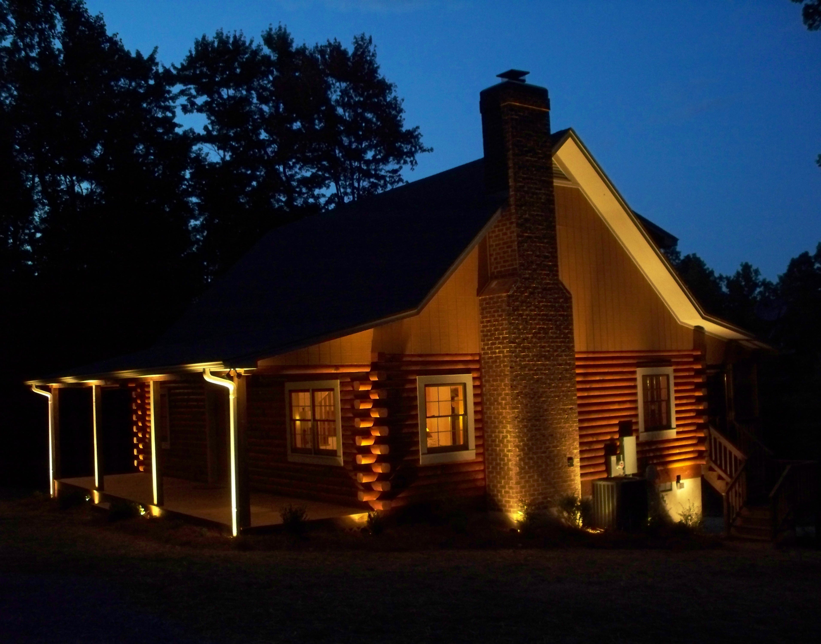
Thank you!
There’s always a light at the end of the tunnel.

