Slide 1
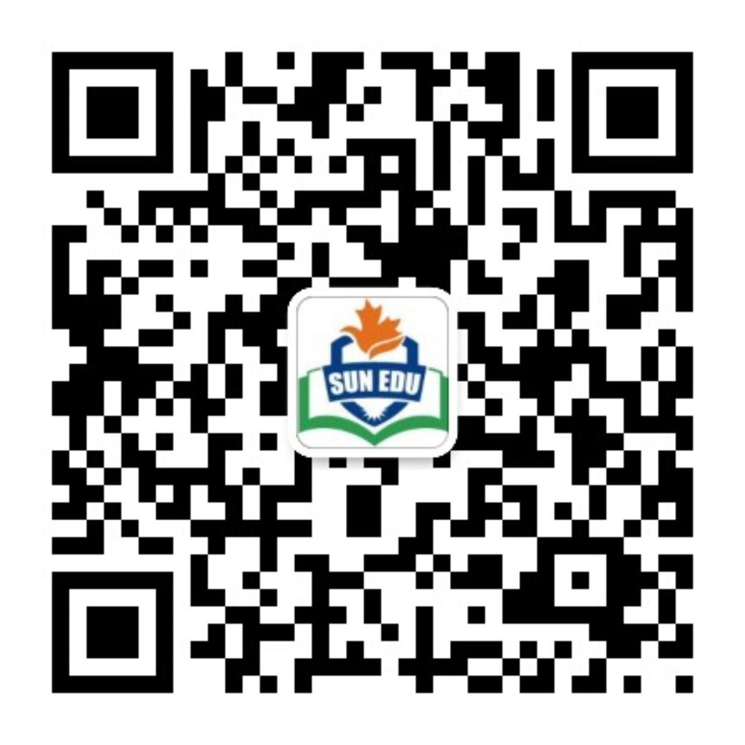
感恩遇见，相互成就，本课件资料仅供您个人参考、教学使用，严禁自行在网络传播，违者依知识产权法追究法律责任。
更多教学资源请关注
公众号：溯恩英语
知识产权声明

Slide 2
2024学年第二学期浙江省七彩阳光新高考研究联盟返校联考高三英语
应用文分析
北师大嘉兴附中 吴晨华

Slide 3
01
03
参考范文+下水范文
审题与谋篇布局
02
04
分段构写
应用文题型拓展
目录 / CONTENTS

Slide 4
01
主题、时态
审题与谋篇布局
你是学生会主席李华。学生会准备为在你校学习的外国留学生组织一次汉语演讲比赛，主题是“保护绿色发展，共同建设美好家园”。请你拟一则英语口头通知，要点如下：1. 比赛目的；2. 演讲内容；3. 比赛安排。
Dear international students,
The Students’ Union
体裁
分段要点及内容
思考：
“李华”重要吗？人称用什么？
口头通知和书面通知的差别是什么？
演讲内容只是“主题”吗？
Para.1
Para.2
Para.3
The purpose of the speech contest
The content and arrangement of the speech contest
The requirements
Hope
隐藏要点

Slide 5
02
分段构写
Para.1
The purpose of the speech contest
你是学生会主席李华。学生会准备为在你校学习的外国留学生组织一次汉语演讲比赛，主题是“保护绿色发展，共同建设美好家园”。请你拟一则英语口头通知，要点如下：1. 比赛目的；2. 演讲内容；3. 比赛安排。
口头通知格式及特点：开头“引起注意”
书面通知格式
1. Hello, everybody / everyone.
2. Ladies and gentlemen.
3. May I have your attention, please? I have an announcement to make.
4. Attention, please! I have something important to tell you.
Notice/Announcement
The Students’ Union

Slide 6
02
分段构写
Para.1
The purpose of the speech contest
你是学生会主席李华。学生会准备为在你校学习的外国留学生组织一次汉语演讲比赛，主题是“保护绿色发展，共同建设美好家园”。请你拟一则英语口头通知，要点如下：1. 比赛目的；2. 演讲内容；3. 比赛安排。
高分句式：
过去分词作后置定语
The activity aimed at [具体目标] will be held /is to be launched in [地点] from [开始时间]to [结束时间]meant to /intended to.
定语从句
The activity whose aim is to [具体目标] will be held in [地点] from [开始时间]to [结束时间].
介词短语
With the purpose/intention of/ In an effort t [具体目标] the activity will be held [地点] from [开始时间]to [结束时间].
要点1：“外国留学生”、“汉语”
display your Chinese learning achievements
showcase your Chinese proficiency
promote cultural exchanges
要点2：“保护绿色发展，共同建设美好家园”
enhance the awareness of green development
deepen your understanding of environmental issues

Slide 7
02
分段构写
Para.1
The purpose of the speech contest
Version1: 我们很高兴地通知，为大家提供一个展示中文学习成果的广阔平台，增强大家的绿色发展意识，学校将举办汉语演讲比赛。
thrilled
It is with great pleasure that we announce
We are glad to announce that a Chinese speech contest will be organized to offer you a wide platform to display your Chinese learning achievements and enhance the awareness of green development.
a fantastic opportunity to connect with fellow students who share your passion for sustainability
Version2:为了展示大家的汉语水平，加深对环境问题的理解，我们为所有在我校的留学生组织/量身定制了一场汉语演讲比赛。
Aiming to/In an effort to showcase your Chinese proficiency and deepen your understanding of environmental issues, a Chinese speech contest is tailored for/intended to you, all the overseas students in our school.

Slide 8
02
分段构写
Para.1
The purpose of the speech contest
活动类素材积累——目的
激发兴趣
拓宽视野
点燃激情
深化理解
提升意识
深入了解
加强情感纽带
增加自信
丰富校园生活
展示…的力量
1. arouse/ignite one’s interest in
2. broaden one’s horizons
3. fuel/ stimulate one’s passion for
4. deepen one’s understanding of/ insight into sth.
5. raise /enhance one’s awareness of
6. gain a better/deeper insight into
7. strengthen the emotional bond between A and B
8. boost/ enhance one’s confidence/ one’s self-esteem
9. enrich students’ campus life
10. demonstrate /display the power of…

Slide 9
02
分段构写
Para.2
The content and arrangement of the speech contest and the requirements
要点1：the content
主题：“保护绿色发展，共同建设美好家园”
Protecting Green Development, Building a Better Home Together
拓展内容：
描述气候变化的现状及原因
发表可持续发展的观点
提出环境保护的个人做法或倡议
……
brief introduction to the climate change
personal ideas on sustainable development
useful suggestions on environmental protection
常用句型：
be themed on …
with the theme of…
be associated with…
reflect the theme in a…way/ with…
is required/supposed to convey a clear message related to ….

Slide 10
02
分段构写
Para.2
The content and arrangement of the speech contest and the requirements
Version1: 以 “保护绿色发展，共建美好家园”为主题，你的演讲可以简要介绍气候变化，并分享你对可持续发展的个人看法。
Themed on “Protecting Green Development, Building a Better Home Together”, your speech can give a brief introduction to the climate change and share your personal ideas on sustainable development.
Version2:以“保护绿色发展，共建美好家园”为主题，你可以就环境保护、生态平衡、可持续发展等问题发表独到的见解和有创意的想法。
With the theme of “Protecting Green Development, Building a Better Home Together”, you can share your profound thoughts and creative ideas on environmental protection, ecological balance and sustainable development.

Slide 11
02
分段构写
Para.2
The content and arrangement of the speech contest and the requirements
要点2：the arrangement
in the school hall at 3 p.m. on March 5, 2025
合理的时间、地点
be held/ organized/ scheduled
常用句式
is to be launched
take place
is scheduled/ is to be launched
The contest will take place in the school hall at 3 p.m. on March 5, 2025.

Slide 12
02
分段构写
Para.2
The content and arrangement of the speech contest and the requirements
整合润色版
以“保护绿色发展，共建美好家园”为主题，本次比赛安排在2025年3月5日下午3点，在学校报告厅，在比赛中你可以就环境保护、生态平衡、可持续发展等问题发表独到的见解和有创意的想法。
is scheduled/ is to be launched in the school hall on March 5, 2025, starting promptly at 3 p.m.
Themed on “Protecting Green Development, Building a Better Home Together”, the contest is scheduled in the school hall at 3 p.m. on March 5, 2025, where you can share your profound thoughts and creative ideas on environmental protection, ecological balance and sustainable development.
personal eco-friendly initiatives, innovative climate solutions, sustainable approaches to conservation.
Your voice matters.

Slide 13
02
分段构写
Para.2
The content and arrangement of the speech contest and the requirements
在3月1日前提交报名表
提交演讲稿，包括标题和150词的介绍
演讲不超过5分钟
字数不超过1000字
必须原创
fill out the registration form before March 1, 2025
submit your speeches (including the title and a 150-word summary of the content)
must not exceed 5 minutes/ within 5 minutes
are expected to be no more than 1000 words
be limited to no more than 1000 words
with a maximum of 1000 words
which can ensure all participants have an equal opportunity
be created originally
originality is highly promoted

Slide 14
02
分段构写
Para.2
The content and arrangement of the speech contest and the requirements
Version1:每一位感兴趣的外国朋友请在2025年3月1日前填写报名表，您的演讲时间不超过5分钟，最多1000字，这能确保所有参与者机会均等。此外，创意受到高度推崇。
Every foreign friend interested should fill out the registration form before March 1, 2025, and your speech is expected not to exceed 5 minutes with a maximum of 1000 words, which can ensure all participants have an equal opportunity. Besides, originality is highly promoted.
Version2:感兴趣的同学请于2025年3月1日前登陆学校网站，填写报名表，并提交演讲（包括演讲题目和150字的内容摘要）。记住，每次演讲应该在5分钟内。
Those interested should visit the school website, fill out the registration form before March 1, 2025, and submit your speeches (including the title and a 150-word summary of the content). Remember, each speech should be within 5 minutes.

Slide 15
02
分段构写
Para.3
Hope
1. We welcome a wide range of fresh voices, anticipating your involvement!
2. Don’t miss this chance to shine and make your voice heard!
3. Embrace this opportunity to express your ideas. Your voice matters, so let it be heard!
4. Every foreign friend interested is welcome to take part in the contest.
5. Your participation will make a great difference! Come and join us!
6. The contest is open to all of our foreign friends studying in our school and we are expecting your participation.
7. Exceedingly looking forward to your active participation.
8. We eagerly anticipate your inspiring contributions.
9. Your inspiring entries and your active involvement are highly expected and appreciated.

Slide 16
03
参考范文+下水范文
May I have your attention, please? In an effort to showcase your Chinese proficiency and deepen your understanding of environmental issues, we are thrilled to announce an upcoming Chinese speech contest which is tailored for you –all the overseas students in our school.
Themed on “Protecting Green Development, Building a Better Home Together”, the contest is scheduled in the school hall at 3 p.m. on March 5, 2025, where you can share personal eco-friendly initiatives, innovative climate solutions and sustainable approaches to conservation. Every foreign friend interested should fill out the registration form before March 1, 2025, and your speech is expected not to exceed 5 minutes with a maximum of 1000 words, which can ensure all participants have equal opportunity. Besides, originality is highly promoted.
Embrace this opportunity to express your ideas. Your voice matters, so let it be heard! That’s all, thank you!

Slide 17
03
参考范文+下水范文
Dear international students,
We are glad to announce that a Chinese speech contest will be organized to offer you a wide platform to display your Chinese learning achievements and enhance the awareness of green development.
With the theme of “Protecting Green Development, Building a Better Home Together”, you can share your profound thoughts and creative ideas on environmental protection, ecological balance and sustainable development. The contest will take place in the school hall at 3 p.m. on March 5, 2025. Those interested should visit the school website, fill out the registration form before March 1, 2025, and submit your speeches (including the title and a 150-word summary of the content). Remember, each speech should be within 5 minutes.
Looking forward to your active participation!
The Students’ Union

Slide 18
04
应用文题型拓展
（2024年1月高三九省联考）你校英文报计划举办主题为“携手行动，节约粮食”的作文比赛。请你写一则活动通知，内容包括：（1）介绍活动目的；（2）说明参赛要求。
Notice
_________________________________________________________（为了提高人们对粮食保护重要性的认识）, an essay contest _______________________________________(以 “联合行动，节约粮食 ”为主题的)will be launched by Our school English newspaper. The detailed requirements for the competition ________________ (要求如下).
Participants are required to write an essay in English, __________________________________________ (重点阐述节约粮食的意义，并提出减少食物浪费的实用方法). The entries should be original, well-structured, and ___________________________________(长度控制在 200-300 字以内). Students from all grades are encouraged to participate, _____________________________________ (交稿提交截止日期为 8 月 14 日).
Let's join hands and ____________________________________(为保护食物资源做出贡献)!
School English Newspaper
In an effort to raise awareness about the importance of food conservation
whose title/theme is "Joint Action, Save Food”
are listed as follows
focusing on the significance of saving food and suggesting practical ways to reduce food waste
limited within 200-300 words in length
and the deadline for submission is set on 14 August
make a difference in conserving food resources!

Slide 19
04
应用文题型拓展
假如你是李华，你校每年一度的校园文化艺术节(Culture and Arts Festival) 即将举行，请你草拟一份通知。 内容包括：1.时间（3月份的第一个星期） 2. 活动（至少两项) 3.活动意义。
Notice
Aiming to gain a better acquaintance with /a deeper insight into Chinese traditional culture, the Culture and Arts Festival of our school is scheduled to fall /take place during the first week of March, lasting about a week.
Various activities will be organized, ranging from photography and calligraphy shows to folk dance and local operas performed by students. Not only will this festival broaden our horizons but also strengthen our confidence in Chinese culture.
Any student enthusiastic about Chinese culture is welcome. We’re firmly convinced that with your active involvement, the festival is bound to leave an unforgettable impression on you.
Students’ Union
February 10th, 2025

Slide 20
04
应用文题型拓展
（改编版1）假如你是李华，你校每年一度的校园文化艺术节即将举行，请给外教Chris写一封信，邀请他参加活动。内容包括：1. 时间（3月份的第一个星期）2. 活动内容 3.邀请参加。
Dear Chris,
Notice
Aiming to gain a better acquaintance with /a deeper insight into Chinese traditional culture, the Culture and Arts Festival of our school is scheduled to fall /take place during the first week of March, lasting about a week.
Various activities will be organized, ranging from photography and calligraphy shows to folk dance and local operas performed by students. Not only will this festival broaden our horizons but also strengthen our confidence in Chinese culture.
Any student enthusiastic about Chinese culture is welcome. We’re firmly convinced that with your active involvement, the festival is bound to leave an unforgettable impression on you.
Students’ Union
February 10th, 2025
Learning /Knowing that the annual Culture and Arts Festival of our school is to be organized, I’m writing to extend/convey my earnest invitation for you to join us.
The Festival is scheduled to fall/take place during the first week in March in our campus, lasting about a week.
It will expose the participants to Chinese traditional
culture, which can not only broaden our horizons but also strengthen our confidence in Chinese culture.
Hopefully, you could accept my invitation and I’m firmly convinced that the activity is bound to leave an unforgettable impression on you.
Yours sincerely,
Li Hua

Slide 21
04
应用文题型拓展
（改编版2）假如你是李华，你的海外笔友Chris想了解你学校每年一度的校园文化艺术节(Culture and Arts Festival) 。 请给他写一封信，内容包括：1.时间（3月份的第一个星期） 2. 活动（至少两项) 3.活动意义。
Dear Chris,
Learning /Knowing that the annual Culture and Arts Festival of our school is to be organized, I’m writing to extend/convey my earnest invitation for you to join us.
The Festival is scheduled to fall/take place during the first week in March in our campus, lasting about a week. Various activities will be organized, ranging from photography and calligraphy shows to folk dance and local operas performed by students. It will expose the participants to Chinese traditional culture, which can not only broaden our horizons but also strengthen our confidence in Chinese culture.
Hopefully, you could accept my invitation and I’m firmly convinced that the activity is bound to leave an unforgettable impression on you.
Yours sincerely,
Li Hua
Learning you are interested in the Culture and Arts Festival hosted by our school, I’m writing to share some relevant details with you.
It will provide an insight
into Chinese traditional culture, which can not only broaden the students’ horizons but also strengthen our confidence in Chinese traditional culture. And these meaningful activities have won a good popularity among students.
Hopefully, you could join us next time and your coming will absolutely light up our day. / Don’t hesitate to contact me if you have any other questions.
.

Slide 22
04
应用文题型拓展
（改编版3）假如你是李华，你校近期举行了每年一度的校园文化艺术节(Culture and Arts Festival) ，请你给校园广播投稿。稿件内容 1.时间（2月份的第一个星期） 2. 活动内容 3.活动感悟 。
Aiming to gain a better acquaintance with /a deep insight into Chinese traditional culture, the annual Culture and Arts Festival of our school fell/took place during the first week in February. Lots of students enthusiastic about Chinese culture participated in it.
Various activities were organized, ranging from photography and calligraphy shows to folk dance and local operas performed by students. What impressed me most was the calligraphy shows, after which I could even write by myself to experience its charm.
Undoubtedly, I benefited a lot from this activity. Not only did the festival broaden our horizons but also strengthened our confidence in our own culture.
(or) Last week witnessed the annual Culture and Arts Festival of our school, which lasted one week, aimed at gaining a better acquaintance with Chinese traditional culture.

Slide 23
THANKS
FOR YOUR ATTENTION

