Slide 1
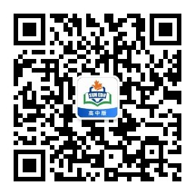
感恩遇见，相互成就，本课件资料仅供您个人参考、教学使用，严禁自行在网络传播，违者依知识产权法追究法律责任。
更多教学资源请关注
公众号：溯恩高中英语
知识产权声明

Slide 2
高中英语应用文写作
---邀请信3
Letters of Invitations（3）
杭州二中许丽君

Slide 3
Lead in
When do you need to write letters of invitations?
Invite to attend school events
Invite to attend outdoor activities
Invite to join in the parties
Invite to join in the ceremonies
Invite to take part in the recreations
Invite to take part in the festival activities
Invite to take part in the sports activities
Invite to take part in charity activities

Slide 4
Write Letters of Invitations to
tours/dinners/parties
meetings/conferences/exhibitions
school events/ceremonies
class reunions/family reunions
weddings/receptions/performances

Slide 5
Format/Frame structure邀请信写作框架
What should be included in a letter of invitation?
Dear ______,
Beginning --- Briefly explain the activities and invite them to attend (Introduction and purpose)
Why are you writing the letter?
Body--- Introduce the specific contents of the activity;
--- state the reason for the invitee, including the specific time, place and contents of the activity.
Why do you invite your friends and your relatives?
Ending --- About your wishes for response and being accepted with your gratitude.
Yours faithfully
***

Slide 6
Writing preparations
Letters of Invitations（3）

Slide 7
Part 1: Purpose of writing the letter
（1）【篇首句】介绍自己(收信人非熟人)，说明写作意图，简要说明活动，并邀请对方。
1. With the Mid-Autumn Festival drawing near/approaching, I’m writing to invite you to celebrate it with us.
随着中秋节的临近，我写信邀请你和我们一起过节。
2. It is our pleasure to inform you that Xinhua School is organizing a Science Fair (whish is) to be held next Saturday.
我们很荣幸通知你新华学校下周六将要组织一次科技展。

Slide 8
Part 1: Purpose of writing the letter
3. Hearing about your schedule to stay in China in the coming winter vacation, I’m writing to extend my invitation to you to spend the Spring Festival with my family.
听说你将在中国过寒假，我邀请你来我家度春节。
4. Knowing that you are fond of Chinese traditional festivals , I am writing to sincerely invite you to celebrate the Dragon Boat Festival with my family together.
获知你对中国传统节日感兴趣，我写信真诚地邀请你和我家人一起庆祝端午节。

Slide 9
Part 2: Body Arrangements
（2）【篇中句】篇中介绍活动具体内容，包括受邀请的人，邀请朋友干什么、地点及具体的时间等；
1. If you are interested, please sign up for it on the school website before January 12th .
如你感兴趣，去于1月12日前在学校网站报名。
2. Our family gathering(聚会), to be held on the night of Febuary18, means cosy(温馨) reunion for us.
将在2月18日晚上举办的家庭聚会是我们全家温馨的重逢。
3. A Chinese poetry recitation contest is going to be held in our school, which is definitely a good chance for you to show your talent.
下周我们学校要举行中文诗歌朗诵比赛，这将是你展示自己的好机会。（被动句）
4. The Science Fair, (which is) themed “Science and Creativity” is scheduled to take place in the lecture hall at 2:00 p.m. on Saturday.
主题为“科技与创新” 的科技节计划于...举行。

Slide 10
Part 2: Body Arrangements
5. I sincerely invite you to participate in a contest(竞赛) to be held in our school on Oct.12 at 10 am.
我诚挚邀请你参加将于……在……举行的竞赛。
6. For someone so fond of Chinese culture like you, it is absolutely a great opportunity you can’t afford to miss.
对于像你一样热爱中国文化的人，这绝对是一个不容错过的好机会。
7. The contest, themed “My First Impression of China”, is scheduled to take place on January 17th in the school auditorium.
以“我对中国的第一印象”为主题的竞赛，计划1月17日在学校礼堂举行。

Slide 11
Part 2: Body Arrangements
8. Your proficiency in Chinese and outstanding presentation skills can never fail to win applause, making you stand out among the participants
你对汉语的精通和杰出的表现能力一定能让你赢得大伙的掌声，使你在参赛者中脱颖而出。
9. On the morning of July 10, we will have a chance to watch a breathtaking Dragon boat race specially held annually to honor the great poet QuYuan.
在7月10日早上，我们将有机会观看为纪念伟大诗人屈原每年一次举办的令人叹为观止的龙舟赛。
10. With the purpose of promoting true scientific spirit, hands-on scientific investigation is the main focus of our Science fair.
为了提升真正的科学精神，我们这次的科学展主要聚焦于身边的科学调研。

Slide 12
Part 3: Ending
【篇尾句】期待对方接受邀请并期待对方尽快回复。
1. I’d be more than happy/pleased to meet you there and if you have any doubts, do not hesitate to drop me a line.
很高兴能在那里遇到你，如有疑问，请告知。
2. Your participation/presence is highly anticipated/expected/appreciated .
非常期待你的参与。（被动句）
3. Never deprive(剥夺) yourself of such simple pleasures!
让自己开心愉悦。
4. I’m sure that these lively celebrations with Chinese flavor will be your cup of tea.
我相信这些中国风味的庆祝活动一定让你喜欢。
.

Slide 13
WRITING HELP
Letters of Invitations（3）

Slide 14
Useful words and expressions
ranked
reliable
recently
responsible
ritual(礼节性的)
self-confident
scheduled
satisfying
salute
spellbound
tell
tended
thirsty
tutored
trustworthy
union
updated
vows
vocation
volunteered
wishes
weather
welcome
well-organized

Slide 15
Writing help: Useful phrases
have you heard
how did you manage to
I enjoyed hearing about
I hope that by now
I meant to tell you
in the lecture hall
in the auditorium
in your last letter you didn’t mention
I thought you might like to know
missing you
participate in…
would enjoy attending
with Chinese flavor
will last for two hours
will/is to be held/take place(举行) from 9:00 am to 5:00 pm
remember the time
sympathize with

Slide 16
Writing help: sentences
1. On behalf of (代表)the Students’ Union, I am writing to invite you to … (Formal)
2. The contest will last for two hours, during which time(在这期间) we will…
3. I suppose the splendid Spring Festival Gala will also be your cup of tea.
4. We’ll have a big feast together, chatting casually.

Slide 17
Writing help: sentences
5. I’m sure that these lively celebrations with Chinese flavor will be your cup of tea.
6. We will have a chance to watch a breathtaking Dragon boat race specially held annually to honor...
7. We will have dinner with ..., having a taste of the traditional food and sharing stories about the festival.
8. With your involvement and precious comments, the activity is bound to be a great success.

Slide 18
Writing help: sentences
9. As is scheduled, the contest themed “doing things right or doing right things” is taking place in our auditorium at 2 pm.
10. The fair will be open to parents from 10:00 am in the gym.
11. Our school students will present their science projects on that day.

Slide 19
邀请信写作模板3
Dear ____,
Beginning --- Briefly explain the activities and invite them to attend (Introduction and purpose)
① Knowing that you are quite fluent in _______/are fond of _______, I am writing to invite you to participate in __________ (活动) organized by our school.
Body--- Introduce the specific contents of the activity;
--- state the reasons for the invitee, including the specific time, place and contents of the activity.
Why do you invite your friends and your relatives?
② The contest, themed “___________________”, is scheduled to take place at/in __________ (地点) on ________ (具体时间) we will have a chance to watch________, After , we will have dinner with ______, having a taste of the traditional ______and sharing stories about the festival.
Ending ---About your wishes for response and being accepted with your gratitude.
③ if you are interested, please sign up for it on the school website before _____ . (再次邀请). Please confirm your participation at your earliest convenience. I would appreciate it if you could accept my invitation. Your presence will be highly appreciated.
Yours Sincerely / Faithfully/ Truly,
________________

Slide 20
Assessment
Purpose | Have you made the purpose clear?
Frame structure | Does the frame structure conform to the requirements?
Language | Are the sentences concise and accurate? Have you used the proper punctuation, words, sentences and paragraphs to convey yourself?
Content | Have you included all the points of view?
Are the details suitable?
Work in groups of four. Each student read the article and others comment on your partner’s work. Then select the best one out to show in the class. When you are discussing, you can pay attention to the following hints.

Slide 21
邀请信参考范文
Letters of Invitations（3）

Slide 22
邀请信范文5：(邀请美国朋友Steven参加夏令营活动)
假定你是李华，计划组织一个夏令营活动，邀请你的美国朋友Steven参加，请你写一封邀请信，内容包括：
参加者
时间、地点
活动内容
注意：1．词数80左右；
2．可适当增加细节，以使行文连贯。

Slide 23
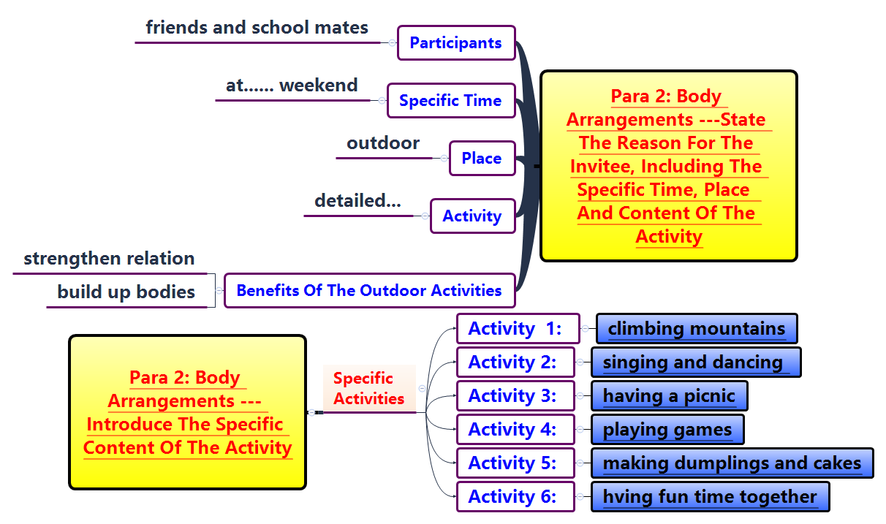

Slide 24
邀请信范文5：(邀请美国朋友Steven参加夏令营活动)
Writing Sample：
Dear Steven,
I am Li Hua, I would be more than pleased to invite you sincerely to join us in our summer camp.
Aiming to strengthen our relation and build up our bodies, large quantities of activities are arranged, involving climbing mountains and a picnic, singing and dancing, playing games, making dumplings and cakes, having fun time together. As is scheduled, the activities will take place at 8:00 a.m. next Saturday morning in the camp near our school. We can not only breathe fresh air but also appreciate the gorgeous scenery on the way.
Hoping you won’t miss the joyful activities. I greatly expect your attendance.
Sincerely yours, Li Hua

Slide 25
邀请信范文6 (邀请美国朋友Jack参加中国戏曲文化节)
假定你是李华，你的美国朋友Jack想了解中国戏曲文化，请你根据以下提示，用英语写一封邮件，邀请他参加中国戏曲文化节，内容包括：
提出邀请并简述理由；
文化节的时间、地点、内容；
期待对方参加。
注意：1．词数80左右；
2．可适当增加细节，以使行文连贯。

Slide 26
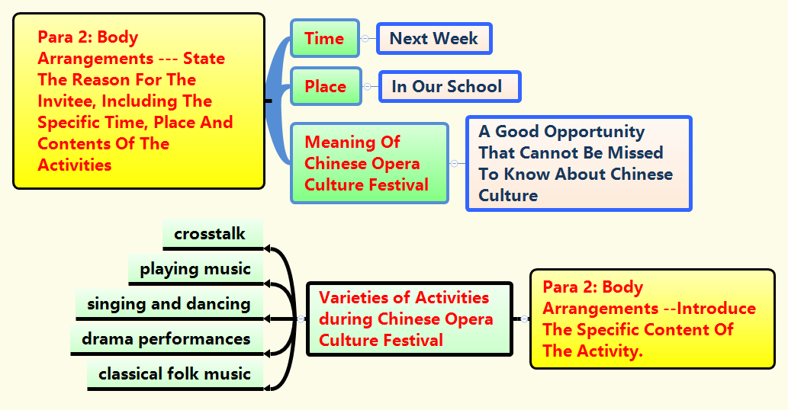

Slide 27
邀请信范文6 (邀请美国朋友Jack参加中国戏曲文化节)
Writing Sample：
Dear Jack，
(告知信息) I have good news for you, Chinese Opera Culture Festival will be held in our school next week. (写信目的，活动时间、地点) Since you are fond of Chinese Opera Culture, I think this is a great opportunity that cannot be missed. （邀请的理由）
(中国戏曲文化节活动内容和意义) Varieties of activities will be included in the festival, such as singing, drama performances, crosstalk and so on. During the festival, we can not only appreciate classical folk music of China, but also enjoy pieces of attractive music originally composed by our students. I truly believe that you will be impressed by the Chinese Opera Culture.
I’m sure we will have a lot of fun then, looing forward to your attendance. Please inform us of your arrival in advance so that early arrangements can be made.
Yours sincerely, Li Hua

Slide 28
THANKS

