Slide 1
感恩遇见，相互成就，本课件资料仅供您个人参考、教学使用，严禁自行在网络传播，违者依知识产权法追究法律责任。
更多教学资源请关注
公众号：溯恩高中英语
知识产权声明

Slide 2
M1U2 Using Language
Standard English And Dialects
杭师大附中 沈如意

Slide 3
Lead in: Read & Guess
Tell ya a story‘bout when I was just a pup.
Houston， Texas accent
Tell you a story about when I was just a kid.
Come on, fugedaboudit.
Come on, forget about it!
New York city accent
Pahk the cah in Hahvuhd yahd.
Park the car in the Harvard yard.
Boston urban accent

Slide 4
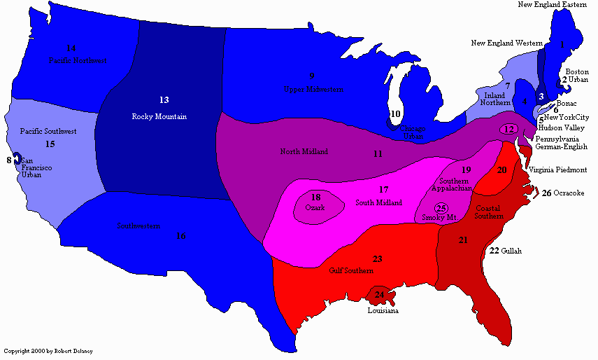
1. What is standard English? Does it exist? Why?
2. What is dialect?
3. Why are there so many dialects in America?
Map of American Dialects

Slide 5
1. What is standard English? Does it exist? Why?
2. What is dialect?
3. Why are there so many dialects in America?
Read for Information
1.What is standard English? Is it spoken in Britain, the US, Canada, Australia, India and New Zealand? Believe it or not, there is no such thing as standard English. Many people believe the English spoken on TV and the radio is standard English. This is because in the early days of radio, those who reported the news were expected to speak excellent English. However, on TV and the radio you will hear differences in the way people speak.
2.When people use words and expressions different form “standard language”, it is called a dialect. American English has many dialects, especially the midwestern, southern, African American and Spanish dialects. Even in some parts of the USA, two people from neighboring town speak a little differently. American English has so many dialects because people have come from all over the world.
3. Geography also plays a part in making dialects. Some people who live in the mountains of the eastern USA speak with an older kind of English dialect. When Americans moved from one place to another, they took their dialects with them. So people from the mountains in the southeastern USA speak with almost the same dialect as people in the northwestern USA. The USA is a large country in which many different dialects are spoken. Although many Americans move a lot, they still recognize and understand each other’s dialects.
Believe it or not, there is no such thing as standard English.
This is because in the early days of radio, those who reported the news were expected to speak excellent English. However, on TV and the radio you will hear differences in the way people speak.
When people use words and expressions different form “standard language”, it is called a dialect
American English has so many dialects because people have come from all over the world
Geography also plays a part in making dialects.
also ?
Signal word: “also” implies that one reason of American dialects has been mentioned in the former paragraph. So what’s the first reason?

Slide 6
1. What is topic sentence of each paragraph?
2.What are the major supporting details ?or how does the author support the topic sentence?
Read for Key Points
Tip 1: Topic sentence usually lies in the first, last sentence or after questions.
1. What is standard English? Is it spoken in Britain, the US, Canada, Australia, India and New Zealand? Believe it or not, there is no such thing as standard English. Many people believe the English spoken on TV and the radio is standard English. This is because in the early days of radio, those who reported the news were expected to speak excellent English. However, on TV and the radio you will hear differences in the way people speak.
2. When people use words and expressions different form “standard language”, it is called a dialect. American English has many dialects, especially the midwestern, southern, African American and Spanish dialects. Even in some parts of the USA, two people from neighbouring towns speak a little differently. American English has so many dialects because people have come from all over the world.
3. Geography also plays a part in making dialects. Some people who live in the mountains of the eastern USA speak with an older kind of English dialect. When American moved form one place to another, they took their dialects with them. So People from the mountains in the southeastern USA speak with almost the same dialect as people in the northwestern USA. The USA is a large country in which many different dialects are spoken. Although many Americans move a lot, they still recognize and understand each other’s dialects.
Tip 2: Topic sentence usually appears after some signal words such as however, but, actually, also, etc.
Tip3: Major supporting details often occur frequently in the passage and focus on the topic.

Slide 7
1. What is topic sentence of each paragraph?
2.What are the major supporting details ?Or how does the author support the topic sentence?
Read for Key Points
Topic sentence
1. What is standard English? Is it spoken in Britain, the US, Canada, Australia, India and New Zealand? Believe it or not, there is no such thing as standard English. Many people believe the English spoken on TV and the radio is standard English. This is because in the early days of radio, those who reported the news were expected to speak excellent English. However, on TV and the radio you will hear differences in the way people speak.
By explaining the expectation of people
Believe it or not, there is no such thing as standard English.
Major supporting details:
those who reported the news were expected to speak excellent English.
on TV and the radio differences in the way people speak.
Tip3: Major supporting details often occur frequently and focus on the topic.
Tip 1: Topic sentence usually lies in the sentence after questions.

Slide 8
1. What is topic sentence of each paragraph?
2.What are the major supporting details ?Or how does the author support the topic sentence?
Read for Key Points
2. When people use words and expressions different form “standard language”, it is called a dialect. American English has many dialects, especially the midwestern, southern, African American and Spanish dialects. Even in some parts of the USA, two people from neighbouring towns speak a little differently. American English has so many dialects because people have come from all over the world.
By listing examples in both different regions and the same block.
Major supporting details:
midwestern, southern, African American and Spanish dialects
neighbouring towns speak a little differently.
American English has so many dialects because people have come from all over the world.
Topic sentence
Tip 1: Topic sentence usually lies in the first or last sentence.
Tip3: Major supporting details often focus on the topic.

Slide 9
1. What is topic sentence of each paragraph?
2.What are the major supporting details ?Or how does the author support the topic sentence?
Read for Key Points
Topic sentence
1.
Geography also plays a part in making dialects.
3. Geography also plays a part in making dialects. Some people who live in the mountains of the eastern USA speak with an older kind of English dialect. When American moved from one place to another, they took their dialects with them. So People from the mountains in the southeastern USA speak with almost the same dialect as people in the northwestern USA. The USA is a large country in which many different dialects are spoken. Although many Americans move a lot, they still recognize and understand each other’s dialects.
2.
Identify or know sth
recognize?
By listing examples in the mountains of the eastern USA .
Unlike Chinese dialects, American dialects vary but can be understood.
We can infer the meaning of new words by reading between the lines.

Slide 10
Read for Structure
Para 1
Para 2
Para 3
phenomenon
no standard English
American dialects vary because people come from all over the world.
Reason 1
Geography also plays a part in making American dialects.
Reason 2

Slide 11
感恩遇见，相互成就，本课件资料仅供您个人参考、教学使用，严禁自行在网络传播，违者依知识产权法追究法律责任。
更多教学资源请关注
公众号：溯恩高中英语
知识产权声明

Slide 12
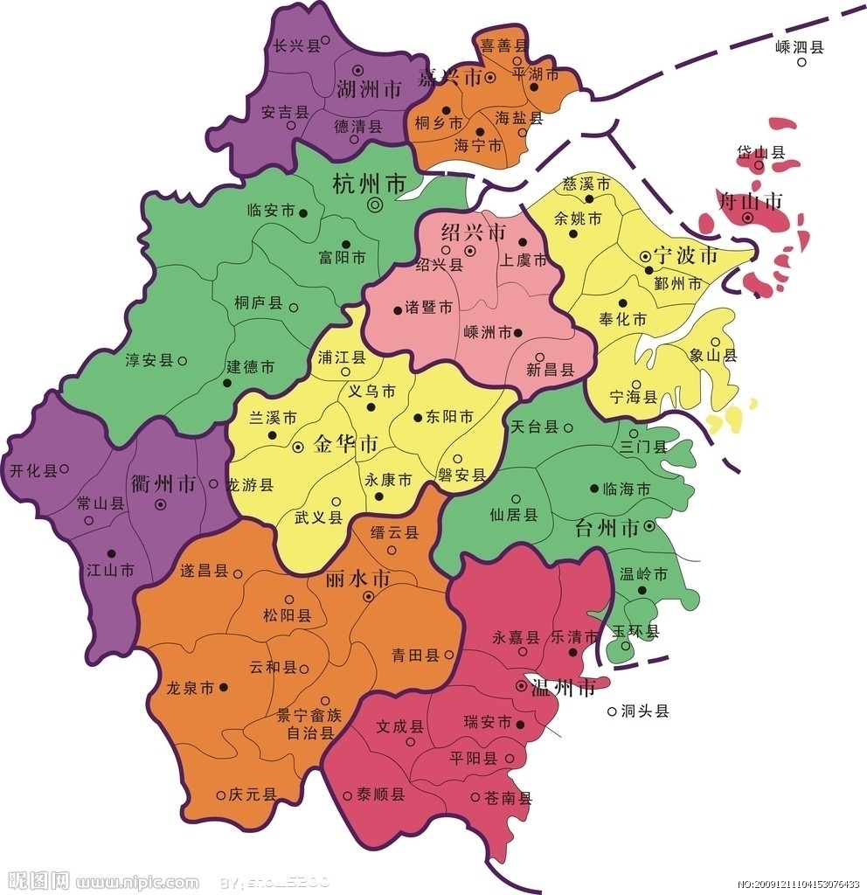
Discussion
How many dialects in Zhejiang Province ? And why are there so many dialects ?

Slide 13
Write a Summary
What is a summary?
A summary is a brief statement that gives only the main points of something, not the details.
《牛津高阶英汉双解词典》

Slide 14
List the Key Points
Para. | Key points
1 | Believe it or not, there is no such thing as standard English…those who reported the news were expected to speak excellent English…differences in the way people speak
2 | American English has so many dialects because people have come from all over the world... neighbouring towns speak a little differently…midwestern, southern, African American and Spanish dialects
3 | Geography also plays a part in making dialects…the mountains of the eastern US…American moved…took their dialects…southeastern dialects are the same with that in the northwestern part…recognize each other

Slide 15
How to restate?
1. change the sentence structure (句型转换)
2. use synonyms (同义词的运用)
3. summarize examples (概括)
5. combine sentences (合并句子)
4. sometimes change the voice (主被动语态转换)

Slide 16
Examples of Restating the Key Points
Key point 1 | Believe it or not, there is no such thing as standard English…those who reported the news were expected to speak excellent English…differences in the way people speak…
restate | Synonyms: Believe it or not— Change the sentence structure：There is no such things as—— Voice: were expected to speak—— Combine sentence:
to tell the truth, Actually
sth doesn’t exist
were expected to be spoken
Actually, standard English, expected to be spoken by news reporters doesn’t exist because of their different dialects.

Slide 17
Pair work: Try to restate the other two key points!
Actually, standard English, expected to be spoken by news reporters doesn’t exist because of their different dialects.
1 | Believe it or not, there is no such thing as standard English…those who reported the news were expected to speak excellent English…differences in the way people speak
2 | American English has so many dialects because people have come from all over the world... neighbouring towns speak a little differently…midwestern, southern, African American and Spanish dialects
3 | Geography also plays a part in making dialects…the mountains of the eastern US…American moved…took their dialects…southeastern dialects are the same with that in the northwestern part…recognize each other
1. change the sentence structure (句型转换)
2. use synonyms (同义词的运用)
3. summarize examples (概括)
5. combine sentences (合并句子)
4. sometimes change the voice (主被动语态转换)

Slide 18
Examples of Restating the Key Points
Key point 2 | American English has so many dialects because people have come from all over the world... neighbouring towns speak a little differently…midwestern, southern, African American and Spanish dialects
restate | Change the sentence structure:American English has so many dialects because people have come from all over the world summarize examples: neighbouring towns speak a little differently…midwestern, southern, African American and Spanish dialects Combine:
American dialects vary due to immigration.
different regions and even the same block
American dialects vary in different regions and even the same block due to immigration.

Slide 19
Examples of Restating the Key Points
Key point 3 | Geography also plays a part in making dialects…the mountains of the eastern US…American moved…took their dialects…southeastern dialects are the same with that in the northwestern part…recognize each other
restate | Synonyms: play a part in making dialects summarize examples: dialects…the mountains of the eastern US…American moved…took their dialects…southeastern dialects are the same with that in the northwestern part…recognize each other
contribute to the diversity of dialects
Despite Americans’ love for travelling, they could understand each other because they took their dialects.
Geography also contribute to the diversity of dialects. Despite Americans’ love for travelling, they could understand each other because they took along their dialects.
Combine:

Slide 20
Use proper conjunctions(连接词） to polish your passage.
After writing:

Slide 21
使用合适的连接词
表转折：but, however, though, although
表并列、递进：as well as, in addition to, not only...but also, besides, what’s more, furthermore,...
表对比：meanwhile, on the other hand, on the contrary, contrast ,...
表列举：firstly/secondly/finally/...
表原因：because (of) ,due to, on account of,...; for…
表举例：for example/instance, such as, and so on
Ending：therefore, consequently, In short, in conclusion, in a word…

Slide 22
A Sample
Actually, standard English, expected to be spoken by news reporters doesn’t exist because of their different dialects. American dialects vary in different regions and even the same block due to immigration. Besides, geography also contribute to the diversity of dialects. Despite Americans’ love for travelling, they could understand each other because they took along their dialects. (56words)

Slide 23
Conclusion of A Good Summary
be brief
be thorough
restate/own words
be objective

Slide 24
感恩遇见，相互成就，本课件资料仅供您个人参考、教学使用，严禁自行在网络传播，违者依知识产权法追究法律责任。
更多教学资源请关注
公众号：溯恩高中英语
知识产权声明

Slide 25
Assignment
Polish your own summary

