Slide 1
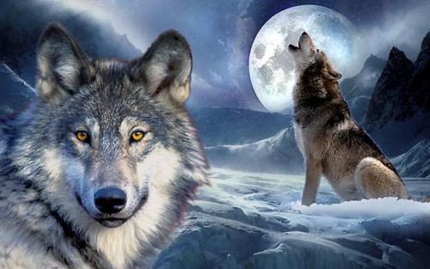
Continuation Writing
The Wolf at the Door

Slide 2
Step1: Read for basic information
one night last summer
when
where
who
what
how
a campsite in Banff National Park, Canada
Russ Fee, Elisa Rispoli, Matt Rispoli,
two boys, a wolf
The wolf attacked the Rispolis.
Russ came to help.
Continuation Writing
How did they escape?

Slide 3
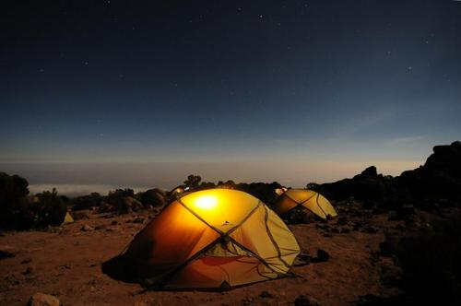
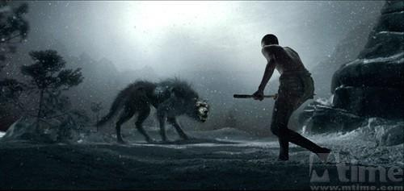
Step2: Understand the structure
Russ Fee was asleep inside his tent last summer when a series of screams jolted him awake. Throwing on his shoes, he ran out to investigate. Fee and his wife were traveling through Canada’s Banff National Park to enjoy its stunning beauty and awesome wildlife. It was the latter he now encountered(遇到). Although it was dark, Fee could detect a neighboring tent in a mess. Backing out was a wolf, dragging something in his teeth. That thing was a man.
one night,last summer
背景介绍
推动故事发展
encounter a wolf

Slide 4
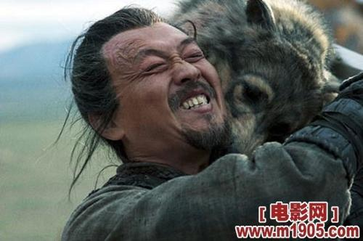
Moments earlier, Elisa and Matt Rispoli, from New Jersey, were asleep with their two young children when the wolf tore into their tent. It was like something out of a horror movie. For three minutes Matt threw his body in front of Elisa and the boys who would stand little chance of running faster than a wolf and fought the wolf with bare hands. At one point, Matt got the upper hand, pinning the wolf to the ground. But the wolf clamped its jaw onto Matt’s arm, set its powerful legs, and began tugging(拖，拽) Matt outside while Elisa was pulling on his legs trying to get him back.
故事发展

Slide 5
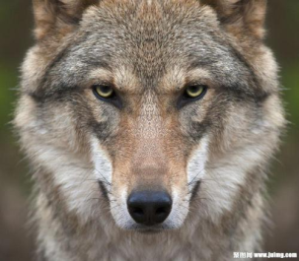
Elisa and Matt Rispoli
VS
The wolf
They were asleep with their two young children.
tore into their tent.
Matt threw his body in front of Elisa and the boys.
clamped its jaw onto Matt’s arm, set its powerful legs, and began tugging Matt outside
Matt fought the wolf with bare hands.
He pinned the wolf to the ground.
Elisa was pulling on his legs trying to get him back.

Slide 6
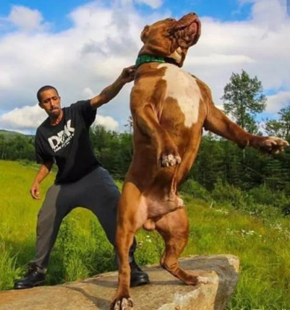
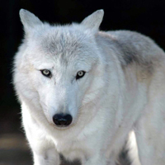
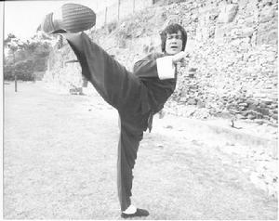
It was then that Russ Fee entered the picture. He ran at the beast, kicking it like he was kicking in a door. The wolf dropped Matt and emerged(出现) from the tent. Wolves are large, Fee felt like he had punched someone that was way out of his weight class. He could feel its heavy breath on his face and he could smell the terrible pungent(刺激性的) ordor it emitted(发出), fishy, oily and bloody.
like he was kicking in a door
dropped Matt
emerged from the tent
heavy breath
terrible pungent ordor
故事发展

Slide 7
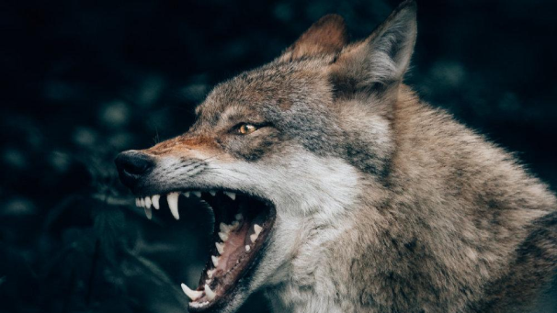
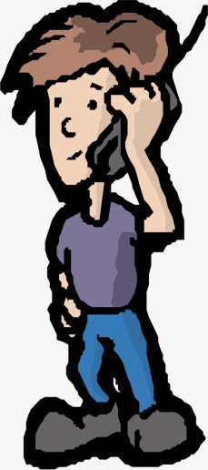
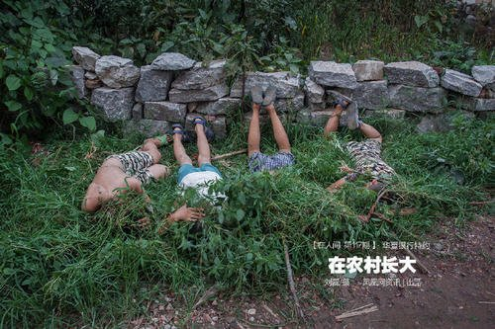
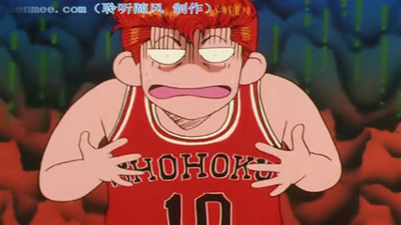
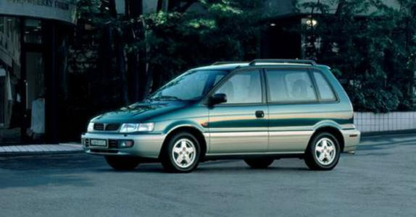
The wolf turned its anger on Fee, exposing his sharp teeth and snarling at him. Terrified, Fee withdrew a bit. Out of the corner of his eyes, he saw his minivan was not far away. Meanwhile, panicked as they were, the two boys concealed themselves at a safe distance from the battle. The elder boy used the satellite phone to call for help.
故事发展

Slide 8
Step 3: Infer what would happen next
Para1: Matt, his arms bloodied, flew out of the tent to resume the battle.
1. What would they do? How do they feel? Elisa, Matt, Fee
2. What would the wolf do?
Para2: Just at that moment, a police car came, along with an ambulance.
1. What would happen after the police car and the ambulance arrived? How do they feel?
2. How would they survive?
Notes:
第一段的第三个问题移到第二段成为I第二个问题。

Slide 9
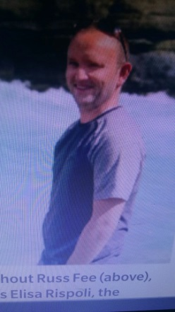
Step4: Describe the wolf’s actions and people’s actions and feelings
the Rispoli, Fee
the wolf
VS

Slide 10
Possible reactions of the people
《纳尼亚传奇》(The Chronicles of Narnia）
imitation
The Naiads and Dryads were scattering in every direction. Lucy was running towards him as fast as her short legs would carry her and her face was as white as paper. Then he saw Susan make a dash for a tree, and swing herself up, followed by a huge grey beast. At first Peter thought it was a bear. Then he saw that it looked like an Alastian, thought it was far too big to be a dog.泉水精和树精正在四处逃散。露西撒开两条小短腿，飞快地向他跑去，脸色吓得苍白。然后，他看到苏珊冲向一棵树，纵身爬了上去。一只灰色的巨兽在追她。起初彼得以为是头熊。后来又觉得像一只阿尔萨斯犬，但是它体型太大了，不能是一只狗。
Notes:
纳尼亚这部分已经移动到Step4之后，设计成供学生欣赏模仿的语料。下面是学生自己动手写。

Slide 11
Then he realized that it was a wolf – a wolf standing on its hind legs, with its front paws against the tree-trunk, snapping and snarling. All the hair on its back stood up on end. Susan had not been able to get higher than the second big branch. One of her legs hung down so that her foot was only an inch or two above the snapping teeth.然后他意识到那是一匹狼——那匹狼用后腿站着，前爪扑在树干上，又咬又吼。它背上的毛全都竖起来了。苏珊爬到第二根大树枝，便无法爬得更高了。她的一条腿荡了下来，脚距离乱咬的狼牙只有一两英寸。

Slide 12
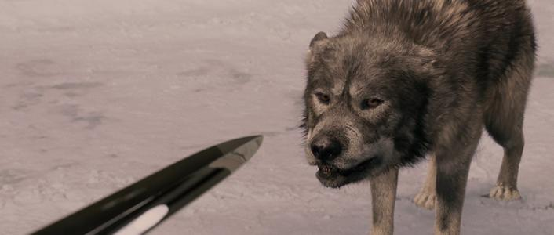
Peter did not feel very brave; indeed, he felt he was going to be sick. But that made no difference to what he had to do. He rushed straight up to the monster and aimed a slash of his sword at its side. That stroke never reached the Wolf. Quick as lightning it turned round, its eyes flaming, and its mouth wide open in a howl of anger.彼得觉得自己一点也不勇敢，真的，他觉得自己都要吐了。但这丝毫不影响他必须要做的事。他径直向猛兽冲去，把利剑对准了它的一侧砍了过去。那一击没有击中狼。它像闪电一样迅速地转过身来，眼睛冒火，张大了嘴，怒吼着。

Slide 13
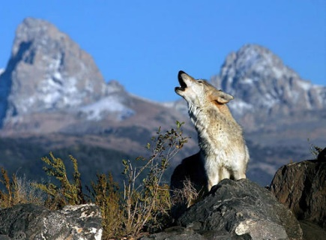
the wolf’s actions
DIY
The wolf stared at him for a moment in silence, lashing his tail wrathfully. 有那么一会儿，那匹狼静静地盯着他，愤怒地甩着尾巴。
Suddenly the wolf pricked up his ears, baring his teeth with an angry snarl. 突然，那匹狼竖起耳朵，呲牙咧嘴愤怒地咆哮着。
Notes:
此处设计成学生结合一起所学加提供原文和纳尼亚的语料自己动手写。

Slide 14
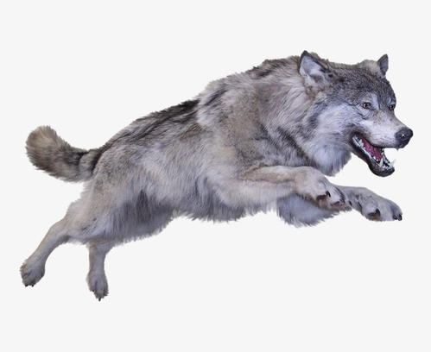
The wolf lifted his head toward him and howled. 狼抬起头对着他嚎叫着。
Suddenly he let out a long snarling, terrible scream and charged at him like a gray arrow. 突然，他发出一声长长的咆哮，可怕的尖叫声，像一支灰色的箭一样朝他扑过来。

Slide 15
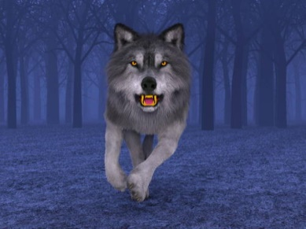
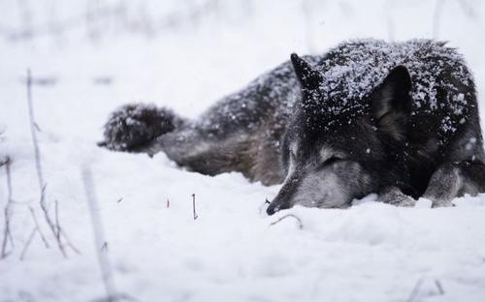
Possible endings of the wolf
In a flash, the wolf slunk into the thick woods, and trotted south. 刹那间，狼潜入密林，向南跑去。
Hearing the sirens, the wolf tried to flee, but was tracked down by park officials and euthanized.听到警笛声，狼试图逃跑，但被公园管理人员追上并实施了安乐死。

Slide 16
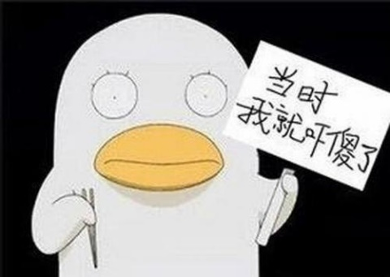
Possible feelings of the people
A flood of fear welled up in him./ Fear flooded over him.他心中涌起一阵恐惧。
So frightened was he that he was frozen on the spot.他吓坏了，一动不动。
For a moment, he just stood there, paralyzed.有那么一会儿，他站在那里，全身瘫痪似的。

Slide 17
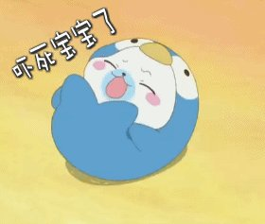
He could hear nothing but the sound of his hearts throbbing violently in his chest. 他什么也听不见，只有他胸口剧烈跳动的心跳声。
His heart beat so violently that he felt nearly suffocated.他心跳得太厉害了，几乎感到窒息。
He turned pale with fright and sweat broke out all over his body. 他大惊失色，汗流浃背。
Scared, he felt his throat dry, his palms sweating and his legs trembling.他吓得喉咙发干，手心冒汗，双腿发抖。

Slide 18
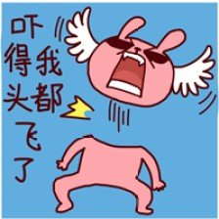
A shiver of fright ran through him when the wolf stared at him in silence.那匹狼静静地盯着他。恐怖的颤栗掠过了他全身。
Suddenly the wolf pricked up his ears, baring his teeth with an angry snarl which made everyone jump with fright. 突然，那匹狼竖起耳朵，呲牙咧嘴愤怒地咆哮着。每个人都吓得跳了起来。
He tried to steady his hands, but they quivered uncontrollably. 他想使自己的手稳住不动，但它们不听使唤还是颤抖着。

Slide 19
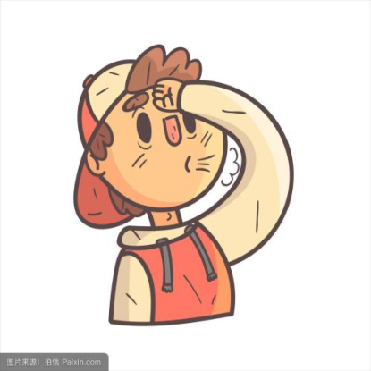
We all breathed a sigh of relief when the wolf had fled. 狼逃跑后，我们都松了一口气。
They congratulated each other on their narrow escape.他们互相拥抱，庆幸自己死里逃生。
They hugged each other tightly, tears in their eyes. 他们互相紧紧拥抱，泪水盈眶。

Slide 20
“Without Russ Fee, ”said Elisa, “the attack could have been so, so much worse.” “如果没有Russ Fee，” Elisa说，“这次被袭后果会严重多了。”
The Rispolis hugged him and told him how fortunate they were. Rispolis夫妇拥抱了他，告诉他他们是多么幸运。
Tears streaming down her face, Elisa offered her heartfelt gratitude. Elisa泪流满面，表示衷心的感谢。
Feeling safe, the Rispolis breathed a sigh of relief and were obliged to Fee for helping him getting them out of the plight. 感到安全了， Rispolis夫妇松了一口气，感谢Fee帮助他们摆脱困境。

Slide 21
Step5: Complete the story
Fee Elisa minivan tent jaw
ran threw kicking terrified battle
Choose at least 5 key words to cover the most important information.

Slide 22
Step5: Polishing your writing
Language: rich, accurate, coherent
Plot: correspondence from the former part to the latter part

Slide 23
rich
Possible version：
Para1: Matt, his arms bloodied, flew out of the tent to resume the battle. Elisa showed great courage, waving her fists at the wolf, shouting and screaming with the intention of intimidating and scaring it away. The men pelted the wolf with rocks, forcing it back, then the Fees and the Rispolis fled to the shelter of the Fees’ minivan. The wolf chased them tightly. Howling wildly, the wolf crashed the van violently and scratched at it with its sharp claws fierecely.
correspondence:the preceding plot: Elisa was pulling on his legs trying to get him back
showed great
courage
waving
shouting
screaming
pelted
forcing
fled
chased …… tightly
Howling wildly
crashed …... violently
scratched
sharp
rich&accurate
fierecely
Notes:
结合范文，分析Language和plot两方面的具体体现。

Slide 24
Para2: Just at that moment, a police car came, along with an ambulance. Hearing the sirens, the wolf tried to flee, but was tracked down by park officials and euthanized(安乐死). Matt was taken to a local hospital suffering puncture wounds. He soon fully recovered. When Elisa thanked Fee for his heroic, whom Elisa nicknamed their guardian angel, he did admit to a fleeting thought during the heat of battle. The moment the wolf locked eyes with him, Fee said, “I immediately regretted kicking it.”
coherent
correspondence:the preceding plot: the wolf clamped its jaw onto Matt’s arm, set its powerful legs, and began tugging Matt outside
tried to
but
Matt was taken
to a local hospital suffering puncture wounds
kicking
correspondence:the preceding plot: He ran at the beast, kicking it like he was kicking in a door
Notes:
结合范文，分析Language和plot两方面的具体体现。

