Slide 1
感恩遇见，相互成就，本课件资料仅供您个人参考、教学使用，严禁自行在网络传播，违者依知识产权法追究法律责任。
更多教学资源请关注
公众号：溯恩高中英语
知识产权声明

Slide 2
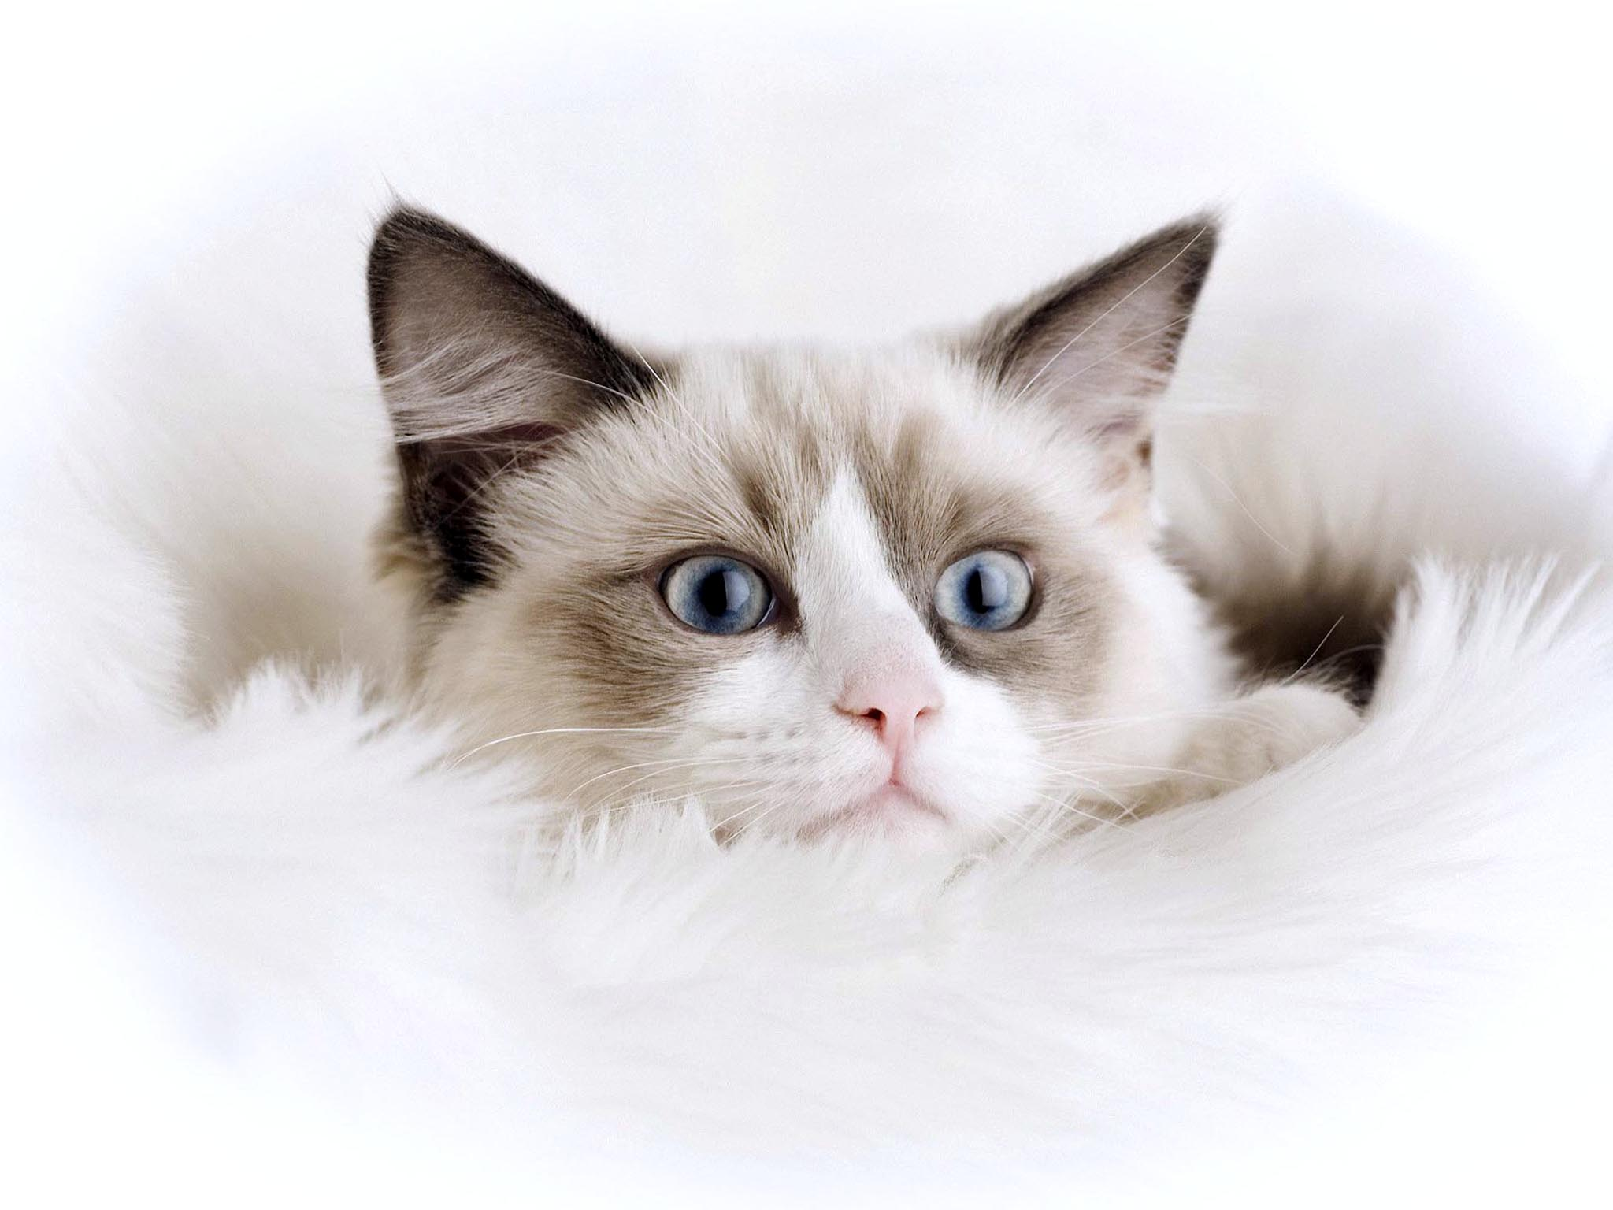
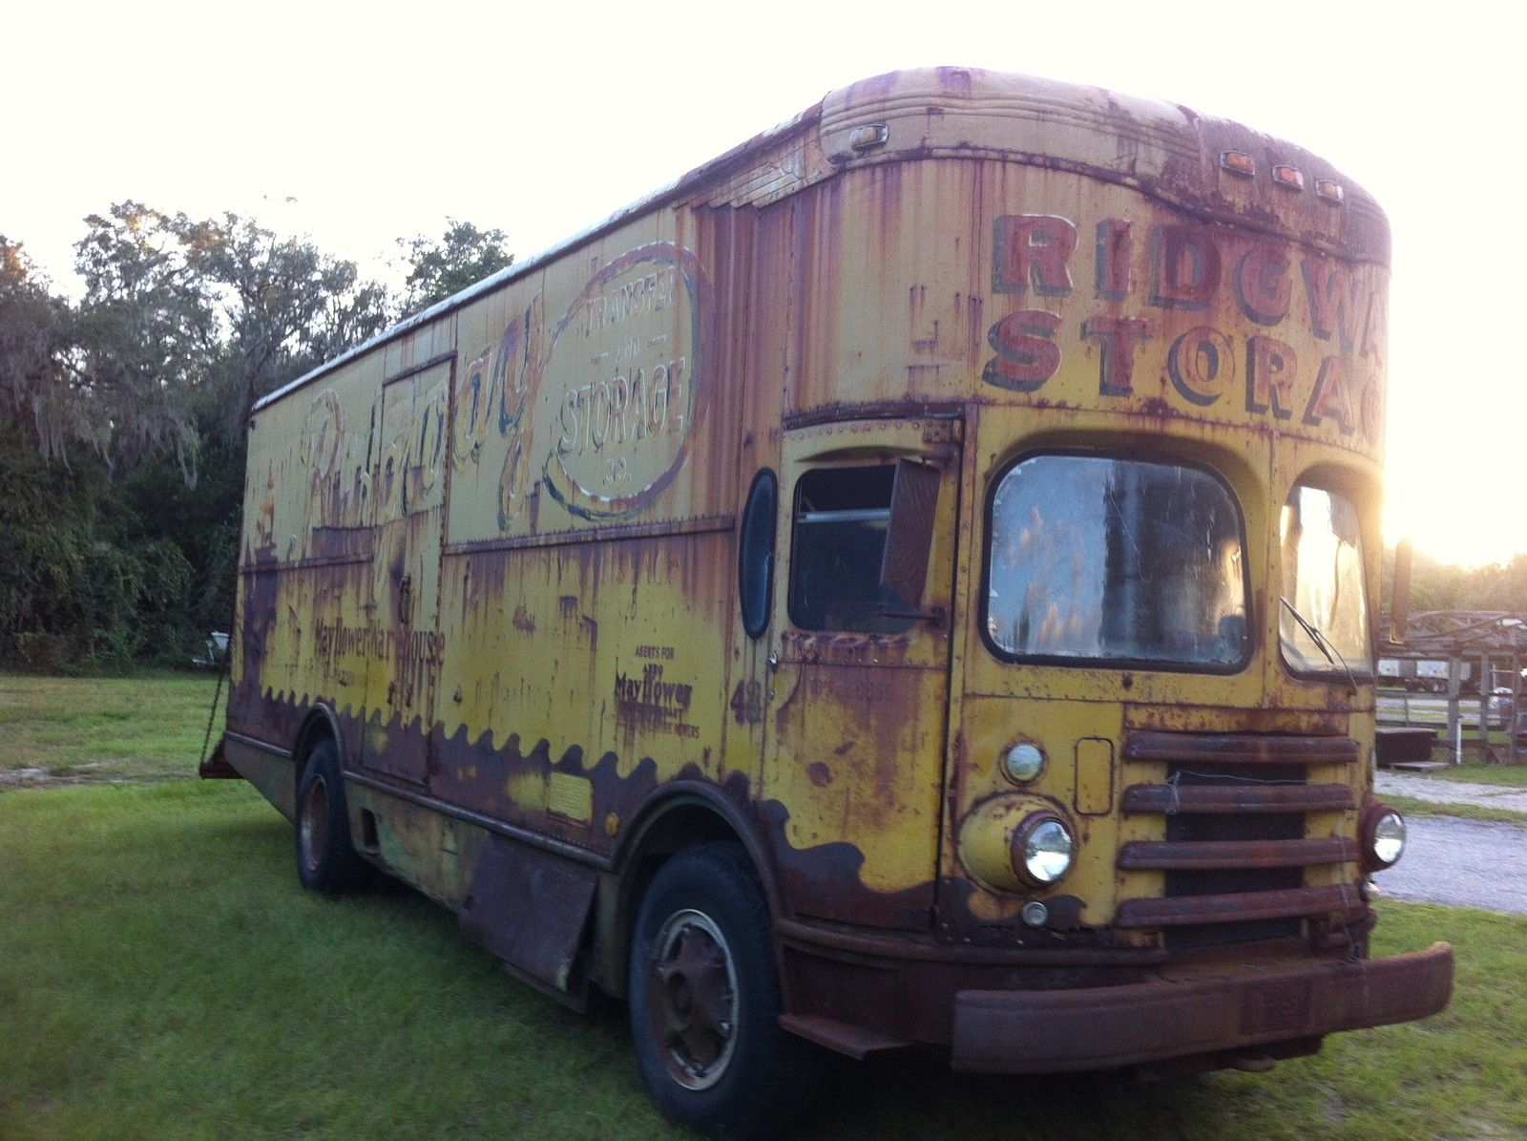
浙江省十校联盟联考
读后续写评析
浙江省衢州第一中学 徐荣仙

Slide 3
You'd think that after hearing Mom and Dad talk about The Trip for a year, I'd be eager to go. But I don't even want to think about it. “Aren't you excited?” asks Dad looking up from his laptop.“This is the trip of lifetime. I'll bet none of your friends will be driving across the United States this summer.” Exactly, I think. Nobody I know is going to pile into an old van, and drive from California to New York and back in 58 days. Fifty-eight days! That's practically my whole summer! But I know it's useless to protest（抗议）. When Dad was offered a summer off for the first time in his career, he said that he'd always dreamed of driving across the country. So now we're going. This is Dad's chance. I pick up my cat. Max, and bury my face in his fur. He paws at my ears playfully. Good-bye, summer vacation. Good-bye, diving at the lake. Good-bye to hanging out and doing absolutely nothing. Good-bye, Max. I'm going to miss this ball of fur. I put him down and laugh as he bats a button across the floor like a soccer player. He is interested in all small objects. The closer The Trip gets, the harder it is to ignore. Thick envelopes arrive from places like Indiana,Tennessee,and Arkansas. Night after night,Mom and Dad huddle around the computer, plotting every inch of our 8,000-mile journey. Three days after school gets out, The Trip is finally here. Everything is packed and ready to go. Mom says that we are supposed to leave at 9 a.m. But when Dad notices a wet spot under the van, I realize we won't be going anywhere for a while. Dad crawls under the van.Car parts spring up around the van like mushrooms. All of my friends from the neighbourhood gather in the front yard. “So when are you leaving?”they ask. “Anytime now,” I say, but inside I'm wondering how we're ever going to make it across the country when we can't even get down the driveway. Minutes turn into hours. By the time Dad gives Mom the news, it's late afternoon.“I fixed the leak,”says Dad. “But now I can't find one of the fan bolts（螺栓）.” Mom organizes a search,but in vain.
Paragraph 1: Dad calls the stores but none carry the bolt that fits this old van.
Paragraph 2: Then it hits me.“Max!” I shout,“Find Max!”

Slide 4
1. Analyze the passage
Main Idea:
The author's tangled emotions about a trip organized by his father
Main plots:
unwilling to accept it
uninterested in experiencing it
something unexpected happened
worried about it or excited at it?
change his mind
expect to find the bolt
offer a helping hand
happy

Slide 5
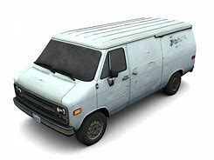
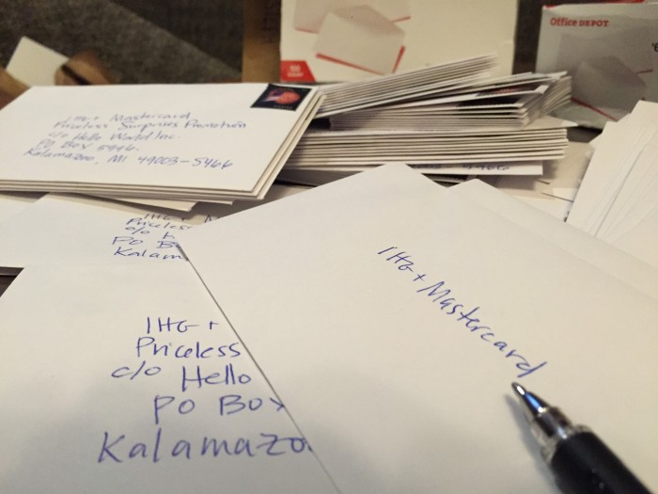
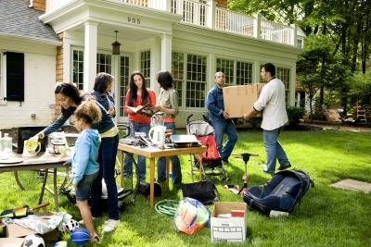
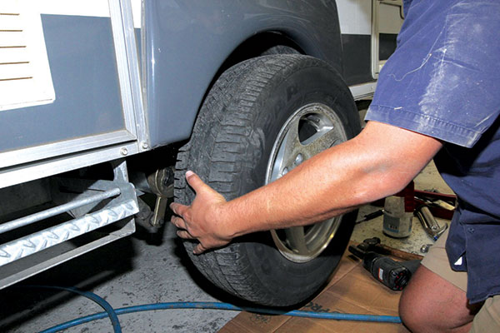
Conflicts:
an old van; extremely long time;
It's none of my business
unwilling
miss Max
thick envelopes
calm
a focus
tangled emotions
many friends
a chance to experience his own summer vacation? happy?
excited?
disappointed?
regretful about the likely abortive trip?
leaking
HOW?
parents' devotion in advance
friends' concern about it

Slide 6
How did the author express his unsatisfied emotion about the plan?
extremely reluctant but helpless
time-consuming and boring
Exactly, I think. Nobody I know is going to pile into an old van, and drive from California to New York and back in 58 days. Fifty-eight days! That's practically my whole summer! But I know it's useless to protest（抗议）. When Dad was offered a summer off for the first time in his career, he said that he'd always dreamed of driving across the country. So now we're going. This is Dad's chance. I pick up my cat. Max, and bury my face in his fur. He paws at my ears playfully. Good-bye, summer vacation. Good-bye, diving at the lake. Good-bye to hanging out and doing absolutely nothing. Good-bye, Max. I'm going to miss this ball of fur. I put him down and laugh as he bats a button across the floor like a soccer player. He is interested in all small objects.
It's none of my business!
have no choice but to accept

Slide 7
Ready for the trip
hard work
The closer The Trip gets, the harder it is to ignore. Thick envelopes arrive from places like Indiana,Tennessee,and Arkansas. Night after night,Mom and Dad huddle around the computer, plotting every inch of our 8,000-mile journey. Three days after school gets out, The Trip is finally here. Everything is packed and ready to go. Mom says that we are supposed to leave at 9 a.m. But when Dad notices a wet spot under the van, I realize we won't be going anywhere for a while. Dad crawls under the van.Car parts spring up around the van like mushrooms. All of my friends from the neighbourhood gather in the front yard. “So when are you leaving?”they ask. “Anytime now,” I say, but inside I'm wondering how we're ever going to make it across the country when we can't even get down the driveway. Minutes turn into hours. By the time Dad gives Mom the news, it's late afternoon.“I fixed the leak,”says Dad. “But now I can't find one of the fan bolts（螺栓）.” Mom organizes a search,but in vain.
One conflict
in a dilemma
Another conflict

Slide 8
2. Read for the possible plots
Paragraph 1: Dad calls the stores but none carry the bolt that fits this old van. _________________________________________
Did the author help them search for the missing bolt?
Will the trip be delayed or cancled?
How did the author feel about the unexpected result?
Paragraph 2: Then it hits me.“Max!” I shout,“Find Max!”
How did they search for Max?
Where was he? And was the bolt found?
How did the author feel after finding the bolt?

Slide 9
下水作文： Dad calls the stores but none carry the bolt that fits this old van. The bolt was gone magically. Father leaned against the van with his face and hands black with grease. He shrugged his shoulder and forced a smile, “The trip would be a bubble!” Contrary to what I had expected, something soft inside touched me.Their busy figures and hopeful expressions appeared before my eyes constantly, which drove me to move towards him. “Maybe it’s only a joke!” I comforted him. But where was Max? He was right near the van while Dad was repairing it. Then it hits me.“Max!” I shout,“Find Max!” “Max, Max...” but the ball was nowhere to be found. Suddenly, the sound in the corner of the backyard caught my attention. I crept quietly towards the direction. The little ball was pawing the earth carefully, trying to hide something in it- the very bolt! Oh, my God! At the sight of me, Max pricked up his ears and miaowed at me proudly as if to announce his victory. All of us laughed in relief. What an unforgettable beginning of a special trip!

Slide 10
Samples from Students

Slide 11
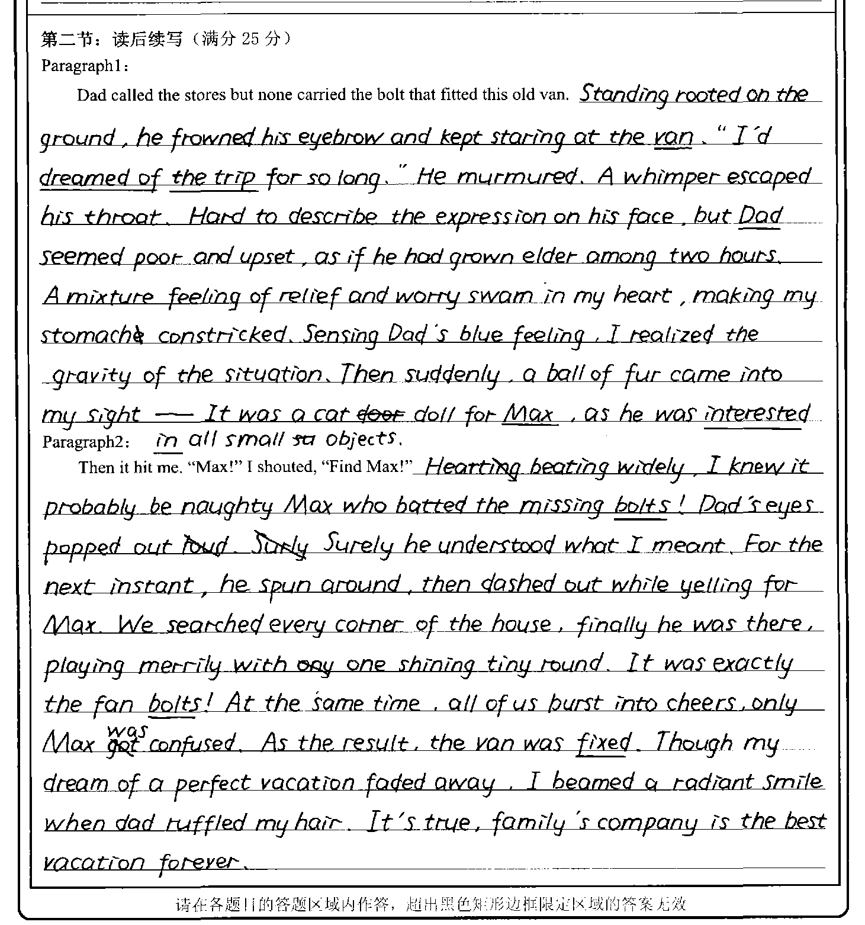
本篇文章的词汇较有特色：rooted, frown, murmur, swim, pop, burst into, ruffle, radiant。但是whimer 用在这里程度上有稍许过了，不适合形容一个坚强的父亲。constrick应该是constrict

Slide 12
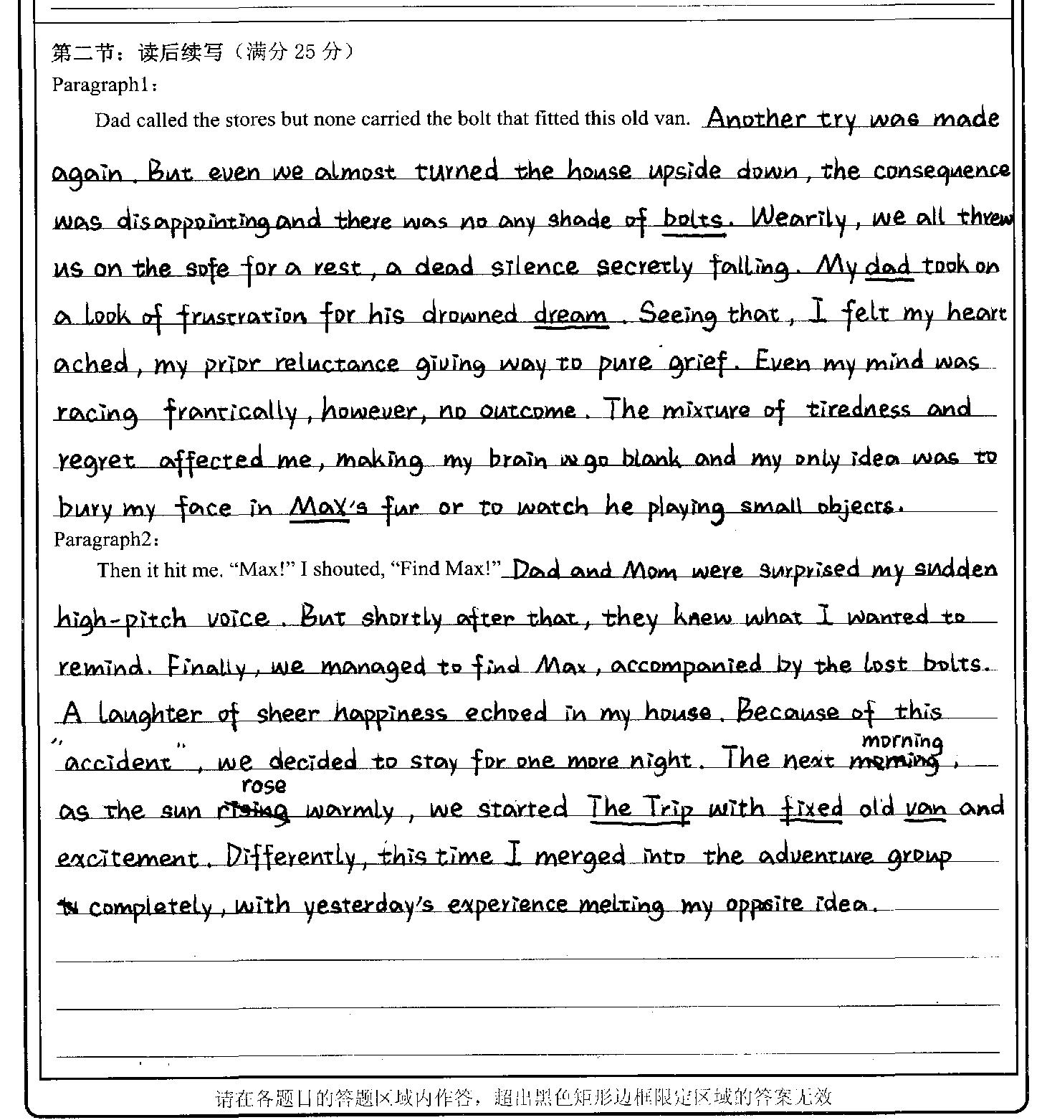
该篇习作紧扣话题，描写自然,能巧妙的运用一些句型和高级词汇 。与所给短文融洽度高，与所给各段落开头语衔接合理。文章结尾与文本内容、文体呼应。但是字体欠缺优美。
him

Slide 13
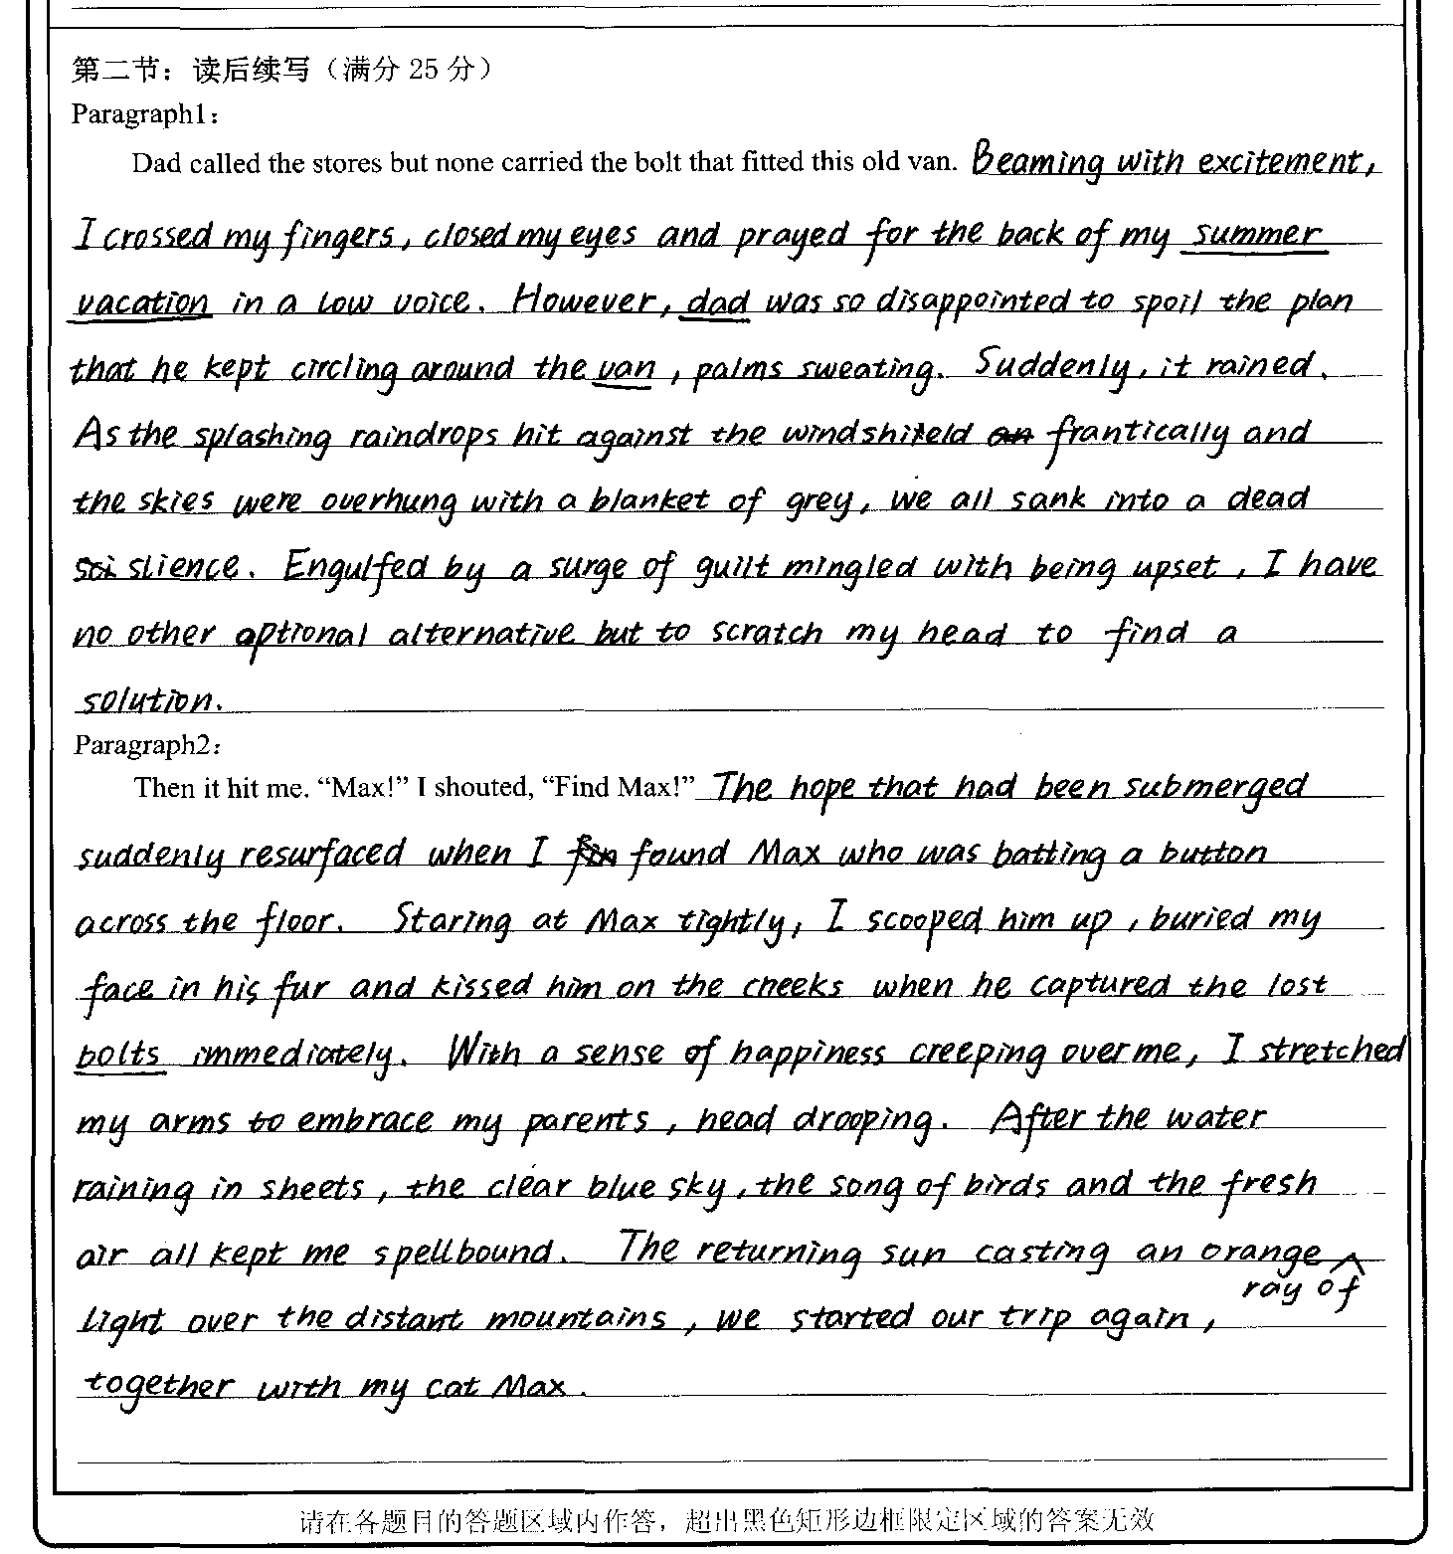
1. 该篇习作使用了较多的高级词汇，句型也很丰富，但是情节跳跃太快。前秒还是眉开眼笑，暗自祈祷，后一秒就因为一场大雨而内疚了。这样的情绪变化有点太牵强。
2. 第一段的最后一句话与第二段段首衔接不够自然。
3. frantically这个词用在这里程度有点大，如此狂风大作的日子怎么出游？
4. 文章结尾“again”使用不合适，旅行根本没开始，谈不上再次出发。

Slide 14
学生好句欣赏：
Exhausted and frustrated, Dad breathed a long sigh of depression and forced a smile.
I could feel the strong sadness hidden behind Dad's simle, which made my heart sink.
With his head drooped, the unexpected situation hit Dad like a bucket of icy water.
Max curled into a ball and pawed the very missing bolt playfully.
With the golden sunshine tracing the outline of the scenery, surges of laughter echoed in the old van.
Pacing restlessly around, I barely knew what I could do to make him feel better.
They all spun around to cast a puzzled look on me.

