Slide 1
感恩遇见，相互成就，本课件资料仅供您个人参考、教学使用，严禁自行在网络传播，违者依知识产权法追究法律责任。
更多教学资源请关注
公众号：溯恩高中英语
知识产权声明

Slide 2
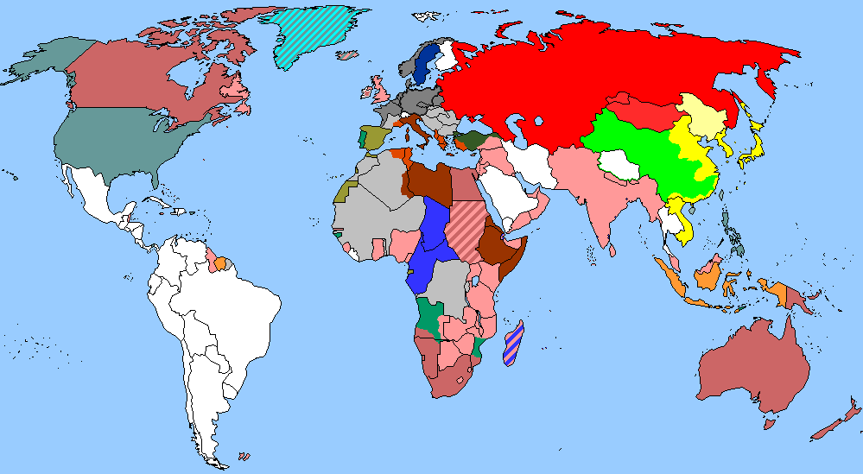
The World
September 1st-15th, 2023

Slide 3
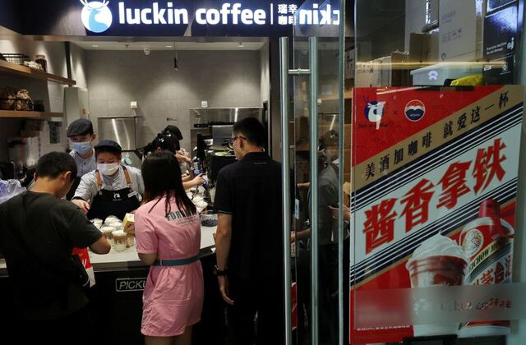
1. China’s Moutai, Luckin launch alcohol-tinged latte to woo young Chinese consumers
“酱香拿铁”刷屏朋友圈
An advertisement promoting a Kweichow Moutai liquor latte is seen at a Luckin Coffee store in Beijing, China, September 4, 2023.

Slide 4
语篇填空
（路透社 2023年9月4日 ）
Kweichow Moutai and coffee brand Luckin Coffee on Monday launched in China a latte _________ (advertise) as containing the fiery Chinese spirit baijiu, as the Chinese luxury liquor maker aims to pull in more younger consumers.
The 38 yuan ($5.23) “sauce-flavoured latte”, which Luckin discounted ___ 19 yuan on the first day of sales, ____ one of the most discussed topics on Chinese social media platform Weibo, with several users ______ (say) they had placed orders. Moutai, known as the national liquor of China, is a potent, colourless spirit that is _______ (usual) served at banquets in China, and drinkers say that the flavour and aroma of Kweichow Moutai’s version are similar to soy sauce. The companies said the latte alcohol content was _____ (low) than 0.5 per cent of its volume.
The launch comes amid a slowing economy and as Kweichow Moutai, ______ alcohol sells at an average market guide price of 1,499 yuan, has been looking for ways to be more _________ (access) and pull in a new generation of users. Chinese social media users posted videos of __________ (them) picking up cups of the drink and being told by sales staff that they should not drive after drinking it. By Monday afternoon in Beijing, the app showed buyers would need to wait for more than ___hour to pick up their drinks, up from the usual few minutes.
advertised
to
was
saying
usually
lower
whose
accessible
themselves
an

Slide 5
词汇讲解
1. luxury: the enjoyment of special and expensive things, particularly food and drink, clothes and surroundings 奢侈的享受；奢华
Now we’ll be able to live in luxury for the rest of our lives. 如今我们可在有生之年过豪华生活了。
2. potent: having a strong effect on your body or mind 有强效的；有力的；烈性的；影响身心的
Crack is a highly potent and addictive derivative of cocaine. 强效纯可卡因是一种药效极强、容易使人上瘾的可卡因制剂。
翻译句子
我们住在一家五星级豪华酒店。
We stayed in a five-star luxury hotel.
翻译句子
这是一种非常强效的药物，可能会有令人不快的副作用。
This is a very potent drug and can have unpleasant side-effects.

Slide 6
句子翻译
Kweichow Moutai and coffee brand Luckin Coffee on Monday launched in China a latte advertised as containing the fiery Chinese spirit baijiu, as the Chinese luxury liquor maker aims to pull in more younger consumers.
贵州茅台和咖啡品牌瑞幸咖啡周一在中国推出了一款含有烈性中国白酒的拿铁，这家中国奢侈白酒制造商旨在吸引更多年轻消费者。
翻译
Moutai, known as the national liquor of China, is a potent, colourless spirit that is usually served at banquets in China, and drinkers say that the flavour and aroma of Kweichow Moutai’s version are similar to soy sauce.
茅台被称为中国的国酒，是一种烈性、无色的烈酒，通常在中国的宴会上供应。饮酒者说，贵州茅台的味道和香气与酱油相似。
翻译

Slide 7
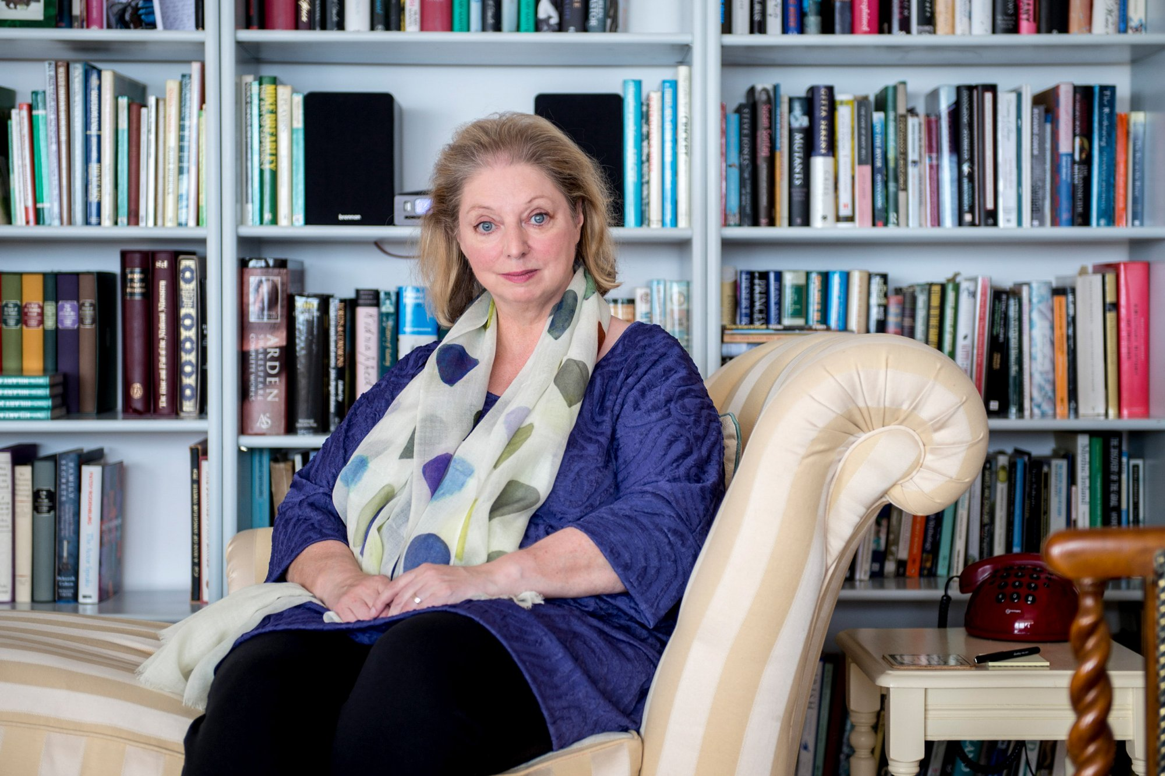
2. Mantel's “final book” to showcase collection of writer's best essays
曼特尔的“最后一本书”展示了作家最好的散文集

Slide 8
语篇填空
（《泰晤士报》 2023年9月7日 11页）
by
A collection of journalistic writing ___ Hilary Mantel is to be published next month, just over a year after the Wolf Hall author’s death.
The new book, A Memoir of My Former Self: A Life in Writing, will feature four decades of Mantel’s work across a range of _______ (subject), from her health struggles as a young woman and her time ______ (live) in Saudi Arabia to themes that fed into her novels, such as revolutionary France and Tudor England.
The collection, ______ publisher John Murray calls Mantel’s “final book”, will be published ____19 October. The author’s 2017 Reith Lectures - which explored the process of art bringing history and the dead back to life - will be published in one place for the first time.“This provocative, intimate and often hilarious collection of Hilary’s best pieces ______ (show) one of our great essayists writing with startling _________ (precise) across a huge spectrum of topics, from the deeply ________ (person) to the sublime and the absurd,” said Mantel’s agent, Bill Hamilton. “It is full of memorable delights and gives ___ (we) a grand stand view of the life and career of ___ outstanding writer.”
subjects
living
which
on
shows
precision
personal
us
an

Slide 9
词汇讲解
1. spectrum: a complete or wide range of related qualities, ideas, etc. 范围；各层次；系列；幅度
We shall hear views from across the political spectrum. 我们要听取各个政治派别的看法。
2. sublime: something that is sublime 崇高的事物；壮丽的景象；绝妙的东西
He transforms the most ordinary subject into the sublime. 他把最普通的主题变得崇高。
翻译句子
会上代表了各种各样的意见。
A wide spectrum of opinion was represented at the meeting.
翻译句子
展出的作品从主流到崇高都有。
The works on display range from the mainstream to the sublime.

Slide 10
句子翻译
The new book, A Memoir of My Former Self: A Life in Writing, will feature four decades of Mantel’s work across a range of subjects, from her health struggles as a young woman and her time living in Saudi Arabia to themes that fed into her novels, such as revolutionary France and Tudor England.
新书《我以前的自我回忆录:写作生涯》将收录曼特尔四十年来的作品，涵盖一系列主题，从她年轻时的健康斗争，到她在沙特阿拉伯的生活，再到她小说中的主题，比如大革命的法国和都铎王朝的英国。
翻译
“This provocative, intimate and often hilarious collection of Hilary’s best pieces shows one of our great essayists writing with startling precision across a huge spectrum of topics, from the deeply personal to the sublime and the absurd,” said Mantel’s agent, Bill Hamilton.
曼特尔的经纪人比尔·汉密尔顿说: “这本引人入胜、亲密无间、常常令人捧腹的希拉里最佳散文集展示了我们伟大的散文家之一，她以惊人的精准度，涵盖了广泛的主题，从深刻的个人话题到崇高和荒谬的话题。”
翻译

Slide 11
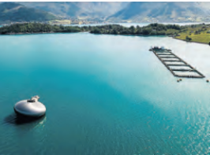
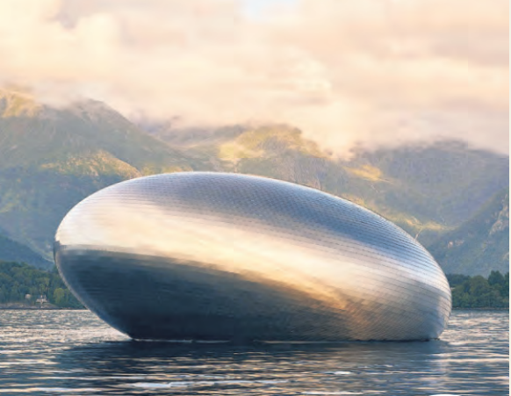
3. 2,000 in queue for fjord fine dining
2000人排队为享用峡湾美食

Slide 12
语篇填空
（《泰晤士报》2023年9月2日 39页）
Noma, Redzepi’s Copenhagen restaurant, had been heralded as the world’s greatest and charged £453 for a dish of pinecones and reindeer.
Now other culinary experts ___________(step) in to the gap left in Denmark’s high-end food market. Among them is Anika Madsen, a Danish chef, _______ 18-course, 6-hourdining experience is set inside the Salmon Eye, a steel-plated ________ (float) art installation, where the restaurant serves a maximum of 24 guests a night.
“We did not expect the bookings would go so crazy ____ lots of people would want to come,”Madsen said.
Madsen, who used to visit the Norwegian fjords on childhood ________ (holiday), created the “hyper-local” menu to raise __________ (aware) about sustainable food practices. Like Redzepi, she is determined ___________ (showcase) the best of Nordic cuisine. “I _________ (definite) hope they[diners] take away more than a really nice dinner,” she said. “Flavour is always first but we have dishes that poke the consciousness, that can be ___________(challenge) for them to eat.”
The evening starts with a multisensory experience on the underwater level of the Salmon Eye, _______ (create) by Eide Fjordbruk, a carbon-neutral salmon farmer.
are stepping
whose
floating
and
holidays
awareness
to showcase
definitely
challenging
created

Slide 13
熟词生义
1. herald: ~ sb/sth (as sth)[ often passive] to say in public that sb/sth is good or important 宣布（好或重要）
The report is being heralded as a blueprint for the future of transport.
这份报告被宣称是未来运输的蓝图。
2. poke: to push sth somewhere or move it in a particular direction with a small quick movement 推；捅；戳；探
He poked his head around the corner to check that nobody was coming.
他从转角处探出头来，查看有没有人过来。
翻译句子
珍妮特·杰克逊的新唱片已在媒体上进行了大规模的宣传。
Janet Jackson’s new album has been heralded by a massive media campaign.
翻译句子
有人从门底下塞进了一张纸条。
Someone had poked a message under the door.

Slide 14
句子翻译
Among them is Anika Madsen, a Danish chef ,whose 18-course, 6-hourdining experience is set inside the Salmon Eye, a steel-plated floating art installation, where the restaurant serves a maximum of 24 guests a night.
翻译
其中包括丹麦厨师安妮卡·马德森(Anika Madsen)，他的18道菜、6个小时的用餐体验是在镀钢的漂浮艺术装置“鲑鱼眼”(Salmon Eye)内进行的，餐厅每晚最多可接待24位客人。
“I definitely hope they [diners] take away more than a really nice dinner,” she said. “Flavour is always first but we have dishes that poke the consciousness, that can be challenging for them to eat.”
翻译
“我当然希望他们(食客)带走的不仅仅是一顿美味的晚餐，”她说。“味道永远是第一位的，但我们的菜能触动他们的意识，这对他们来说可能是一个挑战。”

Slide 15
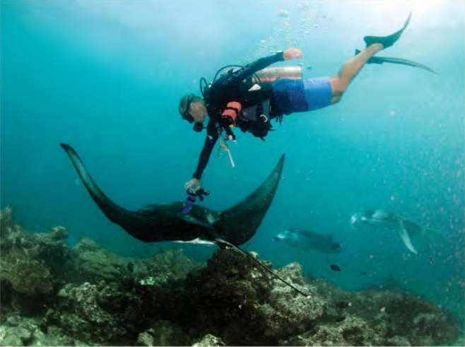
4. Scans Under the Sea 蝠鲼水下超声孕检

Slide 16
语篇填空
（《国家地理》2023年9月刊 BREAKTHROUGHS版面）
Near the end of her 12- to 13-month gestation, a pregnant reef manta ray sports an _________ (impress) bulge: The fetus folded up in her womb has ___ wingspan of almost five feet at full term. ____ in a reef manta (Mobula alfredi), pregnancy doesn’t become _________ (outward) visible until around halfway through gestation —so a group of scientists in the Maldives used contactless underwater sonograms to study the rays’ pregnancy and ________ (mature) states. Their findings, recently _________ (publish) in the Journal of Fish Biology, were “alarming,” says lead author Niv Froman of the Manta Trust. After ultrasounds definitively showed which of the female reef mantas were reproductively mature versus immature, ___ seemed clear that scientists had underestimated the number that were mature—and likely capable of bearing pups. The new data suggest the population’s fertility rate ___ (be) lower than earlier estimates, ________ (bring) reef mantas “to an even more vulnerable level than we previously thought,” Froman says. Could a better understanding of the impact of local pressures ___ fertility rates help identify better manta conservation measures?
impressive
a
But
outwardly
maturity
published
it
is
bringing
on

Slide 17
熟词生义
1. sport: to have or wear sth in a proud way 得意地穿戴；夸示；故意显示
He was heavily-built and sported a red moustache.
他身材魁梧，留着红色的八字胡。
2. term: the end of a particular period of time, especially one for which an agreement, etc. lasts 到期；期满
That makes her the first TV presenter to work the full term of her pregnancy.
那样，她就成了首个怀孕期间一直上班的电视节目主持人。
翻译句子
她穿了一件带有公司徽标 (logo) 的T恤衫。
She was sporting a T-shirt with the company’s logo on it.
翻译句子
贷款期限已经延长了。
The term of the loan has been extended.

Slide 18
句子翻译
But in a reef manta, pregnancy doesn’t become outwardly visible until around halfway through gestation —so a group of scientists in the Maldives used contactless underwater sonograms to study the rays’ pregnancy and maturity states.
翻译
但是礁蝠鲼只有到孕期的一半时间左右才会显现怀孕状态，所以马尔代夫的一组科学家使用非接触式水下超声波来研究蝠鲼的怀孕和成熟状态。
After ultrasounds definitively showed which of the female reef mantas were reproductively mature versus immature, it seemed clear that scientists had underestimated the number that were mature—and likely capable of bearing pups.
翻译
在超声波明确地显示出哪些雌性礁蝠鲼是生殖成熟的，哪些是不成熟的之后，似乎很明显，科学家们低估了成熟并且可能有能力生育幼崽的礁蝠鲼的数量。

Slide 19
5. BBC News 09/06/2023

Slide 20
听力填空
A Japanese man ____________ in court to starting a fire at an animation studio that killed 36 people. Shinji Aoba carried out the attack in Kyoto four years ago because he believed the firm _________________.
Leaders of Southeast Asian countries are in Indonesia for a summit which they hope will help to resolve _________________ in Myanmar. The regional bloc ASEAN came up with a __________ after the Burmese military took power two years ago but it has been _____________ by the army generals.
India has rejected comments by UN experts on the ___________________ in the state of Manipur, describing them as “unwarranted and __________”. The experts said they were _______ by reports of serious violations and abuses, including sexual violence and extrajudicial killings during ethnic unrest. The Indian government claimed the situation in the northeastern state was peaceful. More than 160 people have been killed since May due to ______ between ethnic, Meiteis, and __________ Kuki communities.
has admitted
had stolen his ideas
the political turmoil
peace plan
largely ignored
human rights situation
misleading
alarmed
clashes
indigenous

Slide 21
词汇讲解
1. turmoil: a state of great anxiety and confusion 动乱；骚动；混乱；焦虑
His statement threw the court into turmoil.
他的陈述使得法庭陷入一片混乱。
2. unwarranted: not reasonable or necessary; not appropriate
不合理的；不必要的；无正当理由的；不适当的
He accused the police of using unwarranted brutality.
他指控警方无端施暴。
翻译句子
她心乱如麻。
Her mind was in (a) turmoil.
翻译句子
这种批评基本上是毫无道理的。
Much of the criticism was totally unwarrented.

Slide 22
句子翻译
A Japanese man has admitted in court to starting a fire at an animation studio that killed 36 people. Shinji Aoba carried out the attack in Kyoto four years ago because he believed the firm had stolen his ideas.
翻译
一名日本男子在法庭上承认在一家动画工作室纵火，造成36人死亡。Shinji Aoba四年前在京都发动了这次袭击，因为他认为该公司窃取了他的创意。
Leaders of Southeast Asian countries are in Indonesia for a summit which they hope will help to resolve the political turmoil in Myanmar. The regional bloc ASEAN came up with a peace plan after the Burmese military took power two years ago but it has been largely ignored by the army generals.
翻译
东南亚国家领导人正在印度尼西亚参加峰会，他们希望这将有助于解决缅甸的政治动荡。两年前缅甸军方掌权后，地区集团东盟提出了一项和平计划，但基本上被军方将领忽视。

