Slide 1

感恩遇见，相互成就，本课件资料仅供您个人参考、教学使用，严禁自行在网络传播，违者依知识产权法追究法律责任。
更多教学资源请关注
公众号：溯恩高中英语
知识产权声明

Slide 2

2022
五年高考三年模拟
之习语、谚语

Slide 3
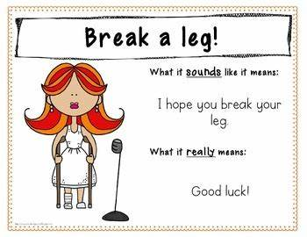
高考一贯注重习语，俚语，谚语等英文素养的培养。

Slide 4

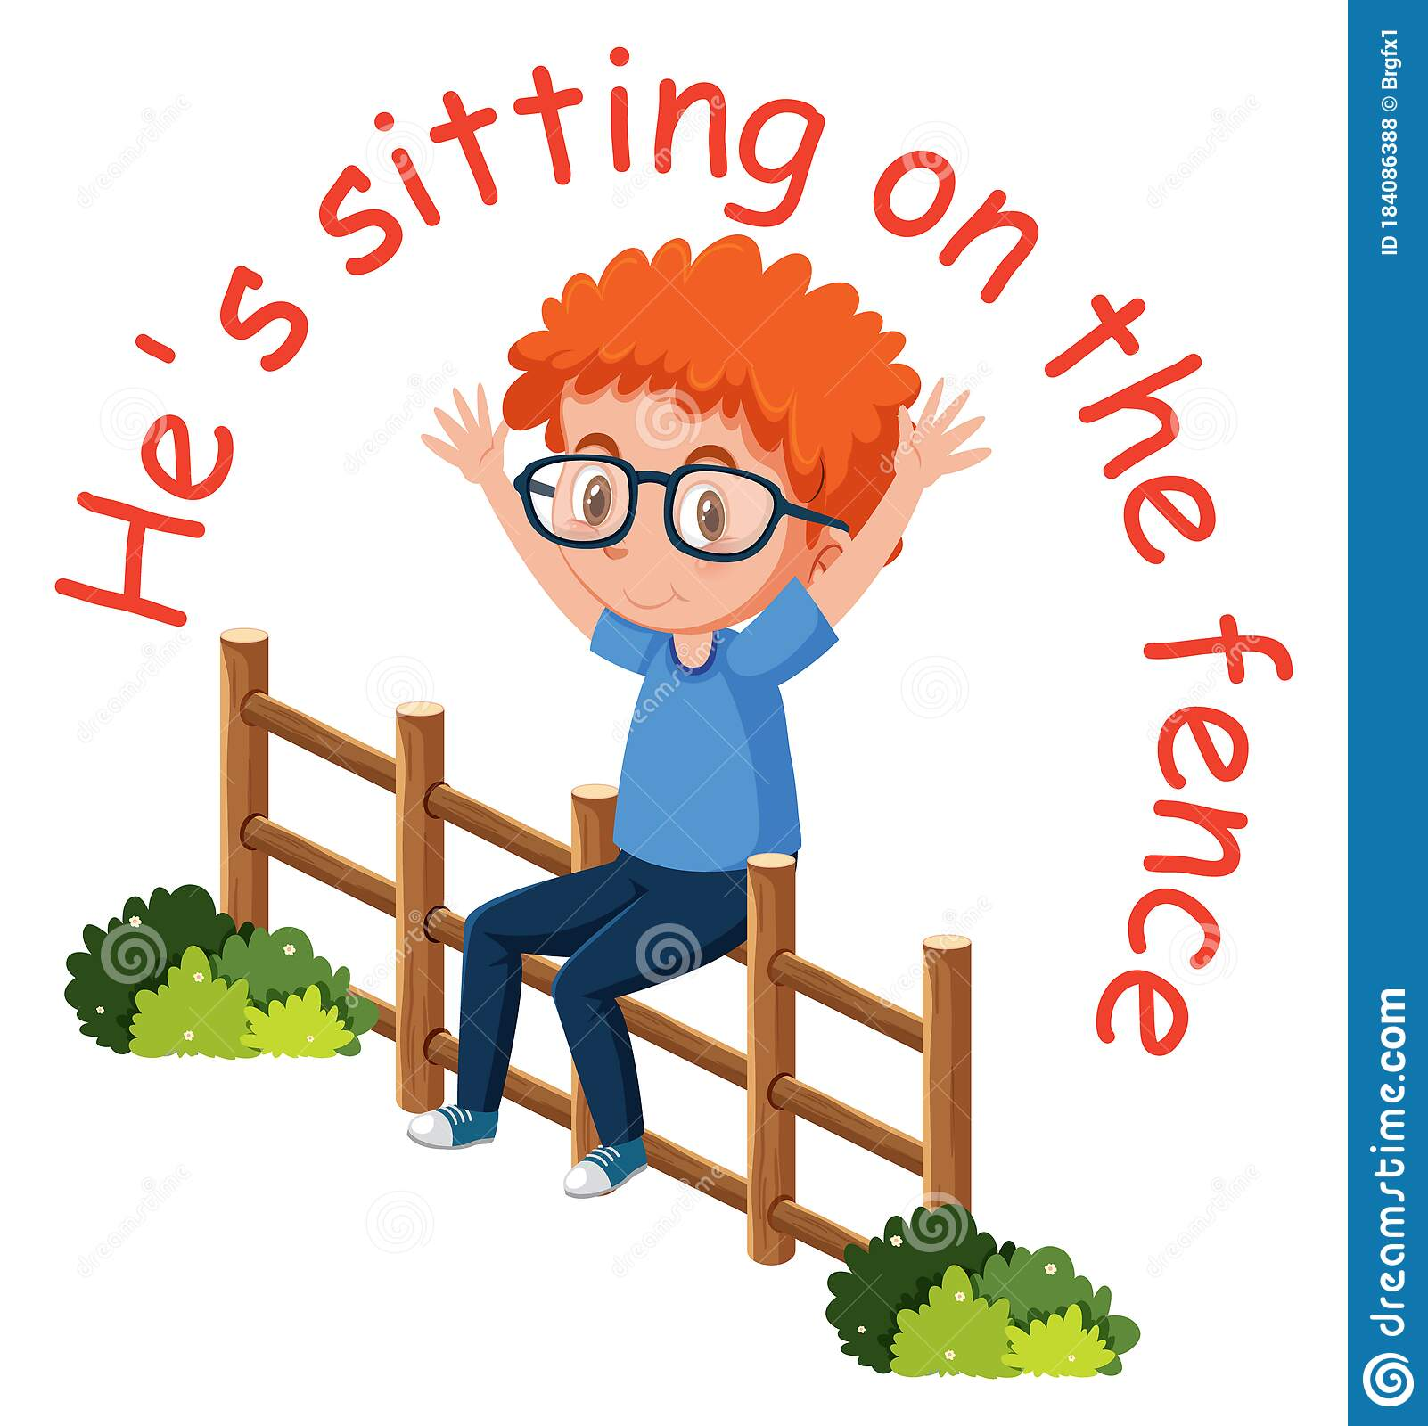
What is an idiom?
01
An idiom is an expression whose meaning cannot be understood based on the definition of its constitutional elements.

Slide 5


2019年6月浙江卷
(完形填空)As you can imagine, the trip is no piece of cake.
轻而易举的事；小菜一碟

Slide 6
2019年6月全国3卷
(阅读B篇)Vera Wang, Alexander Wang, Jason Wu are taking on Galliano, Albaz, Marc Jacobs — and beating them hands down in design and sales.
不费力打败
(阅读C篇)It took a few youthful and daring businessmen to get the ball rolling.
开始某事

Slide 7
2019年6月全国2卷
(2019全国2卷B篇)The coach is able to focus on the kids while the other parents are relieved to be off the hook for another season.
摆脱困境

Slide 8

2020年山西八校第一次联考
Getting caffeine about three to four hours after you get out of bed will do the trick, too.
取得想要的成果，获得成功的窍门

Slide 9
2019年安徽省百所重点中学三模
She was relieved that we could get something arranged for her and liked the fact that we managed to get the ball rolling during her visit.
开始某种行动

Slide 10
2020年山西八校第一次联考
At those times in the day, your body is low on cortisol 皮质醇）--the stress hormone that makes you think quickly—and desperately needs a good pick-me-up.
提神的饮品；提神的东西

Slide 11
Welcome to one of the largest collections of footwear (鞋类) in the world that will make you green with envy.
be green with envy 意为：嫉妒；眼红
Buy time by repeating the question in your own words.
赢得时间；拖延时间

Slide 12
2022年金考卷押题卷
What does the writer mean by saying
“Responsibility is the name of the game”?
最重要的部分；较为重要的事情 (非正式用语)

Slide 13
2022年金考卷押题卷
Maybe you’re an experienced romance reader, or maybe you’re just getting your feet wet in this type of literature.
初次涉足，开始做（新鲜的事）

Slide 14
蕴含有趣背景故事的词语搭配和习语
1. Let your hair down and just take it as a chat.
A. 认真些 B. 放开些 C. 努力些
答案：B
句意：放轻松一些，就当是聊天好了。let your hair down 意为：放开些；彻底放松。17世纪时期，英国女性多留长发，她们外出参加活动的时候，习惯盘起头发，做出各种造型，晚上回到家取下发夹，把头发放下来，让它随意的披在肩上。放下头发这种行为就叫做let one’s hair down。由于它体现了一种回到家不用再顾及形象的放松姿态，英语里面就引申为“卸下包袱，彻底放松”。

Slide 15
2022年金考卷押题卷
Right now, I could eat a horse! I haven’t had anything all day.
狼吞虎咽

Slide 16
2. John studies day in and day out, so after every exam, he comes off with flying colors.
A. 速战速决地 B. 头昏眼花地 C. 成绩优异地
答案：C
句意：约翰日夜勤读，所以每次考试，他的成绩都非常出色。flying colors 是由pass with flying colors演变而来。pass with flying colors表示“有广泛回旋余地的成功或胜利”。其中colors指在桅杆上飘扬的海军军旗或三角旗。当一艘战舰和敌舰进行遭遇战胜出以后，该舰的军旗仍然迎风飘扬，这说明该舰没有受到严重的创伤，即获得完全的胜利。

Slide 17
3. An honest, hard-working man is the salt of the earth.
A. 社会的中坚分子 B. 社会的知识分子 C. 社会的敌对分子
答案：A
句意：诚实而勤劳的人才是社会的中坚分子。the salt of the earth 意为：高尚的人；社会的中坚分子。该词块典故出自《圣经》，耶稣对他的门徒说：“Ye are the salt of the earth: but if the salt have lost its flavor, wherewith shall it be salted?”（你们是世上的盐，盐若失了味，如何才能再咸呢？）在这里，salt转义为elite [ɪˈliːt] of the world（中坚力量，精英，高尚的人）。

Slide 18
4. The hospital staff pulled out all the stops to make sure the children had a wonderful day.
A. 集思广益 B. 别出心裁 C. 竭尽全力
答案：C
句意：医院员工竭尽全力来确保孩子们能过上愉快的一天。pull out all the stops 意为：竭尽全力；全力以赴。这里的stops指管风琴上的圆纽，用来控制琴上的那些笛管是否奏乐。按下stops，笛管就停止奏乐，而演奏者得拔起他要用的笛管上的stops，让气流进入，才能奏出他需要的乐声。所以如果演奏者pull out all the stops，那么这架管风琴上所有的笛管就是在齐声共鸣了。

Slide 19
5. He is too young to separate the sheep from the goats.
A. 做出决策 B. 承担重任 C. 明辨是非
答案：C
句意：他太年轻，无法明辨是非。separate the sheep from the goats 意为：辨明好坏；明辨是非。由于《圣经》的影响，sheep和goat在英语中的形象截然不同，前者比喻好人，后者比喻坏人。英语中有关goat的成语，大多贬义。例如：act/play the goat表示做蠢事。

Slide 20
6. Simon has just left school and is still wet behind the ears.
A. 毫无经验 B. 碌碌无为 C. 年轻气盛
答案：A
句意：西蒙刚从学校毕业，现在还没什么经验呢。据说这个习语源于胎生动物，如牛、羊刚生下来的时候全身湿漉漉的，虽然它们的身体很快就干了，但是耳朵背后却还是湿的。因此，它的真正含义是“乳臭未干，初出茅庐”，形容年轻人“少不更事，缺乏经验”。

Slide 21
7. Her room is always at sixes and sevens.
A. 五颜六色 B. 乱七八糟 C. 千奇百怪
答案：B
句意：她的房间总是乱七八糟的。at sixes and sevens 意为：乱七八糟；杂乱无章。据说sixes and sevens最早出现在14世纪，是一种叫做“hazard”的掷骰游戏。“five and six”被改成了“six and seven”，因为7这个数字根本不可能被掷出来，所以它的意思变成了“不惜冒一切风险”。直到17世纪中期，意思发生了变化，多指处于一种很混乱的状态。

Slide 22
8. After singing all night at home, I had a frog in the throat next morning.
A. 咽喉发炎 B. 声音嘶哑 C. 名声大噪
答案：B
句意：在家里唱了一整夜的歌，第二天早晨我的嗓子有点嘶哑了。have a frog in your throat 意为：(因喉咙干或想咳嗽而) 说话困难；声音嘶哑。关于这个短语的由来，有两种说法。一种是据说以前人们常从小溪中直接取水饮用，可能无意中将青蛙的卵吞进肚子。当时人们相信，卵会在人们的喉咙里化成青蛙，哽住你的喉咙，使你说不出话来。另一种说法是说人在嗓子不舒服时，发出的声音沙哑比较像青蛙。

Slide 23
意思表达非常形象的词语搭配和习语
9. He lives only a stone’s throw from here.
A. 一墙之隔 B. 一步之遥 C. 荒山野岭
10. Rose can be a real challenge to look after at home, even for people with green fingers.
丰富经验 B. 种植新手 C. 园艺技术
答案：B
句意：他住的地方离这里一步之遥。a stone’s throw 意为：很短的距离；一步之遥。
答案：C
句意：在家种养玫瑰花可是件充满挑战的事情，即使对园艺技术高手来说也一样。green fingers 意为：园艺技术；种植技能。

Slide 24
11. I’m a small potato. No one will listen to me.
A. 打工仔 B. 小人物 C. 志愿者
答案：B
句意：我只是个微不足道的小人物，没有人会听我的。small potato 原意是“鸡毛蒜皮等微不足道的东西”，但现在大家较常用它指“小人物、微不足道的人”。
12. As kids we used to fight like cat and dog.
A. 活蹦乱跳 B. 嬉戏玩耍 C. 大吵大闹
答案：C
句意：小时候，我们总是吵吵闹闹。fight like cat and dog 形容“人与人之间的争吵非常激烈、吵得不可开交”。意为：大吵大闹；争吵不休。

Slide 25
13. I’m wearing two hats tonight — parent and teacher.
A. 身兼两职 B. 进退两难 C. 一举两得
答案：A
句意：我今晚身兼两职——既是家长又是老师。wear two hats意为：身兼两职，也就是同时做两份工作或者完成两个任务。
14. The others had complained that Sarah wasn’t pulling her weight.
A. 尽职工作 B. 控制情绪 C. 增加体重
答案：A
句意：其他人抱怨说莎拉没尽职尽责。pull sb’s weight 意为：做好自己的份内事；做好自己的本职工作。

Slide 26
15. Getting him to do his homework is like pulling teeth.
A. 勉强的 B. 复杂的 C. 艰难的
16. I haven’t won, have I? You’re pulling my leg.
A. 拖后腿 B. 开玩笑 C. 马后炮
答案：C
句意：让他做家庭作业真艰难。like pulling teeth 意为：艰难的。
答案：B
句意：我没有赢，是吗？你在开我的玩笑。pull sb’s leg 意为：开某人的玩笑；愚弄某人；哄骗某人。

Slide 27
17. She always turned her term papers in at the eleventh hour.
A. 最后时刻 B. 十一点钟 C. 关键时刻
18. I’d love to stay longer but I must be hitting the road.
A. 潜逃 B. 离开 C. 消失
答案：A
句意：她总是赶在最后时刻交学期论文。the eleventh hour 意为：最后一刻；最后时刻。
答案：B
句意：我很想多留一段时间，但我必须要走了。hit the road 意为：离开；出发。hit使用非常灵活。hit the books意为“学习，做功课”；hit the shops / streets意为“（产品）大量上市”；hit the big time / hit it big意为“突然成名”。

Slide 28
19. I would rather have my nose in a book than playing with other kids outside.
A. 埋头读书 B. 闭门思过 C. 默不作声
20. The strength of an individual, as compared with that of the masses, is but a drop in the ocean.
A. 沧海桑田 B. 滴水之恩 C. 沧海一粟
答案：A
句意：我更喜欢自己埋头读书，而不是和其他小孩一起在外面玩耍。have nose in a book 意为：埋头读书；专心看书。
答案：C
句意：个人的力量和群众的力量相比，不过是沧海一粟。a drop in the ocean 意为：沧海一粟；杯水车薪。

Slide 29
21. I think I’m in deep water with this course — I don’t know how I’ll be able to catch up with all the work!
A. 陷入困境 B. 无法自拔 C. 身心疲惫
答案：A
句意：我觉得我在这门课程中陷入了困境——我不知道怎么才能赶上所有工作。in deep water 意为：陷入困境。
22. Her marriage is in hot water and she’s desperately unhappy.
A. 陷入困境 B. 一败涂地 C. 名存实亡
答案：A
句意：她的婚姻陷入困境，她为此非常郁闷。in hot water 意为：陷入困境；惹上麻烦。常用来指 to be in or get into trouble，也就是“遇到麻烦，处于水深火热之中”的意思。

Slide 30
23. The business is in trouble, but we are just about keeping our heads above water.
A. 停顿整改 B. 宣告破产 C. 勉强应付
答案：C
句意：公司遇到一些问题，但我们还是得勉强应付下去。keep your head above water (尤指财务上) 勉强应付过去；惨淡经营。

Slide 31
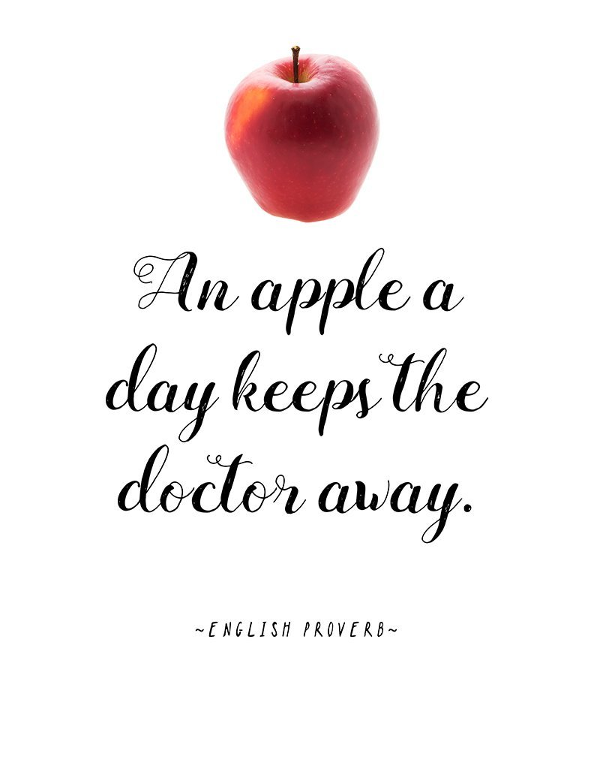
What is a proverb?
01
A proverb is a well-known phrase or sentence that gives advice or says sth that is generally true, for example “waste not, want not.”

Slide 32
2021年6月浙江卷
23. What does Nielsen's career story tell us?
A. Art is long, life is short. B. He who laughs last laughs longest.
C. It's never too late to learn. D. Where there's a will there's a way.
这道题出的就是用谚语来概括全文。
A.人生短暂,艺术长存。B.谁笑到最后谁笑到最好。C. 现在学习永远不会太晚。D. 有志者事竟成。
根据全篇是艺术家的演绎生涯，干扰项是A，但根据文章结构，是分总的结构，最后一段He showed us that even a single desire, never give up on, can make for a remarkable life. 他向我们表明，即使是一种从未放弃的渴望，也能创造出一种非凡的生活。突出莱斯利·尼尔森本来天赋平平（第一段有讲）到不断克服困难，不断学习，最终获得成功。因此选择D。

Slide 33
2020年7月浙江卷
27.What can we learn from Bellevue’s success?
A. It is rewarding to try new things. B. The old methods still work today.
C. It pays to put theory into practice. D.The simplest way is the best way.
从原文得知，对应信号灯的转变是一个在欢迎新方法的价值方面的榜样。
从bellevue的成功中可以得出，尝试新事物是值得的。
A. 选项尝试新事物是值得的。
B. 老办法不会过时。
C. 理论付诸实践是有回报的。
D. 最简单的办法就是最好的办法。

Slide 34
2020年1月浙江卷
26. Milwaukee’s new way to de-ice streets may be an example of ______.
A. barking up the wrong tree B. putting the cart before the horse
C. robbing Peter to pay Paul D. killing two birds with one stone
文中讲到inaddition to saving money, cheese brine could also be a more environment-friendly option.可知相比于常用的岩盐，奶酪盐水既可以帮助道路不结冰，同时又很省钱环保，可知密尔沃基市的街道除冰新方法是一个“一石二鸟”的成功例子。故选D
A选项barking up the wrong tree 指某人找错对象。
B选项 putting the cart before the horse意为本末倒置
C选项robbing Peter to pay Paul 意为拆东墙补西墙

Slide 35
2016年6月浙江卷
60.What is the life lesson the author learned from her mother?
A .Save money for a rainy day.
B. Good advice is beyond all price.
C. Earn your bread with your sweat.
D. God helps those who help themselves.
这是一道主旨大意题。
根据文章内容可知，作者的妈妈教育作者要通过自己的努力获得想要的东西，也就是Earn your bread with your sweat，故选 C。

Slide 36
2020年全国新高考卷
What can we learn from Jennifer’s story?
A. Time is money.
B.Love breaks down barriers.
C. Hard work pays off.
D. Education is the key to success.
这是一道推理判断题。
通读全文，特别是最后一段可以得知，Jennifer 有坚强的毅力,通过自己的努力克服困难，不仅以优异的成绩毕业，还给孩子树立了榜样，同时也激励了家人。由此推测，我们可以从 Jennifer 的故事中学到C项Hard work pays off(付出总有回报)。

Slide 37
2020年7月天津卷
What message does the story convey?
A. A strong-willed soul can reach his goal.
B. Experience helps to promote excellence.
C .Ups and downs make one strong.
D .Devotion requires enthusiasm.
这是一道主旨大意题。
本文讲述了一名叫温妮·雷姆的小女孩用自己的毅力和智慧得到了给总统做雕像的机会，因此意志坚强的人可以达到目的，A.Astrong-willed soul can reach hisgoal意志坚强的人可以达到目的；B. Experience helps to promote excellence经验有助于提升卓越；C.Ups and downs make one strong跌宕使人坚强;D.Devotion requires enthusiasm奉献需要热情，故选A.

Slide 38
2020年6月海南卷
"Success is success but that is all that it is"Dr. Pc troski writes. It is failure that brin gs improvement.
30. What does the last paragraph suggest?
A. Failure can lead to progress.
B. Success results in overconfidence.
C. Failure should be avoided.
D. Success comes from joint efforts.
这是一道推理判断题。
本题意图是引导考生关注该书的内容升华部分，讲述灾难故事，能让读者更好地明白成功和失败之间的关系。根据最后一段中的“It is failure that brings improvement.”可知，失败可以促使进步。故选 A项。

Slide 39
2020年石家庄高三摸底考试
The attempt to be perfect is called perfectionism and it’s damaging our emotional and mental health. We strive for perfection with our body,in our perform ance,and in our relationships. In a society that overstates mistakes, is it any wonder that so many young people attempt the impossible task of being perfect?
13.Which of the following is a perfectionist most likely to agree?
A. Be generous with praise.
B. Nobody is perfect.
C.There is no best, only better. 没有最好，只有更好
D.A contented mind is an everlasting feast. 知足常乐
这是一道推理判断题。根据第四段第一句中的“The attempt to be perfect is called perfectionism”可推知，“没有最好，只有更好”是典型的完美主义者的观点，故C项正确。A项“不要吝惜赞美”、D项“知足常乐”均不属于完美主义，故排除。

Slide 40
2022年浙江金考卷押题卷
23. What can we learn from Tadhg O Seighin’s experience?
A .Knowledge starts with practice.
B .Giving is better than receiving.
C .Many hands make light work.
D .One good turn deserves another.
根据最后一段中Tadhg O Seighin说的话 More surprsingly, I felt even more joy than when Dad bought me it.可知选B， Tadgh OSeighin 在送给别人玩具时看到他人高兴，自己甚至比得到这份玩具时还开心。A.实践出真知 B.给予比得到更快乐 C.人多力量大D.善有善报

Slide 41

2016年10月浙江卷
Yes, you can fool everyone else, but you cannot “fool the chickens”, because in the end, you will find out, as the saying goes, “What goes around comes around.”
善有善报恶有恶报
付出就有收获

Slide 42
2018年6月天津卷
But never ever give up on your dream! Never let anyone tell you, “You can’t.” Dream big and climb high.
梦想远大，攀登高峰

Slide 43
2020年廊坊市统一考试
There is a saying that goes,” All roads lead to Rome.”
条条大路通罗马

Slide 44
2021年绍兴4月适应性考试
I was anxious about telling my coach, and I pressed myself with the advice on the dilemma from the mother, “ If you make your bed, you have to lie in it.“
自己造成的结果需要自己来承受。（自作孽不可活）

Slide 45
2022年金考卷押题卷
Life is a practice of improvisation.
生活是一场即兴表演。

Slide 46
补充
（1）Better late than never. 迟做总比不做好。
（2）Easier said than done. 说起来容易做起来难。
（3）Two heads are better than one. 三个臭皮匠顶个诸葛亮。
（4）Actions speak louder than words. 行动比言语更有说服力。
（5）Health is better than wealth. 健康胜于财富。
（6）The sooner begun, the sooner done. 开始越早，完成得越早。
（7）Honesty is the best policy. 诚实总是上策。
（注：以上谚语运用了形容词或副词的比较级、最高级。）

Slide 47
（8）Seeing is believing. 眼见为实。
（9）It is no use crying over spilt milk. 覆水难收。
（打翻牛奶，哭也没用。）
（10）Time lost cannot be recalled. 光阴一去不复返。
（11）One is never too old to learn. 活到老，学到老。
（12）It’s never too late to mend. 改过迁善从不嫌晚。
（亡羊补牢，未为迟也。）
（13）To stand still is to move back. 逆水行舟，不进则退。
（注：以上谚语运用了非谓语动词。）

Slide 48
14）It is the early bird that catches the worm.
早出的鸟儿有虫吃。（疾足者先得。）
（15）It is love that makes the world go round.
爱使世界更美好。
（注：以上谚语运用了强调句型。）

Slide 49
（16）Never put off till tomorrow. 今日事，今日做。
（17）A fall into the pit, a gain in your wit.吃一堑，长一智。
（18）Once bitten, twice shy. 一朝被蛇咬，十年怕井绳。
（19）Out of sight, out of mind. 眼不见，心不想。
（20）No pains, no gains. 不劳无获。
（21）More hasty, less speed. 欲速则不达。

Slide 50
（22）Well begun, half done. 好的开始等于成功的一半。
（23）An idle youth, a needy age. 少壮不努力，老大徒伤悲。
（24）The older, the wiser. 姜是老的辣。
（25）The sooner, the better. 越快越好。
（26）Nothing brave, nothing have. 不入虎穴,焉得虎子。
（注：以上谚语运用了“省略”结构。）

Slide 51
（27）He laughs best who laughs last. 谁笑在最后，谁笑得最好。
（28）God helps those who help themselves. 天助自助者。
（29）He that corrects not small faults will not control great ones.
小错不纠，大错难控。
（注：以上谚语运用了定语从句。）

Slide 52
（30）When in Rome do as the Romans do. 入境问俗。(入乡随俗)
（31）Strike while the iron is hot. 趁热打铁。
（32）Where there’s a will, there’s a way. 有志者事竟成。
（33）If at first you don’t succeed, try, try, try again.
再接再厉，终会成功。
（34）If a thing is worth doing, it’s worth doing well.
凡值得一做的都值得做好。
（35）Don’t trouble trouble until trouble troubles you.
不要自找麻烦。
（36）Look before you leap. 三思而后行。
（37）East or west, home is the best.金窝银窝不如自家草窝。
（注：以上谚语运用了状语从句。）

Slide 53
（38）A friend in need is a friend indeed. 患难见真情。
（39）No news is good news. 没有消息就是好消息。
（40）A bird in the hand is worth two in the bush.
双鸟在林不如一鸟在手。
（41）An hour in the morning is worth two in the evening.
一日之计在于晨。
（42）It never rains but it pours. 不雨则已，一雨倾盆。（祸不单行）
（43）Reading is to the mind what exercise is to the body.
阅读对于我们心灵之重要，犹如运动对于身体一样。
（注：以上谚语运用了对称结构。）

Slide 54
（40）Practice makes perfect. 熟能生巧。
（50）Many hands make light work. 众人搭柴火焰高。
（51）Every minute counts. 分秒必争。
（52）Time and tide wait for no man.. 岁月不待人。
（53）A good beginning makes a good ending. 善始才有善终。
（54）All roads lead to Rome. 条条道路通罗马。
（55）Rome was not built in a day. 罗马不是一天建成的。
（冰冻三尺，非一日之寒。）
（56）Experience is the mother of wisdom. 实践出真知。
（57）Great minds think alike. 英雄所见略同。

Slide 55
（58）Hope for the best and prepare for the worst.
抱最好的希望，作最坏的准备。
（59）A good medicine tastes bitter. 良药苦口。
（60）Every advantage has its disadvantage. 有利必有弊。
（61）One false step will make a great difference. 失之毫厘，谬之千里。
（62）You cannot have your cake and eat it too. 鱼与熊掌,不可得兼。
（63）Birds of a feather flock together. 物以类聚，人以群分。
（64）A journey of a thousand miles begins with a single step.
千里之行始于足下。

