Slide 1


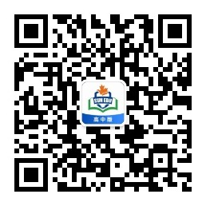
感恩遇见，相互成就，本课件资料仅供您个人参考、教学使用，严禁自行在网络传播，违者依知识产权法追究法律责任。
更多教学资源请关注
公众号：溯恩高中英语
知识产权声明

Slide 2
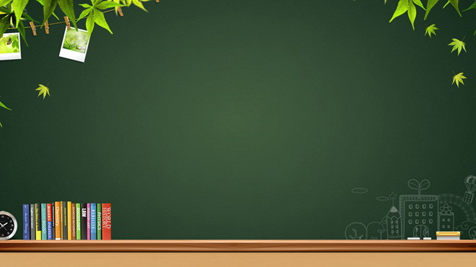

课 题：Grammar--- Subjunctive Mood used in “If- clause”
学 科：英语
区 县：西安市灞桥区
单位名称：西安市东城第一中学
授课教师：常巍

Slide 3
Subjunctive Mood used in “ If-clause”

Slide 4

What is Subjunctive Mood?
Watch a video

Slide 5
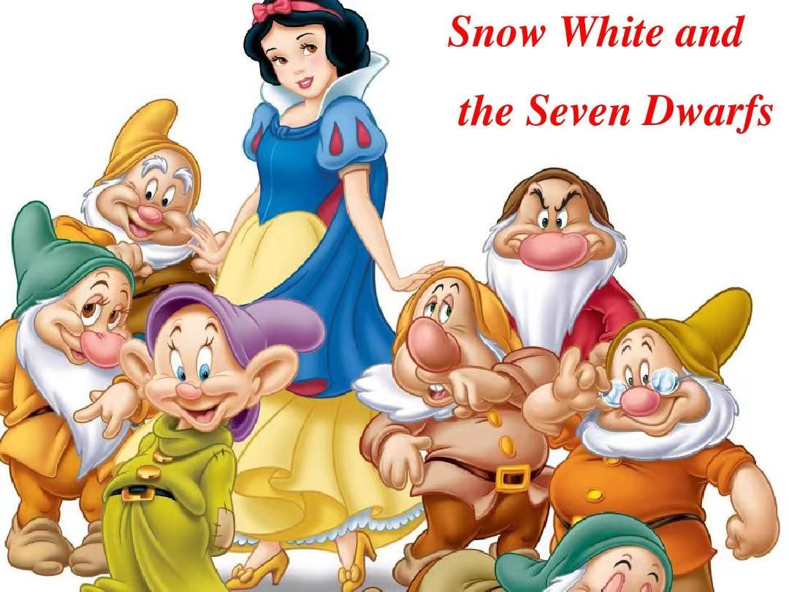

Slide 6


Slide 7
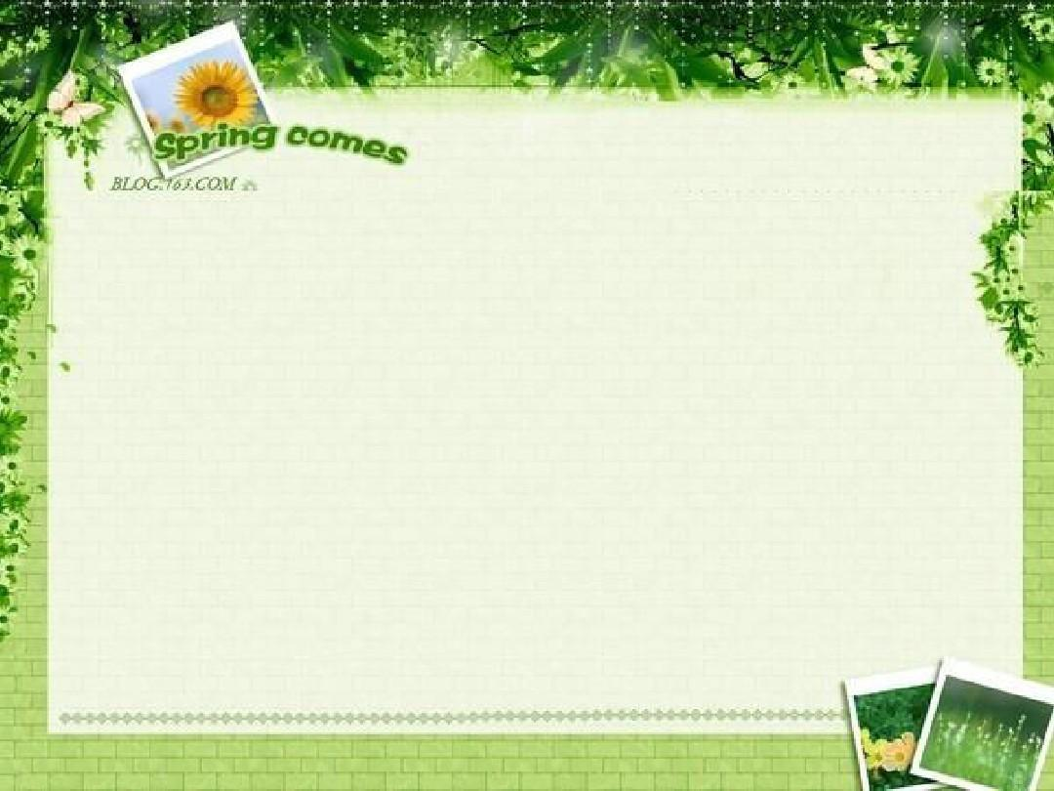
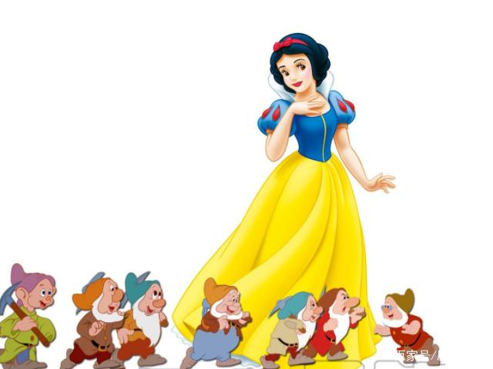
If I were you, I would…
Subjunctive Mood---
the special form of a verb that expresses a wish, possibility, or condition, etc.
Snow White was not the dwarfs. She didn’t listen to them and died at last.
--- the truth

Slide 8

Subjunctive Mood used in “If-clause”
 | If-clause | Main clause
The present situation
The past situation
The future situation

Slide 9


The present situation
What would you do
if you won the lottery?

Slide 10
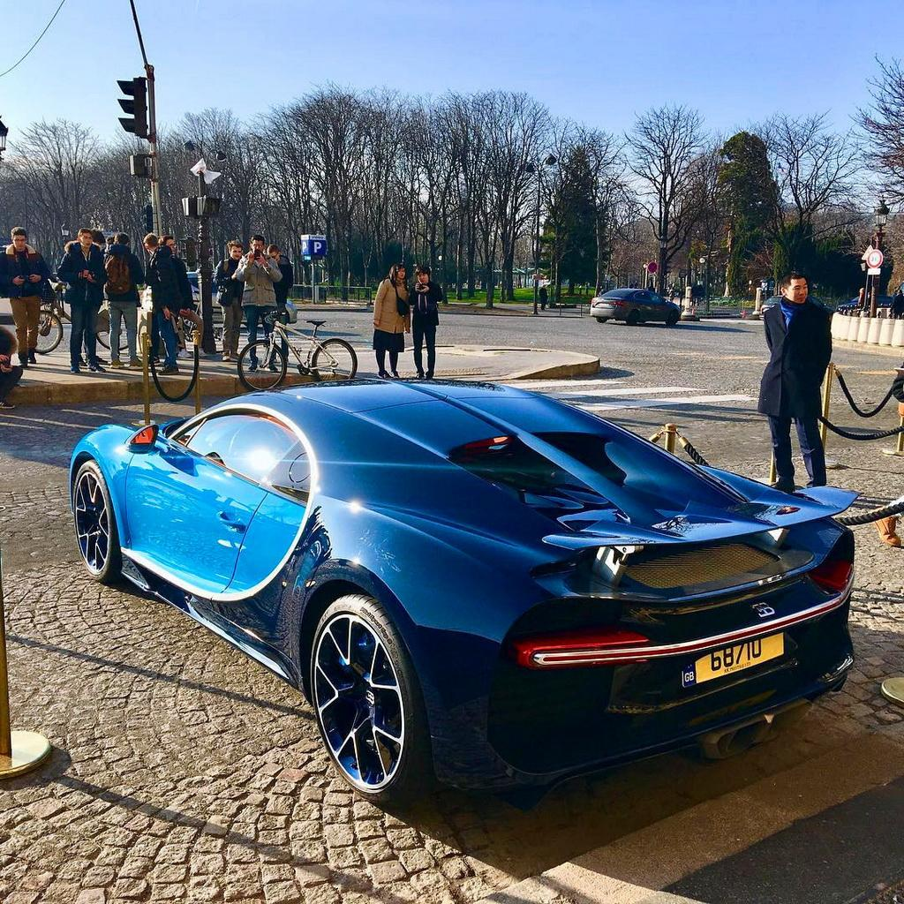
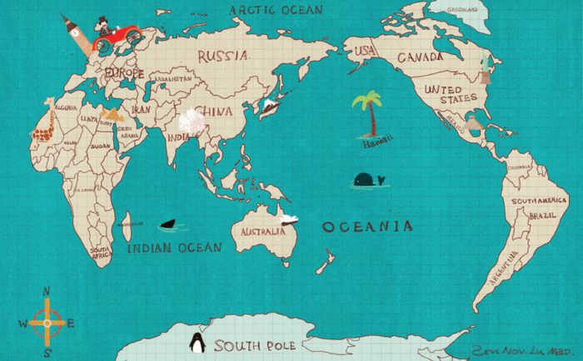
The present situation
If I won the lottery, I would buy a luxury car.
If I had so much money, I might travel around the world.
If I were the one who won the lottery, I could do whatever I want!
 | If-clause | Main clause
The present situation
did/ were
would/might/ could/ should +do

Slide 11
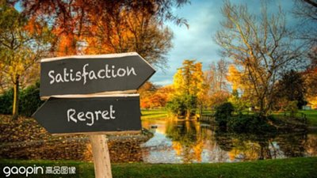
The past situation
What would have happened
if things had gone different?

Slide 12
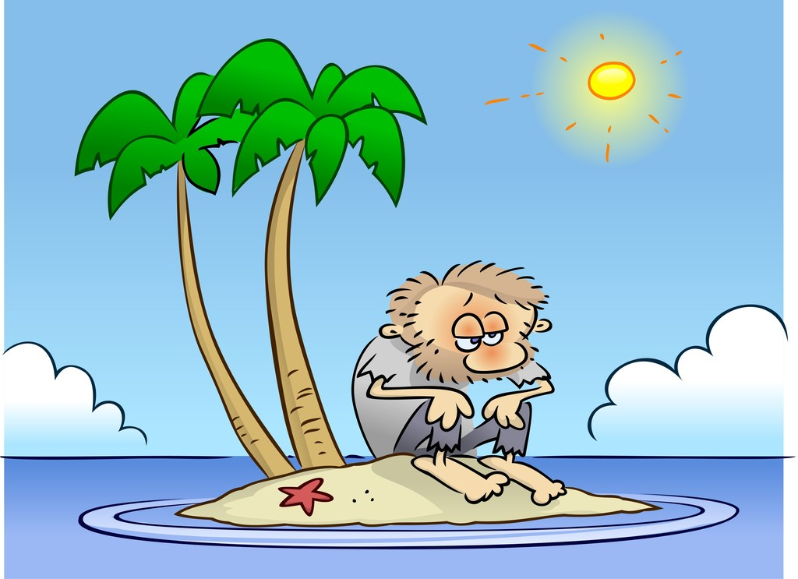
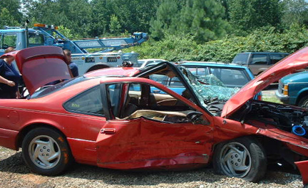
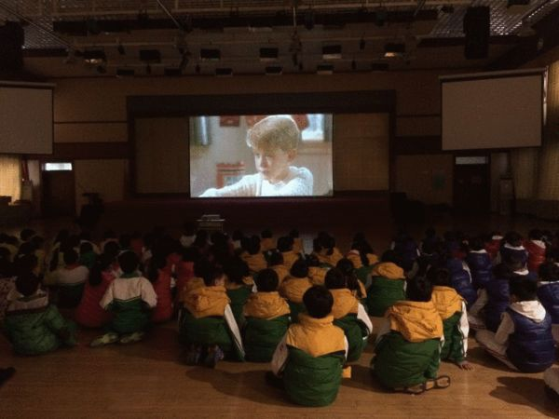
The past situation
If he had driven more carefully, he could not have had the car accident yesterday.
If I had had time last night, I would have gone to see the film with you .
If I had learnt how to swim, I should not have been trapped in this island.
 | If-clause | Main clause
The past situation
had done
would/might/ could/ should + have done

Slide 13
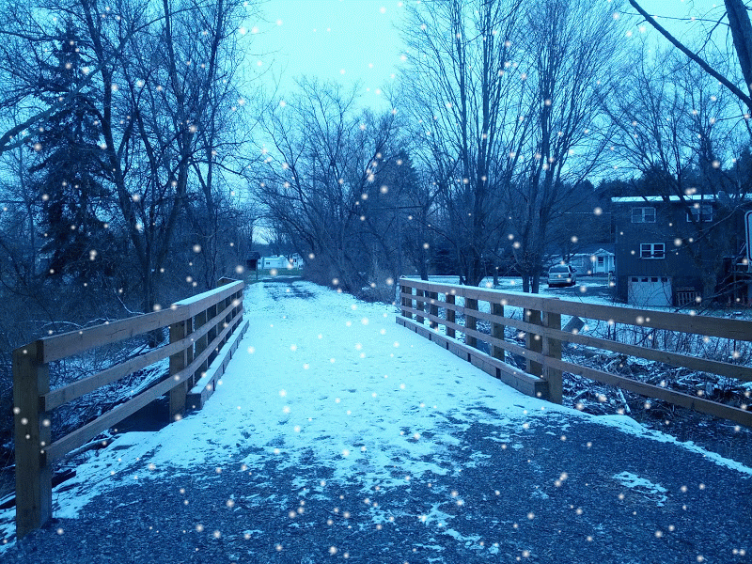
The future situation
What to say if we wish to see snow in summer?

Slide 14
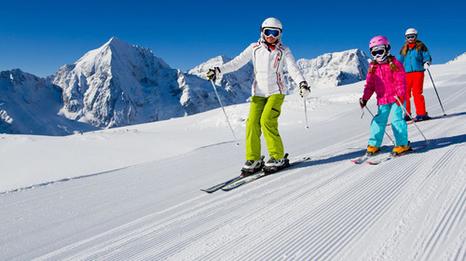
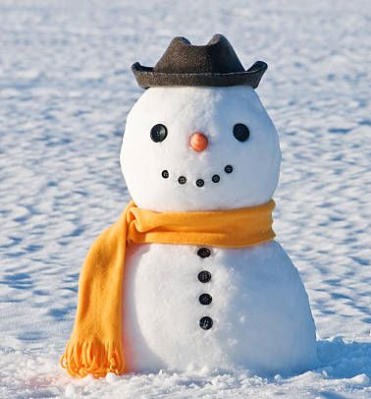
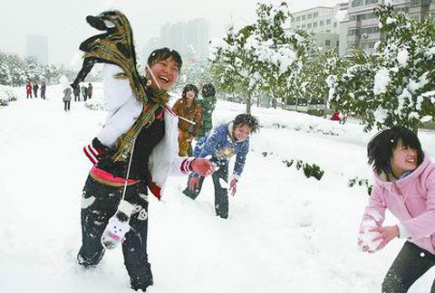
The past situation
If it snowed tomorrow, I could make a snow man.
If it should snow tomorrow, I would have a snowball fight.
If it were to snow tomorrow, I might go to ski with my friends.
 | If-clause | Main clause
① did/ were
② should do
③ were to do
The future situation
would/might/ could/ should + do

Slide 15
Subjunctive Mood used in “If-clause”
 | If-clause | Main clause
The present situation
would/might/ could/ should +do
did/ were
The past situation
would/might/ could/ should + have done
had done
① did/ were
② should do
③ were to do
The future situation
would/might/ could/ should + do

Slide 16
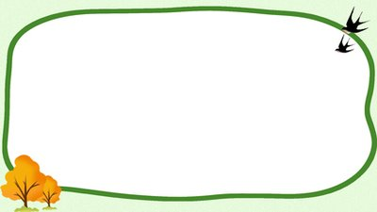
Some special situations
★
If I were you , I would accept his invitation.
= Were I you , I would accept his invitation.
1. 如果虚拟条件句的谓语部分有were，had和should时，可省略if，把were，had和should放到从句主语前面去，多见于书面语。

Slide 17
★
2.含蓄条件： 有时假设的情况并不以条件从句表示出来，而是暗含在上下文中，通过介词短语来表示，比如：but for(要不是...), without(如果没有...), 或者一些连词otherwise（否则）, but（但是）表示虚拟条件.
But for your advice, I couldn't have done it so successfully.
The change could not have taken place without the open-door policy.
I was so busy then, otherwise, I would have told him the answer.
= I would have told him the answer, but I was so busy then.

Slide 18
★
3. 错综时间的虚拟条件句:
If 从句谓语动词发生的时间与主句所假设的谓语动词发生的时间不一致，主句和从句的谓语动词要依照对应的时间而定。
If you had spoken to him last time you saw him, you would know what to do now.
If I were you, I wouldn’t have missed the film last night. 。

Slide 19
Discussion
If there had been another chance,
what would Snow White have done?
If Snow White had had a second chance, she could have listened to the dwarfs. (past)
If I were Snow White, I would take control of my own life! (present)
If Snow White should have a new life tomorrow, she should never talk to the stepmother again. (future)

Slide 20

Homework:
Think about your life and write sentences using Subjunctive Mood.
1. What could you have done if you had had a second chance to start your high school life? (past)
2. What would you do if you graduated/ should graduate/ were to graduate from high school tomorrow? (future)

Slide 21
Homework (possible version) :
1. I should have worked harder on my English if I had had a second chance to start my high school life.
I would have made a better plan for my high school life if I had had a second chance to start it.
I could have got up early for physical exercise from the first day if I had had a second chance to start my high school life.
2. I would travel around the world if I graduated from high school tomorrow.
I could try to learn to play a new instrument if I should graduate tomorrow.
I might learn a new language for the future if I were to graduated from high school tomorrow.

Slide 22
Goodbye!
Thank you!

