Slide 1

感恩遇见，相互成就，本课件资料仅供您个人参考、教学使用，严禁自行在网络传播，违者依知识产权法追究法律责任。
更多教学资源请关注
公众号：溯恩高中英语
知识产权声明

Slide 2
说明文主旨大意解题策略
王婵娟

Slide 3
Learning objectives
1. Get familiar with the three textual patterns by doing the main idea exercises and predicting the following content. 2. Find the expository object according to the textual pattern and some mark words. 3. Get the main idea of the expository passage according to the expository object.

Slide 4
main idea expository object
Steps to find the main idea of expository Passage:
1. Skim the text to find out the textual pattern.
2.Find the expository object
3. Match the object with the options.

Slide 5
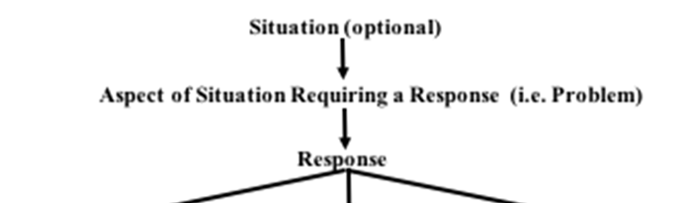
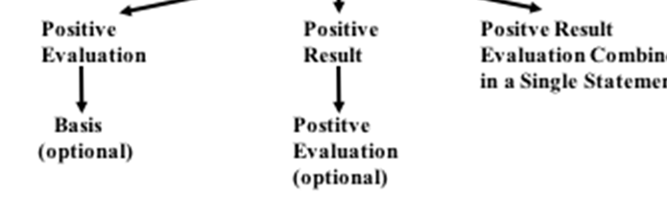
1. Problem-Solution Pattern
①情境 (situation)
②问题 (problem) （+科技背景信息）
③反应/解决 (response/ solution)
④评价/结果 (evaluation/ result)

Slide 6
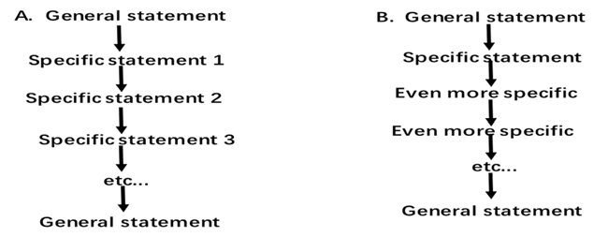
2. General-Specific Pattern (一般特殊型) 语篇模式
“整体---细节式” (preview - detail)
“概括---举例式” (generalization - example)

Slide 7
3. Question-Answer Pattern 语篇模式
（1）情景（situation) ——选择性
（2）问题（question)
（3）回答（answer）
（4）积极评价（positive evaluation)
（5）拒绝（rejection）——选择性

Slide 8

2021年新高考I卷之C篇
Step 3:Match the expositoryobject with the options
Step 1: find out the textual pattern
Problem-Solution Pattern
Step 2: Find the expository object
situation+problem
①When the explorers first set foot upon the continent of North America, the skies and lands were alive with an astonishing variety of wildlife. Native Americans had taken care of these precious natural resources wisely. Unfortunately, it took the explorers and the settlers who followed only a few decades to decimate a large part of these resources. Millions of waterfowl ( 水 禽 ) were killed at the hands of market hunters and a handful of overly ambitious sportsmen. Millions of acres of wetlands were dried to feed and house the ever-increasing populations, greatly reducing waterfowl habitat.
② In 1934, with the passage of the Migratory Bird Hunting Stamp Act (Act), an increasingly concerned nation took firm action to stop the destruction of migratory ( 迁徙的) waterfowl and the wetlands so vital to their survival. Under this Act, all waterfowl hunters 16 years of age and over must annually purchase and carry a Federal Duck Stamp. The very first Federal Duck Stamp was designed by J.N. “Ding” Darling, a political cartoonist from Des Moines, lowa, who at that time was appointed by President Franklin Roosevelt as Director of the Bureau of Biological Survey. Hunters willingly pay the stamp price to ensure the survival of our natural resources.
31Which of the following is a suitable title for the text? A. The Federal Duck Stamp Story B. The National Wildlife Refuge System C. The Benefits of Saving Waterfowl D. The History of Migratory Bird Hunting
General-specific
response/solution

Slide 9
What will the author talk about in the following content?
Problem: Explorers and settlers decimate the nature resources.
Response: Federal duck stamp
Positive Results: A lot of money was gathered to protect the nature resources and the situation has been improved.

Slide 10
2022年新高考II卷之C篇
Step 2: Find the expository object
Step 3:Match the expository object with the options
Problem-Solution Pattern
situation+problem
Step 1: find out the textual pattern
①Over the last seven years, most states have banned texting by drivers, and public service campaigns have tried a wide range of methods to persuade people to put down their phones when they are behind the wheel. ②Yet the problem, by just about any measure, appears to be getting worse. Americans are still texting while driving, as well as using social networks and taking photos. Road accidents, which had fallen for years, are now rising sharply.
... ...
⑤An idea from lawmakers in New York is to give police officers a new device called the Textalyzer. It would work like this: An officer arriving at the scene of a crash could ask for the phones of the drivers and use the Textalyzer to check in the operating system for recent activity. The technology could determine whether a driver had just texted, emailed or done anything else that is not allowed under New York's hands-free driving laws.
31. What is a suitable title for the text? A. To Drive or Not to Drive? Think Before You Start B. Texting and Driving? Watch Out for the Textalyzer C. New York Banning Hand-Held Devices by Drivers. D. The Next Generation Cell Phone: The Textalyzer
response/solution

Slide 11
What will the author talk about in the following content?
Problem: Drivers are using phones while driving
Response: A new device--Textalyzer
Positive Results:
People’s positive comments

Slide 12
Summary1
1.说明文篇章类型_____________________中，文章主题在____________________部分
2.若没有主旨句，那就找_____________________
3.注意转折词___________________________________
Problem-Solve Pattern
解决（response/solution)
关键词/关键词的同义复现
but, however, while, yet, unfortunately

Slide 13
2021年浙江卷
Step 2: Find the expository object
Step 3:Match the expository object with the options
Step 1: find out the textual pattern
General-Specific Pattern
General statement
① Researchers say they have translated the meaning of gestures that wild chimpanzees (黑猩猩) use to communicate. They say wild chimps communicate 19 specific messages to one another with a "vocabulary" of 66 gestures. The scientists discovered this by following and filming groups of chimps in Uganda, and examining more than 5,000 incidents of these meaningful exchanges. ② Dr Catherine Hobaiter, who led the research, said that this was the only form of intentional communication to be recorded in the animal kingdom. Only humans and chimps, she said, had a system of communication where they deliberately sent a message to another group member. ... ...
research result
Which of the following is the best title for the text? A. Chimpanzee behaviour study achieved a breakthrough B. Chimpanzees developed specific communication skills C. Chimpanzees: the smartest species in the animal kingdom D. Chimpanzee language: communication gestures translated
Specific statement

Slide 14
What will the author talk about in the following content?
General statement:Researchers have translated the meaning of gestures that wild chimpanzees use to communicate.
Specific statement: specific information about the research (eg: the significance of the research, the process of the research, their further research)

Slide 15
2020年天津第一次高考
Step 1: find out the textual pattern
General-Specific Pattern
Step 2: Find the expository object
Step 3:Match the expository object with the options
General statement
①For people, who are interested in sound, the field of sound technology is definitely making noise. In the past, sound engineers worked in the back rooms of recording studios, but many of today’s sound professionals are sharing their knowledge and experience with professionals in other fields to create new products based on the phenomenon we call sound.
②Sound can be used as a weapon. Imagine that a police officer is chasing a thief. The thief tries to escape. And the officer can’t let him get away. He pulls out a special device, points it at the suspect, and switches it on. The thief drops to the ground. This new weapon is called a Long Range Acoustic Device(LRAD, 远程定向声波发射器). It produces a deafening sound so painful that it temporarily disables a person. The noise from the LRAD is directed like a ray of light and travels only into the ears of that person, but it is not deadly.
32.What does the passage focus on?
A.How professionals invented sound products.
B.Inventions in the field of sound technology.
C.The growing interest in the study of sound.
D.How sound engineers work in their studios.
技巧点拨: 同义复现
Specific statement

Slide 16
技巧点拨: “剥洋葱”分析长难句
后置定语
based on the phenomenon we call sound.
to create new products
目的状语
many of today’s sound professionals are sharing their knowledge and experience with professionals in other fields.
主系表结构

Slide 17
What will the author talk about in the following content?
General statement: many of today’s sound professionals are sharing their knowledge and experience with professionals in other fields to create new products based on the phenomenon we call sound.
Specific statement: Sound can be used as a weapon
Sound can be used as.... (inventions)

Slide 18
Summary2
1. 说明文篇章类型______________________中,文章主题句在______________________________________部分。
2.常见的主题句提示词：
（1）转折词，主题句在其_______
eg:_________________________________________
(2)总结性、结论性的词，主题句在其__________
in brief, in short, after all, to sum up, in conclusion, in a word...
General-Specific Pattern
General statement(文章首段或前两段)
后
but, however, while, yet, unfortunately
后

Slide 19
(3)表研究结果的词，主题句在其__________
show, say,indicate,publish，suggest,discover, according to......
(4)举例子的词，文章主题在其_____________
for example, for instance, take...for examole,......
3分析长难句用________________，即去掉_____________________一层一层翻译。
4.选项特点：同义复现
后
前
“剥洋葱”分析法
状语、定语

Slide 20
Question-Answer Pattern
Step 3:Match the expository object with the options
Step 2: Find the expository object
2022年全国卷
Step 1: find out the textual pattern
Question
①Can a small group of drones (无人机) guarantee the safety and reliability of railways and, at the same time, help railway operators save billions of euros each year? That is the very likely future of applying today’s “eyes in the sky” technology to make sure that the millions of kilometres of rail tracks and infrastructure (基础设施) worldwide are safe for trains on a 24/7 basis.
② Drones are already being used to examine high-tension electrical lines. They could do precisely the same thing to inspect railway lines and other vital aspects of rail infrastructure such as the correct position of railway tracks and switching points. The more regularly they can be inspected, the more railway safety, reliability and on-time performance will be improved. Costs would be cut and operations would be more efficient (高效) across the board. ... ...
Answer
Which is the most suitable title for the text? A. What Faults Can Be Detected with Drones B. How Production of Drones Can Be Expanded C. What Difficulty Drone Development Will Face D. How Drones Will Change the Future of Railways
技巧点拨: 同义复现

Slide 21
技巧点拨: “剥洋葱”分析长难句
答案指向句分析
1
That is the very likely future of applying today’s “eyes in the sky” technology to make sure that the millions of kilometres of rail tracks and infrastructure (基础设施) worldwide are safe for trains on a 24/7 basis.
宾语从句（主系表结构)
the millions of kilometres of rail tracks and infrastructure (基础设施) worldwide are safe for trains on a 24/7 basis
1
目的状语
to make sure that
主系表结构
That is the very likely future of applying today’s “eyes in the sky” technology

Slide 22
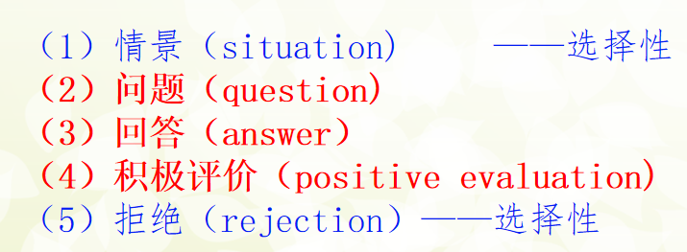
What will the author talk about in the following content?
Question:Can drones guarantee the safety and reliability of railways and save money?
Answer: Yes，it can do that in the future.
Some latest application for drones.
/ People’s opinion about the application of drones at present and in the future

Slide 23

2021年全国卷
Step 3:Match the expository object with the options
Step 1: find out the textual pattern
Step 2: Find the expository object
General-Specific Pattern
Question
①You’ve heard that plastic is polluting the oceans — between 4.8 and 12.7 million tonnes enter ocean ecosystems every year. But does one plastic straw or cup really make a difference? Artist Benjamin Von Wong wants you to know that it does. He builds massive sculptures out of plastic garbage, forcing viewers to re-examine their relationship to single-use plastic products. ... ...
Answer
26. Which of the following can be the best title for the text? A. Artists’ Opinions on Plastic Safety B. Media Interest in Contemporary Art C. Responsibility Demanded of Big Companies D. Ocean Plastics Transformed into Sculptures
expository object: Plastic straw or cup can really make a difference.
技巧点拨: 同义复现

Slide 24
What will the author talk about in the following content?
Question:Can plasic straw and cup make a difference?
Answer: Yes，it can. An artist builds massive sculptures out of plastic garbage.
introduce his works and people positive opinions about his works

Slide 25
Summary3
1.说明文篇章类型________________________中，主题句在_____________部分
2.若首段出现疑问句时，____________________就是文章的主题句。
Question-Answer Pattern
回答(Answer)
对问题的回答

Slide 26
感谢观看

