Slide 1
感恩遇见，相互成就，本课件资料仅供您个人参考、教学使用，严禁自行在网络传播，违者依知识产权法追究法律责任。
更多教学资源请关注
公众号：溯恩高中英语
知识产权声明

Slide 2
Notice

Slide 3
应用文分类
书信
书信
通知
通知
邀请函
道歉信
感谢信
申请信
投诉信
询问信
建议信
推荐信
书面通知
口头通知
应用文分类
报道
倡议
报道
倡议书
套路是关键
得体很重要

Slide 4
书面通知
书面通知又称为通告或布告(Notice)，是部署工作、传达事情、召开会议所使用的一种文体。其格式如下：
1．标题。书面通知要在正文的正上方写上Notice或大写NOTICE。
2．正文。即通知的内容。
3．落款。书面表达要表明出通知的时间和单位名称。布告式通知的时间一般放在正文的左下角，要低于落款(单位名称)。

Slide 5
试题回顾
假如你是学生会主席李华，为了唤起学生们学习英语的热情，学生会将举办一年一度的英语演讲比赛，本年度的主题为“我眼中的英国”，话题可涉及英国国家发展史，国家的组成，以及传统习俗等方面。请你写一则书面通知，邀请有兴趣的同学参加。
内容包括: 1．比赛的目的；2．比赛的相关内容（例如：时间、地点、主题等）；3．期待大家的积极参与。
注意：①词数80词左右 ②可以适当增加细节，以使行文连贯。

Slide 6
Notice
The Students’ Union
April, 20th
1. 通知主要内容（事件，时间，地点，目的）
表目的:
enrich the students’ school life;
stimulate/activate/provoke/evoke/stir up/set off/arouse their enthusiasm/passion for……;
表计划:
2. 具体活动内容拓展
sb be required to do sth / sb be expected to do sth /it is required that sb should do…/it is necessary(a necessity) that…
表顺序 firstly…. Then follows/ followed by…..
3.期待参加
If you are an enthusiast for it/ if you are interested in it, come and sign up for it./ Looking forward to your participation/involvement.
aiming to do/targeted at doing sth/with the purpose of doing sth/in an attempt to do/ (in order) to…..
be scheduled for(to do)/intend to do/mean/plan to do
be to organize; will hold/will be held; will take place

Slide 7
2．常用的词汇和句式。
(1)常见的地点
in the school hall
in the lecture hall
in the school stadium
in the student Activity Center
at the school auditorium (礼堂)
in the music room
in the cultural activity center

Slide 8
(2)时间的表示方法(钟点\星期\年\月\日)
in June, 2023
on June 21, 2023
on Thursday, June 21, 2023
at 7：00 p.m. on June 21,2023
from 2：00 p.m. to 4：30 p.m. on Thursday, June 21, 2023

Slide 9
(3)动词短语
organize a tour/trip/hiking,
have a picnic/ have a football match，
give a lecture/ talk/ speech，
visit the museum，
attend the lecture，
join in the party，
take (an active) part in，
sign up (for...),

Slide 10
(4) 常用句式
A lecture on...主题 is scheduled/due to be held in...地点on/at...日期时间.
There is going to be a lecture on history in the lecture hall at 2:00 p.m. this afternoon, lasting about three hours.
All students are required to be present at the meeting to be held in the school hall at 9:00 a.m. on Saturday, January 14, 2016.
The meeting scheduled to take place this Tuesday afternoon is postponed until further notice.
★ 5. Those who are interested in it/ who want to take part in …, please sign up at the Student Union.
6. Your entry should be submitted before May 1.

Slide 11
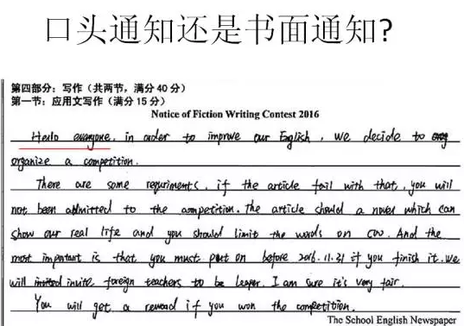
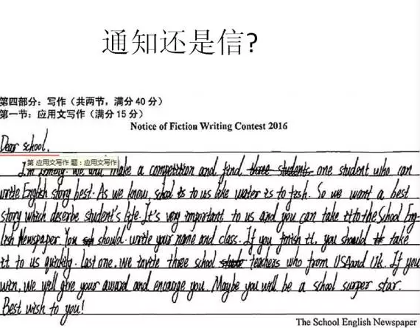
(5) 关于格式

Slide 12
Have a try ! 通知主要内容（事件，时间，地点，目的）
Aiming to/Targeted at/In an attempt to/With the purpose of
… stimulate students’ enthusiasm for English learning, the Students’ Union intends to hold its annual English Speech Contest, ____________________ April 20 in the Lecture Hall.
为了释放学业压力和增加相互之间的理解，英语俱乐部打算组织一次远足活动，安排在下周六。
With the purpose of releasing academic stress and strengthening mutual understanding, the English club is to organize an outing, scheduled for next Saturday.
为了丰富校园生活和选拔新的学生会主席，即将举行一次会议，安排在下周六。
Aiming to enrich campus life and elect a new chairman, a meeting is scheduled for next Saturday.
scheduled for

Slide 13
Aiming to enrich the students’ campus life and activate/arouse their enthusiasm(热情) for English learning, the Students’ Union intends to hold its annual English Speech Contest, scheduled for April 20th in the Lecture Hall.
First, all the participants are expected to introduce themselves in English. Then follows/followed by a five-minute speech whose theme is ‘See Britain through My Eyes’, where you can showcase your language competence and knowledge of British history. Topics ranging from its evolution and composition to the traditions and customs in the UK are welcome. It is the originality and creativity of your understanding of the UK that matter/count.
If you are an enthusiast for/interested in it, come and sign up for it.
The Students’ Union
April, 13th
Writing sample
Notice

Slide 14
某国际中学下周六下午将要举行英语文化节，主题为“西方节日文化”。 假如你是学生会主席李华，请你根据下列要点写一则英语书面通知。
1. 时间和地点 2. 活动内容 3. 欢迎大家参加。
注意：1. 词数80左右； 2. 可以适当增加细节，以使行文连贯。
Notice
_________________________________________________________________________________________________________________________________________________________________________________________________________________________________________________________________________________________________________________________________________________________________________________________________________________________________________________________________________________________________________
实战演习

Slide 15
Writing sample
With the purpose of enriching students' campus life and broaden international vision, the English Culture Festival, whose theme is western festivals, is scheduled to be held on the school playground next Saturday afternoon. There're various well-organized activities waiting for you, which will bring you into a world full of festival atmosphere. Not only will you be introduced to the history of some important western festivals through video clips, but you'll be exposed to some traditional celebrations through hands-on learning. Better yet, you can even be awarded with prizes if you win related games.
Everyone who is interested in it is welcome! Don't miss the chance to have fun!
Students' Union
April, 11th
Notice

Slide 16
Criteria for writing assessment
应用文写作的评分标准与评分原则
1.本题总分为15分,按5个档次给分。
2.评分时,先根据文章的内容和语言初步确定其所属档次,然后以该档次的要求来衡量、确定或调整档次,最后给分。
3.词数少于80和多于120的,从总分中减去2分。
4.评分时,应注意的主要内容为:内容要点、应用词汇和语法结构的数量和准确性、上下文的连贯性。
5.拼写与标点符号是语言准确性的一个方面,评分时,应视其对交际的影响程度予以考虑。英、美拼写汉词汇用法均可接受。
6.如书写较差以至影响交际,将分数降低一个档次。
Courtesy
Completeness
Neatness
Good writing
Diversity
Conciseness
Accuracy
第五档 (很好) (21-25分) | 完全完成了试题规定的任务 ⑴覆盖所有内容要点 ⑵应用了较多的语法结构和词汇, ⑶语法结构或词汇方面有些许错误,但为尽力使用较复杂结构或较高级词汇所致;具备较强的语言运用能力, ⑷有效地使用了语句间的连接成分,使全文结构紧凑完全达到了预期的写作目的
Coherence

