Slide 1
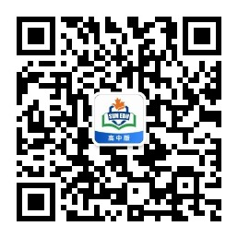
感恩遇见，相互成就，本课件资料仅供您个人参考、教学使用，严禁自行在网络传播，违者依知识产权法追究法律责任。
更多教学资源请关注
公众号：溯恩高中英语
知识产权声明

Slide 2
2022年2月 浙江十校返校考应用文讲评 邀请信
浙江省天台中学 陈星可

Slide 3
试题呈现
假如你是李华，你校将在下周日举行以英语文化习俗为主题的英语角活动。请你给交换生William写一封邮件，邀请他参加，内容如下：
1.发出邀请；
2.告知内容；
3.表达期待。
注意：
1. 词数80左右；
2. 可以适当增加细节，以使行文连贯。

Slide 4
审题
文体：邮件（邀请）
交际对象：交换生/朋友
主题语境：人与社会（跨文化交流）
人称： 第二、三人称
框架结构：首段 (写作背景和目的：要点1)
中段 (要点2)
尾段 (要点3)
内容要点：邀请+告知+期待
你校将在下周日举行以英语文化习俗为主题的英语角活动。请你给交换生William写一封邮件，邀请他参加，内容如下：
1.发出邀请；
2.告知内容：
3.表达期待。

Slide 5
首段—— 背景+目的
假如你是李华，你校将在下周日举行以英语文化习俗为主题的英语角活动。请你给交换生William写一封邮件，邀请他参加
Background:
Our school is to hold/ stage English culture-themed activities in the English Corner next Sunday.
Some English culture-themed activities are to be held in the English Corner next Sunday.
Activities featuring/ focusing on/ with the theme of/ themed English culture are to be held in the English Corner next Sunday.
Purpose:
I’m writing to invite you to join us in the activities/event.
We’d very much like to have you with us in the activities.
I’m writing to invite you, an exchange student growing up the culture, to spend the time with us.

Slide 6
首段—— 背景+目的
假如你是李华，你校将在下周日举行以英语文化习俗为主题的英语角活动。请你给交换生William写一封邮件，邀请他参加
Background+Purpose:
Our school is to hold/ stage English culture-themed activities in the English Corner next Sunday. And we’d very much like to have you with us.
Activities featuring/ focusing on/ with the theme of/ themed English culture are to be held in the English Corner next Sunday. I’m writing to invite you, an exchange student growing up the culture, to spend the time with us.
I’m writing to invite you to participate in the English culture -themed activities in the English corner to be held next Sunday.

Slide 7
Body—— 告知内容
What activities will be launched/scheduled/offered in the English Corner?
 | Element 2: How Talk/ discuss; Give presentations; Deliver speeches; Make comments; Perform live; ...
Element 1: What
Share ideas about English culture in their eyes;
Share their experiences/stories of English culture;
Give performances concerning English culture;
...

Slide 8
Body——告知内容
We will have a theme discussion, sharing our understanding of the English culture and our puzzles.
If possible, our personal experiences of the English culture will also be shared .
告知内容
As an exchange student immersed in the English culture, you are expected to exhibit some representative English culture to us and make comments on the event.
The highlight is when some live performances will be presented by talented students at the end.

Slide 9
Body——告知内容-结构
总：
1.Various activities are scheduled for the day.
2. To improve our spoken English and equip ourselves with a better knowledge of English culture, English Corner organizes various activities this Sunday.
Activity 1:
--We will have a theme discussion, sharing our understanding of the English culture and our puzzles.
--If possible, our personal experiences of the English culture will also be shared .
告知内容
Activity 2:
--The highlight is when some live performances will be presented by talented students.
--You are expected to exhibit some representative English culture, offering us a new dimension in understanding.
总：
1.Hopefully, the event can be a cultural feast.
2.I’m convinced that the activities will be a success, having you with us.
3. I’m sure it will enhance our understanding of English culture and better our spoken English.

Slide 10
积累—— 有关文化的表达
文化交流的方式/途径:
途径：
Study tours, exchange program, be accommodated in a home stay
方式：
1. enjoy/experience the local traditions and customs, unique local culture;
2. explore the spirit of Buddhism and the stories behind
3. taste/appreciate/admire the splendid history of …
4. gain hands-on experience of how … is made/produced
5. watch a live performance/show of tai chi
6. be shown around the school /the city/ the school history museum
7. explore/ enjoy local cuisine

Slide 11
积累—— 有关文化的表达
文化交流的的意义/目的/原因:
人做主语：
You’ll be immersed in its rich/abundant/diverse traditional customs
You will be introduced to.../ be exposed to...
You’ll be fascinated by its splendid and complicated architecture
You’ll get a clearer picture of …
--- catch a glimpse of…
--- gain a deeper insight into…
--- take a deeper dive into…
●

Slide 12
积累—— 有关文化的表达
文化交流的的意义/目的/原因:
活动/事件做主语：
It offers you a deeper understanding of Chinese paintings
■ --- introduce you to…, expose you to…
lead you into a world of reality combined with fantasy
It provides you with a new dimension in understanding…
It opens up a new dimension…
It opens a door to understanding…
It helps you get a better taste of…
--- take a bite of…

Slide 13
尾段—— 表达期待
Your participation will add color to the activity. Looking forward to your involvement.
We will feel much honored if you could come. Looking forward to your reply soon.
Your presence / appearance will be appreciated. Looking forward to your reply soon.
Would you please let me know if you are available at your earliest convenience?
If you’re available, please confirm确认it at your earliest convenience. Your attendance will be highly/greatly expected.

Slide 14
参考范文
Dear William,
I am writing to invite you to participate in the English culture -themed activities in the English corner to be held next Sunday.
Participants will gather in the English corner where they can communicate with each other in English, sharing a knowledge of brilliant English cultures and interesting customs. With the aim of practicing spoken English, the students will spend roughly two hours with like-minded English lovers in various activities, ranging from story-sharing to heated debates. Definitely, the activities will serve as a supplement to school learning, in which students can immerse themselves in the charm of English.
Your participation will add color to the activity. Looking forward to your involvement.
Yours，
Li Hua

Slide 15
下水作文
Dear William,
Our school is to hold activities featuring/themed English culture in the English Corner next Sunday. And we’d very much like to have you join us.
Various activities are scheduled for the day. First, we will have a theme discussion, sharing our understanding of the English culture and our puzzles. Then follow some live performances presented by our fellow students. And I wonder if you could exhibit some representative English culture, giving us a clearer picture of what it’s like.
We will feel much honored if you could come. Looking forward to your reply.
Yours,
Li Hua 98

Slide 16
邀请信--高考真题2017.6
假定你是李华，计划组织一次郊游，请给你的英国朋友Chris写封邮件邀请他参加。内容包括：
1.参加者；
2.时间、地点；
3.活动：登山、野餐等。
注意：
1. 词数80左右；
2. 可以适当增加细节，以使行文连贯.

Slide 17
参考范文
Hi Chris,
I am planning/organizing an outing with some friends this Saturday and wonder if you would like to join us.
We are going to meet at the school gate at 7 a.m. and cycle to the nearby mountain, where we can go hiking and enjoy a picnic. Jenny and Michael are both to come and we would be more than happy to have your company / have you with us as well.
I know you are a hiking lover. I promise/guarantee we’ll have a great time. Looking forward to seeing you then!
Yours,
Li Hua

Slide 18
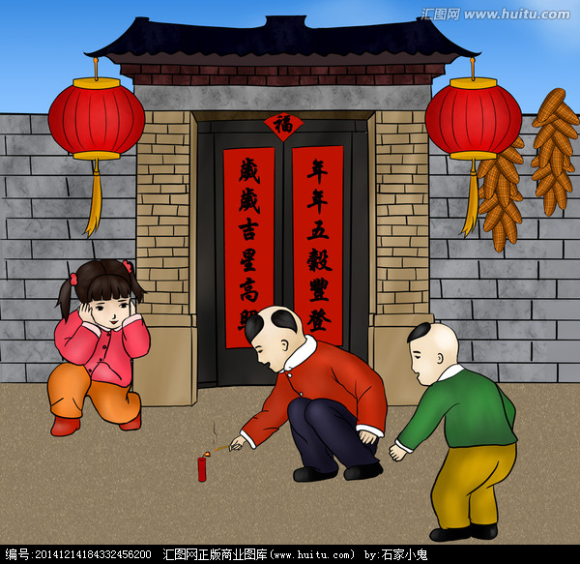
邀请信--高考真题2017.11
假定你是李华,得知外教Mr. Hall寒假不回国，想邀请他到你家过春节。请给他写一封信，内容包括：
1.时间；
2.一同过节的家人；
3.活动。
注意：
1. 词数80左右；
2. 可以适当增加细节，以使行文连贯.

Slide 19
参考范文
Dear Mr. Hall,
Learning that you’re not back to your country this winter vacation, I’m writing to invite you to spend the Spring Festival with my family.
If you like, my parents will pick you up next Monday and drive you straight to my house, where my family members will all be expecting you. We’ll have a big feast together, praying for next year’s good luck. After the meal, fireworks will be set off, making the atmosphere more festive.
Hope that you can join us and please reply at your earliest convenience.
Yours,
Li Hua

Slide 20
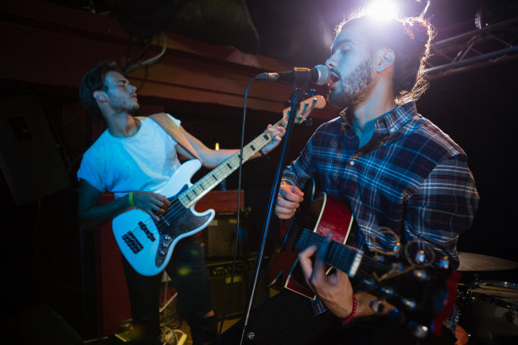
邀请信--2019年6月全国高考卷III
假定你是李华，你校将举办音乐节。请写封邮件邀请你的英国朋友Allen参加，内容包括：
1.时间；
2.活动安排；
3.欢迎他表演节目。
注意：
1. 词数80左右；
2. 可以适当增加细节，以使行文连贯.

Slide 21
参考范文
Dear Allen,
How is everything going? Our school will hold a music festival next Sunday morning in the school hall. And I'm writing to invite you to join us.
The opening ceremony will start at 9:00 am, after which the school president will deliver a speech. Then follows a lecture about History of Chinese Music by a master in the field and fantastic performances presented by talented students.You are definitely welcome to show up on stage, which will add color and fun to our festival.
Looking forward to your early reply. Best wishes,
Yours,
Li Hua (96)

Slide 22
邀请信--高考真题2020.1
假定你是李华，你校将举办外国学生中文演讲比赛，请给你的英国朋友George 写封邮件邀请他参加。内容包括：
1.比赛时间；
2.演讲话题；
3.报名方式。
注意：
1. 词数80左右；
2. 可以适当增加细节，以使行文连贯.

Slide 23
参考范文
Dear George,
Knowing that you’re into Chinese, I’m writing to invite you to attend a Chinese speech contest to be held in the school lecture hall from 2:00pm to 5:00pm February 6th .
All the competitors are required to prepare a speech themed “My favorite Chinese classic”within five minutes. If you’re interested, you can sign up on our school website before January 25th. I’m sure it would be a mix oft fun and learning.
I’d be happy to have you there. Looking forward to your reply.
Yours,
Li Hua

Slide 24
Thank you

