Slide 1

感恩遇见，相互成就，本课件资料仅供您个人参考、教学使用，严禁自行在网络传播，违者依知识产权法追究法律责任。
更多教学资源请关注
公众号：溯恩高中英语
知识产权声明

Slide 2
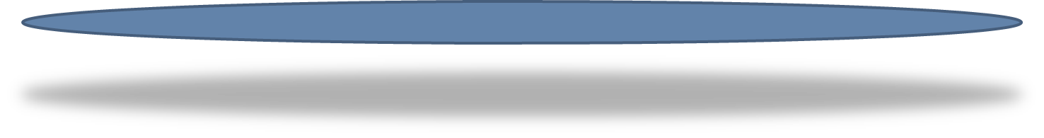
SUMMARY WRITING
浙江宁波市2021届高三一模概要
桐乡市高级中学 邱娟芬
延迟符

Slide 3
概要写作
提供一篇350词以内的短文，要求考生基于该短文写出一篇60词的内容概要。阅卷时将主要考虑以下内容：
（1）对原文要点的理解和呈现情况；
（2）应用语法结构和词汇的准确性；
（3）上下文的连贯性；
（4）对各要点表达独立性情况。
(5) 卷面整洁和书写端正。
5C
Complete & Objective
Correct & Diversified
Coherent & Logical
Concise & Independent
Clear & Neat

Slide 4
Problems
Content
Language
Logic
Handwriting
找不到主题句，或无法概况
找不到替换字词句
不明确段与段之间的关系及连接词的运用
练字，练字，练字，重要的事情写三遍

Slide 5


Music
makes you ______________

Slide 6
01
  Locate
  02
  Draw
Decode
  03
  Paraphrase
  04
  Organise
  05
  Polish
延迟符

Slide 7
①Around the world, music therapy (疗法) is being used to treat different medical conditions and illnesses. Some of the ways people use music therapy are to reduce pain, such as in childbirth or during cancer treatments, or to stimulate brain activity after an injury. Music therapy has also been successful in aiding children to overcome disabilities. Children can move their bodies with the music and stamp along to the beat.
②Why is music a useful therapy? Being comforting and relaxing, music stimulates our brains. We respond to the sounds of music emotionally and physically. The complexity of music( the different tempos, rhythms, melodies and harmonies) provokes(激发) the biggest response. Thus, classical music is most typically used for therapies due to complex sounds and patterns. Although rap or hip hop might be fun to listen to, it's unlikely that such styles of music would produce the same kind of therapeutic effect. Playing a musical instrument rather than simply listening to music can also be therapeutic for some people,helping relieve stress and anxiety.
③ Have scientists been able to prove that music can heal disease? Music has been shown to reduce pain by increasing the release of endorphins(内啡肽). Endorphins are the body's natural painkillers, and when we listen to music,our brains respond by releasing these natural painkillers. It has aIso been known to contribute to the brain development of the babies who have just been born and even babies still in the mother's womb. Certain types of music have also been found to lower blood pressure and slow a person's heart rate. Many people are hopeful that music could replace the need for some medicines that are normally used to treat certain illnesses. At present, music therapy is used in a variety of settings such as hospitals, rehabilitation centers, nursing homes, day cares, and schools.
④ Although music therapy is not yet considered a mainstream treatment, it is recognized more and more as a useful addition to traditional treatment. So next time if you are feeling low or stressed out, put on some relaxing music and let the music heal you.

Slide 8


Decode
Locate
Draw
Paraphrase
Organize
Polish
1. What’s the topic?
2. What’s the writing style of the passage?
A. Narration B. Exposition C. Argumentation
3. What’s the structure of the passage?
A. B. C.
music therapy
①
①
①
②
② ③
② ③ ④
③
④
④

Slide 9
①Around the world, music therapy (疗法) is being used to treat different medical conditions and illnesses. Some of the ways people use music therapy are to reduce pain, such as in childbirth or during cancer treatments, or to stimulate brain activity after an injury. Music therapy has also been successful in aiding children to overcome disabilities. Children can move their bodies with the music and stamp along to the beat.
②Why is music a useful therapy? Being comforting and relaxing, music stimulates our brains. We respond to the sounds of music emotionally and physically. The complexity of music( the different tempos, rhythms, melodies and harmonies) provokes(激发) the biggest response. Thus, classical music is most typically used for therapies due to complex sounds and patterns. Although rap or hip hop might be fun to listen to, it's unlikely that such styles of music would produce the same kind of therapeutic effect. Playing a musical instrument rather than simply listening to music can also be therapeutic for some people,helping relieve stress and anxiety.
③ Have scientists been able to prove that music can heal disease? Music has been shown to reduce pain by increasing the release of endorphins(内啡肽). Endorphins are the body's natural painkillers, and when we listen to music,our brains respond by releasing these natural painkillers. It has aIso been known to contribute to the brain development of the babies who have just been born and even babies still in the mother's womb. Certain types of music have also been found to lower blood pressure and slow a person's heart rate. Many people are hopeful that music could replace the need for some medicines that are normally used to treat certain illnesses. At present, music therapy is used in a variety of settings such as hospitals, rehabilitation centers, nursing homes, day cares, and schools.
④ Although music therapy is not yet considered a mainstream treatment, it is recognized more and more as a useful addition to traditional treatment. So next time if you are feeling low or stressed out, put on some relaxing music and let the music heal you.
The of Music therapy
The of Music therapy
The of Music therapy
The of Music therapy

Slide 10
Decode
Locate
Draw
Paraphrase
Organize
Polish
Topic sentence
①Around the world, music therapy (疗法) is being used to treat different medical conditions and illnesses. Some of the ways people use music therapy are to reduce pain, such as in childbirth or during cancer treatments, or to stimulate brain activity after an injury. Music therapy has also been successful in aiding children to overcome disabilities. Children can move their bodies with the music and stamp along to the beat.
Around the world, music therapy (疗法) is being used to treat different medical conditions and illnesses.
Some of the ways people use music therapy are to reduce pain, such as in childbirth or during cancer treatments, or to stimulate brain activity after an injury. Music therapy has also been successful in aiding children to overcome disabilities. Children can move their bodies with the music and stamp along to the beat.
examples/
detailed explanation
Tip1 抓住关键词或信号词，定位要点。

Slide 11
Decode
Locate
Draw
Paraphrase
Organize
Polish
1st reason/
key supporting details
Question
Answers
②Why is music a useful therapy? Being comforting and relaxing, music stimulates our brains. We respond to the sounds of music emotionally and physically. The complexity of music( the different tempos, rhythms, melodies and harmonies) provokes(激发) the biggest response. Thus, classical music is most typically used for therapies due to complex sounds and patterns. Although rap or hip hop might be fun to listen to, it's unlikely that such styles of music would produce the same kind of therapeutic effect. Playing a musical instrument rather than simply listening to music can also be therapeutic for some people,helping relieve stress and anxiety.
We respond to the sounds of music emotionally and physically. The complexity of music( the different tempos, rhythms, melodies and harmonies) provokes(激发) the biggest response. Thus, classical music is most typically used for therapies due to complex sounds and patterns. Although rap or hip hop might be fun to listen to, it's unlikely that such styles of music would produce the same kind of therapeutic effect.
Detailed explanation
2nd reason
Tip2 逐句分析复杂段落，提取主、次要点，去除冗余信息。

Slide 12
Decode
Locate
Draw
Paraphrase
Organize
Polish
Q
As
1st effect
③ Have scientists been able to prove that music can heal disease? Music has been shown to reduce pain by increasing the release of endorphins(内啡肽). Endorphins are the body's natural painkillers, and when we listen to music,our brains respond by releasing these natural painkillers. It has aIso been known to contribute to the brain development of the babies who have just been born and even babies still in the mother's womb. Certain types of music have also been found to lower blood pressure and slow a person's heart rate. Many people are hopeful that music could replace the need for some medicines that are normally used to treat certain illnesses. At present, music therapy is used in a variety of settings such as hospitals, rehabilitation centers, nursing homes, day cares, and schools.
Endorphins are the body's natural painkillers, and when we listen to music,our brains respond by releasing these natural painkillers.
Detailed explanation
2nd & 3rd
Many people are hopeful that music could replace the need for some medicines that are normally used to treat certain illnesses. At present, music therapy is used in a variety of settings such as hospitals, rehabilitation centers, nursing homes, day cares, and schools.
Detailed explanation
Tip2 逐句分析复杂段落，提取主、次要点，去除冗余信息。

Slide 13
Decode
Locate
Draw
Paraphrase
Organize
Polish
Topic sentence
Although music therapy is not yet considered a mainstream treatment, it is recognized more and more as a useful addition to traditional treatment.
④ Although music therapy is not yet considered a mainstream treatment, it is recognized more and more as a useful addition to traditional treatment. So next time if you are feeling low or stressed out, put on some relaxing music and let the music heal you.
So next time if you are feeling low or stressed out, put on some relaxing music and let the music heal you.
Further explanation

Slide 14
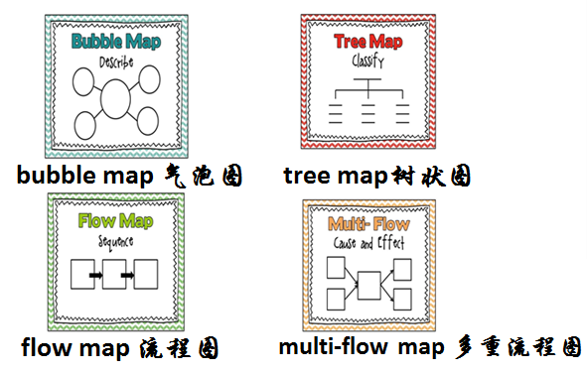
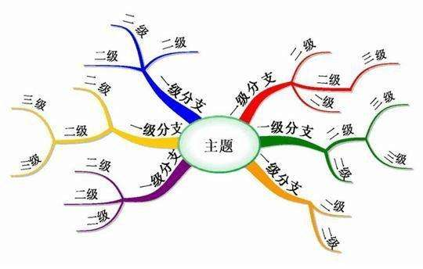
Decode
Locate
Draw
Paraphrase
Organize
Polish
思维导图

Slide 15
Mind Map/ outline
Decode
Locate
Draw
Paraphrase
Organize
Polish
Music therapy
para.1 introduction
Music therapy is being used to treat....
para.3 effects
reduce pain/ contribute to the brain development of the babies/ lower blood pressure and slow a person’s heart rate
para.2 causes
stimulates our brains/
be therapeutic,
relieve stress and anxiety
并列
para.4 conclusion
It is recognized as a useful additon to....

Slide 16
Decode
Locate
Draw
Paraphrase
Organize
Polish
Employ the synonyms
Change the part of speech of words
01
02
Paraphrase
Apply converse expressions
03
Diversify the sentence patterns
05
Change the sentence patterns
04
延迟符

Slide 17
Decode
Locate
Draw
Paraphrase
Organize
Polish
Around the world, music therapy (疗法) is being used to treat different medical conditions and illnesses.
字词替换
around the world
__________/________/_______________/_________________/
______________________/____________________
be being used to treat ....
be being _________/__________ to treat...
be a ________/__________/_______/_________/___________way/
________/_______of/ __________ to ________
different
_________/_______/_________/___________/___________
One version
___________________________________________________________________
worldwide globally all over the world across the world
throughout the world from pole to pole
contribute to/make for treating
applied employed
useful beneficial helpful effective conductive
method means
approach
treating
various diverse numerous a variety of a diversity of
Music therapy is a useful approach to treating various illnesses worldwide.
延迟符

Slide 18
Decode
Locate
Draw
Paraphrase
Organize
Polish
Why is music a useful therapy? Being comforting and relaxing, music stimulates our brains. Playing a musical instrument rather than simply listening to music can also be therapeutic for some people,helping relieve stress and anxiety.
字词替换
stimulate __________/___________
therapeutic _________/_________/________/__________
relieve _________/_________/________/______________
句型变化
__________ (why music is a useful/helpful therapy) is ______...
_________________________________________________________________
________________________________________
activate motivate
beneficial helpful useful effective
ease alleviate reduce free sb from...
The reason
that
The reason is that comforting music or playing musical instruments can activate our brains as well as ease pressure and anxiety.
Tip3 巧用字词句型，整合关键信息，连接主次要点。

Slide 19
Decode
Locate
Draw
Paraphrase
Organize
Polish
Have scientists been able to prove that music can heal disease? Music has been shown to reduce pain ... It has aIso been known to contribute to the brain development of the babies ... Certain types of music have also been found to lower blood pressure and slow a person's heart rate.
句型变化
Music has been proved to generate______ effects of __________(reduce) pain, _________(develop) the babies’ brain, _______(lower) blood pressure and _________(slow) heart rate.
Music, ____________________________, can bring about positive effects, including reducing pain, developing the babies’ brain, lowering blood pressure and slowing heart rate.
as scientists/experts have proved
Tip3 巧用字词句型，整合关键信息，连接主次要点。

Slide 20
Decode
Locate
Draw
Paraphrase
Organize
Polish
Although music therapy is not yet considered a mainstream treatment, it is recognized more and more as a useful addition to traditional treatment.
句型变化
although
______/_________/________/__________
_________________as music therapy is not yet considered, it is....
Despite/In spite of the fact ___________________________________,...
it is recognized more and more as a useful addition to...
it is ________________ regarded/considered as an effective ________ /_______ to traditional...
it is gaining _________________ as an _____ way to assist ...
while as(放句中) despite in spite of
Mainstream treatment
that music therapy is not a main/major treatment
increasingly/growingly
supplement
helper
increasing recognition
extra

Slide 21
Decode
Locate
Draw
Paraphrase
Organize
Polish
Which version is your preference?
A. Major treatment as music therapy is not yet considered, it is increasingly recognized as an effective supplement to traditional treatment.
B. Despite the fact that music therapy is not yet the main treatment, it is gaining increasing recognition as an effective extra way to assist traditional treatment.
C. Though music therapy is not adopted widely, it is regarded as an effective helper to traditional treatment.

Slide 22
Decode
Locate
Draw
Paraphrase
Organize
Polish
Music therapy is a useful way to treat various illnesses worldwide. (要点一)The reason is that comforting music or playing musical instruments can activate our brain and help ease pressure and anxiety.(要点二)_________, music has already been proved to generate positive effects of reducing pain, developing the babies brain, lowering blood pressure and slowing heart rate.(要点三) Though music therapy is not adopted widely, it is regarded as an effective helper to traditional treatment.(要点四)
并列：also, besides, additionally, furthermore, moreover, in addition
Tip4 运用连接词，短文更连贯。

Slide 23
Decode
Locate
Draw
Paraphrase
Organize
Polish
大家来找茬1
Considering its effects on certain conditions, music therapy is applied in some medical treatments worldwide. As a reason, different kinds of music can bring various benefits to people. Moreover, as is scientifically proved, endorphins brought by music can reduce pain and music therapy can lead to a better condition of heart so some places have already used it nowadays. As more effects of music therapy are being discovered, you can use it to reduce your pressure next time.
？
？
缺
？

Slide 24
Decode
Locate
Draw
Paraphrase
Organize
Polish
大家来找茬2
？
Music therapy is widely applied to many medical treatments like reducing pain, activating the injured brain and assisting kids with disabilities. One contributing factor is that the mix of music stimulates our brain to give psychological and physical response. Also, music helps release endorphins, a natural painkiller, and gets blood pressure lowered and heart rate slowed. Though it is not a firstly-considered treatment, music therapy acquires more and more recognition as a helpful addition.
缺
？

Slide 25
Decode
Locate
Draw
Paraphrase
Organize
Polish
大家来找茬3
Grammar Correction
（1）Music is comforting and relaxing, which stimulates our brains, helps reliefing stress and anxiety.
(1) 缺and (2) relieve
（2）Music therapy, not yet a mainstream treatment but a useful traditional treatment, which may heal you when you feeling low.
(1) 删去which（2）删去you
（3）Music therapy is used to reducing pain and overcoming disabilities.
(1) reduce/overcome

Slide 26
Decode
Locate
Draw
Paraphrase
Organize
Polish
（4）It is music therapy that be adopted to tackling various medical treatments and illnesses.
(1) is (2) tackle
（5）The reason why music therapy beneficial is music enhances our brains.
(1)加 is (2) 加that
（6）Though music therapy is not a chief method now, but it is increasing recognized as a significant method.
(1)删去but (2) increasingly

Slide 27
Decode
Locate
Draw
Paraphrase
Organize
Polish
（7）Researches have found that music stimulates our brains and play an instrument can have a better effect in treatment.
(1)playing (2) on
（8）The reason is that music can reduce pain by release more endorphins, it also has the ability to lower blood pressure and slow heart rate.
(1)releasing (2) 加and
（9）Music is a beneficial therapy, stimulating our brains because comfort and relax.
(1)缺of (2) relaxation

Slide 28
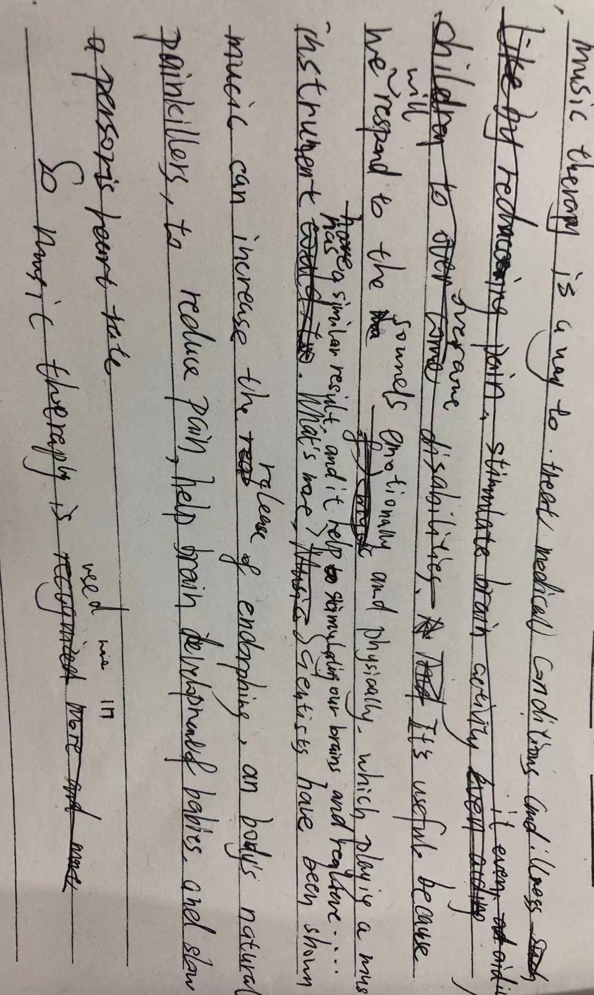
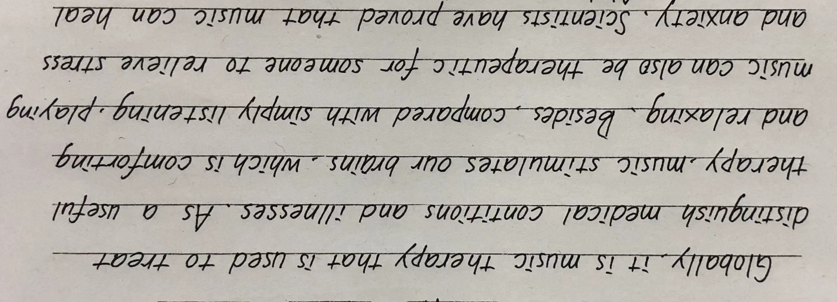
Decode
Locate
Draw
Paraphrase
Organize
Polish
Tip5 关注要点语言，修改润色概要,认真仔细誊写。

Slide 29
Conclude
Locate
Draw
Paraphrase
Organize
Polish
Music therapy is a useful way to treat various illnesses worldwide. (要点一)The reason is that comforting music or playing musical instruments can activate our brain and help ease pressure and anxiety.(要点二)Also, music has already been proved to generate positive effects of reducing pain, developing the babies brain, lowering blood pressure and slowing heart rate.(要点三) Though music therapy is not adopted widely, it is regarded as an effective helper to traditional treatment.(要点四)

