Slide 1
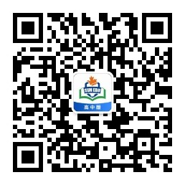
感恩遇见，相互成就，本课件资料仅供您个人参考、教学使用，严禁自行在网络传播，违者依知识产权法追究法律责任。
更多教学资源请关注
公众号：溯恩高中英语
知识产权声明

Slide 2

征 稿 启 事
Contributions Wanted
-- 绍兴二模应用文
基于“4C” 原则的应用文教学

Slide 3
题型解读
征稿启示是杂志社或者报社等发出的书面通知，面向特定的人群发出征集稿件的通知。
一般应首先对杂志社或报社发出的活动进行简单的介绍，然后就要征集的稿件提出具体要求，最后给出时间期限和联络方式。
征稿启事结构:
1. 征稿目的；
2. 稿件内容及要求；
3. 截至日期、投稿方式、注意事项，呼吁积极投稿

Slide 4
Reference standards
应用文评分标准 第五档（13-15）
完全完成了试题规定的任务。
——覆盖所有内容要点
—— 应用了较多的语法结构和词汇
—— 语法结构或词汇方面有些许错误，但为尽力使用较复杂结构或较高级词汇所致；具有较强的语言运用能力
—— 有效地使用了语句间的连接成分，使全文结构紧凑。
完全达到了预期的写作目的
如书写较差，以致影响交际，将分数降低一个档次
Completeness
Correctness
Coherence
Clearness

Slide 5
Step 1: 仔细审题定结构（审）
genre& format?
key points?
Tense and Person ?
征稿启事
有标题，有落款
假定你是校英文报编辑李华，你报正在开展“致敬身边的您”征文活动。请你写一篇英语征稿启事，内容包括：
1. 活动目的
2. 征文要求
3. 投稿方式
注意：1. 写作词数应为80左右；
2. 请按如下格式在答题卡的相应位置作答。
目的 & 投稿要求 & 投稿方式
一般现在时 & 第一/三人称
Tip1: No self-introduction!
purpose + activity
Para.1
Para.2
Para.3
requirements +
submission method
appeal
审题四定
Completeness

Slide 6

学生问题:
糟粕一：冗余的自我介绍
糟粕二：偏差的体裁理解 ，征稿启事 VS 新闻报道，通知，邀请信
糟粕三：单薄的文本内容，思维局限较大
糟粕四：无关的信息提供，脱离题材要求
糟粕五：难懂的中式英文，刻意追求生僻词汇

Slide 7
二、 抓全要点列表达（列）
Completeness
Para 1 purpose + activity
目的
表 目的
提高...意识
激发...热情
展示榜样的力量
传播奉献精神
传播社会正能量
培养良好习惯
活动
开展活动
开设专栏
号召投稿
表 主题
致敬身边的您
in order to, in a bid to, aiming to, (be) aimed at, with the purpose/intention of
enhance/ arouse/ stimulate students’ awareness of ...
ignite/provoke students’ passion/ enthusiasm for ...
demonstrate the power of moral examples
spread the spirit of selfless dedication
spread positive energy in society/promote positive values in society
cultivate students’ brilliant habit
arrange/ hold/ schedule/ launch a meaningful activity
set up/ add a new column
call for contributions
themed / featuring / with the theme of
Salute Everyday Heroes
Respect Heroes around us

Slide 8
Step 3：紧扣要点巧扩充（扩）
Correctness
Para 1 purpose + activity
+ theme
为了表示对我们周围那些伟大人物的尊重，我们正在征集以“致敬身边的您”为主题的稿件
To show respect for those great individuals around us, we are calling for contributions with the theme of “Salute Everybody Heroes” .
In a bid to immensely enhance students’ awareness of gratitude, we're launching a meaningful activity to call for contributions themed “Salute Everybody Heroes”.
Aiming to demonstrate the power of moral heroes and broadcast social energy , the English newspaper of our school adds a new column featuring “Salute Everybody Heroes”.
Tip 2 : Passive Voice outweighs Active Voice
In a bid to demonstrate the power of moral and broadcast social energy, a new column featuring “Salute Everybody Heroes is being launched by the English newspaper of our school.

Slide 9
二、 抓全要点列表达（列）
Para 2 requirements + submission method
征稿对象：全校学生
Anyone interested in it ...
Participants who have passion for...
文章内容
write about the person you admire most
share the experience with him/ her
文章体裁
in any forms--story, essay, and poem.
文章字数
be limited to 800 words.
not more than 800 words.
文章原创，真实
be original and authentic
投稿方式:
提交打印稿或发送邮件等
send it to school office/ students union office
submit it to English Newspaper .com
address it to studentunion@qq.com
投稿截止日期
The deadline is …
no later than…
before…/by...

Slide 10
Step 3：紧扣要点巧扩充（扩）
Correctness
Para 2 requirements + submission method
征稿对象：全校学生 Anyone interested in it ...//Participants who have passion for... ....
Anyone interested in it can participate in the activity
Participants who have passion for sharing your inspiring stories can ...
Whether you are a lover or an amateur, as long as you have a talent for writing and a burning desire to share your story, we want to hear from you.
Anyone enthusiastic about sharing stories about the moral heroes is greatly welcome / preferred .
文章内容 write about the person you admire most /share the experience with him/ her
Contributions to share the experience with him/ her and express your respect and gratitude are preferable.
Your works are required to focus on describing who the person is and how he/she has influenced your life.
Anyone interested in it is welcome to write articles about a hero around you, including the hero's name, his/her great spirit and heroic deeds that touch you.
Everyone is welcome to write about the person in terms of who the person s, why you think he/she is great and how he/she touches you.
Tip 3 : 句式合并

Slide 11
文章体裁 in any forms--story, essay, and poem
The entries can be in any forms/styles -- story, essay, or poem
Your compositions can be written in any forms--story, essay, or poem.
Your compositions can be written in a variety of forms, ranging from story to poem.
非谓语结构
文章字数 be limited to 800 words / not more than 800 words.
Your contributions are expected to be limited to 800 words./... not more than ...
What deserves your special attention is that your work should be limited to 1000 words
Please keep/bear in mind that all the contributions should be limited to ...
主语从句
Each article, with whatever forms you like, may as well be limited between 500 and 600 words.
句式合并
文章原创，真实 be original and authentic
非谓语结构
They are expected to be original and authentic/ positive .
They are expected to be original and authentic, based on your own personal experience

Slide 12
投稿方式: 提交打印稿或发送邮件等 send it to school office/ students union office
submit it to English Newspaper .com
address it to studentunion@qq.com
Please send an email to English Newspaper.com with an example of your work.
Whoever is interested in it, please contact us at Englishnewspaper@126.com
Please email the compositions to Englishnewspaper@126.com
please keep/bear in mind that all the entries should be submitted to our editorial office or emailed to Englishnewspaper@126.com
投稿截止日期 The deadline is … / no later than… /before…/ by...
作品在2020年4月29日前 发至邮箱：Rolland@163.com， 邮件内注明作者姓名、班级、联系方式
句式合并
Those who are interested please submit your work, which contains your name, class and contact information, to Rolland@163.com by April 29th.
The contributions ought to be sent to Rolland@163.com before/ no later than April 29th, 2020 along with your name, class and contact information.

Slide 13
Step 3：紧扣要点巧扩充（扩）
Para 3 appeal
We can hardly wait to admire your masterpieces.
Anticipating your fantastic sharing!
Your active participation/ involvement will be appreciated.
Nothing can be more rewarding than recording your life with your own pens.
Never deprive yourself of such a golden chance to show your literary competence and spread positive energy.
Looking forward to your excellent stories, and your contribution will surely make a difference.
Good examples are the most powerful inspirations. Let’s spread goodness and thus make the world a better place! Looking forward to your active involvement.
泛泛而谈
首尾呼应

Slide 14
Possible Version
Contributions Wanted
To show respect for those great individuals around us,we are calling for contributions withthe theme of"Salute Everyday Heroes".
Here are some relevant requirements. Everyone is welcome to write about the person you admire most in terms of who the personis,why you think he/she is great and how he/she touches you.Additionally, your writing is expected to be realand original in not more than 1,000 words.Please be reminded that all contributions should be addressed to studentsunion @qq.com no later than May 30th.
Good examples are the most powerful inspirations.Let's spread love and goodness and thusmake the world a better place!Looking forward to your active involvement.
Editorial Department of English Newspaper
Coherence

Slide 15
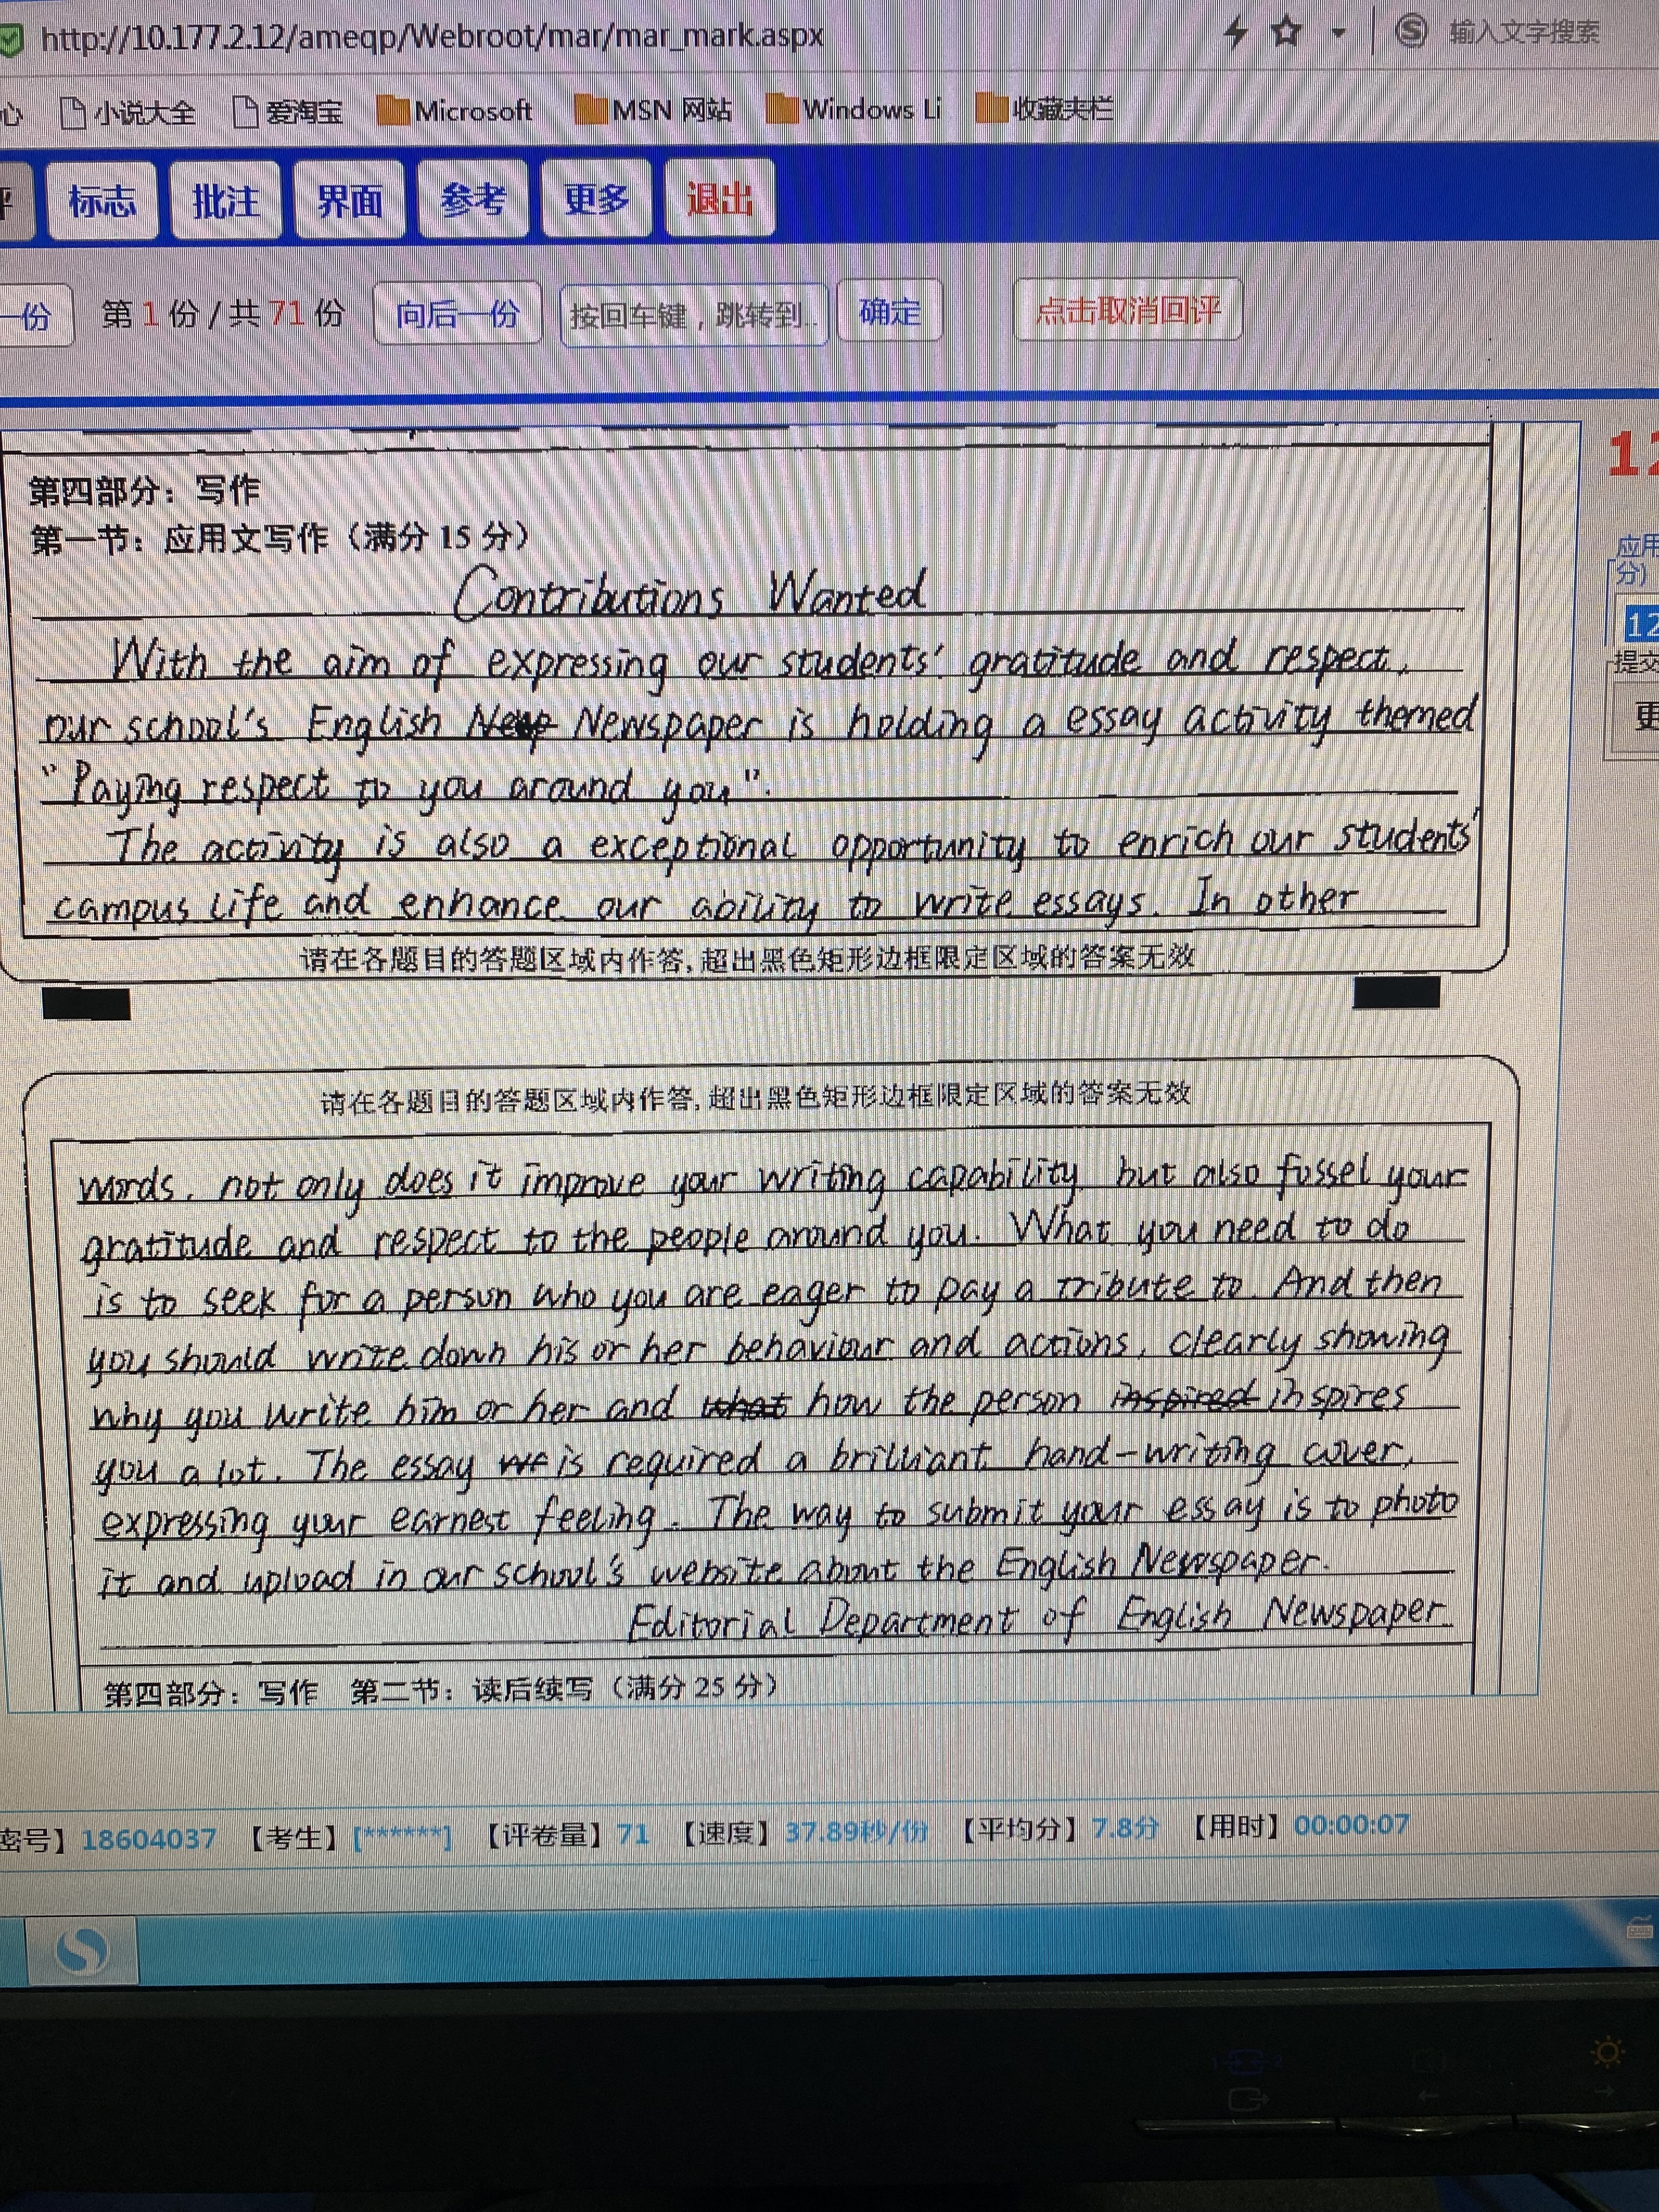
Step 4：卷面整洁齐誊写（誊）
Clearness

Slide 16
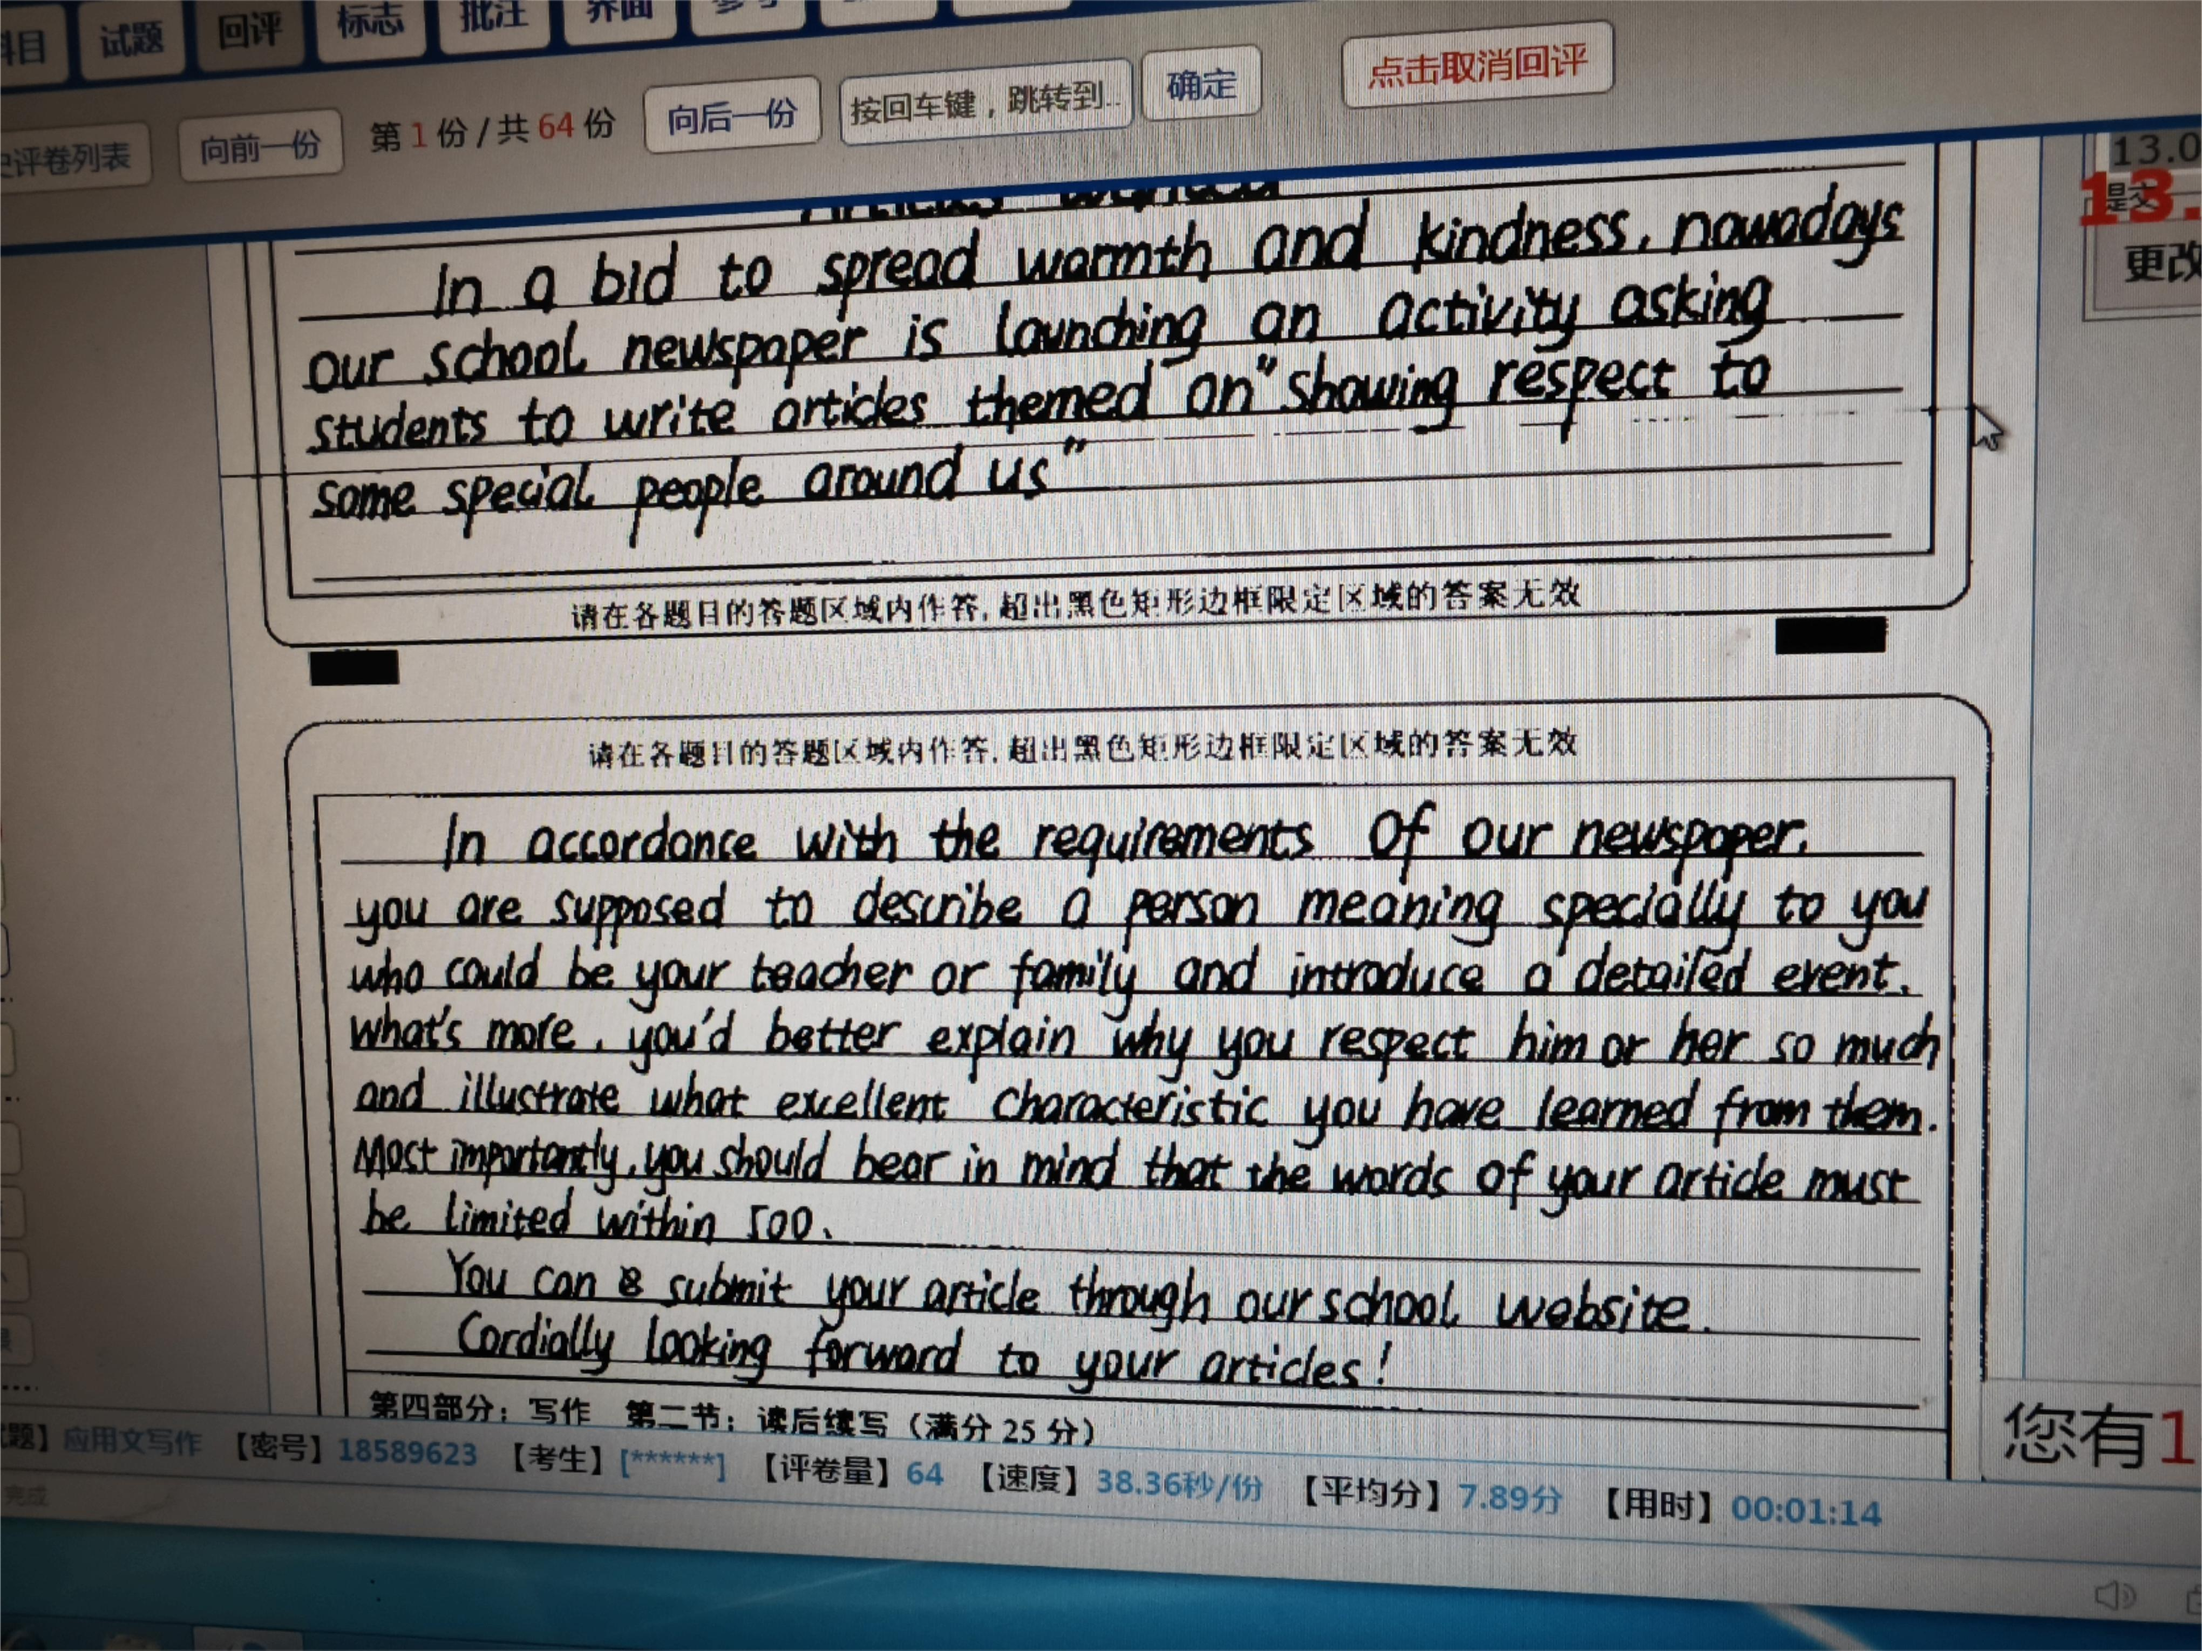
学生习作赏析
1 Completeness
文章要点齐全，对活动目的，文稿要求和投稿方式进行了详细说明
2 Correctness
语言结构丰富，非谓语，被动态，名词性从句等灵活运动，同时用词高级，词形多样化
3 Coherence
连贯较强，in accordance with, what’s more, most importantly 等的运用，使文章自成一体
4 Clearness
书写端正，卷面整洁

Slide 17
真题再现
2015·新课标全国卷Ⅰ卷
假定你是李华，你校英文报“外国文化”栏目拟刊登介绍美国节日风俗和中学生生活的短文请给美国朋友彼得写信约稿，要点如下：
1.栏目介绍；
2.稿件内容：
3.稿件长度：约400词；
4.交稿日期：6月28日前。

Slide 18
Sample
Contributions Wanted
Dear Peter,
I’d like to ask you to write an article for our school’s English newspaper.
The “Foreign Cultures” section in our newspaper is very popular among our students. It carries articles written by foreign friends about the cultures of their home countries. Would you please write something about the culture in your part of the United States? And we would especially welcome articles about how Americans spend their holidays and festivals and the life of American high school students. You can write anything relevant so long as it’s interesting and informative. 400 words would be fine. Could we have your article before June 28th? I’m looking forward to hearing from you!
Yours,
Li Hua

Slide 19
相关话题
2021年惠州模拟题
你校英语报 English World 将开展以“Every Person Is Remarkable !”为主题的征文活动，讲述身边楷模的故事。假如你是该报主编，请根据下面的提示写一则英语征稿启事。内容包括：
1. 征稿的主题和内容；
2. 投稿方式和截止时间；
3. 呼吁大家积极参与。
注意：1. 写作词数应 80 左右； 2. 请在答题卡的相应位置作答。
Contributions Wanted
__________________________________________________
__________________________________________________
English World

Slide 20
Sample
Contributions Wanted
Aiming to inspire people to lead a meaningful life and learn from role models, English World is establishing a new column and calling for articles themed “Every Person is Remarkable”. (用v.-ing作目的状语，点名征稿的目的)
It is well-known that heroes are ordinary people with great hearts. (It形式逐语句补充说明选择该主题原因) Anyone with determination, strong sense of responsibility and extraordinary willingness to devote is supposed to be remarkable and worthy learning. (with结构补充说明征文主题要求). As a consequence, if you admire someone for the above-mentioned traits, feel free to submit your excellent work to englishworld@163.com before May 20th. Not only can you demonstrate your Literary competence but also spread positive energy and build a harmonious society.(倒装句补充说明参加征文的益处). What deserves your special attention is that your work should be limited to 1000 words.（主语从句，体现句式多样化）

Slide 21
相关话题
2021年台州二模
假定你是校英文报Teens Today的学生主编，本学期该报拟开设专栏“科技与人文”（Technology and Humanity），向全校同学征集稿件。请你写一封征稿函，内容包括：
1. 稿件要求；
2. 投稿方式；
3. 录用奖励。

Slide 22
Sample
Contributions Wanted
Dear fellow students,
Good news! Teens today is to start a new column titled Technology and Humanity this term/semester (用非谓语做定语，点名征稿的主题) and we are looking to have your contributions.
Your works are required to focus on how technology has influenced or is influencing your life. They are expected to be original and (positive and) the ones based on your personal experience (用非谓语做状语，点名征稿的内容) and with illustrated pictures are preferred. Please send your articles to our office in the Students’ Center or teenstoday@163.com. If they are admitted/ accepted/ adopted, you will be rewarded with a certificate and a certain amount of prize money.
Looking forward to your sharing/ contribution/ participation.
Teens Today

