Slide 1
感恩遇见，相互成就，本课件资料仅供您个人参考、教学使用，严禁自行在网络传播，违者依知识产权法追究法律责任。
更多教学资源请关注
公众号：溯恩高中英语
知识产权声明

Slide 2
表 语 从 句
汤杰礼名师工作室 庞子凌
选择性必修二 Unit1 Grammar

Slide 3
What is the sentence structure ?
S+Link-v+Predicative(表语)
Youth
Youth is not a time of life; it is a state of mind; it is not a matter of rosy cheeks, red lips and supple knees; it is a matter of the will, a quality of the imagination, vigor of the emotions; it is the freshness of the deep spring of life.
The question is what we can do to keep young.
S+Link-v+Predicative Clause(表语从句)

Slide 4
Link-v
1
Contents
2
表从引导词
3
表从的运用

Slide 5
1
系动词

Slide 6
表状态：
appear, seem, remain, keep, stay...
表证明：
turn out, prove
1
3
5
be动词
2
4
感官动词：
look, sound, feel, find...
表变化：
become, get, turn,
grow, go, fall...

Slide 7
2
从句引导词

Slide 8
It seems ___________no one can keep young forever. However, the truth is ________ no one grows old merely by a number of years but by giving up ideas. That’s _________ years may wrinkle the skin but to give up enthusiasm may wrinkle the soul. Nowadays, the spead of “sang culture” is popular among teenagers who are never disappointed since they want nothing .That’s ______ some people have grown old,even at 20. To keep young, your attitude is _______ really matters. After all, life is ______ you deal with it.
that/as if
that
不作成分
because
作状语
why
what
作主语
how
引导词在从句中充当的成分？

Slide 9
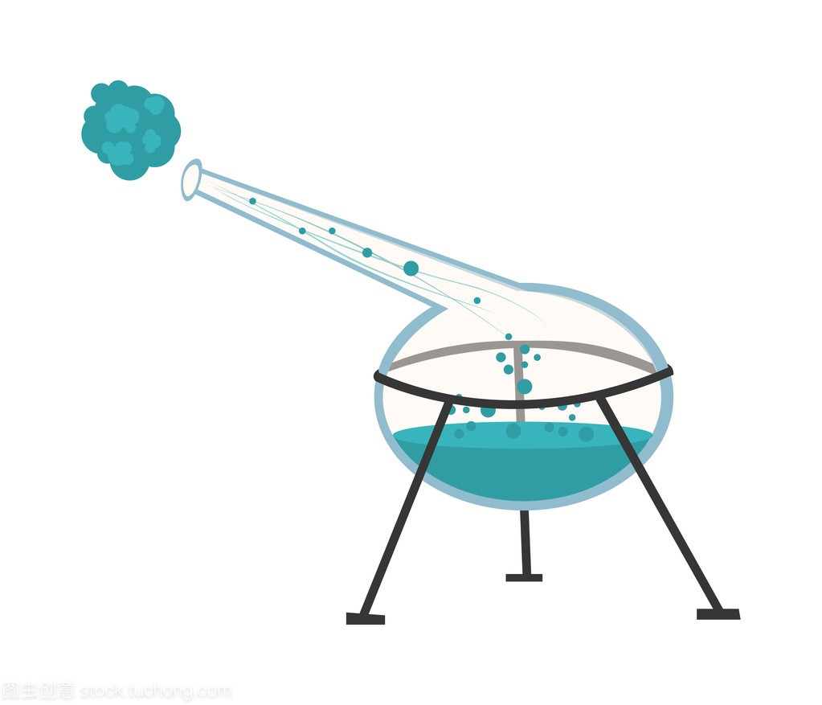
在从句不做成分:
that, whether, as if/as though, because
M: 我担心的是他能否从中抑郁消沉中走出来。
他看起来似乎对自己没有信心。
W: 那是因为他这个实验已经失败很多次了。
M: 我的建议是他可以向有经验的教授请教。
M: My concern is whether he can walk out of depression.
It seems as if he has no confidence in himself.
W:That’s because his experiment has failed over and over again.
M:My suggestion is that he (should) turn to experienced
professors for help.

Slide 10
在从句中作主、宾、表、定语:
what, which, who(m), whose
M: 我父亲希望我毕业后当医生,我母亲希望我当律师。我的苦恼是听谁的建议。
W: 你已经不再是4年前的那个你了。作为成年人，要学会做决定。
M: 我的主要考虑是这两个工作哪个适合我.
W: 我觉得你可以咨询下老师。
M: 问题是向谁求助呢
W: 校长怎么样?他总是很热心地帮助我们。
M: My father wants me to be a lawyer but my mother wants me to be a
doctor after graduation. My trouble is whose advice I should follow.
W: You are not what you were 4 years ago. As an adult, you should learn
to make a decision.
M: My top concern is which job is suitable for me.
M: I think you can consult our teachers.
M: The question is who/whom I should ask for advice.
W: How about the headmaster? He’s always ready to help us.

Slide 11
在从句中作状语:
when, where, why, how
M: 这个小村庄就是Mary生活的地方。一场车祸后她就残疾了。
那是她上高中的时候。
W:可怜的孩子。问题是她如何过上正常的生活。
M: 她是个乐观的女孩，有画画天赋。她的作品在网上很受欢迎。
这就是她能够自食其力的原因了。
M: The small village is where Mary lives. She became disabled
after a car accident. That was when she was in high school.
W: Poor girl! The question is how she has managed to live a
normal life.
M: She is an optimistic girl gifted in painting. Her works are
popular online. That’s why she can earn her living.

Slide 12
Summary
引导词
连词
关系副词
在从句中不作成分，只起连接作用
关系代词
在从句中作状语
that, whether, as if/as though, because
when, where, why, how
在从句中作主宾表定语
what, which, who(m), whose，
whatever,whichever, whoever
表语从句要使用陈述语气(主谓 )
表示建议、命令、要求等名词后的表语从句要用虚拟语气：（should）+do

Slide 13
3
表从的运用

Slide 14
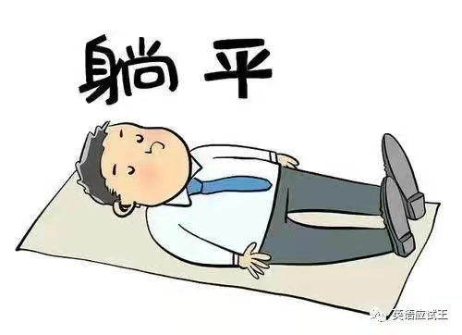
Discussion: Youth Culture
lying down/flat
involution(内卷)
rat race
hard work with little reward
to eacape the pressure of modern life
to do more than necessary and arouse people’s anxiety
What do you think of the two kinds of youth culture? Why?
What kind of youth culture do you prefer? Why?

Slide 15
Discussion: Youth Culture
lying down/flat
involution
In my group, our opinion/idea is that...
☑ That’s because...
☑ It seems as if...
☑ The question/truth is ...
☑ ... is what really matters...
☑ Our suggestion is that...
☑ ...
Try to use the predicative clause we learn today if possible.
What do you think of the two kinds of youth culture? Why?
What kind of youth culture do you prefer? Why?

Slide 16
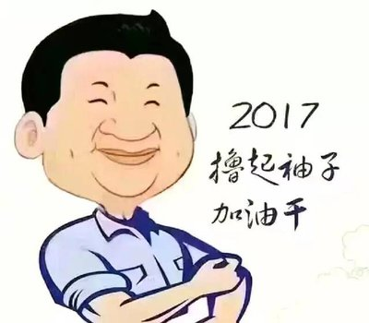
Discussion: Youth Culture
Lying down is too negative and involution is harmful. My idea is that our young generation should still be devoted to study, work or dreams in spite of pressure or difficulty in life. That’s because happiness is achieved through hard work, as President Xi once put it. It seems that sometimes what you get doesn’t match your effort. However, the truth is that Rome was not built in a day. We can not always build the future for ourselves, but we can build ourselves for the future. Diligence, patience and perservence are what really matters in success. Therefore, my suggestion is that we should never give up easily but roll up sleeves and work with added energy.
Do not choose comfort at the age when you should work the hardest.

Slide 17
Dear friends:
To realize the value of 1 year, ask the student who has failed a class.
To realize the value of 1 month, ask a mother who gave birth to a
premature baby.
To realize the value of 1 week, ask the editor of a weekly newspaper.
To realize the value of 1 hour, ask the lovers who are waiting to meet.
To realize the value of 1 minute, ask a person who missed the train.
To realize the value of 1 second, ask a person who just avoided an accident.
To realize the value of 1 millisecond, ask the person who won a silver
medel in the Olympics.
Treasure every moment that you have!
Yesterday is history. Tomorrow is mystery. Today is a gift.
That's why it is called present!
Poem
Let’s seize the day and live it to the full!

Slide 18
Homework
1. Review what we learn today
2. Finish the related exercise
about predicative clause

Slide 19
Thank you
感谢!

