Slide 1
感恩遇见，相互成就，本课件资料仅供您个人参考、教学使用，严禁自行在网络传播，违者依知识产权法追究法律责任。
更多教学资源请关注
公众号：溯恩高中英语
知识产权声明

Slide 2
Unit 5 First Aid
Using Language
period 2

Slide 3
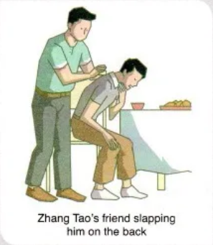
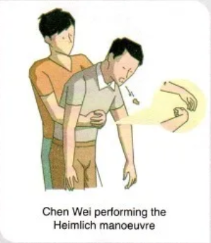
story about providing first aid
for choking

Slide 4
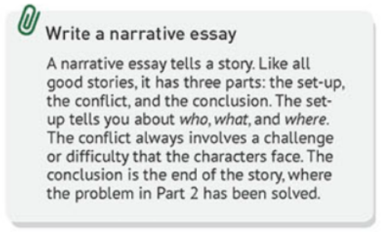
story about providing first aid
for choking
set-up
conflict
conclusion

Slide 5
Read Para 1 and find out the set-up of the story
who
Chen Wei, Zhang Tao,friends
set-up
where
at the restaurant
what
Zhang Tao was choking on some steak

Slide 6
Read the article, first put A-E in the correct places and then divide it into 3 parts.
A Choking victims usually have only about four minutes before they collapse and sometimes die
B If you see someone choking, first call the emergency services
C Chen wasted no time
D With choking victims, every minute counts
E Doing the Heimlich manoeuvre on a small child is not recommended
, leaving no time...
. Then..
. He got up...
, as...
C A B E D

Slide 7
structure:
Part 1 (Para. 1-2):
Part 2 (Para. 3-5):
Part 3 (Para. 6):
the _________ of a choking incident
story
the introduction of ____________________
the Heimlich manoeuvre
_________ on the choking incident
comments

Slide 8
Part1:the story of a choking incident
urgent need emergency
Chen Wei, a high school student in Beijing, had his dinner interrupted when he heard someone screaming from another table. A fellow diner at the restaurant, Zhang Tao, was choking on some steak. He was now holding his throat with his face turning red, while his desperate friends were slapping him on the back.
________________________. He got up and ran to Zhang’s table at once. With the help of Zhang’s friends, he was able to help Zhang to his feet. Then, standing behind Zhang, Chen did the Heimlich manoeuvre. The food was instantly forced out, and Zhang began to breathe again. Ten minutes later, an ambulance arrived. The doctors checked Zhang and made sure that he was fine. They suggested he eat more slowly and take smaller bites before they left.
Chen wasted no time
?
How did Chen save Zhang?
remained calm, reacted immediately
What was the end?

Slide 9
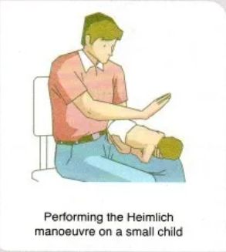
Part2:the introduction of the Heimlich manoeuvre
What is the Heimlich manoeuvre?
How is it performed?
Choking victims usually have only about four minutes before they collapse and sometimes die
_________________________________________, leaving no time for an ambulance to arrive. To solve this problem, in 1974, an American doctor, Henry Heimlich, created the Heimlich manoeuvre, saving thousands of lives around the world. Doing the Heimlich manoeuvre is quick, practical, and easy. It is so easy, in fact, that almost anyone can learn how.
____________________________________________________.Then, make sure that the victim is really choking: A choking person cannot speak. Slapping the victim’s back will often force out the obstruction. If this does not work, you can perform the Heimlich manoeuvre by standing behind him and wrapping your arms around his waist. Make a fist with one hand and place it in the upper part of his stomach. Grabbing your fist with your other hand tightly, push up and into his stomach in one motion. Continue doing this until the obstruction is forced out.
_______________________________________________________, as you may hurt him. Instead, lay the child face down on your lap with the head lower than the rest of his body, and then give firm slaps to his upper back until he can breathe again.
?
If you see someone choking, first call the emergency services
Doing the Heimlich manoeuvre on a small child is not recommended

Slide 10
Part3:comments on the choking incident
_______________________________________. You cannot just stand by and do nothing. Luckily, Chen had learnt how to give first aid in school. Seeing Zhang choking, he remained calm and reacted immediately. Chen later said about the incident, “How could I justify sitting there and doing nothing? We are all humans and we all have a responsibility to look after one another’s welfare.”
With choking victims, every minute counts
What does the quote mean?
What is the purpose of the quote?
summarizes the story;
shows Chen's emotions and opinions;
gives unique insight into his character.

Slide 11
Thinking
Can you think of a proper title for the story?
show its topic or main idea
attract readers' attention
The Heimlich Manoeuvre saved a life

Slide 12
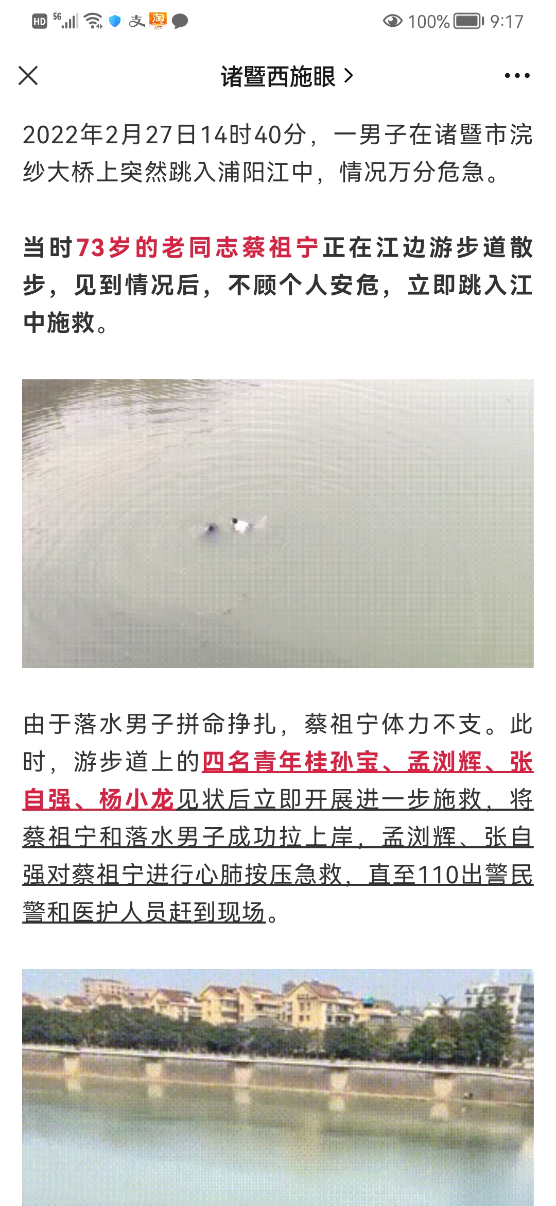
Writing
Suppose you were the reporter, write the story about providing first aid for drowning. Use what you've learnt in this class.
Notes:
several days ago, a man was drowning in the Puyang river. Seeing this, several strangers took off the clothes and jumped into the water without hesitation. Luckily the man was rescued.

Slide 13
Writing
Structure | Questions | useful expressions
Part 1 set-up
Part2 conflict
Part3 conclusion
Part4 comments
Who? What? Where?
scream; desperate; be+doing
Cai Zuning, the drowning man; four passers-by
The fellow jumped from the bridge and was struggling in the water while Cai was strolling(散步).
in the river, on the pavement

Slide 14
Writing
Cai Zuning,a 73-year-old retired worker, was strolling when he heard someone screaming. A fellow jumped into the water from the bridge. The drowning man was struggling in the water desperately.

Slide 15
Writing
Structure | Questions | useful expressions
Part 1 set-up
Part2 conflict
Part3 conclusion
Part4 comments
Who? What? Where?
scream; desperate; be+doing
waste no time; call for an ambulance; ran to... at once; help...to his feet; lay the victim on his back; pat his shoulders; check for a response; perform CPR; blow air in; push down on the centre of his chest
How?
What?
was instantly forced out; breathe again
Seeing..., he remained calm and reacted immediately; ...later said about the incident...
What?

Slide 16
Homework
1.Finish the story and add a proper title to it.
2.Exchange your article with your partner.
3.Polish your article with the help of the checklist on page 57.

Slide 17
Thank You!
It's a great honour to save a life.
--Leigh Bardugo

Slide 18
A Drowing Man Saved by Passers-by
Cai Zuning,a 73-year-old retired worker, was strolling when he heard someone screaming. A fellow jumped into the water from the bridge. The drowning man was struggling in the water desperately.
Cai wasted no time. Regardless of his own safety, he took off the clothes and dived into the freezing cold water at once. Unfortunately, Cai was too weak to draw the drowning man out of water. Seeing the urgent situation, four passers-by joined the rescue instantly. They first succeeded in carrying them onto the pavement. After laying the victims on the back, they patted their shoulders to check for a response. They made sure the drowning man was fine, but there was an urgent need to perform CPR on Cai by blowing air in and pushing down on the centre of his chest. Several minutes later, an ambulance and the police arrived.
Seeing two men drowning, Meng remained calm and reacted immediately. He later said about the incident, “It's a great honour to save a life.”

