Slide 1
感恩遇见，相互成就，本课件资料仅供您个人参考、教学使用，严禁自行在网络传播，违者依知识产权法追究法律责任。
更多教学资源请关注
公众号：溯恩英语
知识产权声明

Slide 2
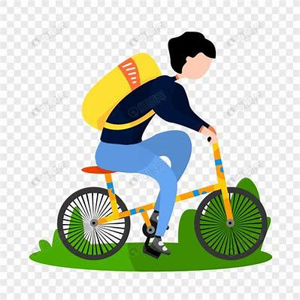
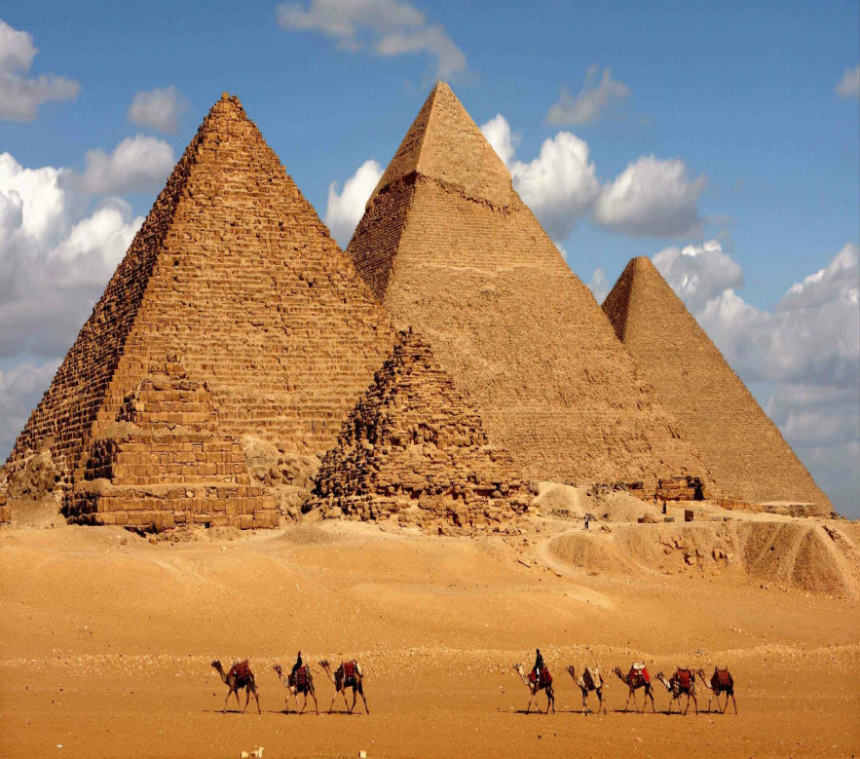
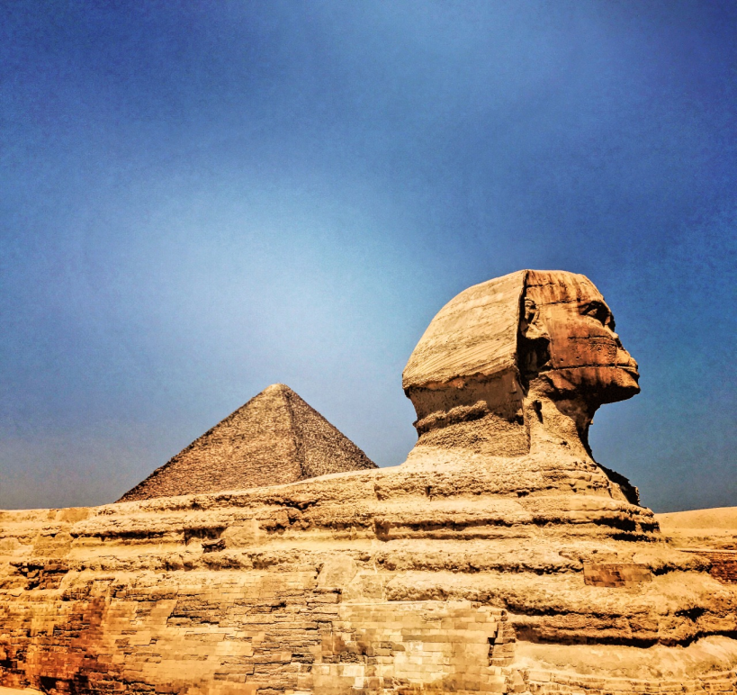
基于“三二一框架构写读后续写”的省统考真题讲评
2024年3月15日云南省高三统测读后续写
——自助的埃及文化探究之旅
浙江省天台中学 汤杰礼

Slide 3
It was July 2019 and my mum Rebecca was taking me on a 120km walking holiday from Portugal to Spain as a special treat for my 10th birthday. One day, while walking along the coastal path staring out at the Atlantic ocean, I chatted away to Mum. “When Lexi turns 10, are you going to take her on a trip like this?” I asked, referring to my seven-year-old sister. Mum said Lexi had already asked to go to Svalbard in the north of Norway because she was crazy about polar bears.
Although I was still on my first special trip, I’d been learning about ancient civilizations at school and knew I’d love to see some relics in the flesh. So I continued saying, “Why don’t I go to Egypt while you’re in Svalbard with Lexi?”, adding that my dad, Olaf, could take me there. “Great, but I’m not paying for it.” Mum replied, chuckling. “That’s fine. I’ll pay,” I said, “I’ll save up my pocket money and get a job.”
So that’s exactly what I did. Though I was too young to do any other paid work, I had my own solution. I started saving my $10-a-week pocket money. Also, I washed my parents’ car or mowed the lawn for extra cash.
In 2020, we moved to Perth. One day, I saw a pamphlet in the letter box advertising a job delivering catalogues. When I told Mum I wanted to do it, she tried to put me off the idea, reminding me that the work was tiring and time-consuming. But when seeing the determination in my eyes, she agreed to call them. Thankfully, my young age didn’t bother them – I got the job. On a Monday, a mountain of catalogues were dropped off at our house, which shocked me a lot. I told myself to calm down and dedicated to work. It took me nine hours to sort through them. At first, I used my bike and carried the catalogues in my backpack to deliver them to 430 houses in my area.
Paragraph 1: After several deliveries, I found it wasn’t very efficient. ____________________________
Paragraph 2: Three and a half years later, I saved a massive $6,500, and Dad and I flew to Cairo, Egypt. ______________________________________________________________________________________
______________________________________________________________________________________

Slide 4
It was July 2019 and my mum Rebecca was taking me on a 120km walking holiday from Portugal to Spain as a special treat for my 10th birthday. One day, while walking along the coastal path staring out at the Atlantic ocean, I chatted away to Mum. “When Lexi turns 10, are you going to take her on a trip like this?” I asked, referring to my seven-year-old sister. Mum said Lexi had already asked to go to Svalbard in the north of Norway because she was crazy about polar bears.
Although I was still on my first special trip, I’d been learning about ancient civilizations at school and knew I’d love to see some relics in the flesh. So I continued saying, “Why don’t I go to Egypt while you’re in Svalbard with Lexi?”, adding that my dad, Olaf, could take me there. “Great, but I’m not paying for it.” Mum replied, chuckling. “That’s fine. I’ll pay,” I said, “I’ll save up my pocket money and get a job.”
So that’s exactly what I did. Though I was too young to do any other paid work, I had my own solution. I started saving my $10-a-week pocket money. Also, I washed my parents’ car or mowed the lawn for extra cash.
In 2020, we moved to Perth. One day, I saw a pamphlet in the letter box advertising a job delivering catalogues. When I told Mum I wanted to do it, she tried to put me off the idea, reminding me that the work was tiring and time-consuming. But when seeing the determination in my eyes, she agreed to call them. Thankfully, my young age didn’t bother them – I got the job. On a Monday, a mountain of catalogues were dropped off at our house, which shocked me a lot. I told myself to calm down and dedicated to work. It took me nine hours to sort through them. At first, I used my bike and carried the catalogues in my backpack to deliver them to 430 houses in my area.
Paragraph 1: After several deliveries, I found it wasn’t very efficient. ____________________________
Paragraph 2: Three and a half years later, I saved a massive $6,500, and Dad and I flew to Cairo, Egypt. ______________________________________________________________________________________
先读续写段首句，迅速抓住核心人物及主体事件。
从续写段首句可知，故事的核心人物是“我”，主体事件是“我”做了投递工作，但发现工作效率不高。但三年半后，“我”积攒了足够的钱，和爸爸一起飞往埃及开罗。
那么，“我”为什么要去做投递工作？这投递工作与去埃及有关吗？
回头扫读文章，用简单的符号标注故事情节推进中的时空信息、人物身份、关系及性格特点、事件发展的基本线索、前文涉及的主要冲突与矛盾以及相应的解决措施（5W+H）。

Slide 5
It was July 2019 and my mum Rebecca was taking me on a 120km walking holiday from Portugal to Spain as a special treat for my 10th birthday. One day, while walking along the coastal path staring out at the Atlantic ocean, I chatted away to Mum. “When Lexi turns 10, are you going to take her on a trip like this?” I asked, referring to my seven-year-old sister. Mum said Lexi had already asked to go to Svalbard in the north of Norway because she was crazy about polar bears.
Although I was still on my first special trip, I’d been learning about ancient civilizations at school and knew I’d love to see some relics in the flesh. So I continued saying, “Why don’t I go to Egypt while you’re in Svalbard with Lexi?”, adding that my dad, Olaf, could take me there. “Great, but I’m not paying for it.” Mum replied, chuckling. “That’s fine. I’ll pay,” I said, “I’ll save up my pocket money and get a job.”
So that’s exactly what I did. Though I was too young to do any other paid work, I had my own solution. I started saving my $10-a-week pocket money. Also, I washed my parents’ car or mowed the lawn for extra cash.
In 2020, we moved to Perth. One day, I saw a pamphlet in the letter box advertising a job delivering catalogues. When I told Mum I wanted to do it, she tried to put me off the idea, reminding me that the work was tiring and time-consuming. But when seeing the determination in my eyes, she agreed to call them. Thankfully, my young age didn’t bother them – I got the job. On a Monday, a mountain of catalogues were dropped off at our house, which shocked me a lot. I told myself to calm down and dedicated to work. It took me nine hours to sort through them. At first, I used my bike and carried the catalogues in my backpack to deliver them to 430 houses in my area.
Paragraph 1: After several deliveries, I found it wasn’t very efficient. ____________________________
Paragraph 2: Three and a half years later, I saved a massive $6,500, and Dad and I flew to Cairo, Egypt. ______________________________________________________________________________________

Slide 6
【试题分析】
如何读 | 视 角 | 第一人称“我”
 | 时空线 | 1. 时间线：从July 2019到2020再到三年半后即2023年； 2. 空间线：西班牙海边，珀斯。
 | 情节线 | 文章讲述了“我”想去埃及文化旅游，但没有父母的经济支持，只能通过自己的劳动存钱，最终实现这一愿望。
 | 情感线 | 故事以“我”想去埃及文化旅游，通过自己的劳动存钱，最终实现这一愿望的故事为主线，故事贯串着“anticipated — determined — devoted — hardworking — delighted”向读者传递这样的理念：通过努力，实现个人理想！
 | 主 题 | “人与自我”。文章讲述了“我”想去埃及文化旅游，但没有父母的经济支持，通过“我”自身劳动努力----洗车、割草和投递目录传单，积攒旅游资金，实现个人理想----去埃及文化旅游，反映自我成长主题。
 | 语 言 | 细致的动作描写、心理描写、环境描写使作品中的人物血肉丰满，厚实感人，增强叙述的画面感。

Slide 7
It was July 2019 and my mum Rebecca was taking me on a 120km walking holiday from Portugal to Spain as a special treat for my 10th birthday. One day, while walking along the coastal path staring out at the Atlantic ocean, I chatted away to Mum. “When Lexi turns 10, are you going to take her on a trip like this?” I asked, referring to my seven-year-old sister. Mum said Lexi had already asked to go to Svalbard in the north of Norway because she was crazy about polar bears.
Although I was still on my first special trip, I’d been learning about ancient civilizations at school and knew I’d love to see some relics in the flesh. So I continued saying, “Why don’t I go to Egypt while you’re in Svalbard with Lexi?”, adding that my dad, Olaf, could take me there. “Great, but I’m not paying for it.” Mum replied, chuckling. “That’s fine. I’ll pay,” I said, “I’ll save up my pocket money and get a job.”
So that’s exactly what I did. Though I was too young to do any other paid work, I had my own solution. I started saving my $10-a-week pocket money. Also, I washed my parents’ car or mowed the lawn for extra cash.
In 2020, we moved to Perth. One day, I saw a pamphlet in the letter box advertising a job delivering catalogues. When I told Mum I wanted to do it, she tried to put me off the idea, reminding me that the work was tiring and time-consuming. But when seeing the determination in my eyes, she agreed to call them. Thankfully, my young age didn’t bother them – I got the job. On a Monday, a mountain of catalogues were dropped off at our house, which shocked me a lot. I told myself to calm down and dedicated to work. It took me nine hours to sort through them. At first, I used my bike and carried the catalogues in my backpack to deliver them to 430 houses in my area.
Paragraph 1: After several deliveries, I found it wasn’t very efficient. ____________________________
Paragraph 2: Three and a half years later, I saved a massive $6,500, and Dad and I flew to Cairo, Egypt. ______________________________________________________________________________________
Read the text again and try to find the conflicts and solutions in the story.
Conflict 1
Solution 1
Conflict 2
Solution 2
Conflict 3

Slide 8
It was July 2019 and my mum Rebecca was taking me on a 120km walking holiday from Portugal to Spain as a special treat for my 10th birthday. One day, while walking along the coastal path staring out at the Atlantic ocean, I chatted away to Mum. “When Lexi turns 10, are you going to take her on a trip like this?” I asked, referring to my seven-year-old sister. Mum said Lexi had already asked to go to Svalbard in the north of Norway because she was crazy about polar bears.
Although I was still on my first special trip, I’d been learning about ancient civilizations at school and knew I’d love to see some relics in the flesh. So I continued saying, “Why don’t I go to Egypt while you’re in Svalbard with Lexi?”, adding that my dad, Olaf, could take me there. “Great, but I’m not paying for it.” Mum replied, chuckling. “That’s fine. I’ll pay,” I said, “I’ll save up my pocket money and get a job.”
So that’s exactly what I did. Though I was too young to do any other paid work, I had my own solution. I started saving my $10-a-week pocket money. Also, I washed my parents’ car or mowed the lawn for extra cash.
In 2020, we moved to Perth. One day, I saw a pamphlet in the letter box advertising a job delivering catalogues. When I told Mum I wanted to do it, she tried to put me off the idea, reminding me that the work was tiring and time-consuming. But when seeing the determination in my eyes, she agreed to call them. Thankfully, my young age didn’t bother them – I got the job. On a Monday, a mountain of catalogues were dropped off at our house, which shocked me a lot. I told myself to calm down and dedicated to work. It took me nine hours to sort through them. At first, I used my bike and carried the catalogues in my backpack to deliver them to 430 houses in my area.
Paragraph 1: After several deliveries, I found it wasn’t very efficient. ____________________________
Paragraph 2: Three and a half years later, I saved a massive $6,500, and Dad and I flew to Cairo, Egypt. ______________________________________________________________________________________
Para. | Conflicts | Resolutions | Feelings
2
3
“Why don’t I go to Egypt while you’re in Svalbard with Lexi?”
“That’s fine. I’ll pay,” I said, “I’ll save up my pocket money and get a job.”
anticipated
“Great, but I’m not paying for it.”
determined
I started saving my $10-a-week pocket money. Also, I washed my parents’ car or mowed the lawn for extra cash.
devoted
hard-working

Slide 9
Para. | Conflicts | Resolutions | Feelings
4
5
It was July 2019 and my mum Rebecca was taking me on a 120km walking holiday from Portugal to Spain as a special treat for my 10th birthday. One day, while walking along the coastal path staring out at the Atlantic ocean, I chatted away to Mum. “When Lexi turns 10, are you going to take her on a trip like this?” I asked, referring to my seven-year-old sister. Mum said Lexi had already asked to go to Svalbard in the north of Norway because she was crazy about polar bears.
Although I was still on my first special trip, I’d been learning about ancient civilizations at school and knew I’d love to see some relics in the flesh. So I continued saying, “Why don’t I go to Egypt while you’re in Svalbard with Lexi?”, adding that my dad, Olaf, could take me there. “Great, but I’m not paying for it.” Mum replied, chuckling. “That’s fine. I’ll pay,” I said, “I’ll save up my pocket money and get a job.”
So that’s exactly what I did. Though I was too young to do any other paid work, I had my own solution. I started saving my $10-a-week pocket money. Also, I washed my parents’ car or mowed the lawn for extra cash.
In 2020, we moved to Perth. One day, I saw a pamphlet in the letter box advertising a job delivering catalogues. When I told Mum I wanted to do it, she tried to put me off the idea, reminding me that the work was tiring and time-consuming. But when seeing the determination in my eyes, she agreed to call them. Thankfully, my young age didn’t bother them – I got the job. On a Monday, a mountain of catalogues were dropped off at our house, which shocked me a lot. I told myself to calm down and dedicated to work. It took me nine hours to sort through them. At first, I used my bike and carried the catalogues in my backpack to deliver them to 430 houses in my area.
Paragraph 1: After several deliveries, I found it wasn’t very efficient. ____________________________
Paragraph 2: Three and a half years later, I saved a massive $6,500, and Dad and I flew to Cairo, Egypt. ______________________________________________________________________________________
再仔细阅读已知文本最后一段，确保续写首段的内容与上文紧密联系，使续写内容与原文高度融合。
I told Mum I wanted to do it (delivering catalogues)
Seeing the determination in my eyes, she agreed to call them. … I got the job.
determined
She(Mum) tried to put me off the idea, reminding me that the work was tiring and time-consuming.
devoted
hard-working
After several deliveries, I found it wasn’t very efficient

Slide 10
It was July 2019 and my mum Rebecca was taking me on a 120km walking holiday from Portugal to Spain as a special treat for my 10th birthday. One day, while walking along the coastal path staring out at the Atlantic ocean, I chatted away to Mum. “When Lexi turns 10, are you going to take her on a trip like this?” I asked, referring to my seven-year-old sister. Mum said Lexi had already asked to go to Svalbard in the north of Norway because she was crazy about polar bears.
Although I was still on my first special trip, I’d been learning about ancient civilizations at school and knew I’d love to see some relics in the flesh. So I continued saying, “Why don’t I go to Egypt while you’re in Svalbard with Lexi?”, adding that my dad, Olaf, could take me there. “Great, but I’m not paying for it.” Mum replied, chuckling. “That’s fine. I’ll pay,” I said, “I’ll save up my pocket money and get a job.”
So that’s exactly what I did. Though I was too young to do any other paid work, I had my own solution. I started saving my $10-a-week pocket money. Also, I washed my parents’ car or mowed the lawn for extra cash.
In 2020, we moved to Perth. One day, I saw a pamphlet in the letter box advertising a job delivering catalogues. When I told Mum I wanted to do it, she tried to put me off the idea, reminding me that the work was tiring and time-consuming. But when seeing the determination in my eyes, she agreed to call them. Thankfully, my young age didn’t bother them – I got the job. On a Monday, a mountain of catalogues were dropped off at our house, which shocked me a lot. I told myself to calm down and dedicated to work. It took me nine hours to sort through them. At first, I used my bike and carried the catalogues in my backpack to deliver them to 430 houses in my area.
Paragraph 1: After several deliveries, I found it wasn’t very efficient. ____________________________
Paragraph 2: Three and a half years later, I saved a massive $6,500, and Dad and I flew to Cairo, Egypt. ______________________________________________________________________________________
Para. | Conflicts | Plot resolutions | Feelings
4
5
6
I used my bike and carried the catalogues in my backpack to deliver them to 430 houses in my area
devoted
hard-working
Try to figure out the reason why it wasn’t efficient and how to solve it. My three and a half years’ hard work and reflections.
Try to figure out the reason why it wasn’t efficient and how to solve it.
After several deliveries, I found it wasn’t very efficient
Three and a half years later, I saved a massive $6,500, and Dad and I flew to Cairo, Egypt.
What I did in Egypt and reflect on this trip and reflections of my growth.
enjoyable

Slide 11
In 2020, we moved to Perth. One day, I saw a pamphlet in the letter box advertising a job delivering catalogues. When I told Mum I wanted to do it, she tried to put me off the idea, reminding me that the work was tiring and time-consuming. But when seeing the determination in my eyes, she agreed to call them. Thankfully, my young age didn’t bother them – I got the job. On a Monday, a mountain of catalogues were dropped off at our house, which shocked me a lot. I told myself to calm down and dedicated to work. It took me nine hours to sort through them. At first, I used my bike and carried the catalogues in my backpack to deliver them to 430 houses in my area.
Paragraph 1: After several deliveries, I found it wasn’t very efficient. ____________________________
____________________________________________________________________________________________________________________________________________________________________________________________________________________________________________________________________________________________________________________________________________________________________________________________________________________________________________________________________________________________________________________________________
Paragraph 2: Three and a half years later, I saved a massive $6,500, and Dad and I flew to Cairo, Egypt. ______________________________________________________________________________________
______________________________________________________________________________________________________________________________________________________________________________________________________________________________________________________________________________________________________________________________________________________________________________________________________________________________________________
In 2020, we moved to Perth. One day, I saw a pamphlet in the letter box advertising a job delivering catalogues. When I told Mum I wanted to do it, she tried to put me off the idea, reminding me that the work was tiring and time-consuming. But when seeing the determination in my eyes, she agreed to call them. Thankfully, my young age didn’t bother them – I got the job. On a Monday, a mountain of catalogues were dropped off at our house, which shocked me a lot. I told myself to calm down and dedicated to work. It took me nine hours to sort through them. At first, I used my bike and carried the catalogues in my backpack to deliver them to 430 houses in my area.
Paragraph 1: After several deliveries, I found it wasn’t very efficient. ____________________________
____________________________________________________________________________________________________________________________________________________________________________________________________________________________________________________________________________________________________________________________________________________________________________________________________________________________________________________________________________________________________________________________________
Paragraph 2: Three and a half years later, I saved a massive $6,500, and Dad and I flew to Cairo, Egypt. ______________________________________________________________________________________
______________________________________________________________________________________________________________________________________________________________________________________________________________________________________________________________________________________________________________________________________________________________________________________________________________________________________________
Conflict 3
Solution 3
[1]
寻求低效原因
[2]
解决低效投递方法
[3]
三年半努力与感悟
[1]
享受埃及文化之旅
[2]
埃及文化之旅感想
[3]
个人成长感悟

Slide 12
In 2020, we moved to Perth. One day, I saw a pamphlet in the letter box advertising a job delivering catalogues. When I told Mum I wanted to do it, she tried to put me off the idea, reminding me that the work was tiring and time-consuming. But when seeing the determination in my eyes, she agreed to call them. Thankfully, my young age didn’t bother them – I got the job. On a Monday, a mountain of catalogues were dropped off at our house, which shocked me a lot. I told myself to calm down and dedicated to work. It took me nine hours to sort through them. At first, I used my bike and carried the catalogues in my backpack to deliver them to 430 houses in my area.
Paragraph 1: After several deliveries, I found it wasn’t very efficient. ____________________________
____________________________________________________________________________________________________________________________________________________________________________________________________________________________________________________________________________________________________________________________________________________________________________________________________________________________________________________________________________________________________________________________________
Paragraph 2: Three and a half years later, I saved a massive $6,500, and Dad and I flew to Cairo, Egypt. ______________________________________________________________________________________
______________________________________________________________________________________________________________________________________________________________________________________________________________________________________________________________________________________________________________________________________________________________________________________________________________________________________________
Q1: Why was my delivery inefficient?
Q2: What could I do to solve this problem?
Q3: What about my routine work and my progress in achieving my dream? What was my reflection on my hard work?
Q1: How did I feel when I got to Cairo?
Q2: What did I do in Egypt and how did I feel?
Q3: What were my reflections on this special trip?

Slide 13
Related vocabulary bank for writing 写作相关词汇库
1. slow … down 减速
2. attach a small trailer to my bike在我的自行车上装一个小拖车
3. cover more houses in less time在更短的时间内送更多的客户4. continue this routine 继续这日常要做的事
5. savings fund 储蓄基金
6. bring me closer to my dream让我更接近我的梦想
7. the ancient pyramids and the majestic Sphinx 古老的金字塔和雄伟的狮身人面像
8. take a cruise down the Nile River 沿着尼罗河乘船游览
9. fascinating history of Egypt迷人的埃及历史
10. achieve … with determination and hard work 以决心和努力实现 ……

Slide 14
范文评析：
After several deliveries, I found it wasn’t very efficient.衔接①低效原因与措施The backpack was too heavy and slowed me down. So, I got creative and attached a small trailer to my bike, which allowed me to distribute the weight more evenly and carry more catalogues at a time.过渡① 改进后的效果This significantly increased my efficiency, and I was able to cover more houses in less time. Despite the physical challenge, the sense of accomplish-ment after each delivery round was immense心理描写 . I even started to receive tips from some of the homeowners who appreciated my dedication意外收获. This extra money went straight into my Egypt savings fund. As I continued this routine, I learned the importance of hard work, perseverance, and the value of money. 个人成长感悟Each catalogue delivered brought me closer to my dream.衔接②

Slide 15
范文评析：
Three and a half years later, I saved a massive $6,500, and Dad and I flew to Cairo, Egypt.衔接③ The trip was everything I had hoped for and more. Seeing the ancient pyramids and the majestic Sphinx in person was surreal, and I couldn’t believe I was standing in front of these historical monuments I had only read about in books.过渡② We even took a cruise down the Nile River, where I saw the beautiful landscapes and learned more about the fascinating history of Egypt.一靓尾：升华主题----感悟个人成长 This journey wasn’t just about seeing the relics; it was a testament to what I could achieve with determination and hard work. It was a trip that went beyond my expectations, filled with memories that I would cherish forever. And it all started with a simple idea and the willpower to save every penny from delivering catalogues.

Slide 16
词汇和表达积累：
chat away to sb 和......聊个不停
be crazy about为......疯狂;着迷于......
learn about ancient civilizations了解古代文明
in the flesh=in person 亲自
mow the lawn 修剪草坪
try to put me off the idea 想让我打消这个念头
be dropped off at our house 被送到我们家
distribute the weight more evenly更均匀地分配重量
significantly increase my efficiency大大提高了我的效率
appreciate my dedication 感谢我的付出
It was a trip that went beyond my expectations, filled with memories that I would cherish forever.
这是一次超出我预期的旅行，充满了我将永远珍惜的回忆。
13. It all started with a simple idea and the willpower to save every penny from delivering catalogues.
这一切都始于一个简单的想法，以及从送货目录中节省每一分钱的意志力。

