Slide 1
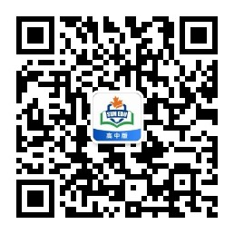
感恩遇见，相互成就，本课件资料仅供您个人参考、教学使用，严禁自行在网络传播，违者依知识产权法追究法律责任。
更多教学资源请关注
公众号：溯恩高中英语
知识产权声明

Slide 2
Unit 1 People of achievement
Period 3 Using language
--Explore the meaning of greatness

Slide 3
Lead in
Tu Youyou
Tu Youyou was awarded Nobel
Prize in 2015 because of her
discovery of artemisinin, a crucial
new treatment for malaria.She
made great achievements in
medicine.

Slide 4
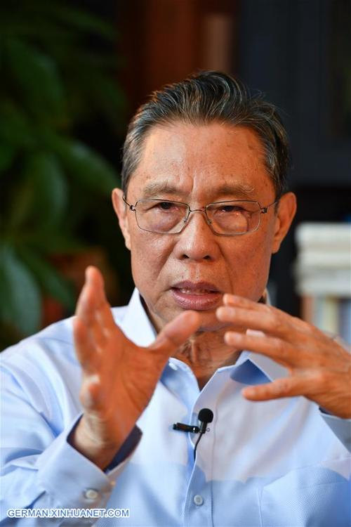
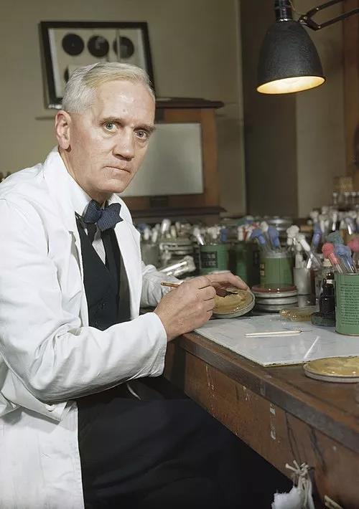
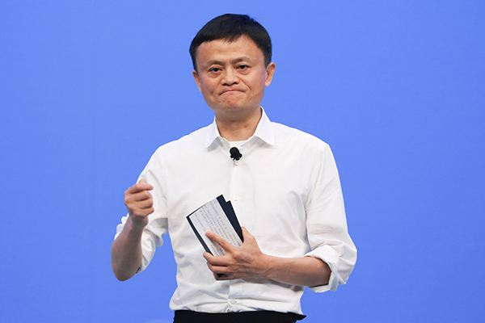
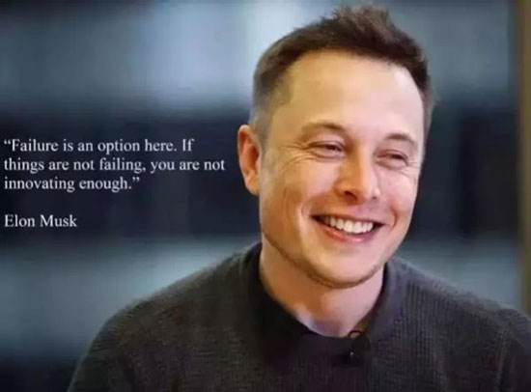
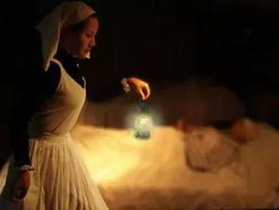
Pre-Listening
Do you know them ?
Text in here
Zhong Nanshan
Alexander Fleming
Jack Ma
Elon Musk
(埃隆·马斯克)
Bill Gates
Florence Nightingale

Slide 5
While-Listening---Activity1 Task 1
1. Match the people with their achievements.
1 Elon Musk
2 Bill Gates
3 Jack Ma(Ma Yun)
4 Alexander Fleming
5 Florence Nightingale
6 Zhong Nanshan
A founder of modern nursing
B founded high tech and futuristic companies
C managed the SARS outbreak
D made great advancement in online shopping
E made home computing accessible
F discovered penicillin
Now, let's learn more information about these great people!
2. Listen to the conversation and check your answers.

Slide 6
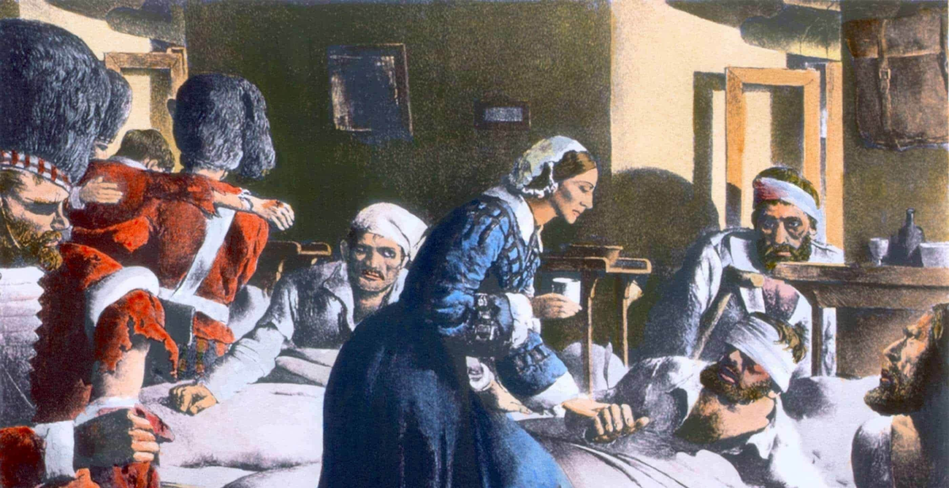
Florence Nightingale
Born: May 12, 1820
Died: Aug. 13, 1910
 Florence Nightingale is best known for her pioneering
work in the field of nursing.
 She tended to wounded soldiers during the Crimean War(克里
米亚战争).
 She became known as the “Lady with the Lamp” because of
her night rounds.

Slide 7
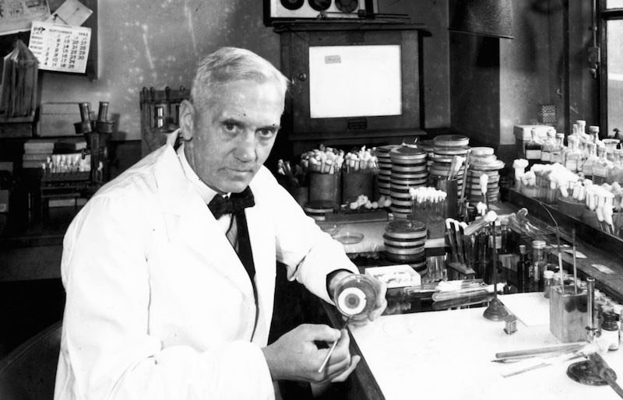
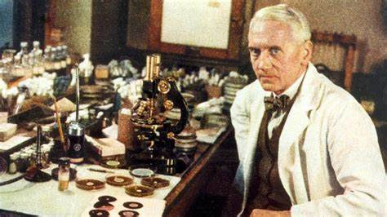
Alexander Fleming
Born: Aug. 6, 1881
Died: Mar. 11, 1955
 Alexander Fleming was a Scottish bacteriologist(细菌学家)
and Nobel Prize winner, best known for his discovery of
penicillin.
 He is one of the most influential people of the 20th century.

Slide 8
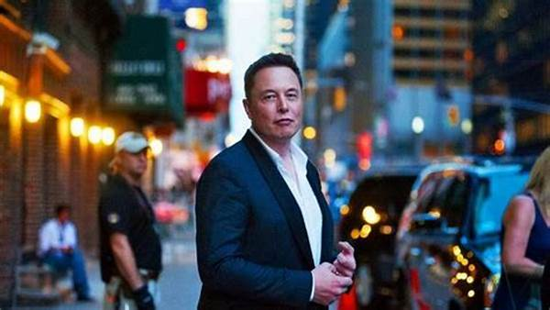
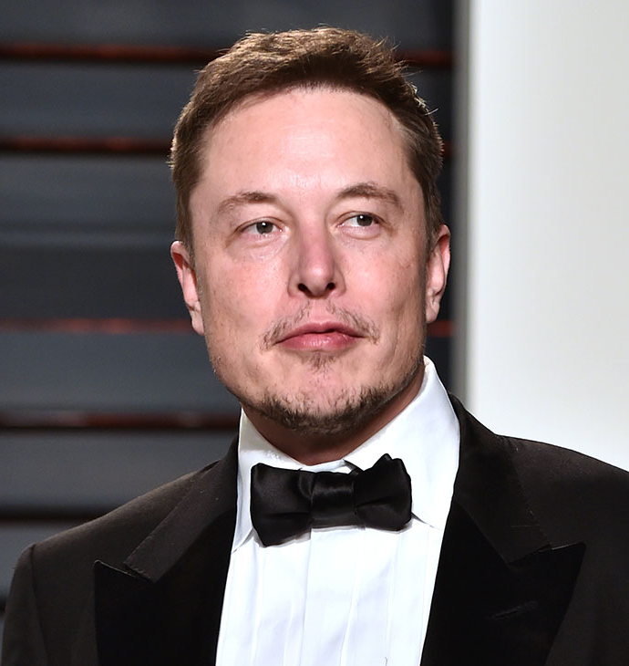
Elon Musk
Born: June 28, 1971
 Elon Musk is a South African-born American entrepreneur
(企业家) and businessman.
 He is known for founding X.com in 1999 (which later became
PayPal), SpaceX in 2002 and Tesla Motors in 2003.

Slide 9
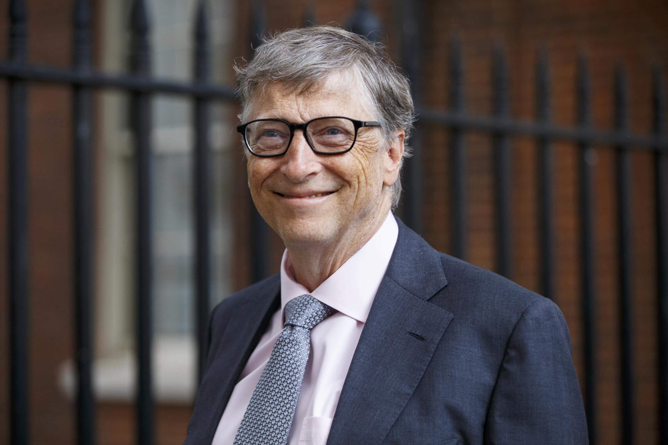
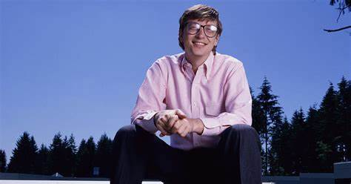
Bill Gates
Born: Oct. 28, 1955
 Bill Gates is an American business magnate, software
developer, investor, and philanthropist(慈善家).
 He is best known as the co-founder of Microsoft Corporation.
 He is one of the best-known entrepreneurs and pioneers of
the microcomputer revolution of the 1970s and 1980s.

Slide 10
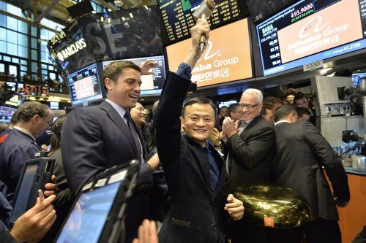
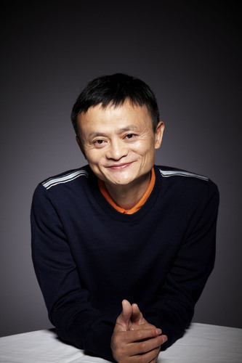
Jack Ma
Born: Sep. 10, 1964
 Jack Ma is a Chinese entrepreneur, founder and former
executive chairman of Alibaba Group.
 During the COVID-19, his foundation donated millions of
masks and other medical supplies to the U.S., Europe, and
Africa.

Slide 11
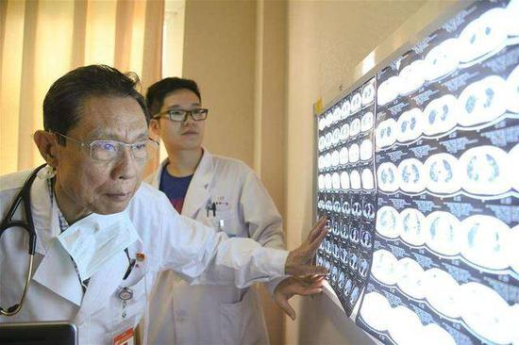
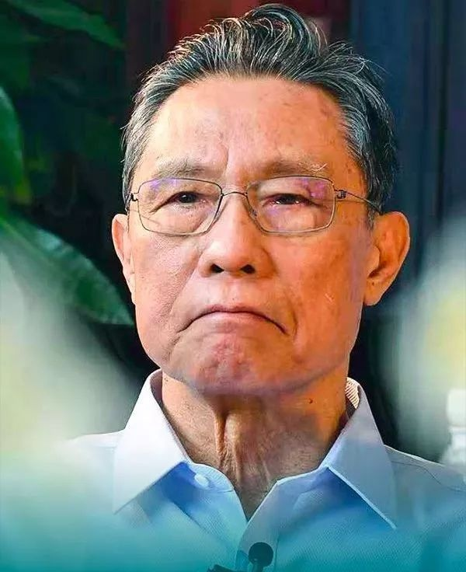
Zhong Nanshan
Born: Oct. 20, 1936
 Zhong Nanshan is one of the greatest doctors in China, as
well as an academic at the Chinese Academy of Engineering.
 Zhong discovered the SARS coronavirus back in 2003 and
played an important role in the country's fight against the
epidemic as a leading scientist.
 He is seen as one of the most respectable and trusted
figures during China's battle against COVID-19 and serves
as an adviser to the government in managing the crisis.

Slide 12
While-Listening---Activity2
Listen to the conversation again. Who does each speaker admire? Tick in the table below.
 | Dr Wang | Wang Lin | Anna Smith
Elon Musk
Bill Gates
Jack Ma
Zhong Nanshan
Florence Nightingale
Alexander Fleming
Dr Wang
√
√
√
√
√
√
√
√
√
√

Slide 13
While-Listening---Activity3
Listen again and answer the questions.
Listen again and answer the questions.
er the questions.
n and answer the questions.
1.Why does Dr Wang say “money isn't everything”?
2. What is the real reason Anna admires the famous people, and what examples does she give?
3. What kind of person do you think Wang Lin admires? Why?
Listen for reasons:
When people give their opinions or decisions on a matter, they often give reasons for them. Sometimes the reason is introduced by words such as because or due to. At other times, the reason is given right after the opinion or decision, and the link can be inferred.
Because he doesn’t believe that money alone is a true measure of success.
Because they have worked so hard to achieve their goals and have positive contributions to society. She mentions Elon Musk and Bill Gates.
She admires people that do good things and inspire her, because she mentions these two things when she talks about how wonderful her father is.

Slide 14
Transcript
Anna Smith=AS; Dr Wang=DW; Wang Lin= WL
AS: Hi, Dr Wang! Hi, Wang Lin! Did you hear? Elon Musk’s company just launched another rocket.
DW: Elon Musk? Who’s he?
AS: He’s the guy who founded a private space company, and also some other companies. The companies he founds are all really high-tech and futuristic. He's made millions of dollars.
WL: Oh, he must be a really smart guy, and so rich right now!
AS: Yes, I'd say he’s as famous as Bill Gates or Jack Ma now. They're really smart, too. Just think of all that money they must make!
DW: Well, you two, it's great that they've been able to become so successful and make all that money, but money isn’t everything. Just look at people like Alexander Fleming, who discovered penicillin, and Florence Nightingale, the founder of modern nursing, and my own personal hero, Dr Zhong Nanshan, who managed the SARS outbreak-they never made millions of dollars, but their contributions to health care have saved countless lives.

Slide 15
Anna Smith=AS; Dr Wang=DW; Wang Lin= WL
WL: Yes, Dad, sorry. We know-they are great examples to everyone … But, you know, successful people like Bill Gates and Jack Ma have donated millions of dollars to charity, which should also count for something, right?
DW: Well, you’re right on that point. They’re certainly being responsible in that way. Moreover, they’re good for working hard and becoming successful.
AS: Yes, exactly! And Dr Wang, I think you misunderstood me just now. I agree with you. I like those people because they have worked so hard to achieve their goals and have positive contributions to society. It's not just due to how much money they make. Elon Musk, for example, is trying to help the future of humankind, and Bill Gates has given us home computers. I think we need more creative people like them.
WL: Well, don’t forget Jack Ma’s contribution. Without him, I wouldn’t find it so easy to shop online! And by the way, Dad, if we’re talking about people who do good things and inspire us - you inspire me, Dad…

Slide 16
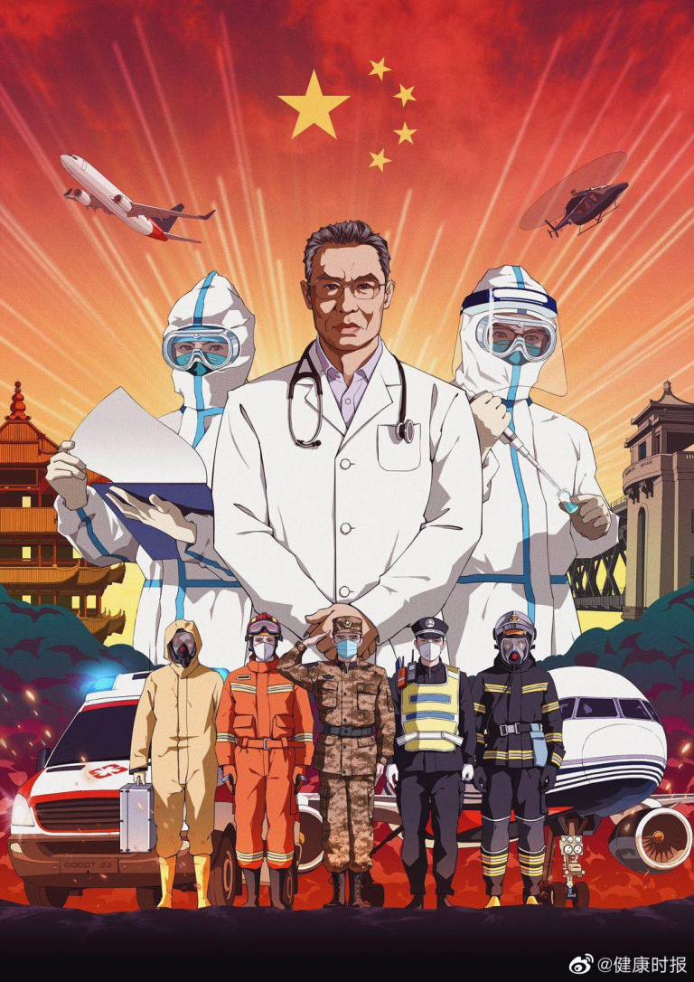
Post-Listening---Activity4 Speaking
Post
Listen
Who do you admire most? Why?
Zhong Nanshan is the person I admire most. Because he is the hero in the fight against SARS and COVID-19.

Slide 17
Sentences for Reference
The person I admire most is...
...is best known for...
...one of the most influential person...
...is seen as one of the most respectable and trusted figures in ...
It is he /she that ...
...

Slide 18
Sample
Hello, everyone! The person I admire most is Dr. Zhong Nanshan, who managed the SARS outbreaks in China in 2003. It's he that prevented the COVID-19 from quick spread all over the country once again. Dr Zhong Nanshan took risks entering the isolated area to cure the patients, sharing his successful experience with other from home and abroad . He serves as a good role model and makes great contributions to society. That's all. Thank you!

Slide 19
Post-Listening---Activity5 Dialogue
Brainstorm the names of some great people and discuss what makes them great .Try to use the following language fillers to give yourself time to think and make a dialogue with your partner.
Giving time to think
(Er/Oh/Um,) let me see/think ... Right./Sure.
Well, er,.... Really? Anyway, ... Well, I guess, ...
Just a moment. You see/know, ...
Hang on a second. So, ...
May I think about that for a moment? I've nealy got it, er, ...
How can/shall/should I put this/it? Well, it's on the tip of my tongue.

Slide 20
Sample
Jack: Bill, what makes these people great ?
Bill: Um, May I think about that for a moment ?
Jack: Jim, what's your opinion about it ?
Jim: I think it's the persistence that makes them great just like the father of India, er, ... It's on the tip of my tongue, but ...
Bill: Mohatma Gandi.
Jim: Right.
Bill: Besides, I guess it's also their wisdom that keeps them free from the dangers till succeess.

Slide 21
Post-Listening---Activity6 Summary
The meaning of greatness
Use the discussion to draw conclusion about the meaning of greatness. The following expressions may help you. Then report back to the class.
 has achieved financial success
 has invented new products
 has made great discoveries
 serves as a good role model
 brings happiness to other people
 makes great contributions
to society
 The greatest person l know of is…, who…
 To be great, a person should…
 To me, greatness means…

Slide 22
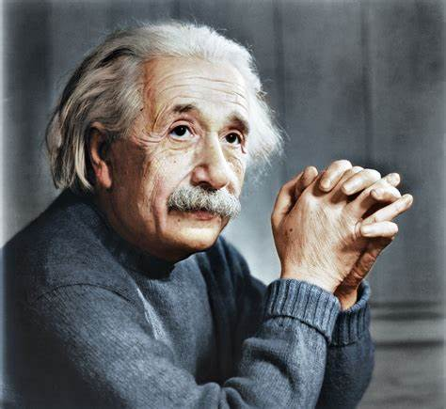
Try not to become a man of success but rather try to become a man of value. —— A. Einstein
不要为成功而努力，要为做一个有价值的人而努力。
——爱因斯坦

Slide 23
Thank You!

