Slide 1

感恩遇见，相互成就，本课件资料仅供您个人参考、教学使用，严禁自行在网络传播，违者依知识产权法追究法律责任。
更多教学资源请关注
公众号：溯恩高中英语
知识产权声明

Slide 2
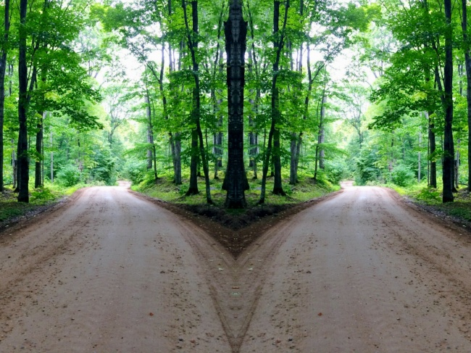
U5 Poems
Reading and Thinking
暨阳分校 陈莹
2022.04

Slide 3

Lead in
nursery rhyme
Hush, little baby, don’t say a word,
Papa’s gonna buy you a mockingbird.
If that mockingbird won’t sing,
Papa’s gonna buy you a diamond ring.
If that diamond ring turns to brass,
Papa’s gonna buy you a looking glass.
If that looking-glass gets broke,
Papa’s gonna buy you a billy-goat.
If that billy-goat won’t pull,
Papa’s gonna buy you a cart and bull.
rhyme
rhythm
poetic devices
often include rhyme, rhythm, repetition, simile(明喻）, metaphor（暗喻）, imagery(意象), personification(拟人)
Notes:
插入音频

Slide 4
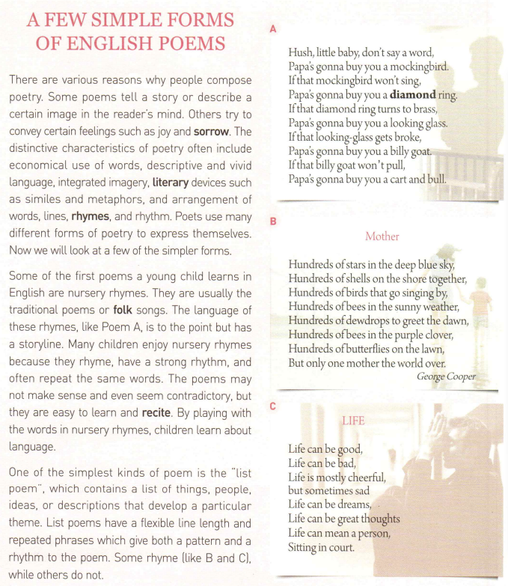
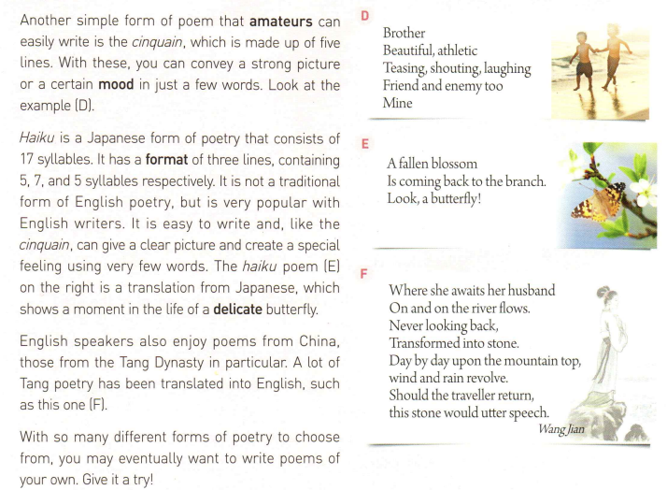
Read for the answers
Predict
What do you expect to read from the passage?
Read the text to find answers

Slide 5
Read for the structure
How to divide the passage into three parts?
introduction
reasons
&
characteristics
forms
forms
conclusion

Slide 6
Group work
Appreciate the poems with your partners and complete the rest of the table
Example | Type of poem | Characteristics | Language (poetic devices) | Theme/image
A | nursery rhyme | to the point, has a storyline, don't make sense, even seem contradictory, easy to learn and write
B
C
D
E
F
rhyme,
rhythm,
repetition
a father's love for baby
Poetic devices often include rhyme, rhythm, repetition, simile(明喻）, metaphor（暗喻）, imagery(意象), personification(拟人)
?

Slide 7
Learn to apply
Type of poem | Characteristics | Language (poetic devices) | Theme/Image
repetition, rhyme, rhythm, contrast
love for his mother
List poem
a list of..., flexible line length, repeated phrasese
repetition, rhyme, rhythm
life

Slide 8
Learn to apply
one word (topic)
two adjs
three verbs with -ing
four words
one word
Type of poem | Characteristics | Language (poetic devices) | Theme/image
economical use of words, descriptive and vivid language
love between brothers
Cinquain
five lines
3 lines with 5,7,5 syllables respectively
a delicate butterfly
Haiku
metaphor

Slide 9
Learn to think critically
《望夫石》
望夫处，江悠悠。
化为石，不回头。
上头日日风复雨，
行人归来石应语。
Which version do you prefer? Why?
Type of poem | Characteristics | Language (poetic devices) | Theme/image
Tang poem
a sad yet hopeful woman waiting for her beloved husband
/
personification

Slide 10
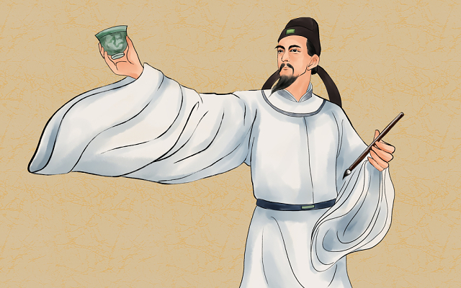
Learn to create
With so many different forms of poetry to choose from, you may eventually want to write poems of your own.
write poems of your own
Give it a try!
one word (topic)
two adjs
three verbs with -ing
four words
one word

Slide 11
Thinking
What can poems bring to us?
◆ Poems bring passion to our life.
◆Poems help us to understand life, virtues, beauty and romance.
◆Poems make us know we are here and that we can make our life and the world more colorful and beautiful.

Slide 12
Homework
1. Appreciate the poem according to what we've learnt in this class.
2. Translate it into Chinese.
When You Are Old
When you are old and grey and full of sleep,
And nodding by the fire, take down this book,
And slowly read, and dream of the soft look,
Your eyes had once, and of their shadows deep;
How many loved your moments of glad grace,
And loved your beauty with love false or true,
But one man loved the pilgrim soul in you,
And loved the sorrows of your changing face;
And bending down beside the glowing bars,
Murmur, a little sadly, how Love fled,
And paced upon the mountains overhead,
And hid his face amid a crowd of stars.
William Butler Yeats

Slide 13
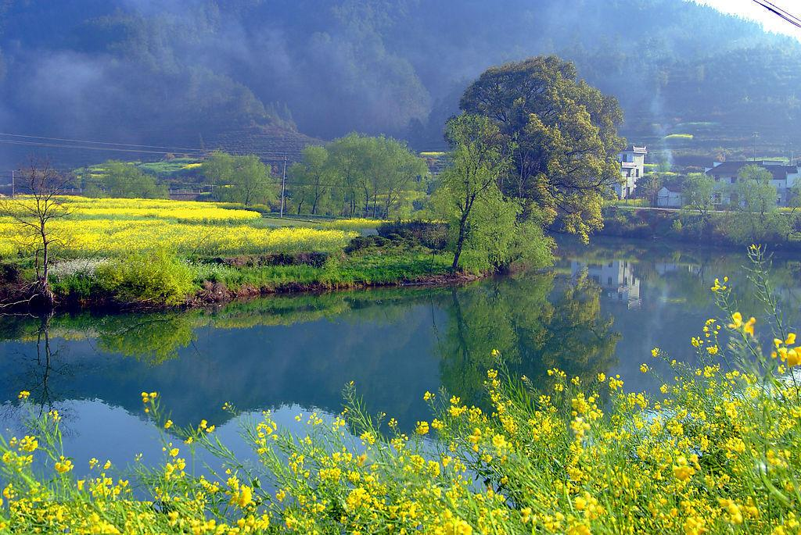
THANK YOU

