Slide 1

扫码关注
回复：hello sun
获取课件制作、录课等实用工具包
知识产权声明
感恩遇见，相互成就，本课件资料仅供您个人参考、教学使用，严禁自行在网络传播，违者依知识产权法追究法律责任。
更多教学资源请关注
订阅号：溯恩英语

Slide 2

高考英语读后续写的问题与策略
——情节与语言
台州市第一中学 仝亚军

Slide 3
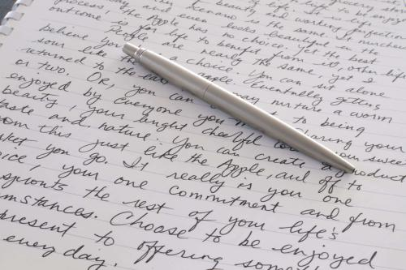
、来自评卷现场的声音
、续写情节构建的问题与策略
、续写中的语言问题与提升策略
、几点建议

Slide 4
一、 来自评卷现场的声音
档次 | 评卷时考虑的因素 | 评卷标准落地
第五档（21-25）
第四档（16-20）
第三档（11-15）
第二档（6-10）
第一档（1-5）
0
与所给短文及段落开头语的衔接程度；
内容的丰富性及关键词的使用情况；
语法结构和词汇的丰富性与准确性；
上下文的连贯性。
漂漂亮亮
清清楚楚
马马虎虎
手舞足蹈
语无伦次

Slide 5
评卷专家说
语言和内容：语言优先，内容符合逻辑即可，不可强求；高考稳中求高分，不要冒险。太科幻的东西不大可能符合逻辑；
衔接：阅卷一定要连着开头语一起读；
上下文的连贯性：注意连接词是否有效；
关键词：词形可变，如-ing, -ed, -es, -’s; 词性不可以变，如 different----difference；关键词的使用：只用了1-2个，扣3分；只用了3个，扣2分；只用了4个，扣1分。

Slide 6

评卷专家说
语法结构和词汇：语言是为表达服务的，文气通畅、自然才重要。
标点符号与拼写：单引号和双引号都可以，全篇统一即可；拼写错误、标点符号错误如果影响意义表达或太多就要扣分。
书写：一般不做加分或减分的标准。看不清楚的话，慢慢看，耐心看。
0分卷：白卷、完全抄袭记0分。抄袭来的进行了修改，逻辑通顺，不扣分。

Slide 7
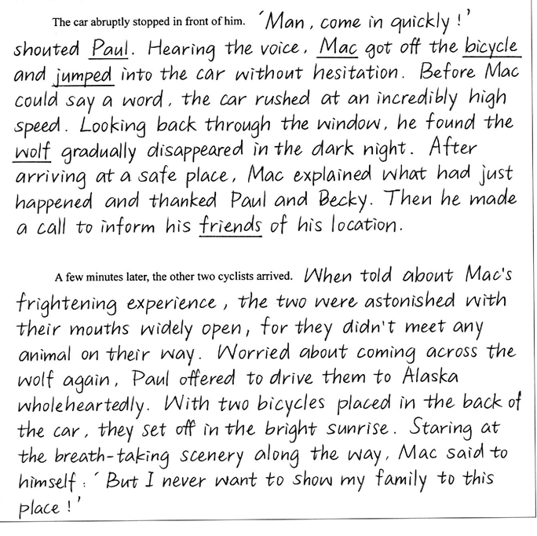
23

Slide 8
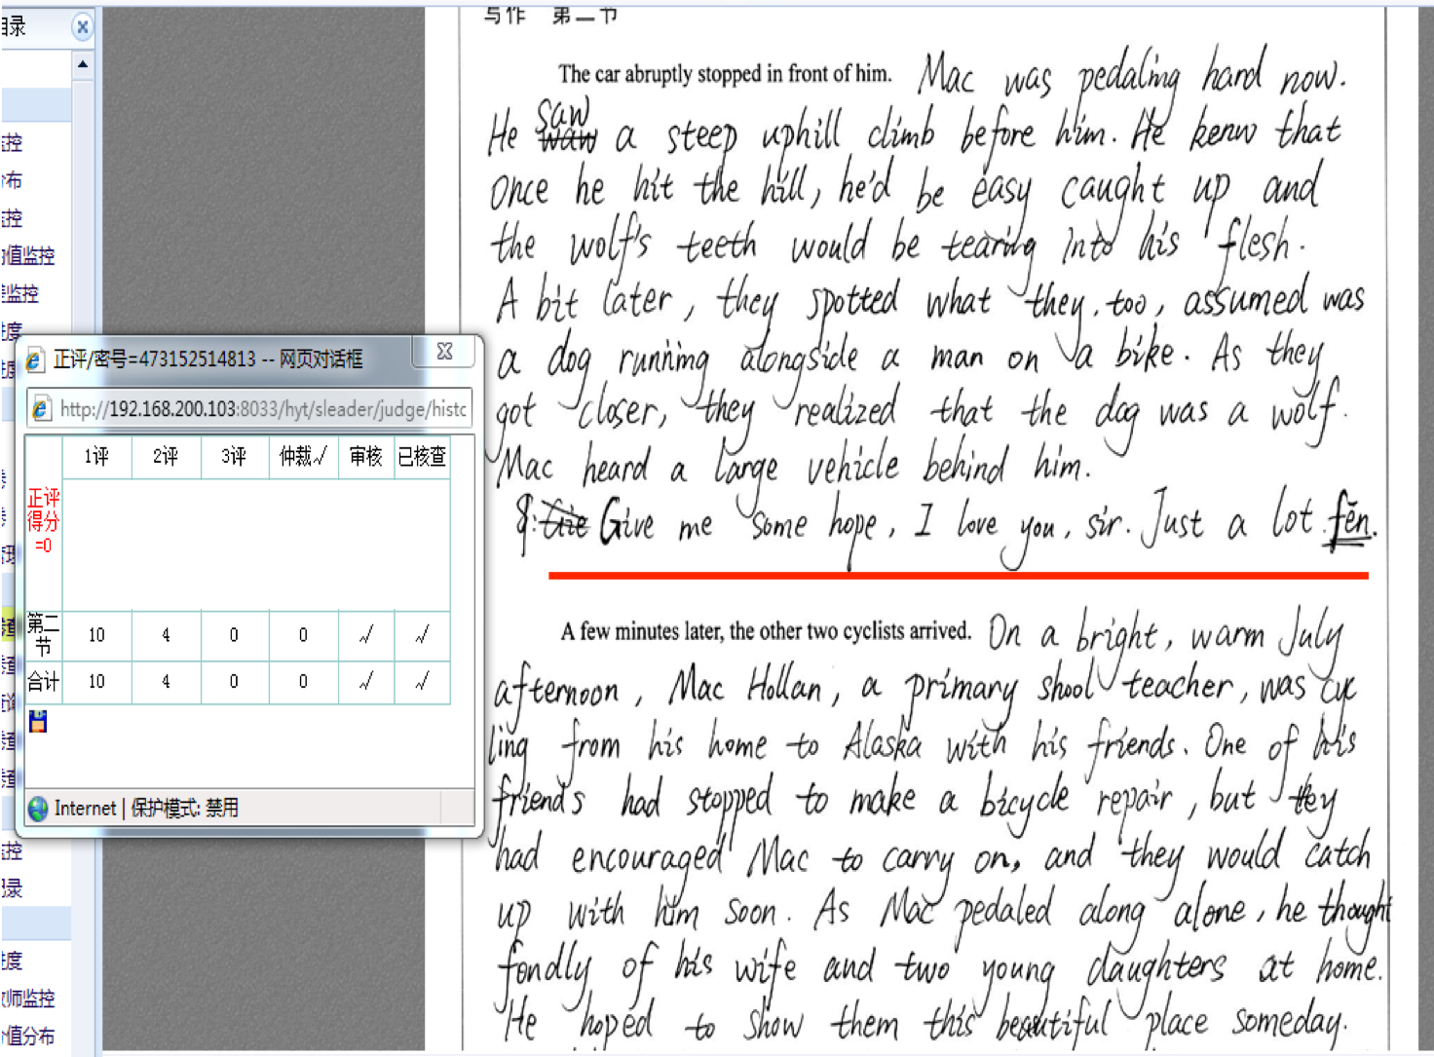

Slide 9
二、 续写情节构建的问题
文章理解不到位，续写情节与原文脱离
But no more helicopters came and it was getting dark again. Jane and Tom drove the car for three hours by a lake in the forest. （2016年10月）
“She finally went home happily with the helicopter.” （2016年10月）

Slide 10
二、 续写情节构建的问题
2. 违背真实生活，缺乏合理性
The car abruptly stopped in front of him. Mac said, “Hi, I am Mac and I am going to Alaska. Where are you going?” Paul answered, “Nice to meet you. I am Paul, I am going to Alaska too.” (2017年6月)
They went back home. Mac decided to tell his parents and wife what happened. He thought it was an amusing experience. It was personal and someone never met or experienced it. He was very lucky. (2017年6月)

Slide 11
二、 续写情节构建的问题
3. 融洽度不高，衔接不合理
读后续写的融洽度高，衔接合理表现在以下四个方面：
（1）续写情节与原文高度相关；
（2）续写情节发展连贯合理；
（3）续写两段之间衔接紧密；
（4）续写段落开头语与后续连贯。
After a long thinking about her family, she fell asleep. The next day she was woken up by a singing bird. She smiled to it and walked away to find the right way to the lake. Everything was going better with the support of her family. （2016年10月）
“But no more helicopters came and it was getting dark again. Jane became satisfied with herself.” （2016年10月）

Slide 12
二、 续写情节构建的问题
4. 出现大量对白，段落之间不平衡
Mac asked, “Where are you going?” Paul answered, “We are going to Alaska.” He said, “Can I take your car? There is a wolf.” Paul said, “Of course, come in, please.”
人教版教材第五模块第二单元的Learning about language板块呈现了whisper、smile、advise、beg、suggest、decide、shout、agree、scream、complain 等人物对白时使用的词汇，非常富有表现力。还有比如murmur, stutter, stammer等词汇。

Slide 13
二、 续写情节构建的问题
5. 主题升华牵强，甚至画蛇添足
In life, there are also difficulties, like fierce wolf, but no one should trap you, as there is love from our family. Calm down and beat the trouble.
“The kindness of human being will never disappear and that is what makes the world a warm and wonder place to live in.”

Slide 14
续写情节构建的策略
深入解读文本，为合理续写奠定基础
2. 从原文整理出几个要点，从中推理出续写的主要情节
3. 根据所提供的段首语推理情节，确定续写方向
4. 根据关键词获取短文信息，预设续写情节
5. 根据生活常识或故事的发展，合理增加情节

Slide 15
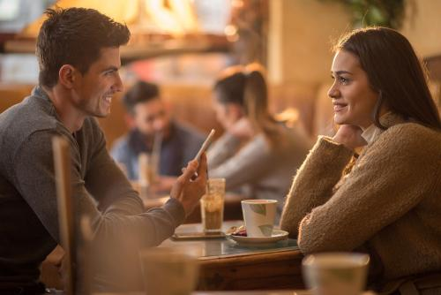
续写情节构建的案例分析
He met her at a party. She was outstanding. Many guys were after her, while he was average looking, shy and awkward. After the party, he invited her for coffee. She was surprised, but out of politeness, she accepted his invitation to go on a date.
As they sat in a nice coffee shop, he was too nervous to say anything and she felt uncomfortable. Suddenly, he asked the waiter, “Could you please give me some salt? I'd like to put it in my coffee.”
They stared at him with a strange look! His face turned red, but when the salt came, he put it in his coffee and drank it. Curious, she asked, “Why this unusual habit?” He took a couple of sips and replied, “When I was a little boy, I lived near the sea. I liked playing in the sea. I could feel the taste of the sea, just like the taste of the salty coffee. Now every time I have the salty coffee, I always think of my childhood and my hometown. I miss it and my parents, who are still there.”
She was deeply touched. A man who can admit his homesickness must love his home and care about his family. He must be responsible. She talked too, about her faraway hometown, her childhood and her family. That was a really nice talk, also a beautiful beginning of their love story.
They continued to date. She found that he met all her requirements. He was tolerant, kind, warm and careful. He was such a good man and had it not been for the salt in the coffee, she’d never have really known him!
The rest of the story was just like any other beautiful love story. They finally got married and lived happily together. And every time she made coffee for him, she put in some salt, the way he liked it.
After 40 years, he passed away and left her a letter which said:
续写两段的段首语：
Para.1: My dearest, please forgive me for my cheating you all the time. Do you still remember our first date in the café?
Para2: She was shocked by the letter, with the feeling of being cheated.

Slide 16

1. 深入解读文本，为合理续写奠定基础
内容
who | He (the hero)
 | She(the heroine)
when | From their first date until 40 years after their marriage
where | At a party and a coffee shop
what | He met her at a party and finally got married. Before death, he left her a letter asking for forgiving.
why | 学生续写
how

Slide 17
1. 深入解读文本，为合理续写奠定基础
意图
“They continued to date. She found that he met all her requirements. He was tolerant, kind, warm and careful. Every time she made coffee for him, she put in some salt, the way he liked it.”
“Sweetheart, I don't exactly like salty coffee. But as it mattered so much to you, I've learnt to enjoy it. If I could live a second time, I hope we can be together again, even if it means that I have to drink salty coffee for the rest of my life.”

Slide 18
2. 整理要点，推理续写主要情节
（1）At a party, an outstanding girl accepted an ordinary boy’s invitation out of politeness.
通过上述4个重要的要点可以合理地推理出续写的主要情节。
第一段：丈夫在信中解释自己编造谎言的原因并乞求妻子的原谅；
第二段：妻子看到书信后的心理反应和行为变化。
（2）Nervous, he asked for some salt and explained why.
（3）Touched by his story and thinking him responsible, she fell in love and married and lived happily with him. She always put in the coffee some salt for him out of love.
（4） After 40 years, he died and left her a letter asking for forgiving.

Slide 19
3. 根据段首语推理情节，确定续写方向
两个段首语是很重要的续写提示，在很大程度上控制着情节的发展方向。对段首语进行分析、设问，结合上文整理出的要点直接或间接推理出续写的主要情节。
第一段情节的构建要成功搭建本段与前文、后文的桥梁。表现在三个逻辑上的衔接：与原文情节的衔接；与段首语的衔接；段尾与第二段段首语的衔接。
第二段是文章的结尾，情节的构建要与给定的段首语衔接，要关注与文章开头的遥相呼应，根据具体语境弘扬感情的真、人性的善或拼搏的美，从而凸显主题，升华精神。

Slide 20
3. 根据段首语推理情节，确定续写方向
第一段可能的情节发展推理
对段首句“My dearest, please forgive me for my cheating you all the time. Do you still remember our first date in the café?”进行设问：
What did he do to cheat her?
Why did he cheat her all the time?
What happened at their first date in the café?
He explained why he made up such a story and asked her to forgive him for his life-long lie.
从第二段首句的关键词shocked和the feeling of being cheated结合上文整理出的要点3可进一步推知：
She never doubted it that he liked salty coffee.
She even tried to meet this special need, which showed what a devoted and considerate wife she was.

Slide 21
3. 根据段首语推理情节，确定续写方向
第二段可能的情节发展推理
对段首句“She was shocked by the letter, with the feeling of being cheated.”进行如下设问：
Hadn’t she felt anything unusual and suspected her husband in the past 40 years?
Would she forgive him for his life-long lie?
She broke down, regretting her naïve decision years before. She would never forgive him and never marry him again if given a second chance.
Reflecting on what he had done for her in the past decades, she came to understand his white lie and chose to forgive him. She would marry him again if given a second chance.

Slide 22
4. 根据关键词获取短文信息，预设续写情节
段落 | 情节发展方向 | 运用关键词预设的续写情节
第一段 | 男主人公为自 己的谎言道歉
第二段 | 读完信后女主 人公的心理反 应与行为变化
An ordinary boy met an outstanding girl and invited her to coffee. Out of politeness, she agreed. At the coffee shop, he asked for salt in his coffee because of nervousness and made up a story about his hometown, which convinced her he was responsible. During the following dates, she found he met all her requirements and married him. Decades later, before his death, he left her a letter asking for forgiving.
读后续写要求将所读短文扩展成一篇与给定材料有逻辑衔接、情节和结构完整的短文，且需运用5个以上所给关键词，因此关键词必然能够反映故事主要内容，传递短文信息。在通读文章的基础上按照人物、动作、时间、地点、等分类标准对原文给出的10个下划线关键词进行分类，并将其合理串接，就能比较准确地获取短文主要信息。
Their first date in the coffee shop; asked for salt instead of sugar due to nervousness; made up a story to keep the love with the outstanding girl; regretful for his life-long lie.
Heartbroken; couldn’t believe a responsible husband should be a liar; aware what he had done met all her requirements; understood his white lie and decided to forgive and marry him again if given another chance.

Slide 23

5. 根据生活常识或故事的发展，合理增加情节
在不影响主要情节的前提下，可以合理增加一些内容，作为续写的次要情节。可以根据情节的需要增加细节描写（环境描写、心理描写、外貌描写等），起到烘托环境气氛、刻画人物性格和揭示主题思想的作用。

Slide 24
扫码关注
回复：hello sun
获取课件制作、录课等实用工具包
知识产权声明
感恩遇见，相互成就，本课件资料仅供您个人参考、教学使用，严禁自行在网络传播，违者依知识产权法追究法律责任。
更多教学资源请关注
订阅号：溯恩英语

Slide 25
5. 根据生活常识或故事的发展，合理增加情节
第一段可以增加的次要情节有：女孩接受邀请让男孩很意外；男孩其实很讨厌咸咖啡，但为了爱，他忍受了一辈子；男孩曾无数次想告诉女孩真相，但怕失去女孩最终没有告诉她，等等。
Actually it was entirely out of expectation that you accepted my invitation to the café. Can you imagine how excited but meanwhile nervous I was in face of such a charming and outstanding young girl? To be frank, I hated salty coffee, but each time we dated, you volunteered to order salty coffee for me, which tasted strange and bad in my mouth, but sweet and warm in my heart. I had tried countless times to tell you the truth, but I was afraid of losing you.

Slide 26
5. 根据生活常识或故事的发展，合理增加情节
第二段可以增加的情节有：桌子上的一个相册勾起了女主人公对过去美好生活的回忆，想起了丈夫为她所做的点点滴滴，理解并原谅了丈夫；女主人公亲自沏了一杯咸咖啡品尝，意识到咸咖啡是多么难喝，理解了丈夫默默无私地付出，等等。
Suddenly, she rose and ran into the kitchen. Having made a cup of coffee, she put some salt into it. Hardly had her mouth approached the coffee cup when a strange and bad smell made its way straight into her nose. She hesitated, and then tried to sip a little. God, she had never had such bad coffee. How could he tolerate it for his whole life? Instantly she became aware that the man who willingly drank salty coffee was worth cherishing permanently.
Suddenly, a family album on the table caught her eyes. No sooner had she slowly opened it than memories flooded in, those exciting moments when they worked together to work wonders, those loving moments when he patiently attended her during her sickness and those bitter-sweet moments when they had to bravely face hardships.

Slide 27
5. 根据生活常识或故事的发展，合理增加情节
在情节构建中，还可以增加描述女主人公从感觉被欺骗到理解丈夫的心理变化及情感表现的情节，以增强文章的感染力。
Simultaneously, a sense of regret and despair slowly crept upon her rippling over her body. She slowly sank into the sofa. It was unbelievable that her seemingly devoted husband made such a big lie. Sitting silently in the sofa with tears rolling down her cheeks，she became conscious neither of time nor space nor anything surrounding her. Her world came crashing down.

Slide 28
三、 续写中的语言问题
单词拼写、名词单复数、动词过去式等词汇方面的低级错误，尤其是副词和不规则动词的变形等拼写错误;
They hugged and kissed each other.
She fell down and hurt her legs.
There are many stars in the sky.
She walked alone in the forest, tired and hungry.
He bent over the golden head, and put the rosy lips to his, and folded her in his arms.(A Tale of Two Cities)
2. 时态、主谓一致、联动结构等语法方面的低级错误；
Huge\huged(hug), standed, lack(lake), weared, descided(decide), strar(start), steam(stream), snack(snake), carve(cave), hole(whole), feeled, feel down, sitted, disappointly, to his surprised, clam down, fortunaly, bursted---
Jane don’t want to walked.
She had to walked to find the lake that they reached.
She would be died.
She should made a plan to let Tom could found she.
After thought, she was fall asleep.
Jane broke into hungry and thirsty again.
Why not founding her?
With nervous and confused, she walked back to----
--------, which made she shake while walking.
She tripped and fell and broke her legs.
3. 生搬硬套所谓的模板；(It is universally acknowledged that---)
Clusters of stars decorated the sky.
4. 直接引语中时态的误用，引号的误用，标点的误用；
5. 刻意追求高级、新颖的词汇、连接词，强行运用复杂句型
She staggered alone in the forest , tired and hungry.
6. 用词贫乏、简单，尤其是描写类的词汇没有亮点

Slide 29
续写语言提升策略
1.夯实语言基础，写好简单句,消除常见的词汇和语法错误，为自己的写作雪中送炭；
2.适当而恰当地运用高级词汇、句型和语段，为自己的写作锦上添花；
3.多练续写微作文，长短句结合、简单句与复杂句结合；
4.积累记叙文、故事方面的词汇、句型和语段,重视细节描写，以打造鲜活灵动的人物形象和丰富充实的情节链条。以动作描写、语言描写和心理描写为主，辅之以恰当的外貌描写和环境描写。

Slide 30
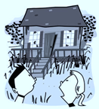
续写细节描写案例分析
The Beach House
It’s a perfect family summer seaside holiday. Occasionally some white clouds floated across the blue sky. The sandy beach was soft and comfortable. The water was glistering in the morning sunlight and the surf was cool on their feet as Krin and Paula leisurely walked along the water edge. The brother and sister began to make some sandcastles. Not far away, mother sat under a big umbrella, reading a book with a bottle of lemonade in her hand. Father was busy exchanging a few words of greetings with strangers he met on the beach.
Suddenly, Krin spotted some pieces of seashells lying scattered on the picturesque beach and small holes stretching along it where the crabs had hidden. He immediately invited Paula to collect shells and search the holes together with him. They were having a ball exploring what appeared to be a never-ending beach.
After a while, they stopped and looked back. Their parents and the umbrellas, beach chairs, and crowds were a long way off. But just ahead, hidden amongst sea grape trees stood a run-down house that seemed to be out of repair for years. It appeared to be unoccupied. Curious, they went to investigate.
The front steps to the doorway of the house creaked(嘎吱作响) as they carefully climbed up them, so did the porch when they stepped onto it. The dusty windows and porch railing(门廊栏杆) were badly weathered and broken. The front door was half open so they squeezed through and cautiously entered. The place was in a total mess, covered with dust, sand, dead leaves, and overturned furniture. They’d taken but a few steps when the door unexpectedly slammed shut behind them.
Scared, Krin and Paula were frozen to the spot. But before they could even utter something like “Oh-oh,” the windows abruptly closed, too. And if this wasn’t scary enough, the stairs to the second floor creaked loudly. When a light in the back bedroom flickered(摇曳), that was absolutely the final straw.
“Let’s get out of here, Paula!” screamed Krin. _______________________
Out they ran, all the way back to those wonderful umbrellas, beach chairs, and crowds.

Slide 31




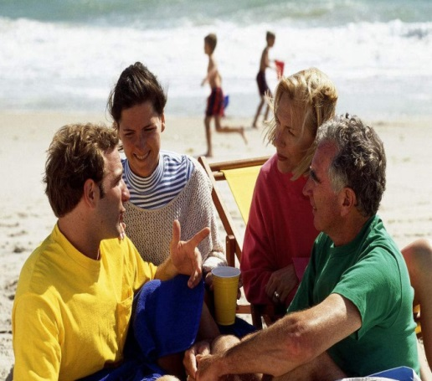

Outside the House (Para 1-2)
floating clouds
glistering water
scattered seashells
To give descriptions of the surroundings and what people do.
How does the author show they were having a perfect and relaxing holiday?

Slide 32

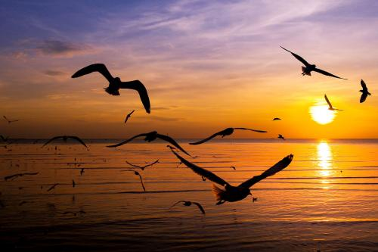
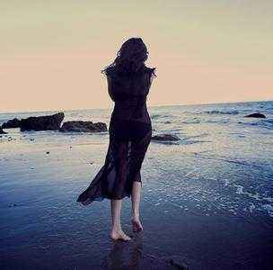

Descriptions of surroundings
A soft breeze gently kissed her hair. The golden red sun was setting. She was spellbound by its color, softly fading into yellow. She could hear nothing but the waves and the seagulls flying up above. The last sunshine gradually cast her shadow on the beach, leaving a long and charming figure in sight.

Slide 33
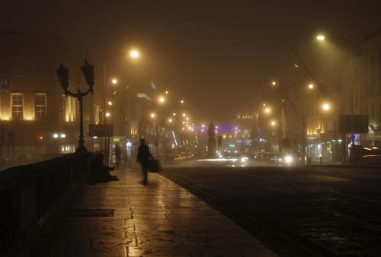
Descriptions of surroundings
The gathering clouds threatened an approaching storm. As darkness increased, everyone had left the café except an old man. He sat in the shadow of the leaves of the tree that swung lonely in the cold wind. The street was deserted and the light was slightly gloomy. The two waiters there knew that if he became too drunk he
would leave without paying,
so they kept watch on him.

Slide 34
Into the House (Para 3-4)
The front steps to the doorway of the house creaked as they carefully climbed up them, so did the porch when they stepped onto it. The dusty windows and porch railing were badly weathered and broken. The front door was half open so they squeezed through and cautiously entered. The place was in a total mess, covered with dust, sand, dead leaves, and overturned furniture. They’d taken but a few steps when the door unexpectedly slammed shut behind them.
How does the author show they were curious and cautious?
To use specific vivid verbs and adverbs to describe actions.

Slide 35

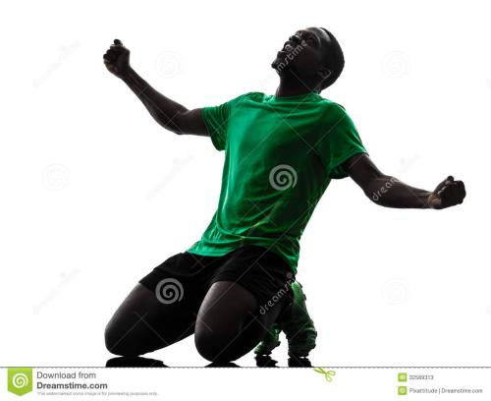
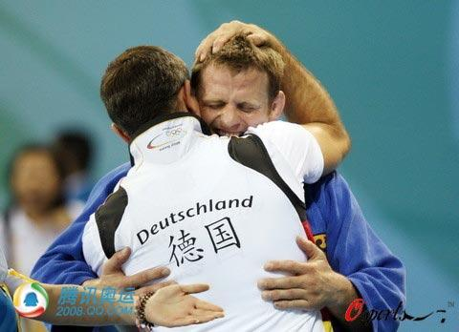
Detailed description of actions
动作细节描写：
Kevin 是一个短跑运动员，在一次全国运动会上，他获得了第一名。请设计一个情节，详细描述他在获胜后的动作，重点突出他激动的心情。
——————————————————————————————————————————————————————————————————————————————————————————————————————————————————————————————————————————————————————————————————————————————————————————————————————————————————————————————————————————————————————————————————————————————

Slide 36
Detailed description of actions
Crossing the finishing line, Kevin let out a roar. He won! After years of hard training, he won! He knelt down, kissing the dear track. Then he ran to his coach and held him tightly in his arms. His coach hugged him, tears of pleasure blurring his vision. Quite a while later, Kevin left his coach and walked to the inner track and waved to the audience, appreciating their support.

Slide 37
Inside the House (Para 5-6)
Frozen with fear, Paula was too scared to move an inch.
Seized by a huge surge of panic, she remained motionless.
Her face turned pale and palms were sweating.
He pointed to the door, with his fingers trembling.
She was so scared that her mouth went dry.
Instantly a sense of terror crept upon him rippling across his while body. He felt every single hair stood on end.
To include details of people’s physical and mental response.
How can you show they were scared? What detailed descriptions can be included to continue the story?

Slide 38
Inside the House (Para 5-6)
----“let’s get out of here, Paula!” screamed Krin.
----“But---ho---how can we make it?” stuttered Paula with a worried look.
----“Hey, bro, look over there in the back bedroom, the window is open.” whispered Paula.
----“Yeah, hurry up, let’s jump out of it.” nodded Krin.
To properly and naturally use dialogues.
.

Slide 39
Inside the House (Para 5-6)
At that critical moment, the survival skills learned at school flashed across his mind. “Yeah, that’s a good idea,” his face lit up.
Desperate and hopeless, they felt as if the world came crashing down. Then suddenly Mom’s encouraging words echoed in her brain, a ray of hope flickering in her eyes. ”I shouldn’t give up easily,” she murmured.
To include mental activities.

Slide 40
Inside the House (Para 5-6)
Without the slightest hesitation, Krin grabbed his sister’s hand and dashed into the back room.
They opened the window, jumped out of it and ran as fast as their legs could carry.
Hand in hand, they cautiously tiptoed to the back room. Unluckily, Krin tripped and fell before they got out of the haunted house.
To include detailed description of actions.

Slide 41




四、 建议
Read more
Accumulate more
Imitate more
Acquire more

Slide 42
Thank You!

Slide 43
扫码关注
回复：hello sun
获取课件制作、录课等实用工具包
知识产权声明
感恩遇见，相互成就，本课件资料仅供您个人参考、教学使用，严禁自行在网络传播，违者依知识产权法追究法律责任。
更多教学资源请关注
订阅号：溯恩英语

