Slide 1
感恩遇见，相互成就，本课件资料仅供您个人参考、教学使用，严禁自行在网络传播，违者依知识产权法追究法律责任。
更多教学资源请关注
公众号：溯恩英语
知识产权声明

Slide 2
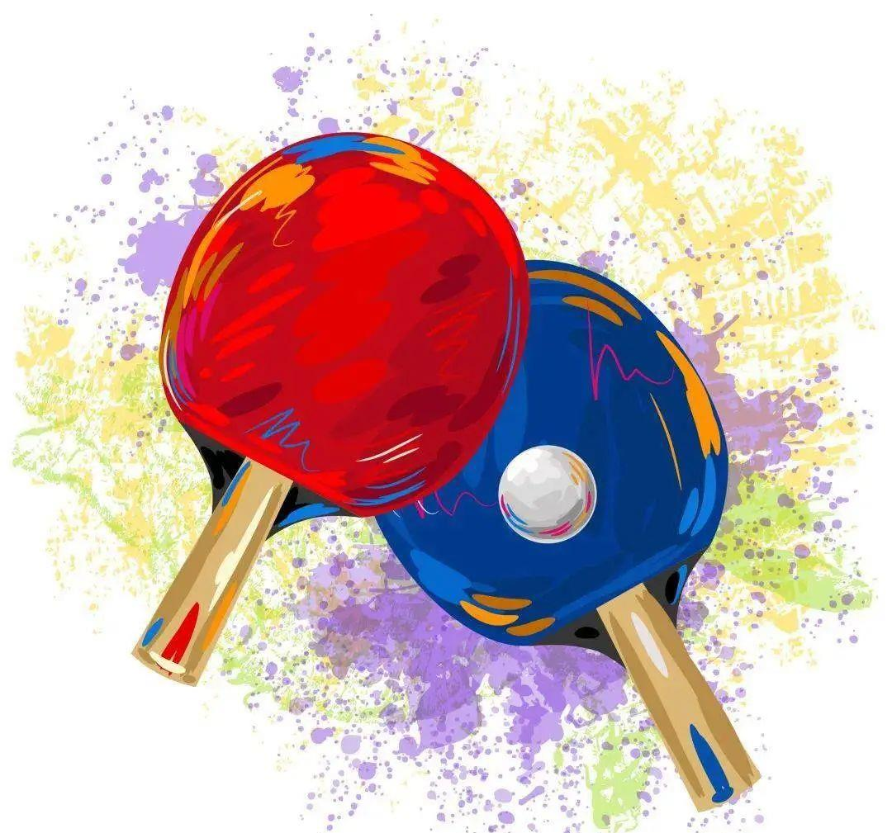
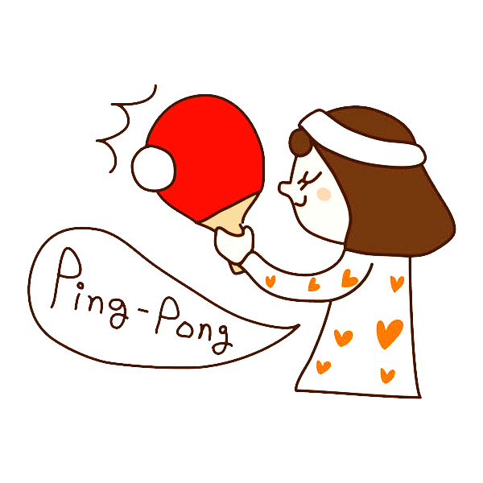
2025年1月高考综合改革适应性演练
应用文 讲评
北师大嘉兴附中 吴晨华

Slide 3
原题重现
假定你是李华，你的留学生朋友 Beth想学打乒乓球，发邮件向你求教。请给她回封邮件，内容包括：
（1）表示支持;
（2）推荐教练。
注意：
（1）写作词数应为80个左右；
（2）请按如下格式在答题卡的相应位置作答。
Dear Beth,
Glad to know that you want to learn to play table tennis.
Yours,
Li Hua

Slide 4
审题与谋篇布局
1.
假定你是李华，你的留学生朋友 Beth想学打乒乓球，发邮件向你求教。请给她回封邮件，内容包括：
（1）表示支持;
（2）推荐教练。
注意： （1）写作词数应为80个左右；
（2）请按如下格式在答题卡的相应位置作答。
体裁：观点+推荐
2.
话题：体育类——乒乓球
3.
时态：一般现在时为主
4.
人称：第二、三人称为主
5.
要点与结构：
Para.1写信背景（已给出）
表示支持+理由
Para.2 推荐教练+理由
Para.3 希望与祝愿

Slide 5
Para.1
写信背景（已给）、表示支持+理由
思考1：
“表示支持”是指对什么的支持？
* “精神”支持
It’s a good choice. I’m excited to see you take up this new challenge, and I'm sure you'll enjoy it as much as l do.
Just take it one step at a time, and you’ll get there.
I’m here for you throughout your table tennis journey. If you ever need advice, practice partners, or just someone to talk to about your progress, I'm your go-to person.
It’s great to see you stepping out of your comfort zone and trying something new.
I wholeheartedly support your decision to embrace this thrilling sport and look forward to seeing you thrive in it!
*“物质”支持
recommend a suitable coach
serve as a training partner
语料库1——关于“支持观点”
convey my unwavering/ firm support for
firmly/ fully/ wholeheartedly support your decision of…
be in favor of
back your decision
can’t help sharing my support with you

Slide 6
Para.1
思考2：
理由需要详写么？写几个？
写信背景（已给）、表示支持+理由
语料库2——关于“打乒乓的理由”
feature：
Adj. enjoyable/ beneficial/social and interactive
a. Table tennis is a dynamic sport that combines speed, strategy, and skill, making it a rewarding pursuit.
b. Table tennis, a low-impact and low-risk sport, is suitable for a wide range of ages, fitness and skill levels.
2. benefits：
* Physical benefits:
a. exercise /build up one’s bodies/muscles; contribute to/ boost/ enhance physical and mental health
b. enhance one’s focus and strategic thinking skills
c. enhance flexibility and agility/sharpness (敏捷性）
d. develop hand-eye /body coordination through the fast-paced game
* Social benefits:
a. expand your interactions and meet like-minded friends
b. broaden social circle scope and make acquaintance with people sharing the same interests.
c. enrich school life and relieve academic pressure
d. strengthen bonds with friends, family and acquaintances.
* Cultural benefits:
a. Table Tennis serves as a marker of friendship in the world now, enjoying great popularity with great populations involved.
b. As national sport of China, table Tennis used to be a powerful symbol of diplomatic relations in the 1960s.
c. With increasingly population involved, Table Tennis bridges nations and connects people through shared enthusiasm in their beloved sport.

Slide 7
Para.1
写信背景（已给出）、表示支持+理由
常见句式(前缀+主句+后缀)：
Besides/ Apart from/ In addition to 优点1, 优点2…, playing table tennis also does 优点3, even 优点4…
Adj. table tennis is a top choice, which not only…优点1, but also …优点2, doing…（结果状语）
Ping pong, 同位语, acts as a cherished maker of our friendship, doing…（结果状语）
Besides/Apart from/In addition to strengthening your muscles, and improving your sharpness, concentration and accuracy, playing table tennis also helps you develop hand-eye /body coordination, even strengthens your bonds with friends, family and acquaintances.
Energetic and rewarding, table tennis is consistently a top choice for …, which not only sharpens your quick reactions but also enhance your hand-eye coordination with skillful spinning and powerful smashing, providing an excellent opportunity to make like-minded friends and enhance your social life.
As the national sport, ping pong is deeply ingrained in Chinese culture, with great population involved. Table Tennis, once a powerful symbol of diplomatic relations, bridging nations and fostering friendship, now serves as a cherished marker of our friendship, connecting people through shared enthusiasm in their beloved sport.

Slide 8
Para.1
写信背景（已给出）、表示支持+理由
Possible versions:
Glad to know that you want to learn to play table tennis. I can’t help sharing my firm support for your endeavor. Table tennis is enjoyable and beneficial, which could enhance your physical strength and relieve your academic pressure.
Glad to know that you want to learn to play table tennis. I wholeheartedly support your decision and firmly believe you will find great pleasure in it, which not only can be beneficial to your health, but also a good chance to make acquaintance with like-minded friends.
Glad to know that you want to learn to play table tennis. It’s such a popular and energizing sport –not only fun and great for fitness but also a wonderful way to connect with others. You’ve really made an excellent choice and I’m fully support you.

Slide 9
Para.2
推荐教练+理由
简单句：To help you learn table tennis faster and better, I’d like to recommend Ms Wu to you.
语料库3——关于“推荐”
升级版1：Aiming to enable you to master the skills of table tennis with greater speed and efficiency, I highly recommend Ms Wu to you, who, from my perspective, stands out as the best choice for the beginners like you.
highly recommend …
a wise choice
the best/ an ideal/ a suitable candidate
be qualified for/ up to/ equal to
There is no better alternative than…
升级版2：Regarding the coach, I am firmly convinced that there is no better alternative than Ms Wu, a distinguished and approachable table tennis player, who is bound to assist you to pick up table tennis skills quickly and proficiently.

Slide 10
Para.2
思考：
1.理由要写几个？ 2.理由怎样写才能让人信服？
推荐教练+理由
理由+解释
语料库4——关于“推荐教练的理由”
She has professional athlete background
She possesses extensive teaching experience, and can provide personalized training plans
She is patient and easy-going
She can speak fluent English
She always receives positive feedback from her previous students
who is equipped with exceptional skills of playing table tennis.
专业能力：
教学经验：
性格：
语言能力：
学员反馈：
professional athlete background
exceptional skills
As a coach/ having been coaching for more than 5 years
provide personalized training plans/ tailored guidance to
possess extensive teaching experience
based on individual’s needs, especially for beginners.
who can always deal with any difficulty you meet with and offer you encouragement.
good personality traits such as patience, enthusiasm, and encouragement
so that she will not have the language barrier when instructing and can have a smooth communication with you.
be proficient in English
speak fluent English/ speak English fluently
Ms Wu has achieved remarkably fruitful results in table tennis teaching
positive feedback from previous students

Slide 11
Para.2
推荐教练+理由
常见句式：
衔接：Firstly… Additionally/ What’s more… Better yet…
倒装：1)Not only…but also… 2) So…that 3) Never has she…
3. 强调：It is… that…
Possible versions:
Having been coaching for 5 years, not only is Ms Wu equipped with exceptional skills but also possesses extensive teaching experience, which enables her to provide personalized training plans based on individual’s needs, especially for beginners. Additionally, so patient and easy-going is she that she can deal with any difficulty you meet with and offer your encouragement timely, thus always receiving positive feedback from her previous students. Better yet, her proficiency in English can facilitate a smoother communication with you.

Slide 12
Para.3
希望与祝愿
常见要点：
愿意提供进一步的帮助：提供联系方式、训练细节等，提供训练场地和陪练
给予对方希望和祝愿：鼓励并期待取得进步
Possible versions:
I’m convinced that, with Ms Wu’s guidance and your own determination, you will achieve remarkable progress in no time. If you have any questions, feel free to let me know.
Never hesitate to contact me if you want more details. Looking forward to your swift acquisition of table tennis skills.

Slide 13
下水作文
Dear Beth,
Glad to know that you want to learn to play table tennis. I wholeheartedly support your decision and firmly believe you will find great pleasure in it, which could enhance your physical strength and relieve your academic pressure.
Aiming to enable you to master the skills of table tennis with greater speed and efficiency, I highly recommend Ms Wu, to you, who, from my perspective, stands out as the best choice for the beginners like you. Having been coaching for 5 years, not only is Ms Wu equipped with exceptional skills but also possesses extensive teaching experience, which enables her to provide personalized training plans based on individual’s needs, especially for beginners. Additionally, so patient and easy-going is she that she can deal with any difficulty you meet with and offer your encouragement timely, thus always receiving positive feedback from her previous students. Better yet, her proficiency in English can facilitate a smoother communication with you.
I’m convinced that, with Ms Wu’s guidance and your own determination, you will achieve remarkable progress in no time. Never hesitate to contact me if you want more details.
Yours,
Li Hua
作文分析：
要点全覆盖、要点有侧重。
内容表述完整、全面，有说服力，即在“支持”后指出原因，在“推荐”后有理由，并对其进一步解释。
应用了较多、较丰富的语法结构和词汇，如倒装句、定语从句、非谓语结构等。
段间、句间衔接合理、有效，整体行文流畅。

Slide 14
同类应用文拓展
假定你是李华，你校将增设体育课选修项目(elective event)，校报英文版面向全校学生征求意见。请你给编辑写一封电子邮件，内容包括： 1. 你的观点； 2. 项目建议及理由。
很高兴了解到增设体育课选修项目(elective event),我表达我坚定的支持，在我看来，这提供了更吸引人的体育体验，也为体育爱好者提供了更多的选择。 从我的角度看，瑜伽，一项身体，心理和精神发展的科学，作为体育课的最佳选择脱颖而出。（我首要推荐的是瑜伽，一项身体，心理和精神发展的科学）首先，鉴于目前我校体育课对女性友好的有限选择，瑜伽会是一个能填补差距的一项有价值的补充。此外，定期练习瑜伽不仅可以增加身体的灵活性，还能助力学生们减轻学业压力。
Dear editor,
____________learn about _________________ elective events to the PE class, I’m writing to ____________________, which, in my opinion, _____________________________________, offers more selection for
___________.
From my ____________, yoga, _____ science of physical, mental and ________(spirit) development, __________ as a beneficial/best choice for PE class. ___________, considering /_______ the current ______________ female-friendly sports in physical education classes, yoga can be a valuable addition to _________________.
What’s more/____________, not only can _____________________, but also it helps students __________________________.
Thank you for__________________ to read my email. Looking forward to my suggestions______________ (consider).
Yours
Li Hua
Delighted to
the addition to/of
convey my firm support
provides a more engaging PE experience
the PE enthusiasts
perspective
a
spiritual
stands out
Firstly
given
limited options for
fill/bridge this gap
practicing yoga regularly increase physical flexibility
Additionally
relieve academic pressure.
taking the time
being considered.

Slide 15
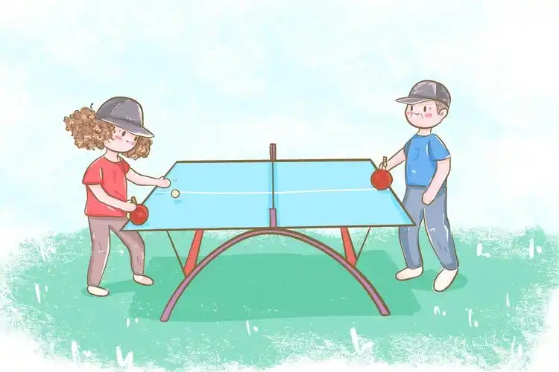
Thanks for your attention

