Slide 1


感恩遇见，相互成就，本课件资料仅供您个人参考、教学使用，严禁自行在网络传播，违者依知识产权法追究法律责任。
更多教学资源请关注
公众号：溯恩英语
知识产权声明

Slide 2
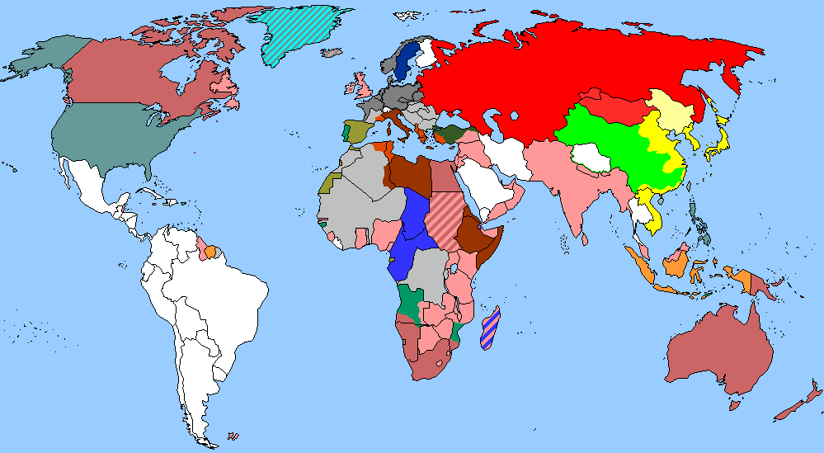
The World
June 16th-30th, 2024

Slide 3
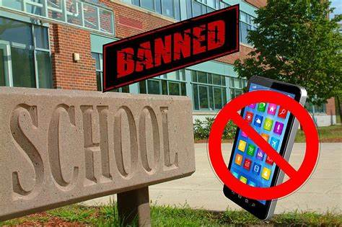
1. Expelling cellphones from schools
该不该禁止学生校内用手机？

Slide 4
Text Completion
The Washington Post (June 30, 2024 A20)
This month, the Los Angeles Unified School District became the largest in the country __________ (approve) a districtwide cellphone ban. Smartphones ___________ (doubt) hinder students’ attention to solving for x or close reading a Shakespearean sonnet. Simply banning their use in class, but not restricting them further, _______ (permit) surreptitious or accidental phone use.
_________ (promote) prosocial skills is another crucial school responsibility; phone bans push kids to interact with their peers face to face and foster relationships outside of cyberspace. Plenty of people still struggle, after the solitude of the covid pandemic, to settle back into their communities. Schools could be just ____ place to start.
Yet many parents remain wary of banning phones during the school day. They are afraid that doing so would sever communication between them and their children — not only when they want to coordinate pickups or drop-offs ____ in the event of an emergency. ______ (give) the rise in school shootings in recent years, parents’ worries are understandable. But they aren’t reason enough to continue permitting device usage on campus.
Schools have managed to function without smartphones for centuries — without their absence causing logistical or any other disasters. For concerned parents, equipping their children _____ traditional cellphones, these days dubbed “dumbphones,” might be the best option; schools might consider whether selective phone bans __________ permit such devices could work. They could be __________ (particular) appropriate for children still in elementary and middle school. Or parents could get even more old-fashioned and simply call their school’s administrative office when necessary. Schools, meanwhile, could ensure they have parental notification systems that work during emergencies.
  to approve
undoubtedly
permits
Promoting
  the
but
Given
with
that / which
particularly

Slide 5

Reading Comprehension
1. What does the underlined word “sever” in paragraph 1 mean?
A. Cut . B. Ban. C. Strengthen. D. Build.
2. Which of the following statements is correct according to the author?
A. Phone bans could hinder students’ communication skills.
B. Parents’ concern over safety justifies their protest against the ban.
C. Schools should ban all types of cellphones during the school day.
D. Schools need to be able to reach parents in time during emergencies.

Slide 6
Vocabulary
1. surreptitious: done secretly or quickly, in the hope that other people will not notice 秘密地；趁人不注意赶紧进行的
He made a surreptitious entrance to the club through the little door.
他从小门偷偷进入俱乐部。
2. solitude: the state of being alone, especially when you find this pleasant
独处；独居
He enjoyed his moments of solitude before the pressures of the day began.
他喜欢在白天的压力到来之前享受独处的时光。
Translation
他们有过几次秘密会谈。
They had several surreptitious conversations.
Translation
她渴望安宁和独享清净。
She longed for peace and solitude.

Slide 7
Translation
Promoting prosocial skills is another crucial school responsibility; phone bans push kids to interact with their peers face to face and foster relationships outside of cyberspace. Plenty of people still struggle, after the solitude of the covid pandemic, to settle back into their communities.
促进亲社会技能是学校的另一项重要责任；手机禁令促使孩子们与同龄人面对面交流，培养网络空间之外的人际关系。在经历了新冠病毒大流行的孤独之后，许多人仍在努力重新融入他们的社区。
Yet many parents remain wary of banning phones during the school day. They are afraid that doing so would sever communication between them and their children — not only when they want to coordinate pickups or drop-offs but in the event of an emergency. Given the rise in school shootings in recent years, parents’ worries are understandable.
然而，许多家长仍对在校期间禁止使用手机持谨慎态度。他们担心这样做会切断他们和孩子之间的沟通——不仅在他们想要协调接送的时候，而且在紧急情况下。鉴于近年来校园枪击事件的增加，家长的担忧是可以理解的。

Slide 8

2. Five Top tips to start Running
开始跑步的五大技巧

Slide 9
Text Jigsaw
Anti-Anxiety For Teens (January 2024 P50-51)
Running is a great cardio activity to build strength, stamina and endurance. It can help you achieve or maintain a healthy weight, and it can boost your heart health. It’s also linked to improved mental well-being, and can be beneficial to those with depression or anxiety. 1__
Start Small
2 Make sure you start slowly when it comes to running. Begin by alternating running and walking - for example, run for one minute, walk for one minute and repeat for 20 minutes. You should always start with a short warm-up before you begin running, and gently stretch at the end.
3__
You don’t need a lot of kit to start running, but it’s important to think about what you are putting on your feet. A lot of injuries can occur because you are wearing trainers that don’t support your feet properly as you run. It’s worth going to a running shop and asking for their advice.They will often look at how you run and recommend the right type of shoe for your feet.
Find A Running Buddy
It’s much easier to motivate yourself to go for a run if you’re meeting a friend. Having someone to talk to while you run helps the time go quicker. 4 You could also run with someone more experienced, who can answer any questions you might have or give you some practical advice.
Set Mini Goals
Think about what you want to achieve with your running. For some people, it's about gaining fitness, for others it’s improving their mental health and for others it might be about losing weight. 5 Track your progress using a running app or writing in a notepad. This will enable you to look back over how far you have come.

Slide 10
Options
Keys: CAFEG
A.Running too much too soon can lead to injury.
B.Learn to Stretch Properly
C.Here’s how to get started.
D.All you need is some well-fitting trainers, sports kit and a can-do mindset.
E. It’s also nice to have someone to share experiences with.
F. Invest in Decent Trainers
G.Whatever the reasons, it’s a good idea to set yourself some goals to achieve along the way.

Slide 11
Vocabulary
1. stamina: the physical or mental strength that enables you to do sth difficult for long periods of time耐力；耐性；持久力
It takes a lot of stamina to run a marathon. 跑马拉松需要很大的耐力。
2. alternate: to make things or people follow one after the other in a repeated pattern使交替；使轮流
He alternated working in the office with long tours overseas. 他在办公室工作一段时间后就会安排一次海外长途旅行。
Translation
那次长距离爬山是对我们健康状况和耐力的考验。
The long climb tested our fitness and stamina.
Translation
他交替进行有氧运动和重量训练，以提高他的耐力。
He alternated aerobic exercises with weight training to improve his stamina.

Slide 12
Translation
Running is a great cardio activity to build strength, stamina and endurance. It can help you achieve or maintain a healthy weight, and it can boost your heart health. It’s also linked to improved mental well-being, and can be beneficial to those with depression or anxiety.
跑步是一项很好的有氧运动，可以增强力量、耐力和耐力。它可以帮助你达到或保持健康的体重，还可以促进你的心脏健康。它还与改善心理健康有关，对那些患有抑郁症或焦虑症的人有益。
Whatever your personal reasons, it’s a good idea to set yourself some goals to achieve along the way.Track your progress using a running app or writing in a notepad. This will enable you to look back over how far you have come.
无论你的个人原因是什么，给自己设定一些目标来实现都是一个好主意。使用跑步应用程序或在记事本上记录你的进步。这将使你可以回顾已经走了多远。

Slide 13
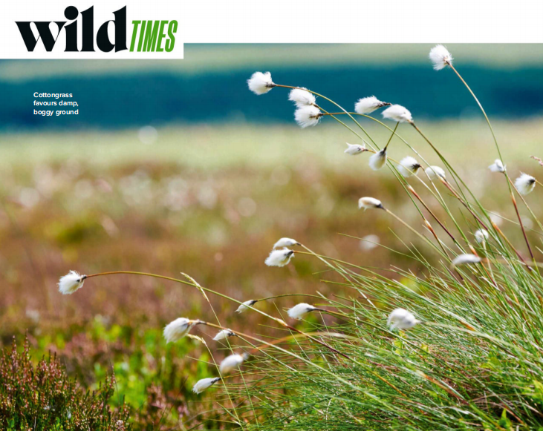
3. Blowin’ in the wind
在风中飘荡

Slide 14
Text Completion
BBC Wildlife (June 2024 P14)
drifts
Photogenic ______ (drift) of billowing white seedheads are a classic feature of peaty uplands in summer. They look _________ (especial) dreamy backlit with the golden light of dawn or evening. These fluffy heads belong to cottongrass, ______ is neither a grass ____ related to cotton. In fact, it’s a sedge, and spends most of the year _________ (blend) in with myriad other green bog plants. _____ from June, as the seedheads dry out, they are transformed into “the snow-white bloom of summer”, in the ___________ (memory) phrase of well-known conservationist RoyDennis.
In his excellent book Cottongrass Summer, Dennis goes on to explain the __________ (important) of this plant as a food in spring for species such as black grouse and red deer. In the past, it ____ (be) important to people, too. During the hardships of the First World War, the soft seedheads were, like sphagnum moss, used _______ (dress) wounds.
especially
which
nor
blending
But
memorable
importance
was
to dress

Slide 15
Vocabulary
1. photogenic: looking attractive in photographs上镜的；上相的
Disease and death in old movies were relatively photogenic. 老电影中的疾病和死亡相对上镜。
2. myriad: an extremely large number of sth 无数；大量
Designs are available in a myriad of colours. 各种色彩的款式应有尽有。
Translation
我不大上镜。
I’m not very photogenic.
Translation
他们在抚养孩子上面临着各种问题。
They face a myriad of problems bringing up children.

Slide 16
Translation
Photogenic drifts of billowing white seedheads are a classic feature of peaty uplands in summer. They look especially dreamy backlit with the golden light of dawn or evening.
翻腾的白色种子头是夏季泥炭高地的典型特征，非常上镜。在黎明或黄昏的金色光线下，它们看起来特别梦幻。
But from June, as the seedheads dry out, they are transformed into “the snow-white bloom of summer”, in the memorable phrase of well-known conservationist Roy Dennis.
但从6月开始，随着种子干枯，它们变成了“夏季的雪白花朵”，这是著名环保主义者罗伊·丹尼斯令人难忘的说法。

Slide 17
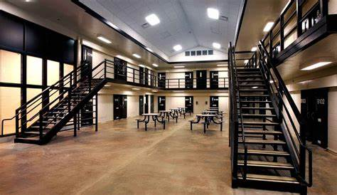
4. Prisons in crisis as ten guards a week quit at high-security jails
狱警接连辞职 英格兰高安全级别监狱陷危机

Slide 18
Text Completion
The Times (June 25, 2024 P2)
The highest security prisons in England and Wales are facing a staffing crisis as ten guards quit every week and almost 1,000 are disciplined for misconduct every year.
Ministry of Justice data has revealed that the number of prison guards _______ (leave) high-security prisons has nearly tripled since 2010, reaching a record 711 in 2022. Last year 556 guards quit category A prisons, ______ house Britain’s most dangerous criminals.
Prison guards in maximum-security prisons are also being dismissed at a higher rate than elsewhere in the prison estate. Last year 166 maximum-security prison guards were dismissed, according to figures ________ (provide) by the Ministry of Justice through parliamentary questions tabled by Labour. The number let go for “unsatisfactory attendance or medical inefficiency” was more than double ____ of any other grade of prison.
Edward Argar, the prisons minister, admitted that the government was having to ask former prison guards ________ (return) to the service. The government has also had to give incentives to guards to work in “harder-to-staff” sites. Prisons are now at 98 per cent capacity. The number of serious ________ (assault) on prison staff has increased by 182 per cent since 2010, and by 20 per cent in a single year. Last year 177 staff a week were assaulted.
MoJ figures also reveal that nearly 9,000 prison guards __________________ (discipline) for misconduct over the past decade.
The number of staff charged with abusive language or behaviour towards prisoners has rocketed by 65 per cent and nearly three times ___ many staff are now acting abusively towards other staff. ________________ (common) reason for disciplinary action last year was “unprofessional conduct”.
The number of staff who were disciplined for “breach of security” topped 190 last year, and the number rebuked for negligence on security grounds tripled to 38 last year, reaching __ record high.
leaving
which
provided
that
to return
assaults
have been disciplined
as
The most common
a

Slide 19
Vocabulary
1. breach: a failure to do sth that must be done by law
（对法规等的）违背，违犯
The congressman was accused of a breach of secrecy rules.
这位议员被控违反了保密规定。
2. negligence: the failure to give sb/sth enough care or attention
疏忽；失职；失误；过失
The soldiers were ordered to appear before a disciplinary council on charges of negligenc. 士兵们被控玩忽职守，被勒令接受纪律委员会的审查。
Translation
安全体系已经出了大问题。
There have been serious security breaches.
Translation
事故是由于司机的过失造成的。
The accident was caused by the driver’s negligence.

Slide 20
Translation
Prison guards in maximum-security prisons are also being dismissed at a higher rate than elsewhere in the prison estate. Last year 166 maximum-security prison guards were dismissed, according to figures provided by the Ministry of Justice through parliamentary questions tabled by Labour.
最高安全级别监狱的狱警被解雇的比例也高于其他级别监狱区的狱警。根据英国司法部通过工党提交的议会质询提供的数据，去年有166名最高安全级别监狱看守被解职。
The number of staff charged with abusive language or behaviour towards prisoners has rocketed by 65 per cent and nearly three times as many staff are now acting abusively towards other staff. The most common reason for disciplinary action last year was “unprofessional conduct”.
被控对囚犯使用辱骂语言或行为的员工数量激增了65%，对其他员工进行凌辱行为的员工数量几乎是之前的三倍。去年最常见的纪律处分理由是“不专业的行为”。

Slide 21

5. BBC News 06/25/2024

Slide 22

Dictation
Microsoft has regained its position as the world’s most valuable company, taking back the title briefly held by the _________________ company Nvidia. Nvidia’s stock sank up to 8% during Thursday’s trading, erasing more than $270 billion of the company’s ___________. Analysts say it’s likely investors were consolidating their profits.
President Biden has declared the wildfires in the US state of New Mexico ______________. The extent of the damage is still being assessed, but it’s thought that about 10,000 hectares of land and 1,400 structures have been burned, including hundreds of homes. Will Grant reports.
The decision by President Biden to declare a major disaster over the wildfires in New Mexico immediately frees up federal funding for local, tribal and state agencies trying to ______ the blazes. Specifically, they can access funds and support from the Federal Emergency Management Agency or FEMA, including for fire mitigation measures around the state. It also allows home and business owners who have been affected to access grants and low cost _____ to cover the costs of temporary accommodation and repairs.
European football’s governing body UEFA is investigating what it calls potential racist or discriminatory _______ by Albanian fans at their men’s European Championship match on Wednesday. Supporters of both sides are accused of singing _______ chants aimed at Serbs. Serbia had threatened to _________ the tournament if UEFA didn’t act.
The actor Donald Sutherland whose career ________ seven decades has died. He was 88. Born in Canada, Donald Sutherland ______ in some of the most groundbreaking and best known films of the 1970s, including MASH and Don’t Look Now.
artificial intelligence
    market value
a major disaster
tackle
loans
  conduct
abusive
pull out of
spanned
starred

Slide 23
Vocabulary
1. blaze: (used especially in newspapers) a very large fire, especially a dangerous one （尤用于报章）烈火；火灾
Two firemen were hurt in a blaze which swept through a tower block last night.
昨晚，一场大火吞噬了一座高层建筑，两位消防员被烧伤。
2. mitigation: (formal) a reduction in how unpleasant, serious, etc. sth is
减轻；缓解
Social support is the most important factor in the mitigation of stress among adolescents. 社会支持是缓解青少年压力的最重要因素。
Translation
火灾中有五人受伤。
Five people were injured in the blaze.
Translation
他身体状况的缓解是由于新药的作用。
The mitigation of his physical condition was due to the new drug.

Slide 24
Translation
Microsoft has regained its position as the world’s most valuable company, taking back the title briefly held by the artificial intelligence company Nvidia. Nvidia’s stock sank up to 8% during Thursday’s trading, erasing more than $270 billion of the company’s market value. Analysts say it’s likely investors were consolidating their profits.
微软重新夺回了由人工智能公司英伟达短暂占据的全球市值最高公司的地位。英伟达的股价在周四的交易中一度下跌了8%，公司市值蒸发了2700多亿美元。分析人士称，投资者很可能是在巩固他们的利润。
They can access funds and support from the Federal Emergency Management Agency or FEMA, including for fire mitigation measures around the state. It also allows home and business owners who have been affected to access grants and low cost loans to cover the costs of temporary accommodation and repairs.
他们可以从联邦紧急事务管理局(FEMA)获得资金和支持，包括在该州采取防火措施。它还允许受影响的家庭和企业主获得赠款和低成本贷款，以支付临时住宿和维修费用。

