Slide 1
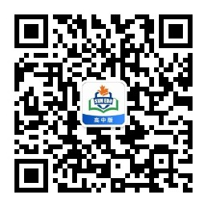
感恩遇见，相互成就，本课件资料仅供您个人参考、教学使用，严禁自行在网络传播，违者依知识产权法追究法律责任。
更多教学资源请关注
公众号：溯恩高中英语
知识产权声明

Slide 2
高中英语应用文-告知信
A letter of Notification
Research
plan
杭州二中 许丽君

Slide 3
01
Preparation for writing：
写作类型（type of writing）
审题
人物、关键词、时态 (characters,key words and tense)
写作框架及图式(writing framework and structure)
构思
内容及表述(content and expression)
遣词造句(words and phrases)

Slide 4
02
告知信文体概述
告知信是历年高考书面表达的热门话题。告知的内容比较广泛：如安排计划类、课外活动类、广告信息类、个人情况类、旅游介绍类等。高考真题中，告知信需要告知的内容均属于积极的信息。告知信的语言要简单明了，在信中一般应告知写信目的，然后再讲述其他事情。

Slide 5
03
【告知信格式：】
简要写明要告知的事情
告知信
写明告知的具体信息和注意事项（时间、地点、前期准备和活动内容）
询问对方是否要了解其他信息，并表达 期待

Slide 6
04
[告知信必备短语]
[必备短语]
1．inform sb.of sth.
告知某人某事
2．provide some information for sb.
为某人提供一些信息
3．work out my schedule
制定我的计划
4．show sb. around ...
带领某人参观……
5．sign up for ...
报名参加……
[必备短语]
6．mean/intend to do sth.
打算做某事
7．pay a visit to ...
参观……
8．make a difference
有影响；起(重要)作用
9．be scheduled at/on ...
被安排在……
10．make preparations for ... 为……做准备

Slide 7
充盈写作语料库：
【篇首句：The beginning---吸引阅卷人眼球的开头句
1. Here is a piece of good news! 这里有一个好消息！
2. I have a piece of good news to tell you!我有一个好消息要告诉你！
3. Our team is going to compete in an important volleyball match next week. I’m writing to share some details with you.
我们队下周将参加一场重要的排球比赛。我写信是想和你分享一些细节。
4. I feel delighted that you are so interested in the speech contest, so I’m writing to give a brief introduction of it.
我很高兴你对这次演讲比赛感兴趣，所以我写信向你简要介绍一下它的情况。
开门见山，简要告知事情

Slide 8
充盈写作语料库：
【篇首句：The beginning---吸引阅卷人眼球的开头句】
5. I feel greatly honored to be asked to contact you, informing you of our arrangements.
我感到很荣幸受委托与你联系，告知你我们的安排。
6. I would like to inform you of some details about the next class.
我想告诉你下一节课的一些细节。
7. Now let me tell you what we have arranged for you.
现在让我告诉你我们为你安排的内容。
8. Learning/Knowing that you are interested in the activities in our school, I'm glad to tell you some relevant information. (v-ing)
知道你对学校的活动感兴趣，我很高兴告诉你相关的信息。
开门见山，简要告知事情

Slide 9
充盈写作语料库：
【篇中句：The Body- 亮点出彩主题句】
My plan about these activities is as follows.
我对这些活动的计划如下。
On July 20, we are going to learn poems of the Tang Dynasty which you are interested in in the lecture hall.
7月20日， 我们将在演讲厅学习你感兴趣的唐诗。
3. Everything here is new to me.
这里的一切对我来说都是新的。
详细说明告知的时间、地点和活动内容等

Slide 10
充盈写作语料库：
【篇中句：The Body- 亮点出彩主题句】
4. I’m writing to tell you something about my life and study in recent days.
我写信是想告诉你一些我最近生活和学习的情况。
5. Now let me tell you what we have arranged for you.
现在让我告诉你我们是怎样为你安排的。
6. The match will take place in our school gym on the afternoon of July 4th and we will play against the team from Honxing High school.
比赛将在7月4日下午在我们学校体育馆举行，我们将与红星高中的球队比赛。
详细说明告知的时间、地点和活动内容等

Slide 11
充盈写作语料库：
【篇尾句：The ending-韵味无穷结尾句】
询问对方是否要了解其他信息，并表达期待
1. Looking forward to seeing you a second time.
期待再一次见到你。
2. If you want to know anything else, please don’t hesitate to control me.
如果你还想知道什么，请不要犹豫，与我联系。
3. Hopefully, our efforts will pay off in the end.
希望我们的努力最终会有回报。
4. Looking forward to the pleasure of meeting you.
期待与你会面。
5. If you have any other questions, please let me know. I’m looking froward to your coming.
如果您有任何其他问题，请让我知道。我期待您的到来。
6. I look forward to your reply. 期待你的回复。

Slide 12
05
【告知信写作模板】
Dear (对象)，
I am writing to tell you (告知内容)．The (活动) will be given (时间、地点)．In the (活动), you will mainly (具体安排)．You had better make full preparations before (活动) and (具体活动细节)．
Please let me know if you are interested and (表达期望)
Yours，
(署名)

Slide 13
应用文习作----告知信题型训练&实践演练&语篇鉴赏

Slide 14
06
※告知信题型训练1：【告知英国朋友Leslie 上课的计划】
【实践演练】：应用文写作（满分15分）
(2017·全国卷Ⅰ)假定你是李华，正在教你的英国朋友Leslie学习汉语。请你写封邮件告知下次上课的计划。内容包括：
1．时间和地点；
2．内容：学习唐诗；
3．课前准备：简要了解唐朝的历史。
注意：1. 词数80左右；
2．可以适当增加细节，以使行文连贯。

Slide 15
06
※告知信1：【告知英国朋友Leslie 上课的计划-学生作文】
Dear Leslie，
I am very glad to know you are interested in Tang poems. I'm writing to tell you the plan for the next class.
To start with，I want to stress that our next lesson will take place in Classroom 8 of the Teaching Building at 10 a．m. next Friday. Besides，in order to know more about Chinese culture，you will learn some Tang poems，which are popular among Chinese people.
I don't doubt that you should know about the history of Tang Dynasty in advance. I think it will make the class go smoothly.
I hope to receive your early reply.
Yours，
Li Hua

Slide 16
06
※告知信题型训练1：【告知英国朋友Leslie 上课的计划】
【习作点评】
(1)本文词数符合要求，由于缺少高级表达影响文章的档次。
(2)有些词汇可进行提升，例如glad可升级为delighted，tell可升级为inform ...of ...，want可升级为intend，should可升级为be supposed to等。
(3)有些句式也可提升，例如第二段第一句可用主语从句和表语从句来表达，第三段可以用一个含有定语从句的复合句来表达。
(4)另外，非谓语动词以及there be句式的合理使用同样能提升文章的档次。

Slide 17
06
※告知信1：【告知英国朋友Leslie 上课的计划】
【作文提升1】
Dear Leslie，
I am very delighted to know you have a taste for Tang poems. I'm writing to inform you of the plan for the next class.
To start with，what I intend to stress is that our next lesson will take place in Classroom 8 of the Teaching Building at 10 a．m. next Friday. What's more, in order to have a better understanding of Chinese culture，you will learn some Tang poems，which are popular among Chinese people.
There is no doubt that you are supposed to know about the history of Tang Dynasty in advance，which I think will make the class go smoothly.
Looking forward to your early reply.
Yours，
Li Hua

Slide 18
06
※告知信1：【告知英国朋友Leslie 上课的计划】
【作文提升2】
Dear Leslie，
I am more than happy that you have made great progress in learning Chinese and you are interested in Chinese culture.
Now I’ll tell you the next learning programme. On July 20th , we are going to learn poems of the Tang Dynasty which you are interested in in the lecture hall. As a foreign learner, it is difficult for you to understand the true meaning and the culture of them. Therefore, before class, you can read some books related to the history of the Tang Dynasty to better appreciate the poems.
If there is anything I can do for you, I would be more than glad to help.
Best wishes.
Yours，
Li Hua

Slide 19
06
※告知信1：【告知英国朋友Leslie 上课的计划】
【作文提升3】
Dear Leslie，
How are you? Glad to see you have made some progress in Chinese learning and I’m writing to tell you something about our next lesson.
The lesson will be given from 3 pm to 5 pm on the afternoon of next Tuesday in the classroom 502. In the class, you will mainly learn Tang poetry, which reflects traditional Chinese culture and is deeply loved by Chinese. You can feel the beauty of Chinese by learning Tang Poetry. You’d better make full preparations before class and have a brief understanding of the history of Tang Dynasty, which makes it easy for you to go through the class.
If there is anything that I can help you, please don’t hesitate to tell me. Looking forward to meeting you.
Yours，
Li Hua

Slide 20
06
※告知信1：【告知英国朋友Leslie 上课的计划】
【作文提升4】
Dear Leslie，
How time flies!（写信目的）Next week, we are going to enjoy our next Chinese class. Are you ready? Now, I am writing to tell you some relevant details about it.
(时间和地点) To begin with, we can have the class on Monday evening in the school library, when there will be less people. （上课内容）Besides, we are going to learn some basic rules about Tang poetry, which will be not only meaningful but also interesting.（课前准备）What’s more, you’d better learn some history about the Tang dynasty, which can cultivate your interests and broaden your horizons.
（结束语）I have the confidence that we will have a great time. Looking forward to meeting you again!
Yours，
Li Hua

Slide 21
06
※告知信1：【告知英国朋友Leslie 上课的计划】
【作文提升5】
Dear Leslie，
How are you? I’m writing to tell you about your next Chinese lesson.
We’ll still meet at my school, but not on Saturday as usual, since I’ll have to participate in a sporting activity that day. So let’s make it three o’clock on Sunday afternoon.
As you know, in order to acquire a good knowledge of Chinese, you should learn more about the Chinese culture and history. Therefore, this time I will introduce Tang Poetry to you, which is of great help in learning Chinese. I advise you to learn about the brief history of the Tang dynasty in advance. It will surely help you in learning the poems.
Hoping to receive your early reply.
Yours，
Li Hua

Slide 22
06
※告知信题型训练2【告知英国朋友Sam给农村小学捐书当志愿者】
第一节：应用文写作（满分15分）
假定你是李华，你校即将举行“给农村小学捐书” (Donating Books to Rural Primary Schools)活动，现向全校招募志愿者，请你写一封信，告诉你的英国朋友Sam有关情况，要点如下：
1. 简单介绍该项活动；
2. 志愿者所需条件。
注意：
1. 词数80左右；
2. 可适当增加细节，以使行文连贯。

Slide 23
06
※告知信2【告知英国朋友Sam给农村小学捐书当志愿者】
【Possible Version】：
Dear Sam,
Delighted to know that you are to donate books to Rural Primary Schools, I am writing to inform you of some detailed information.
The activity is aimed at helping rural primary schools by sending various kinds of books to those students, which can not only broaden their horizons, but also cultivate their capability of thinking and learning independently and critically. Additionally, the volunteers should be diligent and optimistic, assuring them to face some challenges during the process of this activity.
If you have any question about this project, please contact me without any hesitation.
Yours sincerely,
Li Hua (95 words)

Slide 24
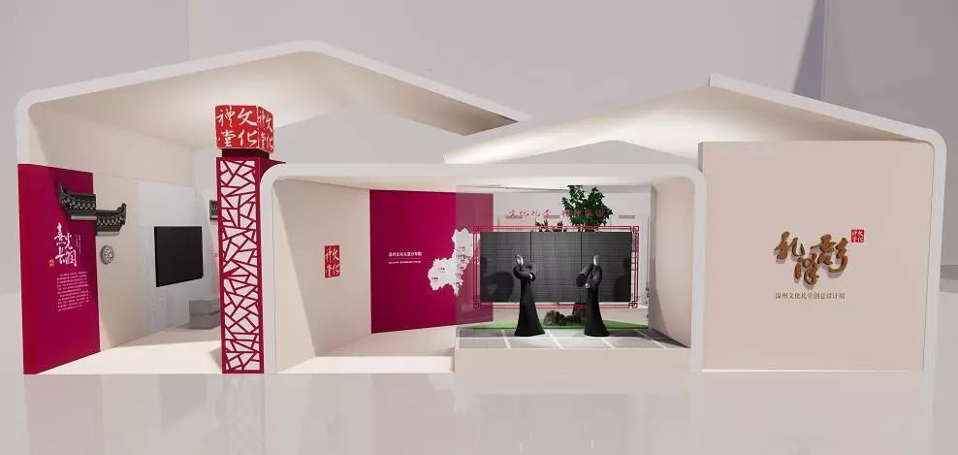
06
※告知信题型训练3【告知Peter博物院举行中国传统民俗文化展】
【江西省2019届高三4月份模拟测】假定你是李华。你市博物院将举行中国传统民俗文化展，请给你校交换生Peter写一封电子邮件，告诉他以下内容，要点如下：
1. 展览时间；
2. 展览内容；
注意：1. 词数80左右；
2. 可以适当增加细节，以使行文连贯。

Slide 25
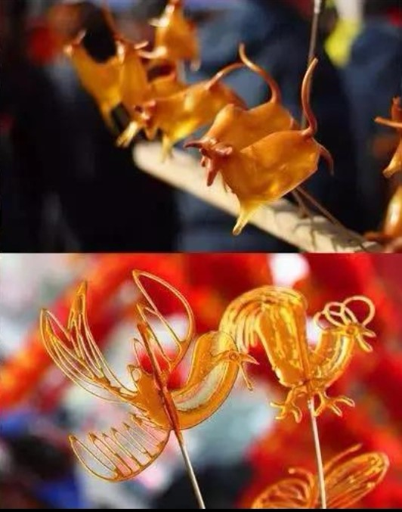
06
※告知信题型训练3【告知Peter博物院举行中国传统民俗文化展】
【详解】分析可知，应该以第一人称为主，一般现在时和一般将来时进行写作。要点已经给出，要求根据提纲自己发挥拓展，要先想好写哪几点，运用合适的语法规则和词汇把各要点都准确表述出来。描述要尽量选择简洁的语言，难点在于选择词汇和句型，可以灵活运用高级词汇和固定短语准确表述。还要用适当的连接词把句子连接起来，这样文章显得更连贯。

Slide 26
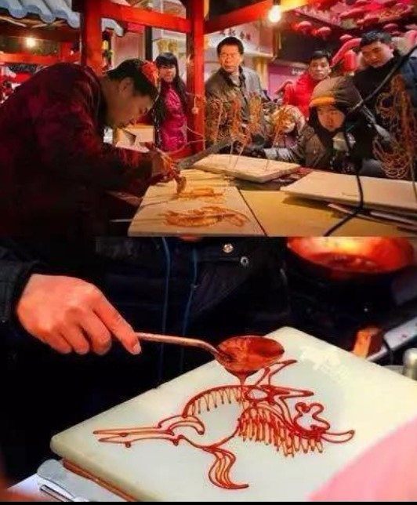
06
※告知信题型训练3【告知Peter博物院举行中国传统民俗文化展】
【点睛】这篇告知信的关键在于要点的拓展，同时注意谋篇布局的顺序，运用合适的连接词连接全文，选择高级的词汇和语法项目让文章更有文采。I have some good news to tell you that our city museum will hold a special exhibition to make the Chinese traditional folk cultures well known. 这里用了that引导的宾语从句；
Let’s decide on the date if you’re free.用了if引导的条件状语从句，这些都是高分亮点句子。

Slide 27
06
※告知信3【告知Peter博物院举行中国传统民俗文化展】
【Possible Version】：
Dear Peter,
I’m Li Hua. I have some good news to tell you that our city museum will hold a special exhibition to make the Chinese traditional folk cultures well known. Now I will give you a detailed description of the exhibition. It will start from April 6 and end on May 6. There will be a total of 1,000 items to be showed at the exhibition and many of them are traditional Chinese festival decorations such as Spring Festival couplets and lanterns. The exhibition will not only present us with antique collections, but will also allow the audience to involve themselves in the cultural atmosphere of ancient China. Let’s decide on the date if you’re free.
Looking forward to your reply.
Your sincerely,
Li Hu

Slide 28
06
※告知信题型训练4【告知英国朋友Jack汉语夏令营相关信息】
第一节：应用文写作（满分15分）
假定你是李华，你的英国朋友Jack即将来你校参加国际中学生汉语夏令营，请写一封电子邮件告知其相关信息，内容包括：
1. 表示欢迎；
2. 介绍活动内容；
3. 你的期待。
注意：1. 词数80左右；
2. 可适当增加细节，以使行文连贯。

Slide 29
What?
Who?
How?
审题
A letter of informing
假定你是李华，你的英国朋友Jack即将来你校参加国际中学生汉语夏令营，请写一封电子邮件告知其相关信息，内容包括：
1. 表示欢迎；
2. 介绍活动内容；
3. 你的期待。
注意：1. 词数80左右；
2. 可适当增加细节，以使行文连贯。
Who am I?
who is the reader?
Li Hua
Jack ( a friend)
Tip1: No self-introduction!
Person:
Tense:
Points
Para.1
Para.2
Para.3
the first + second person
simple future tense
welcome
activity-introduction
expectation

Slide 30
06
※告知信题型训练4【告知英国朋友Jack汉语夏令营相关信息】
搭建框架 Points
Para.1
Para.2
Para.3
Background
国际中学生汉语夏令营即将举办
Purpose
表示欢迎+愿意告知
Activities
学习汉字、书法,欣赏诗歌,介绍文化……
Expectation
愉快度过,学有所获

Slide 31
Para.2：Body –varieties of Activities
offering a platform to Learn basic Chinese characters
Explore the art of Chinese calligraphy
Appreciate classic Chinese movies and poems
…
Tip2: 介绍活动目的
（可适当增加活动时间、地点等细节）
Aimed at offering a platform for foreign students to develop an interest in Chinese, various activities will be arranged, ranging from…
Various activities tailored to Chinese enthusiasts like you are scheduled, ranging from…to…
Themed on traditional Chinese culture, the summer camp will be hosted on July 6th and last for two weeks. A wide range of meaningful activities will be held, including…

Slide 32
06
※告知信题型训练4【告知英国朋友Jack汉语夏令营相关信息】
【Possible Version 1】：
Dear Jack,
Delighted to learn you’ll participate in the Chinese summer camp, I’m writing to extend my cordial welcome and inform you of some relevant information.
Aimed at offering a platform for foreign students to develop an interest in Chinese, various activities will be arranged, ranging from learning basic Chinese characters to explore the art of Chinese calligraphy. Appreciating classic Chinese movies and poems will also add fuel to your enthusiasm.
I highly expect the experience to be rewarding, perfectly mixing learning and fun.
Your sincerely,
Li Hu

Slide 33
06
※告知信题型训练4【告知英国朋友Jack汉语夏令营相关信息】
【Possible Version 2】：
Dear Jack,
Having known that you are going to our school for summer camp, I’m writing to convey my heartfelt welcome and inform you of some relevant details.
With the aim of building the bridge between English and Chinese culture, we’ll participate in various activities, ranging from learning Tang Poems together to writing Chinese stories. Additionally, a party will be held last night, where delicious food will be served.
Looking forward to your arrival. I hope that you could really learn something and enjoy yourself during the camp.
Your sincerely,
Li Hu

Slide 34
06
※告知信题型训练4【告知英国朋友Jack汉语夏令营相关信息】
【Possible Version 3】：
Dear Jack,
Learning that you are to attend our school summer camp. I’m writing to express my sincere welcome and tell you something related.
Abundant activities have been arranged. On the first day, a welcome party with interesting games about Chinese culture will witness a happy beginning. Lectures will be given by famous Chinese writers next day, which will surely sparkle your interest and deepen your understanding on learning Chinese.
Hoping you’ll harvest a lot and we’ll have rosy memories together. Looking forward to your arrival.
Your sincerely,
Li Hu

Slide 35
Thanks for your attention!

