Slide 1

感恩遇见，相互成就，本课件资料仅供您个人参考、教学使用，严禁自行在网络传播，违者依知识产权法追究法律责任。
更多教学资源请关注
公众号：溯恩高中英语
知识产权声明

Slide 2
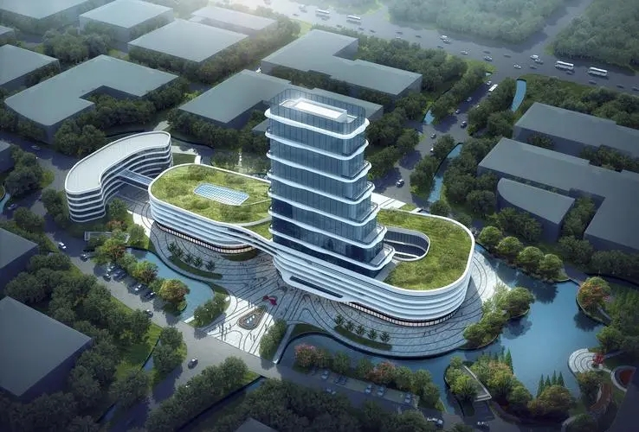
Navigating the Maze
穿越迷宫
浙江省金华市汤溪高级中学 郑素红

Slide 3

Eva spent the first week of high school trying to keep her head above water. One of the major headaches for her was finding her way in the huge school building. It was a six-story building. On each floor, hallways stretched in four directions, leading to classrooms, laboratories, and teachers" offices. Somewhere in the building, there was also a library, a cafetoria, and a gym.
Q1: How did Eva feel in her new high school? Why?
Q2: What was her headache?

Slide 4
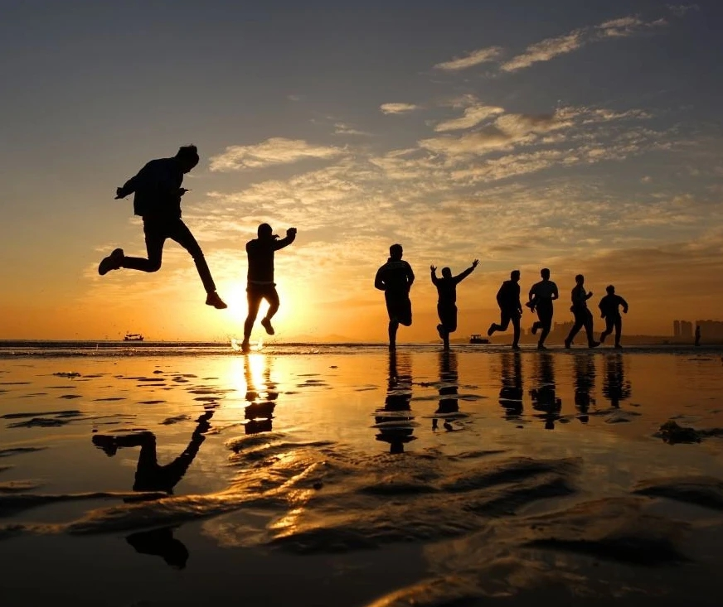
Having a poor sense of direction, Eva found it impossible to get around in such a huge building. All the different hallways and rooms were too much to think about, let alone commit to memory. She decided that she would memorize where her classes were and then pretend that the rest of the place didn't exist.
Q3: What was Eva’s weakness?
Q4: How did she solve her headache?

Slide 5
In her first P.E. class, Eva was shocked when Coach Pitt announced that everyone had to run one mile around the track outside. She searched the faces of her classmates for signs of panic. There was nothing she feared more than having to run a whole mile. To Eva, "a mile" was used to describe long distances. It was ten miles from her home to her grandfather's, and that always seemed like a long way, even in a car!
Q4: What did they do in their first P.E. class?
Q5: How did Eva feel at the news of the one-mile run?

Slide 6
When Coach Pitt blew his whistle, Eva figured she would be left in the dust. However, while some of her classmates edged ahead, others actually fell behind. "It's just the beginning," she thought. I' Il come in last for sure.'
Q6: How did Eva feel? And why?

Slide 7
Soon Eva began to breathe hard, with her heart pounding and legs shaking. Feeling desperate, Eva started using a mind trick on herself. She stopped thinking about the word "mile." Instead, she focused on reaching the shadow cast on the track by an oak tree up ahead. Then she concentrated on jogging to the spot where the track curved (拐弯). After that, she tried to see if she could complete her first lap. One lap turned into two, then three, then four.
Q6: What method did Eva use to face the challenge?
Q7: What was the result of the run?

Slide 8
原文伏笔 | 续写回扣
Eva spent the first week of high school trying to keep her head above water. One of the major headaches for her was finding her way in the huge school building. … It was a six-story building. … | Eventually Eva felt like a fish in water and got fully ready for her future brilliant high school life. Eva got familiar with the building and would never get lost any more, fitting in new school life
Having a poor sense of direction, Eva found it impossible to get around in such a huge building. All the different hallways and rooms were too much to think about, let alone commit to memory. She decided that she would memorize where her classes were and then pretend that the rest of the place didn't exist. | better sense of direction succeed in memorizing all the functional areas in the building

Slide 9
原文伏笔 | 续写回扣
Eva searched the faces of her classmates for signs of panic. There was nothing she dreaded more than having to run a whole mile. When Coach Pitt blew his whistle, Eva figured she would be left in the dust. “It's just the beginning,” she thought, “ I'll come in last for sure.” | face challenge smartly and confidently She won’t be the last . Probably, she will be the first to reach the finish line.
Feeling desperate, Eva started using a mind trick on herself. She stopped thinking about the word "mile." Instead, she focused on reaching the shadow cast on the track by an oak tree up ahead. Then she concentrated on jogging to the spot where the track curved (拐弯). After that, she tried to see if she could complete her first lap. One lap turned into two, then three, then four. | Probably the oak can be connected with the gym or the cafeteria or the laboratory or the library Similarly, around the track curve , may stand the school gym. Goals are easier to achieve in small steps.

Slide 10
Para1：When Coach Pitt said "Great work" to her at the finish line, Eva was surprised.
定首段首句：
手法1：（主位推进叙事，以Eva 为叙事对象：根据原文最后一段，Eva 终于完成了一英里长跑。可以夸张一下Eva 最终跑步的成绩，体现续写开放性）
Never in her wildest dream had she imagined that she could achieve such an eye-catching score!
手法2：（以Coach Pitt 为叙事对象。课堂结束时还是为Eva 的出彩表现表现出赞赏。）
Class dismissed, Coach Pitt gave Eva a thumbs-up for her fantastic performance as Eva waved goodbye to him.

Slide 11
定首段尾句： 根据第二段deal with the school building ，尾句肯定会提到 六层的教学楼。Eva 想到了这个好办法，来回扣原文第一段和呼应第二段首句。
手法1：
Being a freshman, she tended to get lost in the 6-storey maze, leaving her so helpless and defenseless. Staring at the towering school building, Eva came up with a good idea, with a smile blooming/ flowering across her face.
手法2：
“Will the ingenious mind trick apply to her present challenge in this new school?” She thought to herself.
Para 2：Eva decided to use the same trick to deal with the school building.

Slide 12
Para 2：Eva decided to use the same trick to deal with the school building.
定二段首句： 关键字the same trick ，the school building； 推测应该是体育课后返回教学楼实践Eva 的 mind trick.
手法1：
No sooner had she returned to the confusing maze than she set out to explore the first floor.
手法2：
The towering 6- storey building stood tall in front of Eva as she headed towards it step by step from the playground.

Slide 13
Para 2：Eva decided to use the same trick to deal with the school building.
定二段尾句： 回扣原文第一段Eva spent the first week of high school trying to keep her head above water. 以及所给the same trick to deal with the school building, 说明肯定成功突破挑战，顺利融入新的高中生活。
手法1：可以定句群 哲理感悟式结尾：
Days into weeks，/ Time ticking away, Eva eventually got familiar with every hallway，the dynamic gym, the gorgeous cafeteria and the tranquil library in the way she finished the one-mile run. One lap at a time did work! So did one floor/ storey a week! It also dawned on her that goals are easier to achieve in small steps.

Slide 14
Para 1: When Coach Pitt said “Nice work" to her at the finish line, Eva was surprised.
1. （Eva 主位推进叙事，承接教练赞美之词，夸张写一下跑步的成绩。）
Never in her wildest dream had she imagined that she could achieve such an eye-catching performance!
2. (继续主位推进叙事：自己感叹一下 这个成绩是里程碑式的！）
Conquering this one mile was a milestone in her running career!
3. (教练鼓励的意义！让Eva 有成就感！）
Amazingly, Coach Pitts’ positive affirmation infused an enormous sense of achievement into her heart.

Slide 15
Para 1: When Coach Pitt said “Nice work" to her at the finish line, Eva was surprised.
4. （新同学的赞叹与喝彩；收获胜利的喜悦。）
Enthusiastic cheers and thunderous applauses from her classmates kept her on the top of the world.
5. (跑完步虽然气喘吁吁+疲倦，Eva 及时反思经验！）
Breathless and exhausted, she realized that overcoming seemingly invincible challenges just needed a smart strategy like her mind trick.
6. (回扣原文首段高一新生的不适应+ 想到解决办法）
Being a freshman, she tended to get lost in the 6-storey maze, leaving her so helpless and defenseless.
7. （体育课结束后，在操场看着教学综合楼，Eva 想到解决办法）
Staring at the towering teaching building, Eva came up with a good idea, with a smile blooming across her face.

Slide 16
Para 2：Eva decided to use the same trick to deal with the school building.
1.（Eva 主位推进叙事，迫不及待开始一步一步探索。）
No sooner had she returned to the confusing maze than she set out to explore the first floor.
2. (运用跑步的策略，先搞定gym ！）
Convinced that her mind trick would orientate her in the school as soon as possible, she came across the gym, which faced the oak standing on the playground.
3. (再提吃饭的地方！）
On the left of the gym was a cafeteria, which provided a wide range of foods and drinks.

Slide 17
Para 1: When Coach Pitt said "Great work" to her at the finish line, Eva was surprised.
4. （熟悉了gym cafeteria 后，顿觉压力减少。）
As Eva walked back to her classroom, she noticed that she felt less overwhelmed by this huge complex (综合建筑群）.
5. (时间流逝，Eva 最终熟悉了这栋迷宫 。 ）
Time ticking away, Eva eventually got familiar with the vast maze in the way she finished the one-mile run.
6. (回扣一下跑步时的方法;类比穿越迷宫的方法）
One lap at a time did work! So did one floor/ storey a week!
7. （感悟式结尾）
It also dawned on her that goals are easier to achieve in small steps.
The one-mile run and navigating the maze taught her a valuable lesson- A thousand-mile journey begins with one step.

Slide 18
Paragraph 1：When Coach Pitt said "Great work" to her at the finish line, Eva was surprised. Never in her wildest dream had she imagined that she could achieve such an eye-catching score! Conquering this one mile was a milestone in her running career! Amazingly, Coach Pitts’ positive affirmation infused an enormous sense of achievement into her heart. Enthusiastic cheers and thunderous applauses from her classmates kept her on the top of the world. Breathless and exhausted, she realized that overcoming seemingly invincible challenges just needed a smart strategy like her mind trick. Her initial self-doubt gave way to self-confidence. Being a freshman, she tended to get lost in the 6-storey maze, leaving her so helpless and defenseless. Staring at the towering teaching building, Eva came up with a good idea, with a smile blooming across her face.

Slide 19
Para 2：Eva decided to use the same trick to deal with the school building. No sooner had she returned to the confusing maze than she set out to explore the first floor. Convinced that her mind trick would orientate her in the school as soon as possible, she came to a gym, which was well-equipped with various workout facilities. Next to the gym was a cafeteria, which provided a wide range of foods and drinks. As Eva walked back to her classroom, she noticed that she felt less overwhelmed by this huge complex. Time ticking away, Eva eventually got familiar with the vast maze in the way she finished the one-mile run. One lap at a time did work! So did one floor a week! It dawned on her that goals are easier to achieve in small steps.

Slide 20

A thousand-mile journey
begins with one step.
请在此放置您的文字

