Slide 1

感恩遇见，相互成就，本课件资料仅供您个人参考、教学使用，严禁自行在网络传播，违者依知识产权法追究法律责任。
更多教学资源请关注
公众号：溯恩高中英语
知识产权声明

Slide 2


选择性必修四 Unit 4
Sharing
Reading and thinking
Volunteering in the bush

Slide 3
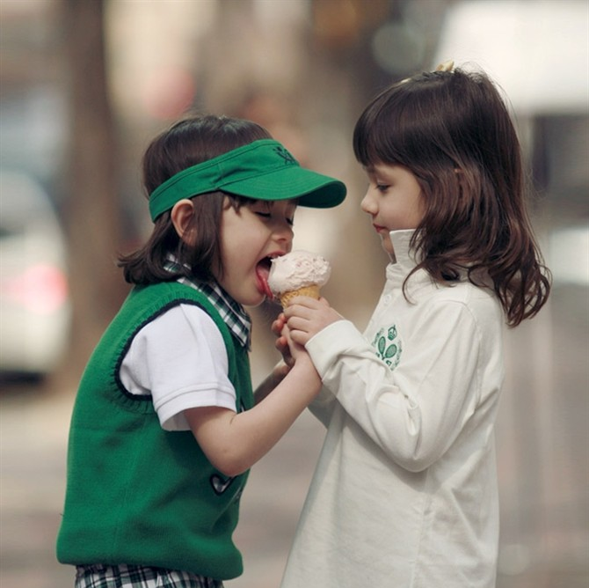
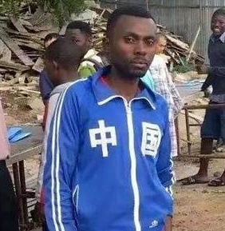
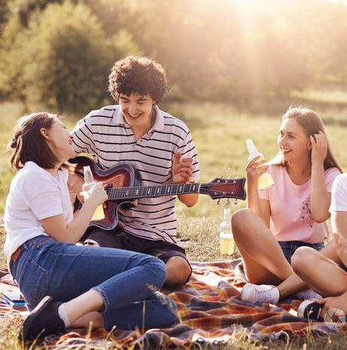

Lead-in
1.What do you often share with others?
food
clothes
joy
love

Slide 4
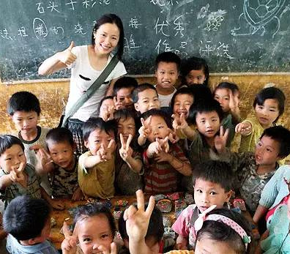
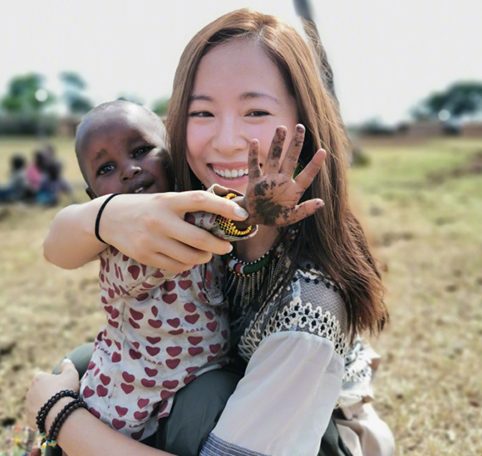
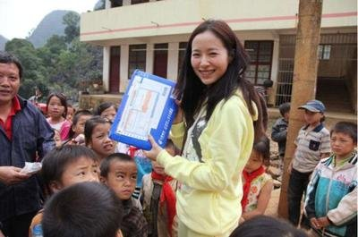
2.Have you ever shared knowledge with others?
How to share knowledge?
Volunteer teachers help convey knowledge and love to poor children in remote villages.

Slide 5
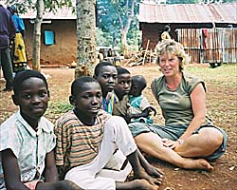
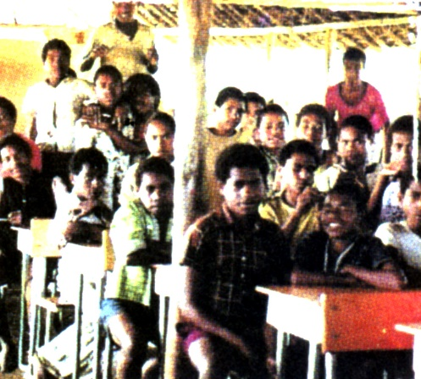
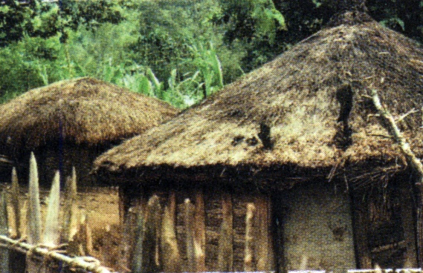
Prediction
Volunteering in the bush
What’s the text about？
A young Australian woman whose name is Joe worked as a volunteer teacher in Papua New Guinea for two years.

Slide 6

Papua New Guinea

Slide 7
Skim the text and divide the text into 4 parts
Part 1
(Para ____)
Part 2
(Para____)
Part 3
(Para____)
Part 4
(Para____)
Recieve a parcel from home.
1
The conditions about the bush school and the students.
2-3
What the author witnessed in Tombe’s village.
4-7
The author’s feeling after visiting the village.
8
Notes:
本资料来自于资源最齐全的２１世纪教育网www.21cnjy.com
7

Slide 8
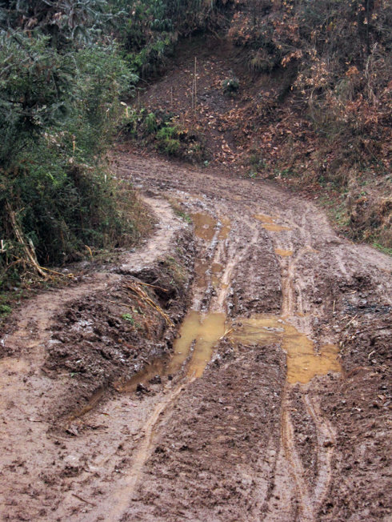
Careful reading
Para 2
Are you willing to go to a bush school?
The tough conditions of the high school
...there are lots of “good mornings”
for me from the boys
be made of bamboo
& the roofs of grass
Many of them have walked a long
way, sometimes up to two hours...
reflect
Backward as the conditions are,
they show_______ for teachers
and treasure _____________________.
respect
walk to school down a muddy track
the opportunity to study

Slide 9
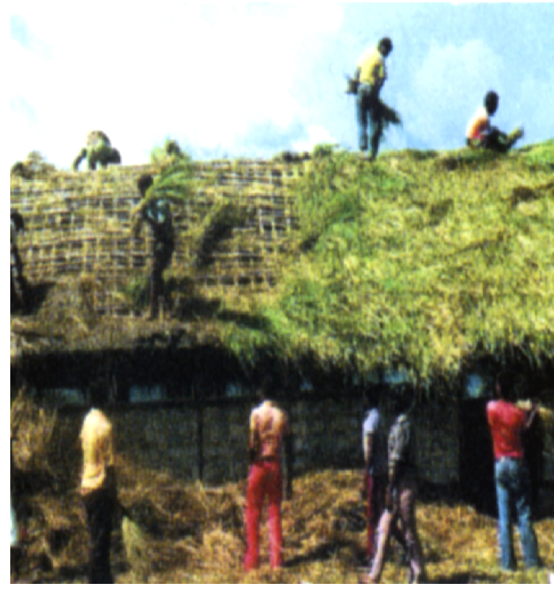
Careful reading
Para 3
no ___________;
no ____________;
no ____________;
no _____________in the lab .
no________
electricity
textbooks
water
school
equipment
poor-equipped
washroom
school
life
walk
have to ______up two hours to school
say a lot of good ______ to me .
have no_________ of doing experiment.
most of them will be going back to their
________ Year 8 any way.
morning
students
concept
uncivilized
but polite
village

Slide 10
poor-equipped school
+
uncivilized students
How does Jo feel ?What’s Jo's reaction?
Science is the most___________subject.
(But) I have become ___________for my teaching.
challenging
imaginative
optimistic
adapt to
I'm still trying to________ these conditions.
I wonder how relevant chemistry is to ...
....To be honest I doubt whether I am making any
difference to these boy’s lives at all .
Jo is doubtful about the effect of her job there

Slide 11
Para4
people
remote
A visit to a __________village
The visit is written in the order of ________.
time
far away ，in the distance & difficult to reach
Before reaching
Upon reaching
Tombe's mother
Few visitors
We walked two and a
half hours to get there.
First_______________
then_______________
Crying “ieee ieee”
All the villagers
up a mountain to a ridge
Shaking hands with us
down a path to the valley
Everyone seemed to be
a relative of Tombe's.
Although they seldom met foreign visitors, all the villagers still treated us with_____________.
hospitality

Slide 12
far away in distance & difficult to reach
While staying in the remote village (para5-7)
Living conditions
Eating culture
Kau kau(sweet potato),
corn and greens
A low bamboo hut with grass sticking out of the roof
Diet
Types of houses
far away from civilization/modern culture
Cooking methods
Putting hot stones in an
empty oil drum with food to steam
Sleeping arrangements
hospitality
All the villagers still treated us with_____________.
contrast
Beliefs
one broom, a few tin plates and cups and a couple of jars
Possessions
They believe that any leftovers attract evil spirits in the night.
primitive
They lived a __________life.
with no concept of science.

Slide 13
What did Jo feel after she left the village?
After leaving (Para. 8)
My muscles were aching and
physically exhausted
my knees shaking
Thinking: Will Jo still wonder whether she will make any difference?
My muscles were aching and my knees shaking as we climbed down the mountain towards home. That evening I fell happily into bed. It was such a privilege to have spent a day with Tombe's family.
fell happily into bed
mentally satisfied
privilege
a sense of achievement
Self-improvement

Slide 14
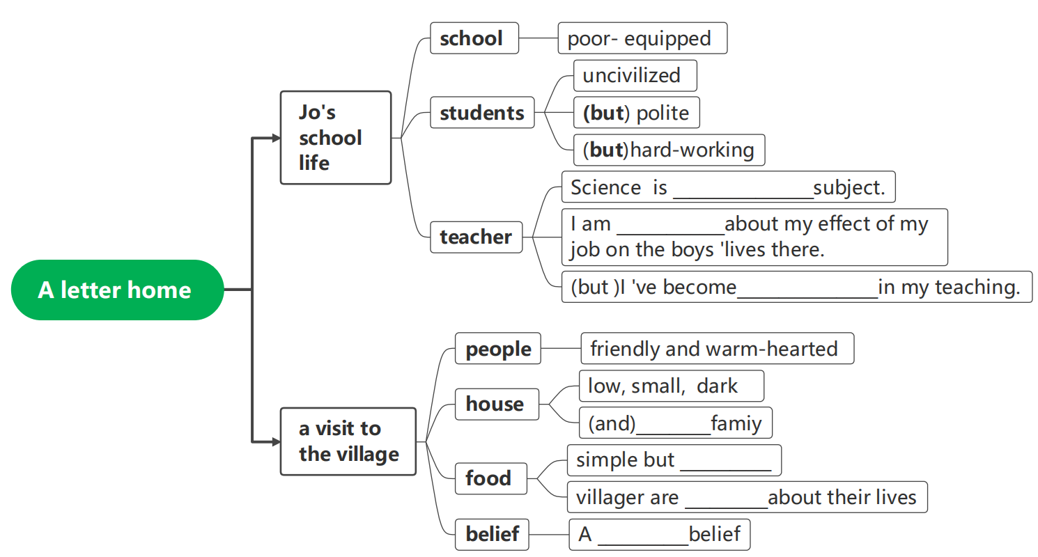
Let ’s draw a mind map of the whole story.
a challenging
doubtful
imaginative
poor
delicious
satisfied
good

Slide 15
Further thinking
1.What does Jo share with the villagers?
2.What changes does she bring to the villagers?
3.If you have the chance to be a volunteer teacher , would you like to go there? Why?

Slide 16
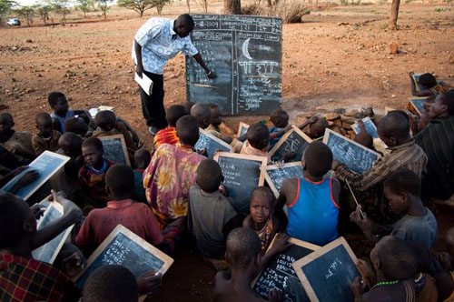
Sharing
Sharing is helping
Sharing is giving
Sharing is understanding
Sharing is love

