Slide 1


扫码关注
回复：hello sun
获取课件制作、录课等实用工具包
知识产权声明
感恩遇见，相互成就，本课件资料仅供您个人参考、教学使用，严禁自行在网络传播，违者依知识产权法追究法律责任。
更多教学资源请关注
订阅号：溯恩英语

Slide 2

浙江省2019年6月高考
英语考前辅导
吴俊峰
浙江省常山一中

Slide 3
1
听力
目 录
2
阅读理解
3
七选五
Contents
4
完形填空
5
语法填空
作文：
应用文/读后续写/概要写作
6

Slide 4

1
听力
（一）考纲解读
高考考纲要求考生能听懂所熟悉话题的简短独白和对话。考生应能：
（1）理解主旨要义；
（2）获取具体的、事实性信息；
（3）对所听内容做出推断；
（4）理解说话者意图、观点或态度。
从考试大纲对听力的要求及近几年听力测试的特点，我们可知，高考听力主要测试考生：
对材料内容、时间、地点、方式、人物关系等事实信息的把握能力；
对话和短文内容的概括能力；
通过用词、语音和语调、时间和人文背景，对说话人的情感、态度和意图的推断能力。

Slide 5
1
听力
（二）注意事项
1、不要抓每一个字，即不要奢望听懂每一个字，没有必要，
也不可能。要做到对内容的整体理解。
2、拿到卷子的第一件事，就是抓紧时间阅读试题选项，预
测谈话大致内容。
3、短对话，答案多在第二个人说话中出现；长对话，短文听
力，要先抓住开头的前几句，这一般是主旨题的答案所在，
而结尾处往往会再次呼应。中部往往是细节题。
4、抓中心词，两次以上连续重复出现，对应某一题干选项中
的答案，一定要提高警惕。
5、遇到数字和时间等信息，要随手记笔记，有助于选项中的
数字听力题答案的准确无误。

Slide 6
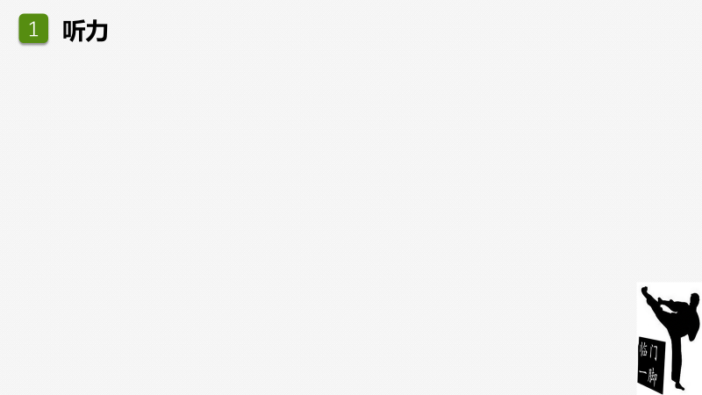
（三）录音未听清怎么办？
听力是非常快的考试，头脑中不应该有杂念，也来不及有杂念。
边听、边理解、边记录、边推测、边选择。保持良好心态，切忌因急躁而影响听后面的内容。
把握复听，侧重难点和漏点。
根据前后几道题所提供的信息，运用阅读理解的推理手段处理未听清的内容。
听完后把答案填涂到答题卡上，涂卡过程中同时对身心作调整。切记！！

Slide 7
1
2018年6月浙江卷听力——解题思路和技巧
听力
1. What will James do tomorrow?
A. Watch a TV program.
B. Give a talk.
C. Write a report.
【答案】B
【录音稿】Text 1
W: James, you've been watching TV for the whole evening. What's on?
M: It's a science program on the origin of the universe. I'll give a presentation on it in my class tomorrow.
高考听力对词汇的广度、深度和宽度都有要求，基本词汇量可以促进听力理解，词汇的解释要学会英英解释（同义词替换），会利用语境排除干扰项，选择正确的单词。

Slide 8

1
2018年6月浙江卷听力——解题思路和技巧
听力
2. What can we say about the woman?
A. She’s generous. B. She’s curious. C. She’s helpful.
【答案】C
【录音稿】Text 2
M: Hello, do you have "The Best of Mozart"?
W: Um, sorry, we've just sold out. But we can order one for you. If you give us your number, we'll call you when the CD arrives.
3. When does the train leave?
A. At 6:30. B. At 8:30. C. At 10:30.
【答案】C
【录音稿】Text 3
W: We'd better be going now, or we'll be late for the train.
M: No rush. It's 8:30 now. We still have two hours.
听力中要特别注意but 后的内容。因为but前的往往是婉转的客套话，而后面的才是真正的心里话，在口语表达中更常见的还有以下几个连接标志：to be honest, to tell the truth, in fact, as a matter of fact, actually等。
数字类解题策略：
在听的时候记录数字，并弄清楚每个选项所表达的含义以及它们之间的关系。数字之间的关系往往要经过一些计算和判断才能够做出正确的选择，另外留意表示时间的时间状语等。

Slide 9
1
2018年6月浙江卷听力——解题思路和技巧
听力
4. How does the woman go to work?
A. By car. B. On foot. C. By bike.
【答案】B 【录音稿】Text 4
M: I am so tired of driving all those hours to work.
W: Yeah. I know what you mean. I used to drive two hours to work each way. But now, I live within walking distance of my office. I don't even need a bike.
5. What is the probable relationship between the speakers?
A. Classmates. B. Teacher and student. C. Doctor and patient.
【答案】A 【录音稿】Text 5
W: Hi, Andy. I didn't see you in Professor Smith's class yesterday. What happened?
M: Well, I had a headache. So, I called him and asked for sick leave.
听力理解，不仅仅是获取信息的“听”，更应该是获取有效信息并进行加工处理的“思维”“思考”的过程，听到并不是听懂，所以听力考试中要学会思考，而不是单纯的“信息搬家”。
人物关系及身份题解题技巧：
1.仔细辨认对话中的职业相关词,抓住其相关的关键词进行答题。
2.在听人物之间关系的题目时，说话人之间的语气尤其重要，如果是上司跟下属之间的关系，语气一般较强硬，有命令的意味；而如果是夫妻之间，则语气较为甜蜜，随意；朋友之间较亲切；服务员对顾客一般较尊敬。

Slide 10
1
高考听力常见的人物之间关系
听力
师生关系：Dear teacher, exam, homework, professor ；
夫妻或其他家庭成员（如母子、父女等）之间的关系：My dear/darling;
医生与病人的关系：What’s wrong with you? Nothing serious, Take this medicine.；
司机与乘客的关系：fare, taxi；
图书管理员与读者的关系：borrow, keep the book, library;
服务员与顾客的关系：Can I help you? What can I do for you?
常见人物之间的关系有：
doctor-patient; lawyer-client
husband -wife; secretary-boss
teacher - student; driver-policeman
colleagues - friends; receptionist- tourist
salesperson-customer shop assistant-customer;
waiter (waitress) - customer

Slide 11
1
2018年6月浙江卷听力——解题思路和技巧
听力
听第6段材料，完成下面小题。
6. What does the woman regret?
A. Giving up her research.
B. Dropping out of college.
C. Changing her major.
7. What is the woman interested in studying now?
A. Ecology. B. Education. C. Chemistry.
【答案】6. B 7. A 【录音稿】Text 6
W: The biggest mistake I made, uh...was leaving college in my last year and not completing my education. So, I', thinking of going back to school.
M: School? To study what?
W: Ecology. I'm interested in the relationship between humans and nature.
M: Cool. Is it what you studied years ago?
M: No, I majored in chemistry then.
理解主旨要义对话或独白：
对所听内容做出推断对所听内容做出推断较获取具体的、事实性信息难度略高，通常考查考生通过已给出的信息对对话或独白发生的地点、人物关系及身份、原因等进行推断的能力。
要求对语段进行整体理解，不应纠结在某些小细节上,否则往往会造成以偏概全。

Slide 12
1
2018年6月浙江卷听力——解题思路和技巧
听力
听第7段材料，完成下面小题。
8. What is the man?
A hotel manager.
B. A tour guide
C. A taxi driver.
9. What is the man doing for the woman?
A. Looking for some local foods.
B. Showing her around the seaside.
C. Offering information about a hotel.
【答案】8. B 9. C
M: Good morning, madam. I am your guide for this trip.
W: How lovely! Could you tell me about the hotel I'm going to stay at?
M: Yes, of course. The Grand Hotel opened in 1990. And it sits on the seaside along the South Coast Highway. It is the most beautiful hotel here.
W: That sounds great.
M: And there are some restaurants outside. So, at dinnertime, you'd have a lot of choices.
W: That's really nice. I like to have some local foods while traveling. What about the scenery around it?
M: The hotel has the best views of the Pacific Ocean.
W: Oh, I think I will love this hotel.
整体理解并获取主旨大意的能力：对这种类型的题目，必须具有较强的语篇理解、概括能力。要求首先听懂整段对话的大体含义，并结合对话内容及所给选项做出判断。

Slide 13
1
2018年6月浙江卷听力——解题思路和技巧
听力
听第8段材料，完成下面小题。
10. Where does the conversation probably take place?
In an office.
B. At home.
C. At a restaurant.
11. What will the speakers do tomorrow evening?
Go to a concert.
B. Visit a friend.
C. Work extra hours.
12. Who is Alice going to call?
Mike.
B. Joan.
C. Catherine.
【答案】10. C 11. A 12. B
W: Hi, Mike.
M: Hi, Alice. Nice to see you. You don't often come here.
W: I usually have fast food delivered to my office. Just came here for a change today.
M: The environment here is good -- clean and relatively quiet.
W: yeah, and I heard the food is tasty. By the way, are you going to the concert tomorrow evening?
M: Yes, are you?
W: Yeah. Catherine was supposed to go with me. But she may have to work extra hours tomorrow. Do you know anyone who might like to go?
M: No. But if you like, I can ask around. Uh, Joan might want to go.
W: Oh, yes. She's a great fan of classical music. I'll give her a ring after lunch.
场景型问题解题技巧：
1.分析选项目, 预测可能出现的词汇,短语,句子.
2.仔细辨认对话中的语境相关词,特别是场景词汇及习惯用语.

Slide 14
1
2018年6月浙江卷听力——解题思路和技巧
听力
听第9段材料，完成下面小题。
13. Why does the woman meet the man?
To look at an apartment.
To deliver some furniture.
To have a meal together.
14. What does the woman like about the carpet?
Its color.
Its design.
Its quality.
15. What does the man say about the kitchen?
It’s a good size.
It’s newly painted.
It’s adequately equipped.
16. What will the woman most probably do next?
Go downtown.
Talk with her friend.
Make payment.
【答案】13. A 14. A 15. C 16. B
W: Hi, I've only just arrived.
M: Oh, good. Now, here are the keys. Let's go in. There are
two apartments. The one for rent is on the right. Do come in.
W: Thank you. I like the carpet. The color is nice, isn't it?
M: Yes, and this apartment is in good condition. Here is your
lounge.
W: Where would we eat?
M: There is this corner here, or you can use your kitchen. Come
and see.
W: The kitchen is quite small.
M: Yes, but it has everything -- cooker, fridge, even a dishwasher.
W: And there are lots of cupboards.
M: Let me show you the bedrooms. This is the smaller one.
W: It's a good size, though.
M: Now come into the other bedroom. You can see the bathroom,
too.
W: Yes. It is very nice, but I will have to ask my friend first. And
we will come together. I understand it is $800 a month.
M: Yes, but a few blocks downtown would be much more
expensive.
W: Well, thank you. I will be in touch.

Slide 15
1
2018年6月浙江卷听力——解题思路和技巧
听力
听第10段材料，完成下面小题。
17. Who is the speaker probably talking to?
A. Movie fans.
B. News reporters.
C. College students.
18. When did the speaker take English classes?
A. Before he left his hometown,
B. After he came to America.
C. When he was 15 years old.
19. How does the speaker mainly talk about?
A. He’s proud.
B. He’s sympathetic.
C. He’s grateful.
20. What does the speaker mainly talk about?
A. How education shaped his life.
B. How his language skills improved.
C. How he managed his business well.
【答案】17. C 18. B 19. C 20. A
Thank you very much. Thank you, Dr. Johnson. Well, it is really great to be back at university again. The thing that I wanted to tell you today is this: Education is important. When I came to the US, I was only thinking about being a carpenter, but I could not read the newspaper. And I could not understand the news on television or movies or anything like this. So, I entered the city college to take English classes for foreign students. I was very proud that I was going to a college because no one in my family ever went to any college or to any university. You know, when you're 15 years old in my country, you finish school and then you learn a trade. And that's exactly what I did. When I was 15 years old, I learned how to be a carpenter. A year later, I came to America. Luckily, I met a very good teacher who encouraged me to take some math classes, business classes, and history classes, and I became a full-time college student. And today, when I look back, I'm so happy because you never know where life will take you. All of a sudden, I started making money because I was really good at math. You know, how work out everything with math is so important. This is something that I learned when I started my own business, which is doing really well.
对说话者态度、看法的判断：此类试题很难由听力材料直接获取，需在理解、领悟和推理、判断的基础上进行选择。格外注意，需要揣摩说话者的语气，领会说话者的意图并结合对话的内容做出判断。

Slide 16
1
听力答题技巧小结
听力
一读
听前读清楚问题，选项一扫而过
关键地方作出勾画（when, where, why…以及提问对象），做好速记
二听
全神贯注，紧抓关键信息，舍弃无关信息
聚焦对话中第二个人的语言
三选
大部分正确选项的标志就是同义替换
正确选项基本出现在一对完全相反的选项之中
直白数字不可信，认真计算防陷阱
直觉带来惊喜

Slide 17
1
听力
目 录
2
阅读理解
3
七选五
Contents
4
完形填空
5
语法填空
6
作文：
应用文/读后续写/概要写作

Slide 18
2
阅读理解
（一）解题要点
忠实于原文, 不断章取义, 看清问题, 看完所有选项
再选择, 复查注意答案的一体性, 不自相矛盾, 首先核准关键答案, 以防一错皆错。
争取找到答案的依据，每个问题的答案均应在原文中找
到相关的语句或段落。注意选项中以偏盖全的失误。
理解作者的观点、态度、写这篇文章的目的，要达到的
效果，作者所持的态度，要与作者站在同一个角度审视问题，才能与作者合拍。尤其是推测性问题。只有与作者视角一致才能作出合理性的推测。

Slide 19
2
阅读理解
（二）注意掌握不同文体特点和阅读方法
说明文、科普文：首句常为主题句。
记叙文：首句交代时间,地点,人物等因素。
新闻报道：首句往往概括事件全貌。
应用文：字里行间找所需信息。
逆读法
广告类、说明文类文章要带着问题去找对应的时间、地点、人物；
顺序定位法
阅读后面的题一般来说与文章内容的顺序是一致的；
主题句寻找main idea法
（topic sentence, best title, best topic etc.）;

Slide 20
2
阅读理解
（三）注意事项
所选有据，避免主观臆断。
2. 阅读题要求选 最佳答案，有的答案从某个枝节来看是对
的，但从全文来看则不是最佳的，因此，必须通盘考虑，
取主要信息，紧扣文章主旨，舍枝节。
3. 遇到生词是正常的，千万不要惊慌，不会对文章的主旨有
太大的影响。词义猜测题，猜词如游戏，对比上下文。
4. 特别提醒：要相信自己的第一感觉，如果需要修改所选答
案，必须在文章找到足够的证据。

Slide 21
2
2018年6月浙江卷阅读理解——语篇导读
阅读理解
2018年高考英语浙江卷阅读理解涵盖人与社会、人与自然两大主题。体裁以议论文和说明文为主。三篇文章都比较有深度，内容丰富，语言地道。
A篇论述了狄更斯的文学地位，以此来纪念这位文学巨人。《普通高中英语课程》（2017年版）文化知识内容要求（必修）中提到“了解英美等国家主要的文学家、艺术家、科学家、政治家及其成就、贡献等”。通过阅读此文，学生能够了解狄更斯的文学成就对世界文学的巨大影响，从而有助于他们文化知识的积累。
B篇与环保有关，开头充满悬念。现在很多购物场所不再免费提供塑料袋，因为塑料袋影响环境，然而塑料袋制造商却希望向公众传达这样一个信息——他们的产品没有人们想象的那么糟糕。文末，环境学家提出了他们的希望。阅读此类文章有助于提升学生分析和解决问题的能力、培养学生的批判性思维。
C篇分析了美国的汽车工业发展对美国社会文化和环境的影响。本文语言较为抽象，其中引用了美国第31任总统胡佛的竞选口号“每个锅里都有鸡，每个车库都有车”，文末引用了美国作家一本书中的话，指出绿色经济才是长远发展之道。文中涉及了较多的文化背景知识。

Slide 22
2
2018年6月浙江卷A篇——语篇结构和特征
阅读理解
In 1812, the year Charles Dickens was born, there were 66 novels published in Britain. People had been writing novels for a century—most experts date the first novel to Robinson Crusoe in 1719—but nobody wanted to do it professionally. The steam-powered printing press was still in its early stages; the literacy（识字） rate in England was under 50%. Many works of fiction appeared without the names of the authors, often with something like “By a lady.” Novels, for the most part, were looked upon as silly, immoral, or just plain bad.
In 1870, when Dickens died, the world mourned him as its first professional writer and publisher, famous and beloved, who had led an explosion in both the publication of novels and their readership and whose characters — from Oliver Twist to Tiny Tim— were held up as moral touchstones. Today Dickens’ greatness is unchallenged. Removing him from the pantheon（名人堂） of English literature would make about as much sense as the Louvre selling off the Mona Lisa.
How did Dickens get to the top? For all the feelings readers attach to stories, literature is a numbers game, and the test of time is extremely difficult to pass. Some 60,000 novels were published during the Victorian age, from 1837 to1901; today a casual reader might be able to name a half-dozen of them. It’s partly true that Dickens’ style of writing attracted audiences from all walks of life. It’s partly that his writings rode a wave of social, political and scientific progress. But it’s also that he rewrote the culture of literature and put himself at the center. No one will ever know what mix of talent, ambition, energy and luck made Dickens such a distinguished writer. But as the 200th anniversary of his birth approaches, it is possible — and important for our own culture—to understand how he made himself a lasting one.
关注文本结构，梳理语篇文脉。
（人物传记类）

Slide 23
2
2018年6月浙江卷A篇——解题思路和技巧
阅读理解
In 1812, the year Charles Dickens was born, there were 66 novels published in Britain. People had been writing novels for a century—most experts date the first novel to Robinson Crusoe in 1719—but nobody wanted to do it professionally. The steam-powered printing press was still in its early stages; the literacy（识字） rate in England was under 50%. Many works of fiction appeared without the names of the authors, often with something like “By a lady.” Novels, for the most part, were looked upon as silly, immoral, or just plain bad.
21. Which of the following best describes British novels in the 18th century?
A. They were difficult to understand.
B. They were popular among the rich.
C. They were seen as nearly worthless.
D. They were written mostly by women.
细节理解题，理解文中具体信息，考查逻辑性思维

Slide 24
2
2018年6月浙江卷A篇——解题思路和技巧
阅读理解
In 1870, when Dickens died, the world mourned him as its first professional writer and publisher, famous and beloved, who had led an explosion in both the publication of novels and their readership and whose characters — from Oliver Twist to Tiny Tim— were held up as moral touchstones. Today Dickens’ greatness is unchallenged. Removing him from the pantheon（名人堂） of English literature would make about as much sense as the Louvre selling off the Mona Lisa.
推理判断题答题技巧：
(1)定位细节。根据题干提供的信息，到原文中去抓关键信息。
(2)揣摩细节。对原文中的关键信息进行分析、推理和判断，利用逆向思维或正面推理，从而推断出这句话所隐含的深层含义。
22. Dickens is compared with the Mona Lisa in the text to stress________.
A. his reputation in France
B. his interest in modern art
C. his success in publication
D. his importance in literature
推理判断题，根据所读内容作出判断和推理，考查评判性思维

Slide 25
2
2018年6月浙江卷A篇——解题思路和技巧
阅读理解
How did Dickens get to the top? For all the feelings readers attach to stories, literature is a numbers game…. It’s partly that his writings rode a wave of social, political and scientific progress. But it’s also that he rewrote the culture of literature and put himself at the center. No one will ever know what mix of talent, ambition, energy and luck made Dickens such a distinguished writer. But as the 200th anniversary of his birth approaches, it is possible — and important for our own culture—to understand how he made himself a lasting one.
23. What is the author’s purpose in writing the text?
A. To remember a great writer.
B. To introduce an English novel.
C. To encourage studies on culture.
D. To promote values of the Victorian age.
技巧点拨 ：
根据文体类别推断写作目的，本篇人物传记，介绍生平，纪念伟大。
写作意图题，理解作者的意图、观点和态度，考查评判性思维

Slide 26
2
2018年6月浙江卷B篇——语篇结构和特征
阅读理解
Steven Stein likes to follow garbage trucks. His strange habit makes sense when you consider that he’s an environmental scientist who studies how to reduce litter, including things that fall off garbage trucks as they drive down the road. What is even more interesting is that one of Stein's jobs is defending an industry behind the plastic shopping bags.
Americans use more than 100 billion thin film plastic bags every year. So many end up in tree branches or along highways that a growing number of cities do not allow them at checkouts(收银台). The bags are prohibited in some 90 cities in California, including Los Angeles. Eyeing these headwinds, plastic-bag makers are hiring scientists like Stein to make the case that their products are not as bad for the planet as most people assume.
Among the bag makers' argument: many cities with bans still allow shoppers to purchase paper bags, which are easily recycled but require more energy to produce and transport. And while plastic bags may be ugly to look at, they represent a small percentage of all garbage on the ground today.
The industry has also taken aim at the product that has appeared as its replacement: reusable shopping bags. The stronger a reusable bag is, the longer its life and the more plastic-bag use it cancels out. However, longer-lasting reusable bags often require more energy to make. One study found that a cotton bag must be used at least 131 times to be better for the planet than plastic.
Environmentalists don't dispute(质疑) these points. They hope paper bags will be banned someday too and want shoppers to use the same reusable bags for years.
建构内在逻辑，厘清文本结构。
（正反议论文）

Slide 27
2
2018年6月浙江卷B篇——解题思路和技巧
阅读理解
Steven Stein likes to follow garbage trucks. His strange habit makes sense when you consider that he’s an environmental scientist who studies how to reduce litter, including things that fall off garbage trucks as they drive down the road. What is even more interesting is that one of Stein's jobs is defending an industry behind the plastic shopping bags.
Americans use more than 100 billion thin film plastic bags every year. So many end up in tree branches or along highways that a growing number of cities do not allow them at checkouts(收银台). The bags are prohibited in some 90 cities in California, including Los Angeles. Eyeing these headwinds, plastic-bag makers are hiring scientists like Stein to make the case that their products are not as bad for the planet as most people assume.
24. What has Steven Stein been hired to do?
A. Help increase grocery sales. B. Recycle the waste material.
C. Stop things falling off trucks. D. Argue for the use of plastic bags.
细节理解题，理解文中具体信息，考查逻辑性思维

Slide 28
2
2018年6月浙江卷B篇——解题思路和技巧
阅读理解
Americans use more than 100 billion thin film plastic bags every year. So many end up in tree branches or along highways that a growing number of cities do not allow them at checkouts(收银台). The bags are prohibited in some 90 cities in California, including Los Angeles. Eyeing these headwinds, plastic-bag makers are hiring scientists like Stein to make the case that their products are not as bad for the planet as most people assume.
25. What does the word “headwinds” in paragraph 2 refer to?
A. Bans on plastic bags. B. Effects of city development.
C. Headaches caused by garbage. D. Plastic bags hung in trees.
词义猜测题:
1. 不管这个词多超纲，都能根据上下文得出其意思。
2. 不管这个词多熟悉，都要通过上下文得出其在特定语境中的意思。
词义猜测题，理解文章的基本结构，考查逻辑性思维

Slide 29
2
2018年6月浙江卷B篇——解题思路和技巧
阅读理解
The industry has also taken aim at the product that has appeared as its replacement: reusable shopping bags. The stronger a reusable bag is, the longer its life and the more plastic-bag use it cancels out. However, longer-lasting reusable bags often require more energy to make. One study found that a cotton bag must be used at least 131 times to be better for the planet than plastic.
26. What is a disadvantage of reusable bags according to plastic-bag makers?
A. They are quite expensive. B. Replacing them can be difficult.
C. They are less strong than plastic bags. D. Producing them requires more energy.
细节理解题，理解文中具体信息，考查评判性思维

Slide 30
2
2018年6月浙江卷B篇——解题思路和技巧
阅读理解
Among the bag makers' argument: many cities with bans still allow shoppers to purchase paper bags, which are easily recycled but require more energy to produce and transport. And while plastic bags may be ugly to look at, they represent a small percentage of all garbage on the ground today.
The industry….
Environmentalists don't dispute(质疑) these points. They hope paper bags will be banned someday too and want shoppers to use the same reusable bags for years.
27. What is the best title for the text?
Plastic, Paper or Neither
B. Industry, Pollution and Environment
C. Recycle or Throw Away
D. Garbage Collection and Waste Control
主旨大意题，理解文章的主旨要义，考查创造性思维

Slide 31
2
好的标题应具备三大特点
阅读理解
标题
A概括——准确而又简短
B醒目——能引发读者的阅读欲望
C针对性——标题外延正好与文章内容相符

Slide 32
2018年6月浙江卷C篇——语篇结构和特征
2
阅读理解
As cultural symbols go, the American car is quite young. The Model T Ford was built at the Piquette Plant in Michigan a century ago, with the first rolling off the assembly line（装配线） on September 27, 1908. Only eleven cars were produced the next month. But eventually Henry Ford would build fifteen million of them.
Modern America was born on the road, behind a wheel. The car shaped some of the most lasting aspects of American culture: the roadside diner, the billboard, the motel, even the hamburger. For most of the last century, the car represented what it meant to be American—going forward at high speed to find new worlds. The road novel, the road movie, these are the most typical American ideas, born of abundant petrol, cheap cars and a never-ending interstate highway system, the largest public works project in history.
In 1928 Herbert Hoover imagined an America with “a chicken in every pot and a car in every garage.” Since then, this society has moved onward, never looking back, as the car transformed America from a farm-based society into an industrial
The cars that drove the American Dream have helped to create a global ecological disaster. In America the demand for oil has grown by 22 percent since 1990.
The problems of excessive(过度的) energy consumption, climate change and population growth have been described in a book by the American writer Thomas L. Friedman. He fears the worst, but hopes for the best.
Friedman points out that the green economy(经济) is a chance to keep American strength. “The ability to design, build and export green technologies for producing clean water, clean air and healthy and abundant food is going to be the currency of power in the new century.”
提出汽车文化现象
明晰篇章类型，问题解决模式。
（说明文）
对社会文化的影响
带来的环境问题
未来发展之路

Slide 33
2
2018年6月浙江卷C篇——解题思路和技巧
阅读理解
Modern America was born on the road, behind a wheel. The car shaped some of the most lasting aspects of American culture: the roadside diner, the billboard, the motel, even the hamburger. For most of the last century, the car represented what it meant to be American—going forward at high speed to find new worlds. The road novel, the road movie, these are the most typical American ideas, born of abundant petrol, cheap cars and a never-ending interstate highway system, the largest public works project in history.
推理判断题技巧：
1. 不选择照抄原文的选项，要选择要有同义词解释的选项。
2. 不选事实细节选项
3. 不选非事实选项
4. 选概括性/哲理性的选项
28. Why is hamburger mentioned in paragraph 2?
A. To explain Americans’ love for travelling by car.
B. To show the influence of cars on American culture.
C. To stress the popularity of fast food with Americans.
D. To praise the effectiveness of America’s road system.
推理判断题，根据所读内容作出判断和推理，考查评判性思维

Slide 34
2
2018年6月浙江卷C篇——解题思路和技巧
阅读理解
The cars that drove the American Dream have helped to create a global ecological disaster. In America the demand for oil has grown by 22 percent since 1990.
The problems of excessive(过度的) energy consumption, climate change and population growth have been described in a book by the American writer Thomas L. Friedman. He fears the worst, but hopes for the best.
29. What has the use of cars in America led to?
A. Decline of economy. B. Environmental problems.
C. A shortage of oil supply. D. A farm-based society.
细节理解题，理解文中具体信息，考查逻辑性思维

Slide 35
2
2018年6月浙江卷C篇——解题思路和技巧
阅读理解
The problems of excessive(过度的) energy consumption, climate change and population growth have been described in a book by the American writer Thomas L. Friedman. He fears the worst, but hopes for the best.
Friedman points out that the green economy(经济) is a chance to keep American strength. “The ability to design, build and export green technologies for producing clean water, clean air and healthy and abundant food is going to be the currency of power in the new century.”
30. What is Friedman’s attitude towards America’s future?
A. Ambiguous. B. Doubtful. C. Hopeful. D. Tolerant.
态度观点题，根据所读内容作出判断和推理，考查评判性思维

Slide 36
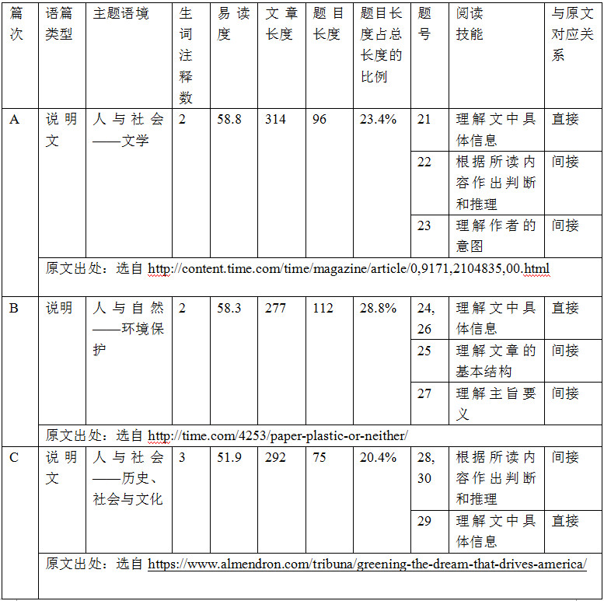
2
2018年6月浙江卷阅读理解——数据统计
阅读理解

Slide 37
2
2018年6月浙江卷阅读理解——考查技能
阅读理解
阅读技能 | 题号 | 题数 | 占比
理解主旨要义 | 27 | 1 | 10%
理解文中具体信息 | 21、24、26、29 | 4 | 40%
理解文章的基本结构 | 25 | 1 | 10%
根据所读内容作出判断和推理 | 22、28、30 | 3 | 30%
理解作者的意图、观点和态度 | 23 | 1 | 10%
阅读理解试题以理解文中具体信息和根据所读内容作出判断和推理为主，兼顾理解主旨要义、理解文章的基本结构、理解作者的意图等深层次技能的考查。
考查逻辑性思维的有4个小题（第21、24、25、29小题）、评判性思维的有5个小题（第22、23、26、28、30小题）、创造性思维的有1个小题（第27小题）。

Slide 38
2
2018年6月浙江卷阅读理解——题目与原文的对应关系
阅读理解
题目与原文关系 | 题号 | 题数 | 占比
直接 | 21、24、26、29 | 4 | 40%
间接 | 22、23、25、27、28、30 | 6 | 60%
直接性题目和间接性题目的比例为4:6，这充分说明了高考英语试题注重对考生推理判断能力的考查。
如果题目和原文的关系是直接的，那么学生就能从原文中直接找到答案，题目的难度自然就比较低。
如果题目和原文的关系是间接的，那么学生就不能直接从原文中找到答案，题目的难度自然就比较高。如果选项也是对原文的转述，那么题目的难度会更加大。

Slide 39
1
听力
目 录
2
阅读理解
3
七选五
Contents
4
完形填空
5
语法填空
6
作文：
应用文/读后续写/概要写作

Slide 40
3
2018年6月浙江卷七选五——语篇导读
七选五
这篇文章的选材涉及学生熟悉的话题，内容贴近学生日常生活。选材理念符合《普通高中英语课程标准》（2017年版）当中提到的课程的基本理念之一“发展英语学科核心素养，落实立德树人根本任务”，指导青少年在日常生活当中如何进行邻里相处，体现了语言学习在德育方面的功能。
七选五阅读材料是一篇结构比较清晰的说明文，考查考生对文章的整体内容和结构以及上下文逻辑意义的理解和掌握。文章就乔迁新居后如何更好更快地融入新社区提出了几点建议，如保持清洁卫生、做个热情的有心人等。文章长度和难度适中。
设题方面，层次分布较均匀。该题型考查了语篇衔接中的连接、同义等技能，体现了句与句之间的因果、顺序、举例、总分等关系，涉及了段落层次和语篇层次两种设题类型。

Slide 41
3
2018年6月浙江卷七选五——语篇结构和特征
七选五
Moving into a new home in a new neighborhood is an exciting experience. Of course, you want to make sure that you become an accepted and valuable part of your neighborhood. The easiest way to accomplish this is to make sure you conduct yourself as a good neighbor should. _____31_____. Here are a few tips to help you win over everyone in the neighborhood quickly
Perhaps one of the most important things you can do as a good neighbor is to keep your property(房产) neat, clean, and in good repair. ____32____ By choosing to keep the outside of the home in great shape, you will help to improve the look and feel of the area.
Second, take the overall appearance of the neighborhood seriously. When going for a walk, take along a small garbage bag. _____33_____ This small act will let your neighbors know that you care about the area.
______34______ If a neighbor is going to be out of town, offer to collect mail and newspapers. If a neighbor suffers an illness, offer to do the grocery shopping. Let them know that you are there to help in any way this acceptable, while still respecting the privacy of your neighbor.
______35______ By following the basic rules of respecting others, taking care of what belongs to you, and taking pride in the appearance of the neighborhood in general, you will quickly become a good neighbor that everyone appreciate.
总分关系
（说明文）

Slide 42
3
七选五
2018年6月浙江卷七选五——解题思路和技巧
Moving into a new home in a new neighborhood is an exciting experience. Of course, you want to make sure that you become an accepted and valuable part of your neighborhood. The easiest way to accomplish this is to make sure you conduct yourself as a good neighbor should. _____31_____
7选5考查的是语篇的连贯性和一致性，TCL：Topic → Coherence（一致性）→ Logic
因此就要使用到各种达到连贯目的的各种衔接手段，即：词汇衔接、逻辑衔接、结构衔接。
G. Here are a few tips to help you win over everyone in the neighborhood quickly.
Perhaps one of the most important things you can do as a good neighbor is to keep your property(房产) neat, clean, and in good repair. ____32____ By choosing to keep the outside of the home in great shape, you will help to improve the look and feel of the area.
Second, take the overall appearance of the neighborhood seriously. When going for a walk, take along a small garbage bag. _____33_____ This small act will let your neighbors know that you care about the area.

Slide 43
3
七选五
2018年6月浙江卷七选五——解题思路和技巧
Perhaps one of the most important things you can do as a good neighbor is to keep your property(房产) neat, clean, and in good repair. ____32____ By choosing to keep the outside of the home in great shape, you will help to improve the look and feel of the area.
Second, take the overall appearance of the neighborhood seriously. When going for a walk, take along a small garbage bag. _____33_____ This small act will let your neighbors know that you care about the area.
F. People tend to take pride in keeping everything in their street fresh and inviting.
E. Should you come across waste paper thrown out of a passing car, pick it up.
词汇衔接----词汇同现法：属于同一词汇搭配范畴或者某一领域的词汇在文章中共同出现，达到语义衔接的目的。如，32题“neat, clean, and in good repair，in great shape, fresh and inviting”是同义复现，而三个“keep”是同词复现。33题同理。

Slide 44
3
七选五
2018年6月浙江卷七选五——解题思路和技巧
______34______ If a neighbor is going to be out of town, offer to collect mail and newspapers. If a neighbor suffers an illness, offer to do the grocery shopping. Let them know that you are there to help in any way this acceptable, while still respecting the privacy of your neighbor.
______35______ By following the basic rules of respecting others, taking care of what belongs to you, and taking pride in the appearance of the neighborhood in general, you will quickly become a good neighbor that everyone appreciate.
B. A good neighbor is also one who likes to help out in small ways.
C. Being a good neighbor is more or less about considerate behavior.
逻辑衔接----逻辑关系线索：从行文逻辑上判断:总分、并列、递进、因果、转折、让步、时间或解释关系（上下义关系）。如，34、35题都是上义词“in small ways”、“considerate behavior”在段首句，统领段中的下义词，从而形成结构衔接。

Slide 45
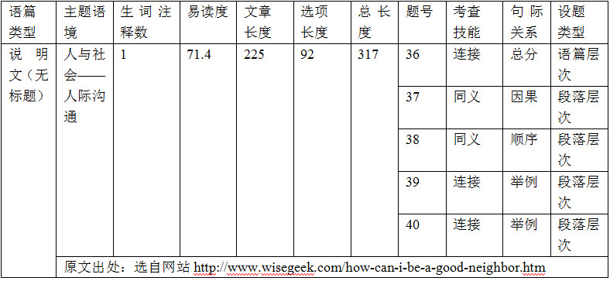
3
七选五
2018年6月浙江卷七选五——数据统计

Slide 46
1
听力
目 录
2
阅读理解
3
七选五
Contents
4
完形填空
5
语法填空
6
作文：
应用文/读后续写/概要写作

Slide 47
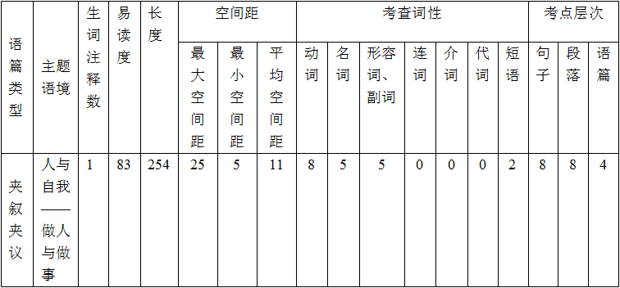
4
2018年6月浙江卷完形填空——语篇导读
完形填空
这篇完形填空是一篇夹叙夹议文。作者认为，越忙的人越可能把事做好，时间“过多”反而可能使人淡化时间意识，患上“拖延症”。这篇文章的选材涉及学生熟悉的话题，内容贴近学生日常生活。如何进行有效的时间管理也是学生们生活当中面临的问题，因此该话题很容易在考生当中引起共鸣，考生可从中领会一些关于时间管理的艺术。
该完形填空考点分布合理，不仅考查学生在语境中运用语言知识的能力，同时也考查学生分析、推断上下文逻辑关系的能力。考点覆盖全面，布局合理。涵盖了句子层次、段落层次和语篇层次的考查。考查以实词为主。

Slide 48
2018年6月浙江卷完形填空——解题点拨
4
完形填空
We have all heard how time is more valuable than money, but is it ___36___ to have too much?
I___37___back in high school I spent most of my day at school since I also ___38___a team sport. By the time I got home, I only had a few hours to do my homework, and I had to do it ____39____
When I got into college, things ___40___. I suddenly found myself out of class before noon time. Because of all this ____41____ there was no sense of ____42____ to do my school work immediately. I was performing this action of waiting until it later became ___43___. Once that happened, I just kept___44___my studying further and further back in my day. Then I got to the point where I was_____45_____really late at night to get my work alone.
1.利用词语同现解题: 某些语义相关联的词语在语篇中有同时出现的倾向性，叫词语同现。同现词之间有同类互补或相对关系等。如ill, hospital, doctor, nurse, operation, medicine等一群相互关联的词语就有同时出现在一个语篇中的可能性。根据这种“同现”关系可确定某一空格的答案。
如本篇中“only had a few hours , right away, immediately, urgency ”都是意思相近的表达方式，或者解释性的语言复现。
39. A. at last B. right away C. of course D. mattered
40. A. happened B. repeated C. changed D. mattered
41. A. extra B. difficult C. valuable D. limited
42. A. duty B. achievement C. urgency D. direction
43. A. burden B. relief C. risk D. habit
44. A. pushing B. taking C. setting D. calling
45. A. hanging out B. staying up C. jogging round D. showing off

Slide 49
2018年6月浙江卷完形填空——解题点拨
4
完形填空
We have all heard how time is more valuable than money, but is it ___36___ to have too much?
I___37___back in high school I spent most of my day at school since I also ___38___a team sport. By the time I got home, I only had a few hours to do my homework, and I had to do it ____39____
When I got into college, things ___40___. I suddenly found myself out of class before noon time. Because of all this ____41____ there was no sense of ____42____ to do my school work immediately. I was performing this action of waiting until it later became ___43___. Once that happened, I just kept___44___my studying further and further back in my day. Then I got to the point where I was_____45_____really late at night to get my work alone.
2.利用逻辑关系解题：从作者上大学前后变化“change”所带出的语境逻辑，与之前的“忙碌”截然相反的是“extra, action of waiting , push back, staying up ”等一些“松散拖延”的语域。
39. A. at last B. right away C. of course D. mattered
40. A. happened B. repeated C. changed D. mattered
41. A. extra B. difficult C. valuable D. limited
42. A. duty B. achievement C. urgency D. direction
43. A. burden B. relief C. risk D. habit
44. A. pushing B. taking C. setting D. calling
45. A. hanging out B. staying up C. jogging round D. showing off

Slide 50
2018年6月浙江卷完形填空——解题点拨
4
完形填空
利用
逻辑关系语
解题
利用
上下文暗示
解题
利用
逻辑关系解题
逻辑关系语指表示各种逻辑意义的连接成分，主要有：①词(包括连词、副词和少数介词)，如and, but, or, because, though, however, yet, therefore, otherwise, despite等。②短语，如in other words, in addition, as a result, on the contrary, instead of 等。③分句和独立结构，如that is to say, what is more, generally speaking等。在解题时要充分利用这些逻辑关系语，找到与文中某些词、短语有密切关系的选项。
在完形填空选项的设置上多考查考生通过上下文的前后提示或暗示，对整体文意进行把握的能力。因此，在做题时要有全局观念，进行连贯性思维，要把每个空白处的含义与前后句的意思联系起来理解，进行合乎逻辑的推理判断。开头的题目需要从下文查找信息；中间或最后的题目需要从上下文查找信息，信息常见的有单个的词、短语、句子，但有时是语境暗示。

Slide 51
2018年6月浙江卷完形填空——解题点拨
4
完形填空
We have all heard how time is more valuable than money, but is it ___36___ to have too much?
… …
One day I _____46_____ a former classmate of mine who was _____47_____ a lot of money running a sideline(副业). Since his regular job was _____48_____, I asked him why he just didn't do his sideline full-time. He said without the job, he would _____49_____ have too much time and would just do what I did back in _____50_____. He said that if he _____51_____the job, he would lose his _____52_____ to work and succeed.
So, try _____53_____ your time with other work. This is why there is a _____54_____ that if you want something done, ask a _____55_____person to do it.
3.利用语篇文脉解题：从开篇点题but is it possible to have too much time?到尾段呼应try filling up your time with other work，全文以“对时间利用的经历感悟”为主线。 从“quit the job”到“lose his drive”，从“filling up your time ”到“a busy person ”，文脉通畅，一气呵成。
48. A. safe B. important C. boring D. rewarding
49. A. luckily B. hardly C. hopefully D. simply
50. A. childhood B. college C. town D. business
51. A. quit B. found C. accepted D. kept
52. A. heart B. chance C. drive D. way
53. A. saving B. filling up C. giving up D. trading
55. A. careful B. busy C. reliable D. kind

Slide 52
2018年6月浙江卷完形填空——解题点拨
4
完形填空
利用
首尾呼应关系
解题
利用
文章发展脉络
解题
利用
语篇文脉解题
记叙文类的完形填空在很多情况下不仅仅是在讲一个故事，而是要通过故事来升华主题，而升华的内容往往在文章结尾处，与首段内容形成首尾呼应关系。因此，我们做题不是只看到最后一空，而是要看到最后一个词，而且要学会“回头看”(重点看首段)。不要因我们过早地放松，忽略了首尾呼应关系，在最后一两道题上留下遗憾。
我们主张在做完形填空的时候要合理想象，其实就是合理思考和推理，不能“胡思乱想”，应“随文应变”，不可“一意孤行”，要随着文段发展脉络，把握情感态度，调整预测偏差。

Slide 53
4
完形填空
完形填空失分原因小结
1.没有严格遵循答题步骤:
多数同学考试时担心时间紧,在没有弄清短文的中心和文章的情节线索的情况下匆忙答题。事实上我们用在这一题上的时间可以达到15-16分钟.切记: 一定要用2-3分钟时间进行缺词阅读,弄清文章大意和基本脉络后再着手逐个填空.
2. 不注意积累答题技巧:
a. 忽略文章中上下文之间的照应关系;
b. 遇到长句不注意分析句子结构,在语义模糊时抱碰运气的心理随意作出选择.
3. 考前需强化五种意识:
词汇语法意识，上下文意识，主题思想意识，社会生活体验意识，跨文化意识。

Slide 54
1
听力
目 录
2
阅读理解
3
七选五
Contents
4
完形填空
5
语法填空
6
作文：
应用文/读后续写/概要写作

Slide 55
（一）2016年10月浙江卷
语法填空
5
Magic Touch
From my hotel room window, I could see a large advertisement board with his face on it: Jason, the Great Magician.
I absent-mindedly turned the 56 (page) of the phone book and came across a city map. Drinking my iced coffee I ran my fingers along the streets 57 the hotel to the opera hall. Not more 58 a half-hour walk, I thought.
I looked 59 (quick) at the clock. The show starts in one hour；plenty of time! I drank the rest of my coffee and went to take a shower. Soon after, I was on my way to the show, 60 (carry) a fancy black handbag and a happy smile.
The hall was dark when I came in; the show was about 61 (begin). I made my way backstage just 62 the great magician was putting on his hot hat.
“Daddy, I’m so glad to see you, ” I 63 (whisper). “I’m in town for the writer’s class, but I just couldn’t miss your show.” I gave him a quick hug and went back into the seating area, leaving him with a 64 (surprise) smile. I settled down in the darkness, and the curtains opened.
Magically, that show remains the Great Jason’s best 65 (perform) to this day.

Slide 56
语法填空
（一）2016年10月浙江卷 ——答题分析和语篇解读
5
56.pages 正答率95.4%
57.from 正答率72.7%， 错误答案：to 错因：没有深入理解“我的手指沿着地图从…直到…, 不足半个小时步
行路程”，from…to…句意连贯没弄清，跨句际的逻辑关联和推理能力较弱。
58.than 正答率98.9%
59.quickly 正答率98.9%
60.carrying 正答率86.4% 错因：词形变化混淆，变y为i加carriing；分词做状语，主动和被动分不清，carried
61.to begin 正答率40.9% 错因：没有深入语篇阅读，仅靠思维定式，介词后加动名词beginning
62.as/when 正答率40.9% 错因：before/where/which, 对从句及连接词的辨析是学生最大的问题。从语篇的角度，
上题“演出正要开始”与此题“正在此时…”形成了一个语义上的连贯，通过 “be about to do…when…”搭配进行
形式上的衔接。
63.whispered 正答率96.6%
64.surprised 正答率85.2% 错因：特殊用法: -ed 形容词通常直接用于说明人，若修饰事物，则多为 air(神态)
/appearance(外貌)/ cry/ laughter/ tears/ face /smiles /expression/ voice/ mood(情绪)等显示某人的情感状况的名词。
65.performance 正答率76.1% 错因：词形变化记忆混乱，单词拼写错误。
答题分析：词形变换、从句、非谓语动词、谓语动词时态语态、没有提示词的纯空格逻辑分析题（通常考查冠词、介词、代词和连接词以及功能性结构副词）是学生语言知识点复习的难点；语法填空（Rational cloze）中的“Rational”是基于理性的语篇型完形填空，语篇的衔接连贯和理解语篇的深层意义是学生语法填空题提分的关键。
语篇解读：本文首段埋下伏笔，逐步制造父子之间的一场美丽的遇见，渲染亲情，心理活动描写细腻，文字优美（absent-mindedly，ran my fingers，made my way， leaving him with a surprised smile, settled down in the darkness, Magically），语篇选材具有很高的思想性和艺术性。“but I just couldn’t miss your show”, 让人潸然泪下，我们会思考，在我们每个人的生命里，都会遇到各种各样的陪伴，你会怎样陪伴你生命中最重要的人呢？

Slide 57
（二）2017年6月浙江卷
56. carrots 57. shiny/shining
58. so 59. myself 60. earlier
61. to cook 62. searched
63. swept 64. where 65. a
语法填空
5
Last October, while tending her garden in Mora, Sweden, Lena Pahlsson pulled out a handful of small 56 (carrot) and was about to throw them away. But something made her look closer, and she noticed a 57 (shine) object. Yes, there beneath the leafy top of one tiny carrot was her long-lost wedding ring.
Pahlsson screamed 58 loudly that her daughter came running from the house. “She thought I had hurt 59 (I),” says Pahlsson. Sixteen years 60 (early), Pahlsson had removed the diamond ring 61 (cook) a meal. When she wanted to put the ring back on later, it was gone. She suspected that one of her three daughters-then ten. eight, and six- had picked it up, but the girls said they hadn‘t. Pahlsson and her husband 62 (search) the kitchen, checking every corner, but turned up nothing. "I gave up hope of finding my ring again," she says. She never replaced it.
Pahlsson and her husband now think the ring probably got 63 (sweep) into a pile of kitchen rubbish and was spread over the garden, 64 it remained until the carrot's leafy top accidentally sprouted (生长) through it. For Pahlsson, its return was
65 wonder.

Slide 58
2017年6月浙江卷——重视句子分析
语法填空
5
1.充分了解英语中各种词性的用途，如形容词修饰名词，副词 修饰动词、形容词、副词以及句子。
But something made her look closer, and she noticed a 57 (shine) object.（形容词修饰名词）
2.熟练掌握各种语法知识，尤其是时态语态、非谓语动词和复合句。
Pahlsson and her husband 62 (search) the kitchen, checking every corner, but turned up nothing.（时态一致性）
3. 认真读题分析句子成分，切忌图快而忽视了一些显而易见的结构。
Sixteen years 60 (early), Pahlsson had removed the diamond ring 61 (cook) a meal.(摘下戒指的目的是为了做饭)

Slide 59
5
语法填空
（一）Where引导定从
Pahlsson and her husband now think the ring probably got 63 (sweep) into a pile of kitchen rubbish and was spread over the garden, 64 it remained until the carrot's leafy top accidentally sprouted (生长) through it.
帕尔松和她的丈夫现在认为，这枚戒指可能是被扫进了一堆厨房垃圾里，并散落在花园里，一直留在那里，直到胡萝卜叶子茂盛的顶端不小心从里面长出来。

Slide 60
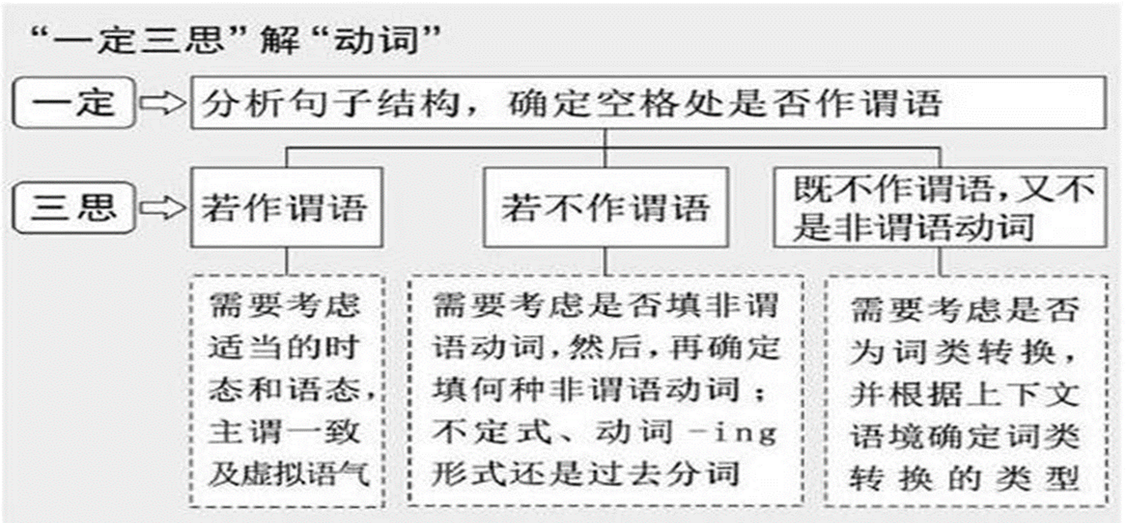
5
语法填空
（二）括号内提供的是动词

Slide 61
5
语法填空
（三）主从与定从中连接词what、that、which的误用
 | 名词性从句 | 定语从句
what | 有意义，泛指“…的东西/事情/话语/地方/时候”等。在从句中常作主语、宾语、定语。 | what 不能引导定从
that | 不充当任何成分且无意义，只起连接作用，常可省略。 | 有意义，指代先行词（人或物），在从句中常作主语、宾语。
which | 有意义，具体指代“…的东西/事情”等。在从句中常作主语、宾语、定语。 | 有意义，指代先行词（物），在从句中常作主语、宾语。可引导非限制性定语从句；可位于介词之后。

Slide 62

5
语法填空
（四）重视句子的学习，标点符号的作用
一
A… ./; B…
逗号粘连错误
二
A… , （连词）B
逗号使用
懂句法明句理
A… , （主语一致）B
悬垂修饰语
A… , （主语不一致）B
独立主格/with复合结构
三
四
逗号粘连错误: 在英语写作标点符号的使用中，出错概率最高的是关于逗号的误用，而且该错误是句子结构中的最严重的问题。主要体现在用逗号连接两个独立的句子、用逗号连接两个谓语动词。

Slide 63
5
语法填空
（四）重视句子的学习，一句多译：
The student wasn’t paying attention in class, (眼睛盯着)the tree in front of the classroom.(fix)
with his eyes on
②his eyes on
③ his eyes on
④but his eyes on /he his eyes on
⑤whose eyes on /who his eyes on
fixed（with复合结构）
fixed（独立主格结构）
fixing（现在分词作伴随状语，表主动）
were fixed; fixed/ was fixing（but连接并列句）
were fixed; fixed/ was fixing（定语从句）

Slide 64
（四）2017年11月浙江卷
56. an 57. which
58. months 59. for
60. effective 61. really 62. sounds 63. reading 64. their 65. learnt
语法填空
5
Easy Ways to Build Vocabulary
It’s not all that hard to build an advanced and large vocabulary. Like many things in life, it’s __56__ongoing process, and the best part of the process is that there’s enough room for improvement, __57__means you’ll just keep getting better and better. Of course you have to work at it. You wouldn’t think that a few __58__(month) of exercise in your teens would be enough __59__ the rest of your life, and that’s also true for building your vocabulary--you have to keep at it daily, and pretty soon you will find that you have an excellent vocabulary.
One of the __60__(effect) ways to build vocabulary is to read good books. You need to __61__(real) read at least one good book a week, preferably a classic. This isn’t as hard as it __62__(sound), and it is far better than any other method because you improve your vocabulary while __63__(read) an interesting piece of literature. Another nice thing is that you learn both new words and __64__(they) use unconsciously, meaning that you will tend to use the words __65__(learn) this way in conversations almost automatically.

Slide 65
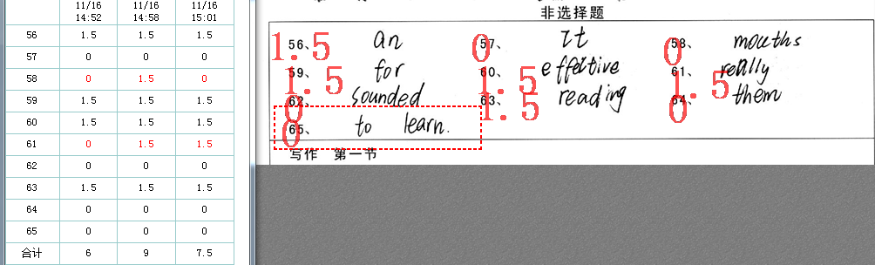
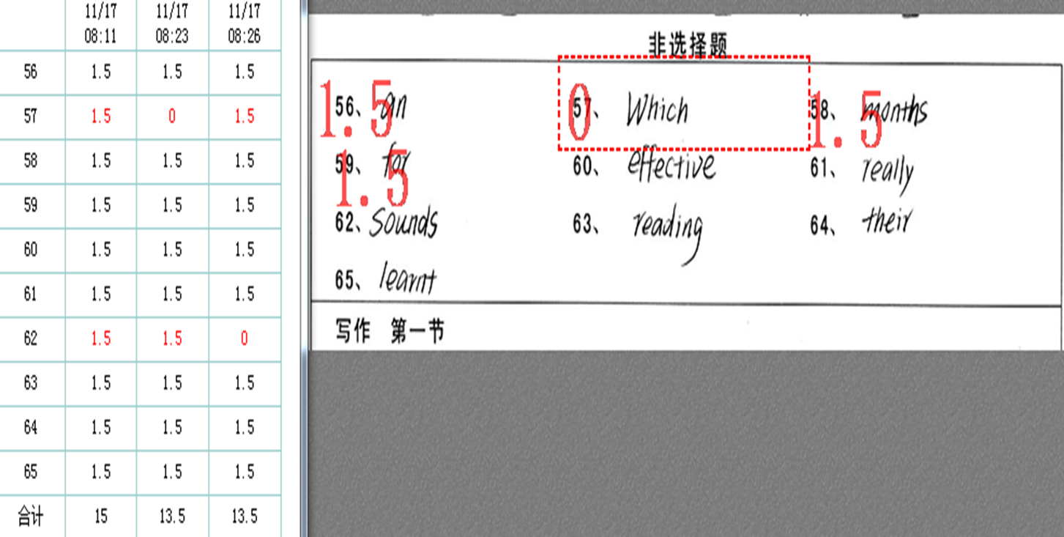
语法填空
（四）2017年11月浙江卷 —— 从拼写到书写
5
尽管有提示词，
拼写仍要小心！
多检查大小写，
尤其是CcSsWwIi！

Slide 66
（四）2018年6月浙江卷
56. dishes 57. who/that 58. it 59. visiting 60. was shocked
61. have become 62. affordable
63. higher 64. weight 65. for
语法填空
5
Few people I know seem to have much desire or time to cook. Making Chinese ___56___(dish) is seen as especially troublesome. Many westerners ___57___ come to China cook much less than in their own countries once they realize how cheap ___58___ can be to eat out. I still remember ___59___ (visit) a friend who’d lived here for five years and I ___60___(shock) when I learnt she hadn’t cooked once in all that time.
While regularly eating out seems to ___61___(become) common for many young people in recent years, it’s not without a cost. The obvious one is money; eating out once or twice a week may be ___62___(afford) but doing this most days adds up. There could be an even ___63___ (high) cost on your health. Researchers have found that there is a direct link between the increase in food eaten outside the home and the rise in ___64___(weigh) problems.
If you are not going to suffer this problem, then I suggest that the next time you go to your mum’s home ____65____ dinner, get a few cooking tips from her. Cooking food can be fun. You might also begin to notice the effects not only on your health but in your pocket.

Slide 67
（二）2018年6月浙江卷 —— 重视构词法的复习
语法填空
5
1.词形变换（3题） 后缀： 62. affordable
比较级 ： 63. higher
词性转换：64. weight
2.名词复数（1题） 56. dishes
3.动词四式 （3题）
非谓动词（1题） 59. visiting
时态语态（2题） 60. was shocked（被动语态）
61. have become （时态）

Slide 68
5
语法填空
重视构词法的复习——容易拼写错误的单词
1．该双写却没有双写的单词
unforgettable, written ,
inferred, referred , occurred, regretting, robbed , permitted, forgetting, wrapping, preferred, begged, hugged; planned; dropped, winning, cutting, beginning, hitting
2．不该双写却双写的单词（括号中为错词）
writing (writting) , eaten (eatten) , suffer (sufferred)
3．词性变化时必须去掉字母e的单词
unbelievable, valuable, argument, truly, gently
4．词性变化时不能去掉字母e的单词
(un) changeable, (re) chargeable, hopeful, envelope，moveable
5．变化非常特别的单词 panic-panicked-panicking

Slide 69
5
语法填空
重视构词法的复习——需强化记忆的词形变化
1．动词变名词
pronounce , explain , prepare
combine , recommend , laugh consider → consideration, recognize →recognition, occupy → occupation
permit → permission, admit →admission,
conclude → conclusion, decide → decision, describe → description
survive → survival→ survivor, arrive → arrival, approve → approval
perform → performance, apologize → apology, acquire → acquisition
apply → applicant申请人→ application-申请
to one’s (satisfy/astonish/annoy/amaze/disappoint/relieve/embarrass)
→satisfaction/ astonishment/annoyance /amazement / disappointment/ relief/ embarrassment) →→ “in + 上述名词”，表“处于…状态”
→ pronunciation
→ explanation
→ preparation
→ combination
→ recommendation
→ laughter

Slide 70
5
语法填空
重视构词法的复习——需强化记忆的词形变化
2.名词变形容词
nature → natural, benefit → beneficial
3.形容词变名词
wise/free →→wisdom/freedom
high/weigh→→height/weight
short/marry →→shortage /marriage
strong/long/deep/wide/grow/dead/warm→→
strength/length/depth/width/growth/death/warmth
curious/ various/anxious/able/responsible/popular→→
curiosity/variety/anxiety/ability/responsibility/popularity
4. 形容词变动词
deep/ fast/ class/ identity/ beauty/ simple/ modern/ popular→→
deepen/ fasten/ classify/ identify/ beautify/simplify/modernize/ popularize

Slide 71
5
语法填空
重视构词法的复习——特殊的词形变化
7．形容词变副词，不去e的单词(绝大多数辅音字母加e结尾的直接加-ly)
unfortunate →unfortunately, immediate → immediately,
absolute→absolutely, rude → rudely, approximate → approximately,
desperate→desperately, large → largely, accurate → accurately
但true-truly, whole-wholly !
8．形容词变副词，以辅音字母加le结尾时, 去e加y (以-ble，pIe结尾 )
simple → simply, impossible → impossibly，
probable → probably，uncomfortable → uncomfortably
9.形容词变副词，以ic 结尾的词，加ally
economic → economically; basic →basically; scientific → scientifically;
automatic → automatically; energetic → energetically;
但是public → publicly 例外

Slide 72
（五）2018年11月浙江卷
56. have been using/have used 57. was
58. Recently 59. or 60.in
61. them 62. called 63. that
64. women 65. to have
5
语法填空
Caffeine, a chemical typically found in coffee, has caused a lot of concern because it is one of the few drugs that show up regularly in our food supply. You probably 56_______(use) caffeine since childhood. Caffeine 57_______(be) in your first Coke. If you ever enjoyed a chocolate bar, you ate caffeine. Soft drinks are the major source (来源) of caffeine for most children and even some adults. 58_______(recent), caffeine has found its way into orange, apple, and other flavored drinks.
Small amounts of caffeine ---- a cup 59_______ two of coffee a day ---- seem safe for most people. However, some people have trouble with even small amounts. One cup of coffee 60_______ the late afternoon or evening will cause 61_______(they) to stay awake almost all night. Larger amounts of caffeine can cause a problem 62_______(call) caffeinism. You get very nervous and you can’t sleep.
It is possible 63_______ caffeine may cause birth defects (缺陷) in humans, too. One study showed that 64_______(woman) who drank a lot of coffee, like eight or more cups per day, while they were pregnant were more likely 65_______(have) children with birth defects.

Slide 73
（五）2018年11月浙江卷 ——从语法到篇章
5
语法填空
You probably 56_______(use) caffeine since childhood.
Caffeine 57_______(be) in your first Coke.
1.把握语境，重视语篇的理解。
2.关注语篇的层次和主题。语法填空不是见空填空，要把所填词放在句中、句 际、段际去综合考虑，尤其是无提示词的填空。
3.抓住语篇的文脉，明晰语篇中“词汇+语法”是如何衔接与连贯的，了解作者的预先设定和布局谋篇的思想。

Slide 74
1
听力
目 录
2
阅读理解
3
七选五
Contents
4
完形填空
5
语法填空
6
作文：
应用文/读后续写/概要写作

Slide 75
（一）容易拼写错误的单词
6-1
应用文
1. 是 or 不是er:
professor, visitor, translator, director, editor, educator, actor, inventor,
competitor, conductor ,monitor
2．容易丢掉一个字母的单词
（1）容易丢掉字母n：government，environment，environmental
（2）容易丢掉不发音的字母：Christmas，Wednesday
（3）拼写比较特别的单词：committee，guarantee，dilemma，
opportunity，bridegroom，spokesman，succeed，competition，
February
3．容易多或少一个字母的单词（括号中为错词）
develop (develope) , habit (habbit) , proud (pround) ,modern (mordern) , until (untill) , souvenir (souvenire) ,similar (similiar), ninth (nineth),
forty(fourty), healthier(healther),

Slide 76
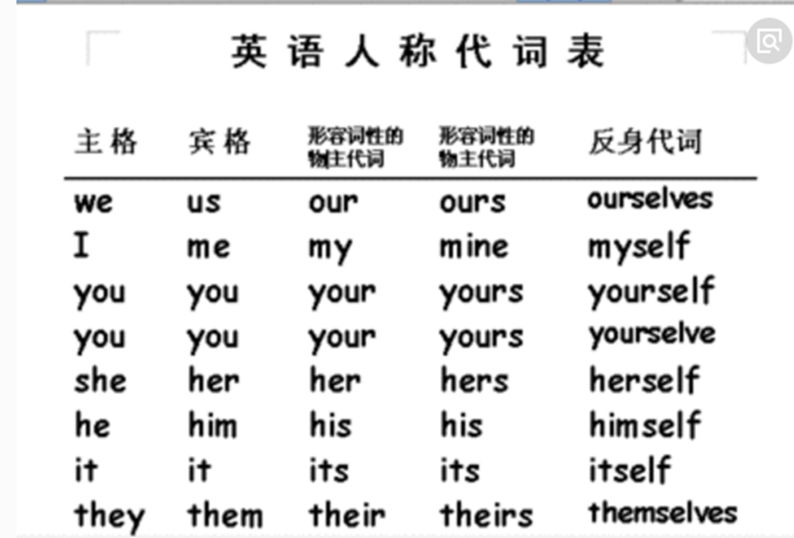
（二）容易错误拼写的熟词
6-1
应用文
1. 星期一 2.星期二 3.星期三 4.星期四 5.星期五 6.星期六 7.星期日
1.Monday 2.Tuesday3.Wednesday 4.Thursday 5.Friday 6.Saturday 7.Sunday
月份的拼写：
January 2. February
3. March 4. April
5. May 6. June
7. July 8. August
9.September 10.October
11.November 12. December

Slide 77
（三）基数词转化为序数词
6-1
应用文
比较特殊的单词
one一 first, two一 second, three一third, five一fifth, eight一eighth, nine
一ninth, twelve一twelfth
整数位的一ty要改为一tieth，如twenty一twentieth, sixty一sixtieth
注意这些数词的变化：four一fourteen一forty , five一fifteen一fifty
拼写训练：1. 第四 2. 第五 3. 第八 4.第九 5.第十二 6. 第十三 7. 第十五 8. 第十九 9. 第二十 10. 第三十 11. 第四十 12. 第五十 13. 第九十 14. 第一百
答案：1.fourth 2. fifth 3. eighth 4. ninth 5.twelfth 6. thirteenth 7.fifteenth 8. nineteenth 9. twentieth 10. thirtieth 11. fortieth 12. fiftieth 13. ninetieth 14. one hundredth

Slide 78
6-1
应用文
（四）时间地点的表达
一般来说,地点在前,时间在后。如：人物-地点-时 间
她上周五和她妈妈在花园里浇花
She watered the flowers with her mother in the garden last Friday.
2. 若想表明是上午/下午，可在时间后加上a.m./ p.m.
eg：we’ll get together at the school gate at 7:30 am. June 21st, 2019
3. 时间地点均由小到大：at half past eight on June 21st, 1996
4. 月份+序数词
eg：2001年4月2日→ April 2nd, 2011.（序数词熟记规律：1 2 3
st nd rd 。8后少t ，9少e即eighth，ninth，整十数把y变ie）
eg：during the dates of 1st to 10th May
5. “在…”， last/next/this Wednesday/week 前不加介词in/on.

Slide 79

6-1
应用文
2018年06月高考试题应用文写作
——Letter of Application
假如你是李华，你校英语协会招聘志愿者，接待来访的外国中学生。请你写信应聘，内容包括：
1.口语能力；
2.相关经验；
3.应聘目的。
注意：1.字数80左右；
2.可以适当增加细节，以使行文连贯。

Slide 80
6-1
应用文
2018年06月高考试题应用文写作——答题要领
文体 | 书信体，要求有书信完整的格式（称谓、正文、结语、落款）
结构 | 写信目的→ 介绍自己特长→应聘目的→表达期待和愿望
要点 | 1.写信目的；2.口语能力；3.相关经验；4.应聘目的
语言 | 这是一封学生写校英语协会负责人的应聘信，遣词造句要比较正式，要求言简意赅，字字珠玑，同时说话语气要礼貌得体。

Slide 81
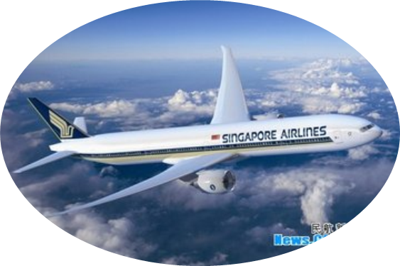
6-1
应用文
2018年11月高考试题应用文写作
——Letter of asking for help
行程信息
钱包特征
假定你是李华，乘坐FL753航班抵达伦敦后发现钱包遗失。请给航空公司写一封邮件说明情况并寻求帮助。
联系方式

Slide 82
6-1
应用文
2018年11月高考试题应用文写作——答题要领
文体 | 书信体，要求有书信完整的格式（称谓、正文、结语、落款）
结构 | 写信目的→介绍行程信息→描述钱包特征→提供联系方式和表达期待
要点 | 1.写信目的；2. 行程信息；3. 钱包特征；4. 联系方式。
语言 | 这是一封乘客写给航空公司的求助信，遣词造句要比较正式，要求言简意赅，叙事准确，同时说话语气要礼貌得体。

Slide 83
6-1
应用文写作的5C原则
应用文
完整(Completeness)
礼貌(Courtesy)
连贯(Coherence)
简要(Conciseness)
清楚(Clarity)

Slide 84
6-1
运用“5C”原则，减少不必失误
应用文
1.Completeness（内容完整）：
考生必须熟知书信类应用文的格式，准确写出称呼语、正文、结束语、签名，以符合英语的写作习惯。
有很多学生写出“Dear classmates”, “Dear fellow students” 称呼语，是没有定位好人物关系的不得体的表达。写信人是向英语协会的负责教师递交应聘信，因此正确的称呼语是 “Dear Sir or Madam”, “Dear teacher”, “To whom it may concern”等。
有学生写出“I take the flight FL753 to London. Upon arrival, I noticed my wallet losing, which makes me extremely anxious. ” 这句表达中缺少航班的日期，且时态错乱，这样的求助让航空公司无法获取有效信息而无能为力。

Slide 85
6-1
运用“5C”原则，减少不必失误
应用文
2. Clarity（表述清楚）：
审题要准确，内容要清楚。不少学生审题不清，写成了招聘信（Volunteer Wanted）或通知（Notice），属于未完成或未适当完成试题规定的任务，分数降到第二档或第一档。
“联系方式”要求具体详实，有些学生只提到联系“Please contact me at any time” 但没有具体方式，不能体现实际交际功能。有些学生写出了e-mail的地址“Contact me at xxx@hotmail.com. ” 这是没有考虑到发邮件时自带地址的。

Slide 86
6-1
运用“5C”原则，减少不必失误
应用文
3. Conciseness（语言简洁）：应聘信的语言应简洁明了，力求主旨鲜明、词决意畅。
有些学生受读后续写描述性语言的影响，在应用文写作中使用心理描写或环境描写的句子，如“Driven by deep curiosity and interest, and to have a further exploration about foreign culture, I was desperate for the volunteer work.”/ “Attributing to its magnificant importance, I’m now writing in quivering and sweat-drenched hands with downright apprehension and anxiety. ” 这种语言过于繁琐和夸张，给人不真实的感觉，因此达不到良好的表达效果。

Slide 87
6-1
运用“5C”原则，减少不必失误
应用文
4. Coherence（行文连贯）：
“按照内容要点展开写作，使用恰当的连接词和表达法使文章内容连贯”是应用文评分的主要依据之一。
例如：口语能力——“I am suitable for this job as I can express myself freely in English” 因果逻辑关系严密；
相关经验——“I have some similar work experience, working as a volunteer last year at an international conference” 用事实说话；
应聘目的——“I love our school and” 展示个人自信和热爱集体的积极人生观。I hope I will have a chance to introduce our school to foreign guests in my own way
所以读者能跟上写作者的推理思路和内在逻辑，实现了真正意义上的连贯。

Slide 88
6-1
运用“5C”原则，减少不必失误
应用文
5. Courtesy（语气礼节）：
求职者与招聘人是较正式的公务关系，语气要礼貌自然，不要趾高气扬，也不卑躬屈膝，而应该抱着双方平等的态度。
然而有学生写出“So important is this activity that you can give me a rapid answer. I’m greatly convinced you won’t make me depressed”这样的结束语，语气咄咄逼人，缺乏理解尊重，缺乏共情能力，表达很不得体。

Slide 89
6-1
2018年06月高考 应用文写作
——中档作文分析
应用文
Dear leader of School English Club,
I’m Li Hua, who want to be an volunteer for greeting foreign friends. Delightful and excited, I jump and run, only wanting to thank you for your reading. As a confident student, I not only have great ability of English expression, but also I have passed CET six. Never in your wildest dream had you thought that I ever took part in international English competition and won the champion. However, I am not satisfied with the success of the grades. Thus, I hope that I could join your club in order to improve my ability. Meanwhile, I also want to make contribution for the communication of China and other countries.
Looking forward to your earliest reply.
Yours,
Li Hua
逻辑性较弱
不能切中要点
过多描述性语言，未能做到言简意赅

Slide 90

6-1
2018年06月高考 应用文写作
——点评优秀作品1，明确高分技巧
应用文
Dear Sir /Madam,
I am writing to apply for the post of volunteer advertised in the school newspaper. I found this position quite appealing and I am well qualified for the job.
First, I have a good command of spoken English, contributing to my interaction with foreign friends. Second, I have previous experience working as a volunteer for G20 so I can communicate with foreigners without any obstacle. Besides, I think it an excellent opportunity to broaden horizons and improve social skills.
I’d highly appreciate it if you could give me the chance. Looking forward to your reply.
Sincerely yours,
Li Hua
内容
要点
作者严格按照题目要求，抓住主要点，层层推进。在次要点上合理拓展，如“have previous experience working as a volunteer for G20”，这是很有价值的独特的闪光点，易受招聘者的青睐。当然阅卷老师也喜欢这样的有创意的“G20经历”，体现了浙江地域特色和社会时代感。

Slide 91
6-1
2018年06月高考 应用文写作
——点评优秀作品1，明确高分技巧
应用文
Dear Sir /Madam,
I am writing to apply for the post of volunteer advertised in the school newspaper. I found this position quite appealing and I am well qualified for the job.
First, I have a good command of spoken English, contributing to my interaction with foreign friends. Second, I have previous experience working as a volunteer for G20 so I can communicate with foreigners without any obstacle. Besides, I think it an excellent opportunity to broaden horizons and improve social skills.
I’d highly appreciate it if you could give me the chance. Looking forward to your reply.
Sincerely yours,
Li Hua
语言
能力
使用的词汇，如“appealing, qualified, have a good command of, contributing to, previous, obstacle, broaden horizons”都是大纲词汇，而且精准妥帖、表达到位。尤其是“I found this position quite appealing”和“I think it an excellent opportunity to…”语言地道，反映了作者语言功底较深厚。

Slide 92
6-1
2018年06月高考 应用文写作
——点评优秀作品1，明确高分技巧
应用文
Dear Sir /Madam,
I am writing to apply for the post of volunteer advertised in the school newspaper. I found this position quite appealing and I am well qualified for the job.
First, I have a good command of spoken English, contributing to my interaction with foreign friends. Second, I have previous experience working as a volunteer for G20 so I can communicate with foreigners without any obstacle. Besides, I think it an excellent opportunity to broaden horizons and improve social skills.
I’d highly appreciate it if you could give me the chance. Looking forward to your reply.
Sincerely yours,
Li Hua
上下文
连贯
该习作最大的亮点，作者通过第一段中“the post”、“this position”和“the job”和第二三段中“an excellent opportunity”、 “a chance”这些语义逻辑密切的相关词的复现，连接全文，形成一条完整的逻辑链，这种连接方式叫做语义承接，属于“暗承接”，即语义连贯，往往是中国学生的软肋。

Slide 93
6-1
2018年06月高考 应用文写作
——点评优秀作品1，明确高分技巧
应用文
Dear Sir /Madam,
I am writing to apply for the post of volunteer advertised in the school newspaper. I found this position quite appealing and I am well qualified for the job.
First, I have a good command of spoken English, contributing to my interaction with foreign friends. Second, I have previous experience working as a volunteer for G20 so I can communicate with foreigners without any obstacle. Besides, I think it an excellent opportunity to broaden horizons and improve social skills.
I’d highly appreciate it if you could give me the chance. Looking forward to your reply.
还有另一种连接方式叫“明承接”即衔接，通过连接词(比如本文中First, Second, Besides等)将句子有机连接起来。
连贯指的是篇章的语义关联，是篇章的无形网络，存在于篇章的底层；衔接是篇章的一种语言显性特征，是篇章的有形网络，作者将这两种连接方式互相配合，娴熟使用，使全文文气通畅，读起来一气呵成。
上下文
连贯

Slide 94
6-1
2018年06月高考 应用文写作高分技巧1
——运用因果逻辑，合理拓展细节
应用文
高考英语应用文写作从功能意念的角度考察学生表达建议、求助、投诉、邀请、推荐、感谢、评价、致歉等具体的交际能力，而所有与这些功能对应的交际内容基本上都可以与表示原因和结果的句型叠加在一起，使句子的表意获得强化的效果。
由于高考英语应用文写作所给的中文提示很少，考生需要对要点进行合理的拓展，如果能够使用因果逻辑来展开思考，可形成逻辑严谨、合情合理的好句子或好段落。

Slide 95
6-1
2018年06月高考 应用文写作高分技巧1
——运用因果逻辑，合理拓展细节
应用文
Dear Sir /Madam,
I am writing to apply for the post of volunteer advertised in the school newspaper. I found this position quite appealing and I am well qualified for the job.
First, I have a good command of spoken English, contributing to my interaction with foreign friends. Second, I have previous experience working as a volunteer for G20 so I can communicate with foreigners without any obstacle. Besides, I think it an excellent opportunity to broaden horizons and improve social skills.
I’d highly appreciate it if you could give me a chance. Looking forward to your reply.
在这篇习作中，作者采用了因果逻辑的思维方式合理拓展细节。
要点一“I am writing to apply…”表结果（已知信息），“I found this position...”表原因（拓展信息），用因果逻辑关系展开写信目的，表达求职的迫切和真诚。
要点二“I have a good command of…”表原因（已知信息），“contributing to…”表结果（拓展信息），用因果逻辑关系拓展口语能力的支撑细节，阐明口语所达到的能力水平。
要点三“I have previous experience of…”表原因（已知信息）， “I can communicate with…”表结果（拓展信息），用因果逻辑关系拓展相关经验，进一步证明交际能力。

Slide 96
6-1
2018年06月高考 应用文写作高分技巧1
——运用因果逻辑，合理拓展细节
应用文
Dear Sir /Madam,
I am writing to apply for the post of volunteer advertised in the school newspaper. I found this position quite appealing and I am well qualified for the job.
First, I have a good command of spoken English, contributing to my interaction with foreign friends. Second, I have previous experience working as a volunteer for G20 so I can communicate with foreigners without any obstacle. Besides, I think it an excellent opportunity to broaden horizons and improve social skills.
I’d highly appreciate it if you could give me a chance. Looking forward to your reply.
要点四“I think it an excellent…”表结果（拓展信息）， “broaden …and improve …”表原因（已知信息），用因果逻辑关系拓展应聘目的，再次表达强烈求职意愿，易于打动招聘者。
上述四个要点的拓展方式要么把已知信息当原因拓展合理结果，要么把已知信息当结果寻找合理原因，都很好地说明了因果逻辑的运用价值，彰显了良好的思维品质，是写出高分作文的一个很重要的技巧。

Slide 97
6-1
2018年06月高考 应用文写作
——点评优秀作品2，明确高分技巧
应用文
To whom it may concern,
I’m Li Hua. Learning you are recruiting volunteers to greet foreign students, I ’m writing for the position, with the purpose of improving my English level and accumulating experience.
Equipped with excellent spoken English, I’m sure I can meet with your essential requirements. Additionally, having served the community as a volunteer for two years, I have sufficient relevant experience, communication skills and teamwork spirit, which will enhance my confidence in the job.
This being a precious opportunity to train myself, I shall be much obliged if you could consider me for the position.
Yours faithfully,
Li Hua
亮明自己身份，说明消息内容，表明写信目的。最可贵的是作者神来之笔，自然地带出了应聘目的。“写信目的→申请成为志愿者→提高英语水平和积累经验”，逻辑清晰，层次分明，结构紧凑，简明扼要。
第一段

Slide 98
6-1
2018年06月高考 应用文写作
——点评优秀作品2，明确高分技巧
应用文
To whom it may concern,
…
Equipped with excellent spoken English, I’m sure I can meet with your essential requirements. Additionally, having served the community as a volunteer for two years, I have sufficient relevant experience, communication skills and teamwork spirit, which will enhance my confidence in the job.
This being a precious opportunity to train myself, I shall be much obliged if you could consider me for the position.
提出自己能胜任的两个理由，用衔接性词语 “additionally” 实现了前后句子的衔接；用“your essential requirements”和 “the job”实现了前后句子照应，从而保证了上下文的连贯与流畅。作者使用非谓语动词短语达到表达简练的目的，如“Equipped with…”和“having served…”, 上下文衔接紧密，句意表达完整清晰。
第二段

Slide 99
6-1
2018年06月高考 应用文写作
——点评优秀作品2，明确高分技巧
应用文
To whom it may concern,
…
Equipped with excellent spoken English, I’m sure I can meet with your essential requirements. Additionally, having served the community as a volunteer for two years, I have sufficient relevant experience, communication skills and teamwork spirit, which will enhance my confidence in the job.
This being a precious opportunity to train myself, I shall be much obliged if you could consider me for the position.
第三段结束语，虽是套话，但有套路，“This being a precious opportunity to train myself, I…”大胆使用了独立主格结构，表达强烈愿望，但不失优雅风度。
需要改进的是，“relevant experience（相关经验）”最好改为“organizational experience”与“communication skills and teamwork spirit”形成并列关系，而非总分关系。
第三段

Slide 100
6-1
2018年06月高考 应用文写作高分技巧2
——着力“开放性要点”，分析要点间关联
应用文
高考英语应用文写作基本上是提纲式或图表式的半开放性作文，考生要学会给写作要点增加适当的细节让文章内容饱满，而找出题目要点中的“开放点（即思维突破口）”和要点之间的“关联度”，是增加细节和行文流畅的关键。

Slide 101
6-1
2018年06月高考 应用文写作高分技巧2
——着力“开放性要点”，分析要点间关联
应用文
…
Equipped with excellent spoken English, I’m sure I can meet with your essential requirements. Additionally, having served the community as a volunteer for two years, I have sufficient relevant experience, communication skills and teamwork spirit, which will enhance my confidence in the job.
…
本次试题中“相关经验（similar /previous/related /relevant experience）”是要点之一, 但此处“相关”具有较强的开放性，大部分考生写的是志愿者的经验，也可以是组织活动的经验，外事活动的经验，交换生的经历。
在这篇习作中，作者着力开发“相关经验”，“having served the community as a volunteer for two years（体现社会正能量）, I have sufficient organizational experience, communication skills and teamwork spirit（满足志愿者所需要的技能与素质）, which will enhance my confidence in the job（显示充满自信的精神状态）”，语言精炼精确，针对性强，富有感染力。

Slide 102
6-1
2018年06月高考 应用文写作高分技巧2
——着力“开放性要点”，分析要点间关联
应用文
I’m Li Hua. Learning you are recruiting volunteers to greet foreign students, I ’m writing for the position, with the purpose of improving my English level and accumulate experience.
Equipped with excellent spoken English, I’m sure I can meet with your essential requirements. Additionally, having served the community as a volunteer for two years, I have sufficient relevant experience, communication skills and teamwork spirit, which will enhance my confidence in the job.
This being a precious opportunity to train myself, I shall be much obliged if you could consider me for the position.
在要点齐全的情况下，大部分考生只是循规蹈矩地按照试题所给的要点顺序组织语言，未仔细思考各个要点间的衔接和逻辑关系。如：口语能力和相关经验是写信人认为能够胜任的理由和优势，但是应聘的目的与前面这两点并非并列或递进关系，所以使用besides或last等关联词衔接并不妥当。在这篇习作中，作者将应聘目的调整到文章开头第一段，是很好的思路，当然也可以放在第三段结尾。

Slide 103
6-2
2018年06月高考 读后续写
读后续写
It was summer, and my dad wanted to treat me to a vacation like never before. He decided to take me on a trip to the Wild West.
We took a plane to Albuquerque, a big city in the state of New Mexico. We reached Albuquerque in the late afternoon. Uncle Paul, my dad’s friend, picked us up from the airport and drove us up to his farm in Pecos.
His wife Tina cooked us a delicious dinner and we got to know his sons Ryan and Kyle. My dad and I spent the night in the guestroom of the farm house listening to the frogs and water rolling down the river nearby. Very early in the morning, Uncle Paul woke us up to have breakfast. "The day starts at dawn on my farm," he said. After breakfast, I went to help Aunt Tina feed the chickens, while my dad went with Uncle Paul to take the sheep out to graze(吃草). I was impressed to see my dad and Uncle Paul riding horses. They looked really cool.
In the afternoon, I asked Uncle Paul if I could take a horse ride, and he said yes, as long as my dad went with me. I wasn’t going to take a horse ride by myself anyway. So, my dad and I put on our new cowboy hats, got on our horses, and headed slowly towards the mountains. "Don’t be late for supper," Uncle Paul cried, "and keep to the track so that you don’t get lost!" "OK! " my dad cried back. After a while Uncle Paul and his farm house were out of sight. It was so peaceful and quiet and the colors of the brown rocks, the deep green pine trees, and the late afternoon sun mixed to create a magic scene. It looked like a beautiful woven(编织的) blanket spread out upon the ground just for us.

Slide 104

6-2
1. 构建写作支架——“点线面”快速构思法
读后续写
①时空线 | ②情节线 | ③情感线
farm house， river， late， track | dad，Uncle Paul， feed ，the sheep， get lost，sight
Suddenly a little rabbit jumped out in front of my horse…
We had no idea where we were and it was getting dark…
明线
明线
暗线

Slide 105
6-2
1. 构建写作支架——“点线面”快速构思法
读后续写
①时空线 | ②情节线 | ③情感线
farm house， river， late， track | dad，Uncle Paul， feed ，the sheep， get lost，sight
Suddenly a little rabbit jumped out in front of my horse…
We had no idea where we were and it was getting dark…
farm house
明线
dad
Uncle Paul
明线
暗线
river
late
get lost
sight
track
?
?
How did we get lost?
?
特别关注两个
段首句的信息量！
Did we find our way back? And how?

Slide 106
6-2
2.捕捉原文伏笔—— 前后呼应，形成亮点
读后续写
It was summer, and my dad wanted to treat me to a vacation like never before. He decided to take me on a trip to the Wild West.
We took a plane to Albuquerque, a big city in the state of New Mexico. We reached Albuquerque in the late afternoon. Uncle Paul, my dad’s friend, picked us up from the airport and drove us up to his farm in Pecos.
His wife Tina cooked us a delicious dinner and we got to know his sons Ryan and Kyle. My dad and I spent the night in the guestroom of the farm house listening to the frogs and water rolling down the river nearby. Very early in the morning, Uncle Paul woke us up to have breakfast. "The day starts at dawn on my farm," he said. After breakfast, I went to help Aunt Tina feed the chickens, while my dad went with Uncle Paul to take the sheep out to graze(吃草). I was impressed to see my dad and Uncle Paul riding horses. They looked really cool.
In the afternoon, I asked Uncle Paul if I could take a horse ride, and he said yes, as long as my dad went with me. I wasn’t going to take a horse ride by myself anyway. So, my dad and I put on our new cowboy hats, got on our horses, and headed slowly towards the mountains. "Don’t be late for supper," Uncle Paul cried, "and keep to the track so that you don’t get lost!" "OK! " my dad cried back. After a while Uncle Paul and his farm house were out of sight. It was so peaceful and quiet and the colors of the brown rocks, the deep green pine trees, and the late afternoon sun mixed to create a magic scene. It looked like a beautiful woven(编织的) blanket spread out upon the ground just for us.
以人物活动为接应点
——性格冲突、内心矛盾
I could picture Uncle Paul’s smiling face and our delicious supper and I thought to myself that our being lost added a special taste to my adventurous vacation which I would remember all my life.

Slide 107
6-2
2.捕捉原文伏笔—— 前后呼应，形成亮点
读后续写
It was summer, and my dad wanted to treat me to a vacation like never before. He decided to take me on a trip to the Wild West.
We took a plane to Albuquerque, a big city in the state of New Mexico. We reached Albuquerque in the late afternoon. Uncle Paul, my dad’s friend, picked us up from the airport and drove us up to his farm in Pecos.
His wife Tina cooked us a delicious dinner and we got to know his sons Ryan and Kyle. My dad and I spent the night in the guestroom of the farm house listening to the frogs and water rolling down the river nearby. Very early in the morning, Uncle Paul woke us up to have breakfast. "The day starts at dawn on my farm," he said. After breakfast, I went to help Aunt Tina feed the chickens, while my dad went with Uncle Paul to take the sheep out to graze(吃草). I was impressed to see my dad and Uncle Paul riding horses. They looked really cool.
In the afternoon, I asked Uncle Paul if I could take a horse ride, and he said yes, as long as my dad went with me. I wasn’t going to take a horse ride by myself anyway. So, my dad and I put on our new cowboy hats, got on our horses, and headed slowly towards the mountains. "Don’t be late for supper," Uncle Paul cried, "and keep to the track so that you don’t get lost!" "OK! " my dad cried back. After a while Uncle Paul and his farm house were out of sight. It was so peaceful and quiet and the colors of the brown rocks, the deep green pine trees, and the late afternoon sun mixed to create a magic scene. It looked like a beautiful woven(编织的) blanket spread out upon the ground just for us.
以情节发展为接应点
——矛盾悬念 ，有效解决
we exclaimed “follow the river”. It was the most beautiful melody in the world that helped us find our way back to the farm house. The smell of cooking meat filled the air surrounding us. On arrival at the door, scooped up by Uncle Paul, I smiled with relief.

Slide 108
6-2
2.捕捉原文伏笔—— 前后呼应，形成亮点
读后续写
It was summer, and my dad wanted to treat me to a vacation like never before. He decided to take me on a trip to the Wild West.
We took a plane to Albuquerque, a big city in the state of New Mexico. We reached Albuquerque in the late afternoon. Uncle Paul, my dad’s friend, picked us up from the airport and drove us up to his farm in Pecos.
His wife Tina cooked us a delicious dinner and we got to know his sons Ryan and Kyle. My dad and I spent the night in the guestroom of the farm house listening to the frogs and water rolling down the river nearby. Very early in the morning, Uncle Paul woke us up to have breakfast. "The day starts at dawn on my farm," he said. After breakfast, I went to help Aunt Tina feed the chickens, while my dad went with Uncle Paul to take the sheep out to graze(吃草). I was impressed to see my dad and Uncle Paul riding horses. They looked really cool.
In the afternoon, I asked Uncle Paul if I could take a horse ride, and he said yes, as long as my dad went with me. I wasn’t going to take a horse ride by myself anyway. So, my dad and I put on our new cowboy hats, got on our horses, and headed slowly towards the mountains. "Don’t be late for supper," Uncle Paul cried, "and keep to the track so that you don’t get lost!" "OK! " my dad cried back. After a while Uncle Paul and his farm house were out of sight. It was so peaceful and quiet and the colors of the brown rocks, the deep green pine trees, and the late afternoon sun mixed to create a magic scene. It looked like a beautiful woven(编织的) blanket spread out upon the ground just for us.
以环境描写为接应点
——环境相同，心境不同
Suddenly, we heard the sound of water rolling down the river. We were over the moon and decided to follow the river. After a while, we heard the familiar sound of sheep and then caught sight of the farm house. The family were waiting for us in the distance. Seeing this, a radiant smile lit up both of our faces.

Slide 109
6-2
3. 段句关联方式——主位推进，语义连贯
读后续写
Suddenly a little rabbit jumped out in front of my horse.
“What a lovely rabbit!” I shouted with eyes glittering with terrific excitement. It was quite different from those I saw in our city, thus immediately stimulating my interest. Dad was also stunned by this special rabbit/creature, gawking at it motionlessly. “Daddy, let’s catch it as our pet!” I suggested, unexpectedly receiving his prompt agreement. Entirely forgetting what Uncle Paul had told us, we chased after that pretty rabbit, frantic with rapture. Unfortunately, so clever and swift was it that it disappeared in the forest before long. Not until then did we realize that the last ray of twilight was quickly disappearing among the numerous trees and we couldn’t find our track at all! We did get lost!
We had no idea where we were and it was getting dark.

Slide 110
6-2
3. 段句关联方式——主位推进，语义连贯
读后续写
Suddenly a little rabbit jumped out in front of my horse.
My horse was so afraid that it began running ferociously. I could feel the air hitting my face heavily and hear my dad’s hysterical cry from a distance. My heart pumping wildly and my blood pulsing through my veins. I pulled back the reins, distracted the horse and tried every means to stop the horse but in vain. After what seemed an eternity, my dad caught up with me breathlessly and managed to stop my horse. But we found that we were in distress, with no track beside us.
We had no idea where we were and it was getting dark.

Slide 111
6-2
3. 段句关联方式——主位推进，语义连贯
读后续写
We had no idea where we were and it was getting dark.
The bone-chilling wind howled fiercely like a wolf, making the darkness even more suffocating. “Dad, what can we do?” I threw my arms around him tightly, quivering and seized by stark horror. “All is going well!” Dad answered in a gentle voice, calm and mollified. We wandered in the scary forest and didn’t know what horrible thing would happen to us, hoping to find the way back. Suddenly, we heard the sound of water rolling down the river. We were over the moon and decided to follow the river. After a while, we heard the familiar sound of sheep and then caught sight of the farm house. The family were waiting for us in the distance. Seeing this, a radiant smile lit up both of our faces.

Slide 112
6-2
3. 段句关联方式——主位推进，语义连贯
读后续写
We had no idea where we were and it was getting dark.
The river beside us was still and serene under the last ray of sunshine but we didn’t have the mood to enjoy it. Suddenly, it occurred to us that there was also a river nearby the farm house. Realizing the river may be a guide back, our spirits soared and we began to trot briskly along the river. Just a few minutes later, catching sight of the silhouette of the house, I felt a feeling of relief and relaxation surging through me. I could picture Uncle Paul’s smiling face and our delicious supper and I thought to myself that our being lost added a special taste to my adventurous vacation which I would remember all my life.

Slide 113
6-2
读后续写
4. 注重语言技巧——细节描写，有效提升语言
1.用词具体化 : 语言表达时选择 specific words，而非 general words。
“骑马”有关，大部分考生写马奔跑时使用run一词，其实有更加具体的词汇。
如：gallop['gæləp]马疾驰、bolt (因受惊吓) 突然快跑、trot 马小跑等。
2．描写形象化: 采用 “don’t tell，but show” 的写作手法。
其根本在于“Let the reader see, feel, hear, smell, taste, not just give the reader a result.”，即：“try to show their readers images rather than just tell them facts. ”
如：Be happy: frantic with rapture/We were over the moon/ a radiant smile lit up both of our faces
3. 独立主格结构/ 非谓语动词：语言表现为多维度、立体化、生动性、内在美（逻辑性和连贯性）。
如： Entirely forgetting what Uncle Paul had told us, we chased after that pretty rabbit, frantic with rapture.
如：My heart pumping wildly and my blood pulsing through my veins, I pulled back the reins, distracted the horse and tried every means to stop the horse but in vain.

Slide 114
概要写作
2018年11月高考 概要写作
6-3
It’s a really good idea to visit colleges before you apply because their websites can all start to look and sound the same. Nothing will give you the sense of what it will actually be like to live on a college campus(校园）like visiting and seeing for yourself the dorms, classrooms and athletic equipment and, of course, the students. It seems a little crazy once senior year hits to find the time to visit college campuses, and it can also be pricey if the schools you are applying to happen to be more than a car ride away. But keep in mind that you are making decision about the next four years of your life, and do all the research you can to make sure you are making the right one.
There’s no excuse not to visit the schools in your local area. In fact, a lot of college applications even ask if you have visited campus, and obviously, if you live across the country that won’t be as much of a possibility, but if you live nearby, go check it out!
If campus visits aren’t going to happen before you apply, at the very least you should find some time between applying and getting your acceptance letters to visit the schools you’d like to attend. It can save you a lot of heartache if you rule out now the things that you don’t like about certain campuses, things that you wouldn’t know unless you actually visit.
Now, if time and money are making it impossible, then check out the online college fairs at CollegeWeekLive. It’s a chance to chat online with admissions officers, students, and college counselors(顾问), and it won’t cost you a penny! You can register for its online college fair at collegeweeklive.com. While visiting an online college fair can’t take the place of an actual campus visit, it can be a very useful tool that along with all your other research will help you make an informed decision about which colleges or universities you’d like to attend.

Slide 115


概要写作
6-3
How to write a summary
To write a good summary, you should _______________
Cover all the key points.
complete
Copy the original sentences
Omit unnecessary details like examples, explanations and other unimportant information.
brief
Use proper transitions.
coherent
Use your own words.
objective
Do not include your own ideas or emotions on the topic.

Slide 116
概要写作
概要写作技巧 1—— 明晰篇章结构
6-3
1.主张-反主张模式
(Claim–counterclaim pattern)
Whether…or not?
2. 先破后立模式
(Break- establish pattern)
篇章组织
结构模式
Why not?
3.提问回答模式
(Question-answer pattern)
How?
4.问题解决模式
(Problem-solution pattern)
What?/ Why?
What?/ Why?

Slide 117
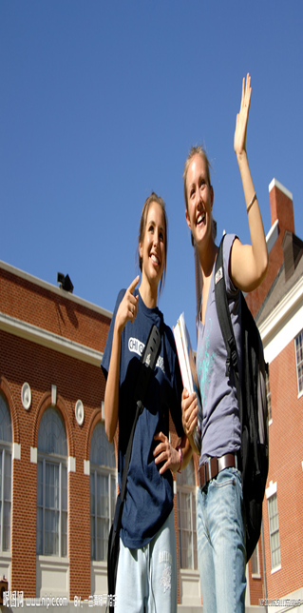
概要写作
2018年11月高考 ——问题解决模式
6-3
基本结构 | 1.展示问题现状和重要性: It’s a really good idea to visit colleges before you apply because their websites can all start to look and sound the same……., and do all the research you can to make sure you are making the right decision. 2. 分析其产生的原因: give you the sense of what it will actually be like. 3. 提出怎样解决（不同解决方案的优缺点） ① if you live nearby, go check it out! ②If campus visits aren’t going to happen before you apply, at the very least you should find some time between applying and getting your acceptance letters to visit the schools ③ if time and money are making it impossible, then check out the online college fairs at CollegeWeekLive.
关注语篇信息的逻辑结构
三个If条件句表明选择关系

Slide 118


概要写作
概要写作技巧 1—— 明晰篇章结构
6-3
篇章模式：问题解决模式 Problem-Solutions Pattern
专业网站咨询查看
接到通知书之前参观
5
就近参观
4
亲自参观
3
2
推展句Supporting sentences
申请理想大学
1
主题句Topic sentence
文章结构：一拖四

Slide 119

概要写作
概要写作技巧 1—— 明晰篇章结构
6-3
思维导图
Mind map
How to make the right decision
before applying to colleges
It’s a really good idea to
visit colleges before you apply
if time and money are making visits impossible, check out the online college fairs
if you live nearby go check it out!
If visits can’t happen before applying, find some time to visit

Slide 120
概要写作
概要写作技巧 2—— 定位主旨要点
6-3
It’s a really good idea to visit colleges before you apply because their websites can all start to look and sound the same. Nothing will give you the sense of what it will actually be like to live on a college campus(校园）like visiting and seeing for yourself the dorms, classrooms and athletic equipment and, of course, the students. It seems a little crazy once senior year hits to find the time to visit college campuses, and it can also be pricey if the schools you are applying to happen to be more than a car ride away. But keep in mind that you are making a decision about the next four years of your life, and do all the research you can to make sure you are making the right one.
次要点
分析上下文，理清层次，提取要点
before you apply
visit colleges
行文逻辑： →
→do all the research
making the right decision
→ the next four years of your life

Slide 121
概要写作
概要写作技巧 2 —— 定位主旨要点
6-3
① It’s a really good idea to visit colleges before you apply because their websites can all start to look and sound the same.
②Nothing will give you the sense of what it will actually be like to live on a college campus(校园）like visiting and seeing for yourself the dorms, classrooms and athletic equipment and, of course, the students. It seems a little crazy once senior year hits to find the time to visit college campuses, and it can also be pricey if the schools you are applying to happen to be more than a car ride away.
③But keep in mind that you are making a decision about the next four years of your life, and do all the research you can to make sure you are making the right one.
visiting college campuses
reduce the examples
leave out the details
特别关注首段出现两个要点的情况！

Slide 122
概要写作
概要写作技巧 2—— 定位主旨要点
6-3
There’s no excuse not to visit the schools in your local area. In fact, a lot of college applications even ask if you have visited campus, and obviously, if you live across the country that won’t be as much of a possibility, but if you live nearby, go check it out!
分析文本，弄懂文意
“当然，如果的确太远，去参观校园就没有可能性了。”
此句中that 指代前文中的visit the schools/ visit campus
live across the country与live nearby 形成语义关联
but为“路标词”
excuse承接上段
It seems a little crazy once senior year hits to find the time to visit college campuses, and it can also be pricey if the schools you are applying to happen to be more than a car ride away.

Slide 123
扫码关注
回复：hello sun
获取课件制作、录课等实用工具包
知识产权声明
感恩遇见，相互成就，本课件资料仅供您个人参考、教学使用，严禁自行在网络传播，违者依知识产权法追究法律责任。
更多教学资源请关注
订阅号：溯恩英语

Slide 124
概要写作
概要写作技巧3 —— 语言信雅达顺
6-3
It’s a really good idea to visit colleges before you apply because their websites can all start to look and sound the same. Nothing will give you the sense of what it will actually be like to live on a college campus(校园）……But keep in mind that you are making a decision about the next four years of your life, and do all the research you can to make sure you are making the right one.
Visiting colleges in advance is highly recommended which enriches your sufficient sense and ensures a satisfying four-year college life.
次要点作定语从句，补充信息，使要点更为完整、丰满和连贯

Slide 125
概要写作
概要写作技巧3 —— 语言信雅达顺
6-3
It’s a really good idea to visit colleges before you apply because their websites can all start to look and sound the same. Nothing will give you the sense of what it will actually be like to live on a college campus(校园）……But keep in mind that you are making a decision about the next four years of your life, and do all the research you can to make sure you are making the right one.
Visiting colleges before application is perceived as the best idea as it will bring you authentic experience and help you make preferable decision.
perceive[pə'siːv] v. 察觉；理解；认知 be perceived as 被认为是, 被视为
authentic [ɔː'θentɪk] adj. 真正的，真实的；可信的
preferable ['pref(ə)rəb(ə)l] adj. 更好的，更可取的；更合意的
使用广义词authentic experience代替具体词

Slide 126
概要写作
概要写作技巧3 —— 语言信雅达顺
6-3
There’s no excuse not to visit the schools in your local area. In fact, a lot of college applications even ask if you have visited campus, and obviously, if you live across the country that won’t be as much of a possibility, but if you live nearby, go check it out!
If there are colleges which aren’t remote to you, don’t miss the visit.
正话反说或反话正说
Visiting colleges before application is really a good way to help you make a right decision, especially those in you local area.
一句多点，高度浓缩，很好地体现思维能力和语言能力

Slide 127
概要写作
概要写作技巧3 —— 语言信雅达顺
6-3
If campus visits aren’t going to happen before you apply, at the very least you should find some time between applying and getting your acceptance letters to visit the schools you’d like to attend. It can save you a lot of heartache if you rule out now the things that you don’t like about certain campuses, things that you wouldn’t know unless you actually visit.
For the sake of decreasing vexation, you should set aside some time to visit in the interval of applying and acceptance.
vexation [vek'seɪʃən] n. 苦恼；恼怒；令人烦恼的事
interval ['ɪntəvəl ] n. 间隔；间距
次要点作状语，使要点更为完整、丰满和连贯

Slide 128
概要写作
概要写作技巧3 —— 语言信雅达顺
6-3
Now, if time and money are making it impossible, then check out the online college fairs at CollegeWeekLive.
While visiting an online college fair can’t take the place of an actual campus visit, it can be a very useful tool help you make an informed decision
Time and money not permitting, CollegeWeekLive is also a practical access to gain insight of colleges.
CollegeWeekLive is a time-saving and free way to help you make a meticulous decision.
meticulous [mə'tɪkjələs] adj. 一丝不苟的；小心翼翼的
独立主格结构，与上文形成很好的过渡衔接和语义连贯
句子变为短语

Slide 129
概要之要领
1.No paragraphing
2.No overwriting
3.No titling
4.No scrabbling
A Good Summary Writing
Outer Beauty
Inner Beauty

Slide 130
概要之要求
complete（完整性）
brief
（简洁性）
coherent（连贯性）
objective（客观性）
Contain all the key points.
Omit unnecessary details.
Use proper transitions.
Use your own words to express the writer's ideas.

Slide 131
概要之要义
01
03
Here are some reasons...firstly,...这种形式，说明理解不准确（小误差）。分数在第二档和第三档之间，要看要点及语言表达能力。
1.是否能找出要点，体现考生阅读理解能力。所以强调要点。
2.是否能体现要点，体现学生语言表达能力。同时强调语言。
3.要点可以找到，但语言表达不易。（初一学生也可以找到几个要点相关的词，但很难准确地连贯地表达）。要点没有，肯定不行；要点全找到了，不一定高分。
概要中尽量不要出现“作者说...”或“文章告诉...”之类的表达。
02

Slide 132
概要之要义
04
06
语言和要点没有主次，只能说在完成概要这个任务过程中，有先后步骤。第一步：理解原文抓要点；第二步：将要点内化后组织语言表达出来。
全文的主题句（Topic sentence）是提出问题“申请理想大学是一个重要的决策 ”，推展句（Supporting sentences ）是四个解决办法。没有结论句（Concluding sentence）。
在写作中，一定要强调主旨句和结论句的呈现，让作品更有层次感。
“概要写作”不宜分段书写。如果分段了，从总分中扣除1分。
05

Slide 133

概要之纲要
文体与考向
(1)篇幅稳定,以议论文和说明文为主。
(2)考向明晰。要求考生对提供的文章整体做理解;在不改变原文中心思想的前提下,用简明、精炼的语句高度浓缩文章的主要内容和观点。
(3)文章一般会有3到5个要点。捕捉要点的准确性将是概要写作的关键之一。
(4)重组所有要点,语法的准确性、必要的逻辑性和层次性也是高分作文的标准之一。
要点与语言

Slide 134


Slide 135
扫码关注
回复：hello sun
获取课件制作、录课等实用工具包
知识产权声明
感恩遇见，相互成就，本课件资料仅供您个人参考、教学使用，严禁自行在网络传播，违者依知识产权法追究法律责任。
更多教学资源请关注
订阅号：溯恩英语

