Slide 1
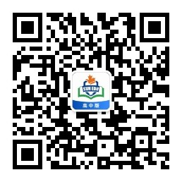
感恩遇见，相互成就，本课件资料仅供您个人参考、教学使用，严禁自行在网络传播，违者依知识产权法追究法律责任。
更多教学资源请关注
公众号：溯恩高中英语
知识产权声明

Slide 2
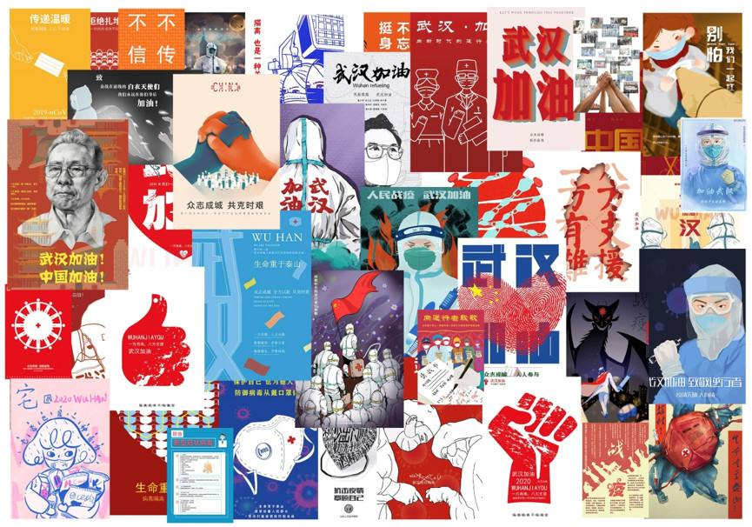
台州市第一中学 周 媚
台州市第一中学 陈泓静

Slide 3
假定你是李华，要向全校学生征集以“抗击新型冠状病毒疫情”为主题的优秀文艺作品刊登在校园网上。请根据下面提示写一则100词左右的征稿启事。
征稿目的：宣传防疫知识、引导同学们正确认识新冠肺炎、鼓舞战胜疫情的信心。
征稿范围：全校学生
艺术形式：绘画、书法、摄影、音乐、曲艺、剪纸等等
作品要求：紧扣主题、传播正能量、原创
投稿要求：作品在2020年4月29日前发至邮箱：Rolland@163.com, 邮件内注明作者姓名、班级、联系方式
参考词汇：稿件：contribution

Slide 4
启事：是一种公告性的应用文，格式由标题、正文、落款组成
标题：关键词 + Wanted组成
正文：发布启事的个人或组织的简介；
发布启事的原因或目的；
启事的具体要求；
报名的时间、地点和方式；
组织方的联系方式等；
落款：发布启事的个人或组织，写在正文右下角

Slide 5

标题
招 聘 保 姆

Slide 6
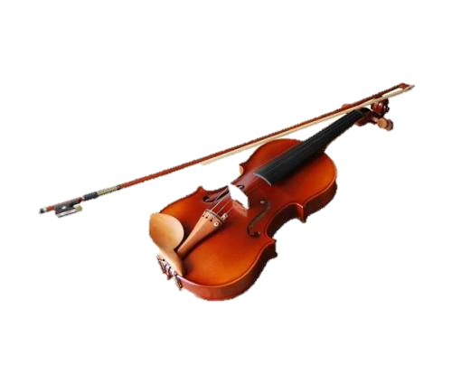
Violin Wanted
求购小提琴

Slide 7


通 缉 令
征 兵 令

Slide 8

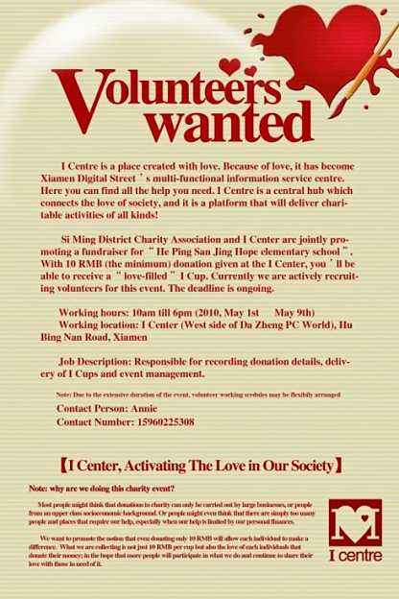
求 职 招 聘
征 集 志 愿 者

Slide 9
标题
Volunteers Wanted
Our annual English Festival, which will be held on June 15-17, 2015, is now looking for /recruiting 20 student volunteers to provide service for Talent Show, Speech Contest, and English Debate. Fluency and accuracy in spoken English is required. Priority and preference will be given to those who have former experiences. If you are interested, please send an application email at your earliest convenience to Ms Chen at chenlaoshi@aef.com.
招募组织方
招募范围
招募目的
招募要求
报名和联系方式

Slide 10

征 稿 启 事

Slide 11
假定你是李华，要向全校学生征集以“抗击新型冠状病毒疫情”为主题的优秀文艺作品刊登在校园网上。请根据下面提示写一则100词左右的征稿启事。
征稿目的：宣传防疫知识、引导同学们正确认识新冠肺炎、鼓舞战胜疫情的信心。
征稿范围：全校学生
艺术形式：绘画、书法、摄影、音乐、曲艺、剪纸等等
作品要求：紧扣主题、传播正能量、原创
投稿要求：作品在2020年4月29日前发至邮箱：Rolland@163.com ，邮件内注明作者姓名、班级、联系方式
参考词汇：稿件：contribution
常用被动
Contributions Wanted(或全部字母大写)
Body
(正文可写成一段，首行空两格)
(写明征稿的目的和要求)
(注意时间、地点以及投稿方式的正确表达)
Li Hua/School Website

Slide 12
Headline
Contributions Wanted
contribute (v.) 撰稿
contribute to sb. 向…投稿
contributor 投稿者
Organizer
School ( website )
Recruitment range
all the students

Slide 13
Purpose
征集以“抗击新型冠状病毒疫情”
为主题的优秀文艺作品刊登在校园网上；
目的是宣传防疫知识、
引导同学们正确认识新冠肺炎、鼓舞战胜疫情的信心。
1. In order to propagate the knowledge of epidemic prevention, guide students to have a good command of the COVID-19 as well as build up confidence, we’re looking for excellent contributions related to the theme “fight against the new coronavirus.”
2. With the purpose of …, Literature and art works themed “fight against the epidemic” are wanted on our school website.
3. For the purpose of …, outstanding contributions with the theme of “fighting against the Coronavirus" are now being collected.
常用被动

Slide 14
4. For the sake of ..., your excellent works, whose theme is/
the theme of which is/of which the theme is “fighting against the virus”, will have the chance to be published on our school website.
5. With the intention of publicizing epidemic prevention knowledge, leading students to have a better understanding of the new pneumonia, as well as inspiring the confidence in winning the fight, some contributions are wanted on our school website.
6. Aimed at publicizing prevention knowledge of the dreadful COVID-19, the Campus Website has decided to publish a special issue to enhance confidence in defeating the virus.

Slide 15
Forms
Requirements
绘画、书法、摄影、音乐、曲艺、剪纸等等
作品要求：紧扣主题、传播正能量、原创
1. The contributions, which vary in forms such as painting, calligraphy, photography, music, opera, paper-cutting and so on, are supposed to be positive, original and to the point.
2. A diversity of forms/a variety of forms/various forms/ diverse forms are welcome: painting, calligraphy, photography and music as well as paper cutting and so on. It couldn’t be better if the works are related to the theme, positive and original as well.
3. Undoubtedly, the priority and preference will be given to those to the point while spreading positive energy. Besides,
originality is a must.

Slide 16
4. The forms can be diverse, such as drawing, calligraphy, music, folk art, paper cutting and so on, while original art works are required to bond with the theme closely and convey a positive energy.
5. Contributions may be in a variety of forms , such as painting, calligraphy, photography, singing, quyi and paper cutting. The preference will be given to those works which spread positive energy and focus on the theme.
6. All the school students are warmly welcome to submit your contributions related to the topic in various art forms and styles such as photography and paper-cuttings. Preferably, the original works that spread positive attitude is in great request.

Slide 17
Deadline
Ways of Contact
作品在2020年4月29日前
发至邮箱：Rolland@163.com，
邮件内注明作者姓名、班级、联系方式
1. Those who are interested please submit your work, which contains your name, class and contact information, to Rolland@163.com by April 29th .
2. The contributions ought to be sent to Rolland@163.com before(the deadline of) April 29th, 2020 along with your name, class and contact information.
3. You can also contact me for further information.

Slide 18
Related Vocabulary
publish
be intended/meant for…
column
all walks of life
adopt
target readers
meet the deadline
have a talent for…
submit … to …
出版，发行，发布
针对（哪类读者群）
专栏
各界
采用
目标读者
赶上最后期限
在某方面有天赋
递交…到…

Slide 19
Useful Sentences
1) All the senior high school students throughout China are welcome to contribute to us/send your contributions to us.
2) Whether you are a lover or an amateur, as long as you have a talent for writing and a burning desire to share your story, we want to hear from you.
3) Please send an email to xxx.com with an example of your work.
4) Whoever is interested in it, please contact …at … by…
5) Please email the compositions to…before ….
6) Nothing can be more rewarding than recording your life with your own pens.
7) We can hardly wait to admire your masterpieces.

Slide 20
Contributions Wanted
For the purpose of propagating the knowledge of epidemic prevention, guiding students to have ___ good understanding of COVID-19 and inspiring the confidence _____ winning the battle against the virus as well, we’re collecting contributions from all the students in our school. __________(variety) of great artworks __________(concern) the topic “Defeating the virus”, _________
(include) paintings, calligraphy, photographs, music, folk art and paper-cutting, _______________(require) on the school website. Priority and _____________(prefer)will be given to original and positive contributions ________(close)related to the theme. Any student ___________(interest)is warmly welcome to send contributions to Rolland@163.com with ______ (you)name, class and ways of contact by April 29th,2020. Don’t miss this precious opportunity!
Li Hua
a
in
Varieties
concerning
including
are required
preference
closely
interested
your

Slide 21
Writing Sample
CONTRIBUTIONS WANTED
With the purpose of making students know the epidemic better and full of confidence, contributions related to fighting against the Corvid-19 are wanted. The following contribution forms are suggested: painting, calligraphy, photography, music, folk art, paper cutting and so on. All the works are expected to be original, positive and to the point. All of the students are welcome to send your artworks to Rolland@163.com no later than/by/before April 29th, 2020. Undoubtedly, some information must be included in the e-mail, such as name, class and other contact details. If you have any question, feel free to contact me./You can also contact me for further information.
Li Hua

