Slide 1

感恩遇见，相互成就，本课件资料仅供您个人参考、教学使用，严禁自行在网络传播，违者依知识产权法追究法律责任。
更多教学资源请关注
公众号：溯恩高中英语
知识产权声明

Slide 2
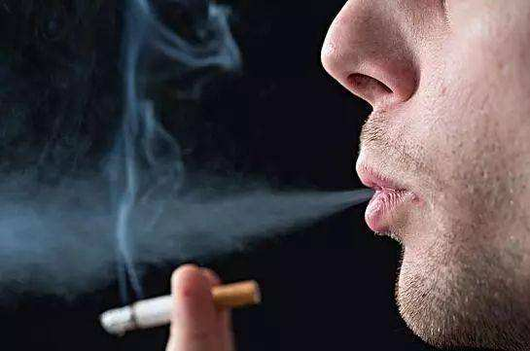
2020 绍兴市高二期末考
读后续写讲评

Slide 3
第二节: 读后续写（满分25分）
阅读下面短文，根据所给情节进行续写，使之构成一个完整的故事。
Growing up, my parents and older brothers all smoked. Being a child of the 80s, it was normal for the adults to be smoking inside and during trips in the car. There just wasn't the same awareness of the dangers of second-hand smoke exposure that there is today.
I remember the day when I started smoking. I was ll. I was trying to impress one of the “bad boys” at school. I stole tobacco from my father and rather clumsily rolled a cigarette that I took to school with me. Smoking gave me a sense of autonomy and choice over my own life, and at 11 it was the ultimate act of rebellion. Soon I got addicted to it and was taking cigarettes from dad's packets on a regular basis. I knew he never started counting them until he had less than half a pack left.
After a while I got caught smoking at school. My parents struck a deal with me:if I stopped smoking at school, they would purchase more tobaccos for me

Slide 4
to smoke at home. This was perhaps a misguided attempt to keep me out of trouble. I jumped at the idea, and simply got smarter about smoking at school.
I smoked right through my teens and early 20s, spending thousands of dollars on cigarettes, sacrificing food and other necessities to ensure I had cigarettes.
I tried many methods to quit, but each time I would go back to smoking, I have always had a love-hate relationship with cigarettes. On the one hand. they were a friend to me when I had no other, one constant in my life I could rely on. On the other hand, I despised being dependent on something that was going to kill me.
I grew concerned about the effect my smoking would have on my children and I felt guilty putting cigarettes over other things that could have benefited my family. It is with great shame that I admit that I continued smoking even after having a daughter born with cystic fibrosis (囊性纤维). My daughter fights every day to breathe ——and here I was intentionally causing damage to my lungs.

Slide 5
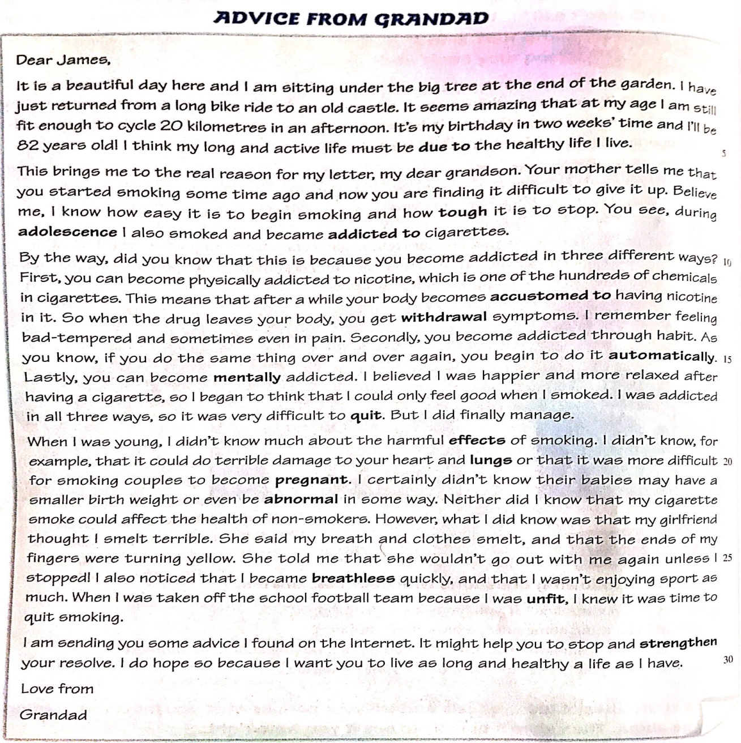
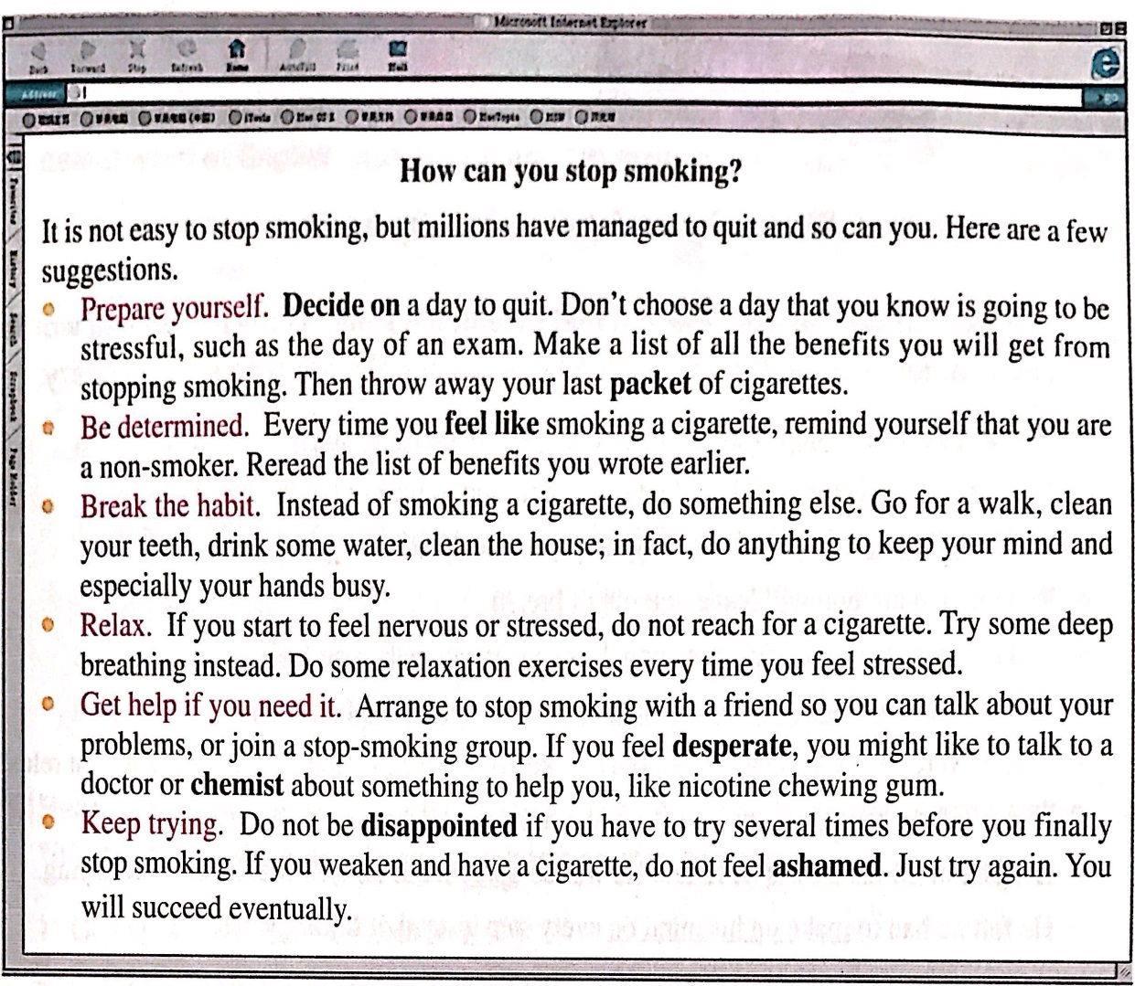
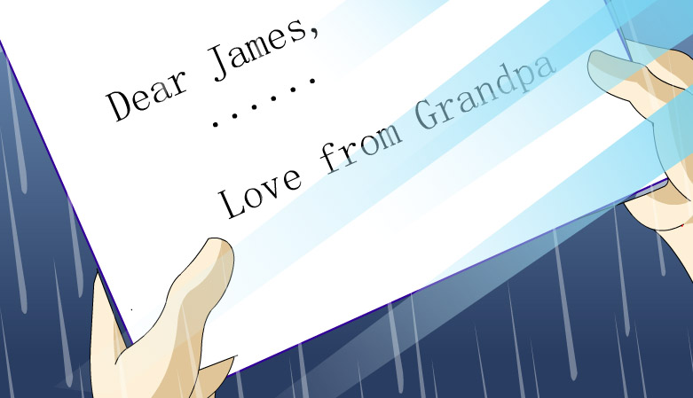
What are granddad's suggestions of quitting smoking?

Slide 6


Know the story
story
What
Why
How

Slide 7
Activity1: Find out the topic and main idea of the story
smoking
Who
Where
When
What
Why
How
What
I, my parents/daughter/family
__________ smoking at 11, I grew into a _______ smoker, which greatly _______ my family and myself. And ______________ an incredibly painful experience, I made efforts and finally __________.
Starting
topic
at school/home
heavy
content
affected
11, teens, early 20s
as a result of
quit smoking
an painful experience
quit smoking
set goals

Slide 8
Activity2: Figure out the purpose of the writing
Writer
to tell readers the harm of smoking
to persuade readers to stay away from smoking
to show his love to his family
...
Contact
Why
Reader
Context

Slide 9
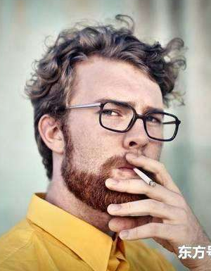
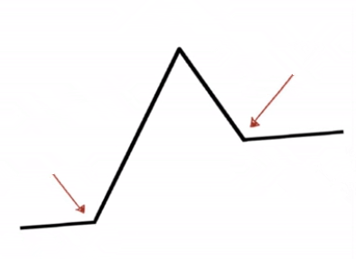
Activity3: Clarify the plot of the story
Overt plot (明线)——_______________
Covert plot (暗线)——_______________
my experience of quitting smoking
Freytag Pyramid
(弗雷塔格金字塔)
changes of my awareness
Climax
Falling action
How
Resolution
Rising action
Inciting incident
Denouement
Setting

Slide 10
Overt plot: my experience of quitting smoking
My daughter born with ____________
and I was causing damage to ___________.
cystic fibrosis
my lungs
I tried many methods to_______ smoking.
incredibly painful
an________________ experience
quit
...
I became _______
to smoking.
addicted
personal experience
I was born in a __________family in an era when smoking was ________ to see.
smoking
normal
family & social background

Slide 11

Covert plot: changes of my awareness
started smoking
action:
caught smoking at school
action:
stole/rolled/took/got addicted to
jumped at/got smarter
a sense of autonomy
my teens and early 20s
action:
spent/sacrificed
tried to quit
action:
have my own family
action:
would go back to smoking
continued smoking
concerned/guilty/ashamed
friend & killer

Slide 12
Weave the story
Activity4: Predict the ending of the story
Predict:
 cigarette
 sense
 purchase
 jumped at
 smoked
 quit
 concerned
 family
 cystic fibrosis
Para.1 The turning point for me was an incredibly painful experience._________
_________________________________
_________________________________
Para.2 I set myself further little goals, such as only taking my e-cigarettes whenever I went.___________________
_________________________________
_________________________________
What painful experience was it?
How did I respond?
What did I do?
What was the result?

Slide 13
Develop the story
Activity5: Develop the story with detailed descriptions
born with...
fights every day
Para.1 The turning point for me was an incredibly painful experience._____
_____________________________________________________________
_____________________________________________________________
shock/sad /guilty
What painful experience was it?
My daughter's condition got worse/ died.
I began quit smoking.
determined
How did I respond?
set further goals
Mental activities: | shock/sad/guilty
Direct/Indirect descriptions | feelings /actions
1. 用无灵主语刻画人物情感（震惊/悲痛/后悔）
A sudden fear seized me.
The words that I got from the doctor gave me a terrible pang(一阵痛苦).
A wave of panic swept my body.
The news hit me like a bucket of cold water. (像被泼了一桶冷水)
The news made me shudder. (不寒而栗)/The news choked me.
A voice inside me said, “That's all your fault.”
My whole world seemed falling to piece.
My heart was broken because it hurt so badly I could barely breathe.

Slide 14
Mental activities: | shock/sad/guilty
Direct/Indirect descriptions | feelings /actions
2. 用行为动词推动情节发展（震惊/悲伤/悔恨）
I felt a sharp stab of guilt （心里一阵刺痛）
I couldn’t help shivering.
“I killed her!”I screamed at myself inside my head.
I knelt on the floor and cried tears of hopelessness and frustration.
I gave a wail(恸哭) of anguish(悲痛).
I clenched my fists(攥紧拳头) with grief, calling myself a murderer over and over again.
Time just stopped, I felt frozen and in disbelief, I was paralyzed and in shock.
Only now did I become aware that I should have quit smoking long ago.

Slide 15
Para.2 I set myself further little goals, such as only taking my e-cigarettes whenever I went.______________________________________________
____________________________________________________________
What did I do?
What was the result?
I made efforts to quit smoking.
determined
/relieved
I made it!
Mental activities: | determined/relieved
Direct/Indirect descriptions | feelings /actions
2. 用行为动词推动情节发展(努力)
I shifted my attention from the cigarettes.
I buried the photo of my daughter under my pillow to remind myself of what a pain it was.
As the efforts accumulated, I was dragging myself further away from cigarettes.
...

Slide 16
Mental activities: | determined/relieved
Direct/Indirect descriptions | feelings /actions
3. 用内心独白升华主题
If I knew it were to take my daughter away from me, I would have never touched a cigarette.
To anyone wanting to quit smoking, all I can say is giving your plan a go! You have nothing to lose and everything to gain.
Sorrow had been plentiful. But I was not left hopeless. In fact, It was times like these when we realize how much hope we have. It's times like these that shape us to be a better self.
...

Slide 17
One possible version:
The turning point for me was an incredibly painful experience. Last June a family member aged only 17, died after a long battle with cystic fibrosis. The cruel twist of fate robbed her of the life that she so richly deserved. Smoking for another five weeks after her death, I suddenly felt ashamed of myself and was overwhelmingly sorry for my daughter. I visited a doctor, who suggested me adopting electronic cigarettes as a substitute. I practiced over a couple of weeks and noticed the number of cigarettes decreasing.
I set myself further little goals, such as only taking my e-cigarettes whenever I went. I made a record of every cigarette I had, and the associated triggers for that particular cigarette. The first day I counted 15 cigarettes, approximately half of what I usually smoked. By day 12, I was down to two. I had my last cigarette on July 14. After 20 years as a smoker, I was free from the addiction, finding the smell of cigarettes unbearable. To any one wanting to quit, all I can say is give your plan a go! You have nothing to lose and everything to gain.

Slide 18
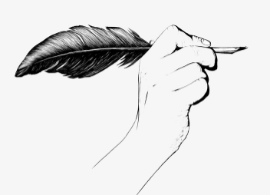
Steps for Reading:
1. Know the story
2. Weave the story
3. Develop the story
Tips for writing:
1. 用无灵主语刻画人物情感
2. 用行为动词推动情节发展
3. 用内心独白升华主题

Slide 19
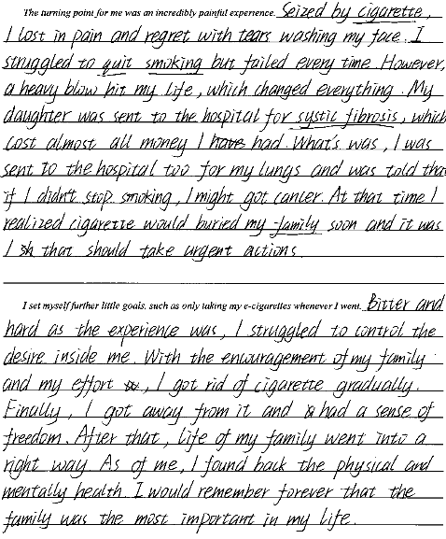

亮点：
1. 情节设计连贯、自然。A heavy blow呼应所给段首句“an incredibly painful experience.”
2. 叙述描写文字丰富：使用了强调句和非谓语等高级句式。

Slide 20
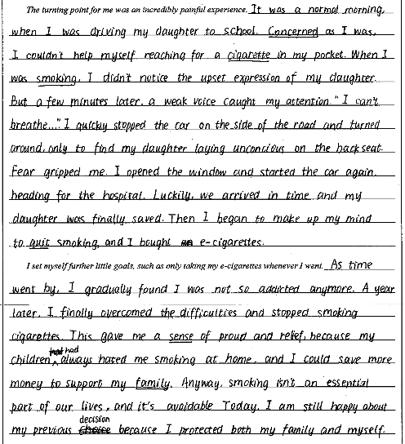
亮点：
1. 作文围绕文章内容和首段进行了合理地拓展，从女儿因“我”吸烟发病到我痛定思痛开始戒烟再到戒烟成功，与提供的段首句衔接合理。
2. 灵活地运用了一些高级词汇和句式：如as引导的倒装句、无灵主语、非谓语等句式等。

Slide 21
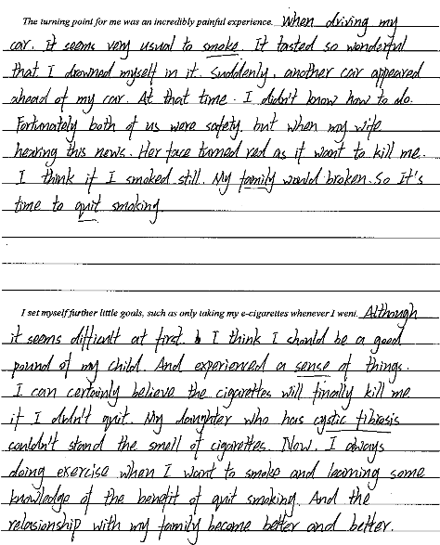

情节设计不太能突出“一次极其痛苦的经历”，且时态不一致，句式结构单一。

Slide 22
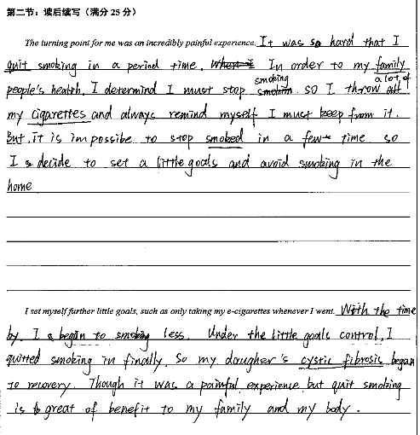
句子不完整、句子之间不连贯且所写内容与之前原文衔接不紧密。

Slide 23
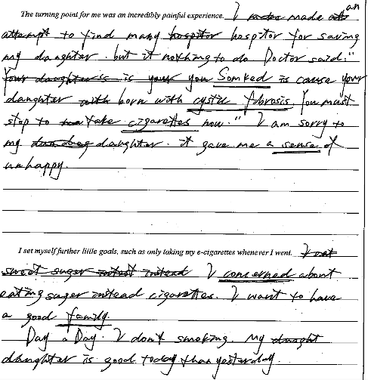
1. 错误分段；
2. 字数不到；
3. 字迹潦草。

Slide 24
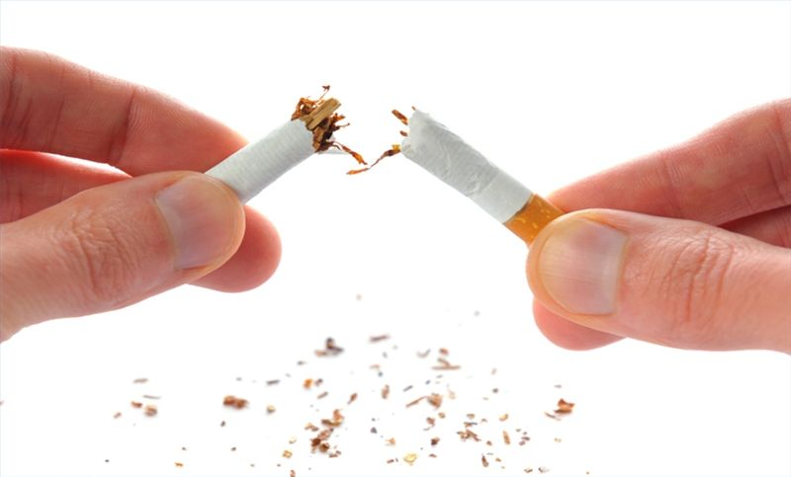
The End

