Slide 1

感恩遇见，相互成就，本课件资料仅供您个人参考、教学使用，严禁自行在网络传播，违者依知识产权法追究法律责任。
更多教学资源请关注
公众号：溯恩高中英语
知识产权声明

Slide 2

完形填空
—衔接意识
毛老师

Slide 3
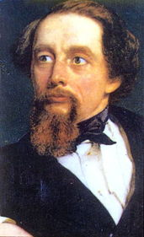

It was the best of times,it was the__________of times
It was the age of wisdom,it was the age of ___________
it was the epoch of belief,it was the epoch of incredulity
it was the season of _____,it was the season of darkness
it was the spring of ______,it was the winter of despair
we had everything before us,we had ________ before us
we were all going direct to Heaven,
we were all going direct the other way
worst
foolishness
light
hope
nothing
t
反义
这是个最好的时代,这是个最坏的时代
这是智慧的时代,这是愚蠢的时代
这是信仰的时代, 这是怀疑的时代
这是光明的季节,这是黑暗的季节
这是希望的春天,这是绝望的冬天
我们前方拥有一切,我们前方一无所有
.......

Slide 4

完形填空（cloze)
词汇衔接(vocabulary cohesion)

Slide 5
完形填空(Cloze)---词汇衔接（cohesion)
1.Hearing my story ，many students followed with their own ____of heads ,arms ,fingers stuck in places they shouldn't be.A few minues later ，they came back ，test tube unbroken and finger returning to a lovely shade of pink (2018浙江11月)
A finds B conclusions C stories D news
2.News about our 4 was appealing to me .He was an international grand master,which means I would be learning from one of the game's 6 . I could hardly wait to meet him (2018课标全国卷)
4.A title B competitor C textbook D instructor
6.A fastest B easiest Cbest D rarest
复现
近义

Slide 6
完形填空(Cloze)---逻辑词衔接
1.What brought this astonishing change in me ？The dessert hadn't changed,_______I had.I had changed my attitude.(2016浙江)
A as B but C for D or
2.The books are in every language — new books ，ancient books ，_____a book on the history of Iraq that is seven hundred years old.(2017浙江)
A then B still C even D rather
3.Looking around ，he continued ,“Cathy has inspired us with her will and enthusiasm .______skills and talents bring great success，the most valuable asset（财产)one can hold is the heart（2016天津)
A Although B Since C Once D Because
4.The professor was deaf and any talking was prohibited .I soon realized that the silence was not unpleasant ._____, if there had been any talking ,it would have caused us to learn less.Now ,I appreciate the silence .(2017全国卷)
A Lastly BThus C Instead D However
转折
递进
让步
对比

Slide 7
形式衔接
词汇衔接 （复现，近义，反义，上义等)
逻辑衔接（ but however even instead
in contrast although 等）
衔接（cloze)
内容衔接

Slide 8

完形填空考查考生在阅读理解的基础上运用词汇的能力。试题要求考生根据文章的主旨和结构以及上下文的逻辑关系选择适合文章内容，语法搭配正确的选项。

Slide 9
He _________this question while we sit in his office overlooking the yard.
A reads B considers C admits D asks
The yard has gone into a state of ____________in recent years .
A decline B peace C boom D repair
2018浙江金丽衢联考
para1-----I ask my grandpa what it feels like to grow old.He _______this question while we sit in his office overlooking the yard ,where an empty bird feeder swings lifelessly from a tree branch.The yard has gone into a state of _______in recent years .Grandpa no longer possesses the energy to maintain its once glory.
considers
decline

Slide 10
练习 与 体会 2019 年 高考真题（江苏卷)
Answer：
Cloze Test Assessment
(错误比例) ：
（1）D；（2）B；（3）C；（4）A；（5）C；
（6）B；（7）A；（8）B；（9）D；（10）D；
（11）C；（12）A；（13）D；（14）C；（15）D；
（16）B；（17）B；（18）C；（19）A；（20）A；
9. 71%
12. 38%
19. 37%
14. 33%
16.25%
20. 23%
vocabulary
logic

Slide 11
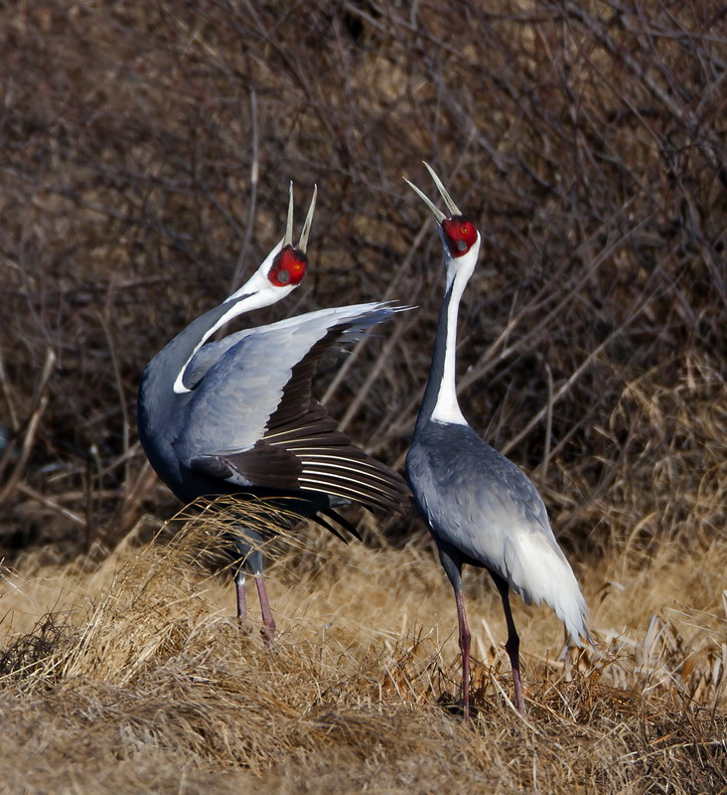
完形语篇分析
Topic(主题)
possible version:
Rare species are endangerd ,so we human being should improve our awareness of protection and take action like Chris and Tim who take care of Emma，a white-naped crane.

Slide 12
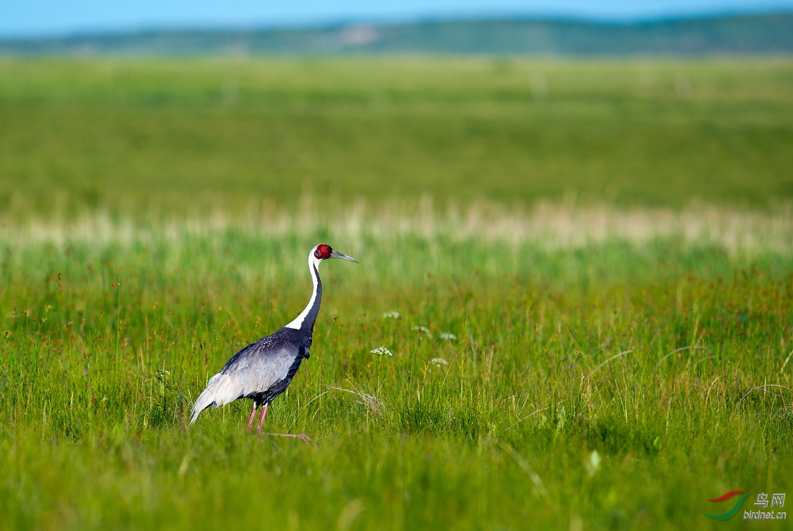
Para 1 :
1.wildlife
threatened
2.species
disappearing
4. so
save from
3.crane
a typical example

Slide 13
Para 2---3
5. Chris and Tim work at a zoo, helping endangered cranes with their reproduction . 6.Emma, a female crane, has been in their care since she arrived in 2004.
7. Born at an international crane foundation, Emma was raised by human caretakers.8. This led to an unexpected consequence , though she had a wonderful time there.9. Emma had never taken herself as a crane and become deeply attached to humans.10.She refused to live with male cranes, and even had a reputation for killing some of them, which made it impossible for her to become a mother.

Slide 14
have a reputation for :
---The Millennials（千禧一代)have a reputation for being impatient and wanting to move up quickly ，by switching jobs often ---Forbes 《福布斯》
---Indian jails have a reputation for overcrowding and poor management . ----NPR 美国国家公共电台

Slide 15
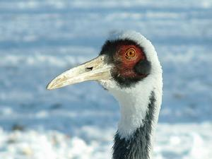
Para 4
The main idea ：
how to help
逻辑词衔接
11. However , the two zookeepers didn't want to see the extinction (灭绝) of
this precious species. With their patience and efforts, they successfully developed
a 12 combination of artificial breeding (人工繁殖) and natural reproduction.This
13enabled Emma to give birth to five baby cranes.
a combination of A and B:
His character is a combination of wisdom and kindness

Slide 16
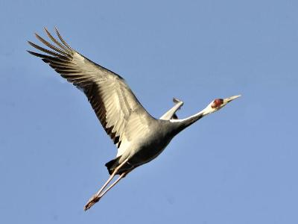
Para 5
14 The two keepers are proud of their productive work. 15 But before they can be assured , more efforts must be made, because the population of the in the wild is on the decline, and many other species appear headed toward extinction. 16 After all , not everyone has realized that wildlife has thoughts, feelings, and most importantly, equal rights to survive.

Slide 17
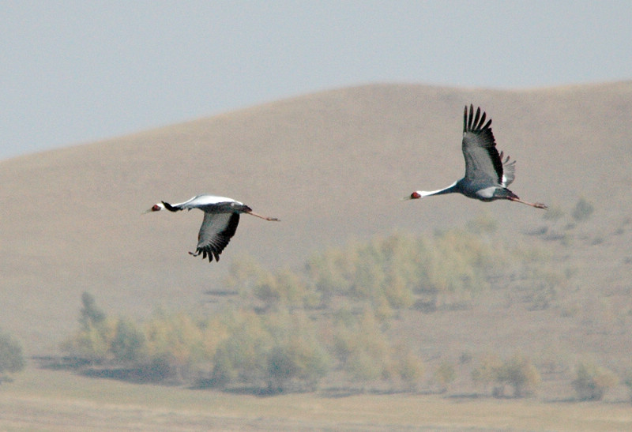
17How can we bridge the ever-widening gap that separates us from other animals? 18 Chris and Tim offered us the answer : human beings took it for granted that their brains held all the solutions, but maybe their hearts can be a better guide.
eg:Some students take it for granted that their parents should work hard to raise them

Slide 18

A cloze test is more than a word-filling exercise .It involves a deep communication with the passage!

