Slide 1
感恩遇见，相互成就，本课件资料仅供您个人参考、教学使用，严禁自行在网络传播，违者依知识产权法追究法律责任。
更多教学资源请关注
公众号：溯恩高中英语
知识产权声明

Slide 2
宁波九校联考读后续写
高一期末英语
浙江省衢州第一中学 徐荣仙

Slide 3
60-year-old Richard Olsen had retired from his work. He was very interested in adventure and hunting. This time he hunted on a sparsely (稀少地) populated land. In the cold winter, he tried a new place and forgot to bring his cell phone, the only time on the trip. He trekked (艰苦跋涉）more than half a mile with two dogs to a harvested wheat field. Eyes fixed on the horizon in expectation of another rabbit, Richard stepped on the thin snow on a canal (沟渠）。 Suddenly，the snow collapsed (班塌）and he dropped four feet to the bottom. Trapped in the canal, Richard couldn’t move at all, his left leg badly hurt. Using his shotgun as a crutch (拐杖)，he spent an hour climbing a half canal but slipped and slid back down when he was partly up. This time, one of his feet got stuck between two rocks. Richard told himself that if he didn’t get himself out of that canal, he wasn’t going to have a very good night. Richard worked his foot free and 6toed more slowly and cautiously out of the canal. Richard immediately realized the difficulty of the task before him. The accident occurred about 2 p.m., and it was nearing 5 p.m. with the road far away as the sun was setting. Richard focused on crawling (爬) to safety. Even with his gun supporting him, hopping (单足跳跃） was impractical. Instead, he sat down and pushed himself backward less than 40 inches at a time with his good leg. He was determined and sure that he must hold on. He was tired out and had more frequent breaks. Temperatures dropped overnight, and snow melted and his gloves and boots got wet. His hands and feet soon were completely numb (失去知觉的）.

Slide 4
Paragraph 1: Richard's dogs had been playing in the field and eventually came up to him.___________________________
_____________________________________________________________________________________________________________________________________________________________________________________________________________________________________________________________________________________________________________________________________________________________________________
Paragraph 2 ：However, gleams (微光) of daylight remained---Richard saw the seventh car. __________________________
____________________________________________________________________________________________________________________________________________________________________________________________________________________________________________________________________________________________________

Slide 5
Analyzing
1. Read for the topic
人与自我
get into trouble
try to save oneself
fail
人与社会
ask for help
successful
reflection/impression/thought

Slide 6
2. Read for the main idea
A
B
C
go hunting
try to save himself
more difficulty
search for help
use his shotgun as a crutch
climb out of the canal
crawl to safety
no people came to his assisstance
trouble
a sparsely populated land
cold weather, snowy
new place
without a cell phone
got left leg badly hurt
the other foot got stuck
night falling
tired out
dropping temperature
wet gloves and boots
numb hands and feet
dogs didn't notice him at first

Slide 7
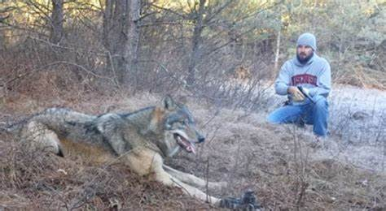
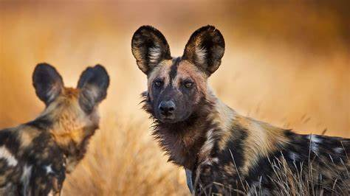
dogs
What?
How?
cars
How many?
Stop for help or not?
Richard
How?
saved or not?
3. Read for hints

Slide 8
4. Read for hints
Paragraph 1: Richard's dogs had been playing in the field and eventually came up to him. ____________
How did the dogs react to the situation?
What could the dogs do for him?
How did they ask for help from the previous six cars?
Did anyone in the car offer to help him?
How did Richard feel then?
Paragraph 2 ：However, gleams (微光) of daylight remained---Richard saw the seventh car.
Did the people in the seventh car help him?
How did they attract the attention of the seventh car?
How did he feel after being helped out?

Slide 9
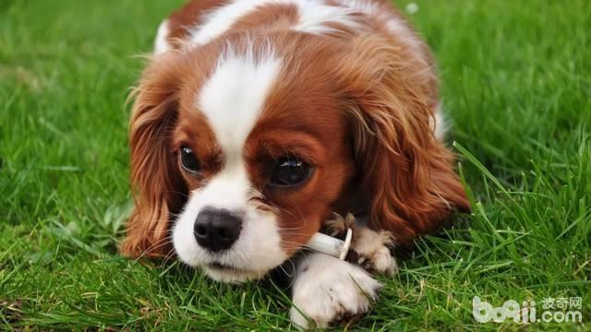
5. How do dogs express their feelings?
对陌生人叫
摇尾巴
扭曲身体
舔主人的脸
用鼻子嗅
四肢不安地踢
竖起耳朵
向马路冲去
bark at strangers
wag its tail
twist one's body
lick one's face
sniff ...
kick one' legs uneasily
prick up one's ears
dash towards the road

Slide 10
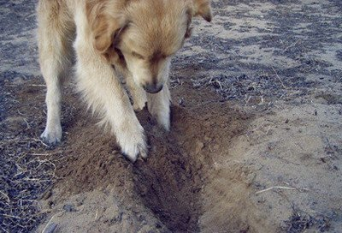
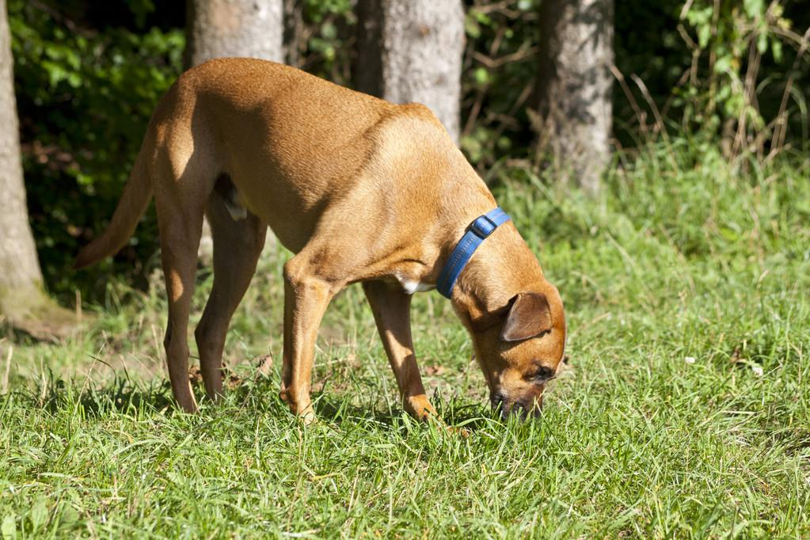
6. How do dogs express their feelings?
gallop like the wind
kick out
snort
paw the ground
moan
飞奔而去
踢腿
用鼻子哼哼
用爪刨地
呻吟、呜咽

Slide 11
Some helpful phrases and sentences
As night fell, ... 当夜幕降临
not long after this 不久之后
Then came the moment when...
feel hopeless and desperate to be home 感到孤独，渴望回家
stretch out one's hand伸出手
curl up and wait for help 蜷缩起来等待救援
give a joyful little cry高兴地轻叫一声
come swaggering towards sb神气十足地向...走来
She sniffed, looked around, and then squated down beside me.
One car after another sped off down the road in the proverbial cloud of dust.
I lay on the icy ground for as long as a century , shivering with cold.

Slide 12
“Woof,woof,” barked the older dog, pricking up his ears.
The dogs lost the scene of the wild and ran about sniffing the ground anxiously.
The boom of a vehicle caught their attention. One dog dashed towards the road. The other one chased him across the bank and stream, then they all thundered across the field for the car.
With my legs shaking and teeth chattering with cold, I noticed one dog galloping for the coming car like the wind.
When they heard me moaning, they licked my face and legs gently, wagging their tails uneasily and pawing the ground anxiously.

Slide 13
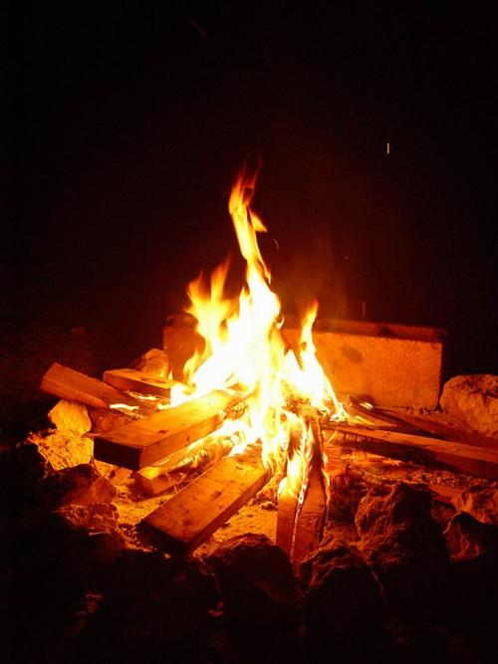
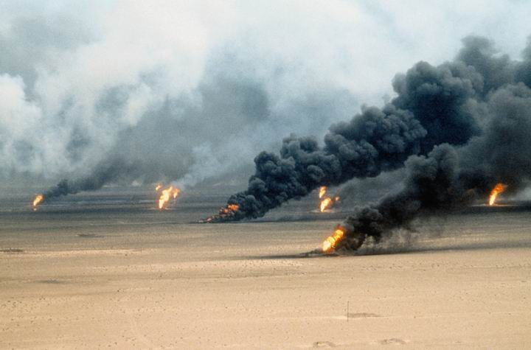
7. Scientific Ways of Asking for Help in the Wild
1. 燃放烟火
light up a beacon fire
2. 燃放三堆火焰
light up three piles of fire in a triangle
3. 做SOS求救信号
make a SOS signal for help

Slide 14
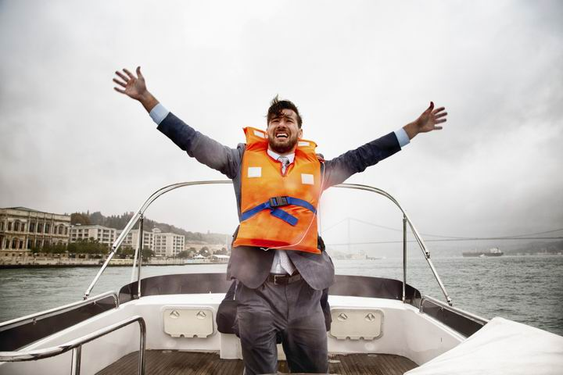
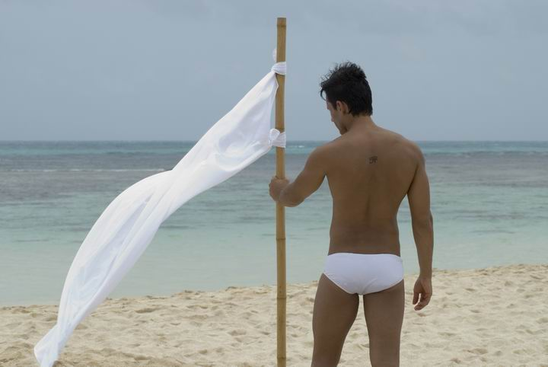
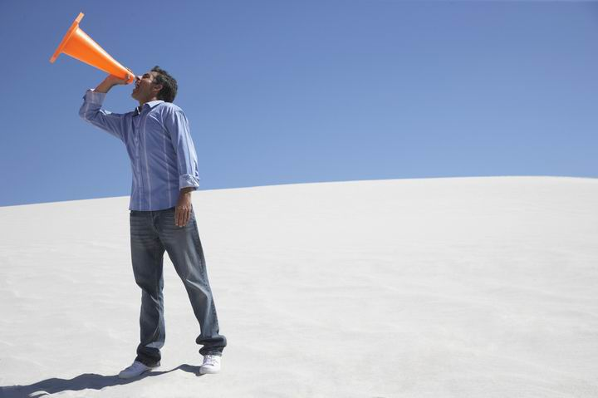
4. 体式求救：大幅度挥舞与周围环境颜色反差较大的衣物
wave your clothes, especially bright color ones to attract others' attention
5. 旗语求救
use a flag to catch one's attention
6. 声音求救
shout/ yell loudly for help
first three long shouts, then three short shouts

Slide 15
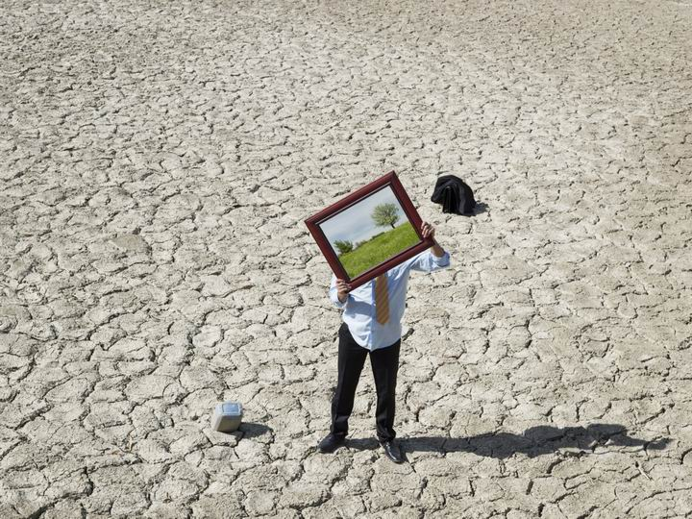
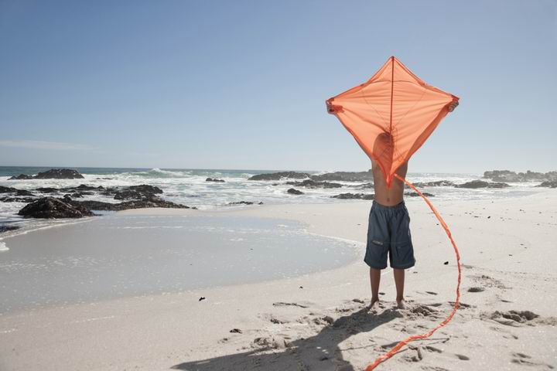
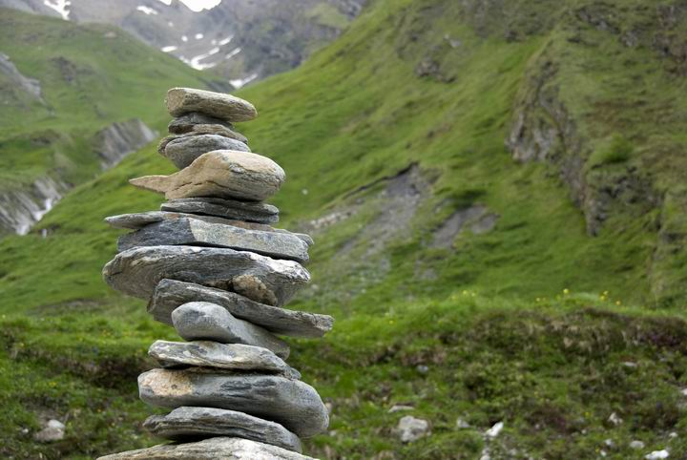
7.制造反光信号
send a signal light by using sunlight or a reflector
8. 放风筝
send a signal by flying a kite
9. 留下路标信号
leave a sign on the road in case you get lost or help the rescusers track you

Slide 16
下水作文
Richard's dogs had been playing in the field and eventually came up to him.When they heard Richard moaning, they licked his face and legs gently, wagging their tails uneasily and pawing the ground anxiously.Suddenly, the boom of a vehicle caught their attention. One dog pricked its ears and dashed towards the road, with the other one chasing after him. However, one car after another sped off down the road in the proverbial cloud of slurry. The dogs' ferocious barks brought Richard's conciousness back, which drove him to crawl slowly towards the road.

Slide 17
However, gleams (微光) of daylight remained---Richard saw the seventh car. The wind howled, piling up snow in drifts, blinding the night with ice-white dust. “If ignored by the seventh one, I could freeze to death!” he murmured. With his legs shaking and teeth chattering with cold, Richard noticed one dog galloping for the coming car like the wind. In a flash, an idea flashed across his mind. Immediately, he gathered some woods and lighted a fire. The thick smoke twisted into the air like a long tail of a dragon. Luckily, he was rescused and rushed to hospital at once. All the way, the dogs lay by Richard like loyal guards, warming Richard's heart!

