Slide 1


感恩遇见，相互成就，本课件资料仅供您个人参考、教学使用，严禁自行在网络传播，违者依知识产权法追究法律责任。
更多教学资源请关注
公众号：溯恩高中英语
知识产权声明

Slide 2
2024年1月8号浙江首考听力精听课件
瑞安新纪元高中
焦海滨老师制作

Slide 3
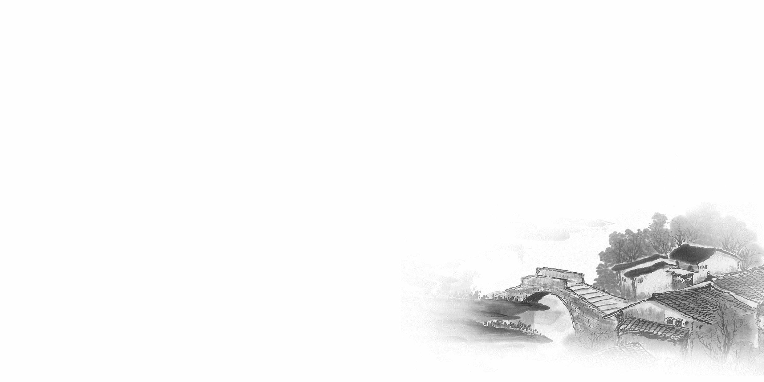

影响听力的因素
心理因素学生在进行听力练习或考试时往往表现为听音时感到紧张、焦虑因而导致无法正常听音。
壹
缺乏背景知识由于没有语言环境，学生很少了解听力材料中的背景知识，无法做出正确的判断、推理、猜测。
贰
叁
学生缺乏听力解题技巧研究发现，很多情况下由于听者未能掌握相关的听力技巧，因而不能很好地理解听力材料。
肆
词汇储备不足一个学生的听、说、读、写要达到一定的水平，必须拥有相应数量的必备词汇。

Slide 4

语音知识对听力的影响
在听力理解的过程中，语音是第一位的，听者首先接受的是语音信息，大脑接受了因素，音节，中音等因素构成的单词，短语和句子后使他们在自己的语言图式中“对号入座”，根据已有的知识结构( 图式 ),开始对该信息进行建构，以理解其意义。

Slide 5
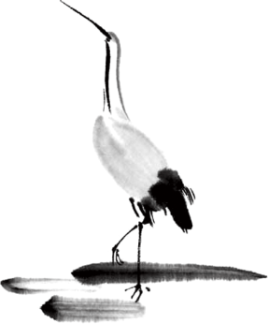
语速的加快主要有一下三种原因
壹
贰
叁
连读
（ 以下用红色标记 )
省音
（ 以下用蓝色标记 ）
音变
（以下用黄色标记 ）

Slide 6


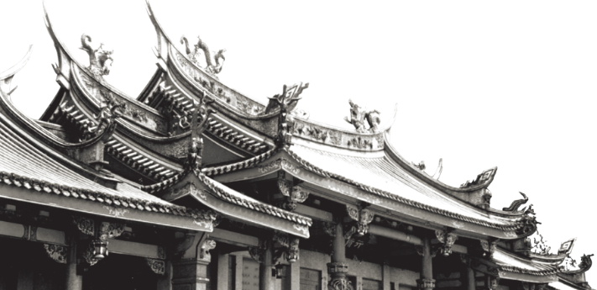
一，连读 （ 以下用红色标记 )
1，“辅音+元音”型连读（异性相吸）
如：I’d like another bowl of rice.
2、“辅音+半元音”型连读英语语音中的/j/和/w/是半元音，如果前一个词是以辅音结尾，后一个词是以半元音，特别是/j/开头，此时也要连读。Thank you .

Slide 7

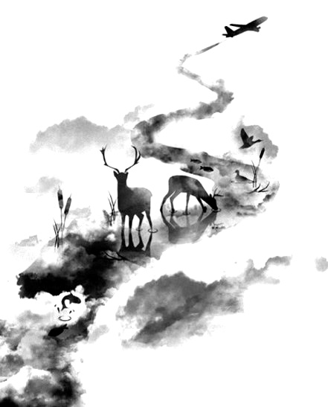

二，省音 （以下用蓝色标记）
01
壹
一、爆破音/b/ /p/ /d/ /t/ /g/ /k/
1.以上任何一个爆破音后面如果紧接着是一个辅音或者半元音，那么这个爆破音将不再发音，仅空半拍就行。如：Good morning!可以发为/gu_'mɔ:niŋ/。
2.以上任何一个爆破音在句尾时，这个爆破音不再发音。如：Good night!最后的/t/音便不再发，整句话可读作/gu_nai_/。

Slide 8
省音 （以下用蓝色标记）
01
二、不完全爆破
① 爆破音中的任何两个爆破音相邻时，前一爆破音失去爆破。如：a big car等。
② 爆破音中的任何一个后接摩擦音f,h,x,sh,s,r时，前面的爆破音失去爆破。
如：I didn't say so.
③ 爆破音后接/t/， /d/， /tr/， /dr /时，前面的爆破音失去爆破。如：a great change等。
④ 爆破音后接/m/, /n/, /l/, /s/时，前面的爆破音失去爆破。如：a bit more expensive等。

Slide 9
省音 （以下用蓝色标记）
01
三、/s/-/z/ /ts/-/dz/ /∫/-/ ʒ / /t∫/-/ dʒ / /θ/-/ ð / ds发/dz以上任何两个音相遇，只读后面的那个音，而前面的音则省略不发。
如：Who is Stone?可把前面一个/z/省掉，只读作/hu i stəun /。

Slide 10
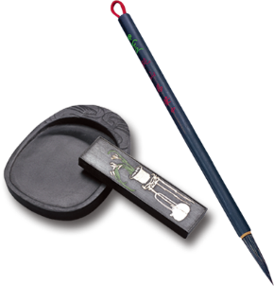
音的变化也是一种连读现象，两个词之间非常平滑的
过渡，导致一个音受临音影响而变化。
主要是以下两种方式：
1、 辅音[d]与[j]相邻时，被同化为[dʒ]：
Would you....?
2、 辅音[t]与[j]相邻时，被同化为[t∫]：
Can’t you？
三，音变
（以下用黄色标记 ）

Slide 11
听力试音材料
M:Hello ! International Friends Club , can I help you ?
W: Oh , hello ! I read about your club in the paper today . And I thought I’d phone to find out a bit more .
M:Yes , certainly . well , we’re a sort of social club for people from different countries . It’s quite a new club .we have about 50 members at the moment but we’re growing all the time .

Slide 12
听力试音材料
W: That sounds interesting .I’m British actually ,and I came to Washington about three months ago ,I’m looking for ways to meet people . . Er ,what kinds of events do you organize ?
M: well , we have social get-togethers ,and sports events ,and we also have language evenings
W: Could you tell me something about the language evenings ?

Slide 13
听力试音材料
M: Yes , every day except Thursday , we have a language evening. People can come and practice their languages .you know , over a drink or something .we have different languages on different evenings . Monday -Spanish; Tuesday- Italian ;Wednesday- German and Friday- French .On Thursday we usually have a meal in a restaurant for everyone who wants to come .

Slide 14
听力试音材料
W:well,that sounds Great , I really need to practice my French .
M: Ok , well if you can just give me your name and address I’ll send you the form and some more information .If you join now ,you can have first month free .

Slide 15
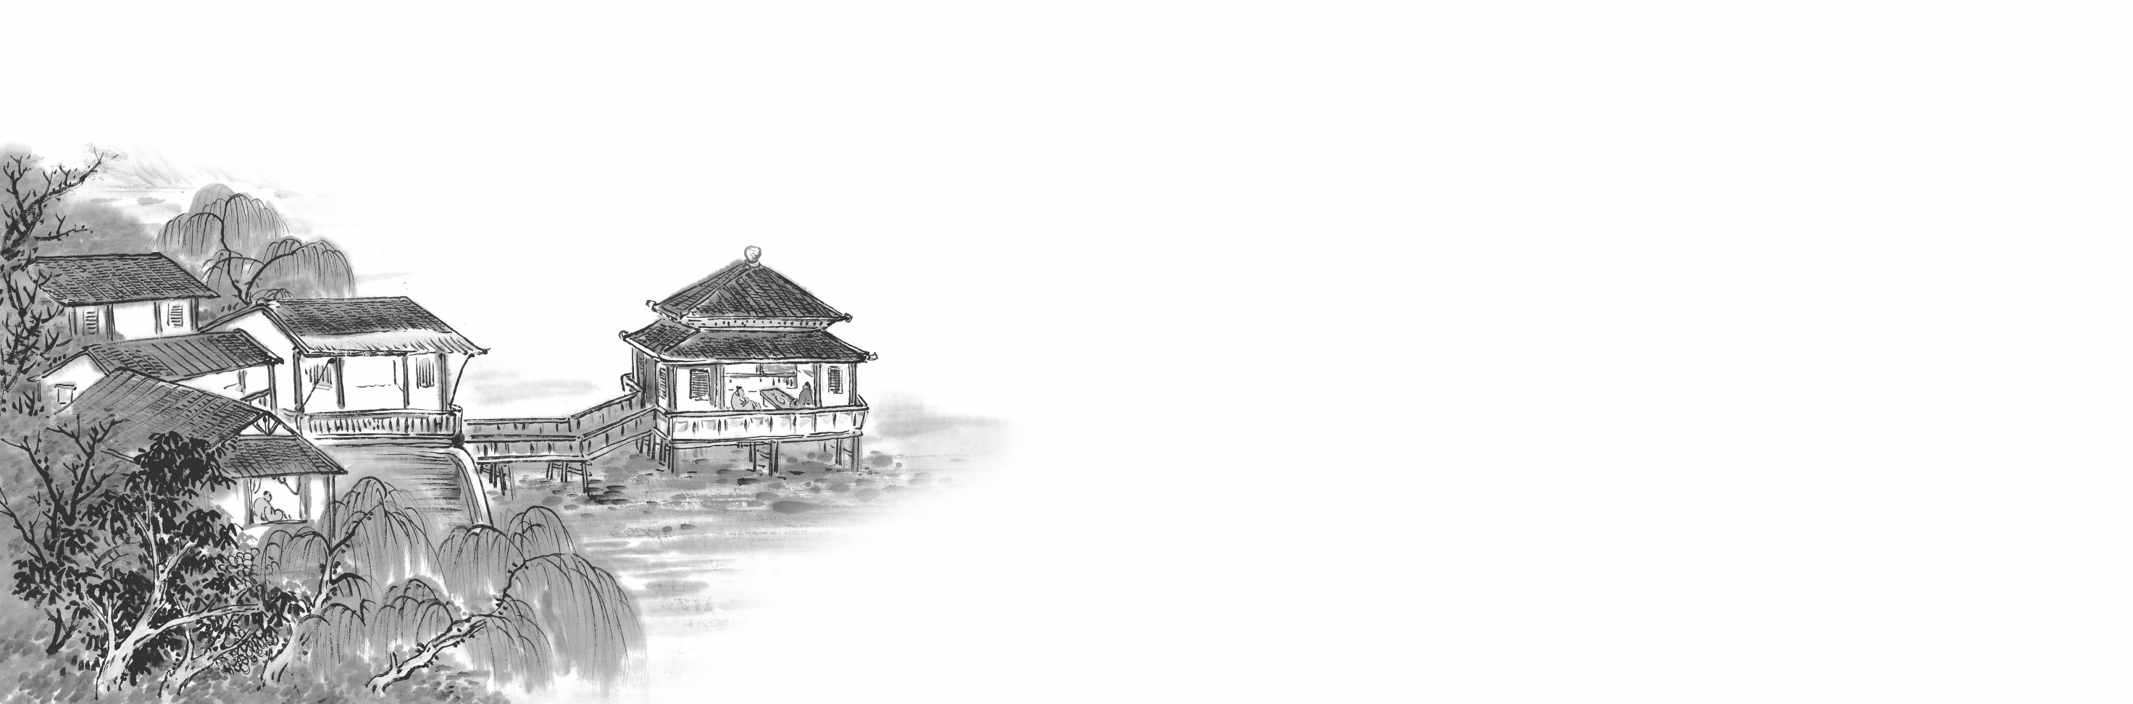

例题
M:Excuse me ,can you tell me how much the shirt is ?
W：Yes, it’s nine-fifteen.
例：How much is the shirt?
A. ￡19.15. B. ￡9.18. C. ￡9.15.

Slide 16
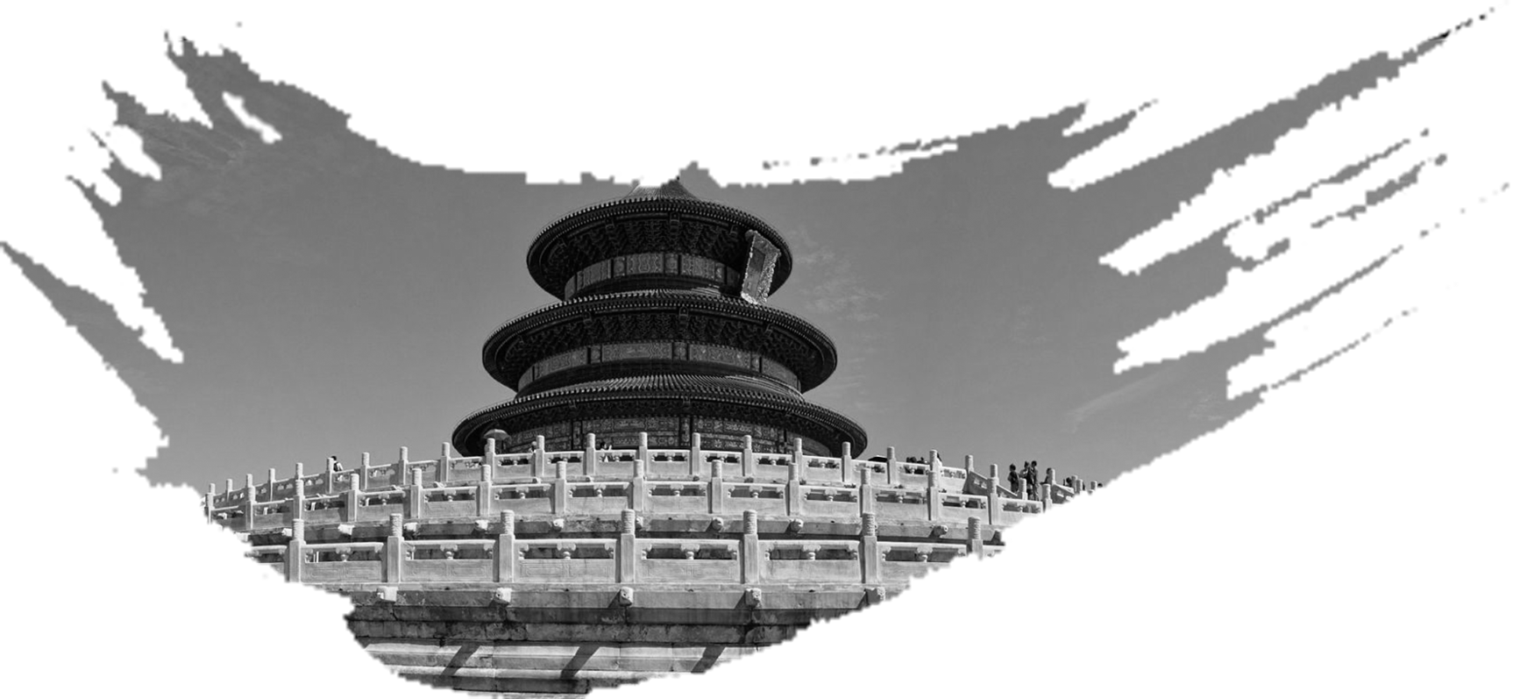

Text 1 34词 请求维修电脑
M: ____ Department. How can I _____ you?
W: My _________ is giving me a lot of trouble. Could you help me with it, please?
M: OK, I just need to _____ _____ a couple of things.
1. What does the man do?
A. A computer technician. B. A hotel receptionist. C. A shop assistant.

Slide 17

Text 1 34词 请求维修电脑
M: IT Department. How can I assist you?
W: My computer is giving me a lot of trouble. Could you help me with it, please?
M: OK, I just need to check on a couple of things.
1. What does the man do?( 推理判断题 ）
A. A computer technician. B. A hotel receptionist. C. A shop assistant.

Slide 18
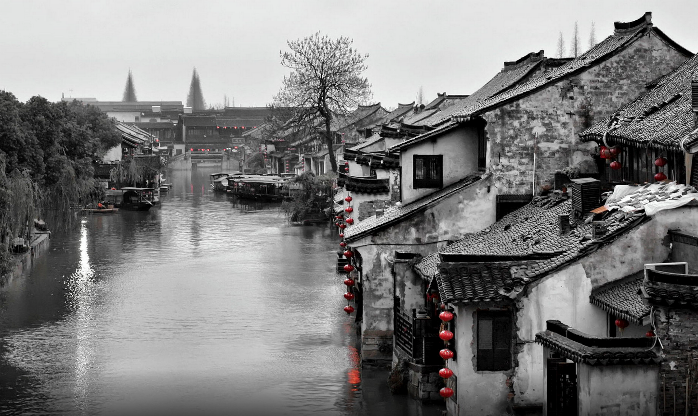
Text 2 29词 洗衣服
——————————
W: Hi, I’d like to have this _____ ______ and ______.
M: OK, but I’m afraid you won’t be able to _____ it until next Friday. We’ve been very busy recently.
2. Where does the conversation take place?
A. At the grocer’s.
B. At the tailor’s.
C. At the cleaner’s.

Slide 19
Text 2 29词 洗衣服
——————————
W: Hi, I’d like to have this blouse washed and pressed.
M: OK, but I’m afraid you won’t be able to collect it until next Friday. We’ve been very busy recently.
2. Where does the conversation take place?( 推理判断题 ）
A. At the grocer’s.
B. At the tailor’s.
C. At the cleaner’s.

Slide 20
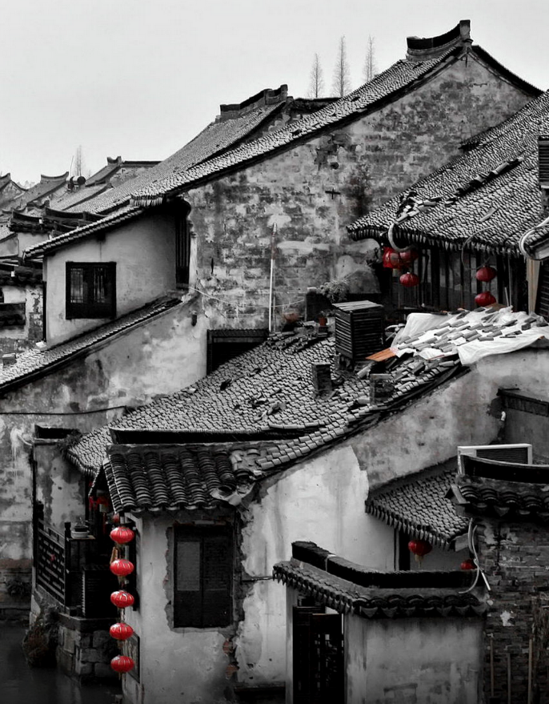
Text 3 36词 出行方式
W: What a journey! ____ travel is more tiring than ______, I’m sure.
M: I don’t think you’d say that, if you’ve just driven 400 miles. Let’s come to Seattle by _____ _____ time. It’ll be more relaxing.
3. How did the speakers come to Seattle?
A. By plane.
B. By car.
C. By train.
天人合一
天 下 皆 知 美 之 为 美 ， 斯 恶 已
皆 知 善 之 为 善 ， 斯 不 善 已
有 无 相 生 ， 难 易 相 成 ， 长 短 相 形
高 下 相 盈 ， 音 声 相 和 ， 前 后 相 随
恒 也

Slide 21
Text 3 36词 出行方式
W: What a journey! Air travel is more tiring than driving, I’m sure.
M: I don’t think you’d say that, if you’ve just driven 400 miles. Let’s come to Seattle by train next time. It’ll be more relaxing.
3. How did the speakers come to Seattle?( 推理判断题 ）
A. By plane.
B. By car.
C. By train.
天人合一
天 下 皆 知 美 之 为 美 ， 斯 恶 已
皆 知 善 之 为 善 ， 斯 不 善 已
有 无 相 生 ， 难 易 相 成 ， 长 短 相 形
高 下 相 盈 ， 音 声 相 和 ， 前 后 相 随
恒 也

Slide 22

T Text 4 37词 商量晚餐吃什么
M: Can I have ____ _____ or ______ for dinner for a change? I don’t feel like _____today.
W: I’m in a hurry. I ____ cook two different meals ____. _______ you can have _____ you _____.
M: Alright.
4. What will the speakers have for dinner today?
A. Fried rice.
B. Noodles.
C. Steak.

Slide 23
T Text 4 37词 商量晚餐吃什么
M: Can I have fried rice or noodles for dinner for a change? I don’t feel like steak today.
W: I’m in a hurry. I can’t cook two different meals today. Tomorrow you can have what you want.
M: Alright.
4. What will the speakers have for dinner today?( 推理判断题 ）
A. Fried rice.
B. Noodles.
C. Steak.

Slide 24
Text 5 33词 Sophie感到焦虑t
M: All well, Sophie?
W: Hmm. ___ _____. I’m just so _____ with writing this report.
M: Are you almost done with it?
W: ____ _____ it. And I’ve got to present it in class tomorrow.
5. How is Sophie feeling now?
A. Confused.
B. Worried.
C. Disappointed.

Slide 25
Text 5 33词 Sophie感到焦虑t
M: All well, Sophie?
W: Hmm. Not great. I’m just so down with writing this report.
M: Are you almost done with it?
W: Far from it. And I’ve got to present it in class tomorrow.
5. How is Sophie feeling now?( 推理判断题 ）
A. Confused.
B. Worried.
C. Disappointed.

Slide 26
Text 6 68词 邮寄生日贺卡
W: Richard, why are you taking everything out of your drawer?
M: I’m looking for a stamp, Sarah.
W: A stamp? What do you want a stamp for?
M: I’ve written a____ to Aunt ____. And I want to put __ in the ___ before _____.
W: Can’t you just email her?
M: Yeah. But it’s___ 70th _____. Vera will be happy to get a real letter with a real birthday card.
6. What does the man want to do before noon?
A. Post a letter. B. Make a card. C. Write an email.
7. Whose birthday is it?
A. Richard’s. B. Sarah’s. C. Vera’s.

Slide 27
Text 6 68词 邮寄生日贺卡
W: Richard, why are you taking everything out of your drawer?
M: I’m looking for a stamp, Sarah.
W: A stamp? What do you want a stamp for?
M: I’ve written a letter to Aunt Vera. And I want to put it in the post before midday.
W: Can’t you just email her?
M: Yeah. But it’s her 70th birthday. Vera will be happy to get a real letter with a real birthday card.
6. What does the man want to do before noon?（ 细节题 ）
A. Post a letter. B. Make a card. C. Write an email.
7. Whose birthday is it? （ 细节题 ）
A. Richard’s. B. Sarah’s. C. Vera’s.

Slide 28
Text 7 74词 申请补考
W: Professor Brooks, I’m Vicky Comore in your _____ ______ _____. Could I speak with you for a few minutes?
M: Sure. What can I help you with?
W: Well, I was ___ for two weeks. So I didn’t ___ the midterm____. Could you give me _____ test?
M: Alright. You can take it next Thursday afternoon.
W: Thank you so much, Professor Brooks. Could I come to you at 3:30 after my English Literature class?
M: No problem.
8. What course does Professor Brooks teach? A. Public Speaking. B. European History. C. English Literature.
9. Why does Vicky come to talk with Professor Brooks?
A. To sign up for his course. B. To ask for a make-up test.
C. To discuss her homework.

Slide 29
Text 7 74词 申请补考
W: Professor Brooks, I’m Vicky Comore in your European History class. Could I speak with you for a few minutes?
M: Sure. What can I help you with?
W: Well, I was sick for two weeks. So I didn’t take the midterm exam. Could you give me another test?
M: Alright. You can take it next Thursday afternoon.
W: Thank you so much, Professor Brooks. Could I come to you at 3:30 after my English Literature class?
M: No problem.
8. What course does Professor Brooks teach?（ 细节题 ） A. Public Speaking. B. European History. C. English Literature.
9. Why does Vicky come to talk with Professor Brooks?( 推理判断题 ）
A. To sign up for his course. B. To ask for a make-up test.
C. To discuss her homework.

Slide 30
Text 8 189词 为戏剧制作服装
M: Linda, you work on plays and shows but you are not on stage. What do you do?
W: I’m a ______ ______. I have the actors become their characters.
M: Is it kind of, like, playing dress-up?
W: A little bit. But I need to study the play to ____ the characters’ ________, not just use my imagination.
M: How do you do that?
W: I read the play and do ____ about the ____ and ____ of the story. If the story is set in the past, I might study old magazines or paintings. For plays set in now, I sometimes collect pictures of people on the street.
M: Then what do you do?
W: I ____ my ____ and ______ to the ______ of the show. We talk about whether I’m on the right track. If it’s good, we will hire a tailor to make the costume.
M: Is it finished then?
W: Almost. We still need to try on the actor to make sure everything fits and looks good.
M: Wow, it takes so many steps to make a costume.
W: Yes, it does. I _____ _____ lots of different_____ to _____ it all _______.

Slide 31
Text 8 189词 为戏剧制作服装
M: Linda, you work on plays and shows but you are not on stage. What do you do?
W: I’m a costume designer. I have the actors become their characters.
M: Is it kind of, like, playing dress-up?
W: A little bit. But I need to study the play to create the characters’ clothes, not just use my imagination.
M: How do you do that?
W: I read the play and do research about the time and place of the story. If the story is set in the past, I might study old magazines or paintings. For plays set in now, I sometimes collect pictures of people on the street.
M: Then what do you do?
W: I take my ideas and pictures to the director of the show. We talk about whether I’m on the right track. If it’s good, we will hire a tailor to make the costume.
M: Is it finished then?
W: Almost. We still need to try on the actor to make sure everything fits and looks good.
M: Wow, it takes so many steps to make a costume.
W: Yes, it does. I work with lots of different people to put it all together.

Slide 32

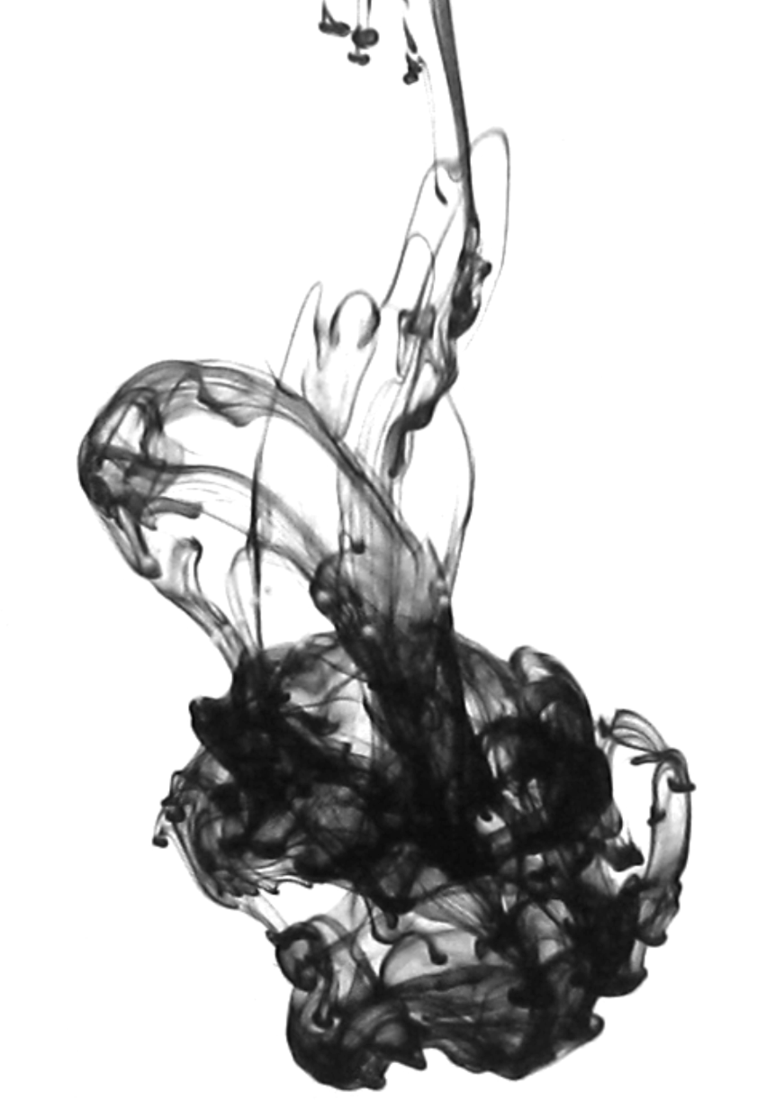
10. What does Linda do for plays and shows?( 推理判断题 ）
A. She gives actors advice.
B. She assigns roles to actors.
C. She designs actors’ clothes.
11. What does Linda need to research?( 推理判断题 ）
A. The setting of the story.
B. The decoration of the stage.
C. The names of the characters.
12. Who does Linda report her work to?（ 细节题 ）
A. The director.
B. The editor.
C. The photographer.
13. What does Linda say about her job?( 推理判断题 ）
A. It pays very well.
B. It requires team effort.
C. It involves frequent travel.

Slide 33
Text 9 185词 讨论一场画展
W: Hi Kevin. I’ve just got back from the Art Gallery. There’s a wonderful show of abstract art. You should have come with me.
M: I don’t know. Abstract art ____ ___ _______ ______ to me.
W: Well, if you don’t understand what the artist is trying to communicate, it can seem a little like that.
M: What did you see then?
W: There were two paintings that impressed me most. The____ was a huge one which I supposed it was a ____ although it could have been anything.
M: What did you like about it?
W: Just the way the tree looked. It was like the ___ was made of ____ _____, and the mix of white and gray made everything look like it was _____, ______ winter.
M: That’s something. What about the other one?
W:The _____ looked like a piece of ______. All the grass was purple and red, and there was _____ sky in the _______. I looked at it and thought of summer.
M: Hmm, your description really teaches me something about appreciating abstract art. Maybe I should ___ and ____ this show a ____ this Saturday.
W: You really should.

Slide 34
Text 9 185词 讨论一场画展
W: Hi Kevin. I’ve just got back from the Art Gallery. There’s a wonderful show of abstract art. You should have come with me.
M: ⑭I don’t know. Abstract art seems like children’s painting to me.
W: Well, if you don’t understand what the artist is trying to communicate, it can seem a little like that.
M: What did you see then?
W: There were two paintings that impressed me most. ⑮The first was a huge one which I supposed it was a tree although it could have been anything.
M: What did you like about it?
W: Just the way the tree looked. ⑮It was like the tree was made of hard metal, and the mix of white and gray made everything look like it was winter, freezing winter.
M: That’s something. What about the other one?
W: ⑯The second looked like a piece of grassland. All the grass was purple and red, and there was green sky in the background. I looked at it and thought of summer.
M: Hmm, your description really teaches me something about appreciating abstract art. ⑰Maybe I should go and give this show a try this Saturday.
W: You really should.

Slide 35
14. What does Kevin think of abstract art?( 推理判断题 ）
A. It has lasting artistic value.
B. It makes little sense to him.
C. It appeals mainly to children.
15. What impression did the first painting give the woman?（ 细节题 ）
A. Hopefulness.
B. Nervousness.
C. Coldness.
16. What color was used for the background in the second painting?（ 细节题 ）
A. Green. B. Purple. C. Red.
17. What will Kevin probably do this Saturday?( 推理判断题 ）
A. Attend an art class.
B. Visit an exhibition.
C. Buy an abstract painting.

Slide 36
Text 10 184词 一则新闻报道
M: You are watching the morning news. This is Steven Johnson. Sydney and the New South Wales coast have been hit by heavy rains. Major roads, the airport, trains and buses were all thrown behind the schedule as more than a month’s worth of rain fell in just one hour during the morning rush. All traffic into city remains very heavy. Pittwater Road is _____ due to a ___ ____. Consider using Wicks Road instead. A police officer has been hurt assisting drivers in North Ryde. A woman is believed to have broken her leg after a tree fell on her car. The ___ of Town Hall Station has ____ ___, causing delays for passengers. The rain is expected to be at its heaviest from 9:00 am until 11:00 am. Today a total of up to 200 millimeters of rain is being forecast, along with damaging winds of more than 90 kilometers per hour to follow. All road users are ____ to _______ the need to be on roads in such wild weather, and _____ their day and continue on their journey _____ the rain_____.

Slide 37
Text 10 184词 一则新闻报道
M: You are watching the morning news. This is Steven Johnson. Sydney and the New South Wales coast have been hit by heavy rains. Major roads, the airport, trains and buses were all thrown behind the schedule as more than a month’s worth of rain fell in just one hour during the morning rush. All traffic into city remains very heavy. Pittwater Road is closed due to a car crash. Consider using Wicks Road instead. A police officer has been hurt assisting drivers in North Ryde. A woman is believed to have broken her leg after a tree fell on her car. The roof of Town Hall Station has fallen in, causing delays for passengers. The rain is expected to be at its heaviest from 9:00 am until 11:00 am. Today a total of up to 200 millimeters of rain is being forecast, along with damaging winds of more than 90 kilometers per hour to follow. All road users are advised to reconsider the need to be on roads in such wild weather, and reschedule their day and continue on their journey after the rain stops.

Slide 38
18. What caused the closure of Pittwater Road?（ 同义转述）
A. A fallen tree.
B. A flooded river.
C. A car accident.
19. What happened at Town Hall Station?（ 同义转述）
A. A police officer got hurt.
B. A passenger went missing.
C. The station roof was broken.
20. What are road users advised to do?( 推理判断题 ）
A. Drive at low speed.
B. Postpone their trips.
C. Follow traffic signs.

Slide 39
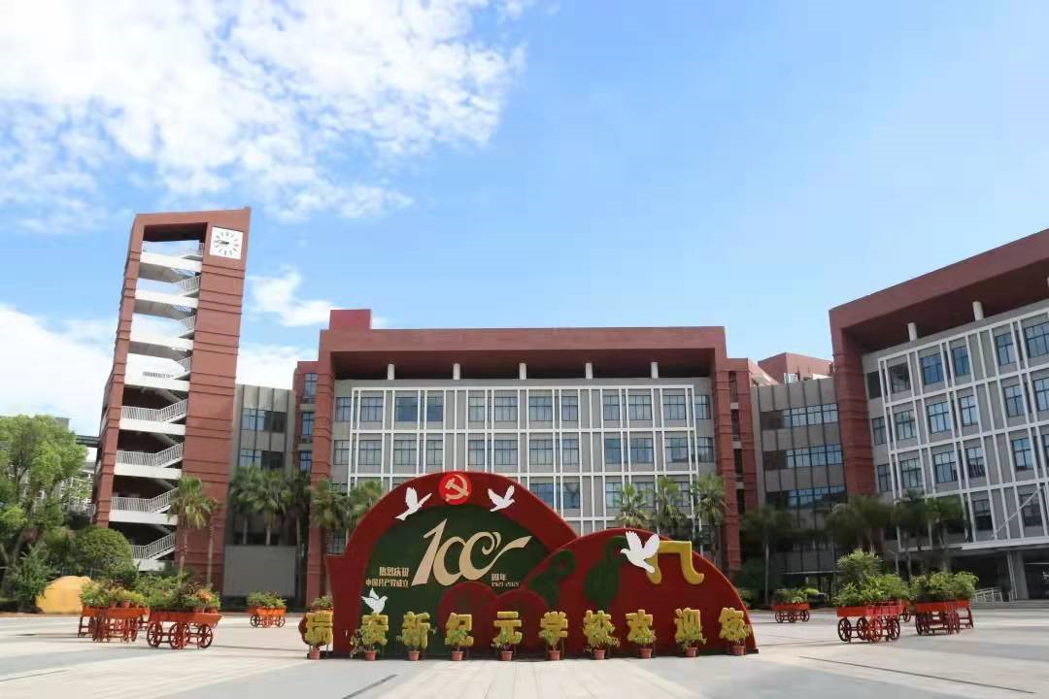
祝各位考生金榜题名！
欢迎指导

