Slide 1


感恩遇见，相互成就，本课件资料仅供您个人参考、教学使用，严禁自行在网络传播，违者依知识产权法追究法律责任。
更多教学资源请关注
公众号：溯恩高中英语
知识产权声明

Slide 2


Teaching Objectives
语言能力
Memorize 5 basic sentence structures.
学习能力
Construct and deconstruct long sentences in tests.
思维品质
Learn to think positively and vice versa.
文化品格
Appreciate the beauty of long sentences.
Distinguish 7 modifiers.
核心素养
Notes:
公开课，需要呈现教学目标，给评委和听课同仁观看。These are the teaching objectives we are going to reach together.

Slide 3
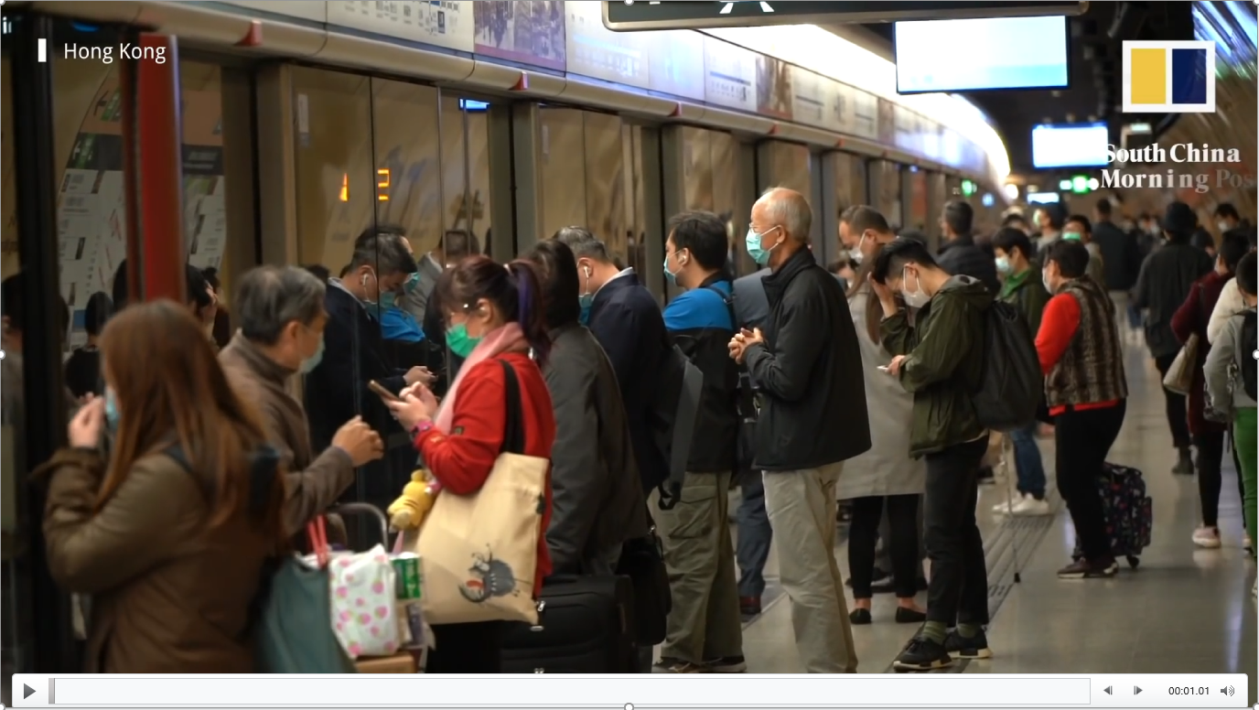
video
Notes:
热身：视频链接时事新闻，引出话题人物。First, let’s watch a piece of news from South China Morning Post.

Slide 4

Notes:
问题，设置悬念。Who is he?

Slide 5
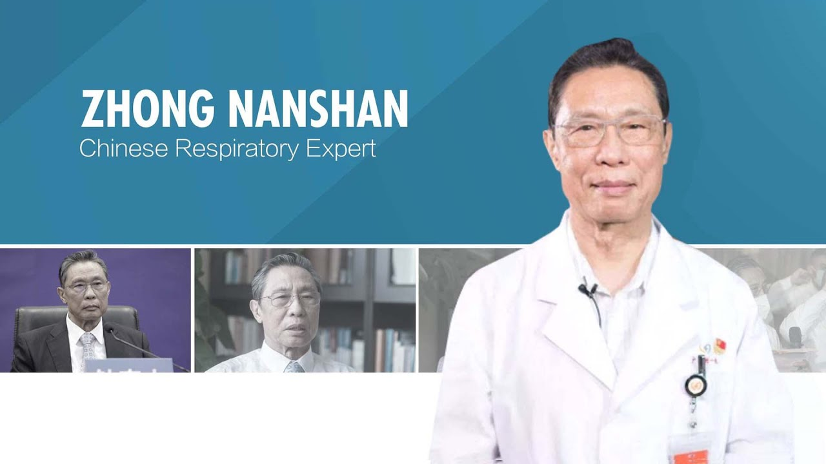
He is Zhong Nanshan, …
job:
doctor
education:
Beijing Medical University
hometown: Xiamen, Fujian
achievements:
SARS (2003)
COVID-19
He is Zhong Nanshan,________________________________
He is Zhong Nanshan, an extremely excellent doctor graduating from Beijing Medical University, whose hometown is Xiamen, Fujian, leading the fights against SARS in 2003 and COVID-19 pandemic.

Slide 6
He is Zhong Nanshan, an extremely excellent doctor graduating from Beijing Medical University, whose hometown is Xiamen, Fujian, leading the fights against SARS in 2003 and COVID-19 pandemic.
S
N
Z
is
He
COVID-19 pandemic
and
2003 in
against SARS
Fujian, Xiamen is hometown whose
leading the fights
graduated from Beijing Medical University
excellent
doctor an
extremely

Slide 7
How to Construct and Deconstruct
A Long Sentence?

Slide 8

CONTENTS
1
Basic sentence structures
2
Construction of long sentences
3
Deconstruction of long sentences
Authentic practice
4

Slide 9
Basic sentence structures
基 本 句 型
1

Slide 10
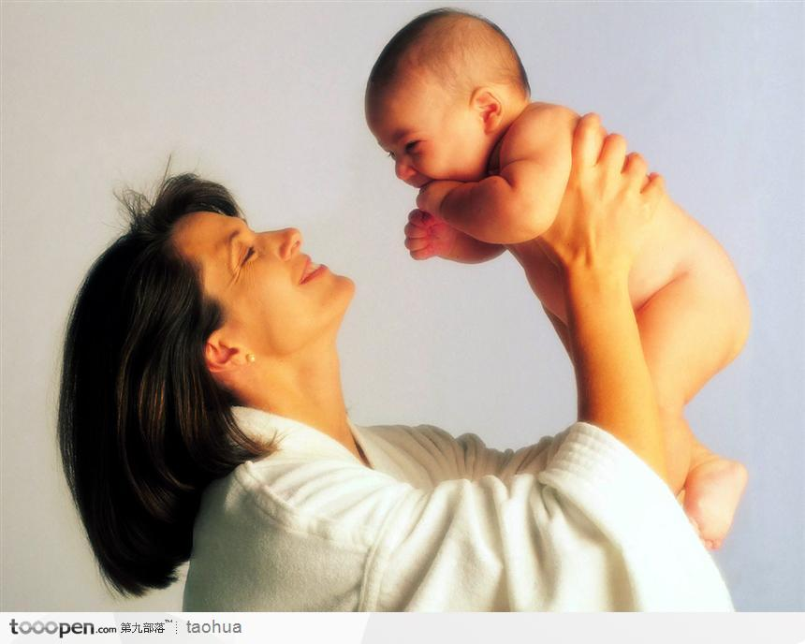
Five Basic Sentence Structures
1. 主谓S.V.: You come.
2. 主谓宾S.V.O.: I love you.
3. 主谓宾宾S.V.O.O.: I give you my heart.
4. 主谓宾补S.V.O.C.: I make you happy.
5. 主系表S. Linking-V. P.: You are my everything.

Slide 11
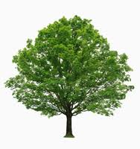
Every sentence is a tree.
宾
宾
谓
主
补
宾
谓
主
宾
谓
主
表
系
主
谓
主
English sentence forest

Slide 12
2
Construction of Long Sentences
长 句 建 构

Slide 13
主系表
副词
形容词
He is Zhong Nanshan, an extremely excellent doctor graduating from Beijing Medical University, whose hometown is Xiamen, Fujian, leading the fights against SARS in 2003 and COVID-19 pandemic.
名词
短语
从
句
介词
短语
非谓语
短语
介词短语
并
列
非谓语
短语
名词短语
“3短2词并列从句”

Slide 14
句子=主干+修饰语
…
谓
主
3
短
从句
2
词
非谓语短语
并列
介词短语
副词
名词短语
形容词

Slide 15
3
Deconstruction of Long Sentences
长 句 解 构

Slide 16

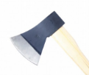
句子=主干+修饰语
…
谓
主
从句
非谓语短语
并列
介词短语
副词
名词短语
形容词

Slide 17
括号化简法
He is Zhong Nanshan, an extremely excellent doctor graduating from Beijing Medical University, whose hometown is Xiamen, Fujian, leading the fights against SARS in 2003 and COVID-19 pandemic.
First, draw brackets of (adjectives, adverbs, noun phrases, preposition phrases, non-predicate phrases, clauses) and square the conjunctions.
Then, delete all of the elements.
Lastly, underline the main sentence.
“3短2词并列从句”

Slide 18
Authentic practice
真 题 演 练
4

Slide 19
2019年全国卷I 语法填空
“3短2词并列从句”
noting
Scientists have responded by 67 (note) that hungry bears may be congregating (聚集) around human settlements, leading to the illusion (错觉) that populations are 68 (high) than they actually are.
从句
higher
(26 words)

Slide 20
2018年全国卷I 阅读理解C篇
“3短2词并列从句”
In recent centuries, trade, industrialization, the development of the nation-state and the spread of universal compulsory education, especially globalization and better communications in the past few decades, all have caused many languages to disappear, and dominant languages such as English, Spanish and Chinese are increasingly taking over. (47 words)

Slide 21
2018年全国卷I 七选五
“3短2词并列从句”
38 . They’re the little spots of color like throw pillows, mirrors and baskets that most of us used to add visual interest to our rooms. Less tiring than painting your walls and less expensive than buying a colorful sofa, small color choices bring with them the significant benefit of being easily changeable. (24+27 words)
D. Small color choices are the ones we’re most familiar with
E. It’s not really a good idea to use too many small color pieces
not

Slide 22
2018年全国卷I 完形填空
“3短2词并列从句”
In order to __50__ the class, among other criteria, we had to write a paper on how we plan to __51__ what we would learn in class to our future professions and __52__ to our lives. (36 words)
50. A. attend B. pass C. skip D. observe
51. A. add B. expose C. apply D. compare
52. A. eventually B. naturally C. directly D. normally
apply … to …
apply (clause) to A and B

Slide 23
2018年全国卷I 书面表达
“3短2词并列从句”
(In addition), (if I were you), I would bring some appropriate gifts (along with me) (when I pay a visit to my Chinese friends), (such as very classic and meaningful souvenirs) (bought) (from my own country), (in order to express my heartfelt gratitude) (towards them). ( 45 words)
假如你是李华，你的新西兰朋友Terry将去中国朋友家做客，发邮件向你询问有关习俗，请你回复邮件，内容包括：
1. 到达时间
2. 合适的礼物
3. 餐桌礼仪
介词短语
从句
His/Her sentence contain(s)… | Evaluation (Please tick “√”)
 | 6 | 5 | 4 | 3 | 2 | 1
a complete simple sentence. |  |  |  |  |  | √
preposition phrases. |  | √
non-predicate phrases. |  |  |  |  |  | √
clauses. |  |  |  |  |  | √
adjectives. | √
adverbs. |  |  |  |  |  | √
parallel structures. |  |  |  |  |  | √
example(s) |  |  |  |  |  | √
形容词
副词
从句
I would bring some gifts……..
并列结构
介词短语
从句
非谓语短语

Slide 24
SUMMARY
Create
Evaluate
Analyze
Remember
Apply
Understand
Designed and constructed your writing sentences.
Evaluated your peer’s writing based on the criteria.
Bloom’s Taxonomy of Learning (2001)
Examined the authentic test in NMET 2018/2019.
Deconstructed long sentences in a new way.
Classified and recognized 7 modifiers.
Recalled 5 basic sentence structures.

Slide 25
名词
短语
介词短语
非谓语短语
副词
形容词
从句
并列
主谓…

Slide 26


长句不一定是难句，长难句可长可难，特殊句式的短句也可能是难句，不在本文讨论范围之内。
“三短两词并列从句”不是灵丹妙药，并非可套用于所有类型的长难句，但是，总结的这个“技巧”对大部分结构较规律的长句进行解构和建构十分见效，前提是基本功要扎实。

Slide 27

Compulsory tasks:
Review the construction and deconstruction of a long sentence.
Decode the long sentences in any test to solve your puzzles.
Optional task:
Polish your composition using at least three long sentences.

Slide 28


