Slide 1


感恩遇见，相互成就，本课件资料仅供您个人参考、教学使用，严禁自行在网络传播，违者依知识产权法追究法律责任。
更多教学资源请关注
公众号：溯恩高中英语
知识产权声明

Slide 2

Phyllis
Huzhou No.5 High School

Slide 3
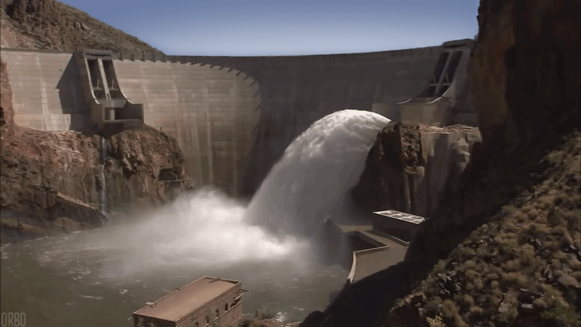

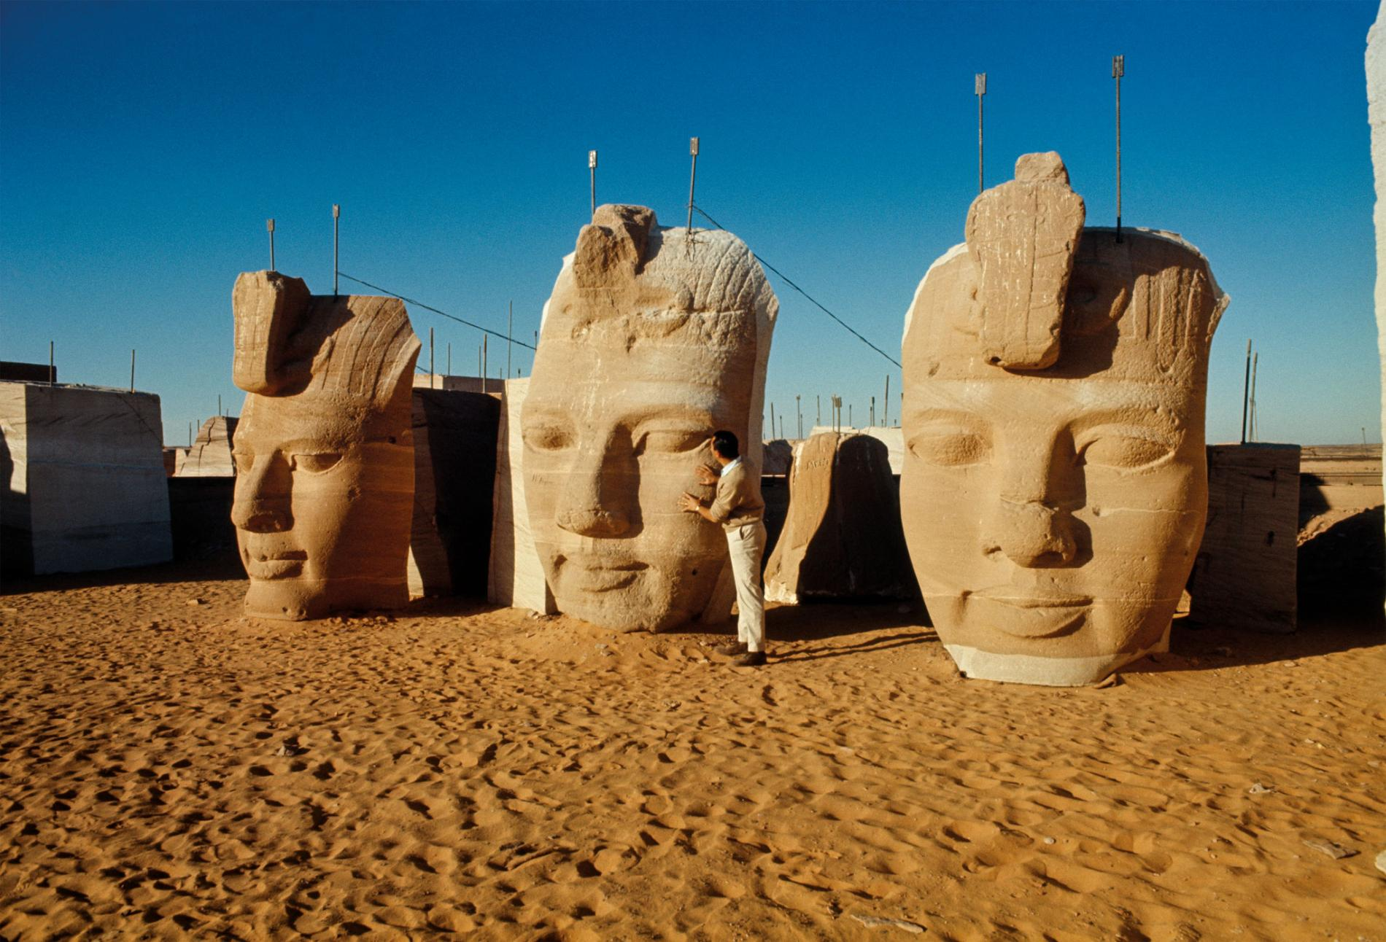
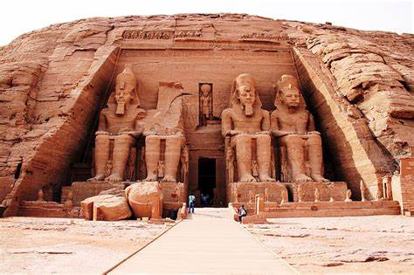
From Problems to Solutions

Slide 4
Problems
Solutions

Slide 5
Para. 1
Balance?
Problem?
Progress of society
Protection of the cultural sites

Slide 6

Para. 2
Think–pair-share
Q1:Why did the government make the proposal?
In order to control floods, produce electricity and supply water.
Q2: Why did the proposal lead to protests?
Because the water from the dam would likely damage a number of temples and destroy cultural relics.
Q3: What did the government do then?
After listening to …, the government turned to the United Nations for help in 1959.
a good listener
government
a “government of action”

Slide 7
Paras. 1-2
Tip 1: Writing a transitional sentence can build a bridge between paragraphs
Economic development is necessary if we want to improve society. There comes a time when the old must give way to the new, and it is not possible to preserve everything from our past as we move towards the future. Finding and keeping the right balance between progress and the protection of cultural sites can be a big challenge.
Big challenges, however, can sometimes lead to great solutions. In the 1950s, the Egyptian government wanted to build a new dam across the Nile in order to control floods, produce electricity, and supply water to more farmers in the area. But the proposal led to protests. Water from the dam would likely damage a number of temples and destroy cultural relics that were an important part of Egypt’s cultural heritage. After listening to the scientists who had studied the problem, and citizens who lived near the dam, the government turned to the United Nations for help in 1959.

Slide 8
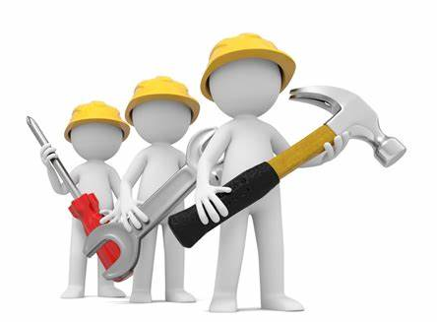

Paras. 3-4
Think-cooperate-present
Student A: Who/What was/were involved?
government; the UN
1959
From 1959 to 1960
1960
1961
Over the next 20 years
1980
Asked for help
Student B: What happened?

Slide 9
Paras. 3-4
governments; environmentalists;
thousands of engineers;
workers;
fifty countries
80 million dollars
committee；
funds；
experts；
test
document；the work
German engineers
government; the UN
Tip 2: Making a timeline can help you understand how the events are connected to each other
all of them
1959
From 1959 to 1960
1960
1961
Over the next 20 years
1980
established;
raised；
investigated;
conducted;
asked for help
signed；
began
moved
rescued
ended

Slide 10

The Aswan Dam Project is not only a project of building the dam and protecting cultural sites, but also a project of …?

Slide 11

Paras. 5-6
Create-pair-share
1 or 2 questions you would like to ask | Your answers
…? …? | … …
Possible questions:
Q1: What is the significance of the great success?
Q2: Why does the author say the best example is shown by UNESCO?
…
Tip 3: Asking a question can help you have a better understanding of a paragraph/passage.

Slide 12
Problems
Solutions
a great success
a living spirit

Slide 13
Title From Problems to Solutions:
Subtitle _______________________________
Building a balance between social development
and cultural heritage protection
Tip 4: Creating a subtitle to offer readers a further explanation of the topic.

Slide 14
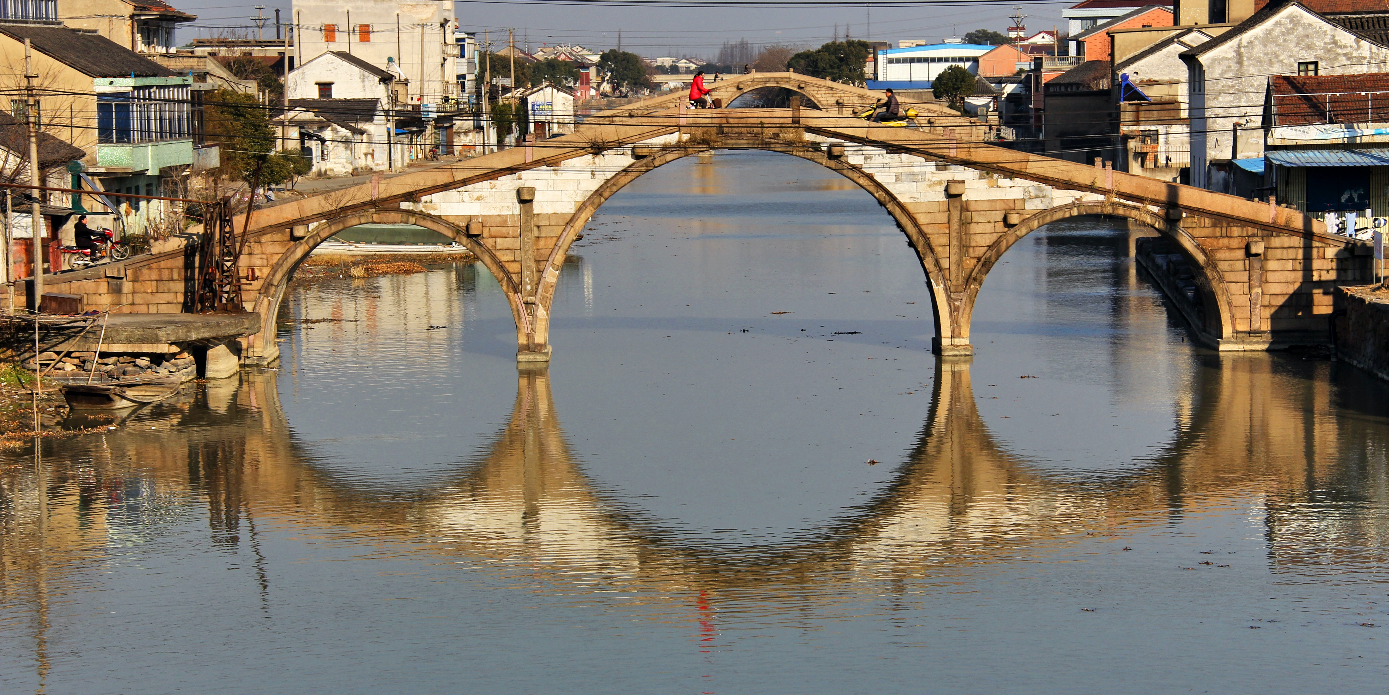

What if the cultural relics can not be moved?
Shuanglin Three-Bridge Relics
A National Historical and Cultural Site

Slide 15
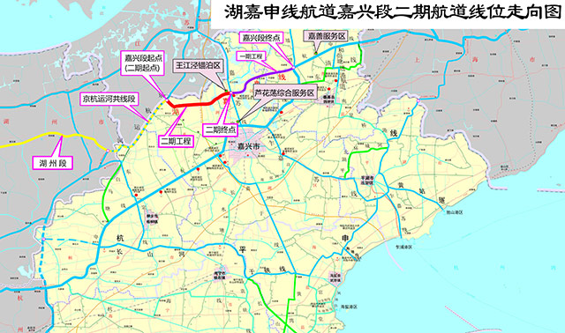
The route (航道) of the New Beijing-Hangzhou Grand Canal (新京杭大运河)

Slide 16
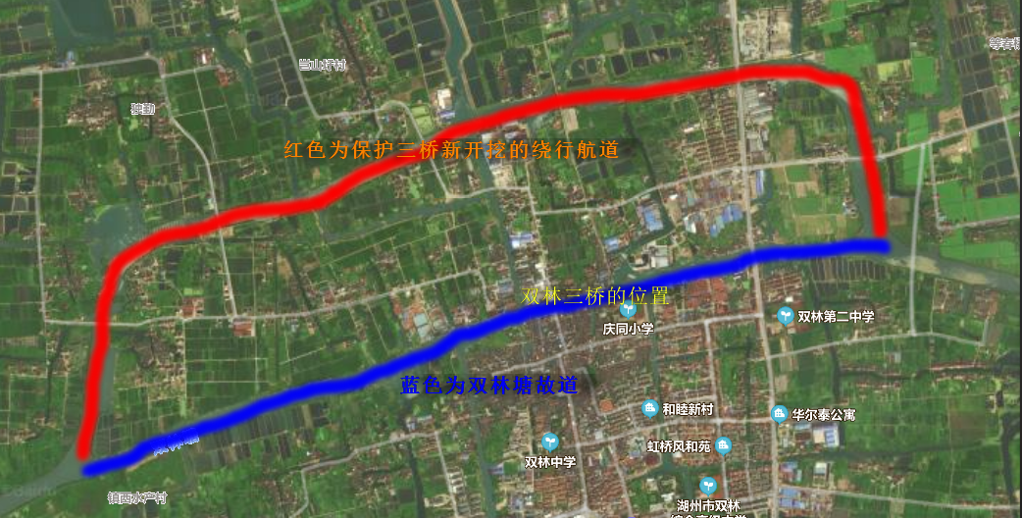
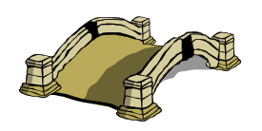
80 million yuan was added to the big change
Worthwhile?

Slide 17

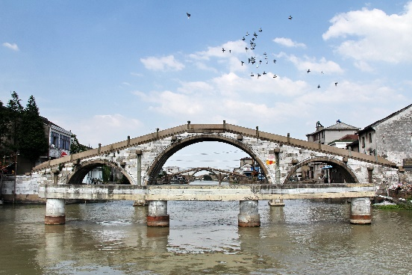
Read-share-explore
The project is also said to be a successful example of finding and keeping the right balance between progress of economy and protection of local historical and cultural relics.
Q: Why was the project successful?

Slide 18
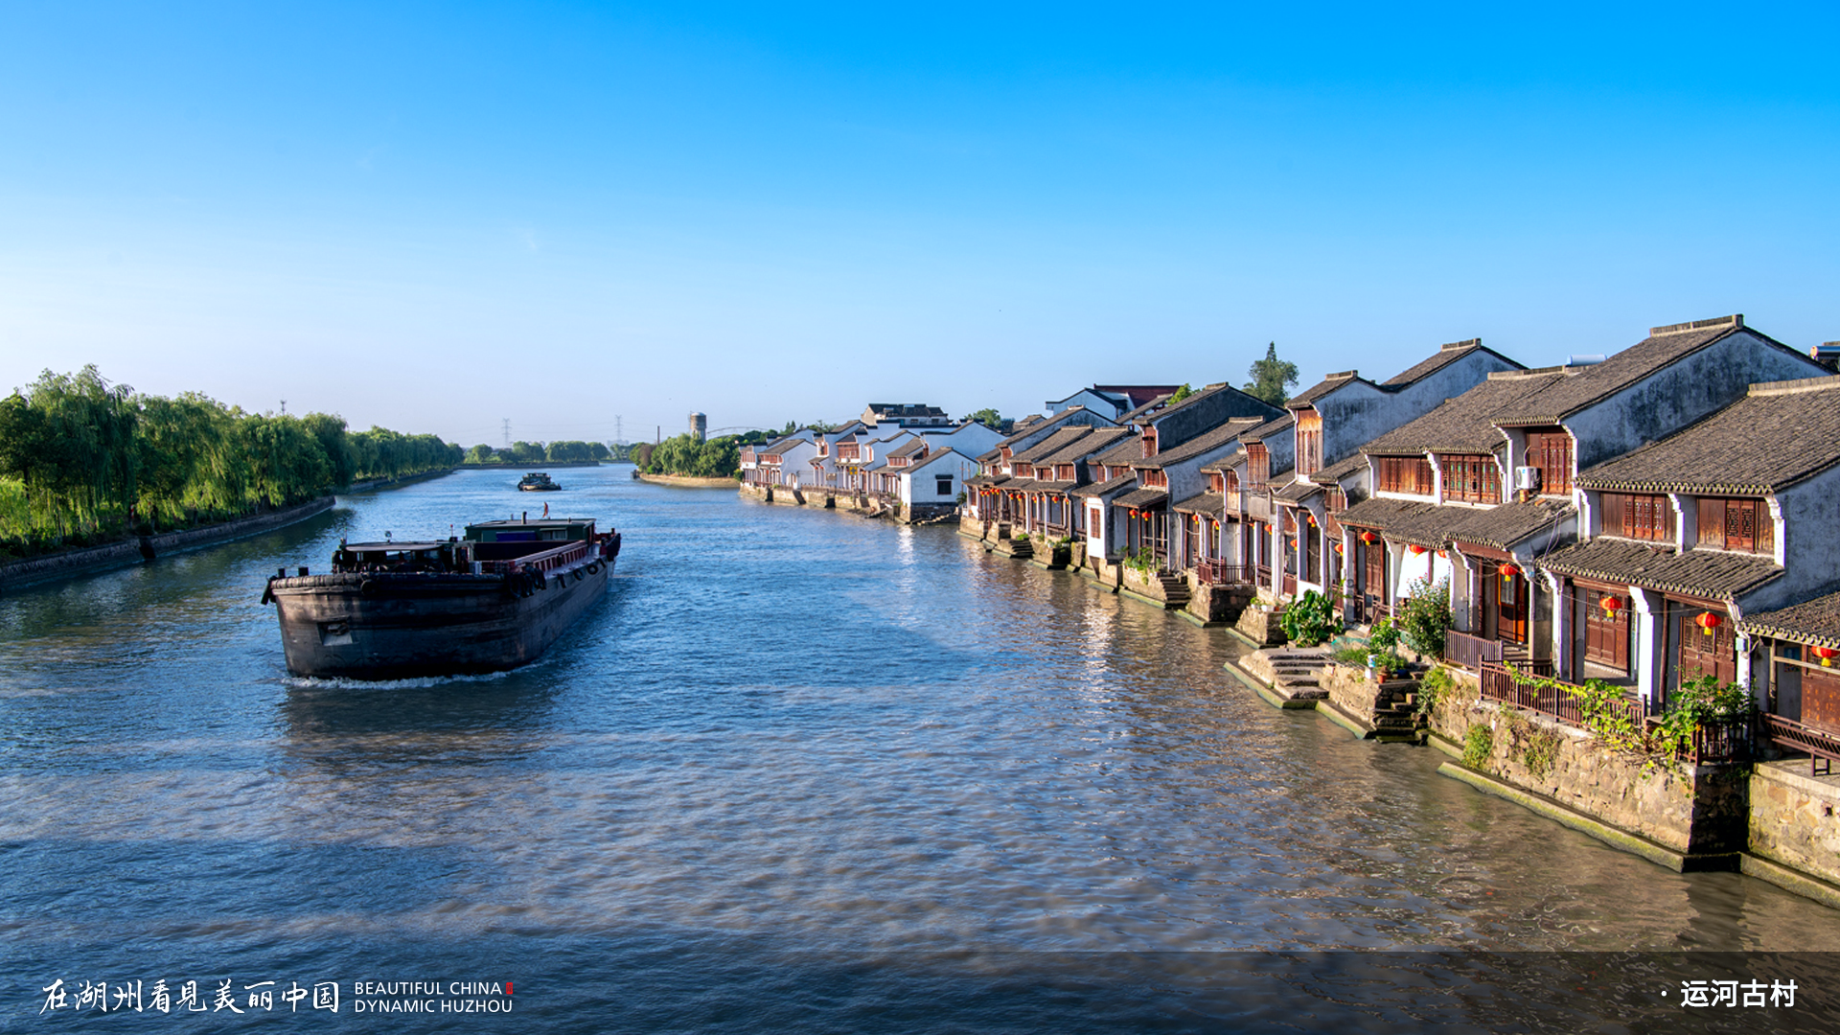
Beautiful China
Dynamic Huzhou
Historical and cultural heritages are irreplaceable precious resources, and protecting them should always be put in the first place in economic development.
—President Xi

Slide 19

Assignments
Finish your K-W-L Charts;
Suppose there will be a “History and Culture Week” in your school, please prepare a speech under the topic of the balance between progress of society and protection of historical and cultural relics.

Slide 20


