Slide 1

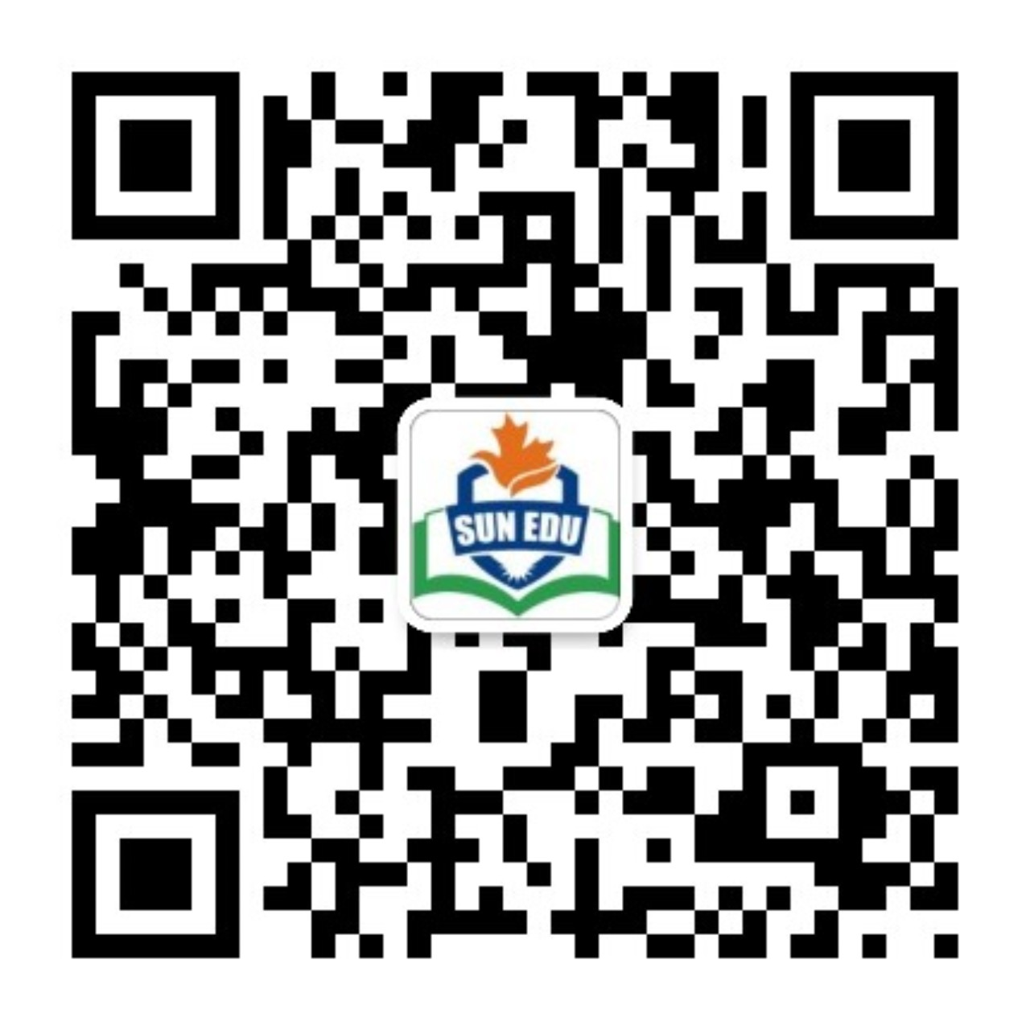
感恩遇见，相互成就，本课件资料仅供您个人参考、教学使用，严禁自行在网络传播，违者依知识产权法追究法律责任。
更多教学资源请关注
公众号：溯恩英语
知识产权声明

Slide 2
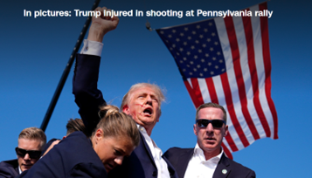
从“特朗普遇刺”
学习新闻报道和感谢信
—— 刘艳

Slide 3
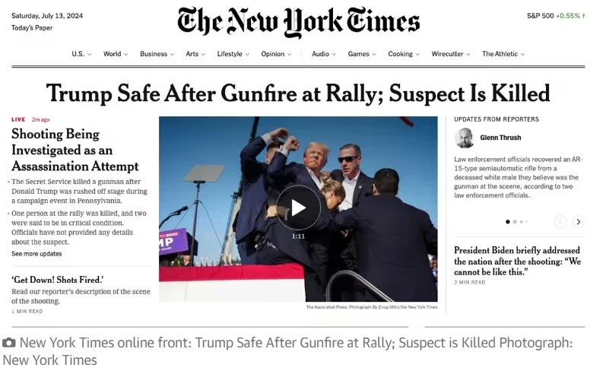
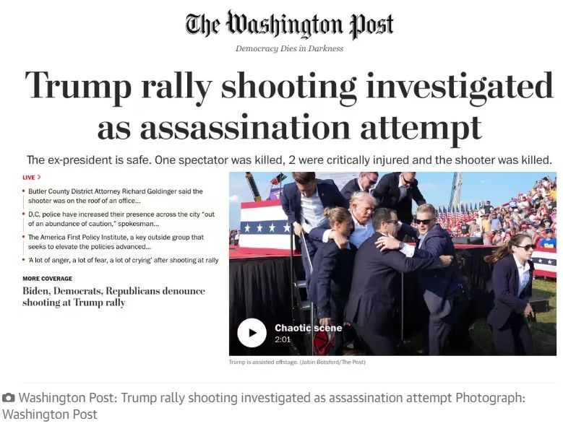
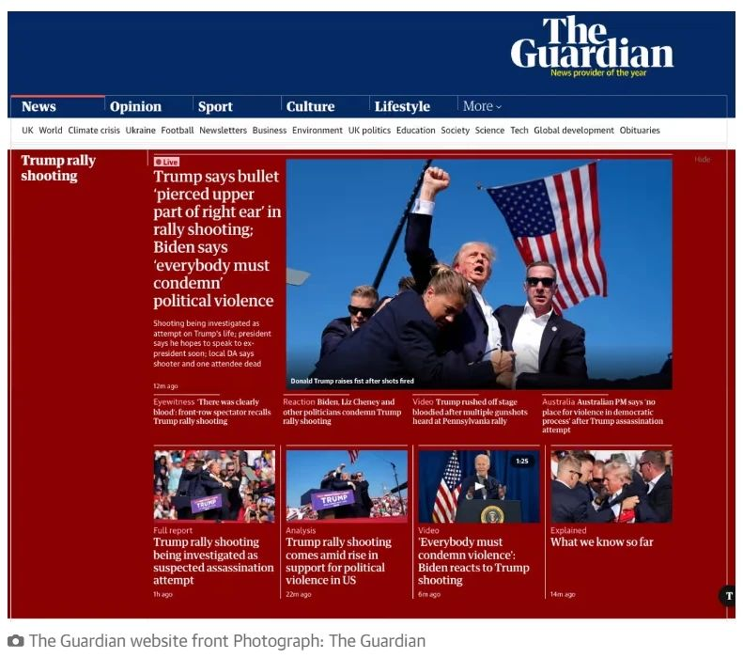
The suspected assassination attempt（刺杀） of Donald Trump during a Republican campaign rally（竞选集会）on Saturday in Pennsylvania immediately made headlines（成为头条新闻）across the US and internationally.

Slide 4
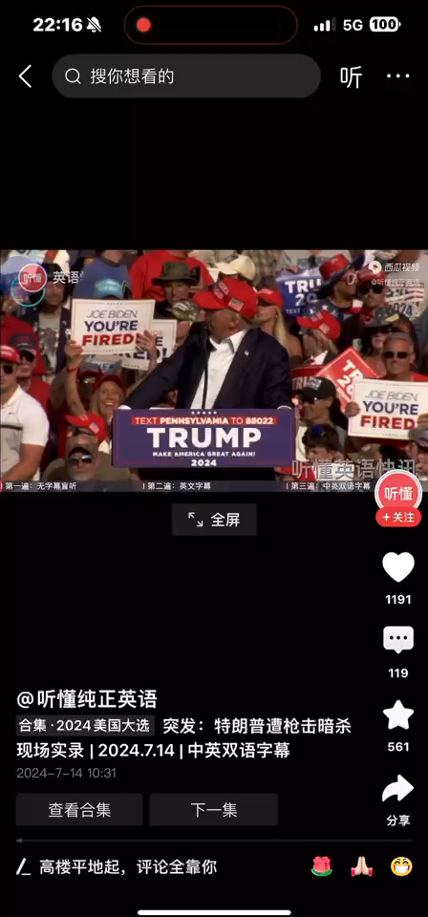

Slide 5





Slide 6
感谢信结构
01
写出写信目的（表达谢意）、简述感谢原因
02
细述道谢的具体事情。
03
再次阐述谢意，并表达回报愿望

Slide 7
目的（表达谢意）、简述感谢原因
I want to thank The United States Secret Service, and all of Law Enforcement, for their rapid response on the shooting that just took place in Butler, Pennsylvania. Most importantly, I want to extend my condolences (慰唁) to the family of the person at the Rally (集会) who was killed, and also to the family of another person that was badly injured.
It is incredible that such an act can take place in our Country. Nothing is known at this time about the shooter, who is now dead. I was shot with a bullet that pierced (穿透) the upper part of my right ear. I knew immediately that something was wrong in that I heard a whizzing sound, shots, and immediately felt the bullet ripping through the skin. Much bleeding took place, so I realized then what was happening.
GOD BLESS AMERICA!
我要感谢美国特勤局和所有执法部门刚刚在宾州巴特勒发生的枪击事件中做出的迅速反应。
最重要的是，我想向集会上遇难者的家属以及另一名重伤者的家属表示哀悼。
令人难以置信的是，这样的行为竟然会在我们国家发生。目前尚不清楚枪手的信息，他现已死亡。我被一颗子弹射中了右耳上部。我立刻意识到有什么不对劲，因为我听到嗖嗖的声音和枪声，立刻感觉到子弹划破了皮肤。出了很多血，我意识到出状况了。
上帝保佑美国！
细述道谢的具体事情
再次阐述谢意

Slide 8
高考真题：（2019 浙江卷6月）
假定你是李华，经常帮助你学习英语的朋友Alex即将返回自己的国家。请给他写一封邮件，
内容包括：1.表示感谢；2.回顾Alex对你的帮助；3.临别祝愿。
Dear Alex,
Having learnt that you will return to your country, I am writing to express my gratitude for what you have done for my English improvement during your stay here.
Had it not been for your assistance, I couldn’t have achieved such tremendous improvement in English. It is you that squeezed time from your tight study schedule to help me practise oral English and take me to English corner regularly, through which my English communication ability developed to a large extent. What you also did for me is frequent and detailed introduction of western culture, leading to my extended knowledge of foreign cultures and broadened horizon.
Words fail to deliver my appreciation. I sincerely wish you a safe trip back and promising future ahead.
Yours
Li Hua

Slide 9
感谢信
【常用词汇】
“真诚的;由衷的” sincere, heartfelt, earnest, deepest
“感谢” v. thank, appreciaten，
n. thanks, appreciation, gratitude
“感谢” adj. thankful; grateful; appreciative; indebted
“因...而感激某人”
1. thank sb for (doing) sth
2.appreciate one’s doing sth
3.be thankful/grateful to sb for (doing) sth
4.express my thanks/gratitude to sb for (doing) sth
5.owe sb a lot for (doing) sth
6.be indebted to sb for(doing) sth
感谢信开头常用句式:
① I am writing to express my sincere/earnest thanks for....
② I would like to convey/extend/express in this letter my heartfelt gratitude to you for...
③ With deepest gratitude, I am writing this letter to you for ....
④ I would like to take this opportunity to express my great appreciation for your timely support.
中段常用句式：
① It was kind/thoughtful (adj.考虑周到的) of you to do sth
② Thank you very much for your kind hospitality (n.好客;款待) and the honor you showed me during my visit to+地点
③ It was because of your kind help/care/encouragement that I.......(强调句型)
④ If it had not been for your (help/guidance/assistance), I wouldn’t have done sth (if虚拟语气的省略倒装)如果没有你的（帮助/指导/帮助），我就不会....
= Had it not been for your (help/guidance/assistance), I wouldn’t have done sth
⑤ But for/Without your timely help, I wouldn’t have done sth(虚拟语气)
⑥ In acknowledgement of(为了感谢) your valuable help, I....
结尾常用句式：
① My true gratitude is beyond the words’ description.
言语无法表达我真正的感激之情。
Words fail to express my gratitude deep in my heart.
② Please accept my sincere thanks for your help, which I will never forget.
③ Nothing could ever return the favor you gave me.
你给我的恩惠是无法回报的。
④ Please don’t hesitate to let me know if there is anything I could do to pay you back(回报).
⑤ Please have no hesitation in writing to me should you want (虚拟语气倒装) me to do something for you help.

Slide 10
新闻报道
01
导语 集中阐释所报道事件的来龙去脉
02
主体 详细叙述所报道事件的起因、经过和结果
03
结语 对该事件进行简要总结或评论

Slide 11
创作练习：假如你是学校英文报编辑，请根据视频内容写100字新闻报道。
提示：美国时间7月13日傍晚6时左右，在美国乡村歌手李·格林伍德的爱国歌曲《上帝保佑美国》的旋律下，特朗普走进位于宾夕法尼亚州巴特勒市的一座农场发表演）。6时12分左右，，现场响起“砰、砰、砰”几次枪声。特朗普旋即捂住右耳，蹲下寻求演讲台的掩护。几秒钟后，几名安保人员上前，用身体护住了特朗普并检查他的伤势。特朗普身后的部分观众也已经蹲下，人群中传来持续的尖叫声。集会现场有一名1名观众死亡，2名观众受重伤。
A shocking incident occurred on the evening of July 13th in the US. Trump was giving a speech at a farm in Butler, Pennsylvania, when gunshots were fired, causing chaos and panic.Donald Trump was delivering a speech at a farm in Butler, Pennsylvania, when gunshots were discharged, instigating chaos and panic.
At approximately 6 p.m., Trump made his entrance accompanied by patriotic music. At 6:12 precisely, gunshots resounded. Trump promptly covered his right ear and sought refuge behind the podium. Security personnel rushed forth to shield him and assess his condition. One audience member tragically lost their life, and two others sustained severe injuries.
The incident has drawn global attention to the US general election.

Slide 12
(2020山东高考真题) 假定你是李华, 上周日你校举办了5公里越野赛跑活动，请你为校英文报写一篇报道。内容包括：
1. 参加人员；
2. 跑步路线：从校门口到南山脚下；
3. 活动反响。
A Cross-Country Running Race
Last Sunday witnessed an extraordinary cross-country running race, which nearly drew the attention of every student and teacher of our school.
The students selected from every class took part in the competition. The route measured five kilometers, from our school gate to the foot of Nanshan Mountain. Every runner tried their best to finish the task, with their classmates along the way giving them necessary help as well as encouragement. At last, all the runners managed to arrive at the finish line, receiving cheers from all the directions.
The activity was highly spoken of, because not only did it provide chance for us to exercise, but also made us more cohesive.

Slide 13
2023年1月 浙江高考
上周末你参加了校学生会组织的“认识我们身边的植物”活动。请为校英文报写篇报道，内容包括：
1. 活动的过程；
2. 收获与感想。
Getting to Know the Plants Around Us
Last weekend witnessed an activity themed “Getting to Know the Plants Around” organized by the Student Union, which is available to all students, in order to enrich our school life and stimulate our interest in nature.
A local botanist’s lecture on the characteristics of several plants around us acted as a curtain-raiser to the activity, which made us realize in amazement that knowledge could be imparted in such an intriguing way. Then, We were asked to walk around the campus to identify the plants and take photos. A competition was held as well to consolidate what we learned.
The activity greatly won our favor. Apart from providing a chance to relax us physically and mentally, it also helped us deepen our insight into the plant world.

Slide 14
活动类的新闻报道模板
__________(时间) witnessed an activity themed/titled “__________(主题)” organized by __________(主办方)， which is available to __________(参与者)， with the intention of/for the purpose of _________(目的). (活动概述)Initially, the activity kicked off as scheduled at ____________(时间) in/on the ____________(地点). Participants who were interested in.............(活动过程)It was through this rewarding experience that we gained an in-depth understanding of __________. Having received many positive feedbacks, the activity turned out to be a enormous success! (活动评价)

Slide 15
Thanks

