Slide 1
感恩遇见，相互成就，本课件资料仅供您个人参考、教学使用，严禁自行在网络传播，违者依知识产权法追究法律责任。
更多教学资源请关注
公众号：溯恩高中英语
知识产权声明

Slide 2
1. 学 科：英 语
2. 年 级：高 一
3. 教材信息：新教材人教版必修二
4. 单元章节：Unit 5
5. 主题语境：Music
6. 单 位：嵊州市高级中学
7. 教师姓名：尹 娟

Slide 3
Music

Slide 4
Warm up & lead in
What can music bring for us?
keep us company
give us courage and power
make us relaxed and peaceful
release our pressure
offer us comfort

Slide 5
In what ways can we enjoy and admire music?
The CDs
The radio
The live performance and concert
The TV
My classmates/ friends
The computers and Internet

Slide 6
What benefits will computers and the Internet bring for us to be exposed to music?
A
help us experience a wide range of music types
B
give us access to millions of songs
C
find exactly what we like
D
create the sound of an orchestra
E
help us change music to something new

Slide 7
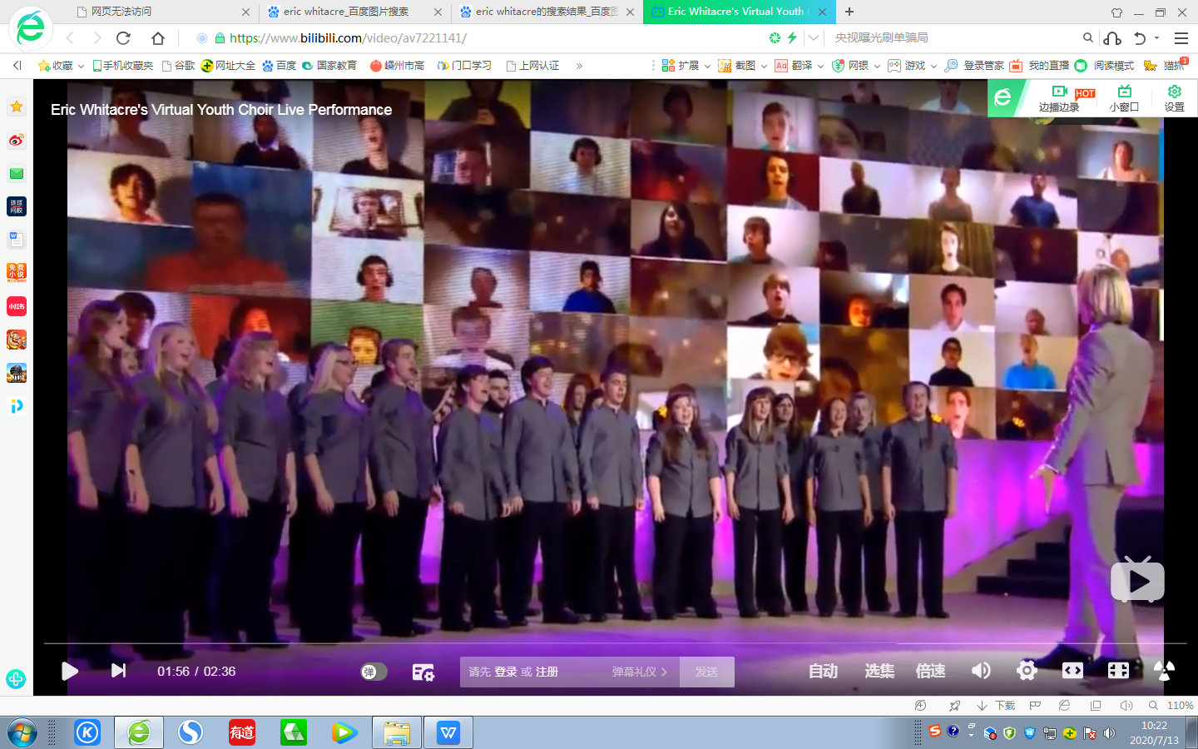
Predict from the title and the picture
made to appear to exist by the use of computer software
The virtual choir
a group of people who sing together
virtual choir
traditional/ reality choir

Slide 8
The virtual choir

Slide 9
Scan & circle
Scan
Scan a text to find important information such as dates, numbers, and names.
1. The man who came up with the idea for a virtual choir.
Eric Whitacre (P2, L1)
2. The place where he studied musical composition.
University of Nevada (P2, L2)
3. The name of his song.
“What If ”(P3, last line)

Slide 10
Scan & match
How was it created?
P1
What is a Virtual Choir?
P2
How did it affect us?
P3
Who created it?
P4

Slide 11
Read & think
What is a Virtual Choir?
The definition
P1
P2
Who created it?
The founder
P3
How was it created?
The creation
P4
How did it affect us?
The influence

Slide 12
What is a Virtual Choir?
Who created it?
How was it created?
How did it affect us?
Person
Anyone
P1
Anywhere
Place
record themselves
perform alone on video
Definition
Procedures
upload videos onto the Internet
put videos together into one
The Virtual Choir
see online
a video camera
Equipment
an Internet connection
do not have close friends or contacts who ...
Reasons
do not have the chance to join a local choir
help connect ordinary people together
enable them to add their voices to those of other individuals
Significance
become part of the global community
be a positive influence on the lives of many people

Slide 13
What is a Virtual Choir?
Who created it?
How was it created?
How did it affect us?
Eric Whitacre
award-winning composer and conductor
P2
his original compositions began to become quite popular
received a master’s degree in musical composition
graduated from university
began studying music at the University of Nevada
was born in the USA
on 2 Jan,1970
in 1988
in 1995
in 1997
Over the next 10 years

Slide 14
What is a Virtual Choir?
Who created it?
How was it created?
How did it affect us?
He fell in love with Mozart’s classical music when he sang for the university choir. Moved by this music, he said, “It was like seeing color for the first time.”
His deep love to the Mozart's classical music
his original compositions began to become quite popular among choirs and singers.
This led to the creation of the virtual choir.
Transitional sentence

Slide 15
What is a Virtual Choir?
Who created it?
How was it created?
How did it affect us?
P3
Over the next 10 years
His original compositions began to become quite popular
In 2009
He received a video from a girl who was singing one of his works
Inspired, he asked his fans to make videos, which he then joined together into one performance.
a worldwide phenomenon
His first virtual choir used _____singers from_______different countries; received _____________ views on the Internet.
185
12
millions of
On 23 July, 2014
Whitacre formed the Virtual Youth Choir for UNICEF. ________young people from_____countries sang “What If”.
2,292
80

Slide 16
What is a Virtual Choir?
Who created it?
How was it created?
How did it affect us?
P3
1. What makes it possible for the Virtual Choir to come into being?
In 2009，Whitacre received a video of a girl who was singing one of his works.Inspired, he asked his fans to make videos, which he then joined together into one performance.
The inspiration from music lover
The support from his fans
His first virtual choir, “Lux Aurumque”, had...Whitacre’s next effort was...
Whitacre’s continuous efforts
2. Why does the author use those numbers?
It is vey important to use data as supporting evidence when organizing an article , as it is more convincing compared to a general introduction or argument.

Slide 17
What is a Virtual Choir?
Who created it?
How was it created?
How did it affect us?
P4
The virtual choir is a wonderful way for people around the world to sing with one voice and thus make the world a better place.
Conclusion
Q1:What’s the writer’s attitude towards the virtual choir?
The writer feels positive about the virtual choir.
Q2: Is there any other evidence from the text to support this idea?
As one virtual choir member said, “Music helps me to ... forget my problems. With music, I become someone else.”
Example
…had 185 singers from 12 different countries…Altogether, 2,292 young people from 80 countries …
Numbers

Slide 18
Summarize & reflect
What is a Virtual Choir?
Who created it?
How was it created?
How did it affect us?
The definition
The founder
The creation
The influence
From your perspective, what makes Eric Whitacre successful in creating the virtual choir?
The development of the Internet & technology
His enthusiasm & capability for music
A
B
The inspiration & support from music lovers
C
D
The desire & love of music sharing

Slide 19
Discuss & share
What are the advantages and disadvantages of being a member of a virtual choir?
People from every corner of the world can upload their videos onto the Internet, which is like a wonderful stage where people come together to sing.
Different people sing together and share similar interests and values, which makes them feel like a family.
Advantages
In the global community, people can exchange feelings and thoughts with each other like real life ommunication.
The Internet is so developed that it makes virtual life no different from reality.

Slide 20
Discuss & share
What are the advantages and disadvantages of being a member of a virtual choir?
A virtual choir cannot have people together on stage where people can communicate in person.
A virtual choir relies too much on the use of technology.
A virtual choir is somewhat unreal because it is just something made up.
disadvantages
Virtual is virtual, which can never be real in any way.
A virtual choir concert can’t have real actor-audience interaction, which will lead to the lack of audience involvement.

Slide 21
Homework
Write a short passage to describe the advantages and disadvantages of the virtual choir and list your ideas about whether it can really bring people together.

Slide 22
Thank you!

