Slide 1

感恩遇见，相互成就，本课件资料仅供您个人参考、教学使用，严禁自行在网络传播，违者依知识产权法追究法律责任。
更多教学资源请关注
公众号：溯恩高中英语
知识产权声明

Slide 2
Continuation Writing
2022年6月高二衢州市统测
The Other Shoe
衢州高级中学 潘悦

Slide 3

the given part
The Other Shoe
Shoes are made for walking.
But Aamir, a homeless Indian boy, doubted it. Wandering the noisy railway platform, he found one of his flip-flops （人字拖鞋) broken again. He hurried to a corner, sat down and tried to fix it, his bare foot pressing awkwardly against the ground. However, it was beyond repair.
He gave up and looked around aimlessly, staring at people’s shoes. Suddenly, his eyes were drawn to two boyish legs wearing flawlessly white socks and equally perfect black leather shoes, which were glittering in the mid-day sun. It was a boy of his age. He couldn’t treasure his possession too much, obviously, because every ten seconds, he stopped, bent down and carefully wiped a dust or two from his shoes. His father was constantly glancing over and urging him, “Hurry up! The train is coming!”
Aamir’s eyes followed the father and son, but mostly the leather shoes, as if enchanted (被施魔法的). Imagining himself wearing them, the comfort from the good leather, jaw-dropping look on his friends’ faces, he couldn’t help cracking a big smile.

Slide 4

the given part
The bell of the train drew him back; the fancy-shoe boy and his father were about to get aboard. They tried to crowd into the doorway. However, the instant the boy entered the compartment（车厢）, one of his shoes fell off and before he could pick it up, the train began to pull away.
The shoe was now lying alone on the platform. Aamir’s eyes lit up with excitement. Like an arrow, he shot for the shoe and then picked it up, holding it with both hands as if holding the Queen’s crown. After a few seconds of hesitating and looking from the shoe to the train and back, he began racing--with only one good shoe, his flip-flop.
He held the leather shoe up, trying to pass it to the boy through the window, who was desperately reaching out his hand as well. However, it was never close enough.
注意：
1. 所续写短文的词数应为 150 左右；
2. 应全少使用5个短文中标有下划线的关键词语：
3. 续写部分分为两段，每段的开头语已为你写好;
4. 续写完成后，请用下划线标出你所使用的关键词语

Slide 5

Activity 1: Get logical and reasonable plots
Time
at mid-day
Place
a railway station
Step 1:
Read for plot
Aamir; a boy with leather shoes
Characters
Event
about shoes
Tip 1: Circle basic information while reading!

Slide 6
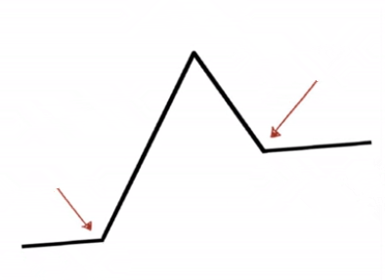


Step 1: Read for plot
Aamir picked the shoe up and tried to ____________, but failed. Then he ___________________.
pass it to the boy
threw the shoe onto the train
Climax
fell off
One of the boy’s shoes __________ when the train pulled away.
Falling action
excited
Resolution
Rising action
attracted
He noticed a boy wearing _______________________.
perfect black leather shoes
inciting incident
Denouncement
sad; in low spirits
railway station
At a _____________, Aamir found a flip-flop of him __________ .
setting
was broken

Slide 7
Step 2: Design the plot
underlined words
Aamir, flip-flops, perfect, shoes, treasure, train, smile, fell, window, desperately
Categoraize: divide the underlined words into different groups
Characters:
Verbs:
Settings:
Items:
Others:
Aamir
treasure, fell
train, window
flip-flops, shoes,
perfect, smile, desperately
Tip 2: Make use of the underlined words to design the plot!

Slide 8
Step 2: Design the plot
given sentences
Para 1: That left Aamir no choice but to throw the shoe onto the train.
Para 2: But when he raised his head, Aamir saw the other shoe thrown out of the train window.
Q1: How did Aamir throw the shoe?
Q2: What was result? Did Aamir succeed?
Aamir lowered his head.
He failed.
Q3: How did Aamir and the boy react to the result? (action, words, facial expression...)
Reverse back.
Q1: How did Aamir feel? What did he do then?
Q2: What is the boy’s reply?
Tip 3: Infer plot according to the given sentences!
Q3: What difference did the act make to Aamir?

Slide 9
Step 2: Design the plot
theme
Let’s compare! Which version of ending do you like best?
Version 1: Implied ending 融情于景
Bathed in the bright sunshine, Aamir beamed sweetly.
The black leather shoes shone under the warm sun, just like the two boy’s shining hearts.
Version 2: Lesson 主题升华
One simple act of kindness is a blessing for both the giver and receiver.
No good deed ever goes unrewarded.
Version 3: Echo 首尾呼应
Twenty years later, wearing a pair of shining leather shoes, Aamir started his presentation with a simple sentence: “Shoes are made for walking.”
Tip 4: Use a proper way to end the story!

Slide 10
Activity 2: Shape the characters with vivd language.
Let’s learn from the original text!
Shoes are made for walking.
But Aamir, a homeless Indian boy, doubted it. Wandering the noisy railway platform, he found one of his flip-flops （人字拖鞋) broken again. He hurried to a corner, sat down and tried to fix it, his bare foot pressing awkwardly against the ground. However, it was beyond repair.
He gave up and looked around aimlessly, staring at people’s shoes. Suddenly, his eyes were drawn to two boyish legs wearing flawlessly white socks and equally perfect black leather shoes, which were glittering in the mid-day sun. It was a boy of his age. He couldn’t treasure his possession too much, obviously, because every ten seconds, he stopped, bent down and carefully wiped a dust or two from his shoes. His father was constantly glancing over and urging him, “Hurry up! The train is coming!”
Tip 1: Use a chain of verbs!

Slide 11
Activity 2: Shape the characters with vivd language.
Aamir’s eyes followed the father and son, but mostly the leather shoes, as if enchanted (被施魔法的). Imagining himself wearing them, the comfort from the good leather, jaw-dropping look on his friends’ faces, he couldn’t help cracking a big smile.
The bell of the train drew him back; the fancy-shoe boy and his father were about to get aboard. They tried to crowd into the doorway. However, the instant the boy entered the compartment（车厢）, one of his shoes fell off and before he could pick it up, the train began to pull away.

Slide 12
Activity 2: Shape the characters with vivd language.
The shoe was now lying alone on the platform. Aamir’s eyes lit up with excitement. Like an arrow, he shot for the shoe and then picked it up, holding it with both hands as if holding the Queen’s crown. After a few seconds of hesitating and looking from the shoe to the train and back, he began racing--with only one good shoe, his flip-flop.
He held the leather shoe up, trying to pass it to the boy through the window, who was desperately reaching out his hand as well. However, it was never close enough.

Slide 13
have a try
a chain of verbs--by splitting
throw the shoe onto the train
[lift/raise the shoe]--[approach for the best angle]--[throw the shoe to the window/the boy]
Structure 1: A, B and C
Aamir held the shoe up, run as fast as he can to approach the best angle, and threw it into the window with all his strength.
Structure 2: Having done...
Having found the best angle, Aamir held the shoe up and threw it into the window with all his strength.

Slide 14
have a try
a chain of verbs--from different angles
Aamir’s reaction to the other shoe’s being thrown out
[facial expression]--[action]--[words]--[inner thoughts]
Structure 1: Doing/Done..., main sentence, doing...
(Being) Speechless and moved, Aamir picked the shoes up, waving hand to show his gratitude and give a farewell to the kind boy.
Structure 2: With...doing/done, main sentence, doing...
With the pair of perfect black leather shoes held in hands, Aamir stood there, shouting “Thank you!” to the boy with excitement.

Slide 15
Activity 2: Shape the characters with vivd language.
Shoes are made for walking.
But Aamir, a homeless Indian boy, doubted it. Wandering the noisy railway platform, he found one of his flip-flops （人字拖鞋) broken again. He hurried to a corner, sat down and tried to fix it, his bare foot pressing awkwardly against the ground. However, it was beyond repair.
He gave up and looked around aimlessly, staring at people’s shoes. Suddenly, his eyes were drawn to two boyish legs wearing flawlessly white socks and equally perfect black leather shoes, which were glittering in the mid-day sun. It was a boy of his age. He couldn’t treasure his possession too much, obviously, because every ten seconds, he stopped, bent down and carefully wiped a dust or two from his shoes. His father was constantly glancing over and urging him, “Hurry up! The train is coming!”
Tip 2: Use diverse adverbs!

Slide 16
Activity 2: Shape the characters with vivd language.
The shoe was now lying alone on the platform. Aamir’s eyes lit up with excitement. Like an arrow, he shot for the shoe and then picked it up, holding it with both hands as if holding the Queen’s crown.
Imagining himself wearing them, the comfort from the good leather, jaw-dropping look on his friends’ faces, he couldn’t help cracking a big smile.
Tip 3: Show emotions vividly in different forms!

Slide 17
useful expressions
emotions
sentence patterns
adj.
Feeling+adj, /(Being) +adj, /Adj, sb...
To one’s+n, sb...
Sb+ verb.+ with+n.
Sb was filled with...
Sb couldn’t contain sb’s+n.
There was apparent+n. in sb’s voice/eyes/ expression/ behaviour.
Sb felt a great sense of +n. welling up in one’s heart
/a mixture of
n.

Slide 18
how to describe happiness
n. : delight, joy, happiness
adj. : delighted, cheerful, merry
v. smile, laugh, giggle, grin, chuckle(轻声笑)
sentences:
He waved his hands with joy.
A bright smile spread across his face.
His heart was filled with joy.
He couldn’t contain his delight, like a dog with two tails.
A mixture of joy and gratitude welled up from the bottom of his heart.
LANGUAGE

Slide 19
How to describe sadness&anger
n. : sadness, sorrow, regret, depression, disappointment, desperation, frustration
anger, rage
adj. : upset, heartbroken, low-spirited
angry, annoyed, irritated, furious
v. : cry, weep, sob, choke, sigh, frown
sentences:
His cheeks were shining with tears.
Tears blurred his vision.
Feeling a lump in his throat, he couldn’t help crying.
LANGUAGE

Slide 20
Appreciation

Slide 21
Sample
That left Aamir no choice but to throw the shoe onto the train. With his eyes fixed on the window, Aamir put all his strength in his right hand and made a powerful throw. However, he abruptly fell off because of the broken flip-flop. Without a second thought, he tried again, the shoe just flew past the window frame and fell on the platform like a dead leaf. Seeing this, Aamir stamped his feet, wearing a frustrated look. “Are shoes really made for walking?”, Aamir thought with depression. He drooped his head, not knowing what to do next.

Slide 22
Sample
But when he raised his head, Aamir saw the other shoe thrown out of the window. Miraculously, it landed on the platform several steps away from him. Before he could look up again and seek out the fancy-shoe boy, the train sped on, vanishing in the distance. What remained in sight was the meandering rail track and the rolling mountains far away. Twenty years later, when he was launching his new footwear product at a press conference, wearing a pair of shining leather shoes, Aamir started his presentation with a simple sentence: “Shoes are made for walking.”

Slide 23
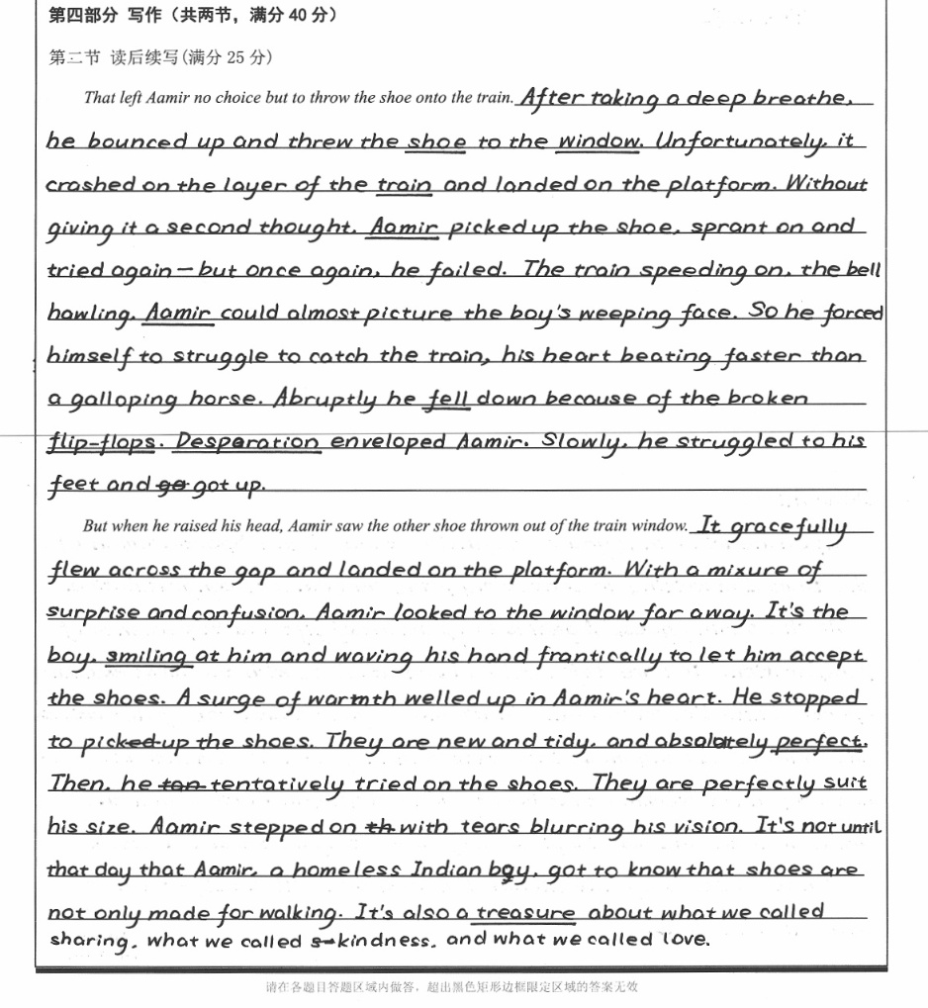
高分作文1

Slide 24
高分作文1
1. 作者的语言基本功较好。作者善用动作链，副词使用也很丰富。
2.两段之间的衔接比较自然，情节流畅。
3.书写清晰美观。
4. 结尾回扣原文，立意把握准确。

Slide 25
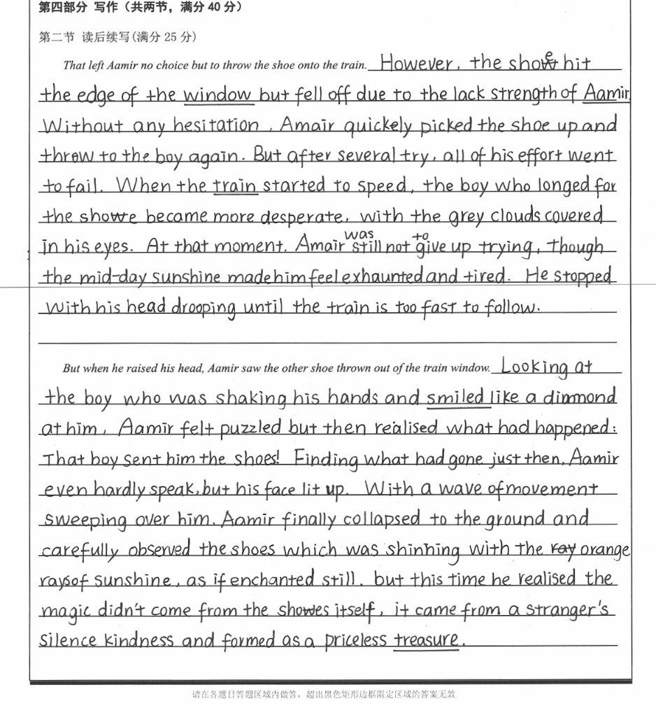
高分作文2

Slide 26
高分作文2
1. 作者的语言基本功较好。语言朴实自然，句式多变，with复合结构，定语从句，非谓语信手拈来。
2.善用原文伏笔，逻辑自洽。
3.书写美观，有部分涂改。
4. 文章结尾的运用环境描写情感真挚，利用原文中的线索as if enchanted, 由magic引申到kindness,升华主题。

Slide 27
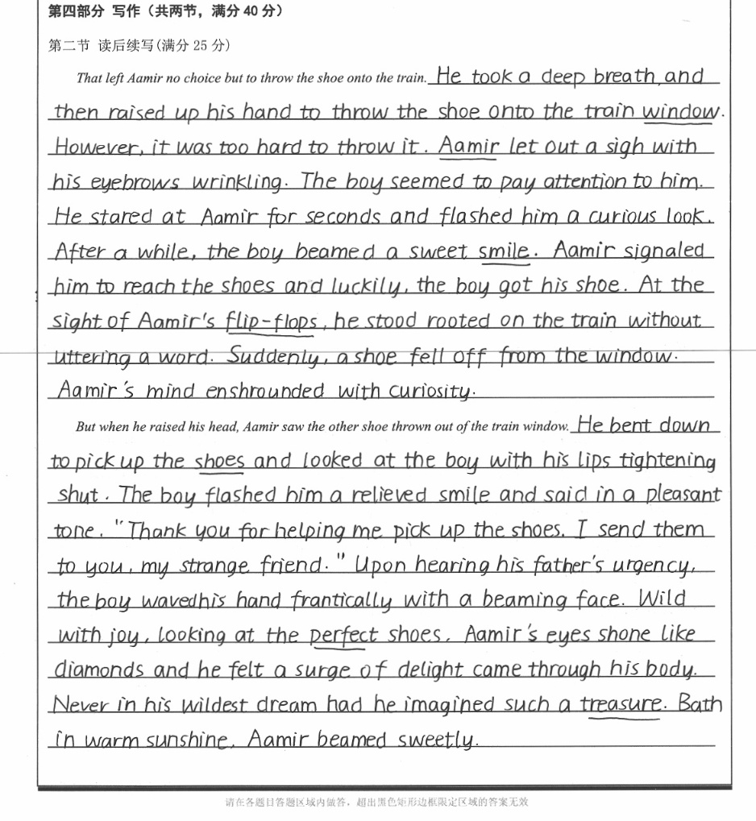
高分作文3

Slide 28
高分作文3
1. 作者的语言功底较好。句式有变换，能使用倒装等高级句式，语言略显堆砌感，
2.两段之间的情节衔接有些生硬。
3.书写美观。
4. 文章结尾融情于景，真情流露。

Slide 29

Revise and polish
your assignment.
Homework

Slide 30
Thanks!

