Slide 1


感恩遇见，相互成就，本课件资料仅供您个人参考、教学使用，严禁自行在网络传播，违者依知识产权法追究法律责任。
更多教学资源请关注
公众号：溯恩高中英语
知识产权声明

Slide 2
建议信
Letter of Advice

Slide 3
目录
1
模拟试题分析
规范审题
谋篇布局
语言表达
佳作欣赏
参考范文
2
建议信总结
分类
实例

Slide 4
试题呈现
2020.6上虞二模
假设你是校英文报编辑李华，近期收到一封署名为Anxiety的求助信，在信中该同学表示由于考试临近压力剧增。请用英文给该同学回信，内容要点如下：
1.表示安慰；
2.提出建议；
3.表达祝愿。
注意：
1.词数80 左右；
2.可以适当增加细节，以使行文连贯。

Slide 5
审题
假设你是校英文报编辑李华，近期收到一封署名为Anxiety的求助信，在信中该同学表示由于考试临近压力剧增。请用英文给该同学回信，内容要点如下：
1.表示安慰；
2.提出建议；
3.表达祝愿。
注意：
1.词数80 左右；
2.可以适当增加细节，以使行文连贯。
1.文体：书信
2.主题：应对考试压力的建议
3.时态：一般现在时
4.要点：安慰，建议，祝愿
5.格式：称呼—信头—正文—信尾—署名

Slide 6
审题
假设你是校英文报编辑李华，近期收到一封署名为Anxiety的求助信，在信中该同学表示由于考试临近压力剧增。请用英文给该同学回信，内容要点如下：
1.表示安慰；
2.提出建议；
3.表达祝愿。
注意：
1.词数80 左右；
2.可以适当增加细节，以使行文连贯。
closely related
Tip 1 What you write should be closely related to the topic.

Slide 7
谋篇布局
The beginning (Para. 1)
The body (Para. 2)
The ending (Para. 3)
目的+安慰
建议+理由
希望+祝愿

Slide 8
语言
话题词汇
Noun
stress, pressure, tension
anxiety, worry
Adjective
stressed, anxious, worried
Phrase
get/feel stressed
stress sb out
be under stress/pressure
suffer from stress/pressure
ease/relieve/reduce/lessen/release stress/pressure/tension

Slide 9
表达多样性
Para.1目的+安慰
I’m sorry to learn that you’re burdened with great stress due to the coming exam. I could completely relate to you as this is fairly common for senior three students. Don’t worry too much and I’ll share you some effective tips/advice.
I’m sorry to know that you’re under intense pressure as the exam is drawing near. Actually, everyone will feel anxious when faced with crucial exams. Don’t worry and I’d like to offer you some proposals to cope with stress.
From your letter I know you’re suffering from great pressure with the exam approaching. It’s normal for senior 3 students to get stressed for the moment. There’s no need to worry excessively and I’ll give you some practical suggestions.

Slide 10
要点完整性
Para.2建议
do sports/ take exercise/ take a walk
turn to teachers and parents for help
talk with peers/ close friends
keep a diary
listen to music
…

Slide 11
要点完整性
Para.2 advice + supporting idea
You'd better spare some time to exercise regularly, which will definitely help you release stress and build up your body.
In my opinion, doing sports on a regular basis is a good way to cheer yourself up and make you stress-free.
It's a good idea to communicate with your teachers and parents who are always willing to share their experience with you.
Talking with your close friends or keeping a diary is also a good idea to relieve pressure.
You can also listen to the music you are fond of, which will surely put you at ease and thus lift your spirit.

Slide 12
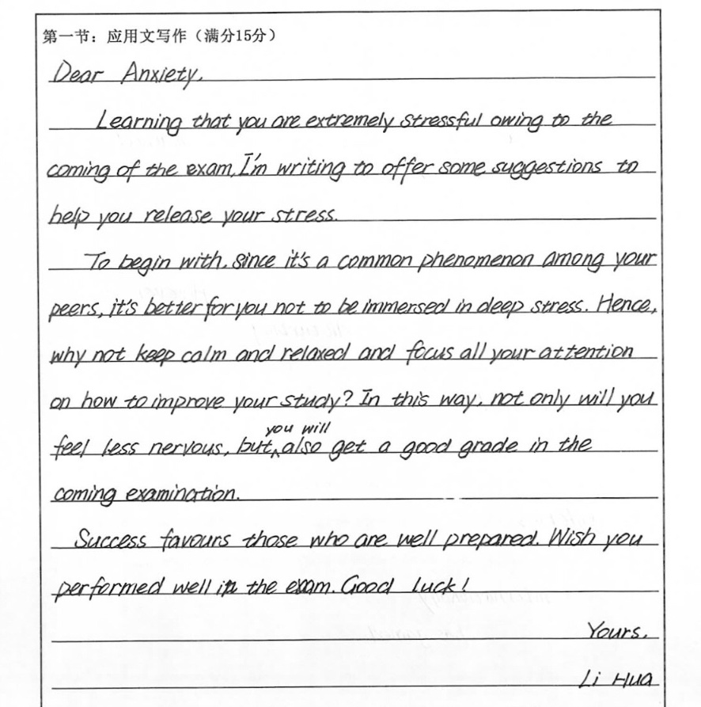
Para. 2
考场作文分析
Comfort
or
Advice?
Tip 2 Separate comfort from advice.

Slide 13
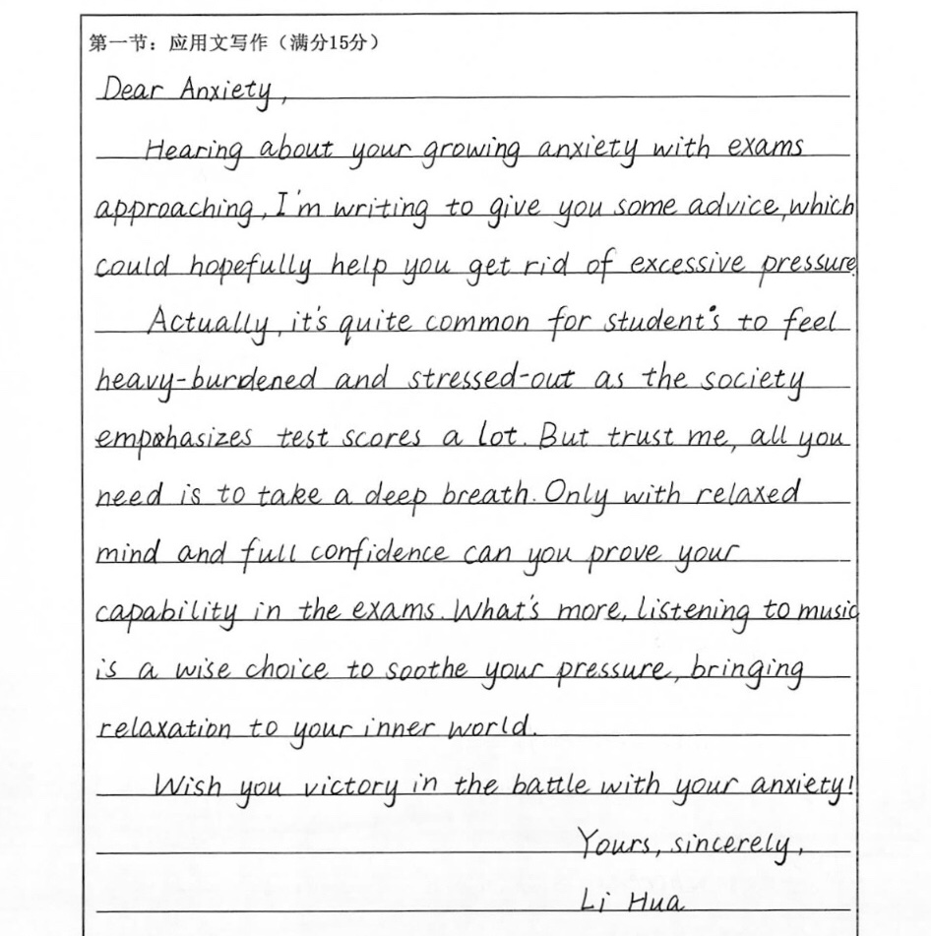
Para. 2
考场作文分析
More comfort than advice!
Tip 2 Separate comfort from advice.

Slide 14
交际得体性
Para.3 希望+祝愿
I would appreciate it if you could take my suggestions into account.
I hope my suggestons will be beneficial/helpful/practical to you and you can overcome your stress soon.
I hope my advice will turn out beneficial. May you become more confidence and less stressed in the near future.
Tip 3 Express your wishes according to the context.

Slide 15
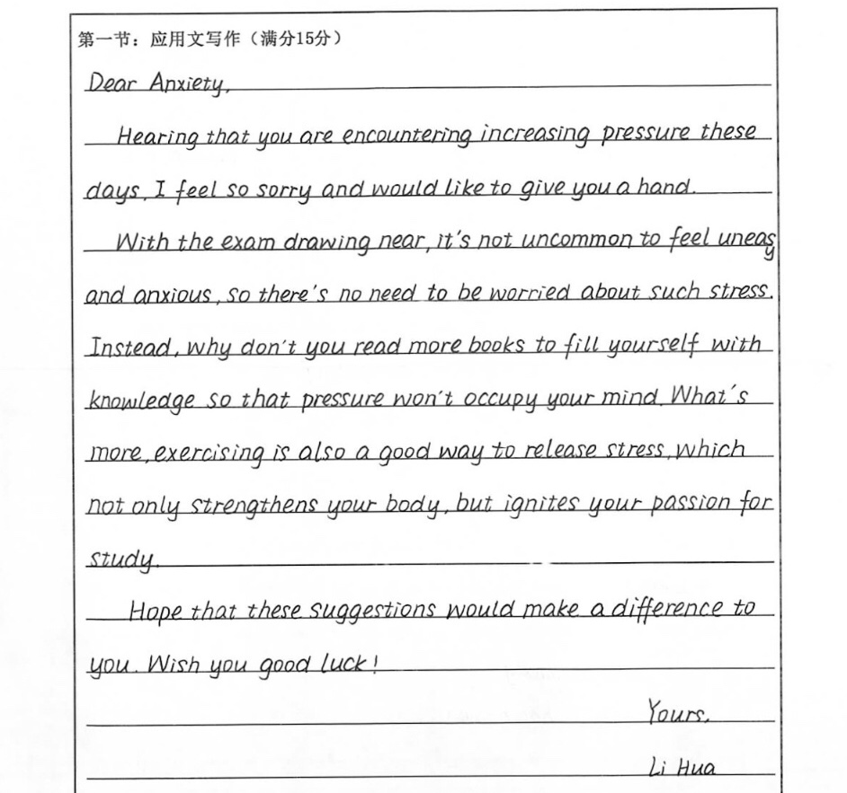
佳作欣赏
点评：本文覆盖所有要点，使用了多种语法结构，如非谓语作状语、介词短语作状语、状语从句、定语从句等，使用了丰富的词汇和表达。全文衔接紧凑，达到了预期的写作目的，但是若能将最后的祝愿进行调整的话，文章会更完美。

Slide 16
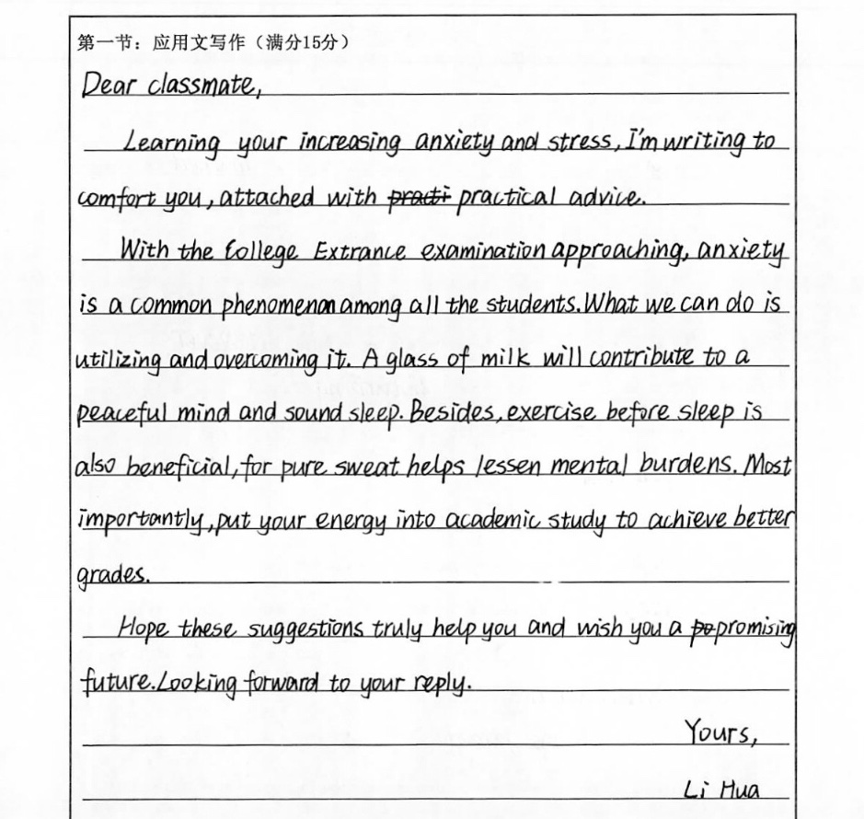
佳作欣赏
点评：本文要点齐全，结构完整，使用了非谓语、介词短语、名词性从句等多种语法结构和丰富的词汇及表达。全文衔接自然，基本完成了写作任务，若能将最后的祝愿进行调整，文章会更优秀。

Slide 17
参考范文
Dear Anxiety,
I’m sorry to know that you are experiencing a tough time now. Actually, everyone will encounter such a period when they are under great pressure, so there is no need to worry too much.
In my opinion, sharing your feelings with your friends is a wise choice as you can remove your negative emotions. Another effective suggestion is that you should take more physical exercise, which can lift your spirit. Also, keep an optimistic attitude towards life about your future.
I hope my advice will be of benefit to you. May you get rid of your
trouble soon.
Yours,
Li Hua

Slide 18
分类
The letter of advice is written to…
个人
学习考试压力大
难以适应新环境
过度使用朋友圈
担心疫区的朋友
容易烦躁发脾气（2014安徽卷）
选择旅游的路线（2017北京卷）
外国朋友学中文（2008全国卷II，2015四川卷）
…
领导
图书馆藏书问题
校园不文明行为（2011浙江卷）
…

Slide 19
例一
难以适应新环境
假如你是李华，你的英国朋友Chris刚到中国来留学，他对新的学习和生活环境不适应。请你根据以下要点给他回一封邮件，要点包括:
1.询问近况；
2.提供建议；
3.表达祝愿。
注意：
1.词数80 左右；
2.可以适当增加细节，以使行文连贯。

Slide 20
语言积累：适应新环境的建议
1. My top tip is to bury yourself in study. Therefore there will be less spare time available for you to feel homesick.
2. I think you may need to communicate with your classmates as much as possible. In this way you can get to know each other better and thus bond with them/develop friendly relationships with them.
3. It’s a good idea for you to join in some school clubs and get yourself involved in some social activities to make new friends, which will promote your Chinse learning.
4. Making new friends and hanging out with them is an effective way to remove/get rid of your negative emotions, like loneliness and homesickness.
5. You can also visit some tourist attractions to make yourself immersed in/exposed to the local culture, which is beneficial to your study and will help you fit in more quickly.

Slide 21
参考范文
Dear Chris,
How is everything ? Learning that you have difficulty adjusting/adapting to the life in China, I could completely relate to you as this is fairly common due to cultural shock. However, if you adopt appropriate approaches, things could turn out better than expected.
I strongly suggest you listen with attention in class, take notes where you can't comprehend and turn to teachers afterwards. Besides, why not make more friends and hang out with me more often? In this way, not only can you master spoken Chinese more proficiently but you can integrate more quickly into Chinese lifestyle.
Hope my advice helps and wish you an enjoyable stay in China.
Yours,
Li Hua

Slide 22
例二
过度使用朋友圈
假如你是李华，你的好友Jim在寒假期间痴迷于微信朋友圈，经常发照片分享生活中的所有细节，请你根据以下要点提示，给Jim写一封信：
1.表示理解；
2.阐述危害；
3.提出建议。
注意：
1.词数80左右；
2.可以适当增加细节，以使行文连贯。
参考词汇：微信朋友圈WeChat Moments
过度分享oversharing

Slide 23
参考范文
Dear Jim,
I’m worried that you’ve been addicted to sharing all sorts of photos in WeChat Moments recently. Undeniably, WeChat makes communication convenient and leisure time colorful. However, there exist some potential risks if we overshare. One severe problem is leaking privacy, which may cause economic losses. Besides, oversharing can make others uncomfortable/jealous/envious, for they think you are showing off.
Thus, don’t always post personal information. Nor should we rashly add strangers to the list of friends. It’s wise to set aside some time to accompany parents or do something more meaningful.
I sincerely hope you can take my advice. Best wishes!
Yours,
Li Hua

Slide 24
例三
担心疫区的朋友
假定你是李华，得知美国现在新型冠状肺炎病毒肆虐，请给你的美国笔友Mark写 一电子邮件，内容包括：
1.表达近况；
2.提出建议；
3.表达祝愿。
注意：
1.词数 80 词左右；
2.可适当增加细节，以使行文连贯。
参考词汇：新型冠状肺炎 COVID-19
流行病epidemic/pandemic

Slide 25
参考范文
Dear Mark，
How’s everything going with you? I’ve heard from the news that the ongoing worldwide epidemic of COVID-19 strikes/hits America hard. But proactive/ preventive measures still can be taken to fight against it effectively.
My top tip is to wear masks and maintain the social distance, because the viruses can spread from person to person in close proximity. It is also important to wash hands regularly and thoroughly with soap, which can kill viruses. Do stock your cupboards with some extra food to lower/reduce the frequency of hangout.
I hope the disease can be under control soon. Stay well!
Yours,
Li Hua

Slide 26
例四
图书馆藏书问题
假如你是李华，就读于某国际学校。请你就本校图书馆英语藏书方面存在的问题给校长写一封信，内容包括：
1.表明写信目的；
2.指出存在问题；
3.提供改进建议。
注意：
1.词数80左右；
2.可适当增加细节，以使行文连贯。

Slide 27
参考范文
Dear Sir,
I hope you don’t mind me writing to point out some problems concerning the collection of English books in our library. For example, the number of original books is limited and the English newspapers and magazines are out of date.
To improve the condition, I think not only can we appeal to students to donate some original books, but also purchase a certain number of new ones. Besides, the magazines and newspapers should be updated regularly to keep students well informed.
I would be grateful if you could consider my suggestions. Best wishes!
Yours sincerely,
Li Hua

Slide 28
Thank you!

