Slide 1
感恩遇见，相互成就，本课件资料仅供您个人参考、教学使用，严禁自行在网络传播，违者依知识产权法追究法律责任。
更多教学资源请关注
公众号：溯恩高中英语
知识产权声明

Slide 2
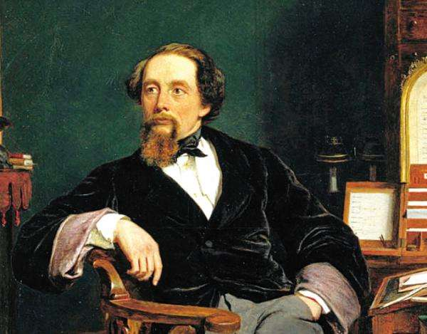
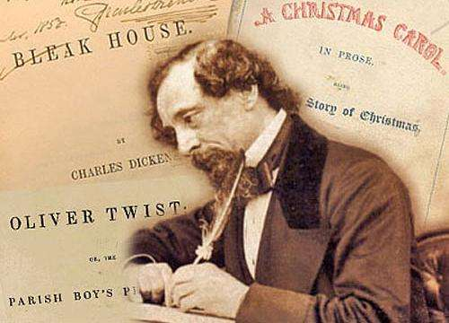
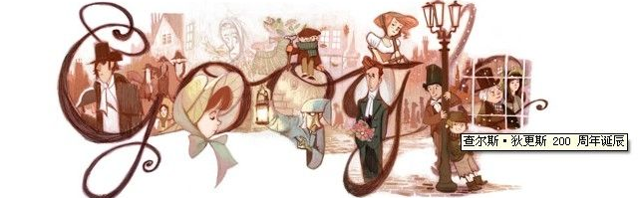
David Copperfield
鲁周焕
杭州市余杭高级中学

Slide 3
Chapter 4
Working in the Warehouse

Slide 4
IV. Chapter 4: Working in the warehouse
1. How did I react to my mom’s death?
1
1
2.Why did I grieve over my mom’s death?
I howled the cry of an orphan. It felt as if my whole world had just been shattered. But Mrs Creakle was very kind to me that day. She let mt stay in the parlour. I cried and slept and cried and slept…
I wailed miserably.
to make long, loud noise to express sorrow or pain
e.g. The women began to wail in mourning.
Maybe my mom was the only one in this world for me to depend on, and now I was left a orphan.
to feel very sad for/over sb.’s death
e.g. They are still grieving for/over their dead child.

Slide 5
3. How did Mr. and Miss. Stone treat Peggotty and me?
4. Why was I sent to work in London?
5. Up to now, what kind of changes have taken
place in my family?
① Peggotty was sacked (fired) from our house.
Then one day, some weeks later, Mr. Murdstone called for me. “You are a difficult boy,” he said coldly, “and you need a good deal of correcting.”
“He needs to be crushed,” chipped in Miss Murdstone.
“I am sending you to London…”
② I was sent to work in a warehouse in London.
a happy, harmonious family
Change
an unhappy, broken family
6. What led to such tragic change of our family?

Slide 6
6. What led to such tragic change of my family?
weak and easily hurt physically or emotionally
e.g. to be vulnerable to attack
a happy, harmonious family
my father’s death
Our family is vulnerable to risks
kind, loving but innocent and weak, typical image of woman at that time
my mother’s character
Change
Mr. and Miss Murdstone’s cruelty
crushing my mother and me physically and mentally
an unhappy, broken family

Slide 7
8. How was the workplace and my work?
The warehouse was by the River Thames in Blackfriars. The whole house stank of dirt and smoke. Its floors and staircases were in ruins and there were swarms of rats in the cellar. (para. 10)
move somewhere in large numbers
e.g. Students swarm into the canteen everyday.
My jobs were to wash empty wine bottles, paste labels on full ones, put corks in bottles, place seals on the corks and pack the finished bottles into boxes.
I was paid seven shillings a week. I had a penny loaf and a pennyworth of milk for breakfast, and another loaf and a tiny bit of cheese for supper. We were only allowed half an hour for a break…
The days were very long and the work was mind-numbing. (para. 11)
extremely boring or dull
e.g. This was a mind-numbing conversation.

Slide 8
9. What kind of trouble were the Micawber couple in?
10. Why were the couple in heavy debt?
11. What kind of people are the couple?
12. What happened to the family eventually?
clever at understanding and making judgements about a situation
e.g. He’s a shrewd businessman and hard as nails.
They were in heavy debt.
“Yearly income twenty pounds, yearly spend one penny less than twenty pounds—result happiness; yearly income twenty pounds, yearly spend one penny more than twenty pounds—result misery.” But he didn’t live by this saying at all.
But Mr. Micawber was as hopeless as ever. I’d pawn some plates and give him the money, and then a few hours later, I’d find the family tucking into a fine feast of lamb cutlets!
Mainly because Mr. Micawber wasn’t shrewd in money matters.
to allow yourself to have or do something that you like, especially something that is considered bad for you
indulge (oneself) in sth.
e.g. Only rarely will she indulge in
a glass of wine.
e.g. I indulge myself in a long hot
bath.
They are good-hearted, kind and generous, but also very short-sighted, indulging themselves in the present.
They were put into prison and later moved to Plymouth.

Slide 9
1
1
13. What decision did I make in face of the crossroads?
1
14.What happened to me on my way to aunt Betsey’s?
1
15. Can you come up with some proverbs to describe my situation?
1
When the Micawbers had gone, I realized I’d reached a major crossroads in my life. I could either stay in London, working at the filthy warehouse and spending my days alone, or I could run away in search of a better life.
I ventured to turn to Great-Aunt Betsey for help.
I was robbed of my money and belongings by a stranger.
It never rains but pours.
in total despair
(desperate)
Misfortune never comes singly.

Slide 10
16. Try to find the sentence describing the following feelings.
unhappy
I felt very low. (para. 25)
It felt as if my whole world had just been shattered. (para. 1)
desperate
“Give me my things, you thief!” I yelled, running after the cart and choking back sobs of fury and desperation. (para. 33)
I was now in a pit of total despair. (para. 34)
frightened
I was horrified. (para. 5)

Slide 11
Chapter 5
It’s me, Aunt Betsey

Slide 12
V. Chapter 5: It’s me, Aunt Betsey
1
1
1.What can you infer about my trip to Dover?
1
2. What does Aunt Betsey look like?
It took me ages to get back to my feet and start walking out of London on the Dover road. I was tired and penniless.
The next few days and nights were a blur. I slept on haystacks, lived on scraps, and sold my jacket to earn a little money. I was constantly freezing and hungry and my feet were covered in blisters.
It was a long, arduous trip.
difficult and tiring, involving a lot of effort
e.g. The work was arduous.
She had grey hair and quick, bright eyes, and had a handkerchief tied over her head. She was wearing gardening gloves and held a knife.
3. What can you infer Aunty
Betsey’s character?

Slide 13
4. What was Aunt Betsey’s initial (first) reaction on seeing me?
5. Why did Aunty Betsey reacted that way?
6. What was Aunt Betsey’s reaction after recognizing me?
She demanded I go away immediately.
I knew I looked terrible—my shoes were full of holes, and my shirt and trousers were filthy and ragged…
① She didn’t like boys.
② She didn’t recognize me.
7. What can you infer Aunty
Betsey’s character?
“Go away!” she shouted firmly at me…
“We don’t want any boys round here”
① She cried, “Oh my goodness!” and sat flat
down on the garden path.
Change
② She led me straight into…She poured all kinds
of medicines down me…Then she made me have
a long hot bath and gave me a hot meal.

Slide 14
v
8. How did my feelings change from Para. 14~22?
9. Who played a key role in Aunt
Betsey allowing me to stay?
…that gave me the hope that she might do the same for me.
hopeful
Mr. Dick.
I felt like my entire future rested on his reply
anxious
A man with cherry face bounded into the room, laughing…childlike…
A wave of relief flooded over me.
relieved
contented
10 .Why do you think Aunt Betsey
trusted Mr. Dick on all matters even if she was strong-willed and shrewd?
I fell into the bed and instantly sank into the world of dreams

Slide 15
v
9. How was the talk between the Murdstones and Aunt Betsey?
“My sister and I did our best to correct him…He is the worst behaved boy…”
“That’s a bit strong!” declared my aunt...
“Well ,what do you want to do with David?” demanded Aunt Betsey.
“Absolutely nothing,” he replied.
Mr. Murdstone’s expression hardened. “I’m here to take the boy back…
“Dispose of him!” Aunt Betsey cried with a horrible expression. “Do you mean …?”
…looking sternly at the Murdstones, “I don’t believe a word of what you’ve said…”
Mr. Murdstone eyed her coldly but…
“B…but,” uttered Mr. Murdstone.
“But, nothing.” snapped Aunt Betsey.
…stood in shock, unsure what to do…
“No, you look here!” Aunt Betsey cried, her eyes shining like balls of fire.
“Now, look here,” said Mr. Murdstone
“GET OUT.” commanded Aunt Betsey, bustling towards the door.
“I…I,” Mr. Murdstone tried to protest.

Slide 16
v
9. How was the talk between the Murdstones and Aunt Betsey?
“My sister and I did our best to correct him…He is the worst behaved boy…”
“That’s a bit strong!” declared my aunt...
“Well ,what do you want to do with David?” demanded Aunt Betsey.
“Absolutely nothing,” he replied.
Mr. Murdstone’s expression hardened. “I’m here to take the boy back…
“Dispose of him!” Aunt Betsey cried with a horrible expression. “Do you mean …?”
…looking sternly at the Murdstones, “I don’t believe a word of what you’ve said…”
Mr. Murdstone eyed her coldly but…
“B…but,” uttered Mr. Murdstone.
“But, nothing.” snapped Aunt Betsey.
…stood in shock, unsure what to do…
“No, you look here!” Aunt Betsey cried, her eyes shining like balls of fire.
“Now, look here,” said Mr. Murdstone
“GET OUT.” commanded Aunt Betsey, bustling towards the door.
“I…I,” Mr. Murdstone tried to protest.

Slide 17
V
11. How did my feelings change during the talk?
My spirits sank.
downhearted
My whole body shook with anxiety.
anxious
…I felt all of the fear and fury returning.
terrified
I stared at the Murdstones with hatred.
furious
My fists clenched with rage.
anxious
I held my breath anxiously…
delighted
My heart leaped with joy…

Slide 18
12. What kind of people is Aunt Betsey?
She didn’t start another marriage after being abandoned by her ex-husband.
independent
kind
merciful
She adopted David when he was hopeless, and she also .
bald
She argued with the Murdstones over how to deal with David.
manly
She is planned her property well and grasped many commercial activities.
shrewd

Slide 19
13. Try to find the sentence describing the following feelings.
surprised
When I’d finished, she looked at me with disbelief.
And this gave me a glimmer of hope that she might do the same to me.
hopeful
relieved
A wave of relief flooded over me.
frightened
“Will I have to go back?” I asked in dread.
My whole body shook with anxiety.
anxious
I held my breath anxiously as she thought everything…
serious
Mr. Murdstone’s expression hardened.

Slide 20
happy
My heart leaped with joy as she shoved the confused…
…I felt all of the fear and fury returning.
I stared at Mr. Murdstone with hatred.
A flush of anger and embarrassment spread across Mr. Murdstone’s cheeks.
angry
“No,” I blurted out, my fists clenched with rage.
“No, you look here!” Aunt Betsey cried, her eyes shining like balls of fire.

Slide 21
17. Try to find the words indicating “say sth”.
say
“You’re my…my …aunt”, I said in a quivering voice.
cry
At this ,she cried, “Oh, my goodness!” and sat…
cut in
“He is the worst behaved boy…” cut in Miss Murdstone.
blurt out
“No,” I blurted out, my fists clenched with rage.
announce
“This is what I think,” she announced, looking sternly...
utter
“B…but,” uttered Mr. Murdstone.
snap
“But, nothing!” snapped Aunt Betsey.
“Well, what do you want to with David?” demanded Aunt Betsey.
demand

