Slide 1
感恩遇见，相互成就，本课件资料仅供您个人参考、教学使用，严禁自行在网络传播，违者依知识产权法追究法律责任。
更多教学资源请关注
公众号：溯恩高中英语
知识产权声明

Slide 2
概 要 写 作 解 析
——以“2021年3月温州高考适应性考试”为例
浙江省衢州第一中学 徐荣仙

Slide 3
What is a summary?
A summary is a brief statement that gives only the main points of something, not the details.
《牛津高阶英汉双解词典》

Slide 4
思维能力发展的阶段性
critical thinking
creating
imagining
predicting
reasoning, responding
researching, reviewing
comparing, constrasting
reorganizing, relating
retelling, recalling
remembering, reciting
receiving, repeating
高 阶
中 阶
低 阶

Slide 5
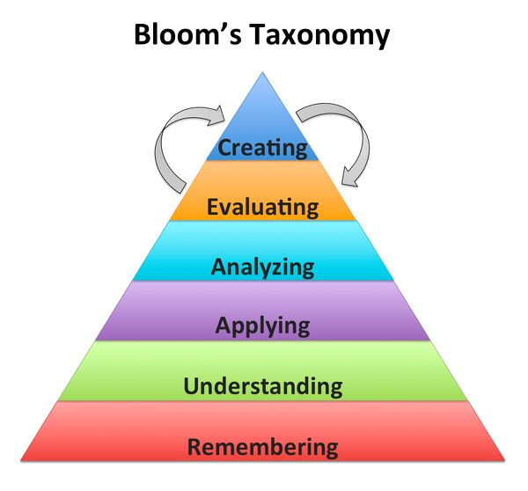

Slide 6
新题型 新要求
评分时主要考虑： 1. 对原文要点的理解和呈现情况 2. 应用语法结构和词汇的准确性 3. 上下文的连贯性 4. 对各要点表达的独立情况 | 档次 | 描 述
 | 第 五 档 （21- 25） | — 理解准确，涵盖全部内容 — 能准确使用相应的语法结构和词汇 — 有效的使用语句间的连接成分，使所完成的概要紧凑 — 完全使用自己的语言

Slide 7
写作特点
√
be brief
√
be thorough
√
restate / own words
√
be objective

Slide 8
common mistakes
×
unable to find the structure
×
unable to find the key points
×
unable to rewrite in your own words
×
not knowing how to polish the whole passage

Slide 9
常用概要写作的技巧
把握全文大意
分析文章结构
使用主题句
提炼关键词
选取重要层面
合并分层意思
转换视角
省略细节
减少例子

Slide 10
Some ways to improve summary writing
Some ways to improve summary writing
统观全局，理清脉络
1. 一带一路，一句多译
2. 有效整合信息，删除无用细节
3. 理清逻辑关系，注意转折、解析信息

Slide 11
Feeling hungry? If you're feeling starved, what is the easiest way to satisfy your hunger? Many of us will reach for a takeaway menu and order some delicious but possibly unhealthy food. And our increasingly busy life adds to our need to buy ready-made food on the go or delivered to our home
Eating options are endless, and new technology means we can feed our desire at the push of a button. Takeaway delivery apps make ordering food quick and convenient. This is especially the case during the recent coronavirus crisis, when people stuck at home with nothing to cook or lacked the skills to prepare a meal for themselves. It's calculated that in the UK alone, people eat three million takeaway meals a day, and the three biggest delivery apps together offer a choice of 100 cuisines from 60,000 restaurants. Amelia Brophy, Head of UK Data Products at Yougov told the BBC that its research "suggests that the frequency of takeaways ordered is expected to increase in the future.
It's no wonder we are tempted (诱惑)to skip the grocery shopping, avoid the kitchen. and tuck into ( 大口吃)something that someone else has prepared. But ordering a deep crust pizza, a spicy curry or a box of noodles, can come at a price both financially and to our health. Eating too much processed and unhealthy fast food has some effect on obesity and the risk of developing certain diseases. Children and adolescents who eat fast food at least three times a week are more likely to develop eczema, according to one study. Eczema is a skin condition that causes patches of itchy skin.
Of course, reducing salt, sugar zksq and fat is one way to make takeaway food healthier. Yet, that's far from enough. The best advice you might want to take is to find a recipe book and try making your own meal.

Slide 12
To be a focused reader
Step1 : get a general idea
Q1: What is the writing style of the passage?
A. Argumentation B. Narration C. Exposition
Q2: How is the passage organized?
Exposition: is a type of writing to introduction, inform or explain...
Argumentation: is a type of writing to convince or persuade

Slide 13
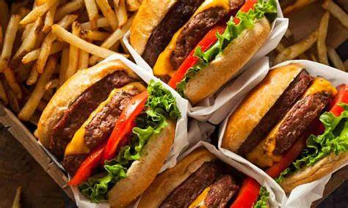
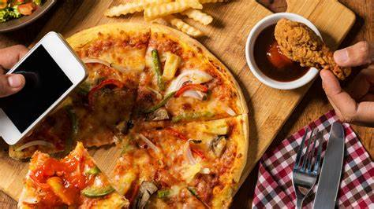
problem/phenomenon
+cause (para1)
structure of the text
cause (para2)
cause(para3)
conclusion(para4)

Slide 14
Para1 key information
Feeling hungry? If you're feeling starved, what is the easiest way to satisfy your hunger? Many of us will reach for a takeaway menu and order some delicious but possibly unhealthy food. And our increasingly busy life adds to our need to buy ready-made food on the go or delivered to our home
ready-made food
fast-pace life
由于
owing to, due to, as a result of, as a consequence of
lead to, result in, be responsible for, give rise to, contribute to

Slide 15
一带一路，一句多译 Key Point1
With the fast pace of modern life, people tend to order takeaways when hungry.
Owing to the busy life, people choose to order ready-made food when hungry.
The fast pace of modern life drives more people to order takeaway food when hungry.
The busy life contributes to the phenomenon that people tend to order ready-made food when hungry.

Slide 16
Para2 key information
Eating options are endless, and new technology means we can feed our desire at the push of a button. Takeaway delivery apps make ordering food quick and convenient. This is especially the case during the recent coronavirus crisis, when people stuck at home with nothing to cook or lacked the skills to prepare a meal for themselves. It's calculated that in the UK alone, people eat three million takeaway meals a day, and the three biggest delivery apps together offer a choice of 100 cuisines from 60,000 restaurants. Amelia Brophy, Head of UK Data Products at Yougov told the BBC that its research "suggests that the frequency of takeaways ordered is expected to increase in the future.
reasons
tendency

Slide 17
2.有效整合信息，删除无用细节
Eating options are endless, and new technology means we can feed our desire at the push of a button. Takeaway delivery apps make ordering food quick and convenient. This is especially the case during the recent coronavirus crisis, when people stuck at home with nothing to cook or lacked the skills to prepare a meal for themselves. It's calculated that in the UK alone, people eat three million takeaway meals a day, and the three biggest delivery apps together offer a choice of 100 cuisines from 60,000 restaurants. Amelia Brophy, Head of UK Data Products at Yougov told the BBC that its research "suggests that the frequency of takeaways ordered is expected to increase in the future.

Slide 18
一带一路，一句多译 Key Point2
递进关系词：besides, moreover, furthermore, additionally, plus
Besides, wide food choices and convenient delivery apps make it more popular.
Moreover, numerous choices and advanced delivery apps give rises to increasing popular takeaway food ordering.
Additionally, wide food choices and convenient delivery apps are also the contributory factors, leading to the popularity of ordering takeaway food.

Slide 19
Para3 key information
negative effects
It's no wonder we are tempted (诱惑)to skip the grocery shopping, avoid the kitchen. and tuck into ( 大口吃)something that someone else has prepared. But ordering a deep crust pizza, a spicy curry or a box of noodles, can come at a price both financially and to our health. Eating too much processed and unhealthy fast food has some effect on obesity and the risk of developing certain diseases. Children and adolescents who eat fast food at least three times a week are more likely to develop eczema, according to one study. Eczema is a skin condition that causes patches of itchy skin.
不重要的例子可以一笔带过或者删除

Slide 20
一带一路，一句多译 Key Point3
转折词：however, yet, but, nevertheless
However, takeaway food costs a lot and also does harm to health.
However, eating too much takeaway food increases economic burden and does harm to health.
Nevertheless, eating too much takeaway food contributes to not only economic burden but also poor health, like obesity or some diseases.
However, too much takeaway food costs a lot and causes some health problems like obesity and certain diseases.

Slide 21
Para4 key information
Of course, reducing salt, sugar zksq and fat is one way to make takeaway food healthier. Yet, that's far from enough. The best advice you might want to take is to find a recipe book and try making your own meal.
ways of solving the problem
并列词：
not only..., but also...
as well as
in addition to

Slide 22
一带一路，一句多译 Key Point4
What can people do to solve the problem?
①
to make takeaway food healthier
②
to make your own meal
To avoid the problem, not only should the takeaway food be made healthier but also more meals be made by yourself.
Thus, more healthier takeaway food and more self-made meals are suggested.
To improve the situation, some measures should be taken, such as offering much healthier takeaway food and learning to make meals by yourself.

Slide 23
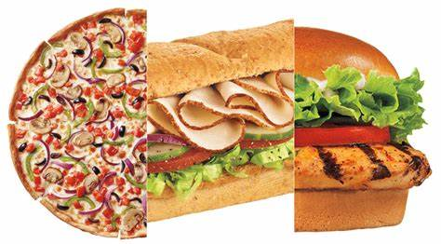
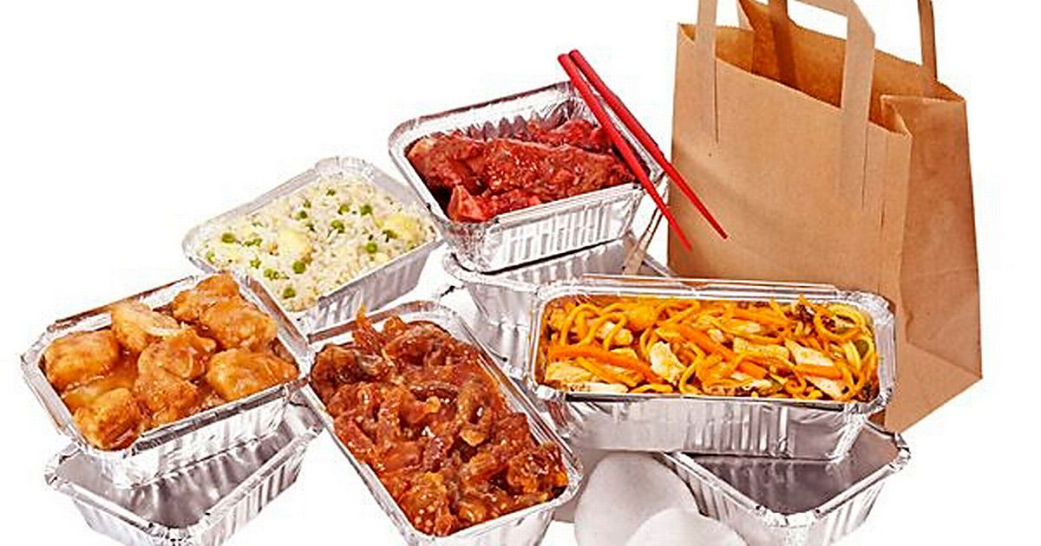
Challenge Yourself

Slide 24
The busy life contributes to the phenomenon that people tend to order takeaway food when hungry.Additionally, wide food choices and convenient delivery apps are also the contributory factors, leading to the popularity of ordering takeaway food. However, too much takeaway food costs a lot and causes some health problems like obesity and certain diseases.Thus, to improve the situation more healthier takeaway food and more self-made meals are suggested. (68字)

