Slide 1

感恩遇见，相互成就，本课件资料仅供您个人参考、教学使用，严禁自行在网络传播，违者依知识产权法追究法律责任。
更多教学资源请关注
公众号：溯恩高中英语
知识产权声明

Slide 2

2022年1月8号浙江首考听力精听课件
瑞安新纪元高中
焦海滨老师制作

Slide 3


影响听力的因素
心理因素学生在进行听力练习或考试时往往表现为听音时感到紧张、焦虑因而导致无法正常听音。
壹
缺乏背景知识由于没有语言环境，学生很少了解听力材料中的背景知识，无法做出正确的判断、推理、猜测。
贰
叁
学生缺乏听力解题技巧研究发现，很多情况下由于听者未能掌握相关的听力技巧，因而不能很好地理解听力材料。
肆
词汇储备不足一个学生的听、说、读、写要达到一定的水平，必须拥有相应数量的必备词汇。

Slide 4

语音知识对听力的影响
在听力理解的过程中，语音是第一位的，听者首先接受的是语音信息，大脑接受了因素，音节，中音等因素构成的单词，短语和句子后使他们在自己的语言图式中“对号入座”，根据已有的知识结构( 图式 ),开始对该信息进行建构，以理解其意义。

Slide 5
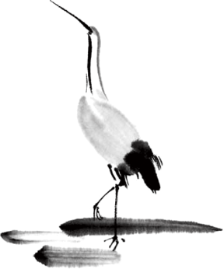
语速的加快主要有一下三种原因
壹
贰
叁
连读
（ 以下用红色标记 )
省音
（ 以下用蓝色标记 ）
音变
（以下用黄色标记 ）

Slide 6



一，连读 （ 以下用红色标记 )
1，“辅音+元音”型连读（异性相吸）
如：I’d like another bowl of rice.
2、“辅音+半元音”型连读英语语音中的/j/和/w/是半元音，如果前一个词是以辅音结尾，后一个词是以半元音，特别是/j/开头，此时也要连读。Thank you .

Slide 7

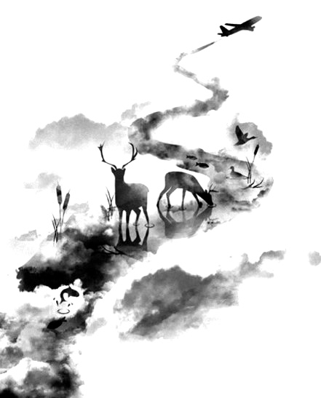
01
二，省音 （以下用蓝色标记）
一、爆破音/b/ /p/ /d/ /t/ /g/ /k/
1.以上任何一个爆破音后面如果紧接着是一个辅音或者半元音，那么这个爆破音将不再发音，仅空半拍就行。如：Good morning!可以发为/gu_'mɔ:niŋ/。
2.以上任何一个爆破音在句尾时，这个爆破音不再发音。如：Good night!最后的/t/音便不再发，整句话可读作/gu_nai_/。

Slide 8
01
二，省音 （以下用蓝色标记）
二、不完全爆破
① 爆破音中的任何两个爆破音相邻时，前一爆破音失去爆破。如：a big car等。
② 爆破音中的任何一个后接摩擦音f,h,x,sh,s,r时，前面的爆破音失去爆破。
如：I didn't say so.
③ 爆破音后接/t/， /d/， /tr/， /dr /时，前面的爆破音失去爆破。如：a great change等。
④ 爆破音后接/m/, /n/, /l/, /s/时，前面的爆破音失去爆破。如：a bit more expensive等。

Slide 9
01
二，省音 （以下用蓝色标记）
三、/s/-/z/ /ts/-/dz/ /∫/-/ ʒ / /t∫/-/ dʒ / /θ/-/ ð / ds发/dz以上任何两个音相遇，只读后面的那个音，而前面的音则省略不发。
如：Who is Stone?可把前面一个/z/省掉，只读作/hu i stəun /。

Slide 10
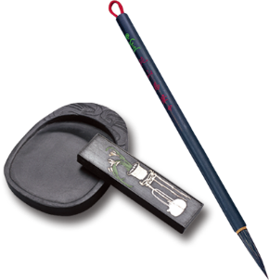
音的变化也是一种连读现象，两个词之间非常平滑的
过渡，导致一个音受临音影响而变化。
主要是以下两种方式：
1、 辅音[d]与[j]相邻时，被同化为[dʒ]：
Would you....?
2、 辅音[t]与[j]相邻时，被同化为[t∫]：
Can’t you？
三，音变
（以下用黄色标记 ）

Slide 11
听力试音材料
M:Hello ! International Friends Club , can I help you ?
W: Oh , hello ! I read about your club in the paper today . And I thought I’d phone to find out a bit more .
M:Yes , certainly . well , we’re a sort of social club for people from different countries . It’s quite a new club .we have about 50 members at the moment but we’re growing all the time .

Slide 12
听力试音材料
W: That sounds interesting .I’m British actually ,and I came to Washington about three months ago ,I’m looking for ways to meet people . . Er ,what kinds of events do you organize ?
M: well , we have social get-togethers ,and sports events ,and we also have language evenings
W: Could you tell me something about the language evenings ?

Slide 13
听力试音材料
M: Yes , every day except Thursday , we have a language evening. People can come and practice their languages .you know , over a drink or something .we have different languages on different evenings . Monday -Spanish; Tuesday- Italian ;Wednesday- German and Friday- French .On Thursday we usually have a meal in a restaurant for everyone who wants to come .

Slide 14
听力试音材料
W:well,that sounds Great , I really need to practice my French .
M: Ok , well if you can just give me your name and address I’ll send you the form and some more information .If you join now ,you can have first month free .

Slide 15


例题
M:Excuse me ,can you tell me how much the shirt is ?
W：Yes, it’s nine-fifteen.
例：How much is the shirt?
A. ￡19.15. B. ￡9.18. C. ￡9.15.

Slide 16


Text 1 相约会面
M:Professor Jackson，could I talk to you about my paper sometime today？
W:Sure,when the class is over. I need to go to the lab first and then I'll be the _______ at about 12:30. let's meet ______.
M:Okay.thanks ,professor Jackson!
1.Where are the speakers going to meet ?
A . In a lab B. In a cafeteria . C . In a classroom

Slide 17

M:Professor Jackson，could I talk to you about my paper sometime today？
W:Sure,when the class is over. I need to go to the lab first and then I'll be the cafeteria at about 12:30. let's meet there.
M:Okay.thanks ,professor Jackson!
1.Where are the speakers going to meet ?
A . In a lab B. In a cafeteria . C . In a classroom
重点词汇：cafeteria 咖啡馆

Slide 18
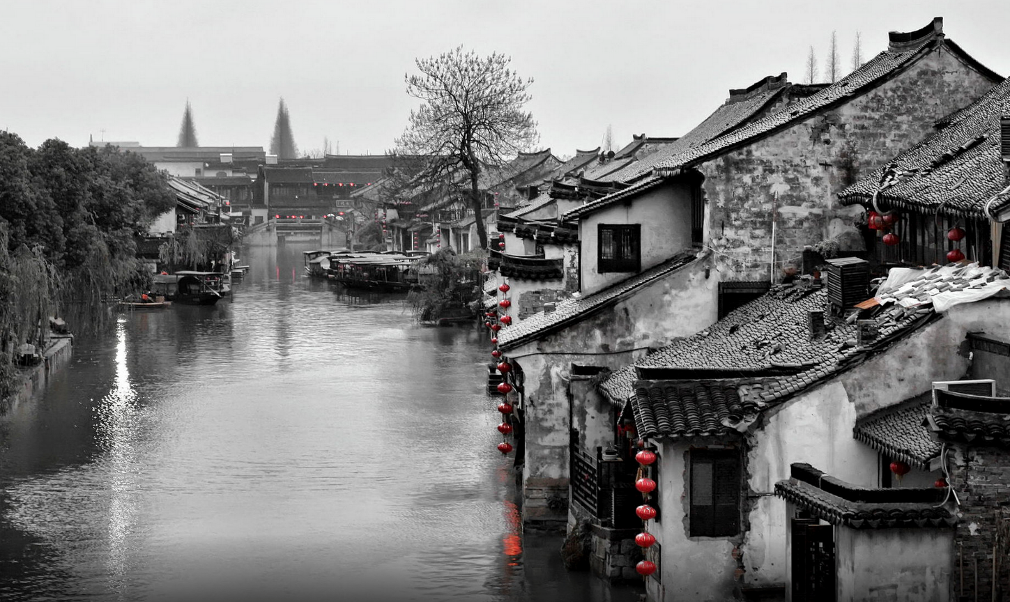
Text 2 烹饪美食
——————————
M:What are you cooking？It smells delicious.
W:I'm making a carrot cake.
M:Nice，I see a roast chicken and an ___ ____ over there,too.
W:The chicken is for dinner and the ____is for ____.____ has to take _____ to school tomorrow.
2.What will Jeff take to school tomorrow ?
A . An apple pie .
B. A carrot cake
C . A roast chicken.

Slide 19

Text 2 烹饪美食
——————————
M:What are you cooking？It smells delicious.
W:I'm making a carrot cake.
M:Nice！I see a roast chicken and an apple pie over there,too.
W:The chicken is for dinner and the pie is for Jeff.He has to take something to school tomorrow.
2.What will Jeff take to school tomorrow ?
A . An apple pie .
B. A carrot cake
C . A roast chicken.
apple pie 苹果派
carrot cake 胡萝卜饼
roast chicken 烤鸡

Slide 20
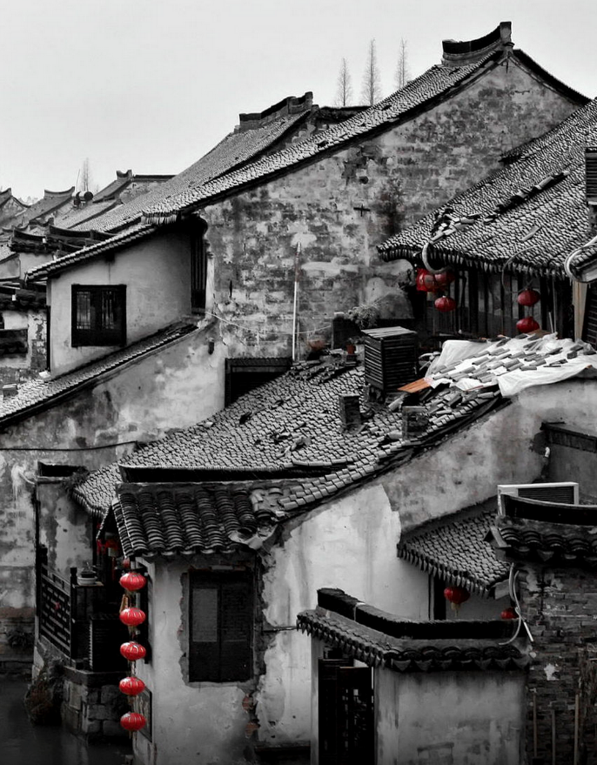
Text 3 图书馆
W:This neighbourhood really needs a _____, how can we get _____？
M:I think we should have a meeting to talk about ____.
3.What are the speakers talking about ?
A . Visiting a neighbor.
B . Getting a library
C . Attending a meeting
天人合一
天 下 皆 知 美 之 为 美 ， 斯 恶 已
皆 知 善 之 为 善 ， 斯 不 善 已
有 无 相 生 ， 难 易 相 成 ， 长 短 相 形
高 下 相 盈 ， 音 声 相 和 ， 前 后 相 随
恒 也

Slide 21
Text 3 图书馆
W:This neighbourhood really needs a library, how can we get one？
M:I think we should have a meeting to talk about it.
3.What are the speakers talking about ?
A . Visiting a neighbor.
B . Getting a library
C . Attending a meeting
天人合一
天 下 皆 知 美 之 为 美 ， 斯 恶 已
皆 知 善 之 为 善 ， 斯 不 善 已
有 无 相 生 ， 难 易 相 成 ， 长 短 相 形
高 下 相 盈 ， 音 声 相 和 ， 前 后 相 随
恒 也

Slide 22

T Text 4 新工作
M:Hi,Jim .How's your new job going？
W:It's very exciting and I'm really learning a lot but it's also quite tiring.I feel like a ____ ______ this weekend.
4.What will Jim probably do this weekend ?
A . Finish a project
B . Take a class
C . Have a rest

Slide 23
T Text 4 新工作
M:Hi,Jim .How's your new job going？
W:It's very exciting and I'm really learning a lot but it's also quite tiring.I feel like a
good break this week end.
4.What will Jim probably do this weekend ?
A . Finish a project
B . Take a class
C . Have a rest
finish the project 完成一个项目
have a break =have a rest

Slide 24
Text 5e培养技能xt
M:Amanda ,What skill would you like to develop ？
W:Well，I want to learn to play the _____. I love writing songs, you know. and I think it would be _____ if I could play my own _____ and entertain people。
5.Why does Amanda want to learn to play the guitar ?
A.To record popular songs .
B. To perform her own music
C. To become a guitar teacher .

Slide 25
Text 5e培养技能xxt
M:Amanda ,What skill would you like to develop ？
W:Well，I want to learn to play the guitar. I love writing songs, you know. and I think it would be lovely if I could play my own music and entertain people.
5.Why does Amanda want to learn to play the guitar ?
A.To record popular songs .
B. To perform her own music
C. To become a guitar teacher .
develop a skill 培养技能
perform music 演奏音乐
entertain people 娱乐人们
play music = perform music

Slide 26
Text 6 银行开户
M:Hello，City Bank .Can I help you？
W:Hi,I'm calling ___ __________ on opening a ______ ______.
M:Have you had any accounts in our bank before ？
W:No,I don't think so .
M:Then you'll have to go in person to one of our branches and talk to a clerk there.
W:I see. Is there a bank near Brown college？
M:We have one branch at 135 Dudley Road and one at 512 Kingfield Street.
W:I think I'll ____ to the one at _______ .Thank you.

Slide 27
Text 6 银行开户
M:Hello，City Bank .Can I help you？
W:Hi,I'm calling for information on opening a savings account.
M:Have you had any accounts in our bank before ？
W:No,I don't think so .
M:Then you'll have to go in person to one of our branches and talk to a clerk there.
W:I see. Is there a bank near Brown college？
M:We have one branch at 135 Dudley Road and one at 512 Kingfield Street.
W:I think I'll go to the one at Dudley .Thank you.
open a savings account
开一个储蓄账户
in person 亲自
branch 支行，支流 ，树枝

Slide 28


6.What does the woman want to do ?（ 细节题）
A . Open a bank account . 开一个账户
B . Cancel a credit card . 吊销信用卡
C . Withdraw some money . 取钱
7 . Where will the woman go ? （ 细节题）
A . Brown College .
B . Dudley Road .
C Kingfield Street .

Slide 29
Text 7 约会见面
W: Good morning , Frank Sampson’s .
M: Good morning,This is Peter Clifford from Smart Tech .________________________ ,please?
W:I’m sorry .Mr .smith is _____________ right now .Would you like to _________________ or ________ later？
M: What time is the meeting over？
W:Well，it started at ______ o'clock and it usually lasts about______ hours.
M:All right.In that case,could you please tell him to check this email? I’ve sent him an important document.I'm waiting for his reply.
W:Certainly, anything else ,sir?
M: Yes, I'd like to know what would be the best time for ________before ________. I ____________ this week. Please tell him to include the time in his reply.
W:Do you want to meet him in our office or in your office, sir ？
M: Oh , either is fine .
W: Alright ,sir ! I'll tell him when he's back.

Slide 30
Text 7 约会见面
W: Good morning , Frank Sampson’s .
M: Good morning,This is Peter Clifford from Smart Tech .Could I speak to Mr. smith ,please?
W:I’m sorry .Mr .smith is having a meeting right now .Would you like to leave a message or call back later？
M: What time is the meeting over？
W:Well，it started at one o'clock and it usually lasts about two hours.
M:All right.In that case,could you please tell him to check this email? I’ve sent him an important document.I'm waiting for his reply.
W:Certainly, anything else ,sir?
M: Yes, I'd like to know what would be the best time for us to meet before Friday. I must
meet him this week. Please tell him to include the time in his reply.
W:Do you want to meet him in our office or in your office, sir ？
M: Oh , either is fine .
W: Alright ,sir ! I'll tell him when he's back.
include .vt. 包含，包括
document .n. 文件

Slide 31
8.What does the woman do ? （推理题 ）
A . She’s a secretary 秘书
B . She’s a manager 经理
C . She’s a salesperson 销售员
9.What time will the meeting probably be over ?（数字题）
A . At 1:00
B . At 2:00
C . At 3:00
10 . What does the man want to do before Friday ?（ 细节题）
A . Meet Mr.Smith
B . Write a document
C . Move to a new office
天人合一
天 下 皆 知 美 之 为 美 ， 斯 恶 已
皆 知 善 之 为 善 ， 斯 不 善 已
有 无 相 生 ， 难 易 相 成 ， 长 短 相 形
高 下 相 盈 ， 音 声 相 和 ， 前 后 相 随
恒 也

Slide 32
Text 8 参加毕业典礼
M:Hi,Annie .That's a very lovely bunch of flowers.
W:It's for my____ . It's her _________ day today.
M:It must have cost you a fortune .
W: I paid sixty dollars for it，but it's worth it. ____ worked very hard for her degree over the last four years.Today is a very important day for her and I wanted it to be special.
M:That's very nice of you.I wish for _____ _______ ______ ,too.
W: Another three years and we'll be done ,too .
M: Where are they going to hold the graduation ceremony?
W:In the conference hall at 2 p.m.It'll be a big ceremony
M:I guess you should be there ______ .Otherwise you won’t get a seat.
W: Yes,I'll try to find a seat close to the stage.I want to take some good pictures of my sister.
M:Have fun,Annie .Give Jane my best wishes .
W:Thanks.Bye Steve .

Slide 33
Text 8 参加毕业典礼
M:Hi,Annie .That's a very lovely bunch of flowers.
W:It's for my sister . It's her graduation day today.
M:It must have cost you a fortune .
W: I paid sixty dollars for it，but it's worth it. Jenny worked very hard for her degree over the last four years.Today is a very important day for her and I wanted it to be special.
M:That's very nice of you.I wish for our graduation day ,too.
W: Another three years and we'll be done ,too .
M: Where are they going to hold the graduation ceremony?
W:In the conference hall at 2 p.m.It'll be a big ceremony
M:I guess you should be there early .Otherwise you won’t get a seat.
W: Yes,I'll try to find a seat close to the stage.I want to take some good pictures of my sister.
M:Have fun,Annie .Give Jenny my best wishes .
W:Thanks.Bye Steve .
degree.n . ( 大学 ）学位 a bunch of flowers . 一束鲜花
graduation day .n. 毕业典礼日 cost ( sb ) a fortune 花（某人）一大笔钱
be worth it .值得 hold a graduation ceremony 举行毕业典礼
conference hall .礼堂，会议厅

Slide 34

11.Whose graduation day is it today ?(事实细节题）
A .Annie’s
B. Steve’s
C. Jane’s
12.What does the man suggest the woman do ?(事实细节题）
A . Arrive early
B . Sit near the stage .
C .Take some pictures
13.What is the relationship between the speakers ?(推理判断题）
A . Brother and sister
B . Fellow teachers .
C. Schoolmates

Slide 35
Text 9 熟人相遇
W:Oh,I _____ ______ _____, Peter.I haven’t seen you for ages. How are you？
M:Hi,laura. Nice to meet you here! I'm pretty good.How about you？
W: I’m fine. It's really great to see you. Do you have time to sit down？
M: I was leaving . but I could join you for a few minutes.
W:Great !So tell me how's your family?
M:Well.It keeps getting bigger.We have______ ______ now.All boys .
W:All boys ?I suppose they keep you busy.
M:They sure do .The baby is only one month old,so Sally is not working right now. And what's new with you and Jim ?
W:Believe it or not,he's home with the kids.
M:You're kidding!
W:No，I'm not. Jim chose to _____ _____ ______ so we can spend less on ________.I love it because he does all the shopping and cleaning.
M:Good point.Yikes.It's already12:30. I have to go now.I ______ _____ _____ _________ this afternoon . Tell Jim I said hi. And I'll call you so we can have dinner sometime.
W:Great !And say hi to Sally and your kids .See you!
M:See you!

Slide 36
Text 9 熟人相遇
W:Oh,I can't believe it, Peter.I haven’t seen you for ages. How are you？
M:Hi,laura. Nice to meet you here! I'm pretty good.How about you？
W: I’m fine. It's really great to see you. Do you have time to sit down？
M: I was leaving . But I could join you for a few minutes.
W:Great !So tell me how's your family?
M:Well.It keeps getting bigger.We have four kids now.All boys .
W:All boys ?I suppose they keep you busy.
M:They sure do .The baby is only one month old,so Sally is not working right now. And what's new with you and Jim ?
W:Believe it or not,he's home with the kids.
M:You're kidding!
W:No，I'm not. Jim chose to work from home so we can spend less on childcare.I love it because he does all the shopping and cleaning.
M:Good point.Yikes.It's already12:30. I have to go now.I have an important meeting this afternoon . Tell Jim I said hi. And I'll call you so we can have dinner sometime.
W:Great !And say hi to Sally and your kids .See you!
M:See you!
childcare.n . 儿童看护；儿童照管
yikes .exclamation .呀；啊

Slide 37
14.How does Laura sound at the beginning of the conversation ?
A . Anxious （观点态度题）
B . Regretful
C . Surprised
15.What do we know about Peter ? (事实细节题）
A . He has got a new job .
B He has four children .
C He has a big house .
16.Why did Jim choose to work from home ?(事实细节题）
A.To look after the kids.
B. To get more sleep .
C To accompany his wife .
17.What is Peter going to do this afternoon ?(事实细节题）
A . Hold a dinner
B . Give Sally a call
C . Attend a meeting

Slide 38
Text 10 痛苦能带来欢乐
Good evening, _____！I'm Jennifer Green.Thanks for ____ ____.In today’s ____ of Perfect Life our ______ is Brock Bastian, a social psychologist from university of Melbourne. Professor Bastian’s research focuses on pain, happiness and morality .Recently he published a book on the _____ of _____ in ________ _______.The title of the book is The Other Side of Happiness. In this book, he argues that as we seek to escape pain or sorrow, we are weakening ourselves and may lose our adaptability to deal with pain in the future. _____ _______ are in fact _____for our _________ and how they face the unavoidable challenge ahead and they play a key role in helping us to develop our ability to feel truly happy .______ let's _____ professor Bastian to ____ _____ his _____ in the book.

Slide 39
Text 10 痛苦能带来欢乐
Good evening, everyone！I'm Jennifer Green.Thanks for joining us.In today’s edition of perfect life our guest is Brock Bastian, a social psychologist from university of Melbourne. Professor Bastian’s research focuses on pain, happiness and morality .Recently he published a book on the role of pain in promoting pleasure .The title of the book is The Other Side of Happiness. In this book, he argues that as we seek to escape pain or sorrow, we are weakening ourselves and may lose our adaptability to deal with pain in the future. Painful experiences are in fact vital for our development and how they face the unavoidable challenge ahead and they play a key role in helping us to develop our ability to feel truly happy .Now let's welcome professor Bastian to talk about his ideas in the book.
edition.n . ( 广播，电视节目的）一期 psychologist .nl 心理学家
morality .n. 道德；品行；美德 argue vt 主张；认为
weaken .vt 减少；使变弱 vital adj 至关重要的
promote .vt 促进；推动 adaptability .n. 适应能力

Slide 40
18.What is Jennifer Green doing ?( 推理题）
A . Conducting a class . =having a class
B. Presenting a speaker . = introducing a speaker
C . Recommending a book 推荐一本书
19.What is Professor Bastian’s book about ?(推理题）
A .Tips for escaping unhappiness .
B . Benefits of painful experiences
C. Ways to develop reading ability .
20 . What is Professor Bastian going to do next ?（ 推理题）
A . Share his stories
B . Discuss his plans .
C . Explain his views .

Slide 41
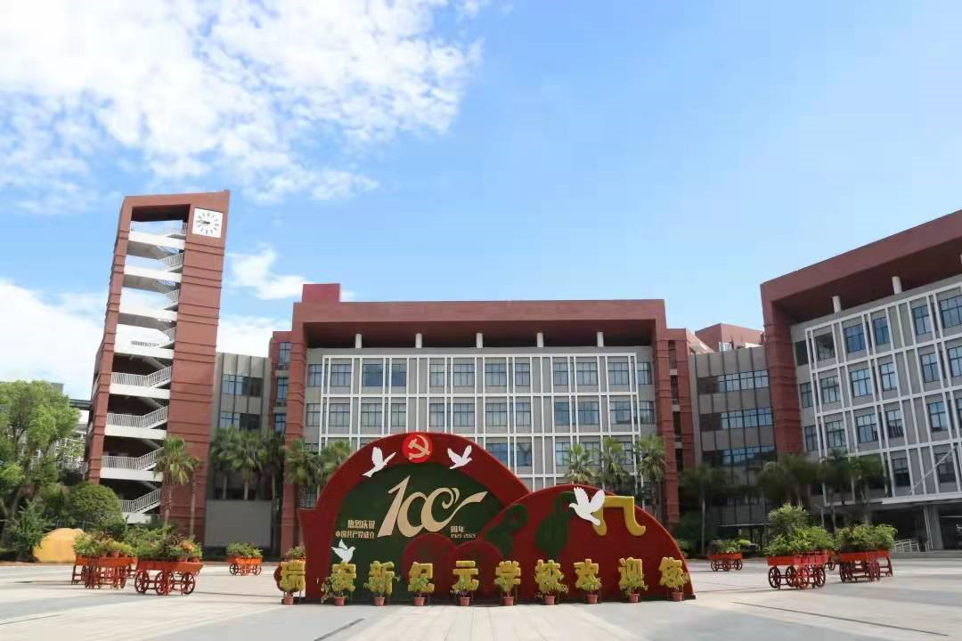
欢迎指导

