Slide 1


感恩遇见，相互成就，本课件资料仅供您个人参考、教学使用，严禁自行在网络传播，违者依知识产权法追究法律责任。
更多教学资源请关注
公众号：溯恩英语
知识产权声明

Slide 2
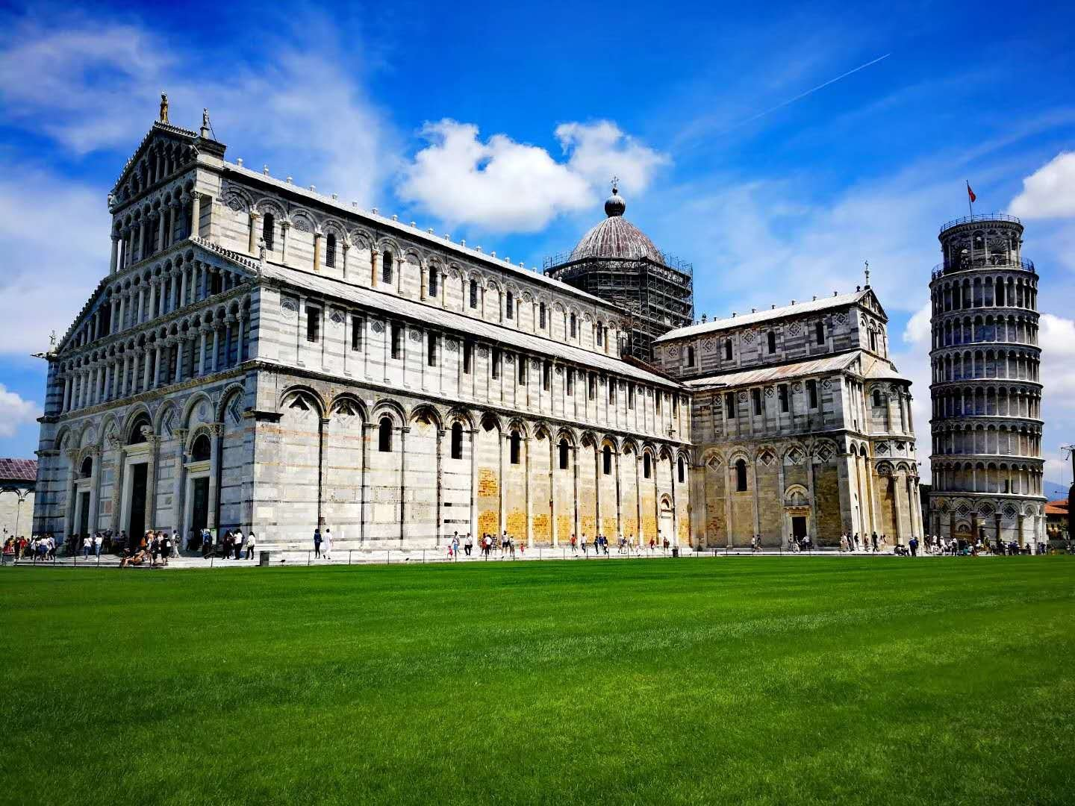
B1U2
Expanding
your world
Shirley Tong

Slide 3

What do you think of your hometown?
What is the landmark(地标性建筑) of your hometown?
What do you think the people in your hometown?
Notes:
according to your description, I know your hometown is really fine... Let’s try to learn another find city.

Slide 4
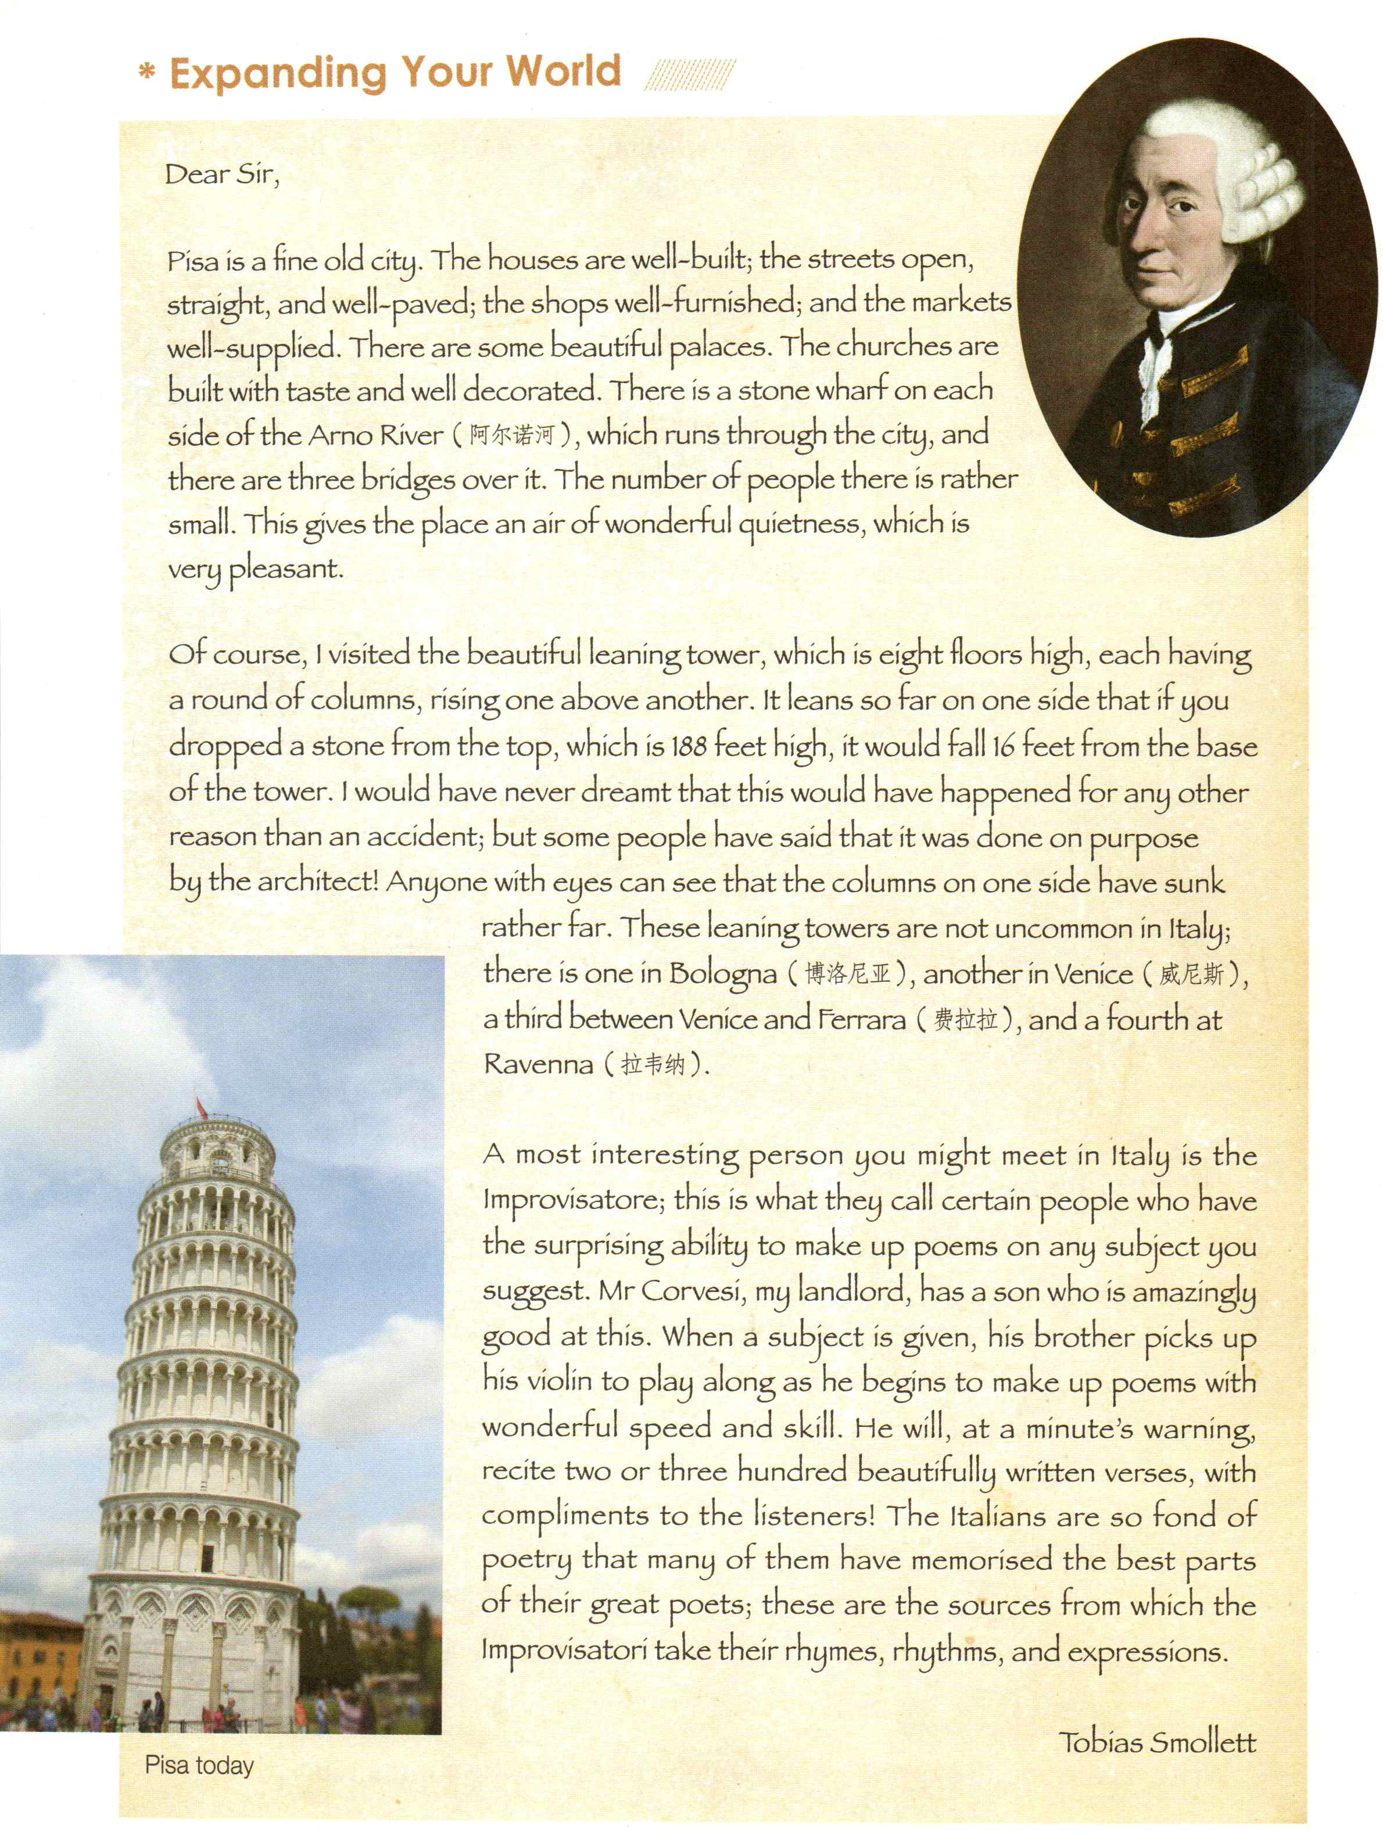
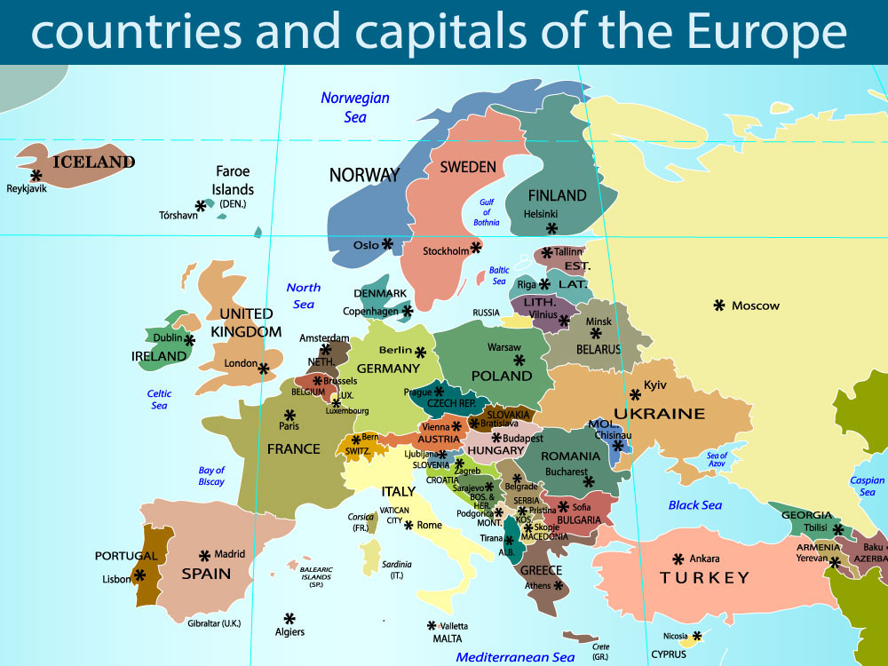
Who write this letter?
Where did he go?
Tobias Smollett (1721-1771) was a Scottish poet and author.
What do you expect to know from the text?
raise questions with “wh-”
Where
When
Who
What
Why
How
Pisa,Italy
Notes:
Let’s explore how did he describe Pisa? What do you expect to learn from the text?

Slide 5
Pisa is a fine old city.
I visited the beautiful leaning tower.
What’s his first impression of Pisa?
Where did he visit?
Who did he meet?
A most interesting person ...
Improvisatore/ɪmˌprɒviːzɑːˈtɔː/
Notes:
When did he visit? What did he see? What did he do?(activity) Where did he visit?(place) How did he feel?(feeling) What kind of city it is?

Slide 6
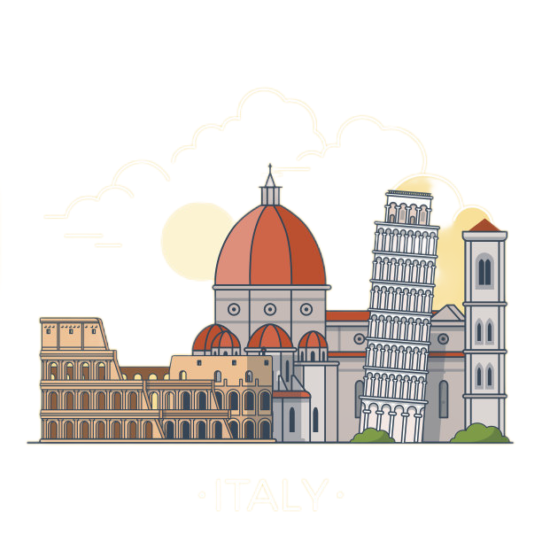
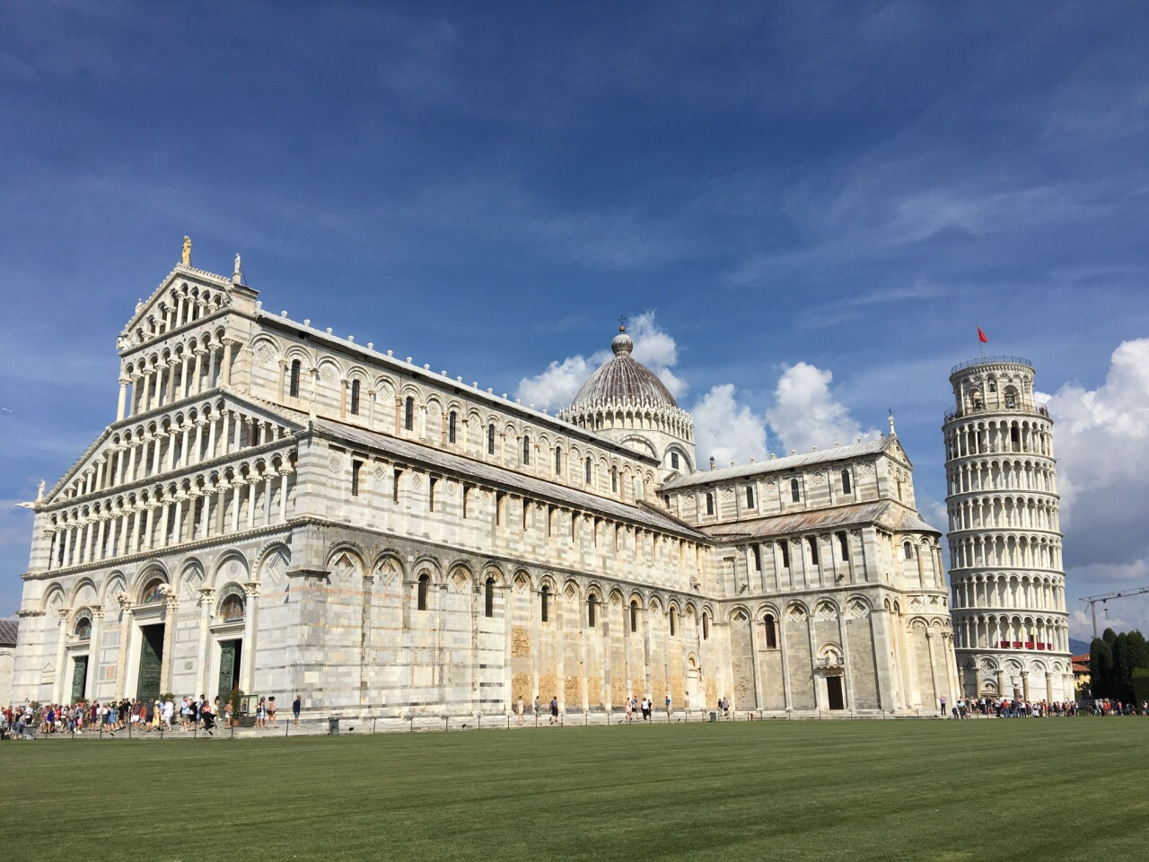
General Impression:
Pisa is a fine old city.
Why is it a fine city?
Pisa is a fine old city. The houses are well-built; the streets open, straight, and well-paved; the shops well-furnished; and the markets well-supplied. There are some beautiful palaces. The churches are built with taste and well decorated. There is a stone wharf on each side of the Arno River(阿尔诺河), which runs through the city, and there are three bridges over it. The number of people there is rather small. This gives the place an air of wonderful quietness, which is very pleasant.
well-built
well-paved
well-furnished
well-supplied
well decorated
Tip1: use descriptive words (描述性语言) and repetition to paint a vivid(生动的） picture.
Why does the author use so many “well-”adjectives?
City feature(特征): a well-built city
Repetition(重复)
What rhetorical device (修辞手法) is used?
Notes:
Why does the author use so many “well-”adjectvies? to describe a vivid picture of Pisa city. describe what he saw... repetition - tip Enjoy a short video about pisa = city feature of pisa well-built

Slide 7
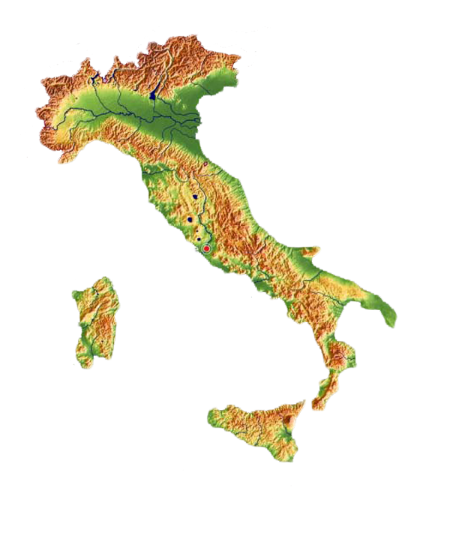

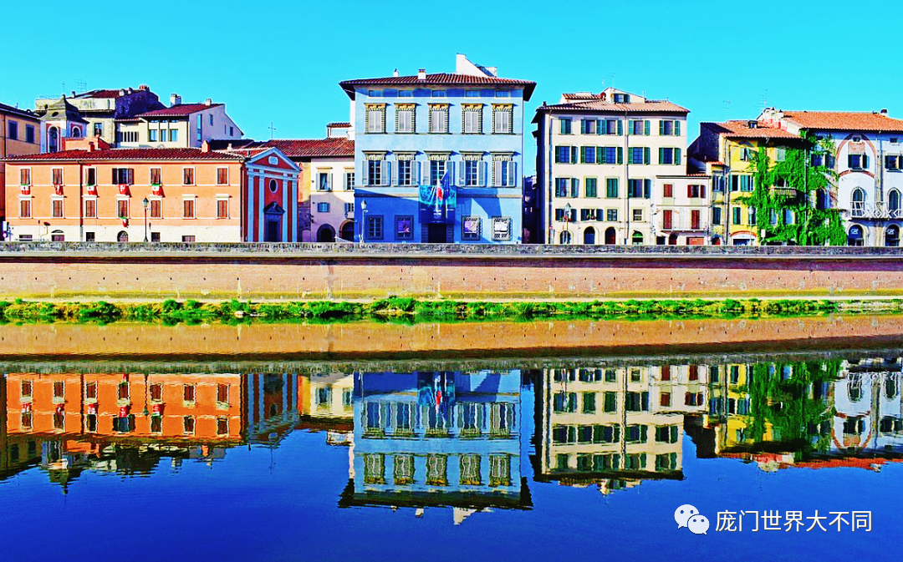
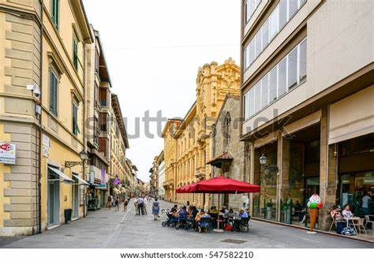
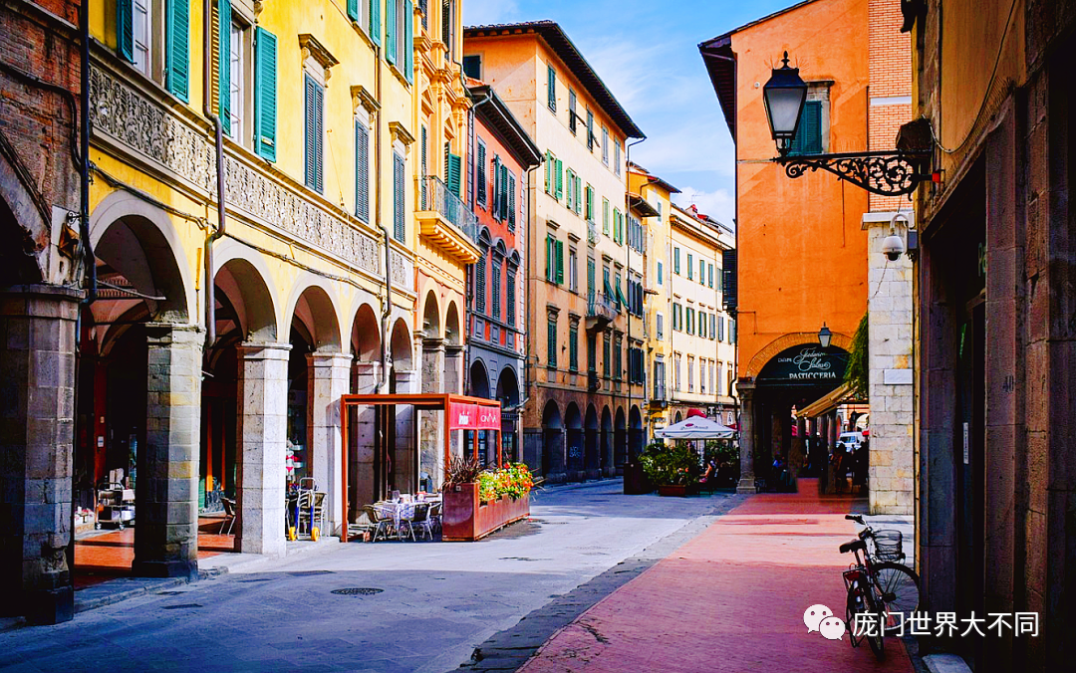

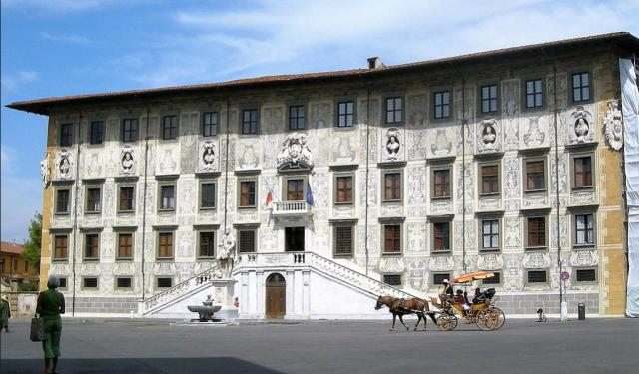
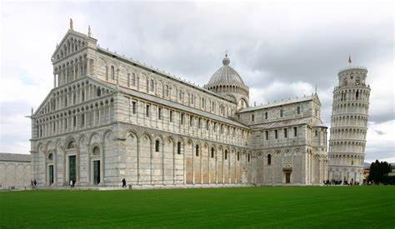
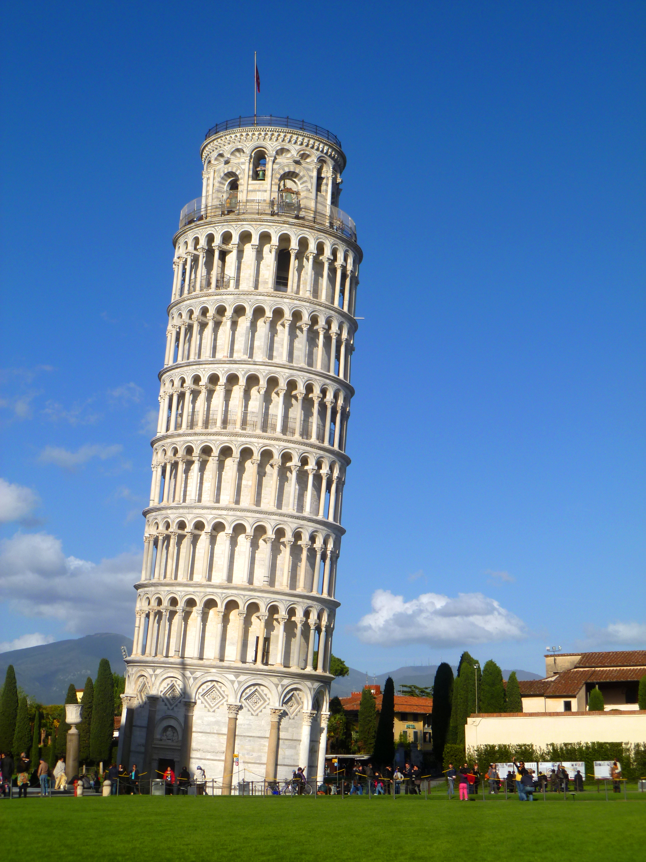
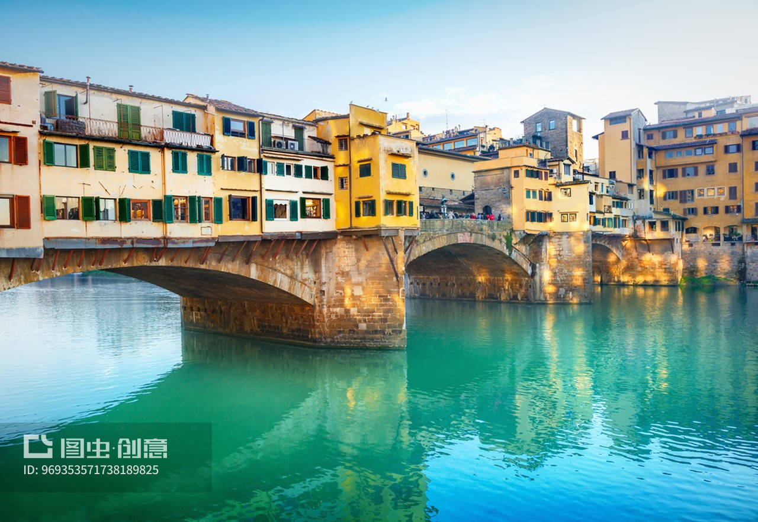

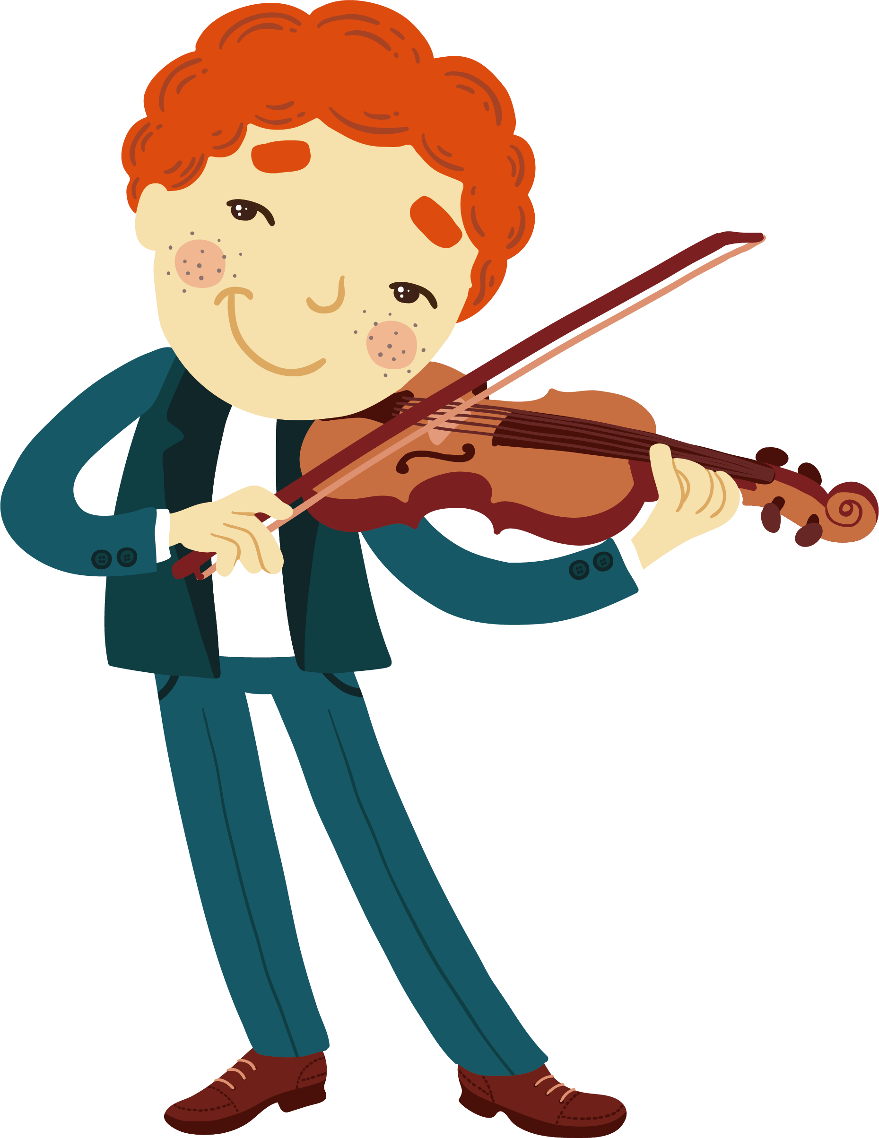
General Impression: Pisa is a fine old city.
the houses
the street
the shops
the markets
the palaces
the churches
Which sentence does the writer use to show how “leaning” the tower is?
Why is it beautiful?
Why are the people interesting?
City feature: a well-built city
Arno River
Improvisatore
/ɪmˌprɒviːzɑːˈtɔː/
Leaning tower
I visited the beautiful leaning tower.
A most interesting person ...
Notes:
Where did he go? What did he see? What did he do?
What is the first impression of Pisa? Fine= old city How does the author feel? fine; old; beautiful; quiet; pleasant ; admired

Slide 8
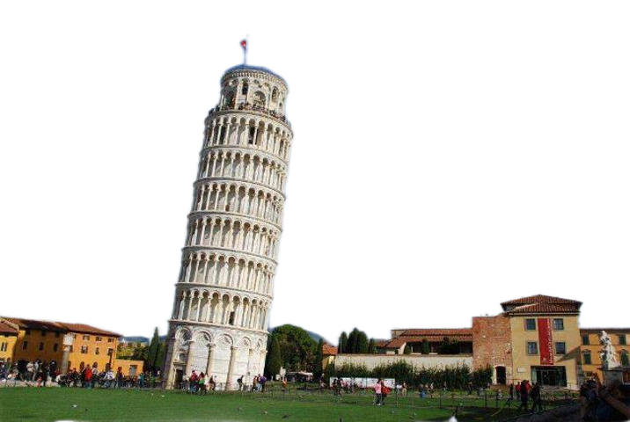
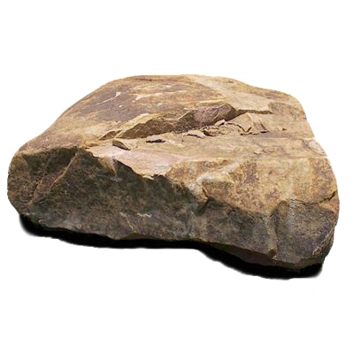
unique beautiful landmark
Landmark: beautiful leaning tower
It leans so far on one side that if you dropped a stone from the top, which is 188 feet high, it would fall 16 feet from the base of the tower.
Draw a picture to show how leaning the tower is according to the author.
Why is the leaning tower beautiful?
I would have never dreamt that this would have happened... These leaning tower are not uncommon in Italy;
Why does the author use figures to describe leaning tower?
Hight
188 feet
Tip2: use figures(数字) to make the description easy to understand and more convincing.
16 feet
Length
Notes:
用数字更好的解释the leaning tower feature... beautiful how beautiful= not uncommon 在中国不常见 。。。 use an adj to describe = 美是一个独特的点

Slide 9

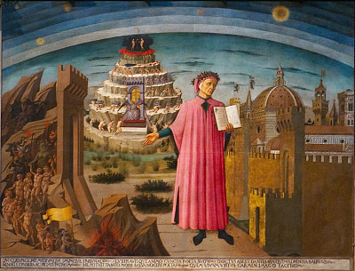
People: interesting people
fond of poetry
A most interesting person you might meet in Italy is the Improvisatore; this is what they call certain people who have the surprising ability to make up poems on any subject you suggest. Mr Corvesi, my landlord, has a son who is amazingly good at this. When a subject is given, his brother picks up his violin to play along as he begins to make up poems with wonderful speed and skill. He will, at a minute's warning, recite two or three hundred beautifully written verses, with compliments to the listeners! The Italians are so fond of poetry that many of them have memorised the best parts of their great poets; these are the sources from which the Improvisatori take their rhymes, rhythms, and expressions.
Passion for poetry;
Great poems of
great poets;
culture
Dante(但丁)
Your hometown shapes your personality(性格). 一方水土养一方人
Tip3：reflect regional(区域) culture when introducing people.
Notes:
so fond of peotry Why are Italians fond of poetry?
? because they can recite two or three hundred ... verses, to listeners... = surprising? 有趣的原因是什么？

Slide 10
General Impression: Pisa is a fine old city.
the houses
the street
the shops
the markets
the palaces
the churches
City feature: a well-built city
Arno River
Improvisatore
/ɪmˌprɒviːzɑːˈtɔː/
Leaning tower
The unique beautiful landmark
A most interesting person ...
Notes:
Where did he go? What did he see? What did he do?
What is the first impression of Pisa? Fine= old city How does the author feel? fine; old; beautiful; quiet; pleasant ; admired

Slide 11

Languge
Content
How
Tip1: use descriptive words (描述性语言) and repetition to paint a vivid picture.
Para.1 City features + impression
well-built; open, straight, and well-paved; well-furnished; well-supplied; beautiful; are built with taste and well decorated...
...is a fine old city. ;...an air of wonderful quietness, which is very pleasant.
Tip2: use figures(数字) to make the description easy to understand and more convincing.
Para.2 Landmark
...which is eight floors high, each ...; It leans so far on one side that ... which is 188 feet high,... 16 feet...
Tip3：reflect regional(区域) culture when introducing people.
...so fond of ...that ...; these are the sources from which ...take their rhymes, rhythms, and expressions.
Para.3 People
Feelings
I would have never dreamt.../are not uncommon/ I visited the beautiful.../A most interesting person...

Slide 12

Imagine that Tobias Smollet came to your hometown. Try to describe experience visiting your hometown.
Content:
The beautiful scenery of ...
Landmark ...
People ...

Slide 13


