Slide 1
感恩遇见，相互成就，本课件资料仅供您个人参考、教学使用，严禁自行在网络传播，违者依知识产权法追究法律责任。
更多教学资源请关注
公众号：溯恩高中英语
知识产权声明

Slide 2
活用教材词汇，靶向高考写作
M1U5 Languages Around The World

Slide 3
native /ˈneɪtɪv/ a. 本地的；土著的 n. 本地人
1. native speakers 说母语的人
作为一名中文母语并且流利掌握英语的人，我在沟通我们的中国客户与来自英语国家的人之间拥有独特的优势，确保协作顺畅高效。(应用文之应聘信)
As a native Chinese speaker with fluency in English, I possess a unique advantage in bridging the communication gap between our Chinese customers and people from English-speaking countries, ensuring smooth and effective collaboration.
2. be native to+sp 原产于某地
龙井茶产自杭州，你可以参观茂密的茶园，并亲身体验传统的制茶过程，品尝这种著名的中国绿茶的真正风味。（应用文之介绍茶文化）
Longjing Tea is native to Hangzhou, where you can visit the lush tea plantations and experience the traditional tea-making process firsthand, savoring the authentic taste of this renowned Chinese green tea.

Slide 4
attitude
/ˈætɪtju:d/
n.态度;看法
one’s attitude to /toward(s) sb/ sth 对...的态度/看法
态度对我们来说比事实更重要。我们不能改变我们的过去；我们不能改变事实。然而，我们唯一能做的就是对生活保持积极的态度。 （续写主题升华之战胜消极促“改变”）
Attitude is more important than facts for us. We cannot change our past; we cannot change the fact. However, the only thing we can do is hold a positive attitude towards life.

Slide 5
refer to /rɪˈfɜ:(r)/ (-rr-) 指的是;描述;提到;查阅
这本书提到的一些故事已经成真了。
遇到不认识的词，我就查阅字典。
Some stories this book refers to have come true.
Once I meet the word I don’t know, I refer to a dictionary.
我写信是关于您公司网站上发布的招聘广告。我对该职位非常感兴趣，并希望提交我对该职位的申请。(应用文之应聘信)
I am writing with reference to the job advertisement posted on your company's website. I am highly interested in the position and would like to submit my application for it.

Slide 6
despite /dɪˈspaɪt/ prep.即使;尽管
although/though 与despite
_________ the terrible weather, we continued working in the field.
_________ the weather was terrible, we continued working in the field.
Despite
Although/Though
despite是介词，although/though是连词
尽管写作过程中充满了挑战、怀疑和疲惫，但我很高兴我没有放弃。(2023浙江卷续写写作比赛)
Despite the challenges, doubts as well as fatigue while writing, I'm glad that I didn't quit.
=Despite the fact that I was confronted with challenges, doubts as well as fatigue while writing, I'm glad that I didn't quit.

Slide 7
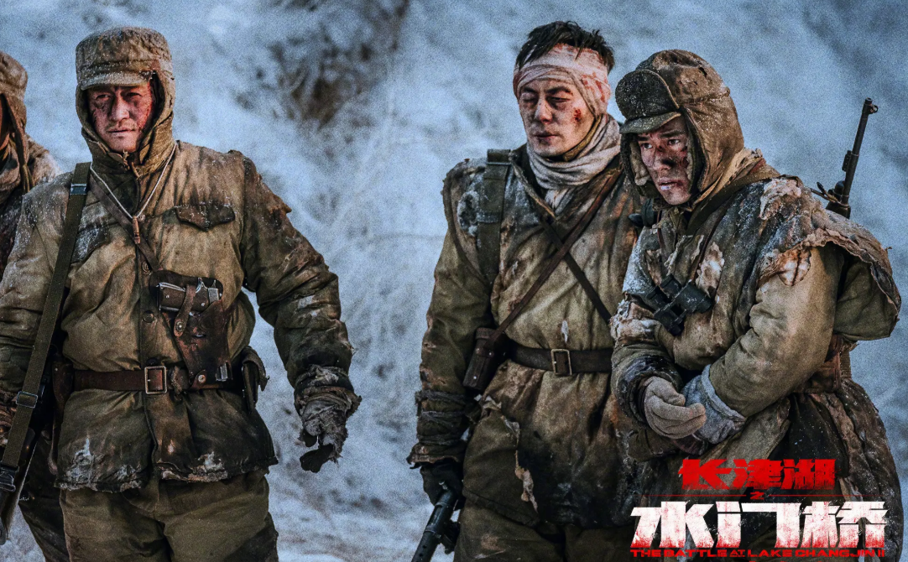
based /beɪst/ adj.以(某事)为基础的
在开始的时候，书写中文是一种以图像为基础的语言。（课文原句）
At the beginning, written Chinese was a picture-based language.
这部电影以历史上真实发生的一件事为原型。
The movie is based on/upon a true historic event.

Slide 8
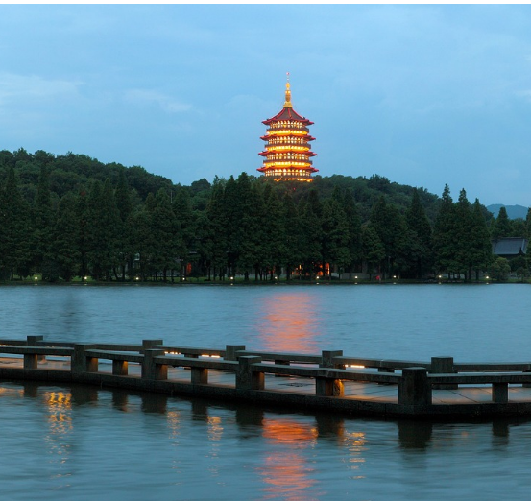
date back to/from 追溯到
雷峰塔可以追溯到唐代，是一座文化宝藏，吸引着游客们来探索其丰富的历史和建筑之美。(应用文之推荐旅游城市)
Lei Feng Pagoda, dating back to the Tang Dynasty, is a cultural treasure that attracts tourists to explore its rich history and architectural beauty.
out of date过时的
up to date 赶上......的潮流
I always make sure to keep my computer's software up to date to ensure security.
我总是确保及时更新我的电脑软件，以确保安全。

Slide 9
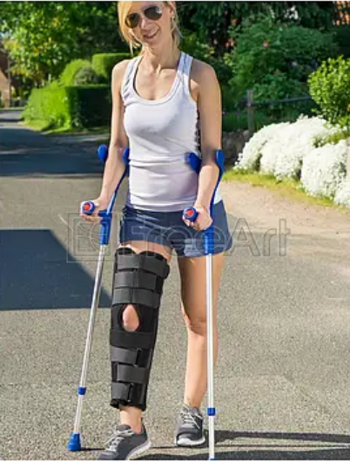
symbol /ˈsɪmbl/ n.符号;象征
1. a symbol of 是...的象征
她恍然大悟，这个支撑器(brace)不是什么可羞愧的东西，而是她对抗挑战时的坚强和毅力的象征。（续写主题升华之战胜胆怯促“自信”）
It dawned on her that the brace wasn’t something to be ashamed of but rather a symbol of her strength and resilience against challenges.
2. symbolize v.象征着
White has always __________ (v.象征着) purity in Western culture.
symbolized

Slide 10
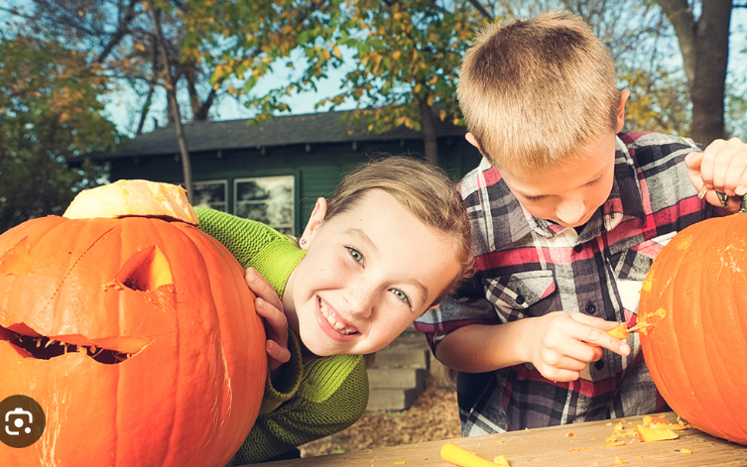
carve /kɑ:v/ vt.&vi.雕刻
孩子们在为万圣节雕刻南瓜。
The kids are carving a pumpkin for Halloween.
她微笑的面容和亲切的话语深深地刻在他的脑海中，留下了永久的印象，他会永远珍藏。
The image of her smiling face and kind words carved deeply into his mind, leaving a lasting impression that he would cherish forever.

Slide 11
variety /vəˈraɪəti/ n.(植物、语言等)变体;异体
1. a (wide) variety of=(wide) varieties of = various+n.各种各样的...
在春节，有各种各样的活动来庆祝这个传统节日。（应用文之节日介绍）
During the Spring Festival, there are varieties of activities to celebrate this traditional festival.
2. vary from ...to... 从...到...不同
人们对互联网的态度因人而异。（应用文之对网络看法）
People's attitude towards Internet vary from person to person.
3. vary in ... 在...方面不同
The contributions, which vary in forms such as painting, calligraphy, photography, music, opera, paper cutting and so on, are supposed to be positive and original.（应用文之投稿）
投稿的形式多样，比如绘画、书法、摄影、音乐、歌剧、剪纸等，稿件应该是积极向上并且是原创的。

Slide 12
major /ˈmeɪdʒə(r)/ a.主要的;重要的 n.主修课
1. major in+专业 主修...
我主修英语，因此对英语的口语和书写都有很好的掌握。（应用文之申请信）
Having majored in English, I have a good command of both spoken and written English.
2. n. majority 大多数 minority n. 少数
The vast majority of people realize the importance of protecting the environment.
绝大多数人都意识到保护环境的重要性。
In the annual Water Splashing Festival, the Dai ethnic minority will wear brightly colored costumes to ring out the old and ring in the new.
在每年的泼水节上，傣族民众会穿着鲜艳的服饰来辞旧迎新。

Slide 13
means /mi:nz/ n.方式;方法;途径
1. means单复数同行
Every possible means _________(have) been tried.
All possible means _________(have) been tried.
has
have
2. by means of 借助...
3. by no means 绝不
4. be mean to sb ___________
他们依靠努力工作而获得成功。
They succeeded by means of hard working.
我们绝不能忽视成为诚实的人的重要性。
By no means should we ignore the importance of being an honest person.
苛刻的
Mrs. Green, a mean person, rarely showed kindness to others.

Slide 14
means /mi:nz/ n.方式;方法;途径
mean to do & mean doing
I mean __________(go) , but my father wouldn’t allow me to.
In some parts of London, missing a bus means _________(wait) for another hour.
to go
waiting
mean to do 计划做...
mean doing 意味着...

Slide 15
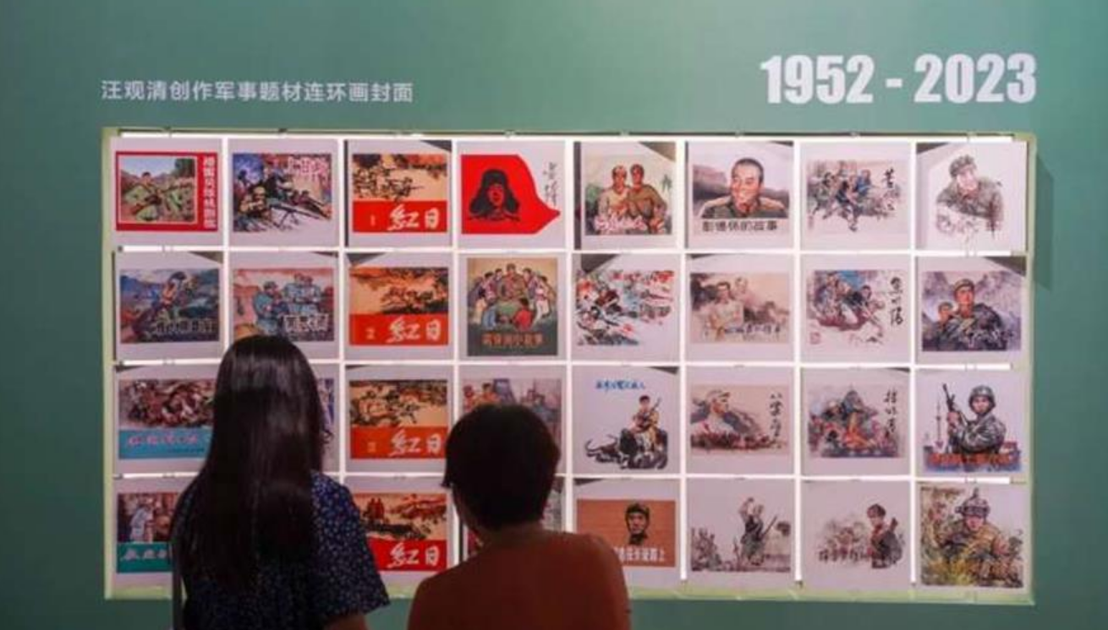
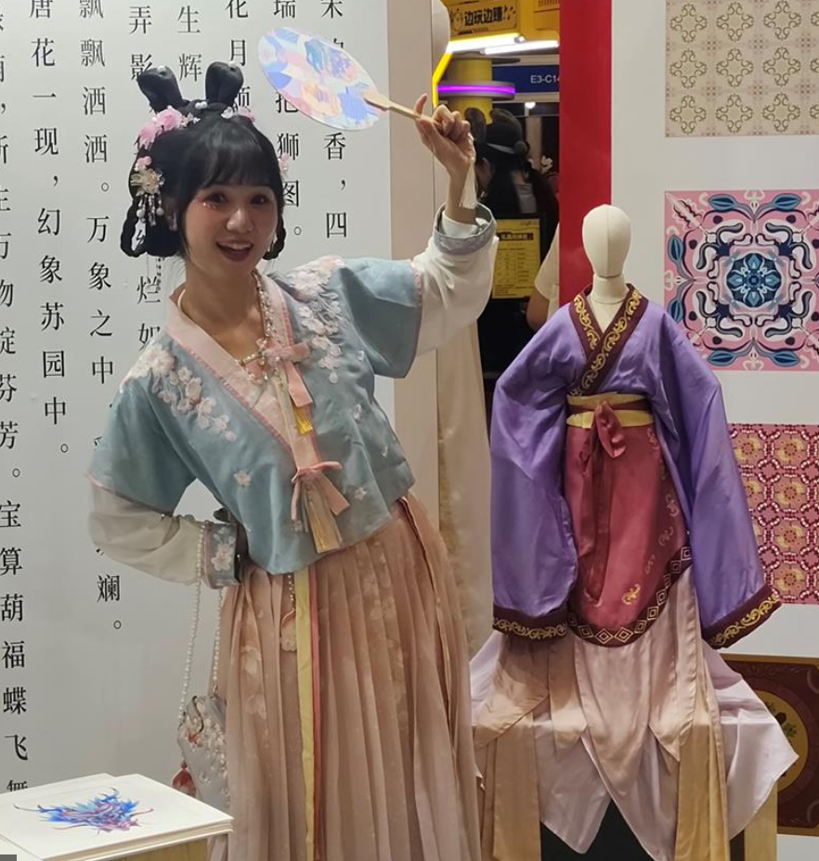
classic /ˈklæsɪk/ a.传统的;最优秀的；典型的 n.名著
The exhibition showcases the classic military-themed paintings created by renowned Chinese artist Wang Guanqing.
该展览展示了中国著名艺术家汪冠清创作的经典的军事题材绘画作品。
The exhibits included clothes with designs based on the famous Chinese classic "A Dream in Red Mansions."
展品包括根据中国著名名著《红楼梦》设计的服装。

Slide 16
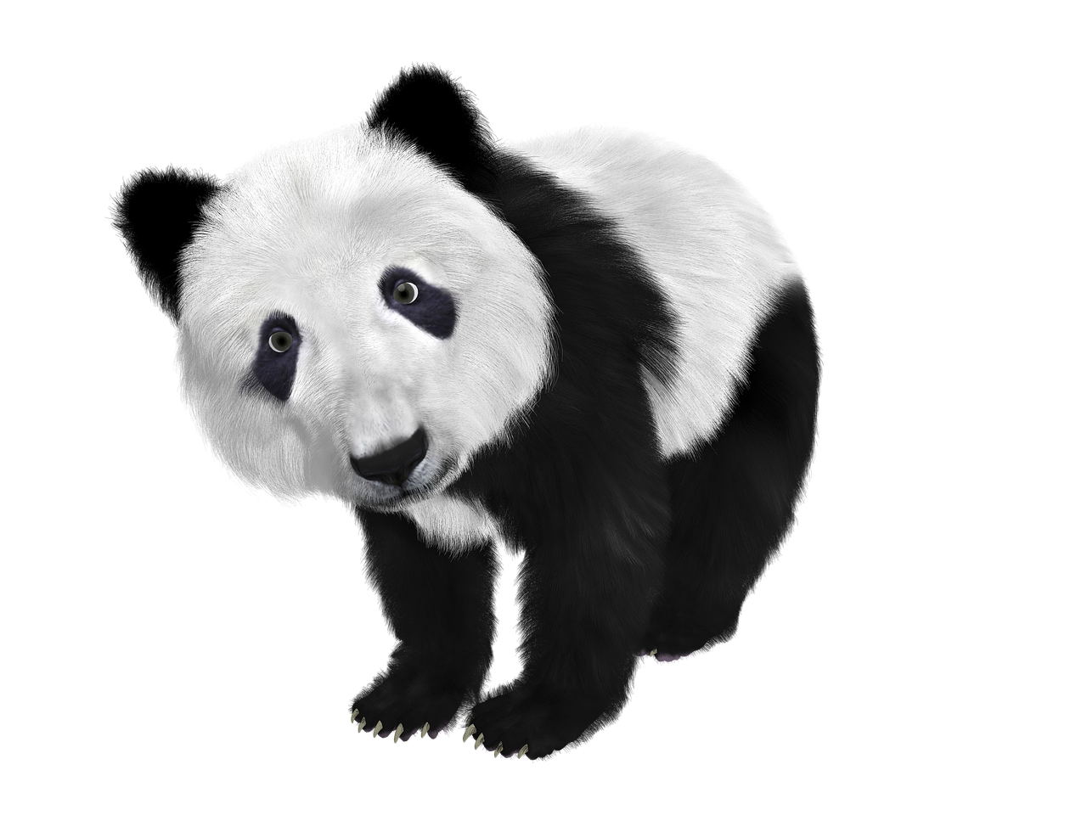
regard /rɪˈgɑ:d/ n.尊重;关注 vt.把……视为
对某人(很)尊重
1. have (high /great) regard for sb_________________
I have very high regard for him and what he has achieved.
2. give one’s regards to sb ________________
3. regard sb/sth as...______________
The giant panda is regarded as the symbol of Chengdu.
我对他和他所取得的成就表示崇高的敬意。
代某人向某人问候
Feeling grateful, I told him to give my regards to his family.
如果你见到乔治，请代我问候他。
把......视为
大熊猫被认为是成都的象征。

Slide 17
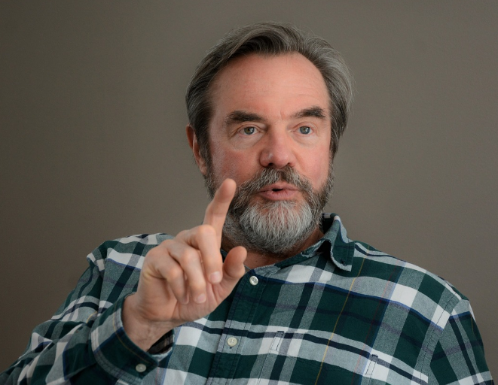
regard /rɪˈgɑ:d/ n.尊重;关注 vt.把……视为
4. regarding _______________
Exceedingly privileged to invite professor Smith to deliver a lecture regarding “Food and Culture", I couldn't help extending our cordial gratitude and appreciation to him.
关于
非常荣幸地邀请史密斯教授做一场关于“饮食与文化”的讲座，我不禁向他表示衷心的感谢和赞赏。(应用文之邀请信)

Slide 18
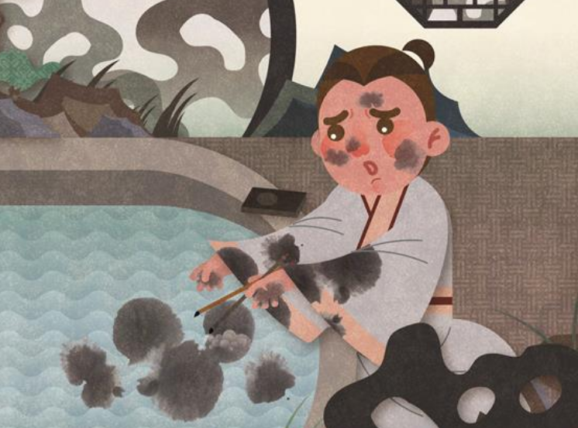
character /ˈkærəktə(r)/ n.文字;符号;角色;品质
假定你是李华，你的美籍好友Tom在他所在学校组织的汉字听写大赛中获得了一等奖。请你写一封英文邮件，
内容包括：1. 向他表示祝贺；2. 你认为他获奖的原因；3. 请教参赛经验。
1. 很高兴得知你在学校举办的汉字听写比赛中获得一等奖。
_____________________________________________________________________________
_____________________________________________________________________________
Delighted to learn that you have won first prize in the Chinese Characters Dictation Competition held by your school.
2. Fu told the prince that if he wanted to be a good man and a good emperor, he needed to associate himself with people of excellent character.
傅告诉王子，如果他想成为一个好人和一个好皇帝，他需要与品格优秀的人交往。

Slide 19
character /ˈkærəktə(r)/ n.文字;符号;角色;品质
3. The film portrays growth of the three young characters.
这部电影描绘了三个年轻角色的成长过程。

Slide 20
calligraphy /kəˈlɪgrəfi/ n.书法;书法艺术
假定你是李华，你的英国笔友Lucy在学习中国书法时，因为太难学而打算放弃。请你发一封电子邮件鼓励她，内容包括：1. 中国书法的意义；2. 鼓励她不要放弃；3. 提出你的建议。
Dear Lucy,
I am more than delighted to know that you have learnt __________________________. ____________________________________________ (书法是中国文化的精髓), which is valuable, for it is like a window to better understand the Chinese culture. Thus, I advise that you shouldn’t give it up.
Chinese calligraphy
Calligraphy is the essence of Chinese culture

Slide 21
global /ˈgləʊbl/ adj.全球的;全世界的
随着世界正在变成一个地球村，英语变得越来越重要。因此，掌握英语意味着我们可以通过一个新的窗口看世界。
As the world is becoming a global village, English is getting more and more important. So mastering English means we can see the world through a new window.
《Global Mirror》的与众不同之处在于其杰出的品质。国内和国际新闻为像我这样的读者提供了一个全球视角去充分了解世界事件。
What sets Global Mirror apart is its outstanding qualities. The domestic and international news offers readers like myself a global perspective to stay well-informed about worldwide events.

Slide 22
affair /əˈfeə(r)/ n.公共事务;事件;关系
1. have an affair_________________
She divorced her husband after she discovered that he was having an affair.
2. _____________
As a leader, he's been criticized for his inexperience in foreign affairs.
外遇
事件

Slide 23
appreciate /əˈpri:ʃieɪt/ vt.欣赏;重视;感激 vi.增值
1. appreciate+n./pron./v.ing
如果你能给我早日回复，我将不胜感激。（应用文之求助信）
如果你能考虑我的建议，我将不胜感激。（应用文之推荐信）
我很感激你在我交换期间给我的帮助。（应用文之感谢信）
游客被要求购买100元左右的门票，才能欣赏到令人叹为观止的景色。
I’d greatly appreciate it if you could give me an early reply.
I’d greatly appreciate it if you could take my recommendation into consideration.
I would appreciate your helping me during my exchanged terms.
Visitors were required to purchase tickets costing around 100 yuan to appreciate the breathtaking views.

Slide 24
appreciate /əˈpri:ʃieɪt/ vt.欣赏;重视;感激 vi.增值
2. express one’s appreciation
在此我真诚地为你在英语上给我的帮助，向你表示感谢。（应用文之感谢信）
Here I sincerely express my appreciation to you for your help with my English.

Slide 25
specific /spəˈsɪfɪk/ adj.特定的;明确的;具体的
Her goal was to become a skilled photographer, capturing the beauty of specific moments in everyday life.
她的目标是成为一名高明的摄影师，捕捉日常生活中特定时刻的美。
如果您能提供关于活动安排具体信息，我将不胜感激。(应用文之求助信)
I would be obliged if you could offer some specific information about the arrangements of the activity.

Slide 26
struggle /ˈstrʌgl/ n.&vi.斗争;奋斗;搏斗
用法
1. struggle for... 为......而奋斗
2. struggle with/against... 与......而斗争
3. struggle to do sth 努力/挣扎着做某事
4. struggle to one’s feet 挣扎着站起来
从现在起我会为我的未来做好充分的准备，为梦想而奋斗。
From now on, I will make full preparations for my future, and struggle for my dream.
“有志者事竟成”这句谚语提醒我:成功的道路并不总是平坦的，并鼓励我与困难作斗争。
The proverb “ Where there is a will, there is a way” reminded me that the path to success was not always smooth and encouraged me to struggle with the difficulties.

Slide 27
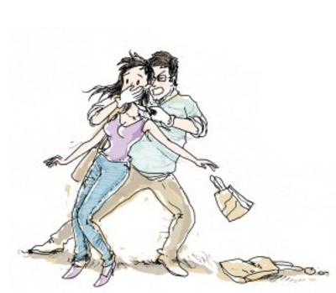
struggle /ˈstrʌgl/ n.&vi.斗争;奋斗;搏斗
当他转身走下山坡时，他用泪眼回望，看着他的宝藏慢慢消失。他汲取了一个教训，那就是我们必须经历挫折才能实现我们的梦想。(续写之克服困难挑战自我)
As he turned to walk down the mountain side, he looked back with tearful eyes and saw his treasure slowly disappear. ________
____________________________________________________
He drew a lesson that we must experience the struggles to achieve our dreams.
As he struggled from within, the girl’s cries were growing weaker. Jim knew he had to act fast. (续写之挣扎后的挺身而出)
当他内心挣扎的同时，女孩的哭声变得越来越弱。吉姆知道他必须迅速采取行动。

Slide 28
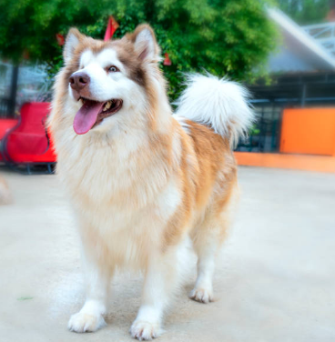
tongue /tʌŋ/ n.舌头;语言
The French feel passionately about their native/mother tongue.
Tongue lolling, the dog came back from the forest.
法国人非常热爱他们的母语。
舌头耷拉着，狗从森林里回来了。

Slide 29
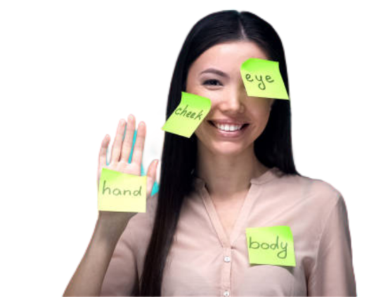
point of view 观点;看法
以我之见，如果你能每天坚持练英语听力会更好。
From my point of view, it would be better if you practice spoken English every day.

Slide 30
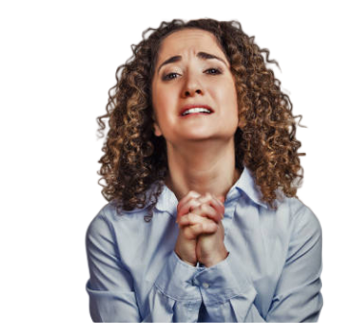
beg /beg/ (-gg-) vt.恳求;祈求;哀求
After hearing the boy’s words, Clara_____________________________ , (她站起来，用低声乞求的口气说道。) “Officer, I did steal those things, but there’s nothing else I could do. It’s my baby’s birthday, and I’ve got neither job nor money. Please don’t take those things away. I’ve just used them to make him a cake.” (续写之两个警察和一个女窃贼)
stood up and begged in a low voice
On returning to our apartment, we were astonished to see a beautiful, six-foot Christmas tree propped（支撑） against our front door. In silent wonder, we looked back and forth, from the tree to one another and around the empty street. Excitement built, and________________
_____________________. (续写之意外收获的圣
诞树)
the girls begged to keep the tree

Slide 31
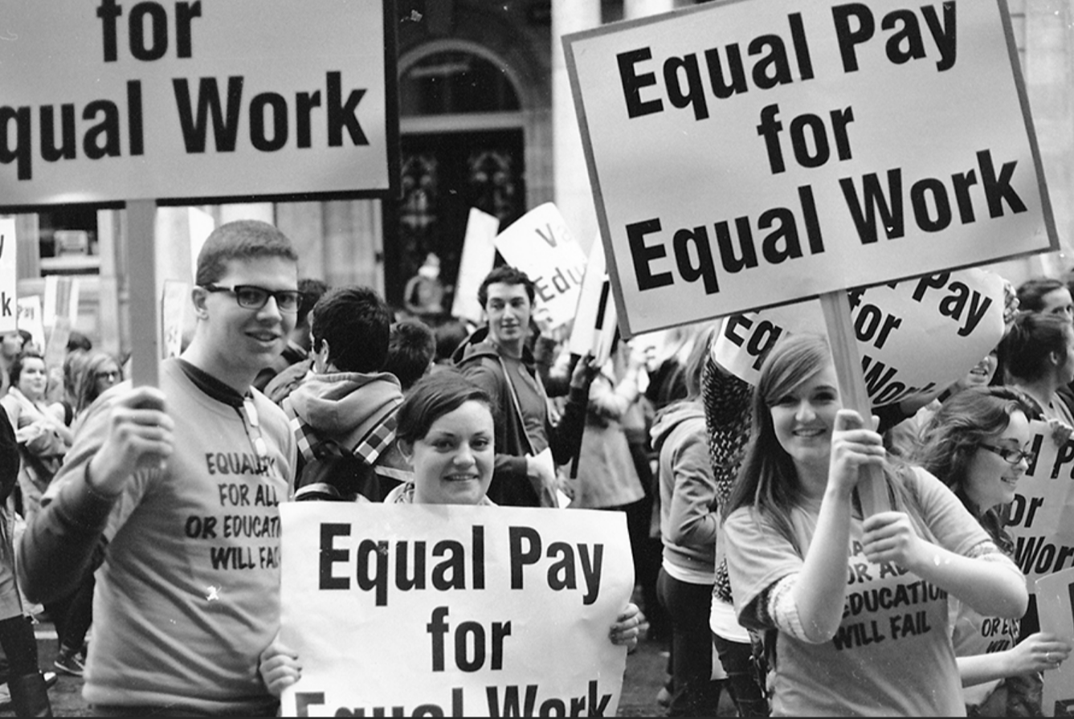
equal /ˈi:kwəl/ n.同等人;相等物 a.相同的
Every action has an equal and an opposite reaction.
每一动作都有一个相等且相反的反作用力。
They are demanding equal rights and justice.
他们要求平等的权利和公平的待遇。

Slide 32
equal /ˈi:kwəl/ n.同等人;相等物 a.相同的
be equal to (doing) sth 等于/胜任（做）某事
The area of the blue part is equal to that of the other parts.
蓝色部分的面积和其他部分相等。
Be positive and cheerful, for your mental health is equal to your physical health.
要积极向上，心情愉快，因为你的心理健康和身体健康同等重要。

Slide 33
gap /gæp/ n.间隔;开口;差距
1. cause the gap
Language competence varies from person to person, which may cause communication gap.
语言能力因人而异，这可能导致沟通障碍。
2. narrow/close/bridge/shorten the gap
填补缺口、减少差距、弥合分歧
充分利用你的热情和善良，架起你和他人之间的桥梁。
Make full use of your passion and kindness to bridge the gap between you and others.

Slide 34
demand /dɪˈmɑ:nd/ n.要求;需求 vt.强烈要求
1. be in (great) demand（急）需
我们俱乐部急需一些新成员。(应用文之社团招新)
New members are in great demand in our club.
2. satisfy/meet one’s demand满足某人需求
经理许诺他们会尽力满足顾客的需求。
The manager promised that they would try to meet their customers’ demands.

Slide 35
demand /dɪˈmɑ:nd/ n.要求;需求 vt.强烈要求
3. demand v.强烈要求
demand to do sth要求做某事
demand that sb (should) do sth 要求......做某事
“Who the hell are you? ” he demanded angrily.
She demanded an immediate explanation.
他气势汹汹地查问道。
她强烈要求立刻做出解释。
4. demanding a. 要求高的；苛刻的
我发现要学好英语很有挑战性。所以我写信来向你寻求帮助。
I find it demanding to learn English well, so I’m writing to ask you for help.

Slide 36
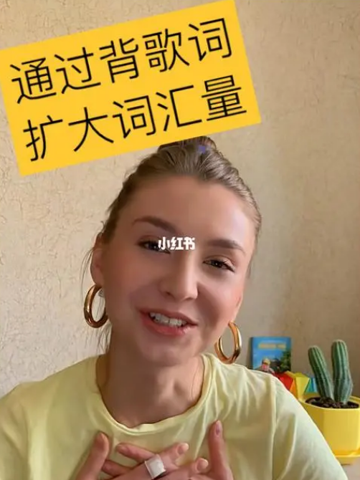
vocabulary /vəˈkæbjələri/ n.词汇
首先你需要扩大你的中文词汇量，从而有可能帮你更好的适应这个班级。(应用文之建议信)
First you need to enlarge/expand your Chinese vocabulary, thus potentially helping you better fit into the class.

Slide 37
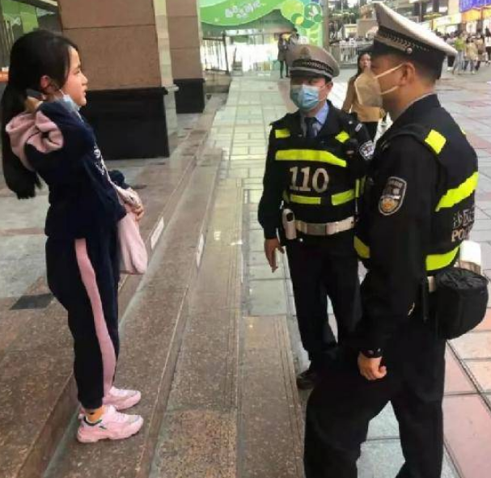
description /dɪˈskrɪpʃn/ n.描写(文字);形容
1. give sb a full description of 向......详细描述
她向警员详细描述了抢劫者的相貌。
She has given the police a very detailed/full description of the robber.
2. be beyond description无法形容，难以描述
我的感激之情无以言表。（应用文之感谢信）
My gratitude is beyond description.

Slide 38
relate to /rɪˈleɪt tə/ 与……相关;涉及;谈到
1. relate to 与......相关
我写信是为了寻求关于选择与我对技术和创新的热情相关的职业道路的指导。
I'm writing to seek guidance on choosing a career path related to my passion for technology and innovation.
2. relate to sb/sth _______________________
Having grown up in quite a poor household, I could really relate to the character’s struggle to find financial success.
能够理解并同情
我生长在一个贫穷的家庭，所以我很能理解那个角色为追求金钱方面的成功而艰苦奋斗的过程。

Slide 39
relate to /rɪˈleɪt tə/ 与……相关;涉及;谈到
3. be closely related to 与......密切相关
有些疾病与空气污染密切相关。
Some diseases are closely related to air pollution..

Slide 40
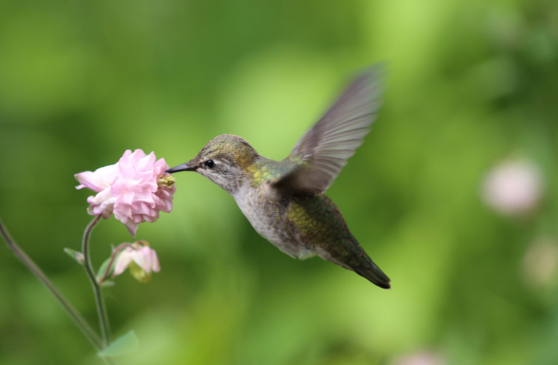
no matter +特殊疑问词 不论……;不管……
我们意识到鸟类对人类来说与朋友对我们的重要性相似。因此，无论我们身处何地，我们都必须保护鸟类，使它们成为我们永恒的伙伴。
(2023.1浙江续写之蜂鸟)
It suddenly came to my realization that birds hold a significance to humans similar to that of friends. Consequently, ______________________________
______________________________________________________________
no matter where we are, we must safeguard them, enabling them to be our eternal companions.

Slide 41
the reason +why引导定语从句
他对我的态度变了。原因是我被开水烫了。
原句：My burns were the reason for his change of attitude.
改写：___________________________________________
___________________________________________
The reason why he changed his attitude towards me was that I got burned.

Slide 42
a time when... 一段......的时期
我记得有一次我们一群人在费格森夫人(Mrs. Ferguson)家后面的田地里玩棒球。
I remembered a time when a bunch of us were playing baseball in the field behind Mrs. Ferguson's house.
这是我第一次浏览长城。
It is the first time (that) I ___________(visit) the Great Wall.
It was the first time that I ___________(visit) the Great Wall.
have visited
had visited

Slide 43
the more...the more... 越...越...
我逐渐意识到，我工作得越努力，获得的结果就会越好。
It dawned on me that the harder I worked, the better result I would get.
你越仔细，你犯的错误就会越少。
The more careful you are, the fewer mistakes you'll make.

Slide 44
Thank you!

