Slide 1


感恩遇见，相互成就，本课件资料仅供您个人参考、教学使用，严禁自行在网络传播，违者依知识产权法追究法律责任。
更多教学资源请关注
公众号：溯恩英语
知识产权声明

Slide 2


备战 2025年高考系列
指向提升思维品质的
读后续写的培优策略探究
常山一中 吴俊峰

Slide 3


目录
Contents
1
读后续写中痛点难点问题
3
读后续写准确读题和快速构思
——以2021年6月浙江高考卷
2023年6月新高考1卷
2024年11月杭州一模
2024年11月稽阳联考 为例
2
读后续写培优学情分析
——以2024年11月湖衢丽三地市联考为例
4
2025首考读后续写培优建议

Slide 4
基于提升思维品质的
01
读后续写中痛点难点问题
——思维训练迫在眉睫

Slide 5


读后续写中遇到的痛点难点问题
1.词汇句法单一，语法错误较多: 学生可能因为词汇量和语法知识不足，导致续写时语言表达单一，语法错误频发。
2.语言单调贫乏，段落间不平衡: 学生缺少各种描写技能（动作、神态、心理、对话、环境），单调过多使用人物对白。因时间分配不均，或思维简单，导致段落内容不平衡。
3.时间前松后紧，续写草率完工：客观题太慢，续写内容和卷面无法高质量完成。
4.文本解读随意，语篇分析不深: 学生可能没有完全理解原文的人物关系、情节逻辑和核心词汇，情感态度词，导致续写内容（语言、逻辑、情感）与原文脱节。
提升思维品质
5.主题升华牵强，回扣前文乏力: 学生在续写结尾时可能对主题理解有偏差，导致主题升华不自然或无中生有。
6.协同效应不高，缺乏合情合理: 续写与原文在情节发展、情感态度和语言风格上的融洽度不高，两个续写段落之间衔接不紧密。

Slide 6

读后续写思维品质的提升
思维品质的目标_{(教育部,2020:6)}：
辨析语言和文化中的具体现象，
梳理、概括信息，
建构新概念，
分析、推断信息的逻辑关系，
正确评判各种思想观点，
创造性地表达自己的观点，
具备多元思维的意识
和创新思维的能力
1
逻辑性
思维品质
批判性
3
2
创造性

Slide 7
以2025年11月湖衢丽三地市联考高三英语卷为例
02
读后续写培优学情分析
——高分学生养成记

Slide 8

指向提升思维品质的读题审题能力——读懂情感态度
When Devon's sister, Lil, went off to college, Devon's stomach felt all twisty. Then Mom said that Kapil, a high-school student from India, would be staying in their house and living in Lil's room, for they were the host family. The piece of news made Devon's stomach feel worse, as he missed his sister so much. "What if I can't understand him?" Devon asked. "He speaks English well," Mom said.
On Kapil's first day, he exchanged some small talk with Devon before disappearing into his new room. Lil's room, Devon reminded himself. As days went on, Kapil started spending more time in the rest of the house. He was in the kitchen a lot, whose cooking always filled the air with steam and spice that made Devon's eyes water. "Smells wonderful!" Mom exclaimed. When Lil called a few days later, Devon told her about Kapil's cooking, "Lucky! I love Indian food!" Lil said. "But it seems too spicy for me," replied Devon.
One day, Mom had to work late. "Kapil will stay with you until I get home," she explained. Devon's stomach twisted. Lil had always stayed with him when Mom had to work late.
When Devon got home from school, Kapil greeted him at the door. "Would you like à snack?" Kapil asked. Devon shrugged. Lil and he used to cook together after school, which they called "making messes." Kapil opened the refrigerator. "How about a yogurt?" "I had one at breakfast," responded Devon in a cold voice. Kapil opened a cupboard and smiled. "Wait here." He returned with a package. "I 'lI cook an Indian snack," he announced. Kapil pulled out a round, thin cracker the size of a small Frisbee, poured oil into a pan and fried the cracker. Then the kitchen was filled with spicy smells. After a while, Kapil handed Devon a plate with the sizzling pancake on it. “Papadum(印度薄饼),” he said. “Made from bean flour.”
Para1: Devon's stomach twisted again.
Para2: Looking at the empty plate, Devon said to Kapil, "Let's make messes!"
01
stomach twisted
的情感隐喻
Devon's stomach twisted，是隐喻表达，不是真的胃不舒服（生理反应），而是情绪心理反应如：“难受”；“难过”；“讨厌反感”
所以要分析理解清楚句意和情感，关乎第一段“Para1: Devon's stomach twisted again.”的合理走向：讨厌 →→尝试→→ 喜欢 →→ 一起动手做。
不少考生错误解读为Devon“胃疼” → Kapil关心帮助 →Devon心生好感，愿意吃Kapil做的饼。

Slide 9

指向提升思维品质的读题审题能力——读懂人物关系和铺垫
When Devon's sister, Lil, went off to college, Devon's stomach felt all twisty. Then Mom said that Kapil, a high-school student from India, would be staying in their house and living in Lil's room, for they were the host family. The piece of news made Devon's stomach feel worse, as he missed his sister so much. "What if I can't understand him?" Devon asked. "He speaks English well," Mom said.
On Kapil's first day, he exchanged some small talk with Devon before disappearing into his new room. Lil's room, Devon reminded himself. As days went on, Kapil started spending more time in the rest of the house. He was in the kitchen a lot, whose cooking always filled the air with steam and spice that made Devon's eyes water. "Smells wonderful!" Mom exclaimed. When Lil called a few days later, Devon told her about Kapil's cooking, "Lucky! I love Indian food!" Lil said. "But it seems too spicy for me," replied Devon.
One day, Mom had to work late. "Kapil will stay with you until I get home," she explained.Devon's stomach twisted. Lil had always stayed with him when Mom had to work late.
When Devon got home from school, Kapil greeted him at the door. "Would you like à snack?" Kapil asked. Devon shrugged. Lil and he used to cook together after school, which they called "making messes." Kapil opened the refrigerator. "How about a yogurt?" "I had one at breakfast," responded Devon in a cold voice. Kapil opened a cupboard and smiled. "Wait here." He returned with a package. "I 'lI cook an Indian snack," he announced. Kapil pulled out a round, thin cracker the size of a small Frisbee, poured oil into a pan and fried the cracker. Then the kitchen was filled with spicy smells. After a while, Kapil handed Devon a plate with the sizzling pancake on it. “Papadum(印度薄饼),” he said. “Made from bean flour.”
Para1: Devon's stomach twisted again.
Para2: Looking at the empty plate, Devon said to Kapil, "Let's make messes!"
02
姐姐 Lil的伏笔铺垫
姐姐 sister, Lil，与Devon姐弟情深，在本文中是解决矛盾冲突和解决的关键：讨厌 →→→ 尝试→→ 喜欢 →→ 一起动手做。
第一段最佳逻辑是思念姐姐或姐姐的影响 "Lucky! I love Indian food!" Lil said，而转变态度，尝试着吃。
第二段make messes，也是与姐姐类似的经历，增强对Kapil 的认同感和家人般友谊。

Slide 10
指向提升思维品质的读题审题能力——读懂文化背景
When Devon's sister, Lil, went off to college, Devon's stomach felt all twisty. Then Mom said that Kapil, a high-school student from India, would be staying in their house and living in Lil's room, for they were the host family. The piece of news made Devon's stomach feel worse, as he missed his sister so much. "What if I can't understand him?" Devon asked. "He speaks English well," Mom said.
On Kapil's first day, he exchanged some small talk with Devon before disappearing into his new room. Lil's room, Devon reminded himself. As days went on, Kapil started spending more time in the rest of the house. He was in the kitchen a lot, whose cooking always filled the air with steam and spice that made Devon's eyes water. "Smells wonderful!" Mom exclaimed. When Lil called a few days later, Devon told her about Kapil's cooking, "Lucky! I love Indian food!" Lil said. "But it seems too spicy for me," replied Devon.
One day, Mom had to work late. "Kapil will stay with you until I get home," she explained.Devon's stomach twisted. Lil had always stayed with him when Mom had to work late.
When Devon got home from school, Kapil greeted him at the door. "Would you like à snack?" Kapil asked. Devon shrugged. Lil and he used to cook together after school, which they called "making messes." Kapil opened the refrigerator. "How about a yogurt?" "I had one at breakfast," responded Devon in a cold voice. Kapil opened a cupboard and smiled. "Wait here." He returned with a package. "I 'lI cook an Indian snack," he announced. Kapil pulled out a round, thin cracker the size of a small Frisbee, poured oil into a pan and fried the cracker. Then the kitchen was filled with spicy smells. After a while, Kapil handed Devon a plate with the sizzling pancake on it. “Papadum(印度薄饼),” he said. “Made from bean flour.”
Para1: Devon's stomach twisted again.
Para2: Looking at the empty plate, Devon said to Kapil, "Let's make messes!"
03
读懂make messes的英式幽默和共情
make messes是 英式幽默中的Self deprecation/mocking 自贬/自嘲；自我调侃。
也是姐弟间的快乐共情和私密话语，对于 Devon的提议，Kapil由困惑到共同参与making messes= cook together，感情迅速升温，形成亲人般友谊。

Slide 11
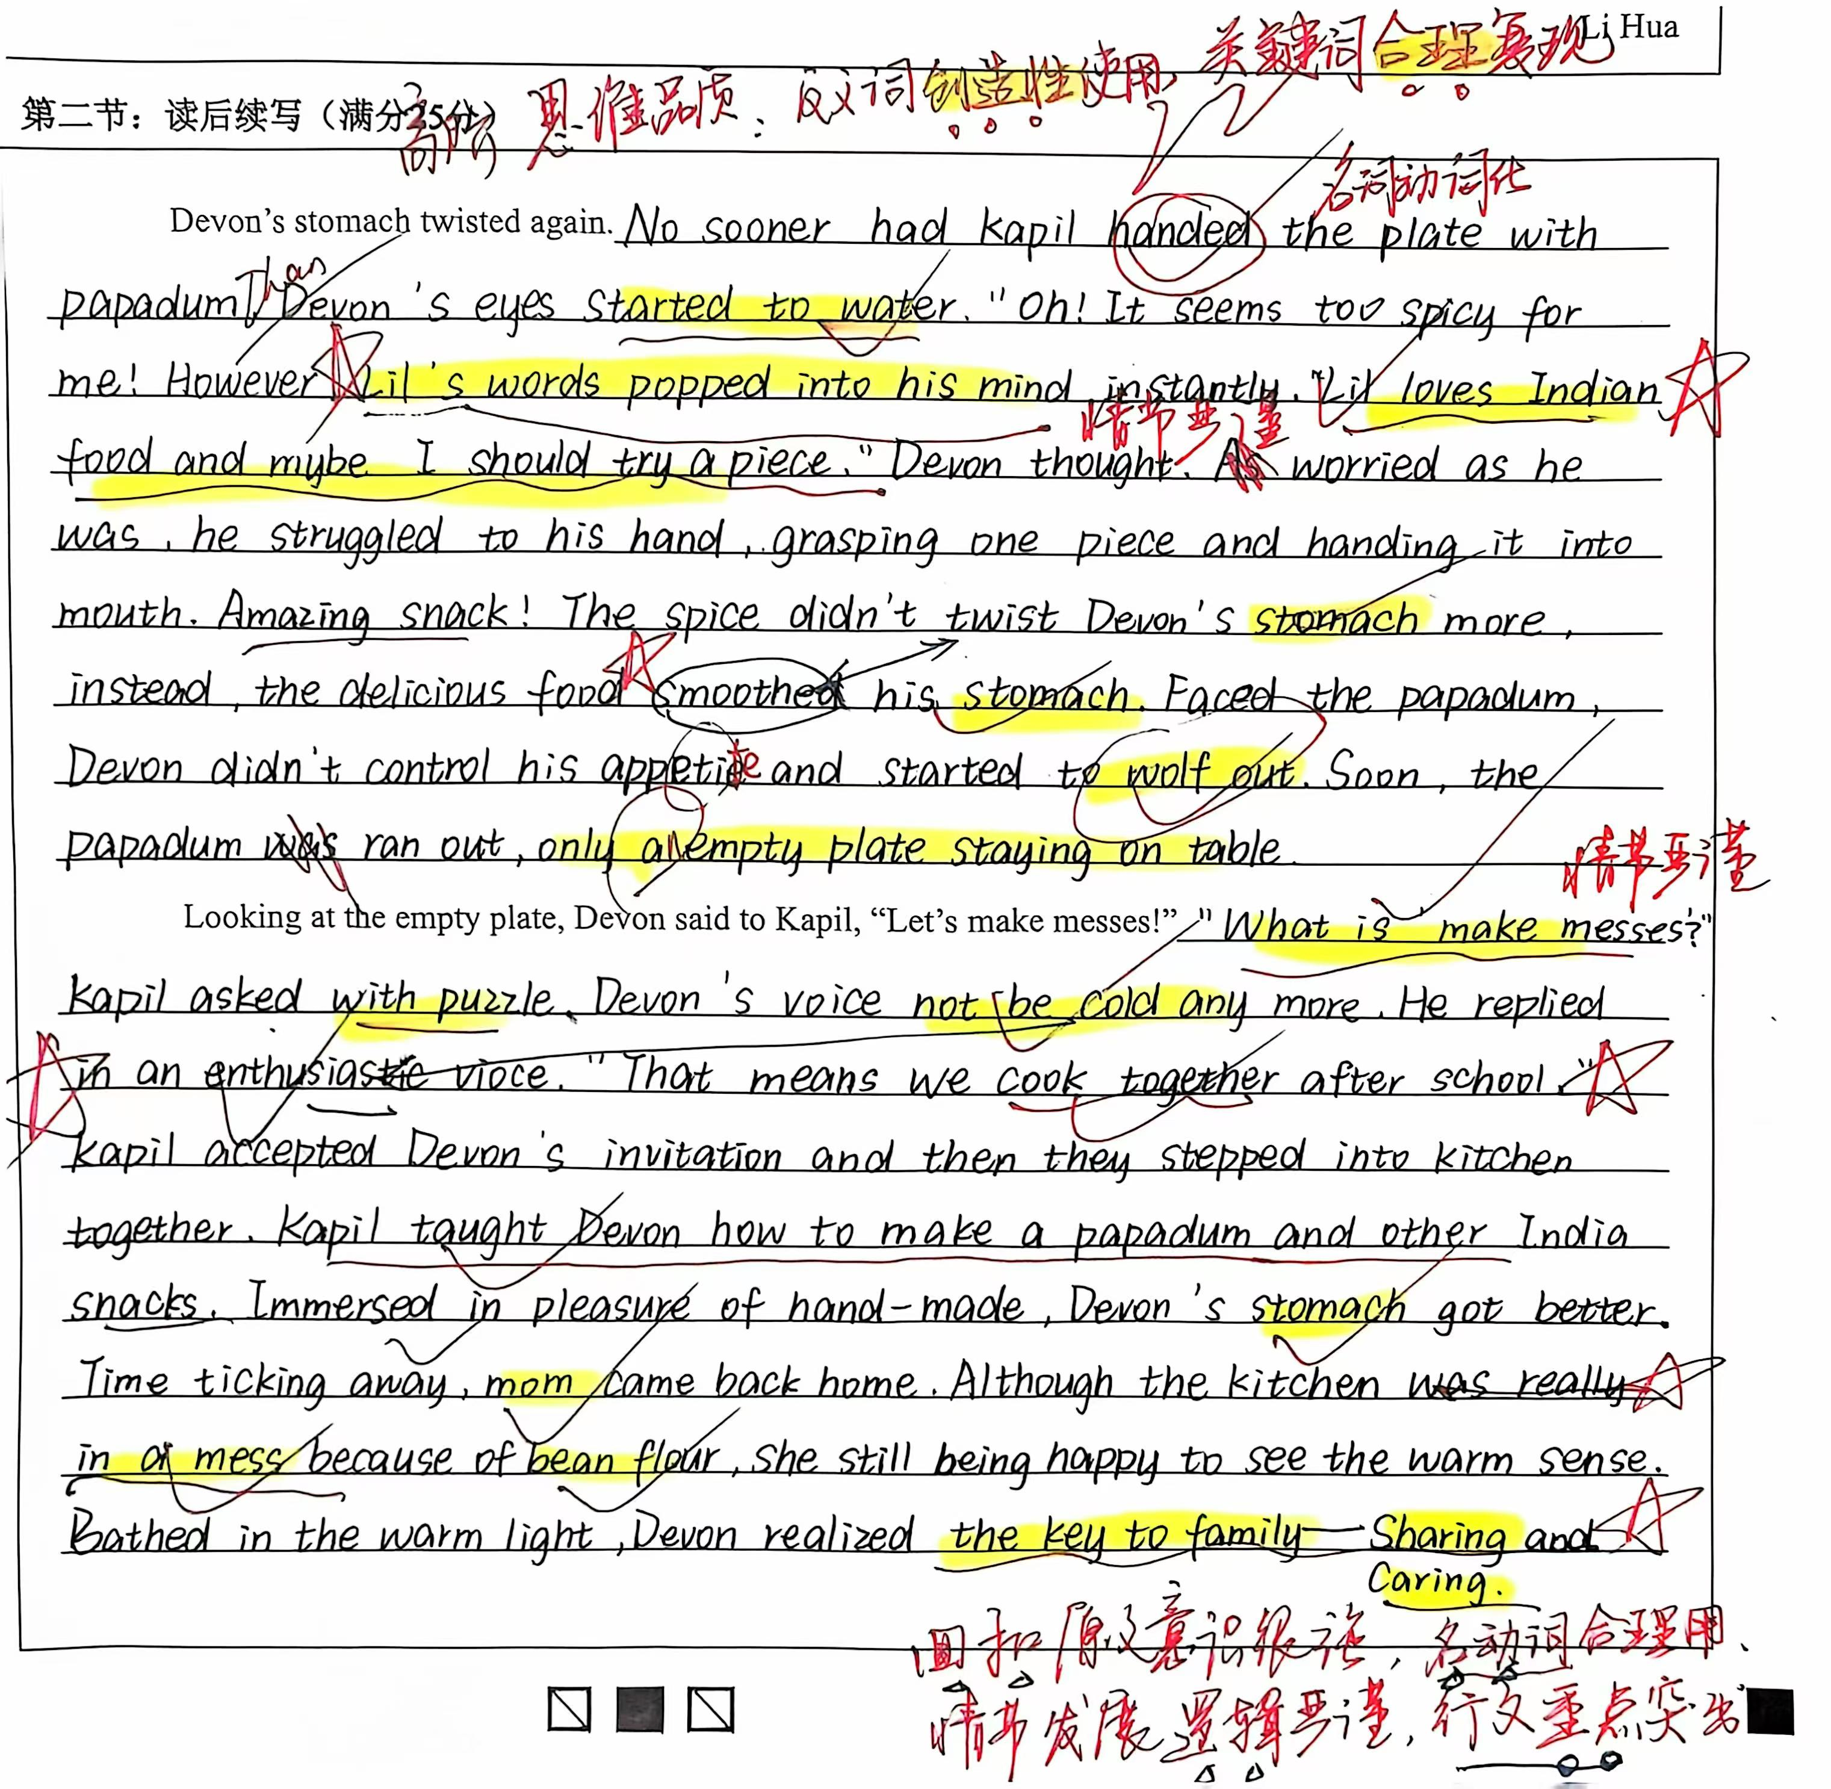
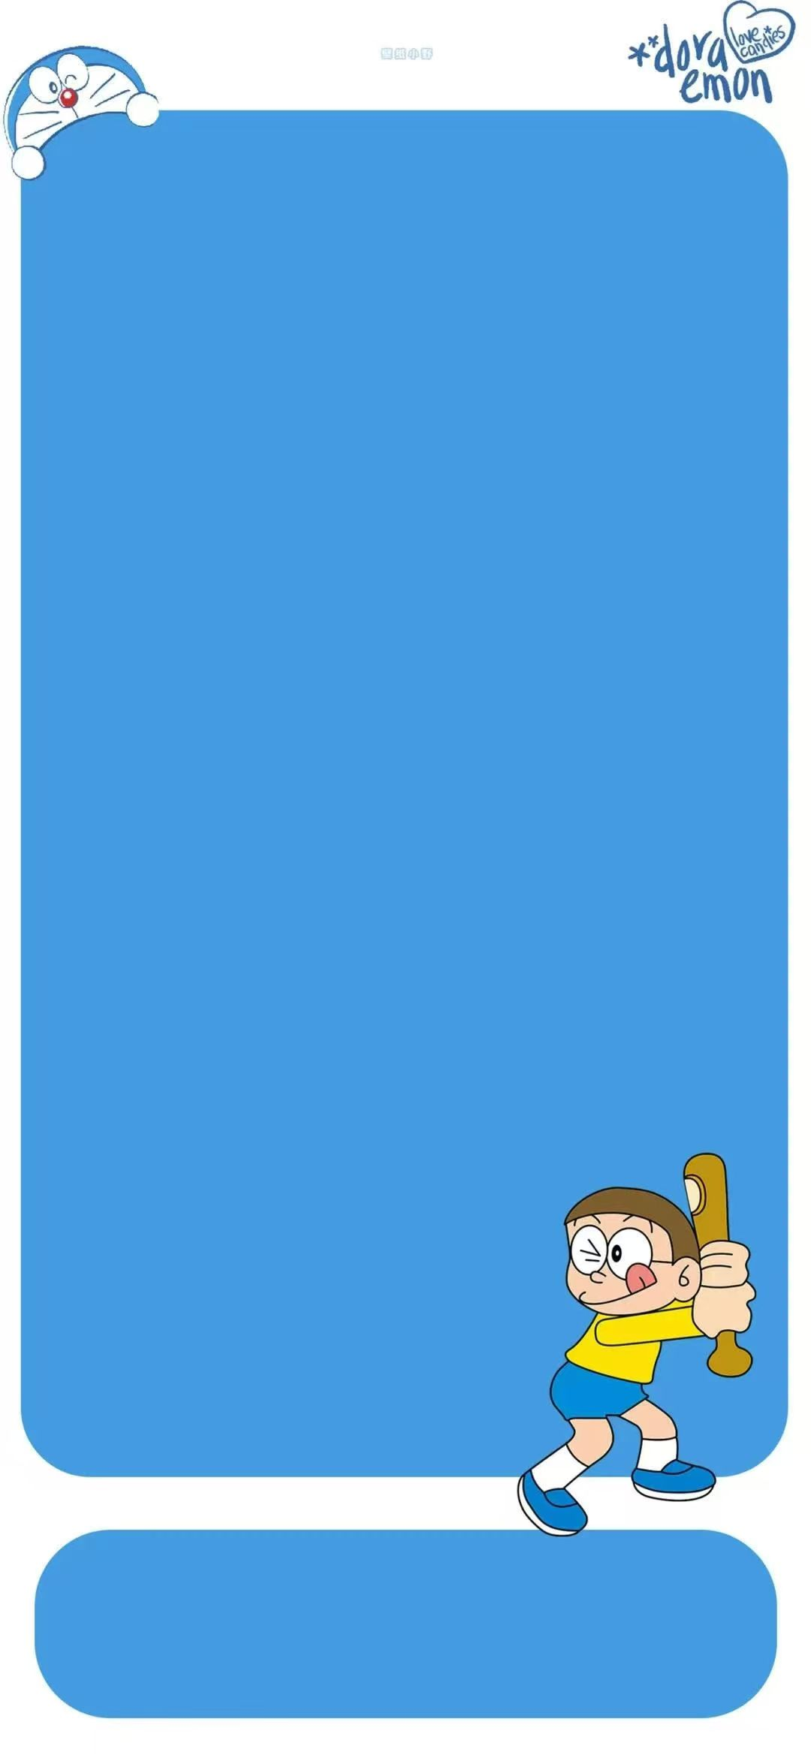
培优分析——高分学生养成记
该22分习作回扣原文意识很强；合理运用名次和动词推动情节发展（没有过多的心理神态描写），语言精炼，情节清晰。
行文重点突出（Lil的伏笔，make messes的幽默效果），抓住了作者写作意图，形成很好的协同效应。
高阶思维的体现：反义词创造性使用；关键词合理复现；情节发展逻辑严谨。
情节发展逻辑特别严谨

Slide 12
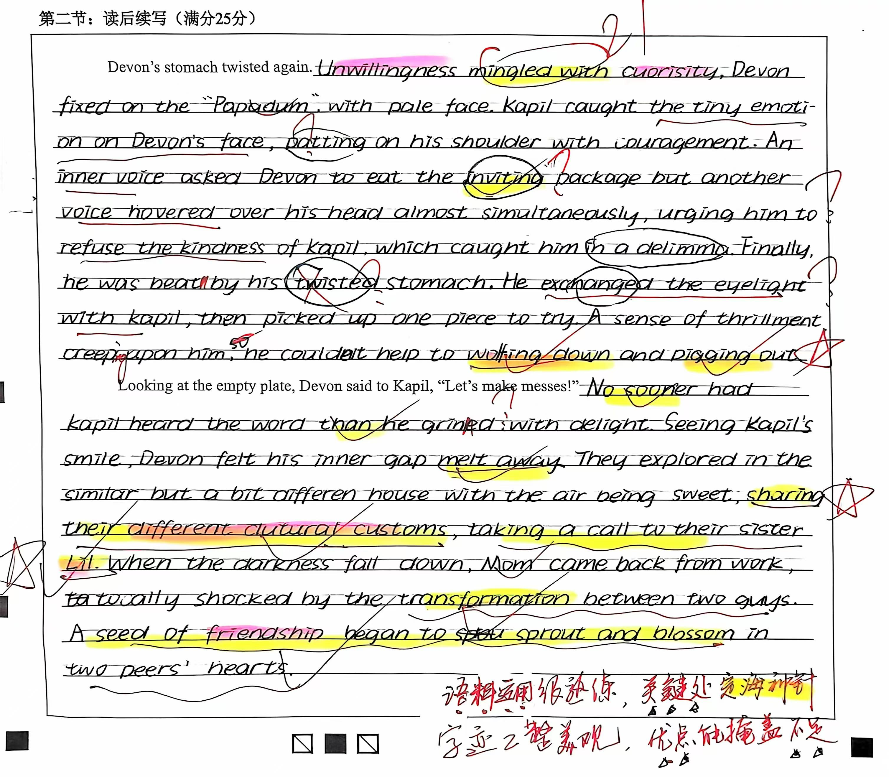
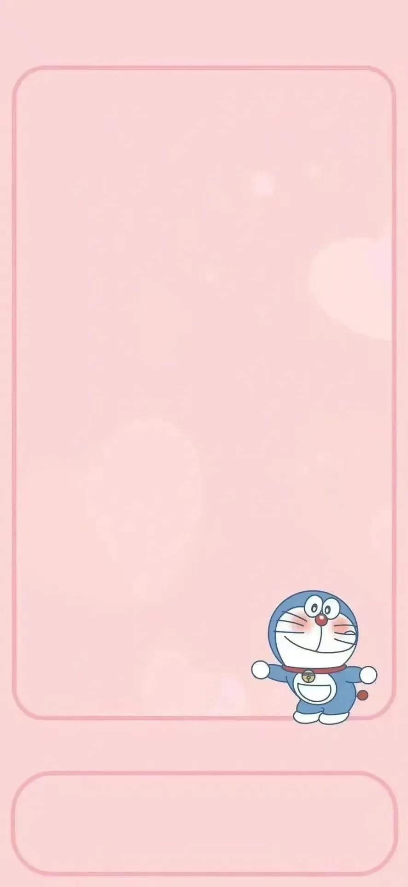
培优分析——高分学生养成记
该21分习作 在第一段有很多不足和瑕疵。
但在第一段结尾“wolf down and pig out”比喻形象生动；第二段sharing their different culture customs体现创新思维；最后结尾的friendship主旨明确；guys和peers词汇丰富贴切。
高阶思维的体现：词汇丰富；创新思维。
卷面美观，关键处优点明显

Slide 13
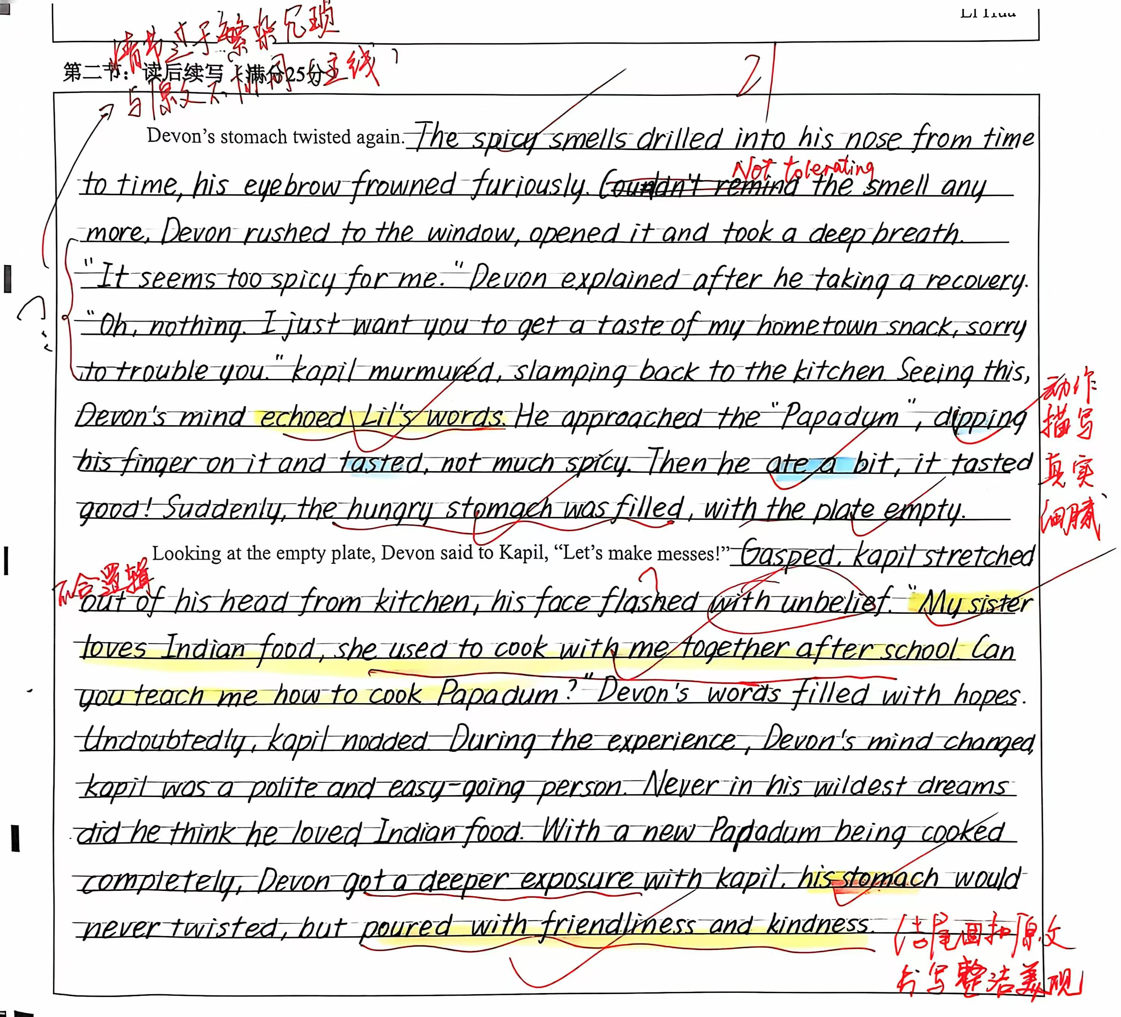
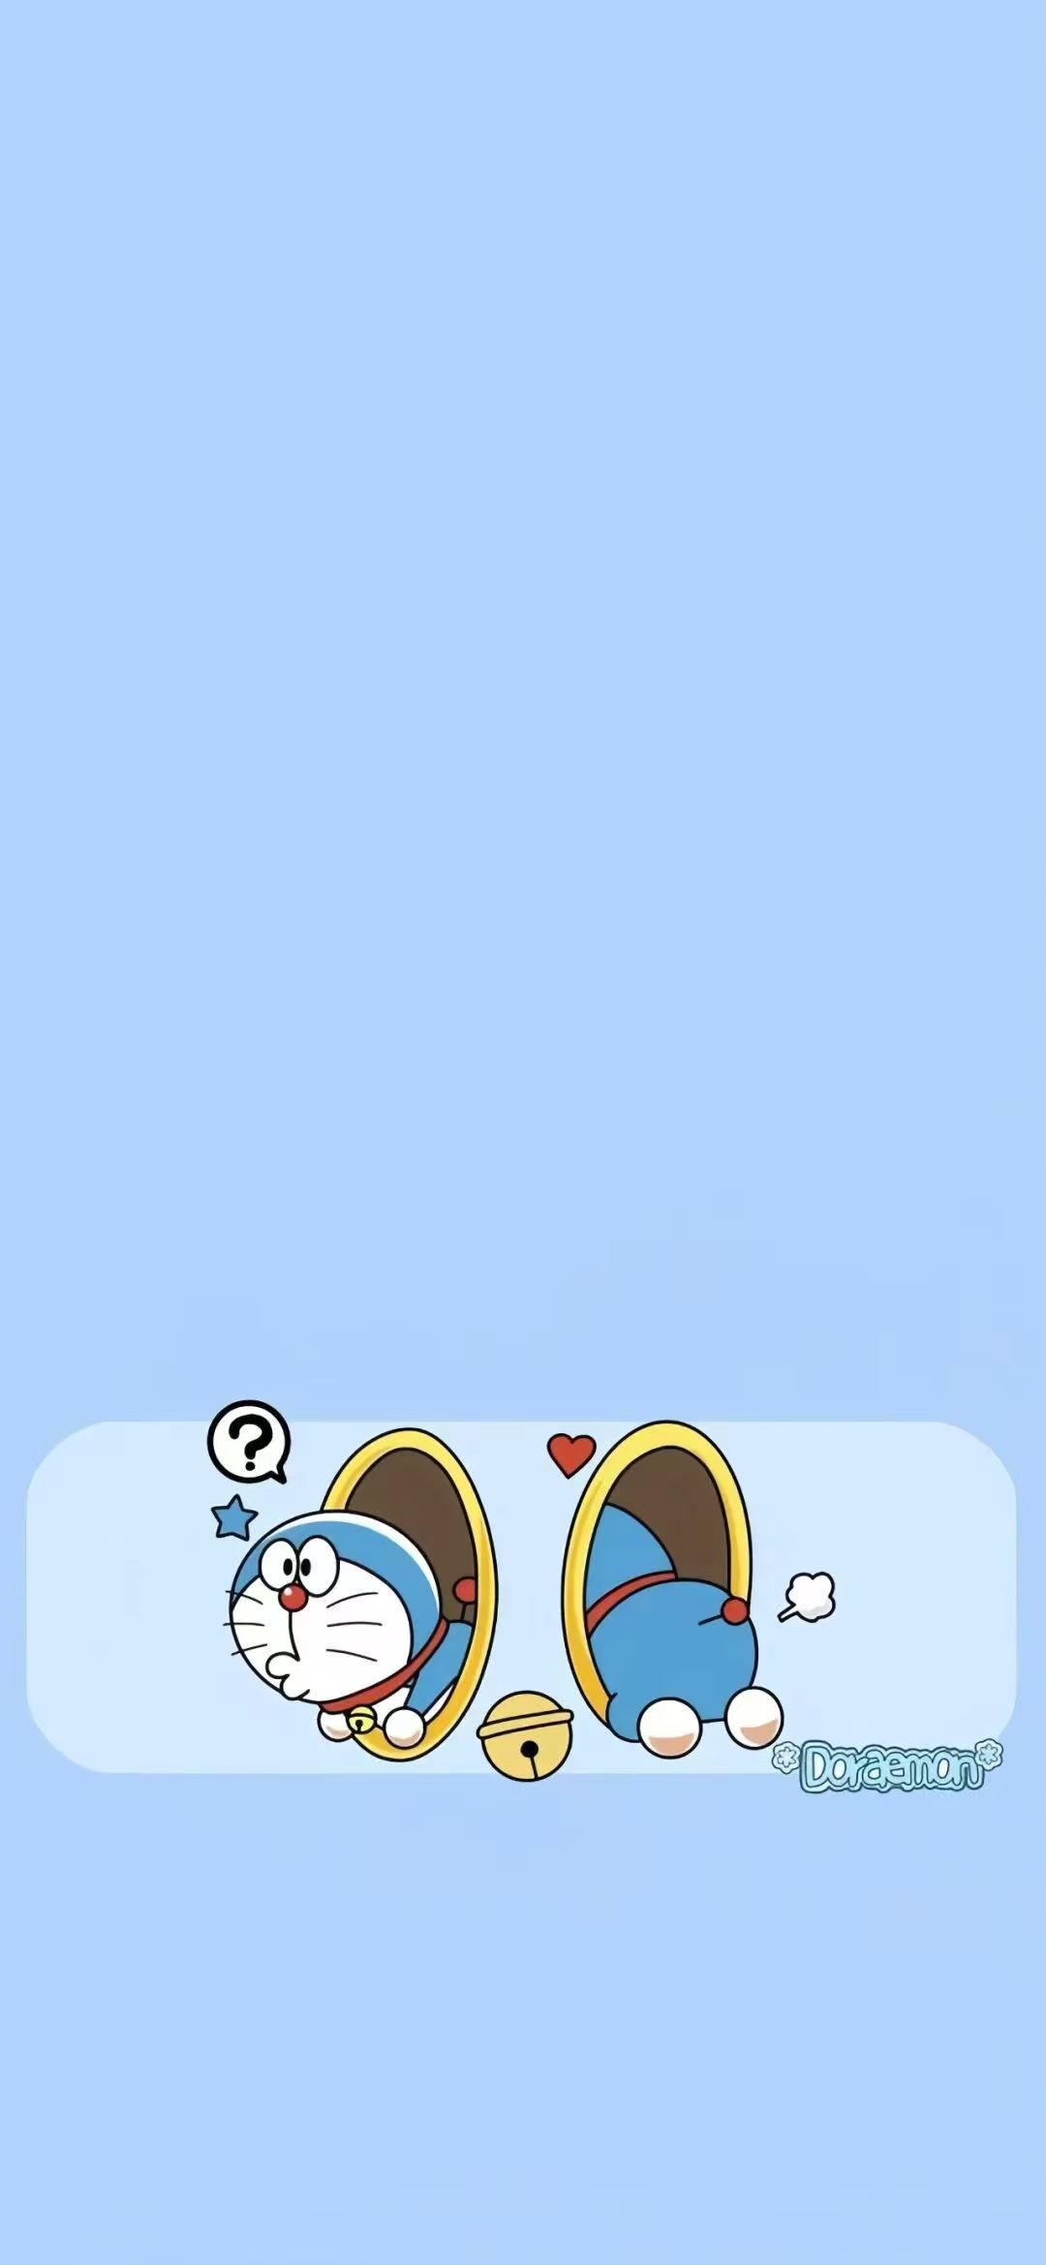
培优分析——高分学生养成记
卷面美观，关键处优点明显
该21分习作 在第一段的情节过于繁杂冗琐，与原文主线不协同。第二段开头也有类似问题。
但在第一段结尾动作描写细腻生动，富有生活气息；第二段回扣前文cook together；最后结尾的stomach的意义升华自然，pour with friendliness and kindness。
高阶思维的体现：词汇丰富；创新思维。

Slide 14
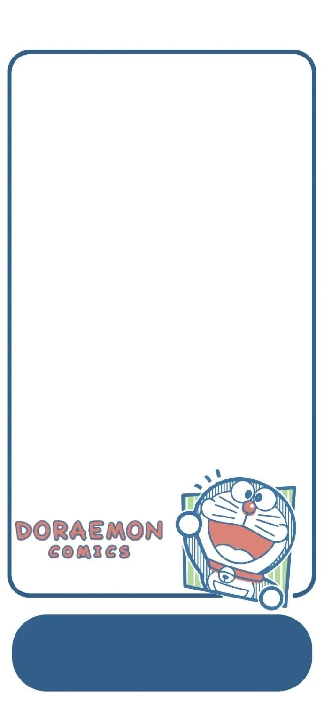
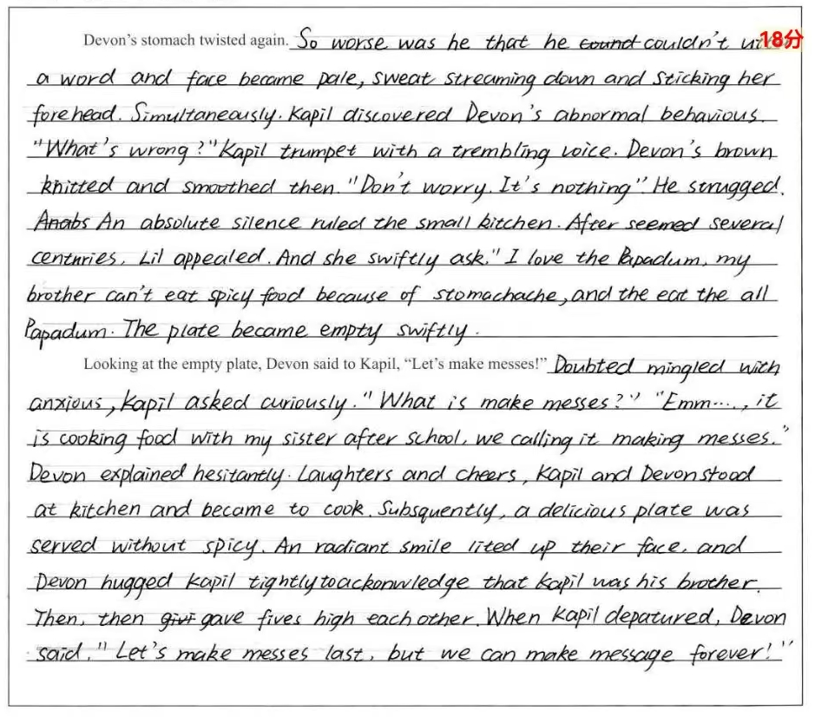
培优分析——高分学生养成记
该习作 智学网批改18分
老师双评批阅 实际给了多少分？
9分
续写第一段中习作者错误理解 stomach twisted，导致情节设计不合逻辑，另外姐姐Lil的appear也是不合逻辑。第二段的结尾也与原文脱节。
逻辑混乱，大型翻车现场

Slide 15
指向提升思维品质的
03
读后续写准确读题和快速构思
——语义连贯挖词法

Slide 16
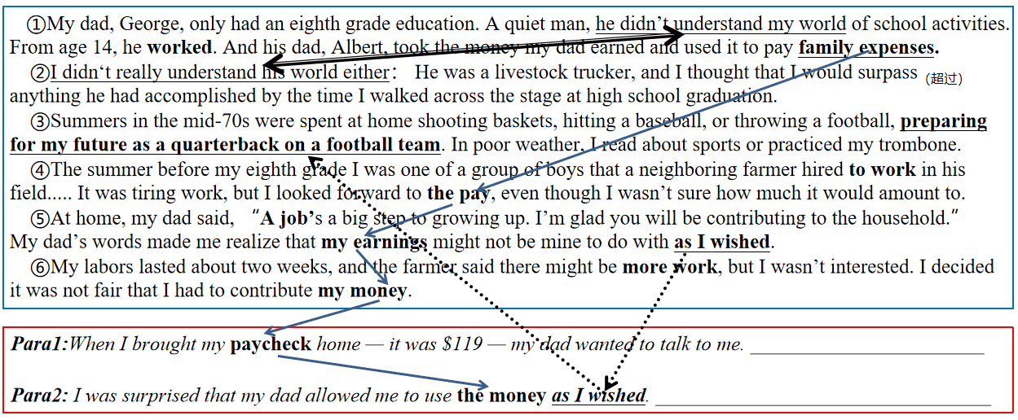
理顺主题词汇，
逻辑构建语言协同
2021年6月“我的假日薪水”
利用关键词重复来突出并强化主旨。核心关键词存在复现的关系，围绕同一主题前后呼应，形成词汇链和语义链，增强语义，语境和主题的关联性，达到语义和逻辑的连贯性使文本语际间实现语义上的衔接和连贯。
Please sort out the key words:
①My dad, George, only had an eighth grade education. A quiet man, he didn’t understand my world of school activities. From age 14, he worked. And his dad, Albert, took the money my dad earned and used it to pay family expenses.
②I didn‘t really understand his world either： He was a livestock trucker, and I thought that I would surpass_{（超过）}anything he had accomplished by the time I walked across the stage at high school graduation.
③Summers in the mid-70s were spent at home shooting baskets, hitting a baseball, or throwing a football, preparing for my future as a quarterback on a football team. In poor weather, I read about sports or practiced my trombone_{（长号）}.
④The summer before my eighth grade I was one of a group of boys that a neighboring farmer hired to work in his field..... It was tiring work, but I looked forward to the pay, even though I wasn’t sure how much it would amount to.
⑤At home, my dad said, “A job’s a big step to growing up. I’m glad you will be contributing to the household.” My dad’s words made me realize that my earnings might not be mine to do with as I wished.
⑥My labors lasted about two weeks, and the farmer said there might be more work, but I wasn’t interested. I decided it was not fair that I had to contribute my money.
1:When I brought my paycheck home — it was $119 — my dad wanted to talk to me. _______________________
2: I was surprised that my dad allowed me to use the money as I wished. _________________________________

Slide 17
理顺主题词汇，
逻辑构建语言协同
2021年6月“我的假日薪水”
增强语义，语境和主题的关联性，达到语义和逻辑的连贯性
词汇_{又称语汇}，是一种语言中所有词和词组的总和。词是语言的建构材料，也是最小的能够独立运用的语言单位。词汇中的任何词语都是通过一定的句法关系和语义关系与其他词语建立起一定的联系的，并在语境中传递_{（主题）}信息。（ 2017版新课程标准P 21）
①My dad, George, only had an eighth grade education. A quiet man, he didn’t understand my world of school activities. From age 14, he worked. And his dad, Albert, took the money my dad earned and used it to pay family expenses.
②I didn‘t really understand his world either： He was a livestock trucker, and I thought that I would surpass_{（超过）}anything he had accomplished by the time I walked across the stage at high school graduation.
③Summers in the mid-70s were spent at home shooting baskets, hitting a baseball, or throwing a football, preparing for my future as a quarterback on a football team. In poor weather, I read about sports or practiced my trombone_{（长号）}.
④The summer before my eighth grade I was one of a group of boys that a neighboring farmer hired to work in his field..... It was tiring work, but I looked forward to the pay, even though I wasn’t sure how much it would amount to.
⑤At home, my dad said, “A job’s a big step to growing up. I’m glad you will be contributing to the household.” My dad’s words made me realize that my earnings might not be mine to do with as I wished.
⑥My labors lasted about two weeks, and the farmer said there might be more work, but I wasn’t interested. I decided it was not fair that I had to contribute my money.
1:When I brought my paycheck home — it was $119 — my dad wanted to talk to me. _______________________
2: I was surprised that my dad allowed me to use the money as I wished. _________________________________

Slide 18
语义连贯技巧 ^{呼应对应情节, 回扣主题，升华思想}
习作者显然关注了as I wished 同词复现，利用原文“might not be mine to do with as I wished”和续文“allowed me to use the money as I wished”出现反义互补的表达，突显矛盾的冲突与化解。续文“bought many things I wanted”与原文“I wished”近义词复现，实现情节的严谨发展，且在深入理解词汇衔接的基础上拓展了语义“a basketball bat and a pair of sneakers”，合理发挥了想象力和创造力，落实了叙事结构的呼应部分，彰显了写作者必须具备的解读文本和逻辑拓展的能力。
对情感变化的评议呼应原文中的伏笔，由原文“he didn’t understand my world of school activities”和“I didn’t really understand his world either” 到续文结尾的“came to understand”，消除代沟，情感上与父亲和解，使文章前后照应，逻辑严谨。
原文 | 第二段续写的语义连贯 | 技巧
He was a livestock trucker, and I thought that I would surpass_{（超过）}anything he had accomplished by the time I walked across the stage at high school graduation. | ...On that day, after calculating my budget, I went to the local store and bought many things I wanted—a new football, a basketball bat and a pair of sneakers and so on. Better yet, the idea of going back to the farmer and working more popped into my mind. At exactly that moment, I realized why my father let me have the money—it was his expectation for my future, his encouragement and quiet love. And that was something I never surpass. | 同词复现，赋予新义（父爱无法超越）
preparing for my future as a quarterback on a football team |  | 同词复现，赋予新义（人生未来）
A job’s a big step to growing up. ... my earnings might not be mine to do with as I wished. |  | job的引申义，“年少不知工作苦，读懂已是过来人”，工作艰辛和意义。
he didn’t understand my world... I didn’ really understand his world either |  | 反义词关系， didn’t understand→ realize（expectation...）, 内心情感，消除代沟
2021年6月普通高等学校招生全国统一考试（浙江卷）

Slide 19

语篇衔接的三个“一定”_{(以2021年6月浙江高考读后续写“我的假日薪水”为例)}
原文（第一段 第二段） | My dad, George, only had an eighth grade education. A quiet man, he didn’t understand my world of school activities. From age 14, he worked. And his dad, Albert, took the money my dad earned and used it to pay family expenses. I didn’t really understand his world either： He was a livestock trucker, and I thought that I would surpass_{（超过）}anything he had accomplished by the time I walked across the stage at high school graduation.
第一段 | When I brought my paycheck home — it was $119 — my dad wanted to talk to me. “Good for you, breadwinner!” He said, an absolute gaiety spreading across his face. ..... .... Then, he gripped my wrist, with his eyes full of love. “Now that you have grown up, and I'm sure you will manage your money successfully!”
第二段 | I was surprised that my dad allowed me to use the money as I wished. I jumped a mile. my mouth wide open in amazement. After a pregnant pause, we began to laugh together, ideas of buying new shoes, a football and a basketball flooded into my mind. ... ....At exactly that moment, I understood why my father let me have the money—it was his expectation for my future, his encouragement and quiet love. And that was something I never surpass.

Slide 20

Self-evaluation and mutual-evaluation form
Specific item | Self-evaluation | Mutual-evaluation
1.你在读原文是画出哪些关键词词汇/词组/句子？有什么依据吗？
2.你在本篇写作中使用了多少种词汇衔接的方法使续文中哪些词汇/词组/句子与原文或续文的上下文有衔接？这些衔接是否促成了连贯? (在续文的相关表达下划线）
3.你是如何利用段首句信息，运用词汇衔接的三个“一定”，实现实现情节发展的严谨性？
4.你是如何对故事的起因、过程及结果进行渗透性评议，增强故事的感染力和思想性？
5.从词汇衔接的角度，文中有哪些词汇运用的失误？(将续文的相关不妥当的表达圈出）修改后，语篇各个部分与语义、主题和语境更关联?（用红笔修改）

Slide 21
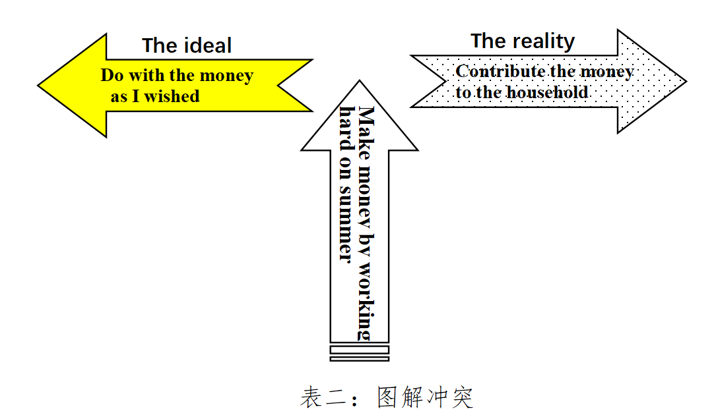
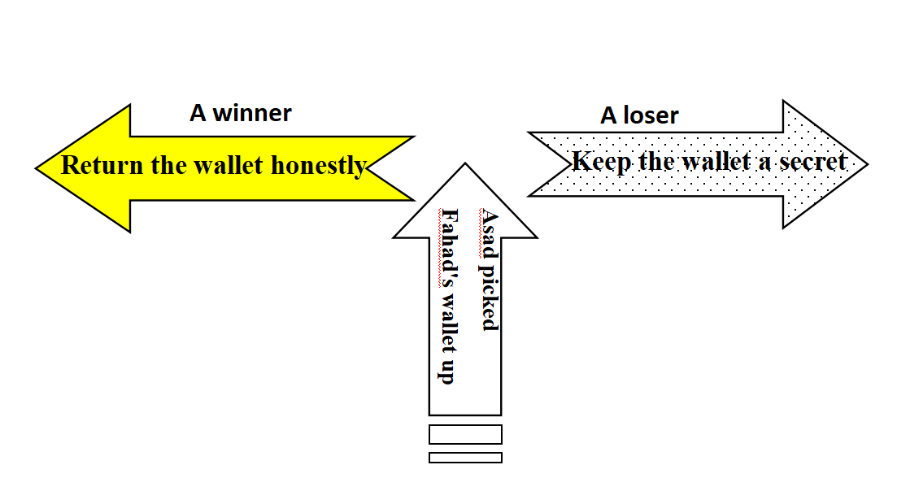
基于语义连贯 的读后续写准确读题和快速构思
1.确定关键词：肯定会同/近义词的高频复现，以增强原文和续文的语义连贯性、语言协同性、主题关联性。
2.确定反义表达：以厘清矛盾和冲突，在具体的情节中相互交织或独立推动情节发展。构建“冲突-危机-解决模式”的叙事模式。
3.确定主题词：前后呼应（隐喻/语义链），拓展语义，升华主题

Slide 22
语义连贯，快速读题 提升续文中扩展逻辑语义关系的能力
Please sort out the key words:
When I was in middle school, my social studies teacher asked me to enter a writing contest, I said no without thinking. I did not love writing. My family came from Brazil, so English was only my second language. Writing was so difficult and painful for me that my teacher had allowed me to present my paper on the sinking of the Titanic by acting out a play, where I played all the parts. No one laughed harder than he did.
So, why did he suddenly force me to do something at which I was sure to fail? His reply: “Because I love your stories. If you’re willing to apply yourself, I think you have a good shot at this.” Encouraged by his words, I agreed to give it a try.
I chose Paul Revere’s horse as my subject. Paul Revere was a silversmith (银匠) in Boston who rode a horse at night on April 18, 1775 to Lexington to warn people that British soldiers were coming. My story would come straight from the horse’s mouth. Not a brilliant idea, but funny, and unlikely to be anyone else’s choice.
What did the horse think, as sped through the night? Did he get tired? Have doubts? Did he want to quit? I sympathized immediately. I got tired. I had doubts. I wanted to quit. But, like Revere’s horse, I kept going. I worked hard. I checked my spelling. I asked my older sister to correct my grammar. I checked out a half-dozen books on Paul Revere from the library. I even read a few of them.
When I handed in the essay to my teacher, he read it, laughed out loud and said, “Great. Now, write it again.” I wrote it again, and again and again. When I finally finished it, the thought of winning had given way to the enjoyment of writing. If I didn’t win, I wouldn’t care.
Para. 1 A few weeks later, when I almost forgot the contest, there came the news.
Para. 2 I went to my teacher’ office after the award presentation.
2023年6月普通高等学校招生全国统一考试（浙江卷）

Slide 23
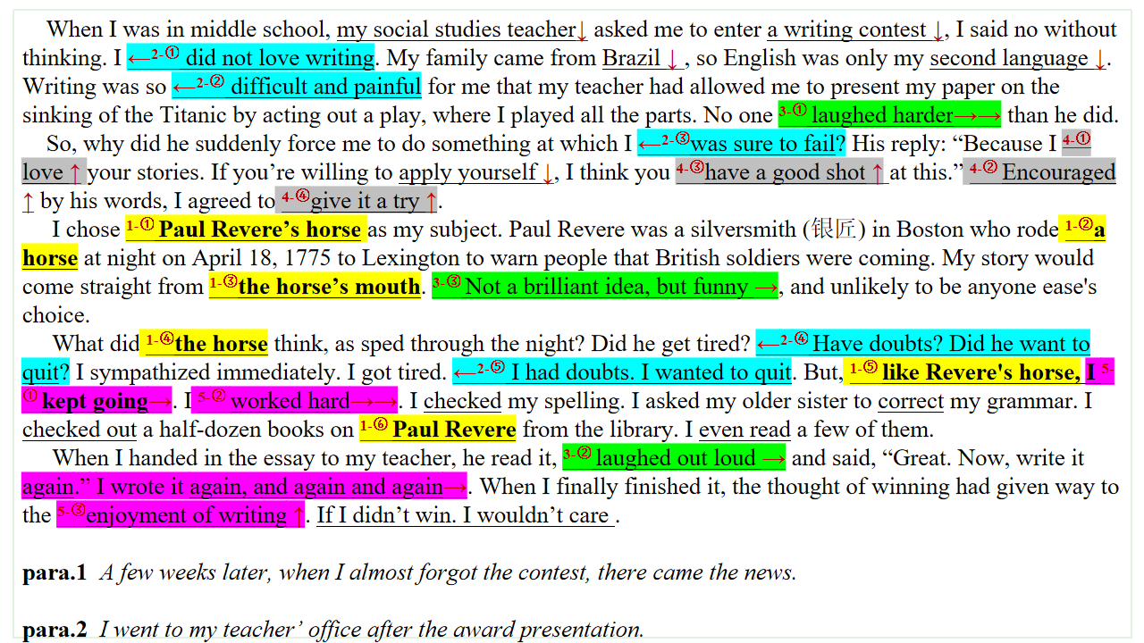
语义连贯，快速读题 提升续文中扩展逻辑语义关系的能力
原文中Revere's horse是一个复现5次的高频的词汇，形成以Revere's horse为中心的词汇衔接链。1-①解释主题概念和意义；1-③说明作者的参赛故事直接以马的口吻讲述，简单质朴，天真可笑，符合孩子的天性特征，隐喻作者得奖的主要原因；1-④借喻战马精神，激励作者worked hard和keep trying again and again；1-⑤翻阅资料，体现作者严谨的求是精神。
作者对参赛初期的不自信和写作过程的自我否定也构成一条语义链，2-① did not love writing；2-② difficult and painful；2-③was sure to fail；2-④ Have doubts? Did he want to quit?；2-⑤ I had doubts. I wanted to quit，在续文中我们可以写出反义互补的词汇衔接，合理化解矛盾和冲突。
作者的作文引起老师的大笑 3-① laughed harder，但3-② laughed out loud and said, “Great. Now, write it again.”老师鼓励作者不断尝试，修改和完善，同时3-③ Not a brilliant idea, but funny作者平实而生动的写作特点，三者共同组成一致性语域，说明老师慧眼识才，循循善诱，严格要求，为后文续写I went to my teacher’ office after the award presentation埋下伏笔。
2023年6月普通高等学校招生全国统一考试（浙江卷）

Slide 24
语义连贯，快速读题 小小的语篇挖呀挖, 连贯语义开红花
A few weeks later, when I almost forgot the contest, there came the news. When one of my classmates dashed towards me, patted on my shoulder and congratulated me that I had won the first prize. My mind went totally blank and I thought it must be a joke. However, when I received the message which invited me to attend the award presentation, I knew miracle had happened! Paul Revere’s horse did reach Lexington! Scene after scene where I worked day after day to check the errors and I looked up the books on came flooding into my mind. The moment I was awarded the prize, my mouth carved into a ear-to-ear grin for I was overwhelmed by the pride mixed with delight that all my efforts had paid off.
2023年6月普通高等学校招生全国统一考试（浙江卷）

Slide 25
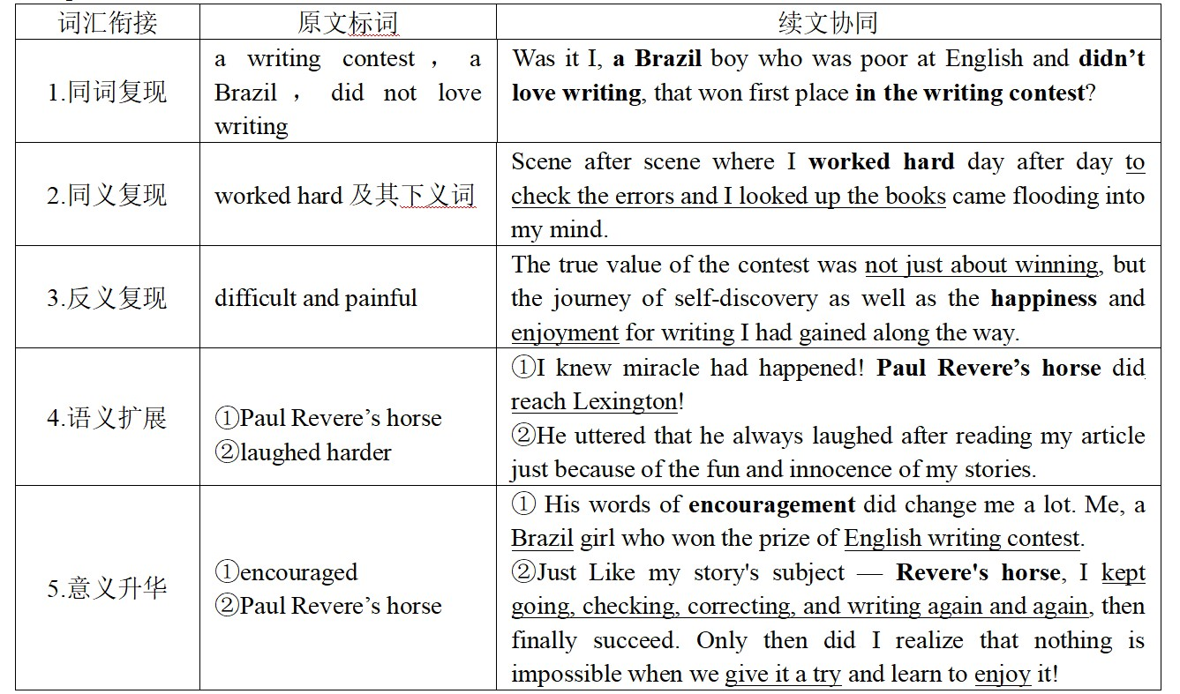
语义连贯，协同效应 提升续文中扩展逻辑语义关系的能力
2023年6月普通高等学校招生全国统一考试（浙江卷）

Slide 26
指向提升思维品质的读题审题能力 —— 以2024年11月浙江杭州一模为例
Mary was the art teacher for primary school students. On this particular day, she was guiding them through the process of drawing a scenic landscape. Akila yawned (打哈欠), clearly disinterested — drawing wasn’t her thing. A small group of students gathered around Tina, laughing at her unusual drawing: a sun sporting sunglasses and trees topped with ice cream cones.
Mary instructed Tina firmly but with unease, “Draw it the way I showed you.” As the lesson continued, doubt crept into Mary’s mind. Had the joy of creativity been overshadowed by the pressure to fit in? She scanned the room, observing her students’ faces — some concentrated, others uncertain. Akila’s disinterest was clear, and Tina’s imaginative drawing had been met with ridicule instead of praise.
After class, Mary sat down with Tina, her tone softening. “Why did you draw the sun with sunglasses and the trees with ice creams?” she asked gently.
Tina’s eyes sparkled with a touch of rebellion (叛逆). “I love ice cream, and I thought the sun would look cool with sunglasses. Why do we always have to draw like everyone else?”
Mary paused, her thoughts racing. Tina’s drawings weren’t just curious —— they were a window into a world where imagination ruled, where rules could be bent into delightful chaos. Was she, by enforcing a rigid style, killing that very creativity?
The next morning, Mary walked into the classroom with a renewed sense of purpose. She placed a large sheet of paper in front of the class and announced a new project: they would create a collective (集体的) artwork titled “Our Dream World” with no rules. They were free to use colors, shapes, and patterns however they wished.
At first, the students hesitated, unsure of this newfound freedom. Akila leaned back, skeptical of what seemed like another pointless exercise. But Tina, her creativity no longer restricted, eagerly grabbed her crayons and began to draw with abandon. Then, Maya joined in. And then Michael…
As the students worked, Mary observed them with curiosity.
Mary stood back and surveyed the creation.
找准语义链形成逻辑链
本文两条语义链，形成矛盾冲突：pressure to fit in → rules→ enforcing a rigid style → killing→ rules → restricted ；以及unusual drawing →creativity→imaginative → however they wished→ freedom→with abandon
对孩子两张不同的教学法的描述，同时也产生不同的情绪价值disinterested → joy→ delightful chaos → ridicule instead of praise → rebellion 。
基于以上语义链的分析，可以促成逻辑的合情合理产生，精准而快速地深度解读文意和理解作者写作意图。
同时抓住核心词“Our Dream World”统领全文，主题升华——“我们理想世界的What-How-Why?”.

Slide 27
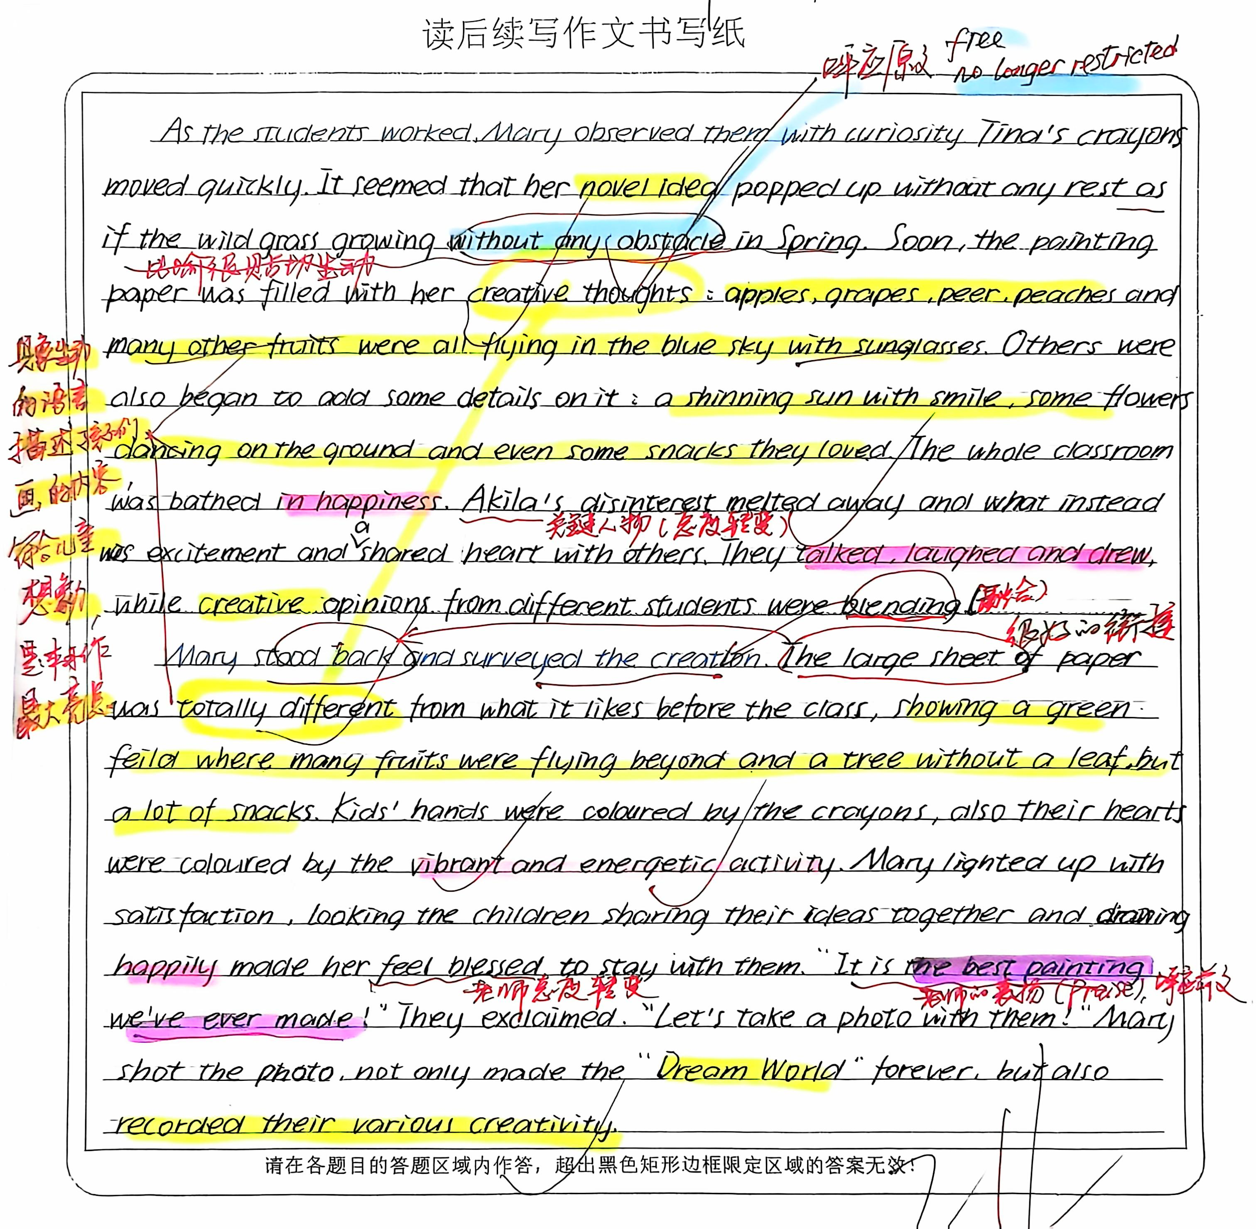
体现高阶思维品质的写作能力 —— 以2024年11月浙江杭州一模为例
提升续文中
扩展逻辑语义关系的能力
该习作紧扣关键词，创造性使用 “novel ideas→ as if the wild grass growing without any abstacle in spring →vibrant and energetic activity” 凸显孩子们的创造力。本习作最精彩之处在续文能与原文共情，具象生动的语言描述孩子们画画的内容，充满想象力和童趣。
习作多次重复关键词 creative / creativity, 突出主题词 Dream World 体现批判性思维。
在情感态度上渲染 happiness →disinterested melt away→excitment →happily →laughed→ the best painting we’ve ever made 与原文写作意图高度
契合和协同。

Slide 28
指向提升思维品质的读题审题能力 —— 以2024年11月稽阳联考为例
The cat was out of the bag. I was caught on the spot.
The security guard grabbed my arm. “Come with me,” he barked, leading me back inside thediscount store and into the office. Then he pointed to a lime-green chair. “Sit down!”
I sat. He glared at me. “You can give it to me or I can take it, your choice. What will it be?” I pulled the package of hair ribbons out of the pocket of my jeans, handed it to him and begged, “You’re not going to call my dad, are you?”
“I’m calling the police. They will call your father.”
My head dropped onto my hands and I sobbed, “No, please! Can’t you just let me go? I can pay you. I have money in my pocket. I’m only fourteen years old. Please, I won’t ever shoplift again!”
“Save your tears. They won’t work on me. I’m sick of you bad kids stealing, just for the thrill of it.”
I sat there, trembling uncontrollably. The previous excitement brought by stealing lipstick, teen magazine and all that stuff... now gave way to immense fear and shame.
The police arrived, and the policemen walked me to their black-and-white car and opened the backdoor. I got in, and they drove me through the middle of our small town. I slouched down into the seat so no one could see me as l looked out the window at the evening sky. Then I saw the steeple(尖塔) of my family’s church, and the guilt pierced me like a dagger. “How could I have been so stupid? I’ve broken my father’s heart...and God’s,” thought I.
We arrived at the station, and a round woman with a square face asked me questions until I ran out of answers. She pointed to the door of a large open cell and said, “Sit. Wait.” I walked in, and my footsteps made an echo that bounced off the bars. The tears started again as I sat down on a hard bench and heard her dial the telephone and say, “I have your daughter in a cell at the police station. No, she’s not hurt. She was caught shoplifting. Can you come and get her? Okay. You’re welcome, good-bye.” She yelled, “Hey kid, your father’s on his way.”
About one hundred years later, I heard his voice say my name.
After we arrived home, Dad finally asked me, "Why?"
因果关系推断
合理拓展情节
从第二段段首句Dad finally asked me, "Why?" 的质问，要求习作者在原文中合理推断原因 for the thrill=previous excitement brought by stealing。
高阶思维1：关键词 thrill= excitement 的同义复现，并在续文中能合理构思有价值的excitement，体现作者的个人成长。
高阶思维2：挖掘原文伏笔 family’s church，做慈善义工来忏悔错误。
高阶思维3：逆向思维，利用关键词excitement 主题升华，做有价值的事才是 真正的兴奋。

Slide 29
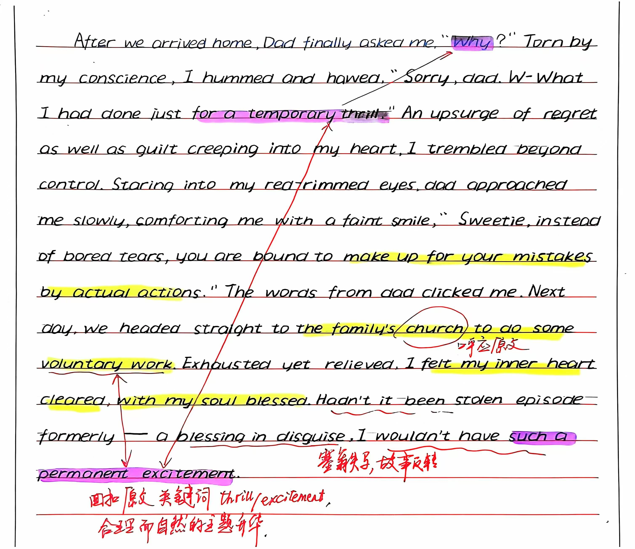
体现高阶思维品质的写作能力 —— 以2024年11月稽阳联考为例
本习作很好地利用关键词，创造性使用 “for a temporary thrill→→→
such a permanent excitment”，从而隐喻 “之前错误→→ 纠正错误后，在教堂做志愿者的实际行动，形成正确的价值观 ”主题升华自然合理。
习作者用了“a blessing in disguise”归纳总结事件的反转，同时与“church”语言风格协同，是神来之笔。
创造性利用关键词
进行主题升华

Slide 30
指向提升思维品质的
04
2025高考读后续写培优建议
——思维，审题，语料，卷面

Slide 31

^{全国新高考Ⅰ卷} 续写路径优化和时间分配_{（30分钟）}
写作文
20m’
工整书写，精细排版
构思+草稿
5m’
结合段首句，打四句话草稿，实现全篇语义和逻辑的连贯性
读题
5m’
构建语义，语境和主题的关联性
先看第一段---最后一段---两个段首句---语义连贯挖词（7个）

Slide 32
读后续写培优建议: 增强语境关联，促成情境模式层面的协同效应
动作面微写作 = 动作链 + 情感、环境、心理、语言等(培养与原文在语言及情境层面的协同提升语言能力)
Action scene=Actions+Emotions, surroundings, inner thoughts, dialogues
emotions
dialogues
Action scene
surroundings
inner
thoughts

Slide 33
2025高考读后续写培优建议
4.作文审题训练要科学：
3.作文语料记忆强运用：
读后续写 5分钟读原文_{（语义连贯挖词法,至少挖7个词）}，打草稿_{（4个关键句）}
平时可以开卷写，静心慢写，同伴相互欣赏开悟，批判性思维
语料记忆，定期复盘（想写而写不出；写出而写不对； 写对但有涂改； 要写却没储备）
1.高阶思维品质重培养
2.高分书写排版贵坚持
提升语篇分析能力
语义连贯挖词法的运用
培养学生思维的逻辑性、批判性和创新性
工整书写，巧妙涂改，精细排版；
字数无上限；每段10行，字数220

Slide 34


THANKS

